Slide 1

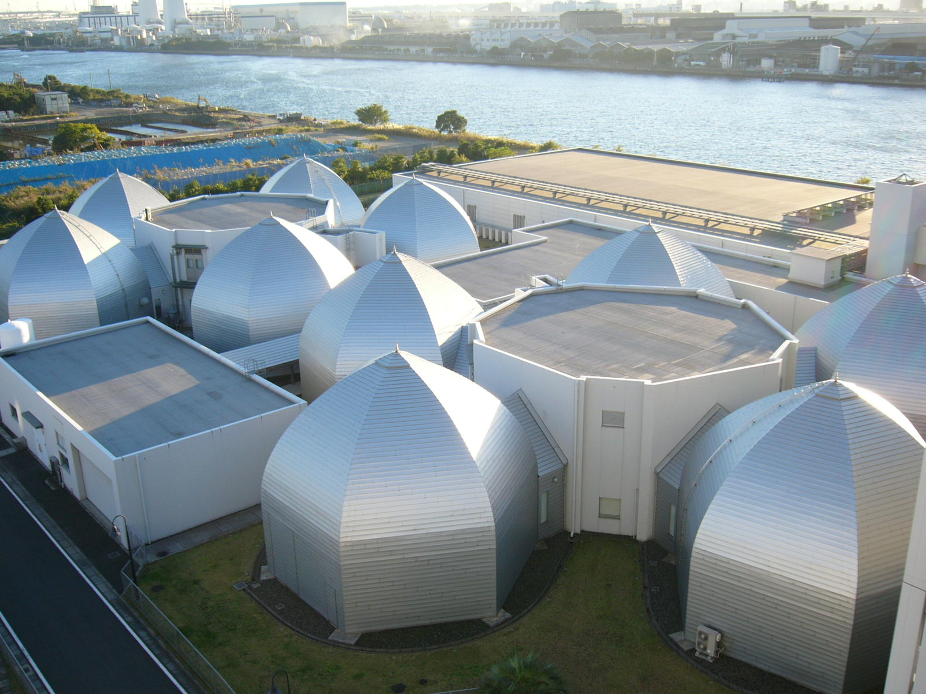

WAMHTS-3, 10-11, Sep., 2015
Lyon Convention Centre Roseraie 1 & 2
The actual quenches of HTS coils
Y. Yanagisawa and H. Maeda
NMR Facility, RIKEN, Japan
Notes:
First of all, I would like express my gratitude for the organizers of the workshop for giving me to make a talk.
Today I would like to talk about the actual quenches of HTS coils, mainly REBCO, and overview of the winding methods from a protection point of view.
The photogram is our NMR Facility. We have about ten commercial NMRs made of LTS coils and are developing a high-field NMR using HTS coils.
Although this is the session for simulation, I would like to show both simulated results and experimental results obtained in our NMR development.

Slide 2






Acknowledgement
National Institute for Materials Science
Dr. Shinji Matsumoto
Dr. Gen Nishijima
Chiba University
Prof. Hideki Nakagome
Mr. Renzhong Piao
Ms. Kyoko Yanagisawa
Ms. Yi Xu
Mr. Masato Nawa
Mr. Yu Suetomi
Sophia University
Prof. Tomoaki Takao
Mr. Seiya Iguchi
Mr. Kentaro Kajita
Japan Superconductor Technology, Inc.
Dr. Mamoru Hamada
JEOL RESONANCE, Inc
Mr. Hiroto Suematsu
Part of the present work was supported by Japan Science and Technology Agency (JST).
Notes:
These are our collaborators of the development, the members in NIMS, Chiba University, Sophia University, JEOL, and JASTEC.
Part of the present word was supported by Japan Science and Technology Agency (JST).

Slide 3
Contents
Various kinds of actual quenches of HTS (REBCO) coils
Protection of high current density coils
  Pancake-winding vs. layer-winding
Overview of winding methods:
  Trade-off between degradation and protection
Notes:
My talk has three parts. First, I would like to show various kinds of the actual quenches of HTS coils due to conductor degradation.
Then, I am going to talk protection of high current density coils. In this part, suitability of NI method for pancake-winding and layer-winding will be described.
Finally, based on these results, I would like to discuss the overview of the winding methods considering trade-off between degradation and protection.
I want to start with the first part.

Slide 4
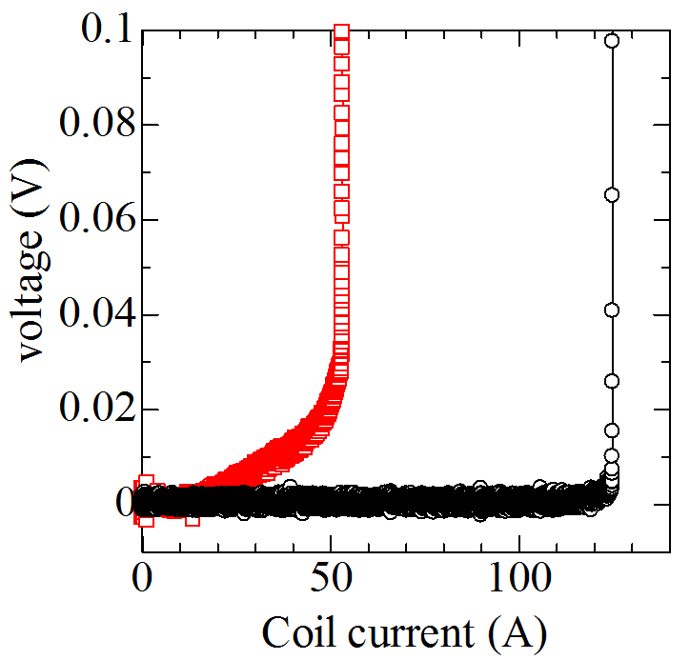
Two basic patterns of quench for REBCO coils
Premature quench
(unpredictable)
Natural quench
(predictable)
Paraffin-impregnated REBCO coils at 77K
Degraded coil (n=1.5)
I_{c}
Undegraded coil (n=27)
Maeda and Yanagisawa, IEEE TAS, 24, 4602462, 2014.
Irreversible
thermal runaway
Systematic investigation and the remedies for the degradation are the essential for stability and protection of REBCO coils.
Notes:
There are two basic patterns of quench for REBCO coils. This graph shows quenches for a small REBCO coils operated at 77K. One is natural quench occurred at a current higher than the coil critical current. This is predictable quench. Another is premature quench which we encountered below the critical current. Basically, this type of quench is caused by conductor degradation and the problem is that this is not predictable. Therefore, a systematic investigation and remedies for the degradation is the essential for stability and protection of REBCO coils. In the following slides, I am going to show the actual examples of the degradation and quench.

Slide 5
Premature quenches
The premature quenches in REBCO coils are caused by local heating due to degradation owning to thermal stress and electromagnetic force.

Slide 6

1) Degradation due to thermal stress
Thermal runaway
○ Dry winding
□ Paraffin impregnated winding
△ Epoxy impregnated winding
Epoxy impregnation
Thermal stress delaminates the conductor, resulting in degradation
Superconductor
Thermal stress
Stabilizer
Hastelloy
Takematsu et al., Physica C, 470, 674-677, 2010
Notes:
One origin of degradation is thermal stress during cool down, which is widely known in the HTS community. So I think I do not have to explain the detail. This type of degradation is frequently observed for epoxy impregnated coil. The thermal stress delaminates the conductor and degrades the coil performance. If you continue to charge such a coil, the Joule heating from the conductor leads to irreversible thermal runaway.

Slide 7
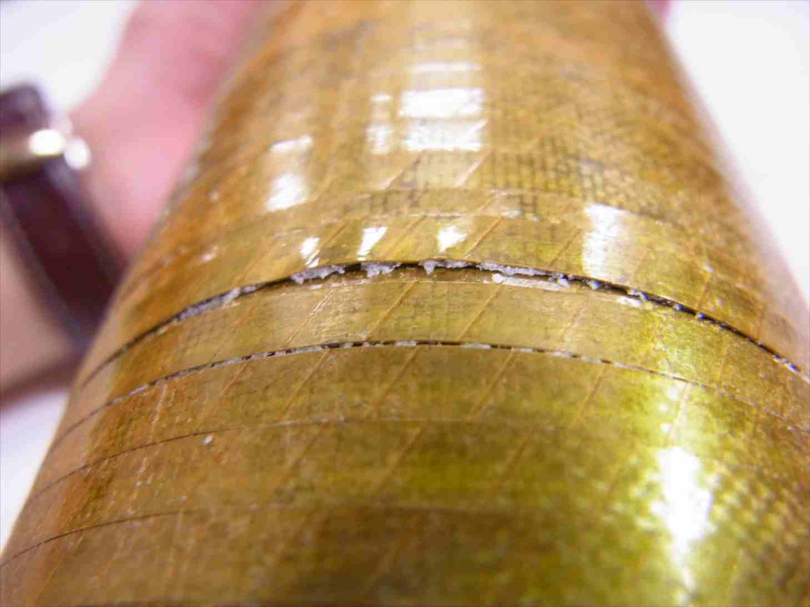
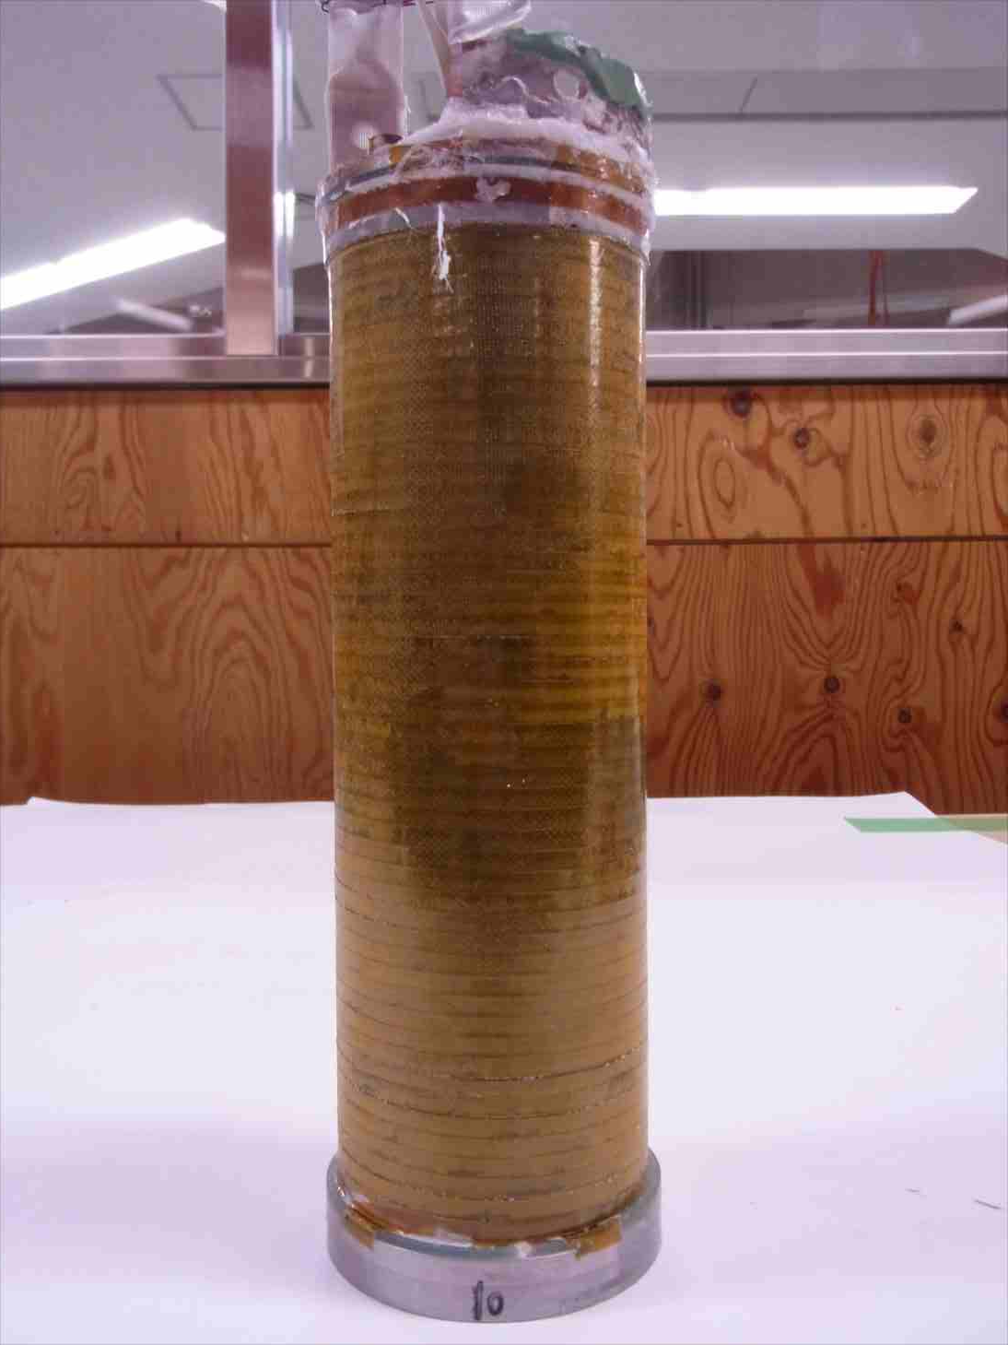
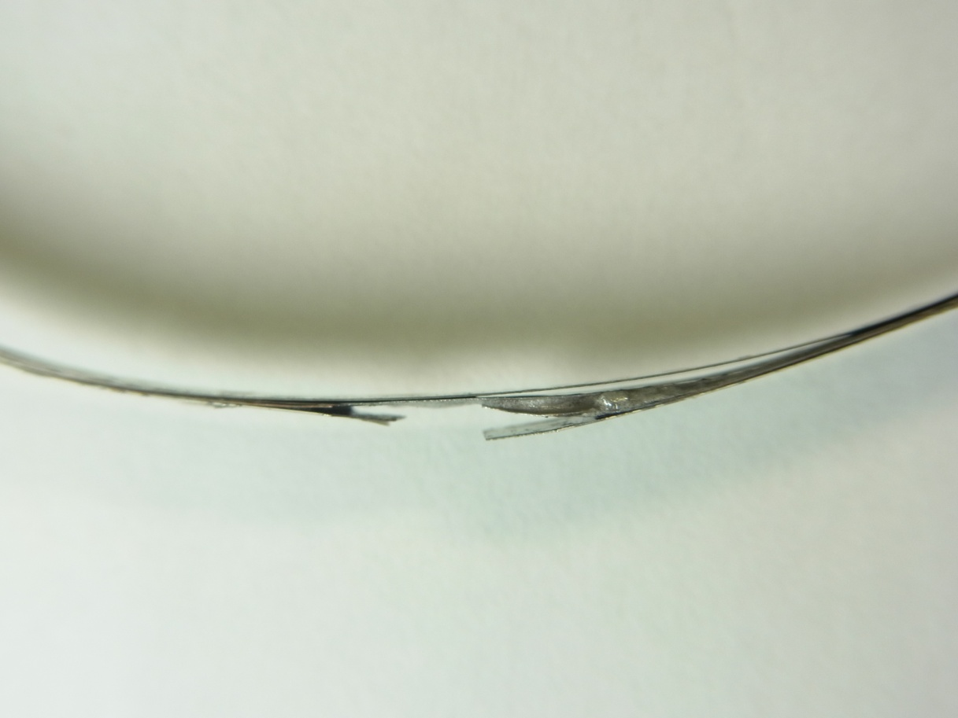
2) Degradation due to an electromagnetic force
REBCO
Bi-2223
> Series-connected
> Layer-wound
> Paraffin impregnation
REBCO (layer-wound, paraffin-impregnation)
F_{z}
17T LTS coils (NIMS)
Designed to
generate 28T
(LTS 17T + HTS 11T)
Expected:
28T
17T
25T
Edgewise bent due to the axial force
Copper
0.1 μV/cm
Hastelloy
Delamination
Hastelloy
REBCO coil
Thermal runaway
Copper
Delamination
Delamination
REBCO coil voltage (mV)
BJR: 205MPa
Copper (Backed conductor)
Hastelloy
(Backed conductor)
Discharge
Delamination in the solder bridge joint due to the hoop stress
Charge
Electromagnetic force proceeds the degradation during charging
Coil current (A)
Notes:
Recently, we encountered another type of degradation. That is electromagnetic force in a high field. We are facing this problem in our NMR development. This is our recent high field generation test using two HTS coils with the 17T outer LTS coils. Here you can see a REBCO coil and Bi-2223 coil. They are layer-wound coil for obtaining a homogeneous field. These coils are designed to generate 28T in combination with LTS coils. First, we charged only HTS coils and succeeded in generating 13T. However, in a background field of 17T, the REBCO coil showed the premature normal voltage as shown here. So, we stopped the charging at 25T and discharged the coils. As you can see, in the charging and discharging process the voltage shows irreversible behavior. This is indicating the degradation was caused and proceeded by the electromagnetic force.
After the experiment, we un-wound the coils and found two types of degradation. One is edgewise bent due to the axial electromagnetic force and another is delamination of a solder bridge joint in the winding. The conductor in the bridge joint was delaminated by the hoop stress.
The serious point here is that the normal zone did not propagated in the coil winding unlike LTS coils. So, the conductor motion results in the permanent damage and if you would continue to charge the coil thermal runaway occurs.

Slide 8
Natural quenches
Natural quenches sometimes appear due to over current caused by mutual inductance between coils.
Notes:
Then I want to you show an example of natural quench. This type of quench …

Slide 9
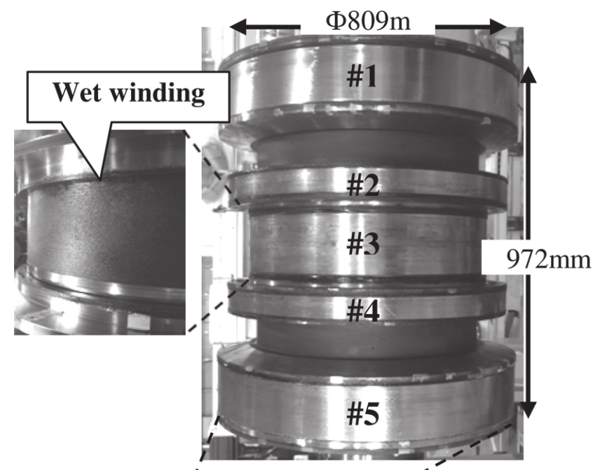
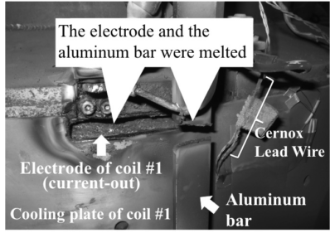
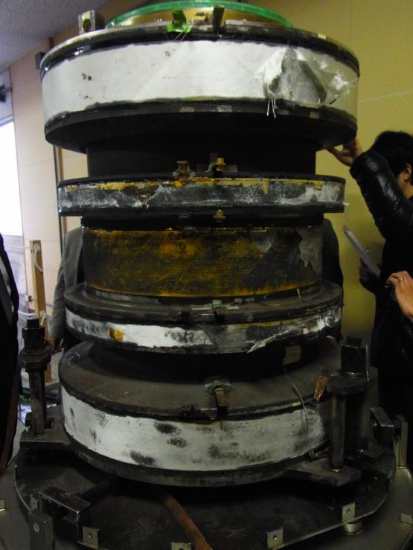
A worst case of a natural quench
3T Bi-2223 MRI (Kyoto University, NIMS, Kobe Steel, and Sumitomo Electric)
F_{z}
Terao et al. IEEE TAS, 23, 4400904, 2013.
Terao et al. IEEE TAS, 24, 4401105, 2013.
F_{z}
Courtesy of Prof. Fukuyama and Dr. Urayama
Thermal runaway in one coil causes an unbalance of the axial magnetic force, resulting in the mechanical breakdown of the terminal and the catastrophic arching.
Notes:
Here you can see the 3T Bi-2223 MRI coils developed by Kyoto University, NIMS, Kobe Steel, and Sumitomo Electric. Although this is a case of Bi-2223 coils, it show the seriousness of HTS coil quench and thermal runaway. First, this MRI was operated at 1.5T and they successfully obtained the good imaging. However, after the 3T operation, one coil shows thermal runaway and the current of that coil was decreased. As a result, the unbalance of the axial electromagnetic force broke the terminal conductor, resulting in the arching and catastrophic damage on the overall magnet.

Slide 10
Contents
Various kinds of actual quenches of HTS (REBCO) coils
Protection of high current density coils
  Pancake-winding vs. layer-winding
Overview of winding methods:
  Trade-off between degradation and protection
Notes:
Then, I would like to move on to the second part. Protection of high current density coils. I will compare the applicability of NI method for pancake-winding and layer-winding.

Slide 11
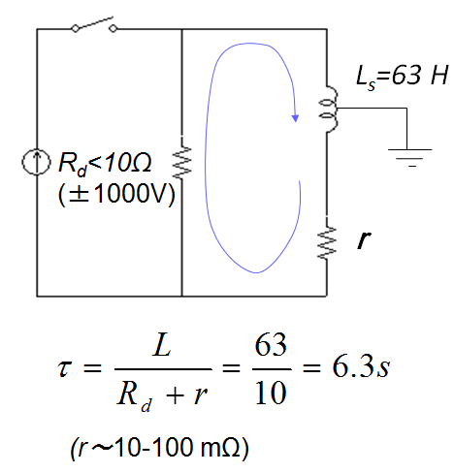
Example: 1.2 GHz (28.2T) LTS/HTS NMR magnet
1.2 GHz LTS/HTS NMR
Detect and dump circuit for the Bi-2223 NMR magnet
495.98 mm
200A
764.4 mm
NbTi
Bi2223
BJR < 371 MPa
J_{e} < 220 A/mm²
Notes:
Here I want to simply describe protection of 1.2GHz NMR magnet using HTS coils base on the conventional protection idea. If you protect this magnet with a detect-and-dump circuit. You require at least 6 second to dump the magnet which is determined by the inductance and the dump resistor. But problem is current density. The engineering current density of the coil is higher than 200 A/mm2.

Slide 12

Protection of HTS coils
Active protection
(Detect-and-dump)
Required current dump time (s)
Intermediate region
Passive (self) protection
Engineering current density (A/mm²)
For LTS coils, 3D-quench propagation gives a sufficiently short current dump
Notes:
If you operate the magnet with low current density you can get a sufficiently long current dump time. However, for a high current density operation higher than 200 A/mm2, there is not enough time. As you know, in a case of LTS coils, normal zone propagation velocity is sufficiently high and therefore the coil can be self-protected.
However, the velocity of HTS is very slow and cannot be protected. One possible solution of self-protection is no-insulation method proposed by Dr. Hahn.

Slide 13
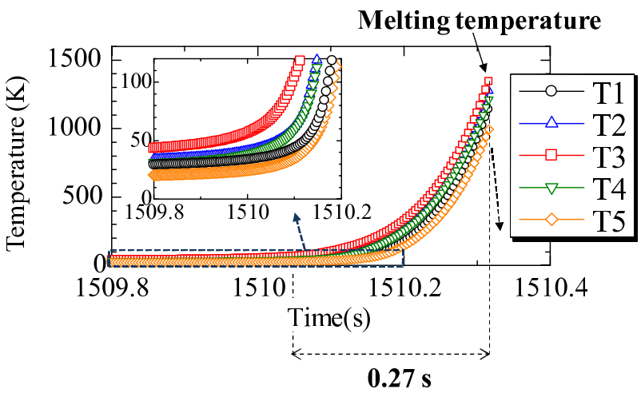
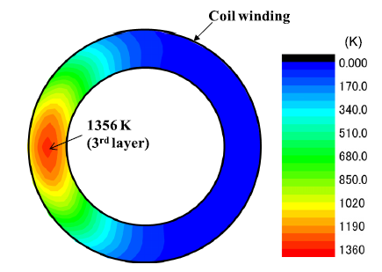
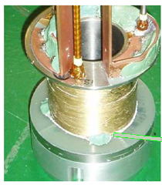
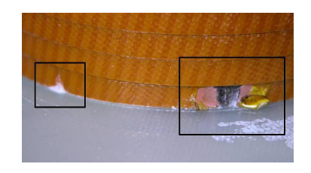
Premature quench
for high-current density operation
Premature quench at 258A (645A/mm²) under 10T; 52% of the coil critical current (simulation)
Yanagisawa et al., SuST, 25, 075014, 2012.
Matsumoto et al., IEEE TAS, 22, 9501604, 2012
Notes:
But for HTS coils, such a self-protect cannot be expected because the normal zone propagation velocity is very slow compared to LTS coils and a hot spot temperature rise results in a meltdown of the condudctor.

Slide 14
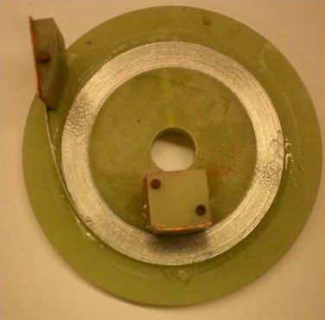
Protection of REBCO coils
Active protection
(Detect-and-dump)
Hahn et al., IEEE Trans. Appl. Supercond., 21, 1592-1595, 2011.
Required current dump time (s)
Intermediate region
Passive (self) protection
No-insulation (NI) method is a solution for REBCO coils
→ current spills along the radial direction
Engineering current density (A/mm²)
For LTS coils, 3D-quench propagation is necessary to get sufficient internal resistance.
Notes:
One promising solution of self-protection is no-insulation method which was proposed by Dr. Hahn 2010.
If you operate the magnet with low current density you can get a sufficiently long current dump time. However, for a high current density operation higher than 200 A/mm2, there is not enough time. As you know, in a case of LTS coils, normal zone propagation velocity is sufficiently high and therefore the coil can be self-protected. However, the velocity of HTS is very slow and cannot be protected. One possible solution of self-protection is no-insulation method proposed by Dr. Hahn.

Slide 15
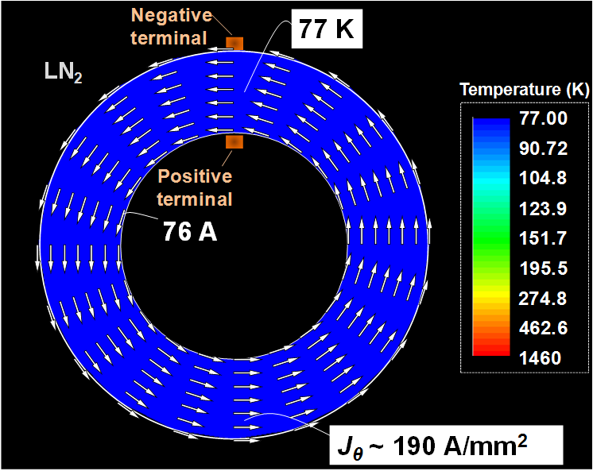
Basic operation modes of a NI coil
Yanagisawa et al., Physica C, 499, 40-44, 2014.
Self-protected from quench (thermal runaway)
Similar to high NZPV of LTS coils
Normal operation below the critical current.
Catastrophic
overheating
(I) Multi-turn
(II) Single-turn (Safe)
Notes:
Here I want to show a basic operation mode of a NI coil. This is a simulated magnetic field of NI REBCO pancake as a function of power supply current. Under the coil critical current, the coil is operated in multi-turn mode. This is normal operation. If the coil shows quench, the thermal runaway propagates in the coil winding and the coil rapidly moves to single turn mode. This is safe operation. Interesting point is that this is like quench of LTS coils with rapid normal zone propagation.

Slide 16

“Self protection” versus “Charge delay”
“Pancake winding” versus “Layer winding”
Notes:
The question here is whether the self-protect characteristics and the charging delay characteristics uniquedto NI coils are compatible or not.
In the following slides, I am going to describe these points by showing the experimental and simulated results for pancake winding and layer winding.

Slide 17
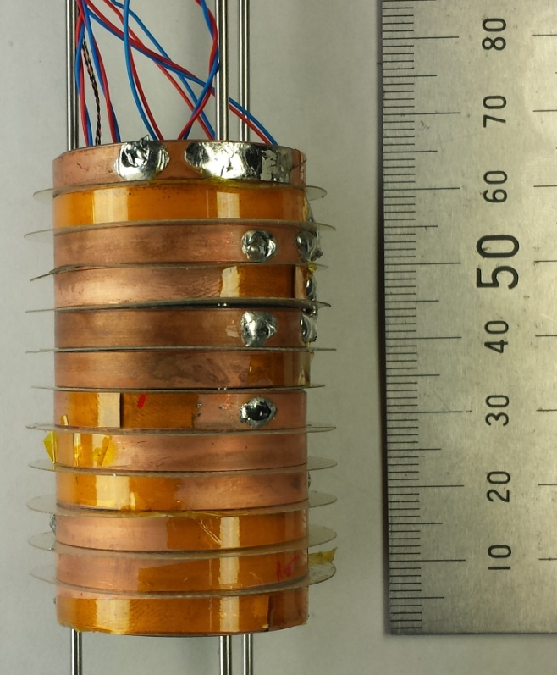
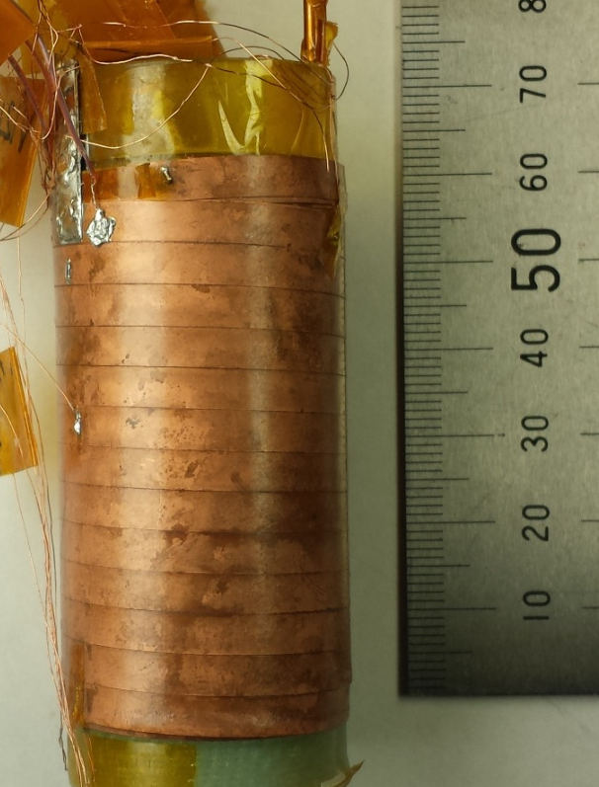
Self-protection
Double pancake
Layer
N_{r}=6
z
Bz,upper
N_{z}
~12
~60mm
Bz,center
o
r
Bz,lower
32mm
Thermal runaway
Thermal runaway
77K
77K
Self-protected by single-turn mode transition
Notes:
Here you can see, the self-protect characteristics of NI double pancake coil and a NI layer-wound coil. I am not going to explain the details but As you can see, for both coils, self-protect behavior from the thermal runaway is observed.

Slide 18
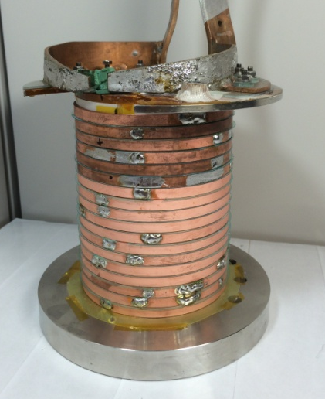
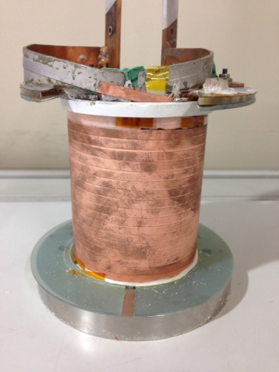
Charging delay
Double pancake
Layer
N_{r}=8
Terminals
z
N_{z}
~18
103
mm
o
r
101
mm
Terminals
80.7mm
L ~ 1mH
81.2mm
77K
77K
τ ~ 0.4 s
τ ~ 500 s
Charging delay for the layer-winding is ~2000 times longer
Notes:
Then I want move on to the charging delay characteristics for another pair of double pancake coil and the layer-wound coil. These two coils have similar shape and configuration. For the double-pancake coil, the charging delay was 0.4 s. A lot of reports show the similar time constant. On the other hand, for the layer case, it was 500 s, which is 2000 times longer than that for the pancake. Originally we had considered the NI layer-wound coil for NMR, but we were surprised for this data and we investigated the mechanism of the extraordinary long time constant.

Slide 19
Simulated current distribution
Double pancake
Layer
I
Hahn and Iwasa
I
I
(+)
I
(+)
(-)
(+)
I
I
z
z
(+)
(-)
(-)
I
Twist
pitch
Twist
pitch
Magnetic diffusion
o
r
o
r
τ ∝N_{turn}² x N_{layer}
(-)
I
Pancake: Twisted => Short charging delay
Layer: Untwisted => Impractically long charging delay
Notes:
Here you can see the circuit model NI pancake proposed by Dr. Hahn and Prof. Iwasa. On the other hand, we made a circuit for NI layer wound coil like this. We calculated the current distribution in both coils during charging process. As you can see, there is uniform current distribution in the winding. But, if you look at the right side, you can see the current flows at the outer edges of the coil winding for the layer-wound coil. Obviously this is skin effect.
Interesting point is that you can explain this substantial difference with the analogy of twisted multi-filaments.
For the pancake-winding, the turns can be considered as twisted and the twist pitch corresponds to a one turn.
On the other hand, the turns in the layer winding are not twisted and the coupling current are reduced by magnetic diffusion along the coil axial direction. This indicates that the charging delay substantially become longer for a lager coil. This is interesting interpretation but it shows that NI is not suitable for layer-winding.

Slide 20
Contents
Various kinds of actual quenches of HTS (REBCO) coils
Protection of high current density coils
  Pancake-winding vs. layer-winding
Overview of winding methods:
  Trade-off between degradation and protection
Notes:
Finally, I would like to describe the overicew of the windin gmethods from the protection point of view.

Slide 21
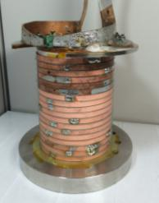

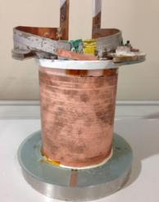
High current density REBCO coil winding methods from a view point of degradation and protection
 |  | Preventing degradation | Self-protect | NMR
Pancake | Insulated (Example: NHMFL 32T) | ○ | × | > Inhomogeneous field > Driven mode
 | NI (Example: MIT/NHMFL/Su-NAM 26T) | ○ | ○
Layer | Insulated (Example: RIKEN NMR) | ○ | × | > Homogeneous field > Possibility of persistent mode (ultimate goal)
 | NI | × | ×
 |  | Preventing degradation | Self-protect
Pancake | Insulated (Example: NHMFL 32T) |  | X
 | NI (Example: MIT/NHMFL/ SuNAM 26T)
Layer | Insulated (Example: RIKEN NMR) |  | X
 | NI | X | X
: OK
X : NG
Epoxy + polyimide coating, dry, or paraffin
Dry
Epoxy +
polyimide
coating
Yanagisawa et al. Physica C, 476, 19-22, 2012.
Dry: Conductor movement due to electromagnetic force
Long charging delay
Notes:
Here we have a list of winding methods for high current density REBCO coil from the view point of degradation and protection.
For pancake winding, you have two choice, Insulated and NI. For the insulated coil, you can prevent degradation, with various option, epoxy-impregnation with polyimide coating insulation, dry-wound, and paraffin-wax-impregnation. But, the coil cannot be self-protected.
The notable advantage of NI is the compatibility of degradation-prevention and self-protect characteristics.
For layer winding, NI is not suitable because the conductor is easily moved by an electromagnetic force and give a extraordinary long charging delay.
If you choose layer winding, polyimide coating insulation and epoxy impregnation are preferred because they prevent the delamination and conductor motion. The problem is the coil cannot be self-protected. In our NMR development, basically we have been choosing the layer-winding for field homogeneity and the ultimate goal of persistent operation. But anyway the protection is still have

Slide 22
Summary
Major origin of quench for REBCO coils is conductor degradation
  Thermal stress
  Electromagnetic force
NI self-protection for high current density coil
  Pancake: Twisted, compatible with charging delay
  Layer: Untwisted, extraordinary long charging delay
NMR:
  Layer-wound, polyimide coating + epoxy impregnation
  To be actively protected.

