Slide 1

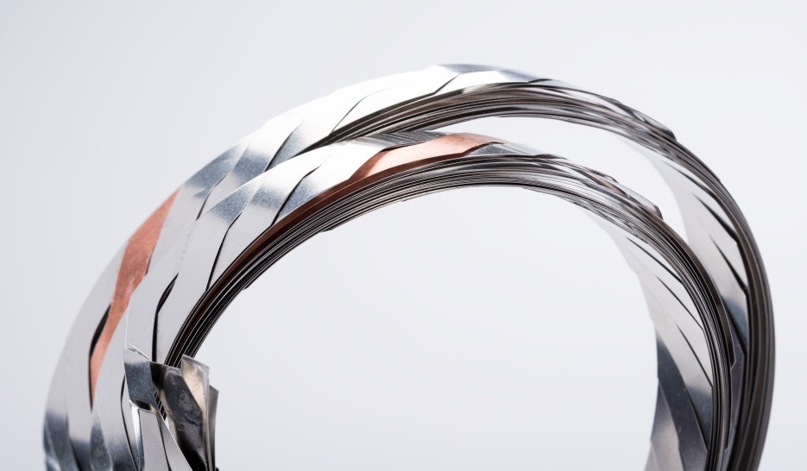
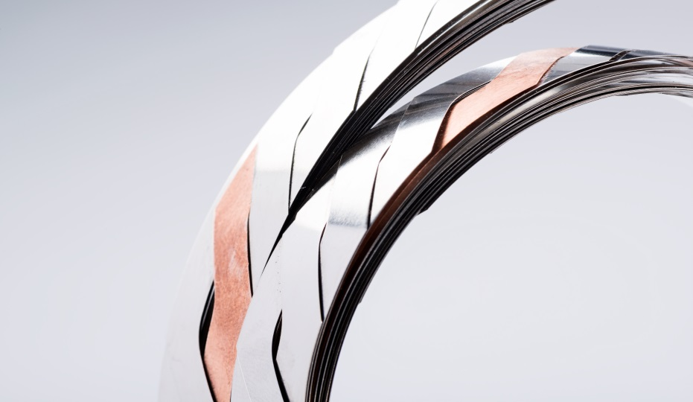
Roebel cables for EuCARD²:
experience and options.
A. Kario, S. Otten, A. Kling, A. Jung, B. Runtsch, R. Nast, W. Goldacker
Institute for Technical Physics, Karlsruhe Institute of Technology, Karlsruhe

Slide 2
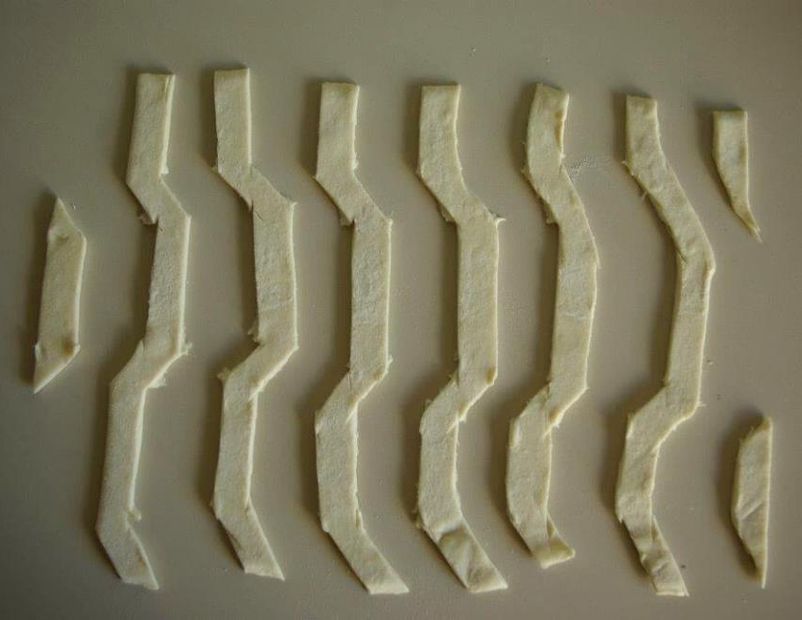
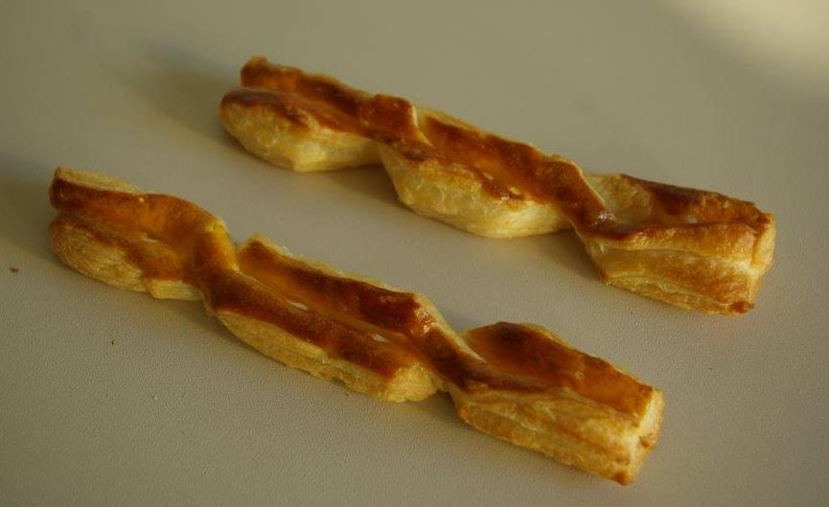
Recipe for the ’’good’’ Roebel cable:
Ingredients:
EuCARD² coated conductor material.
Punching vs. tape homogeneity.
2. Directions: Punch and coat.
3. Outcome:
Roebel cable geometry.

Slide 3
Recipe for the ’’good’’ Roebel cable:
Ingredients:
EuCARD² coated conductor material.
Punching vs. tape homogeneity.
2. Directions: Punch and coat.
3. Outcome:
Roebel cable geometry.

Slide 4
Coated conductors performance at 4.2 K:
C. Senatore, C. Barth, M. Bonura, G. Mondonico, M. Kulich, 1st Workshop on Accelerator Magnets in HTS, DESY, 21 - 23 May 2014.
Target performance for RE123 tape at 4.2 K perpendicular magnetic field:
J_{eng} = 450 A/mm² at 15 T
J_{eng} = 400 A/mm² – 600 A/mm² at 20 T

Slide 5
Tape architectures – macroscopically (sketch):
SuperOx, SuNAM
Bruker
Cu 20 µm
Cu 20 µm
REBCO 1-3 µm
REBCO 1-3 µm
Hastelloy 60 µm
Steinless Steel 100 µm
Cu 20 µm
electroplating
Cu 20 µm
electroplating
SuperPower
Fujikura
Cu 20 µm
Cu 20 µm
REBCO 1-3 µm
REBCO 3-6 µm
Hastelloy 50, 30 µm
Hastelloy 75 µm
Cu 20 µm
laminate
electroplating
Tape Width 12 – 12.3 mm.
Tape Thickness 0.1 - 0.2 mm.
Stabilizing copper layer technology.
Cu 20 µm
REBCO 3-6 µm
Hastelloy 75 µm
Cu 20 µm
electroplating

Slide 6
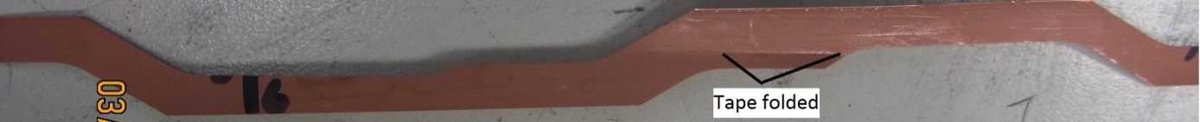
Punching defect due to tape being wider than
specified:
The critical current is measured before and after punching (T = 77 K, self-field)
The critical current degraded by 9% percent on average over the different segments.
The cause of this defect was found to be the excessive tape width of 12.26 mm. The punching tool is suitable only for widths up to 12.1 mm.
A. Usoskin, A. Rutt: Bruker tape provided in frame of EuCARD² project.

Slide 7
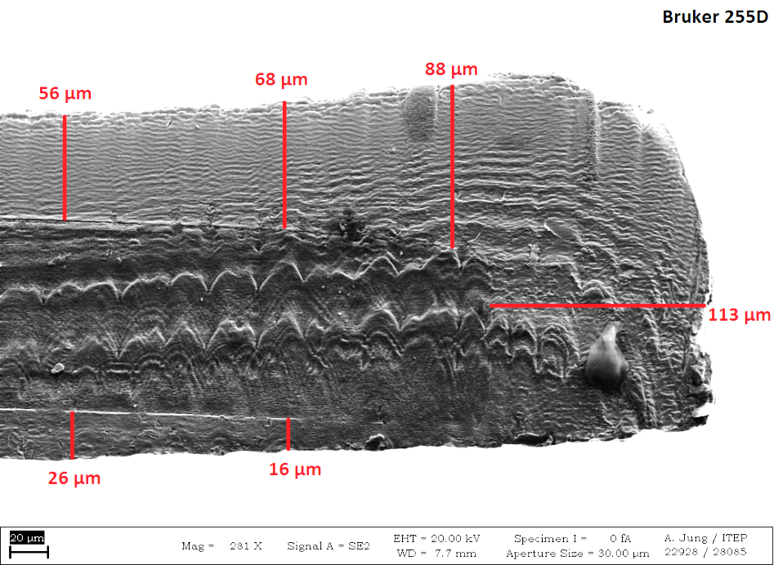
Successful punching after tool modification:
The punching tool was modified to accommodate tape widths up to 12.4 mm, and the punching test was repeated on a new sample.
56 μm
68 μm
88 μm
113μm
26 μm
16 μm
The average degradation of the segments was low at 1.4%, and there were no visible punching defect as in the previous sample.
A. Usoskin, A. Rutt: Bruker tape provided in frame of EuCARD² project.

Slide 8
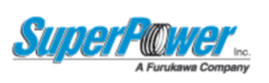
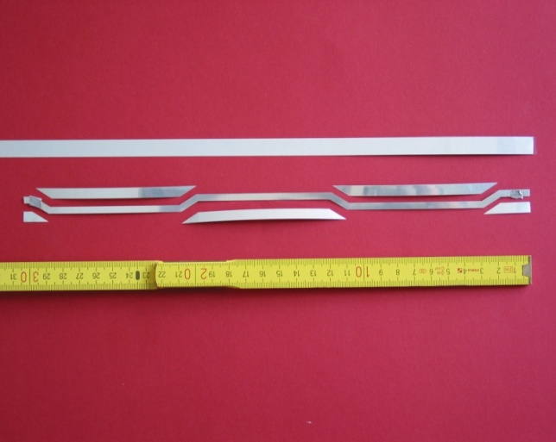
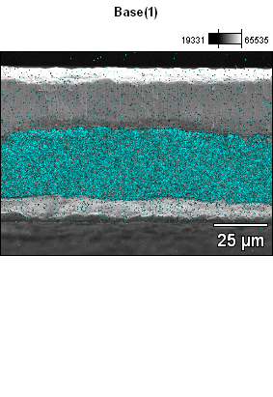
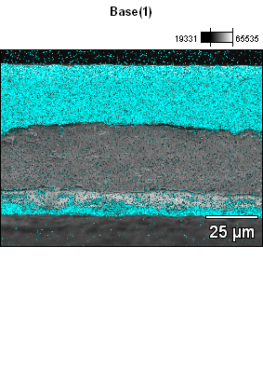
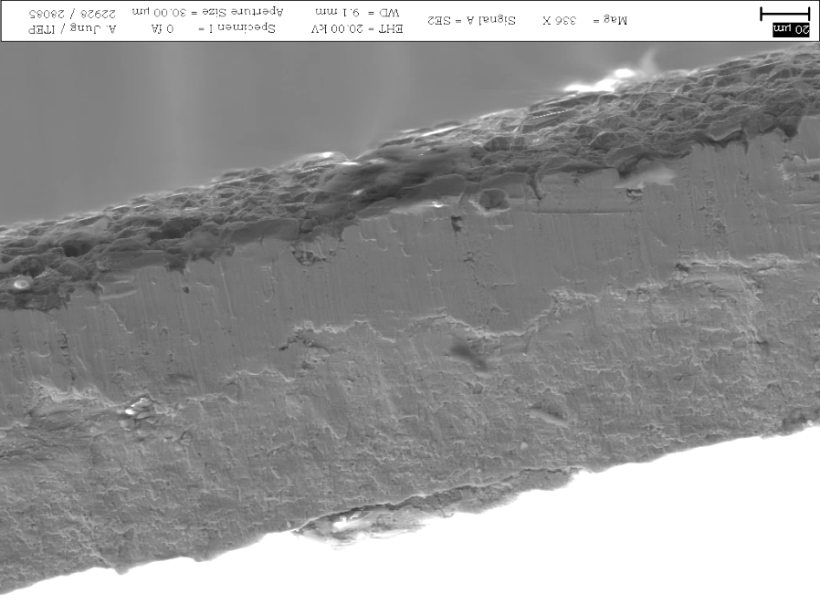

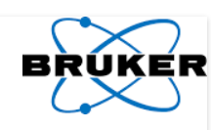
Tape edge after punching process with smeared Cu:
Punching direction
Cu
REBCO
Hastelloy
Cu
Hastelloy
20 µm
Punching direction
20 µm
Punching direction
Cu
Cu
REBCO
Hastelloy
YBCO
Stainess Steel
20 µm

Slide 9
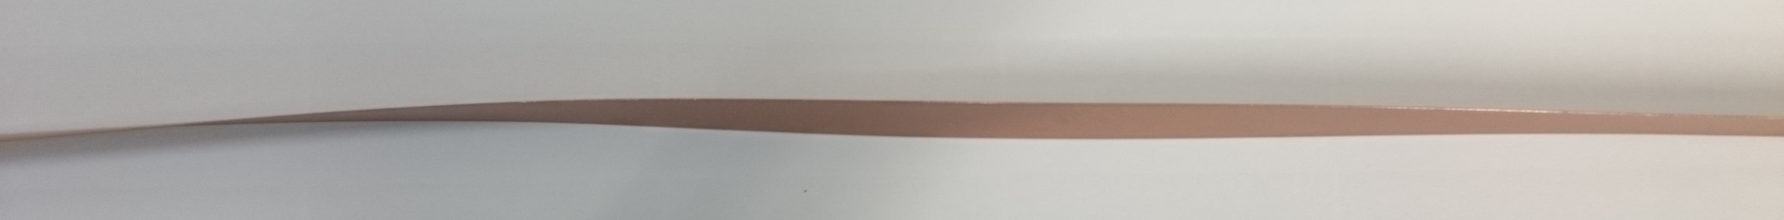
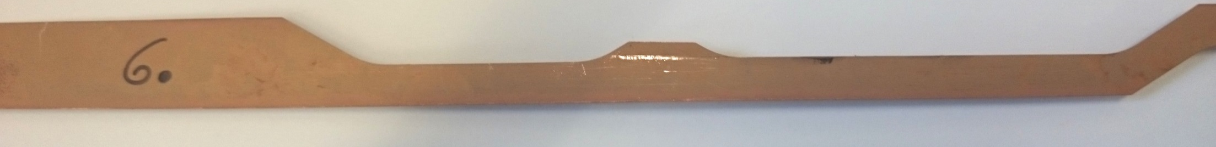

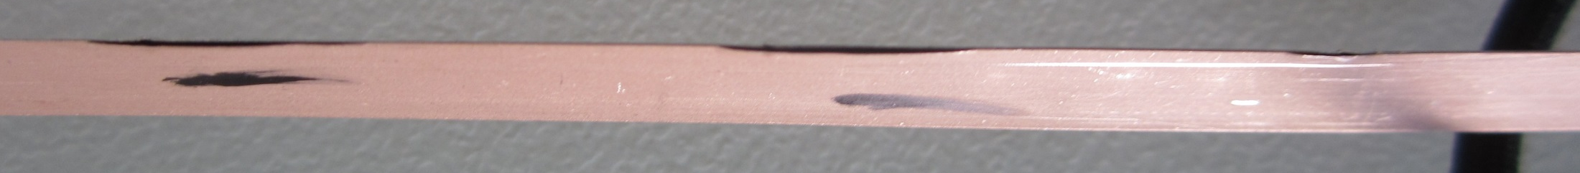
Non-planarity and delamination and after punching:
Non planarity and punching defect:
Side view of the 12 mm Bruker tape
12 mm
5.5 mm
Delamination examples:
16 mm
16 mm
5 mm
5.5 mm
A. Usoskin, A. Rutt: Bruker tape provided in frame of EuCARD² project.

Slide 10
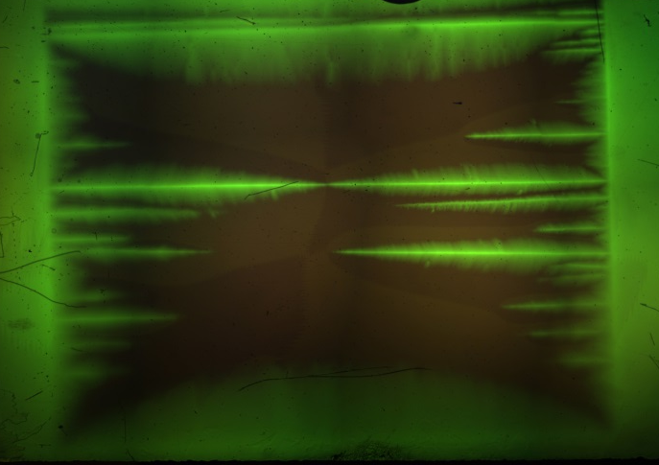
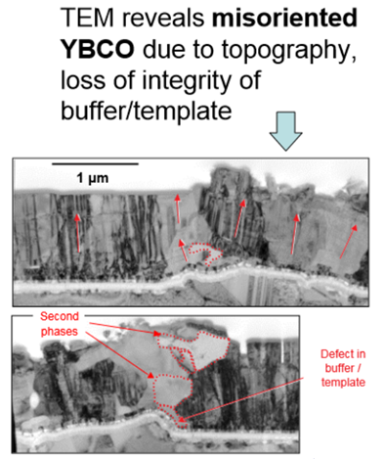
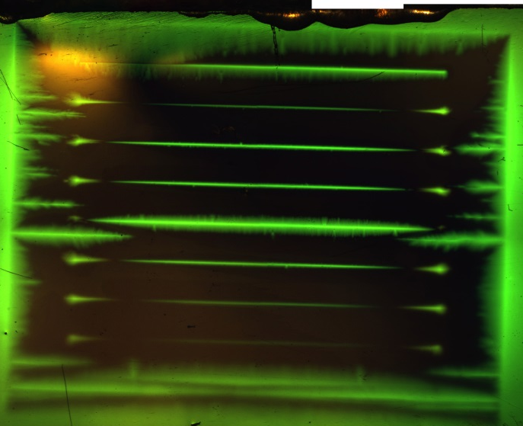
Microscopically - linear defects:
12 mm width
across tape
Ag cap
42.7 mT
50 K
Laser
grooves
12 mm width
across tape
Ag cap
10 filaments
42.7 mT
50 K
D.J. Miller et al.,
http://www.superpower-inc.com/files/
2006_ASC+4MI12+ANL+Poster.pdf

Slide 11
Recipe for the ’’good’’ Roebel cable:
Ingredients:
EuCARD² coated conductor material.
Punching vs. tape homogeneity.
2. Directions: Punch and coat.
3. Outcome:
Roebel cable geometry.

Slide 12

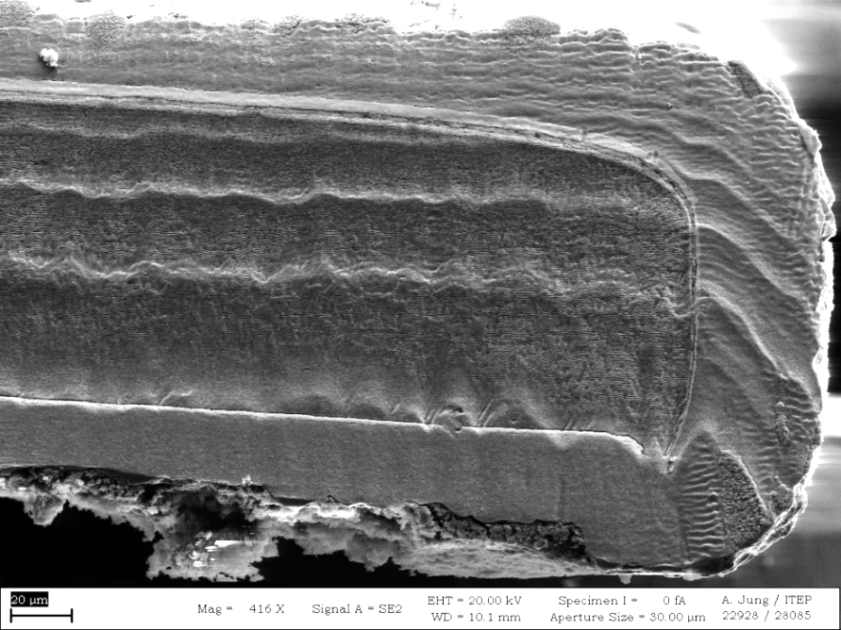
Cu-plated tape after punching - Bruker:
width of this Cu plated tape is 5.46-5.67 mm and thickness 175 µm
207 µm
176 µm
181 µm
181 µm
176 µm
188 µm
185 µm
185 µm
202 µm
176 µm
Cu
Ag
Stainless Steel
punching burr
20 µm
The average critical current per unit width degraded by 6% after punching and copper plating. Stinless steel
No local defects were found.
A. Usoskin, A. Rutt: Bruker tape provided in frame of EuCARD² project.

Slide 13

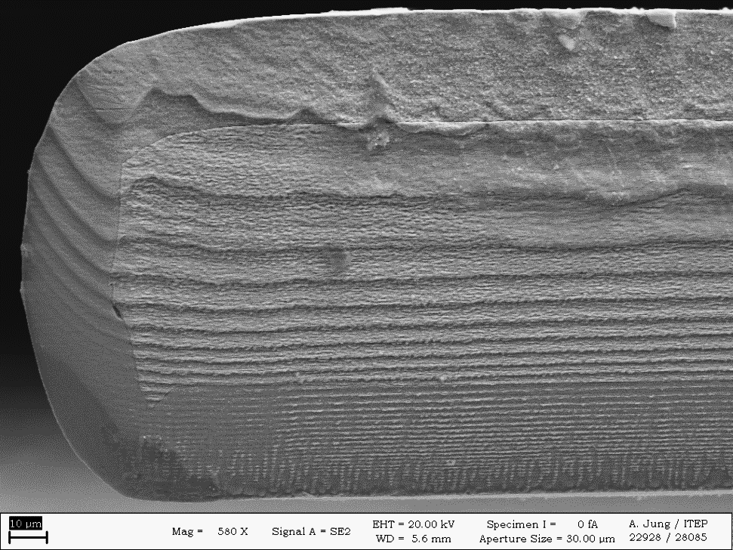
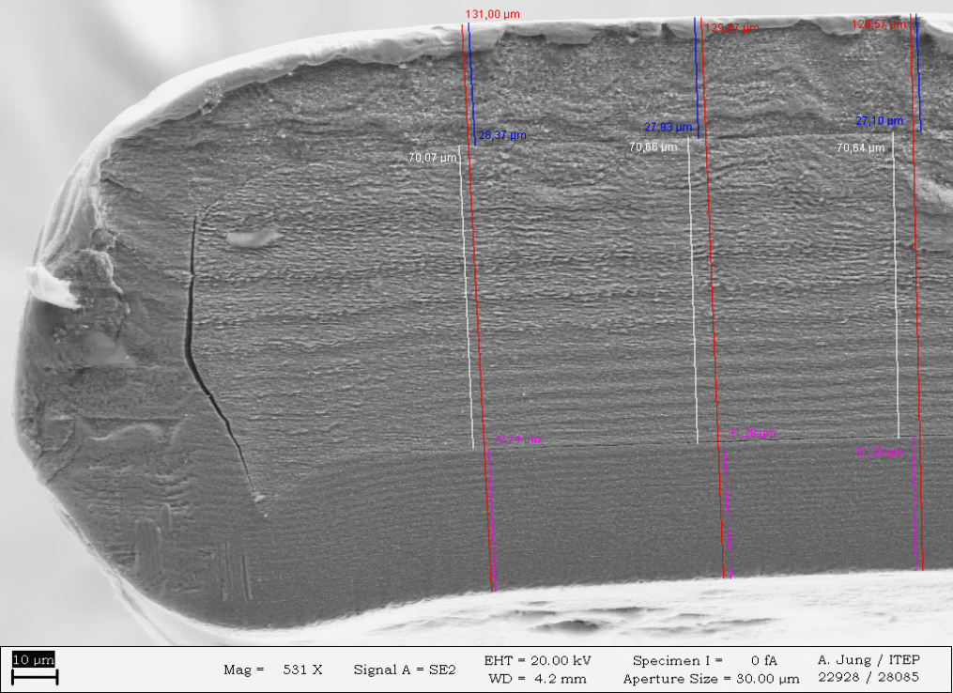
Cu-plated tape after punching - SuperOx:
Thickness of Cu plated tape between 115 µm - 131 µm
118 µm
121 µm
114 µm
119 µm
117 µm
115 µm
121 µm
121 µm
Cu
28 µm
Ag
70 µm
Hastelloy
131 µm
punching burr
10 µm
10 µm
No dog-bone effect.
Cu layer homogeneous across and along the tape.
A. Molodyk, SuperOx, tape provided in frame of collaboration.

Slide 14
Recipe for the ’’good’’ Roebel cable:
Ingredients:
EuCARD² coated conductor material.
Punching vs. tape homogeneity.
2. Directions: Punch and coat.
3. Outcome:
Roebel cable geometry.

Slide 15
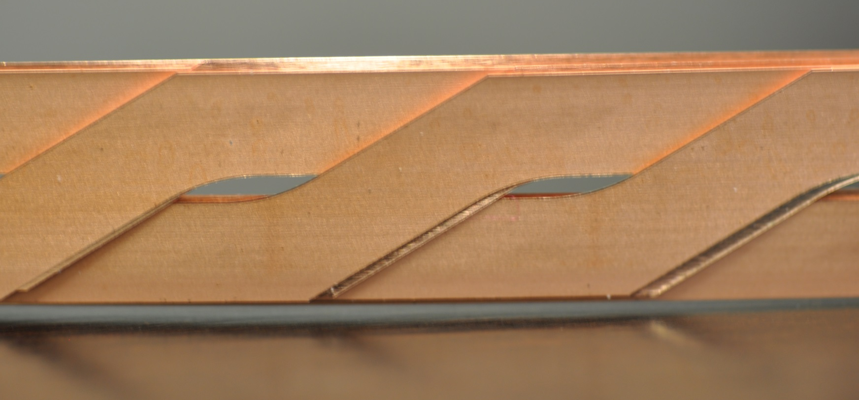
Roebel geometry parameters:
T_{p} = 126, 226, 426
W_{c} = 5.5
W_{l} = 5.5
α
R_{i}= 10
Horizontal gap
Vertical gap
Search for optimal geometry with good alignment of the strands in the cable…

Slide 16
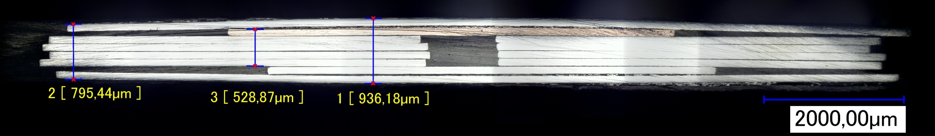
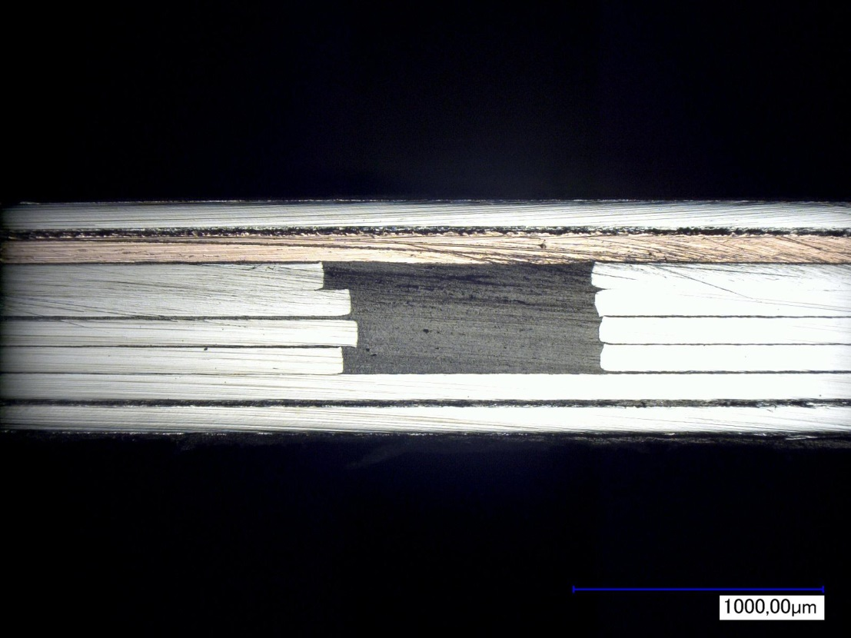
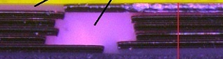
Roebel enclosed between two 12 mm tapes:
Vertical gap
Roebel strands
12 mm Stainless steel tapes
Roebel dummy cable cross-section
126 mm transposition length
10 strands
0.4 mm x 1 mm central space
Roebel dummy enclosed between two 12 mm stainless steel tapes.
Strands pressed together.
Homogeneously filled central Roebel gap with filled epoxy resin.

Slide 17
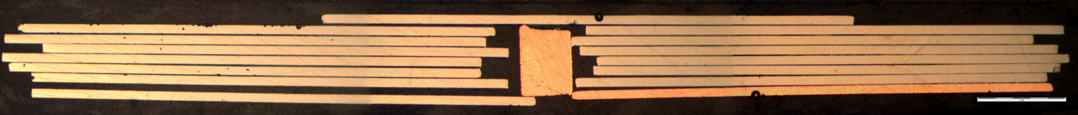
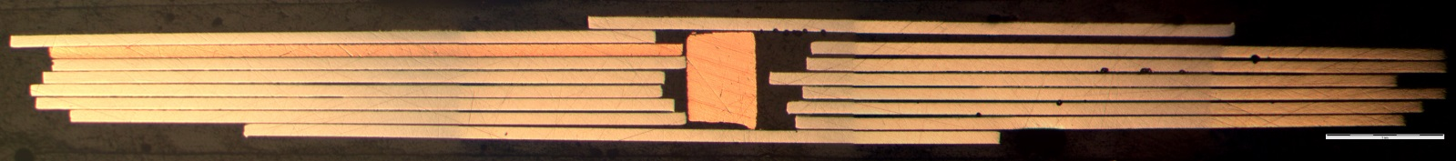
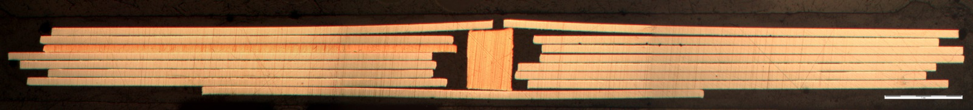
Roebel central space insert – rectangular smaller
than central space:
1 mm
1 mm
0.6 mm
0.9 mm
The 12 mm cable, 15 strands, 226 mm transposition length.
Insert is twisting when inserted, it was added after cabling procedure.
1 mm

Slide 18
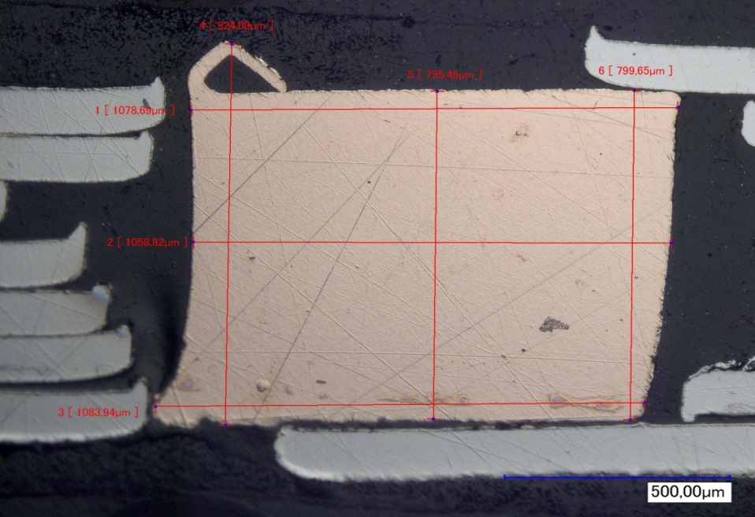
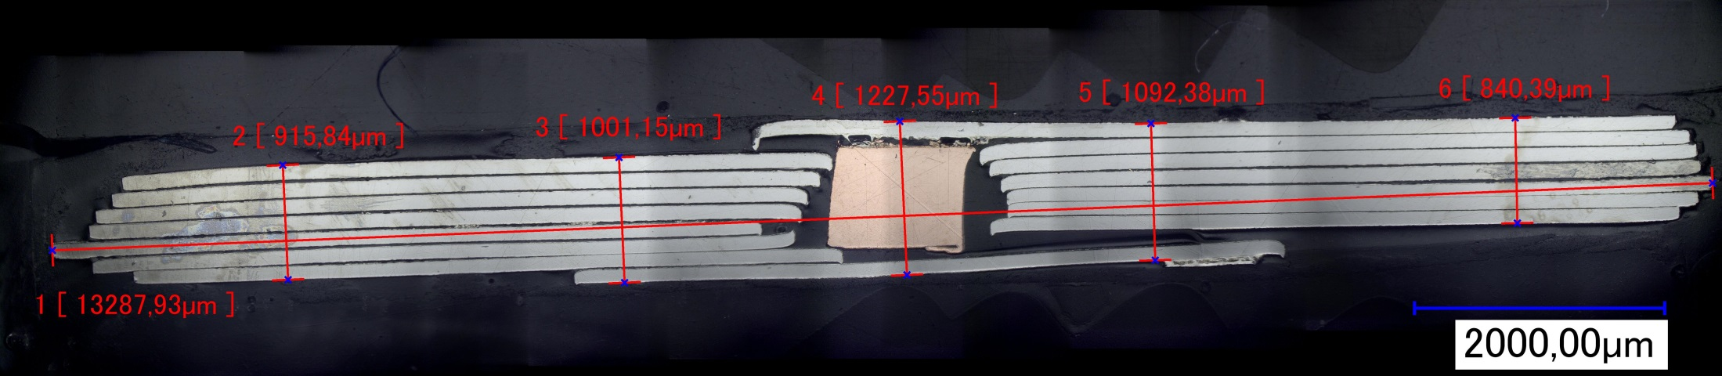
Roebel central space insert – rectangular filling
central space:
924 µm
795 µm
800 µm
Roebel dummy with 15 strands
Transposition length: 226 mm
Core was rolled using 0.8 mm wire
It was done with Turk head rolling machine
Inserted into cable after cabling
1079 µm
1059 µm
1084 µm

Slide 19
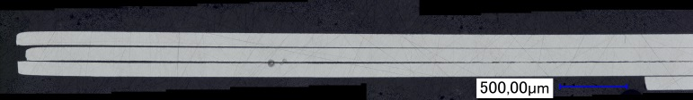
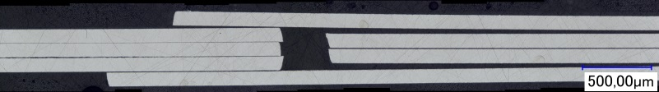
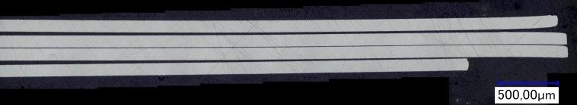
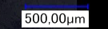
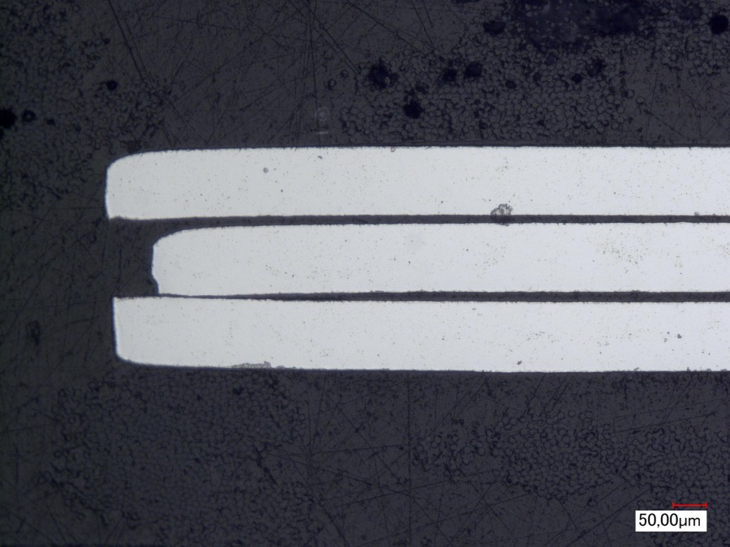
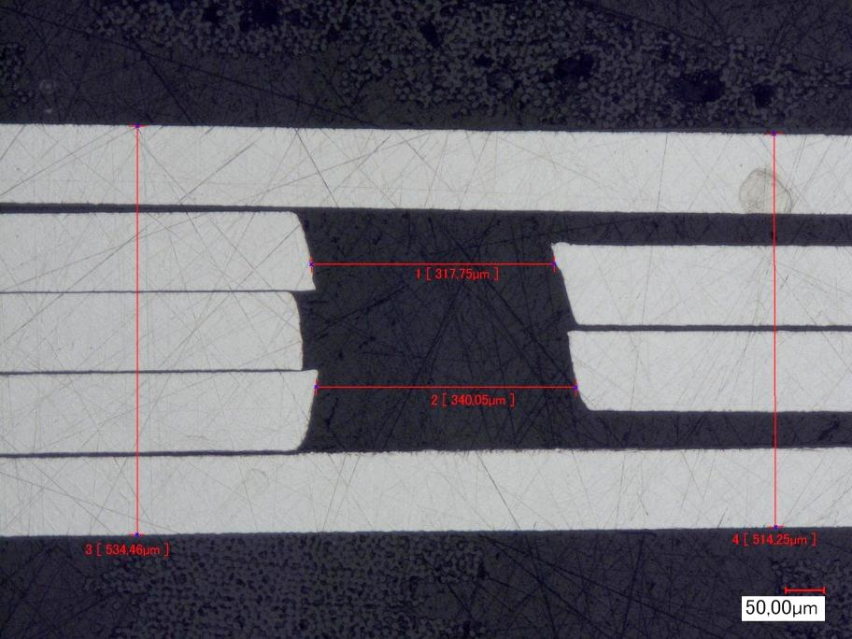
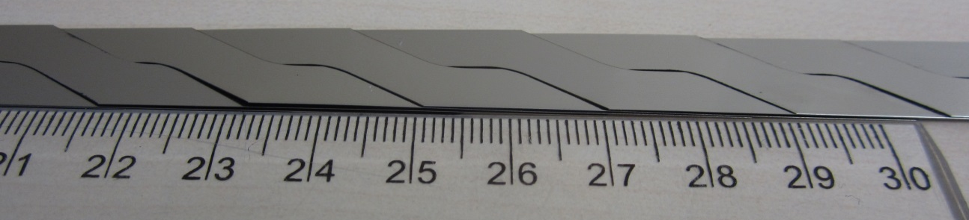
Roebel with reduced central space – changed
strand geometry:
318 µm
340 µm
Maximum 7 strands
Vertical space: 0.3 mm
534 µm
514 µm
T_{p} = 126
W_{c} = 5.9
W_{l} = 5.9
α
R_{i}= 10

Slide 20
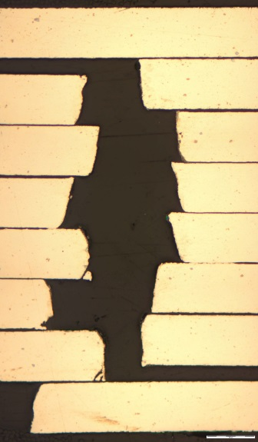
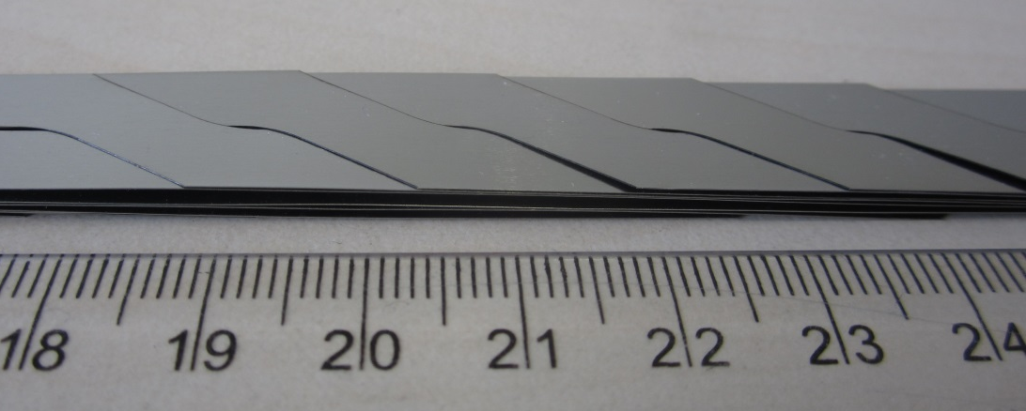
Roebel with reduced central space – changed
strand geometry:
200 µm
Maximum 14 strands
Vertical space:
0.12 -0.3 mm
897 µm
686 µm
T_{p} = 226
W_{c} = 5.9
200 µm
W_{l} = 5.9
α
R_{i}= 10

Slide 21
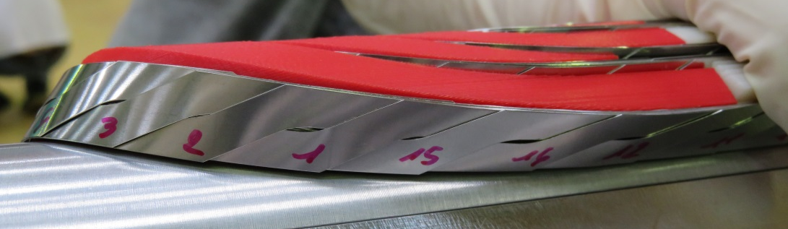
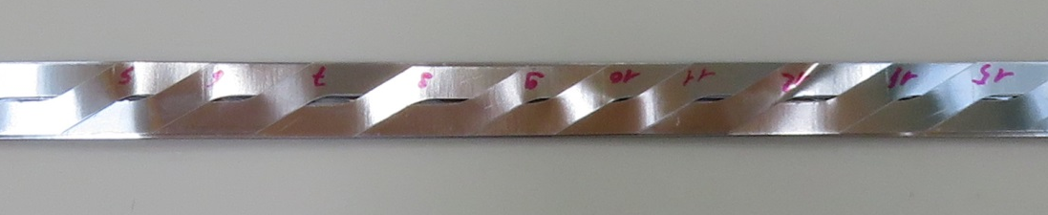

For racetrack type coil winding horizontal gap is
important parameter:
CEA – Saclay: increasing of horizontal gap
Pictures by courtesy of M. Durante, C. Lorin.
Transposition length ~ 350 mm with 5.9 mm wide strands result in 7 mm distance
between strands.

Slide 22

Recipe for the ’’good’’ Roebel cable:
Quality of punching depends on tape properties:
Coated conductor macroscopic homogeneity - tape planarity and constant
width of the tape.
Microscopic defects in the tape.
Quality of punching influences properties of cable:
Punching tool for specific tape – tape thickness, material (substrate and stabilization).
Punching tool length = transposition.
Tool control (wear off).
Cable geometry:
Should be adjusted to coil design.

