Slide 1
Status of WP10.2
Presented by L. Bottura
WAM-HTS3, September 10th - 11th, 2015

Slide 2
Outline
Recall of specifications and targets
Status of production and procurement
Issues

Slide 3
Target performance
Parameter |  | R&D target | Minimum
J_{E} (4.2 K, 20 T) | (A/mm²) | 600 | 400
Unit length | (m) | 100 | 50
σ(I_{c}) | (%) | 10
M (1.5 T, 10 mT/s) | (mT) | 300
Minimum σ_{transverse} | (MPa) |  | 100
Range of ε_{longitudinal} | (%) |  | ±0.3
Target cable I_{C} in the range of 10 kA

Slide 4

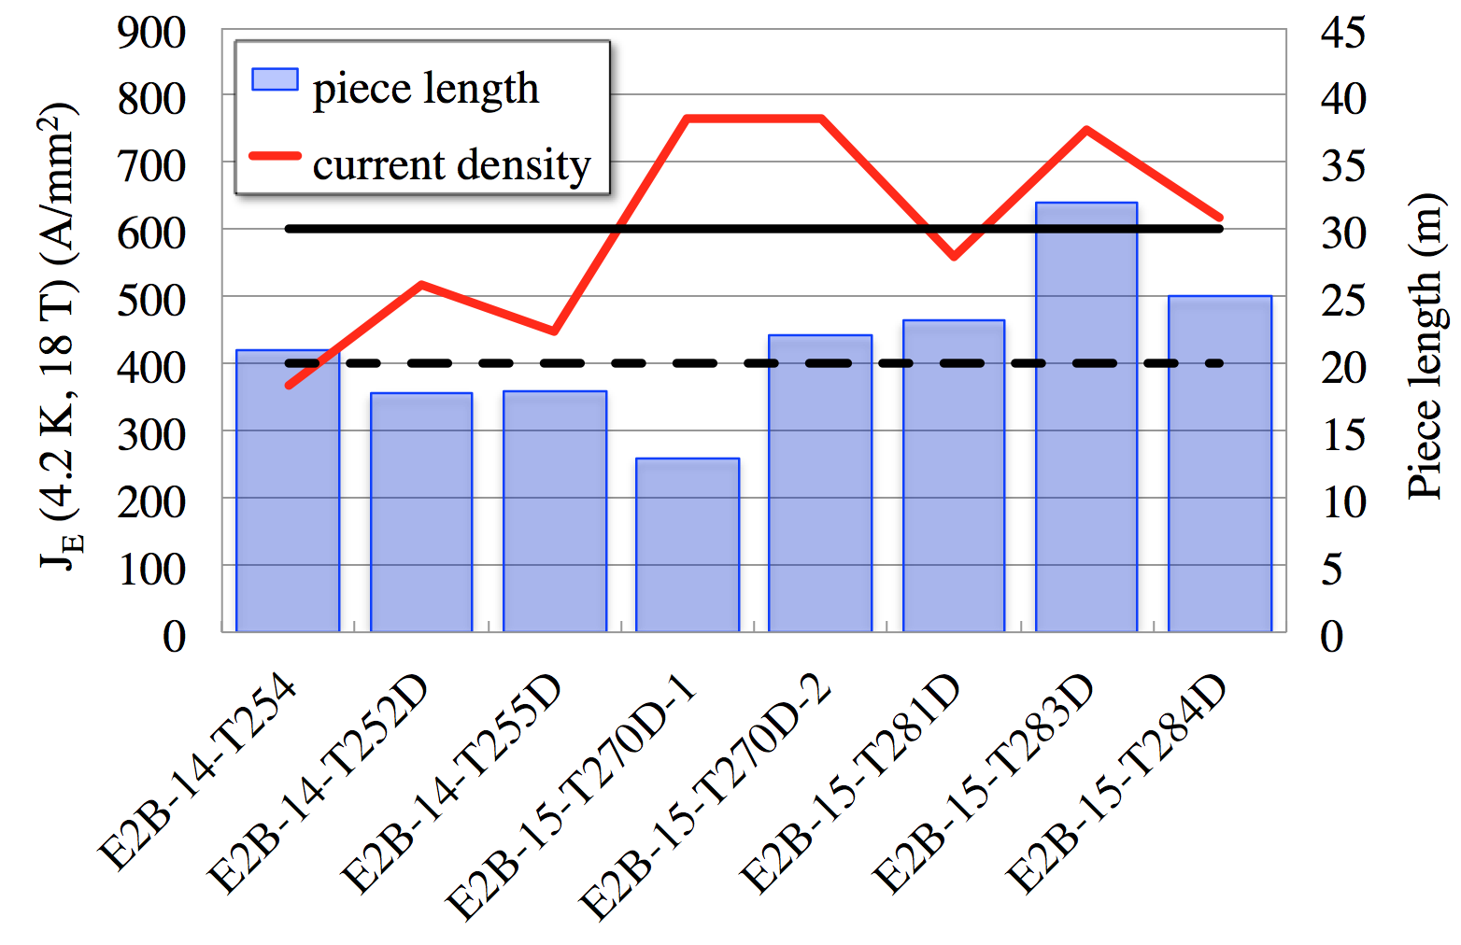
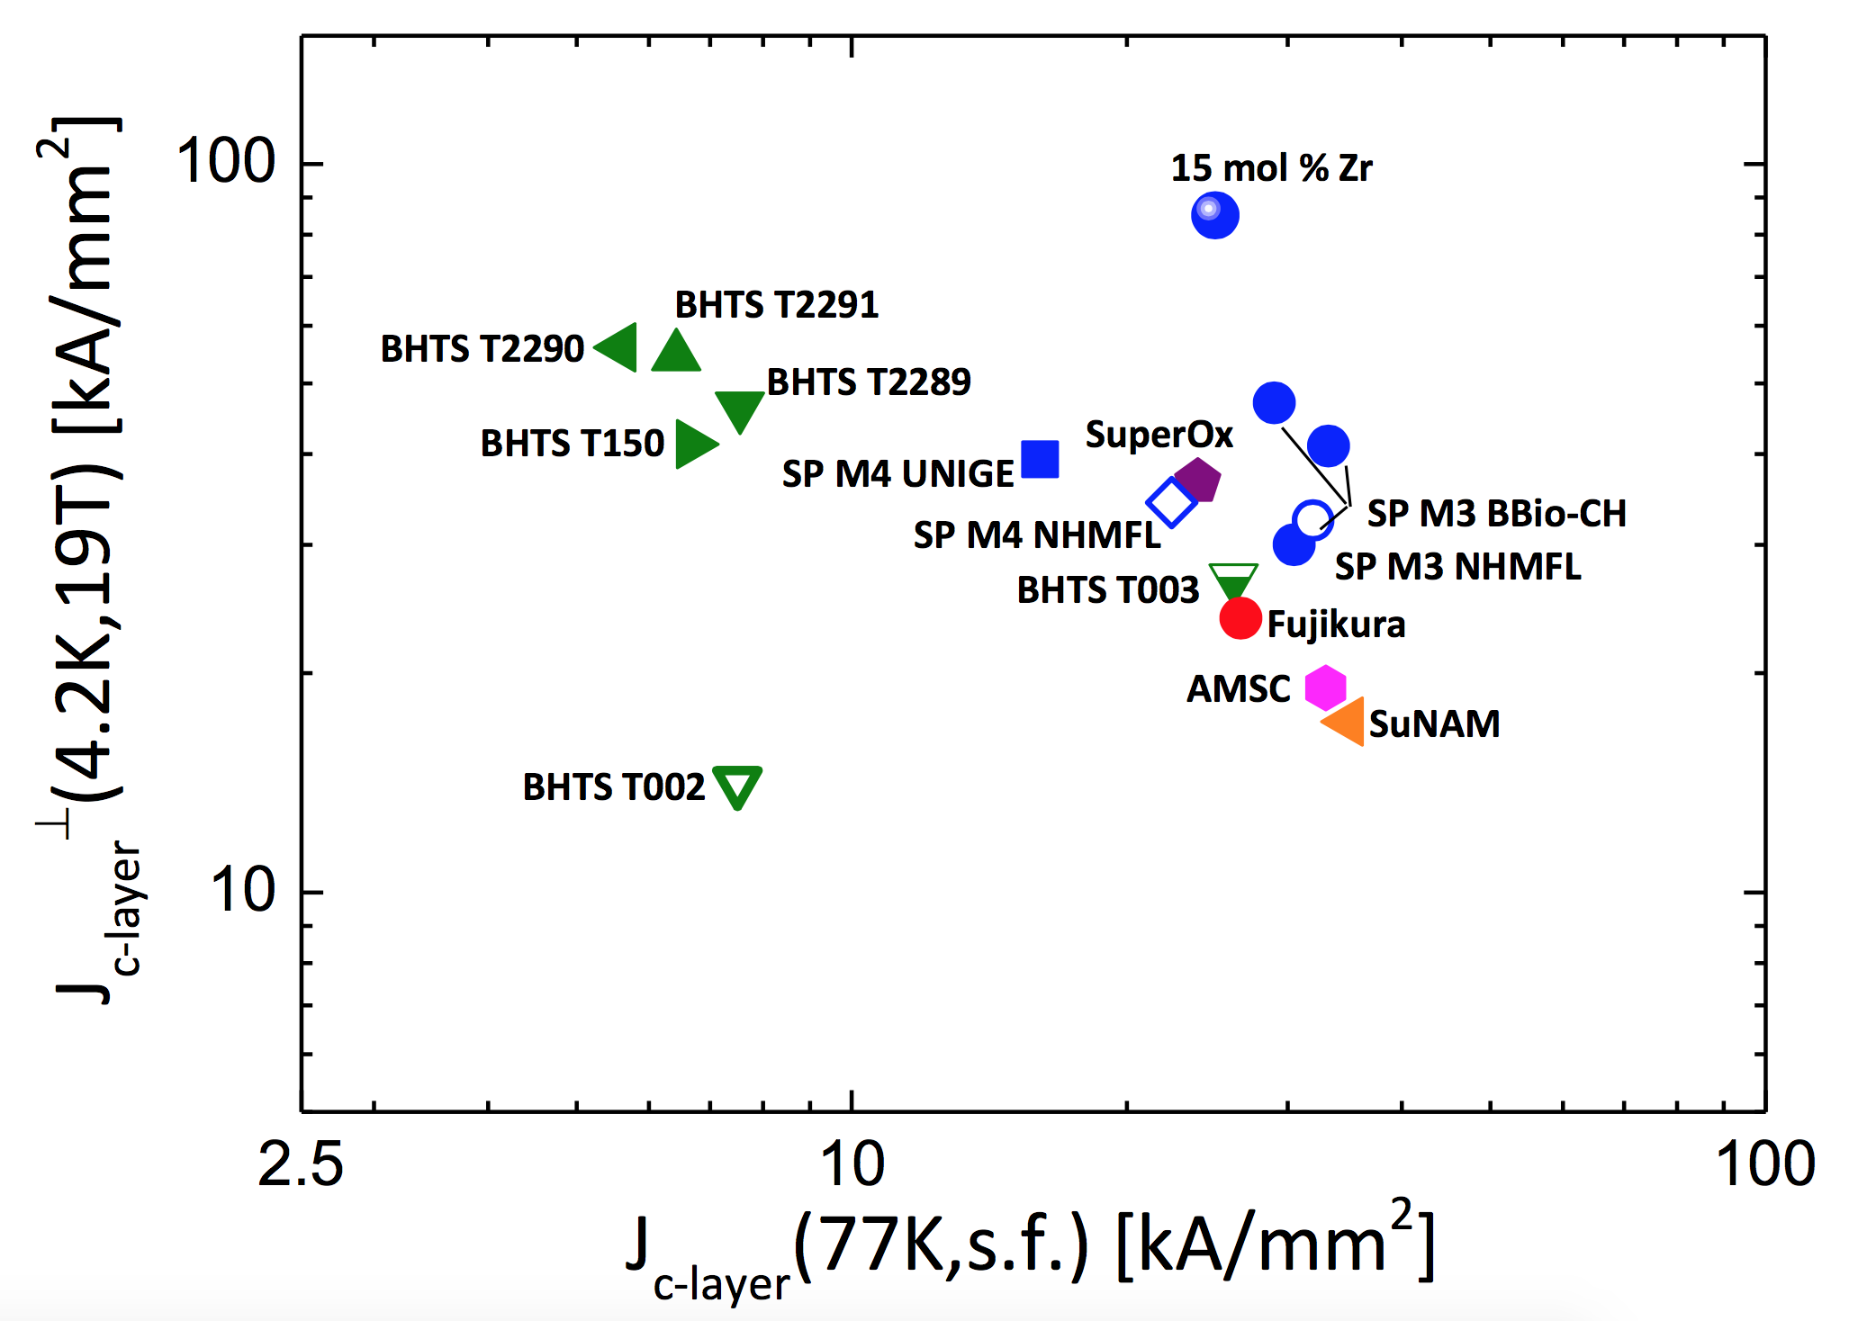


Tapes
Tape production for EuCARD2
Master plot (C. Senatore, U. Geneva)
Target J_{E}
Minimum J_{E}
Approximately 250 m of 12 mm tape produced:
all above minimum (400 A/mm²)
most at target (600 A/mm²)
some up to J_{E} (4.2 K, 18 T) ≈ 800 A/mm²
Highest layer J_{C} obtained in an industrial process
J_{E} achieved, piece length to scale up

Slide 5
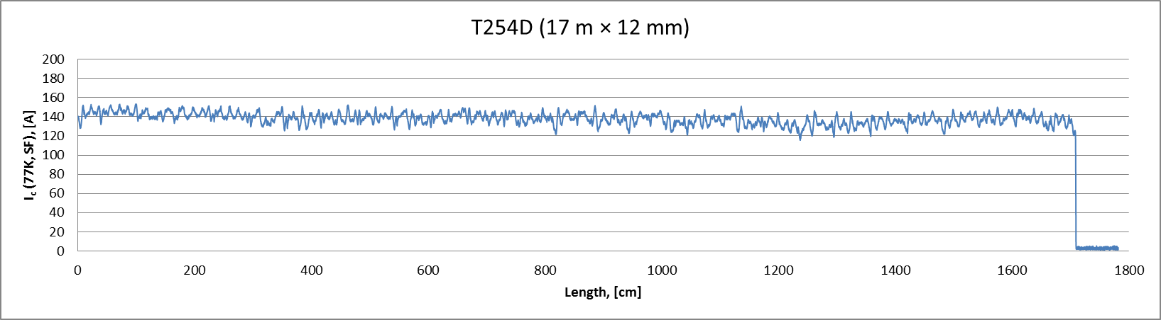
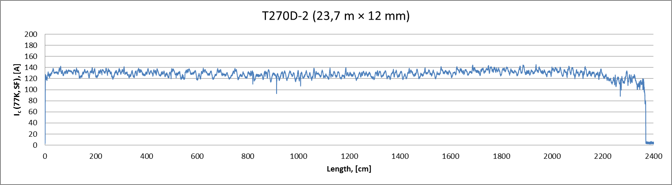
Homogeneity
±10 %
±10 %
homogeneity achieved

Slide 6
Tape catalog
 | Tape ID | Delivery | Length | Width | Thickness | Substrate | REBCO | Cu | Ic(77 K, s.f.) |  | Ic(4.2 K, 18 T) | Je(4.2 K, 18 T) | Comments and use
 |  |  |  |  |  |  |  |  | minimum | average
 |  |  | (m) | (mm) | (mm) | (mm) | (mm) | (mm) | (A) | (A) | (A) | (A/mm**2)
 | E2B-T003 | 13.6.2013 | 2 | 4.05 | 130 | 97 | 1 | 30 |  | 110 | 120 | 228 | test material (distributed CERN, UniGe)
 | E2B-T002-C | 19.7.2013 | 2 | 4.05 | 150 | 97 | 3.8 | 50 |  | 130 | 235 | 387 | test material (distributed CERN, UniGe)
 | E2B-T053-C | 8.2.2014 | 1.5 | 12 | 160 | 97 | 2.2 | 30 |  | 210 |  |  | punching test (KIT)
 | E2B-T189D-C | 8.2.2014 | 22 | 4 | 150 | 97 | 1.7 | 25 |  | 52 | 334 | 557 | benchmark material (CERN, UniGe, UniTwente, CNRS)
 | E2B-T190D-C | 24.3.2014 | 2 | 4.2 | 195 | 97 | 2 | 45 |  | 47 | 502 | 613 | high-performance tape (CERN, UniGe)
 | E2B-T191D-C | 11.4.2014 | 2 | 4.2 | 200 | 97 | 2 | 50 |  | 54 | 420 | 500 | high-performance tape (CERN, UniGe, ASC-NHMFL)
 | SP-KIT-2013030 |  |  | 12 | 100 |  |  |  | 362 | 364 |  |  | tape used for KIT cable E2S-15/5.5-005
 | SP-KIT-20130729 |  |  | 12 | 100 |  |  |  | 278 | 283 |  |  | tape used for KIT cable E2S-15/5.5-006
 | E2B-14-T254 | 11.12.2014 | 21 | 12 | 155 | 97 | 1.3 | 20 |  | 125 | 684 | 368 | Roebel qualification (punching and assembly tests, delivered to KIT, 17.8 m in reserve)
 | E2B-14-T252D | 18.12.2014 | 17.8 | 12 | 150 | 97 | 1.5 | 20 |  | 145 | 933 | 518 | Roebel sample E2B-15/5.5-008 manufacturing (delivered to KIT)
 | E2B-14-T255D | 18.12.2014 | 18 | 12 | 150 | 97 | 1.3 | 20 |  | 126 | 808 | 449 | Roebel sample E2B-15/5.5-008 manufacturing (delivered to KIT)
 | E2B-15-T270D-1 | 8.1.2015 | 13 | 12 | 140 | 97 | 1.8 | 20 |  | 130 | 1284 | 765 | Roebel sample E2B-15/5.5-008 manufacturing (delivered to KIT)
 | E2B-15-T270D-2 | 8.1.2015 | 22.1 | 12 | 140 | 97 | 1.8 | 20 |  | 130 | 1284 | 765 | Roebel sample manufacturing E2B-15/5.5-008 (delivered to KIT)
 | E2B-14-T253 | 3.6.2015 | 20 | 12 |  |  |  |  |  |  |  |  | Scrap material for tests and leads (stored at CERN)
 | E2B-15-T280D | Q1 2015 | 20 | 12 |  |  |  |  |  | 129 | 913 |  | Scrap material for punch-and-coat test (Bruker and KIT)
 | E2B-15-T281D | 30.4.2015 | 23.2 | 12 |  | 97 |  |  |  | 133 | 940 |  | Roebel sample E2B-15/5.5-008 manufacturing (delivered directly to KIT from BHTS)
 | E2B-15-T283D | Q1 2015 | 32 |  |  |  |  |  |  | 177 | 1258 |  | For final cable validation (punch-and-coat) at KIT
 | E2B-15-T284D | Q1 2015 | 25 |  |  |  |  |  |  | 146 | 1036 |  | For final cable validation (punch-and-coat) at KIT
 | E2B-T278D | 26.6.2015 | 7.3 | 4.2 | 195 | 97 | 1.7 | 47 |  | 47 | 343 | 419 | test material for cable stacks (stored at CERN)
 | M | Q3 2015 | 100 | 12 |  |  |  |  |  |  |  |  | Roebel qualification and benchmark tests (at CERN)
 | X | Q3 2015 | 200 | 12 |  |  |  |  |  |  |  |  | Roebel qualification and benchmark tests (at CERN)
 | S | Nov-15 | 200 | 12 |  |  |  |  |  |  |  |  | Roebel qualification and benchmark tests (ordered)
 | F | Q4 2015 | 200 | 12 |  |  |  |  |  |  |  |  | Roebel qualification and benchmark tests (ordered)
 | B | Q2 2015 (TBD) | 750 | 12 |  |  |  |  |  |  |  |  | cable production for magnet winding
 | B | Q3 2015 (TBD) | 750 | 12 |  |  |  |  |  |  |  |  | cable production for magnet winding (CERN order)
 | _ | Q2 2015 (TBD) | 750 | 12 |  |  |  |  |  |  |  |  | cable production for magnet winding
 | _ | Q3 2015 (TBD) | 750 | 12 |  |  |  |  |  |  |  |  | cable production for magnet winding (CERN order)
Ordered material incoming
Need to take action for the final production

Slide 7
Baseline cable design
REBCO Tape
Tape width (before punching) | (mm) | 12
SC layer | (μm) | 1 … 2
Cu layer | (μm) | 2 x 20
Substrate | (μm) | 50 … 100
Tape thickness | (mm) | 0.1 … 0.15
Critical current (4.2 K, 20 T perpendicular) | (A) | ≥ 670
Roebel cable
Number of tapes | (-) | ≤ 15 (17)
Width | (mm) | 12
Thickness | (mm) | 0.8 … 1.2
Transposition pitch | (mm) | 226
Critical current (4.2 K, 20 T perpendicular) | (kA) | ≥ 4.2

Slide 8
Cable catalog - dummies
Name | Length | Delivery | Width | Pitch | Thickness | SC Tapes | Cu Tapes | Tape origin | Tape width | Tape thickness | Comments
 | (m) |  | (mm) | (mm) | (mm) | (-) | (-) |  | (mm) | (mm)
E2D-15/5.5-001 | 3 | 4.4.2014 | 12 | 226 | 0.8 | 15 | 0 | dummy SS | 12 | 0.1 | Dummy 3 m for winding tests
E2D-15/5.5-002 | 3 | 4.4.2014 | 12 | 226 | 1.5 | 15 | 15 | dummy SS | 12 | 0.1 | Dummy 3 m with 1:1 Cu tapes for winding tests
E2D-15/5.5-003 | 20 | 13.5.2014 | 12 | 226 | 0.8 | 15 | 0 | dummy SS | 12 | 0.1 | Dummy 20 m for winding tests
E2D-15/5.5-004 | 6 | 6.11.2014 | 12 | 226 | 0.8 | 15 | 0 | dummy SS | 12 | 0.1 | Dummy 6 m for winding tests
E2S-15/4.5-005 | 13 | 1.10.2014 | 10 | 426 | 0.8 | 15 | 0 | dummy SS | 10 | 0.1 | Dummy 13 m for winding tests at CEA-Saclay
E2D-15/5.5-006 | 20 | ???? |  |  |  |  |  | dummy SS |  |  | Dummy 20 m for winding tests sent directly to Saclay
E2D-15/5.5-007 | 32 | Aug-15 | 12 | 300 | 0.8 | 15 | 0 | dummy Hastelloy+Cu | 12 | 0.1 | Dummy for Feather-M0 test (procured at GCS)
E2D-15/5.5-008 | 32 | Aug-15 | 12 | 300 | 0.8 | 15 | 0 | dummy Hastelloy+Cu | 12 | 0.1 | Dummy for Feather-M2 test (procured at GCS)
E2D-15/5.5-009 | 5 | Aug-15 | 12 | 226 | 0.8 | 15 | 0 | dummy SS | 12 | 0.1 | Dummy for Feather-M0 test
E2D-15/5.5-010 | 5 | Aug-15 | 12 | 226 | 0.8 | 15 | 0 | dummy SS | 12 | 0.1 | Dummy for Feather-M0 test
E2D-15/5.5 | 40 | Aug-15 |  |  |  |  |  |  |  |  | Dummy for Feather-M2 test, SS with Cu coating
E2D-15/5.5 | 20 | Oct-15 |  |  |  |  |  |  |  |  | Dummy for Cos-theta-pole 1, SS with Cu coating
E2D-15/5.5 | 20 | Oct-15 |  |  |  |  |  |  |  |  | Dummy for Cos-theta-pole 2, SS with Cu coating
Use these dummies for the validation of the manufacturing process

Slide 9
Cable catalog - SC
Name | Length | Date | W | Lp | t | SC Tapes | Cu Tapes | Tape origin | Tape width | Tape thickness | Tape Ic |  | Expected cable Ic |  | Comments
 |  |  |  |  |  |  |  |  |  |  | 77 K, s.f. | 4.2 K, 20 T | 77 K, s.f. | 4.2 K, 20 T
 | (m) |  | (mm) | (mm) | (mm) | (-) | (-) |  | (mm) | (mm) | (A) |  | (A)
E2S-15/5.5-001 | 1.6 | 6.11.2014 | 12 | 226 | 0.8 | 15 | 0 | SP-KIT-2013030 | 12 | 0.1 | 362 |  | 1443 |  | Cable sample for layer jump tests - AC loss samples (0.6 m)
E2S-15/5.5-002 | 1.8 | 6.11.2014 | 12 | 226 | 0.8 | 15 | 0 | SP-KIT-20130729 | 12 | 0.1 | 278 |  | 1126 |  | Cable sample for impregnation tests - G. Kirby
E2B-15/5.5-003 | 5 | 1.5.2015 | 12 | 226 | 1.12 | 15 | 0 | E2B-14-T252D, E2B-14-T255D, E2B-15-T270D-1, E2B-15-T270D-2, E2B-15-T281D | 12 | 0.14 | 133 | 1050 | 896 | 4253 | Frankenstein: delivery of first cable length (Feather-M0-1)
E2B-15/5.5-004 | 2 | Sep-15 | 12 | 226 |  |  |  | E2B-15-T283D | 12 | 0.14 | 177 | 1258 | 1198 | 5095 | Final verification for critical current test FRESCA
E2B-15/5.5-005 | 2 | Sep-15 | 12 | 226 |  |  |  | E2B-15-T284D | 12 | 0.14 |  |  |  |  | Final verification for transverse pressure test UTwente
E2S-15/5.5 | 10 | Sep-15 |  |  |  |  |  |  |  |  |  |  |  |  | Feather-M0-2
E2X-15/5.5 | 10 | Oct-15 |  |  |  |  |  |  |  |  |  |  |  |  | Feather-M0-3
E2M-15/5.5 | 6 | Oct-15 |  |  |  |  |  |  |  |  |  |  |  |  | Feather-M0-4
E2F-15/5.5 | 10 | Oct-15 |  |  |  |  |  |  |  |  |  |  |  |  | Feather-M0-5
E2_-15/5.5 | 30 | Dec-15 |  |  |  |  |  |  |  |  |  |  |  |  | Feather-M2-pole 1 - MILESTONE (MS66)
E2_-15/5.5 | 30 | Dec-15 |  |  |  |  |  |  |  |  |  |  |  |  | Feather-M2-pole 2
E2_-15/5.5 | 30 | Dec-15 |  |  |  |  |  |  |  |  |  |  |  |  | Feather-M2-pole spare
E2_-15/5.5 | 20 | Feb-16 |  |  |  |  |  |  |  |  |  |  |  |  | Cos-theta-pole 1
E2_-15/5.5 | 20 | Feb-16 |  |  |  |  |  |  |  |  |  |  |  |  | Cos-theta-pole 2
Work to start soon on further 6 m length cable
We will be late for the nominal delivery of the first winding UL (3 months ?)

Slide 10


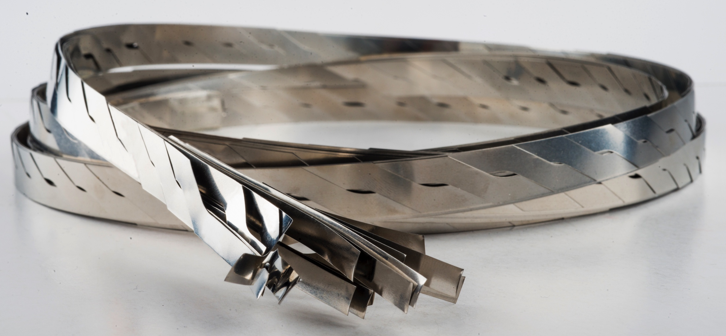
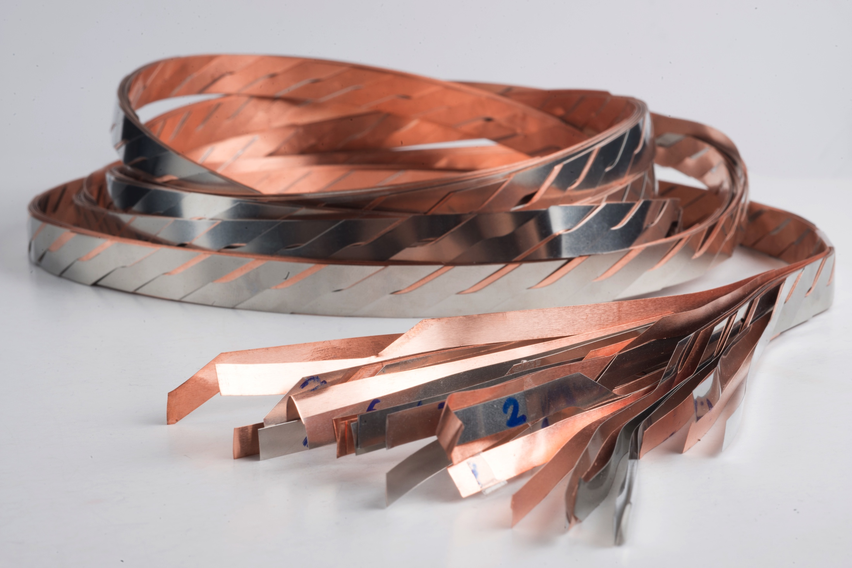
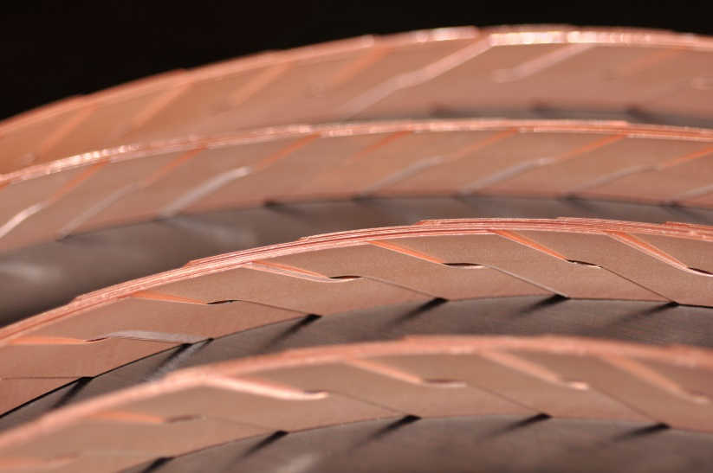
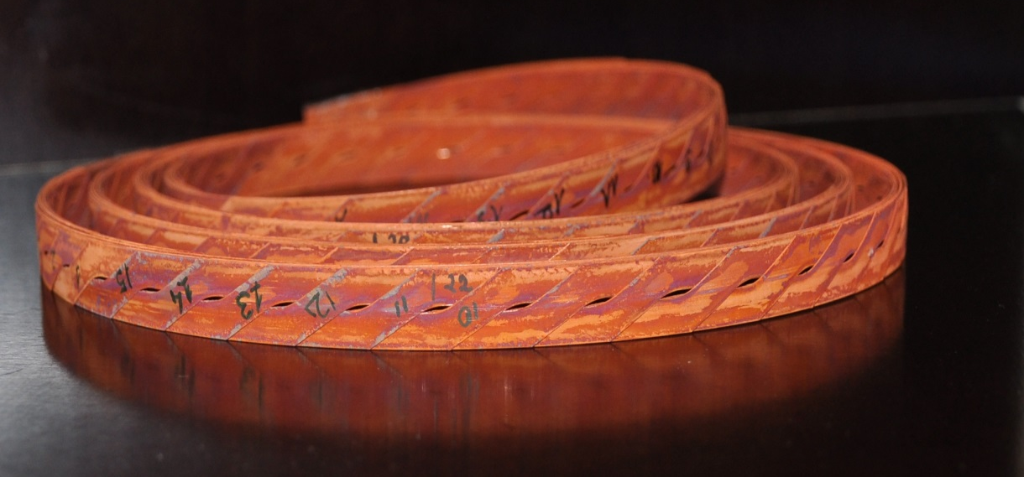
Roebel cables
Total of ≈ 140 m produced/procured
E2D-15/5.5-001
E2D-15/5.5-002
15 SS tapes (0.1 mm), 3 m
15 SS+15 Cu tapes (0.1 mm), 3 m
Total of ≈ 10 m produced
15 BHTS tapes (0.14 mm), 5 m
Expected I_{C} (4.2 K, 20 T) ≈ 4.2 kA
15 BHTS tapes (0.14 mm), 2 m
Expected I_{C}(4.2 K, 20 T) ≈ 5.1 kA
Cable length OK, can be wound

Slide 11
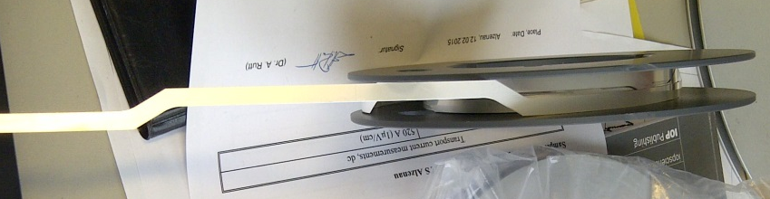
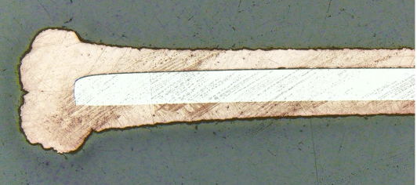
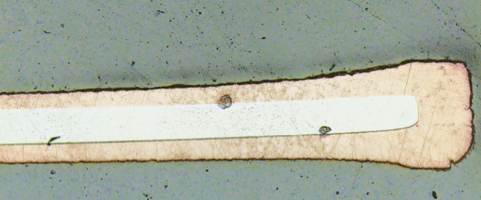
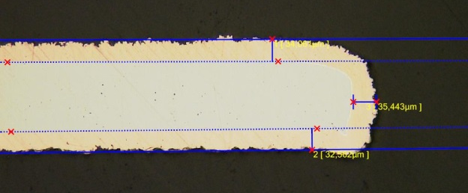
Punch-and-coat
Standard Roebel production sequence
  Produce Cu-coated tape
  Punch meanders
  Assemble cable
Modified Roebel production sequence
  Produce Ag-capped tape
  Punch meanders (less than 5% I_{C} degradation !)
  Cu-coat (dog-boning !)
  Assemble cable
Ag capped punched tape
2x40 μm coating
2x20 μm coating
Optimized
2x20 μm coating
Use punch-and-coat as baseline, validate Cu-coating

Slide 12
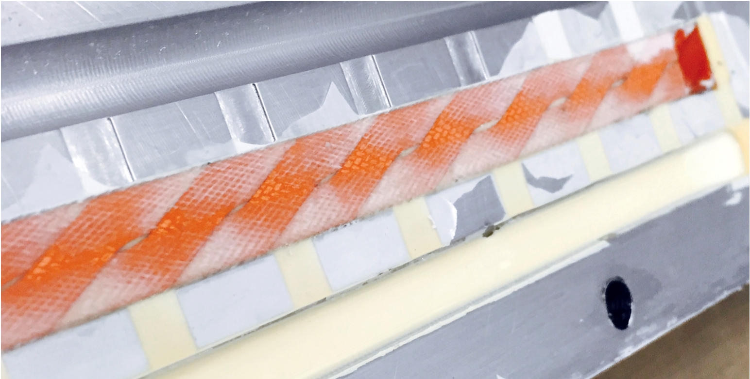
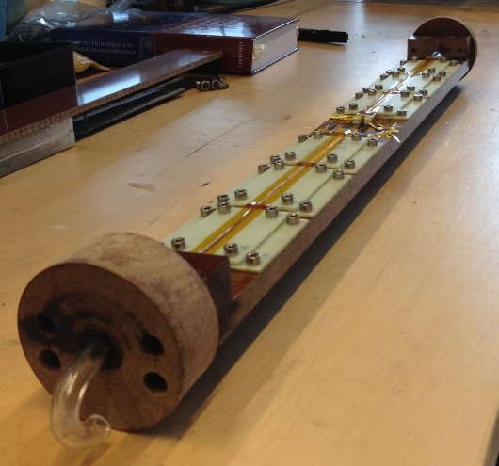
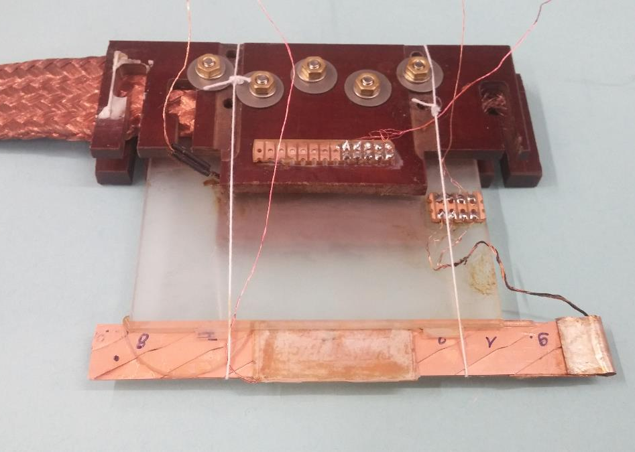



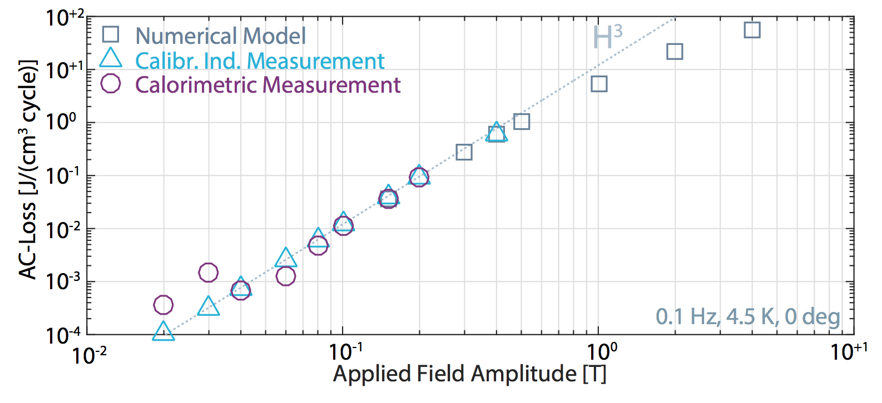
Magnetization
4.2 K, 400 mT
4.2 … 100 K, 350 mT
Impregnated (CTD101G) Roebel cable sample, 226 mm
As expected, the cable has large loss and magnetic moment
Penetration field is o(1T)
Work in progress as to the understanding and evaluation of field quality in the various magnet design
1 J/cm³
0.5 T
Magnetization will be large, deal with it

Slide 13
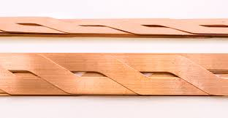
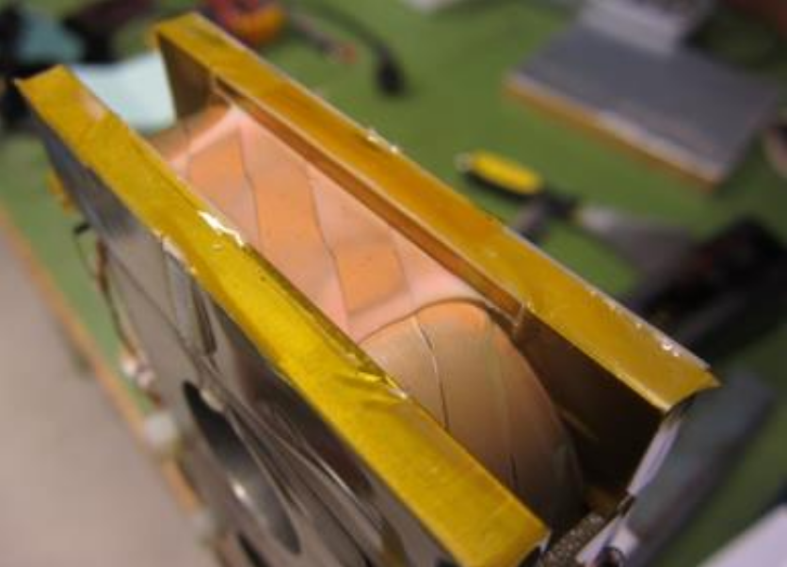
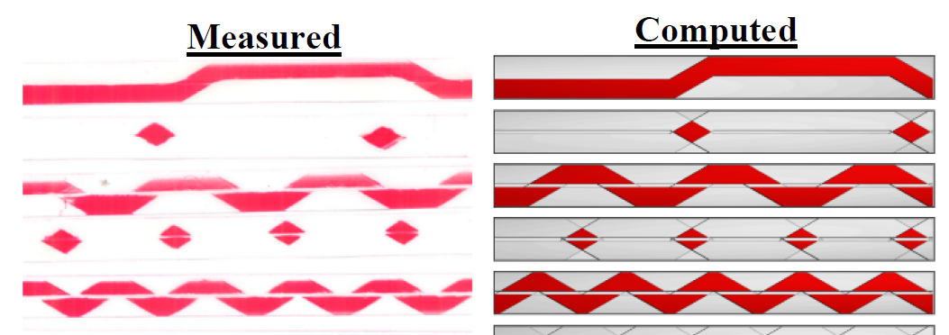
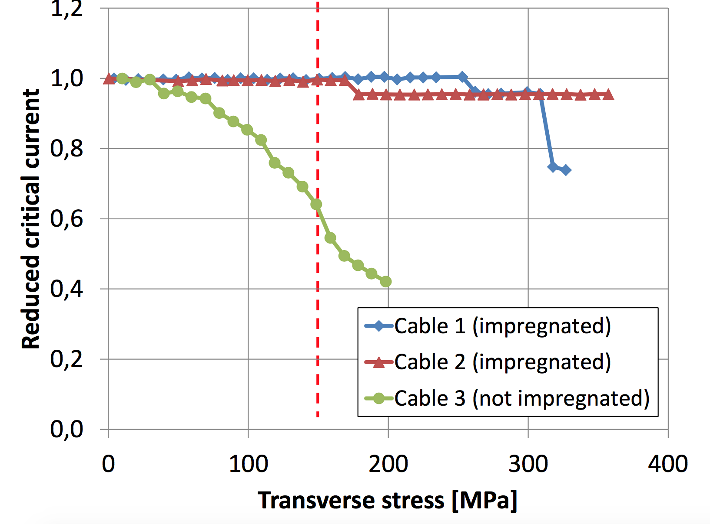
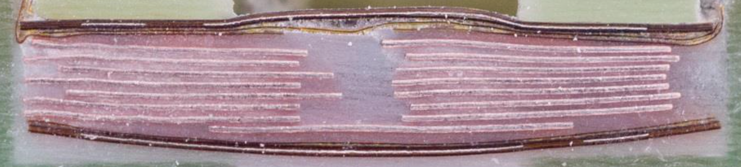
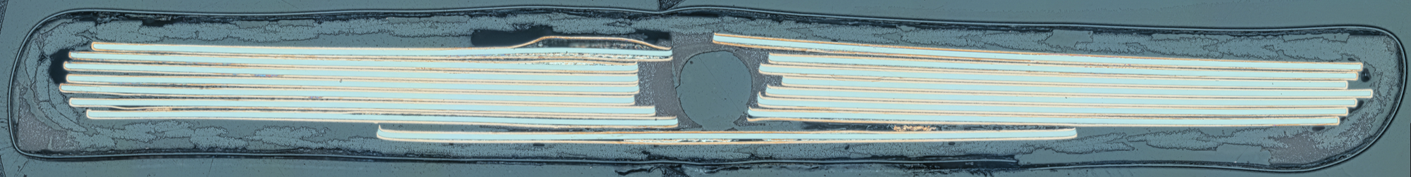
Transverse forces
Measurement in the cable press at the University of Twente
Red=thicker spots =>stress
Grey =thinner spots =>no stress
J. Fleiter, C. Lorin. A. Ballarino, 2015
Benefit of impregnation
Ch. Barth
KIT: 1:1 epoxy-fused silica
G. Kirby, J. van Nugteren
S. Otten et al., 2015
CERN: CTD101G
Transverse mechanics looks OK

Slide 14
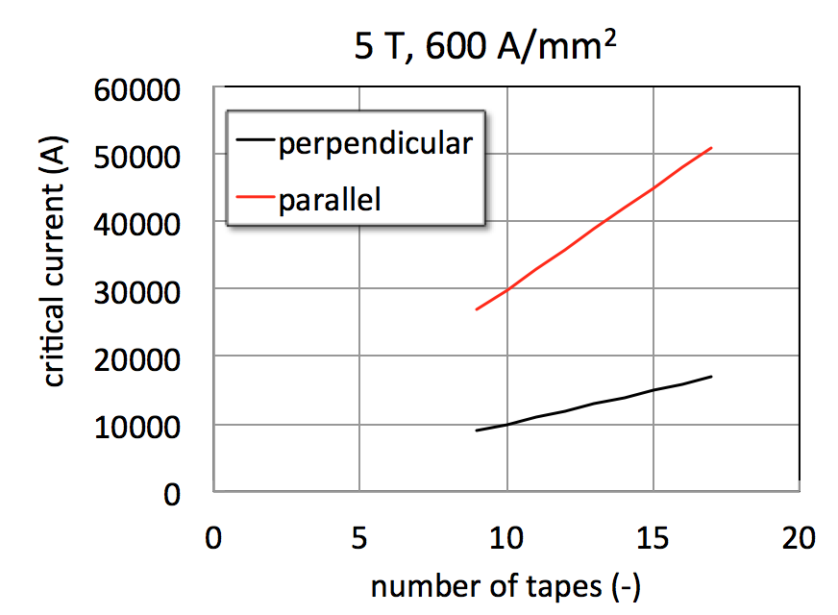
Cable dimensions
More than 9 tapes
Minimum 13 tapes
11.7 kA
7.92 kA
9 x 5.5 ≈ 4 x 12
EuCARD2 = EuCARD ?!?

Slide 15
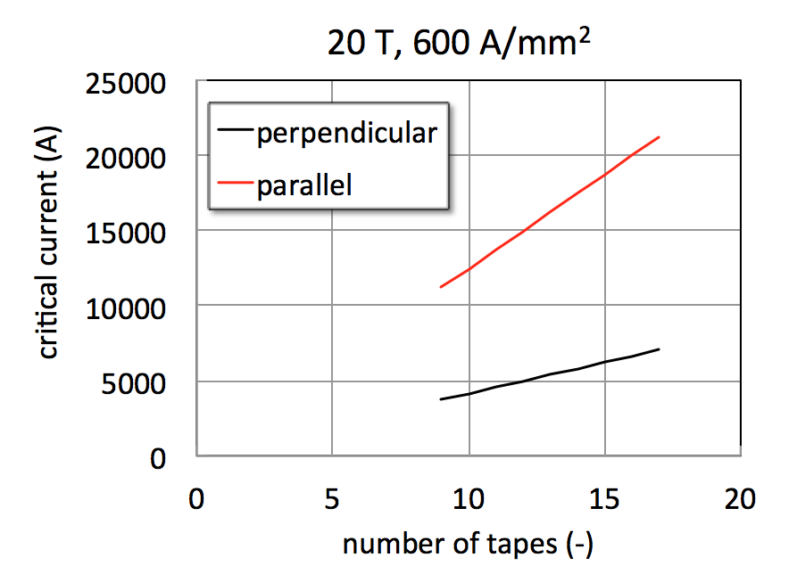
Cable dimensions
15 T +5 T from the insert
15.25 kA
10.43 kA
More than 9 tapes
13 tapes

Slide 16
Cable dimensions
Consider these three configurations:
  0.1 mm (std J_{c}^{layer}), 15 tapes, t=0.8 mm
    Ic(5 T) = 10.7 kA (32.1 kA) CT(4.5 T) / AB
    Ic(20 T) = 4.5 kA (13.5 kA) CT(1.5 T) / AB
  0.14 mm (high J_{c}^{layer}), 15 tapes, t=1.12 mm
    Ic(5 T) = 15 kA (45 kA) CT / AB
    Ic(20 T) = 6.3 kA (18.9 kA) CT(2 T) / AB
  0.14 mm (high J_{c}^{layer}), 13 tapes, t=0.98 mm
    Ic(5 T) = 12.9 kA (38.7 kA) CT / AB
    Ic(20 T) = 5.4 kA (16.2 kA) CT(1.8 T) / AB
We could change to 13 tapes, instead of 15 – worth it ?

Slide 17
J_{Copper}
Aligned blocks, I_{op}=7.9 kA
Cable option | w | t | J_{cable} | f_{copper} | J_{copper}
 | (mm) | (mm) | (A/mm²) | (-) | (A/mm²)
15/0.1 | 12 | 0.8 | 825 | 0.40 | 2063
13/0.14 | 12 | 0.98 | 673 | 0.29 | 2357
15/0.1 | 12 | 1.12 | 589 | 0.29 | 2063
Cos theta, I_{op}=11.7 kA
Cable option | w | t | J_{cable} | f_{copper} | J_{copper}
 | (mm) | (mm) | (A/mm²) | (-) | (A/mm²)
15/0.1 | 12 | 0.8 | 1219 | 0.40 | 3047
13/0.14 | 12 | 0.98 | 995 | 0.29 | 3482
15/0.1 | 12 | 1.12 | 871 | 0.29 | 3047

Slide 18
Issues and plan
Continue procurement and cabling with the material as it comes
  Finalize cable dimensions (need a benchmark on “real” cable dimensions, after insulation) – possibly at the end of WAM-HTS3 ?
  Steel dummies, punch-and-coat procedure validation
  Re-baseline the final production of cable (need 1.5 km tape within the next 3 months)
Other critical steps in the next half term
  Validate cable performance in FReSCa and by transverse pressure test
    Compare different materials and cables (e.g. SuperOX)
    Needs final insulation scheme for transverse test (FReSCa sample ?)
  Design magnet joint (geometry, materials, procedure)
  Quench detection and protection with the actual tape and cable geometry and properties
  Complete magnetization study, understand implications

