Slide 1
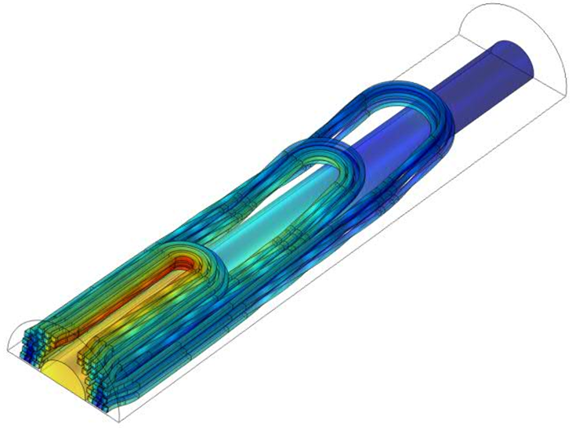
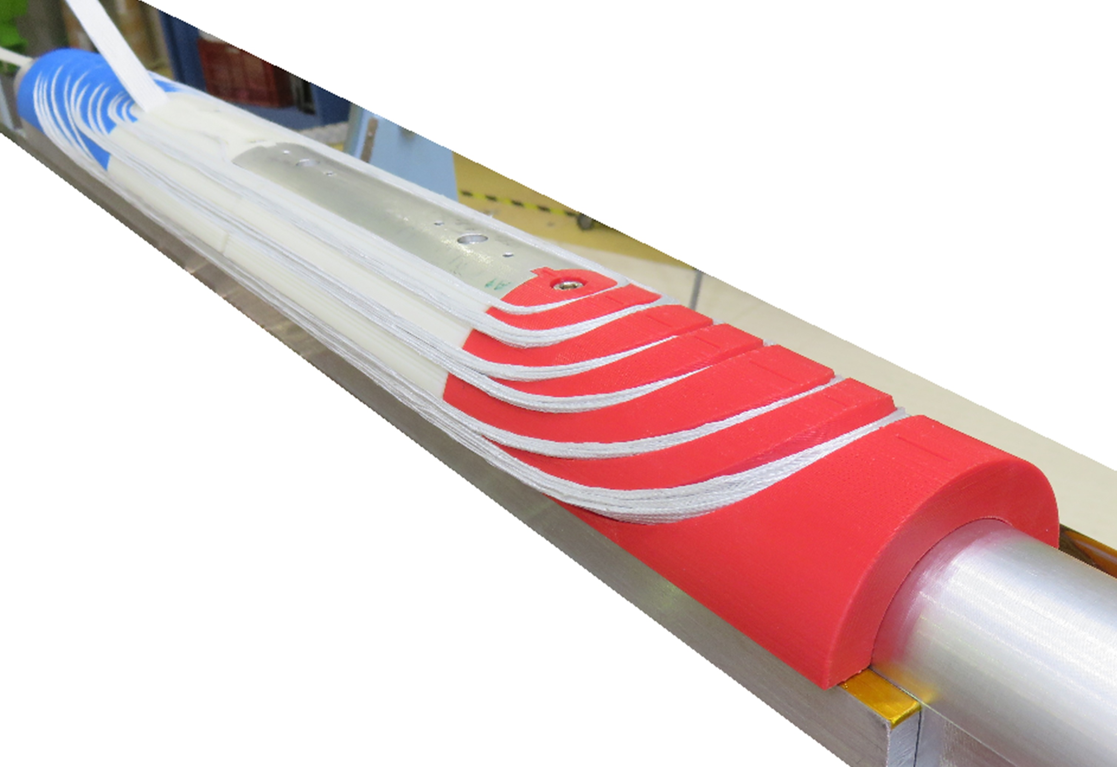
Alternative EuCARD-2 dipole status: cos-θ and stack designs
Clément Lorin, Maria Durante (CEA)
John Himbele (INPG)
and all WP10.3 members
Third Workshop on Accelerator Magnets in HTS (WAMHTS-3)
10-sept-2015
Lyon, FRANCE

Slide 2
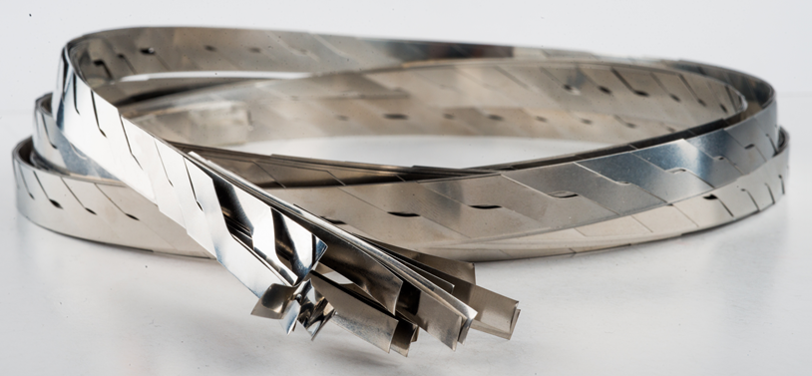
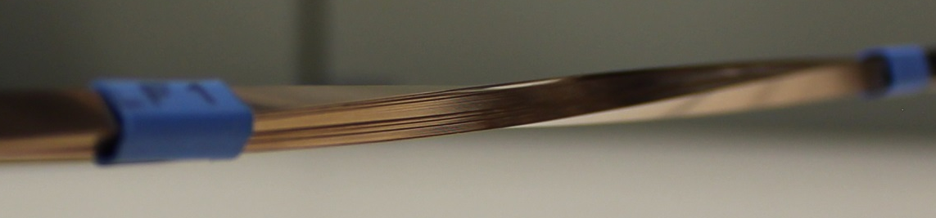
Framework
Field target: Accelerator-type magnet
  stand-alone mode + yoke: 5 T
  insert mode: the more the better
Constraints:
  Magnet dimension: 40 mm aperture and 99 mm outer diameter
Contents
Cos-θ design at CEA:
  12-mm wide Roebel cable
Stack design at INPG:
  4x4 mm² stack of tapes

Slide 3
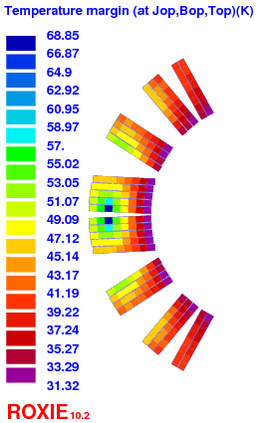
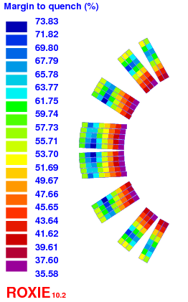
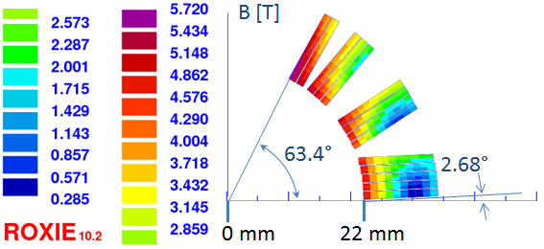
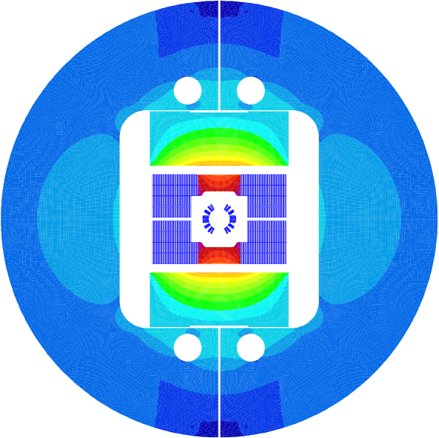
Cos-θ : Magnetism
  Bruker J_{e,c tape} = 1741 A/mm² (5 T, 4.2 K, ∟)
  = 725 A/mm² (18 T, 4.2 K, ∟)
Stand-alone:
  J_{o,insulated cable} = 684 A/mm²
  5 T with a yoke
Insert:
  J_{o,insulated cable} = 450 A/mm² (~20 % loadline margin)
  13 T + 2.5 T (max) in Fresca2
5T
5T

Slide 4
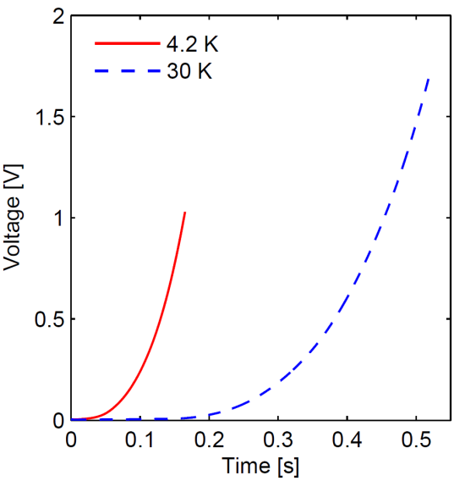
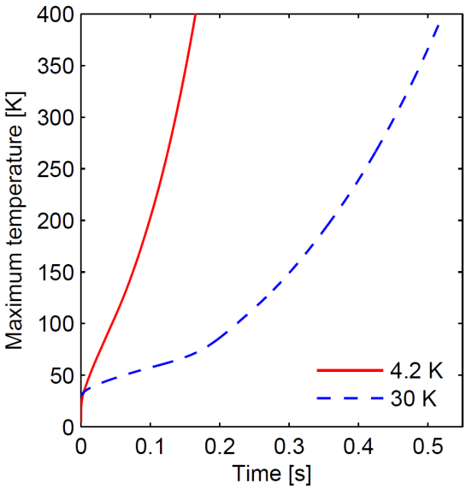
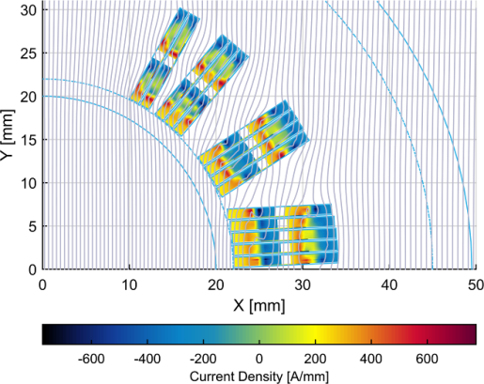
Cos-θ : Quench/Magnetization
Quench analysis carried out by Erkki Härö and Antti Stenvall (TUT)
  Standalone: very challenging
  Insert mode: ok ->
  see Antti’s talk.
Magnetization analysis carried out by Jeroen van Nugteren (CERN/Twente)
  “b3, 60 unit’s variation at low field
  reducing to < 20 units at high field.
  b5 and b7 we see ~ 10 units variation,
  then converge to low values at high field.”*
~ 47 ms
detection
+ validation
177 K
detection
100 mV
75 ms
85 ms
122 ms
G. Kirby, L. Rossi et al. “Status of the High Current REBCO Roebel Cable Coils for the EuCARD-2 Future Magnets Project” EuCAS 2015, IEEE TAS

Slide 5
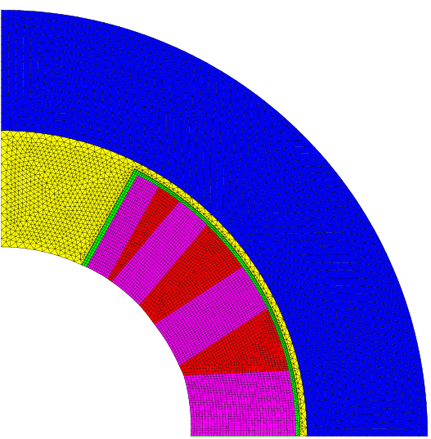
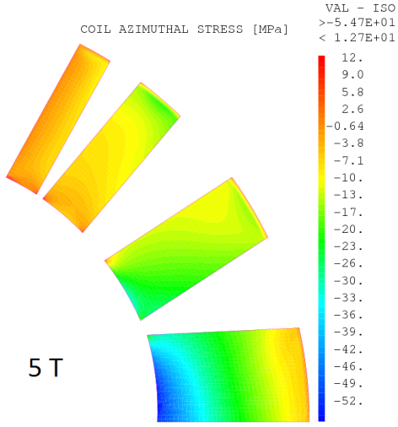
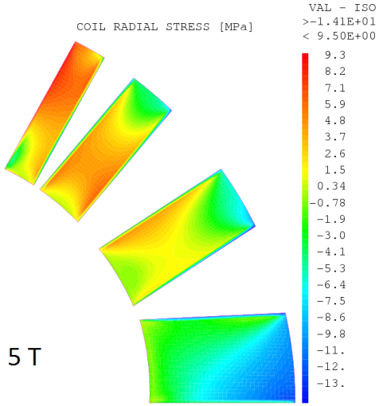
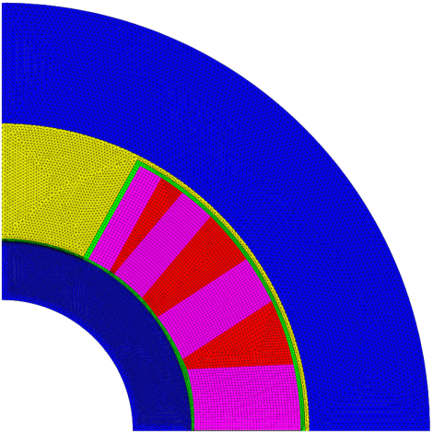
Cos-θ : Mechanics
Roebel transverse stress limit: 170 MPa (tests carried out at Twente University)
Stand-alone stress (no inner shell)
  σ_{T} = 55 MPa
  σ_{R} = 15 MPa
Insert mode
  13 T background field
  + 2.5 T (no inner shell) σ_{T} = 220 MPa
  + 2 T (no inner shell) σ_{T} = 170 MPa
y
x
22 mm
12 mm
14 mm
y
x
15 mm
7 mm
12 mm
14 mm

Slide 6
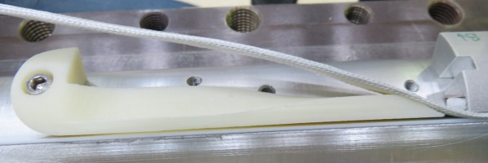
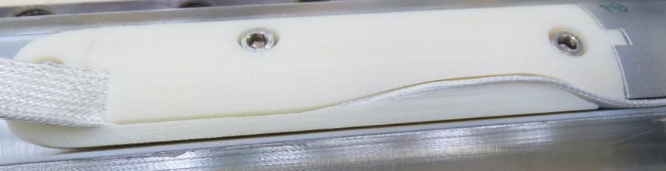
Cos-θ : Magnet ends
Two end designs
  One spacer for each cable turn (ew: 7.6 mm, hw: 2 m)
  Conventional design (ew: 7.3 mm, hw: 22 cm)
Innermost turn path outwards the magnets
  Twist strain: ε ϵ [-0.16 % ; 0.31%]
  Test at KIT at 77 K coming soon.

Slide 7
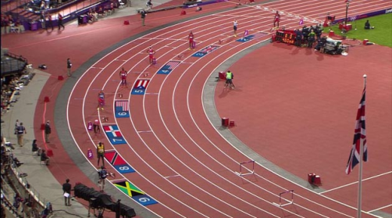
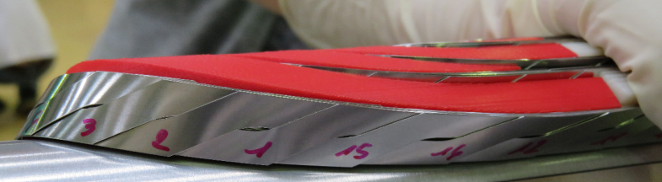
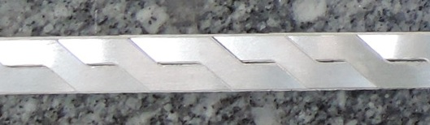
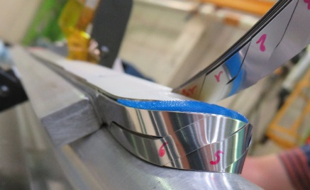
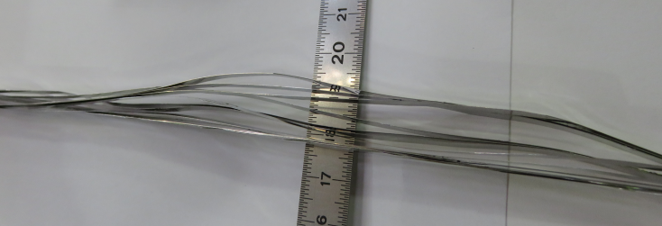
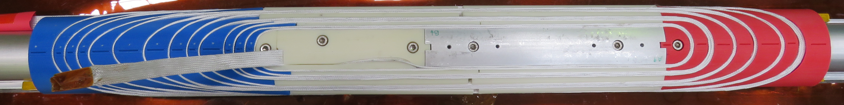
Cos-θ : Winding tests
Roebel cable
  Differential path in magnet ends*
  Longitudinal gap long enough to absorb: winding variation, assembling mis-placement, punching precision…)
Similar behavior for both ends
  Keep the conventional way as baseline
  Conductor length 20 m per coil
*J. Fleiter et al. “On Roebel Cable Geometry for Accelerator Magnet”, EuCAS 2015

Slide 8
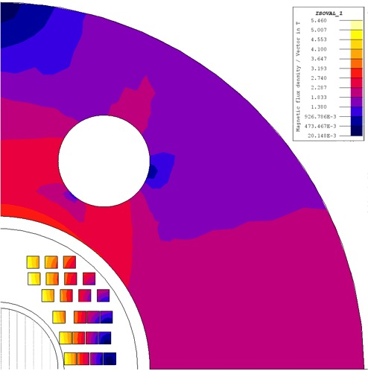
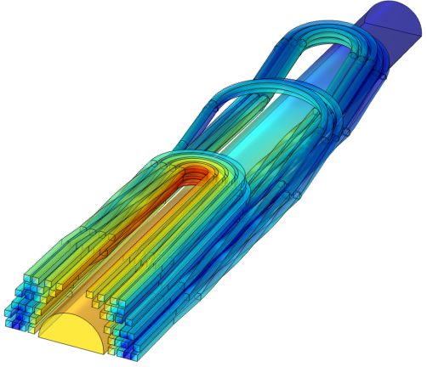
Stack: Magnetism
23 turns/coil
Parameter |  | Value
Centrer field B0 |  | 5 - 17.2 T
Current density J_{op} |  | 535 - 650 A/mm²
Field quality | B₃ | 0.8 unit
 | B₅ | 0.5 unit
Block-coil size |  | 4 x 4 mm²
Conductor area/half coil |  | 368 mm²
Inner - external tube |  | 2 - 4 mm
Bmax = 7.3 T
Min(J_{e})

Slide 9

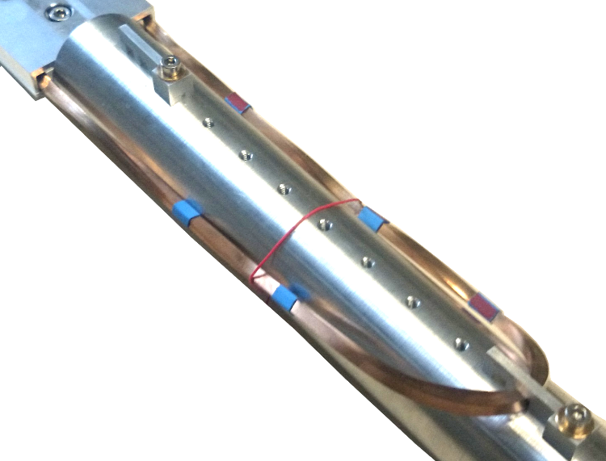
Stack: Transposition
Stack of tapes ≠ Roebel or Rutheford
  Partially transposed
Transposition in magnet ends
Twist trajectory
1
2
3
4
1
2
3
4
1
2
3
4
1
2
3
4
Above the clear bore
180° twist one side
0° on the other
360° twist
Below the clear bore
180° twist one side
360° twist on the other
180° twist

Slide 10
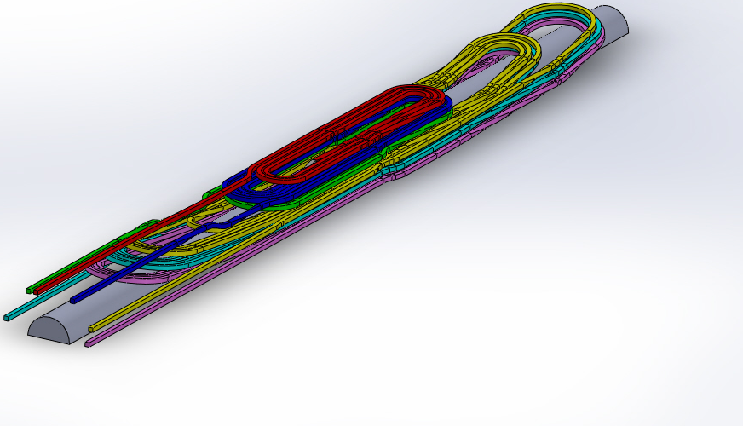
Stack: Magnet ends
Bending
  hw > 2 m
  ew > 10 mm
  twist 1.8°/mm -> ε ϵ [-0.06%; 0.13%]
Bending
  hw > 2 m
  ew > 10 mm
  twist 1.8°/mm -> ε ϵ [-0.06%; 0.13%]
Connections outside magnet
Transposition side
40 cm
Layer jump side
40 cm
Total length of stack cable: 22 m

Slide 11
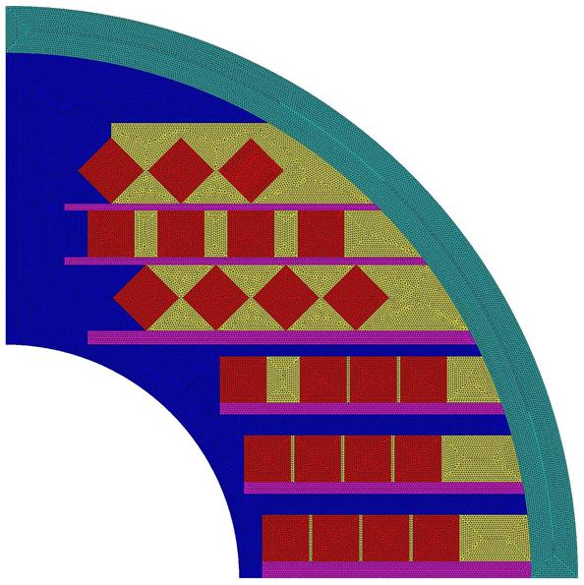
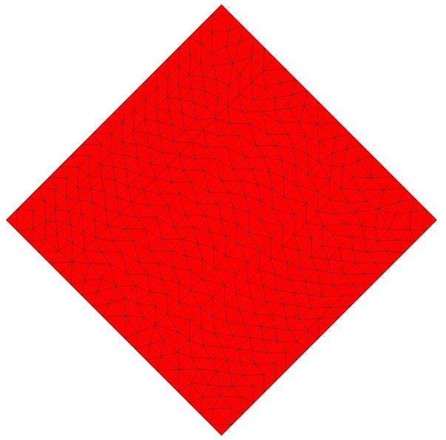
Stack: Mechanics
Mechanical analysis carried out by Chhon Pes and Philippe Fazilleau (CEA)
External tube
(SS 316)
Shear stress analysis of 4 stack tapes
Sliding contact between tapes
Sliding contact or glued
  on its perimeter and copper
Copper (yellow)
A
Sliding contact
or
glued
Sliding tapes
Titanium
Red: Conductor(SS 304)
Pink: Plate(SS 316)

Slide 12
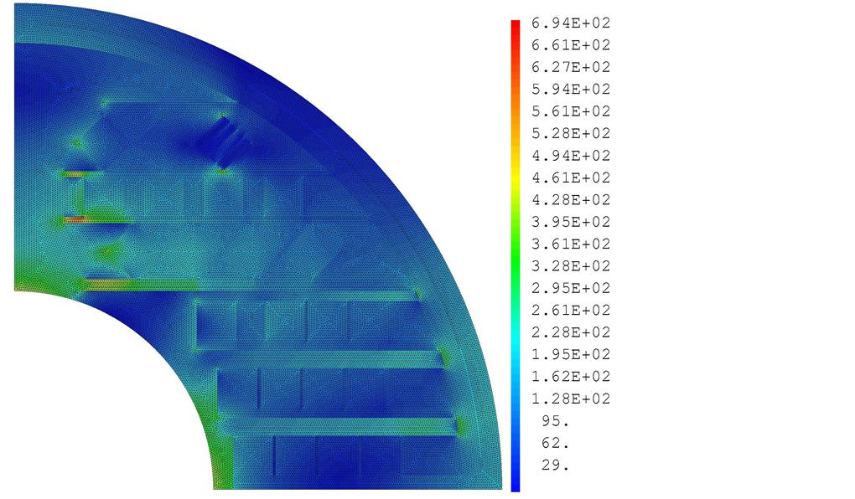
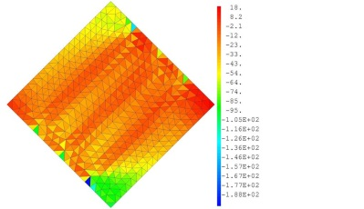
Stack: Mechanics
Max Von Mises stresses (MPa) in different parts of structure
Total von Mises stress distribution
  Max deflection ~ 100 µm
Shear stress in conductor
  49 MPa with sliding, 188 MPa no sliding
Component | Cooldown | Magnetic forces | Total
Conductor | 342.5 | 295 | 511.7
CuBe | 293.6 | 351.2 | 585.5
Plate – SS316 | 444 | 376.3 | 699.5
Titanium | 325.8 | 431 | 460.75
External tube | 311.9 | 168.6 | 429.15
Max Von Mises allowable stresses (MPa) in different parts of structure
Material | Yield stress(MPa) | Allowable stress(MPa)
SS 304 | 890 | 593
SS 316 | 980 | 653
CuBe | 1077 | 718
Titanium | 1200 | 800
Max(V.M.) =
699.5 MPa
12

Slide 13
Conclusion
Cos-θ design
  5 T standalone, an extra 2 T possible as insert
  Inner shell reinforcement
  End design (conventional way)
  Path outwards the magnet (to be tested at KIT)
  Protection to be deeply investigated
  Tooling development (drawing office working on it)
Stack design
  > 5 T in standalone, an extra 4.2 T possible as insert
  End design with transposition
  Mechanical fine tuning to be done
  Winding test coming soon

