Slide 1

EuCARD-2 baseline design: Aligned block design status (Feather M0/M2)
Glyn Kirby – CERN

Slide 2
Over view
Feather2
Dummy and Real cable
Design 3d model
Philosophy
FEA 2d And 3D
Winding development
Jointing tests.
Impregnation
Instrumentation
  Spot heaters
  Quench detection using temperature
Cable geometry , internal support.
Drawing Complex shapes tolerances costs
Tooling
Field quality

Slide 3
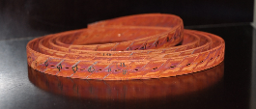

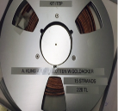

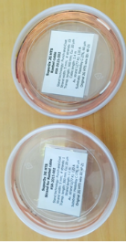
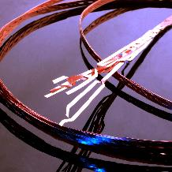

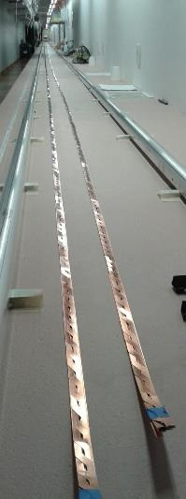

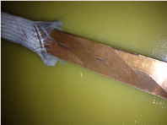
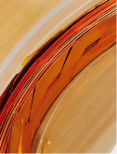
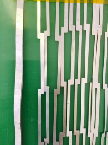

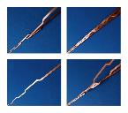

Roebel Real & Dummy stainless steel, Copper plated, cables
CERN
CERN 2m chemically cut dummy tapes hand assembled cables
KIT. longer lengths 20-30 m Punched tapes semiautomatic assembly.
SuperOx provided a demonstration length of Robel cable with ReBCO tapes.
General Cable Superconductors Limited (“GCS”) 2 x34m dummy Cu plated stst cable.
Thanks to Nick Long cable GCS NZ.
GCS NZ

Slide 4
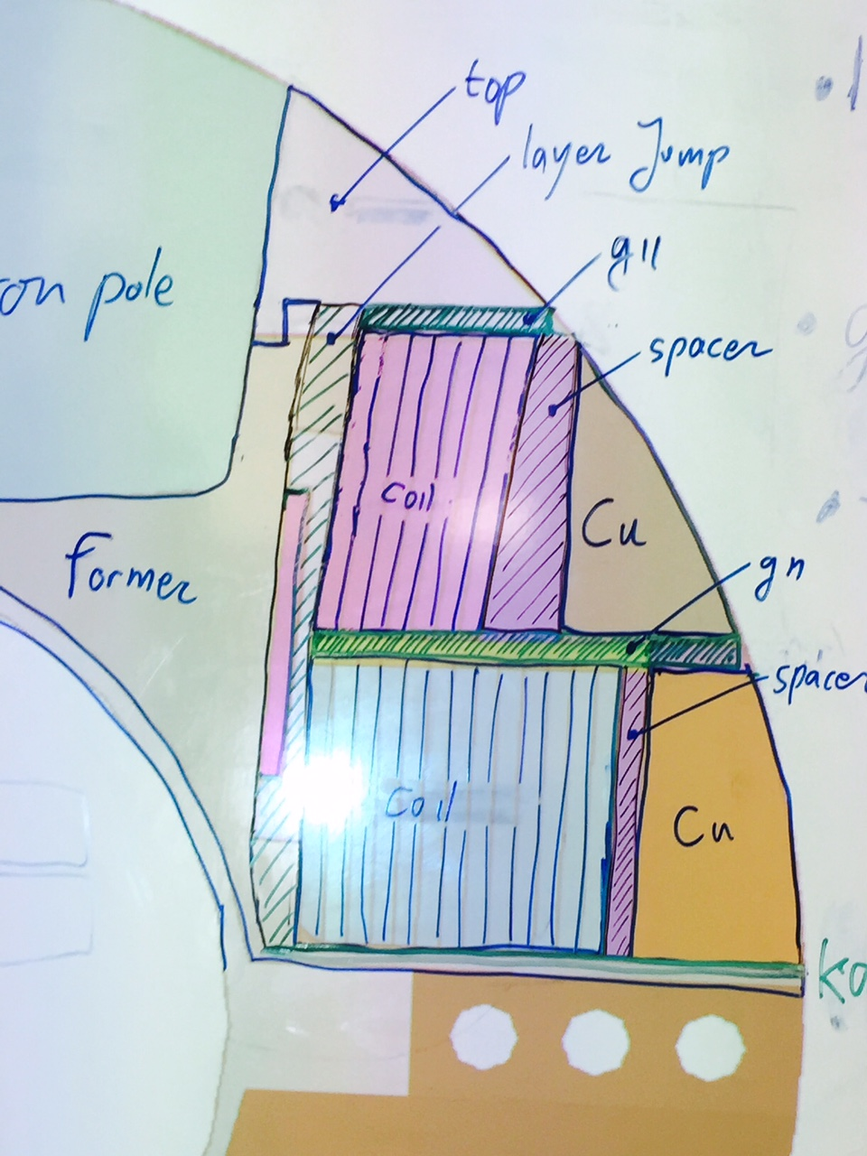
Feather2 the starting idea's

Slide 5
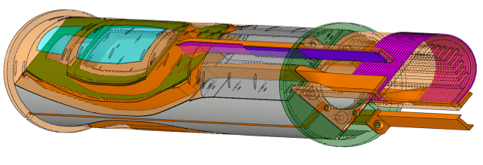
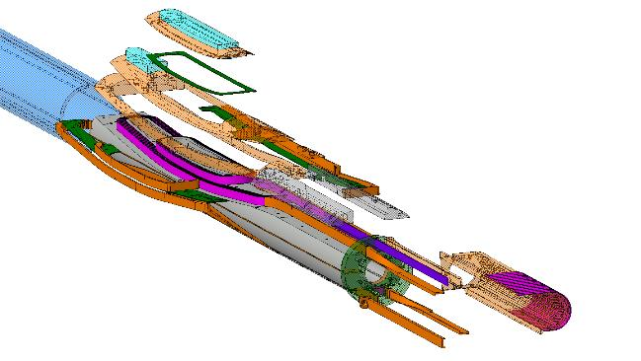
Feather 2
Baseline design

Slide 6
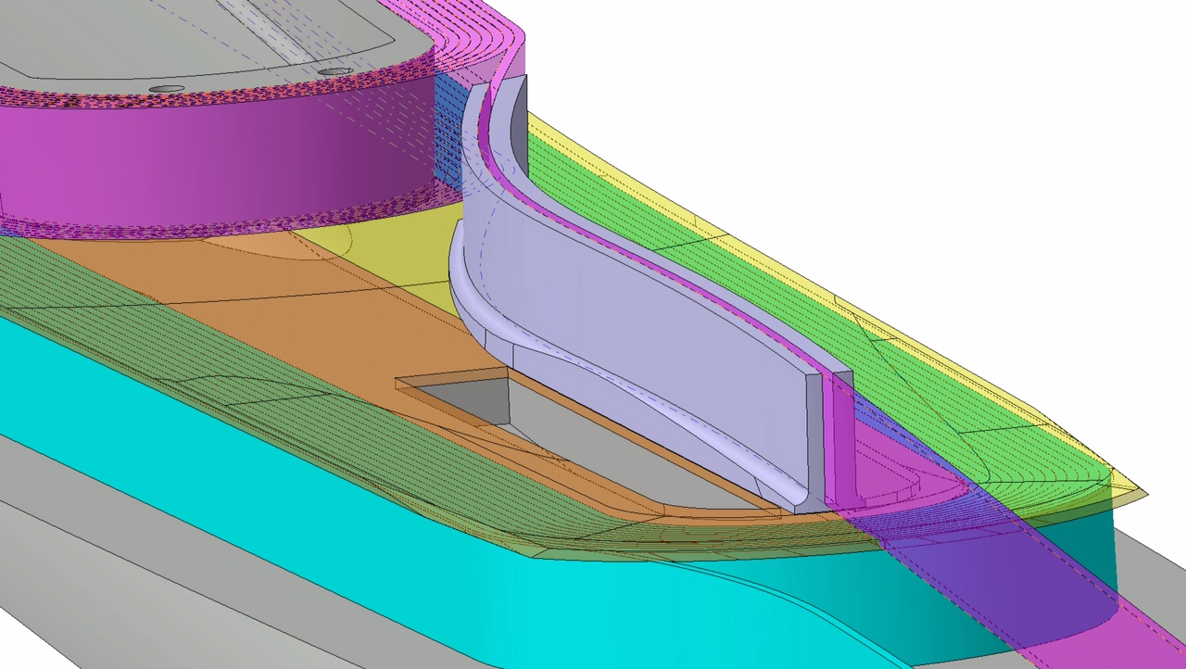
Complex , early designs ,

Slide 7
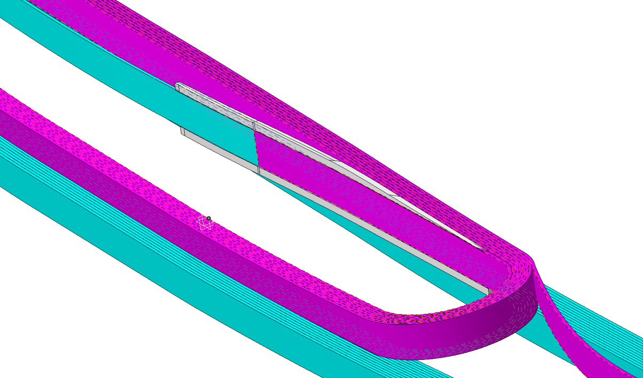
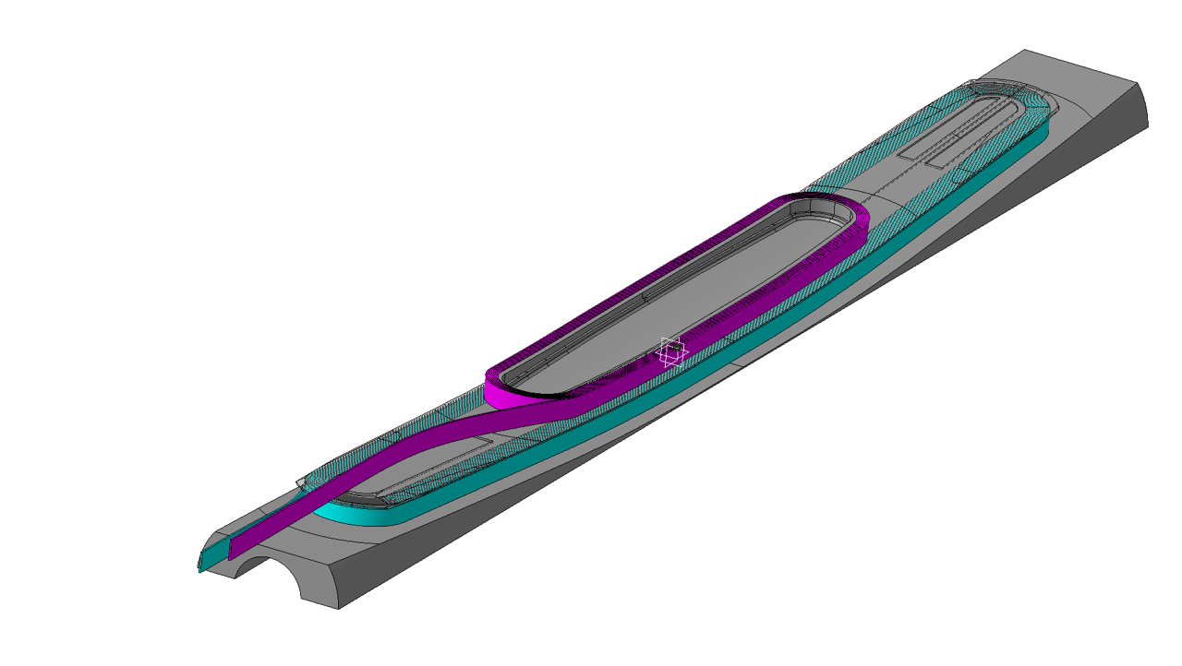
Coil idea

Slide 8
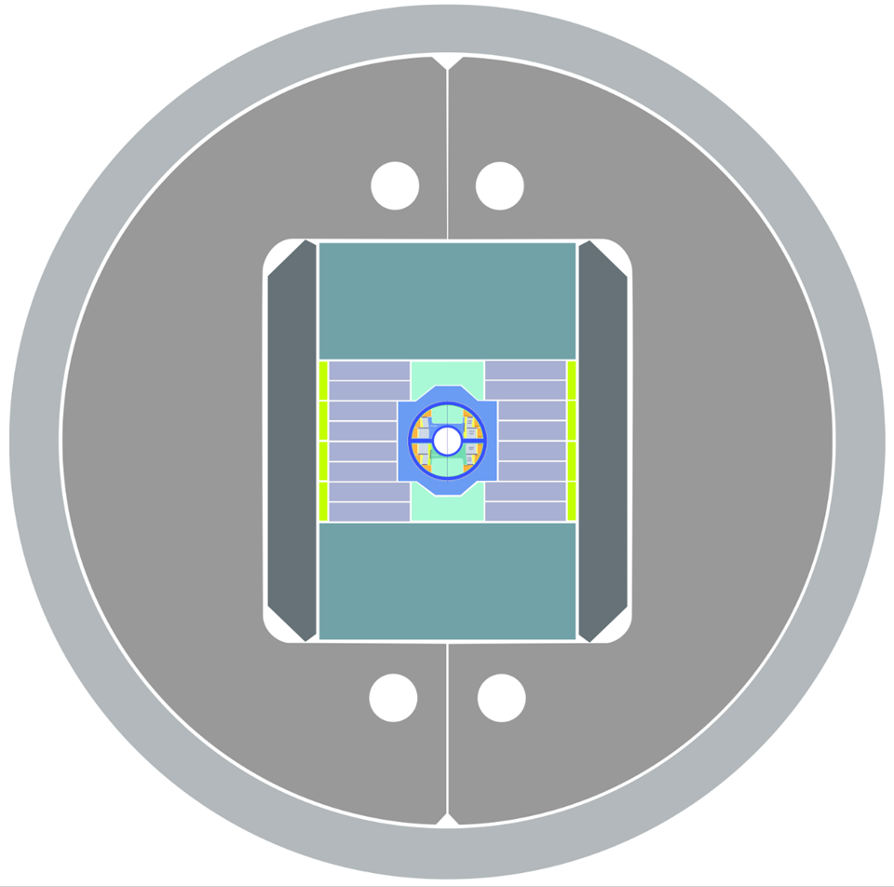
Fresca2
Don’t touch the
100 mm aperture

Slide 9
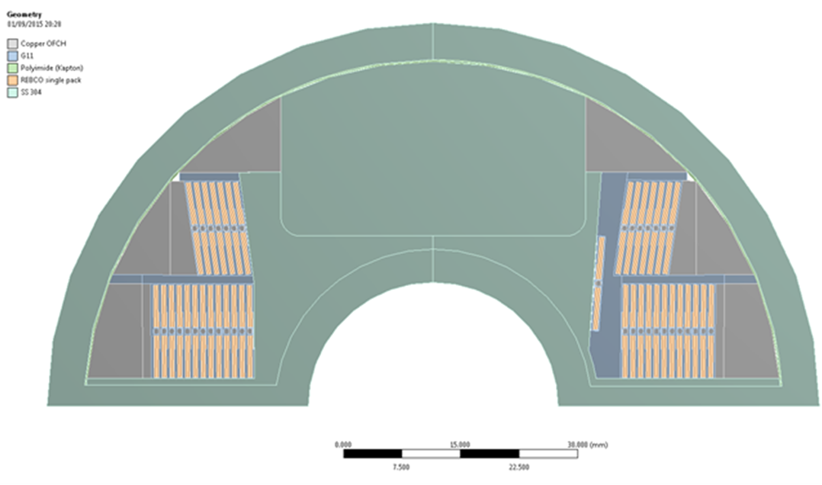
High field support for Feather2

Slide 10
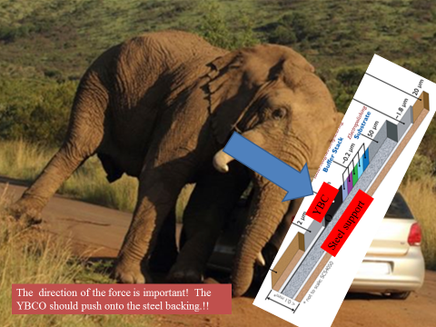
Philosophy leaning against wall.
REBCO

Slide 11
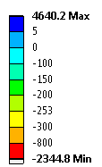
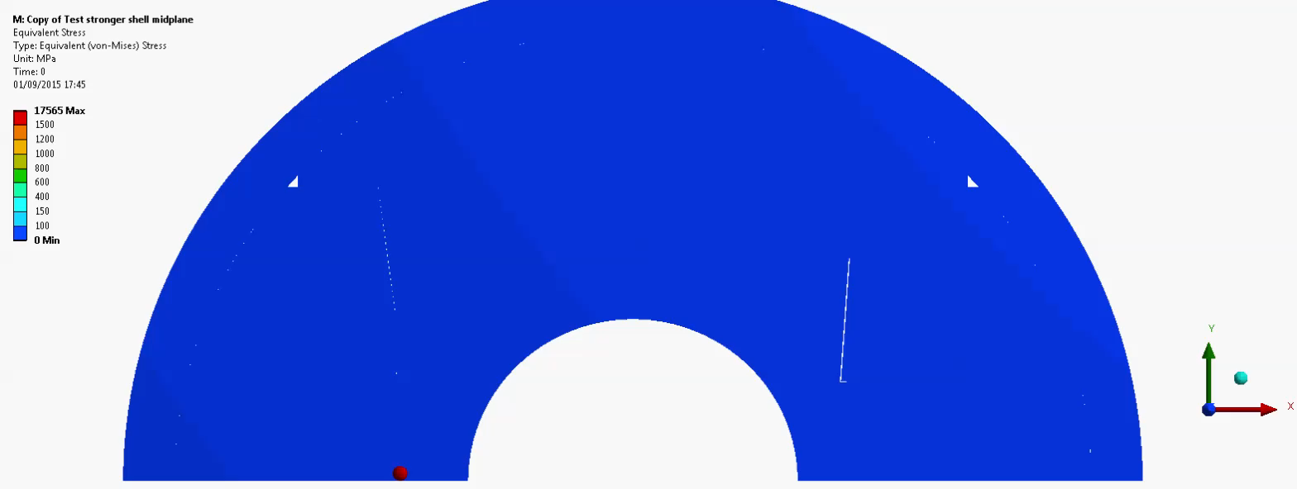
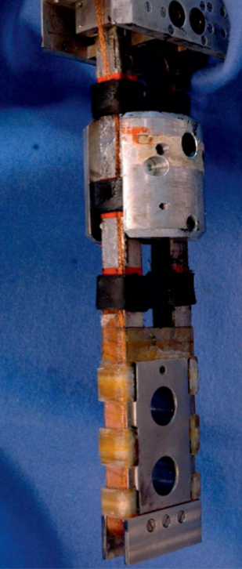

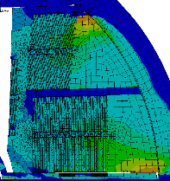
Feather2 FEA 20Tesla coil stress under control 170 / 253 MPa
(REMEMBER: Transverse limit on cable 253 MPa)
Uniform Je over coils
99.0 mm outer dia of Feather2
Coil stress 170 MPa @ 20 Tesla
Coil deflection 270 um
Outer support tube deflection 120 um
Transversally compressive peak stress on coil (X)
≈ 170 MPa

Slide 12

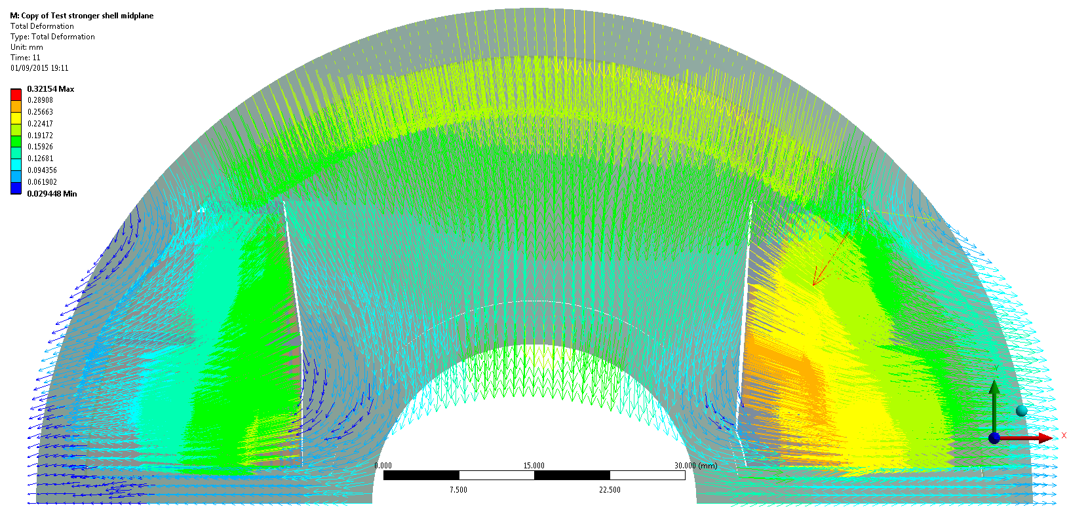
FEATHER M2 2D Total deformation vector plot, Cool down + powering 9kA + 16 T background field ≈ 20 T in the bore
mm
Safe factor we can allow radial play of 0.5 mm
O X: -0.06 mm
O X:
0.12 mm
O X: -0.19 mm
O X: 0.27 mm
O X: -0.10 mm
O X: 0.14 mm

Slide 13
Drawing complex shapes

Slide 14
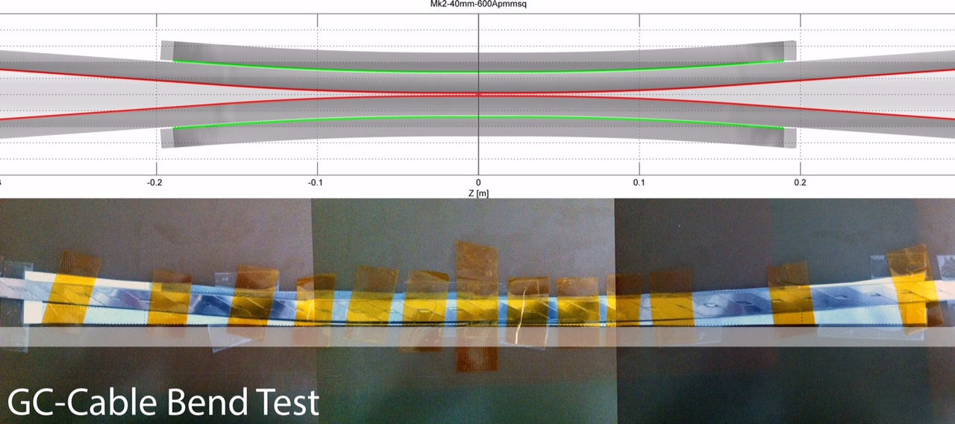
Flared ends

Slide 15
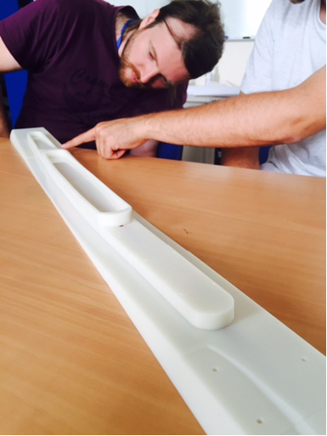
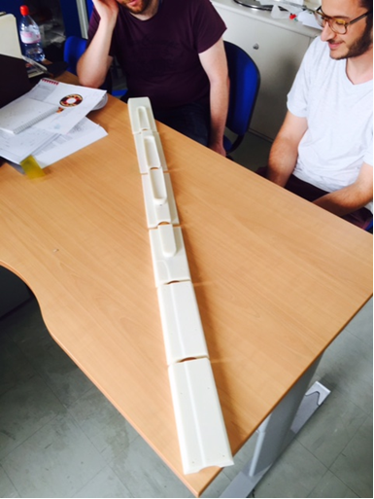
3D Printed former to test flared end

Slide 16
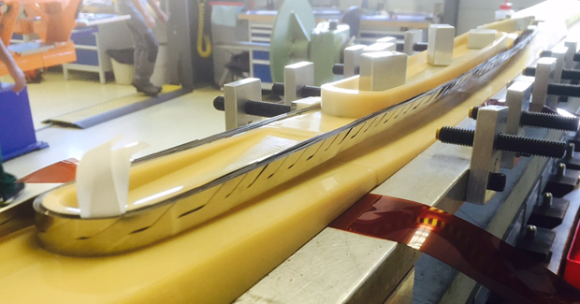
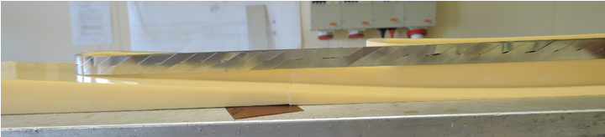
Hard-way bend of Roebel cable, test wind on printed former

Slide 17
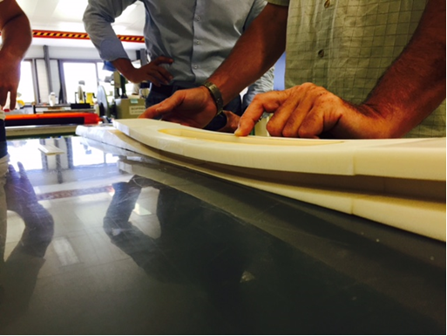
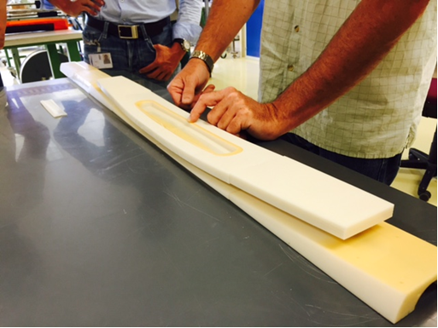

Slide 18
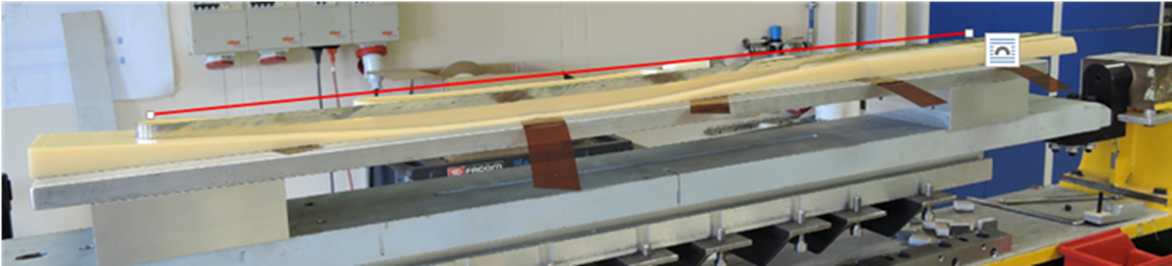
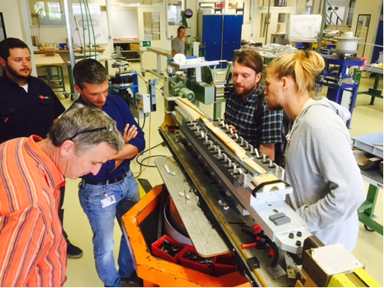
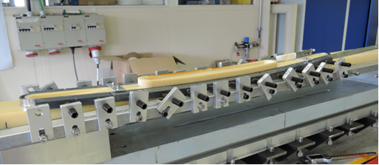
Dummy cable tests , Fixing the hard way bend

Slide 19
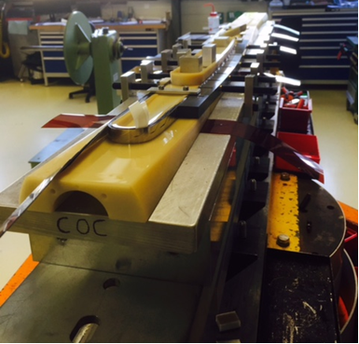
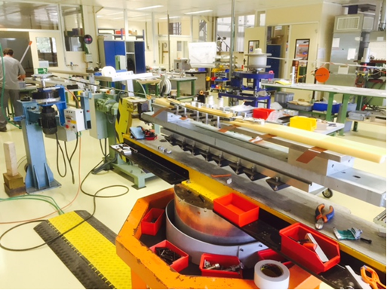
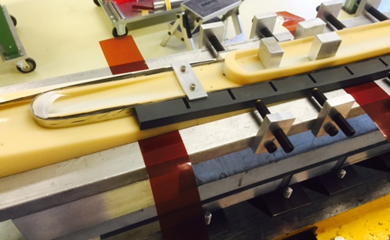
Test winding developing the tooling

Slide 20
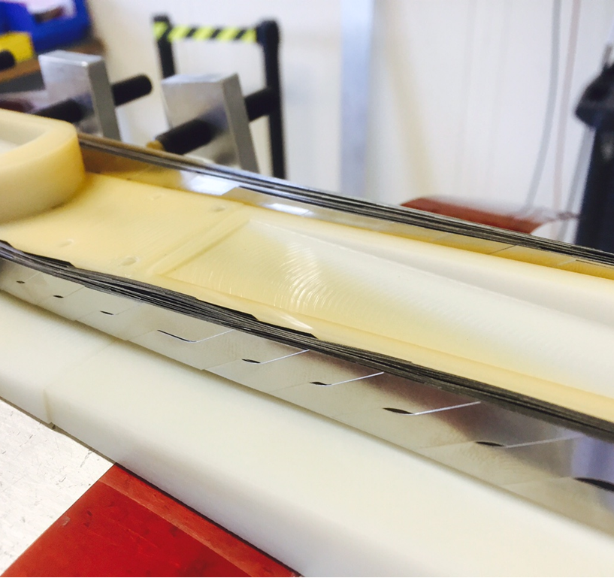

Slide 21
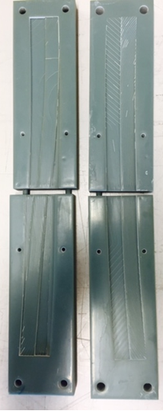
Layer Jump cover
3D printed Mould to for manufacture of GRP layer jump covers

Slide 22
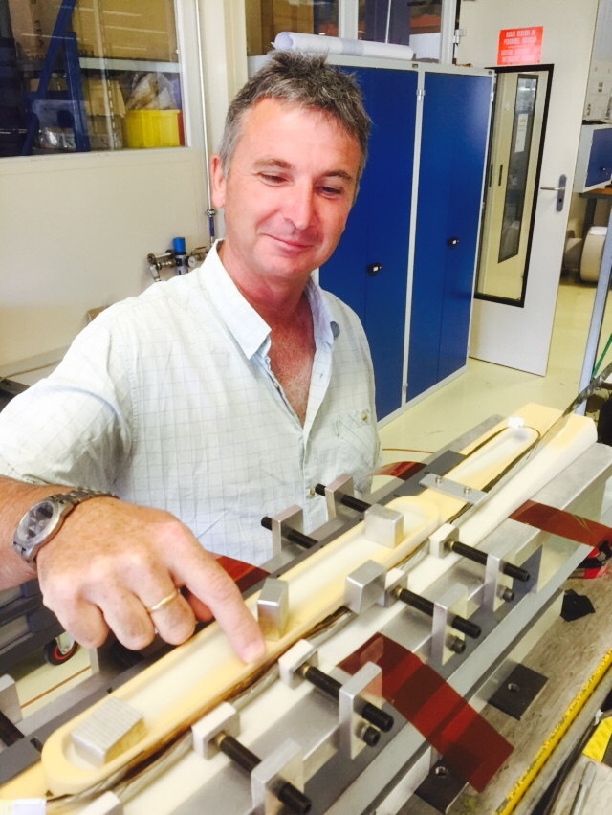
Jacky Mazet
Big thank you to Jacky our lead tech.

Slide 23
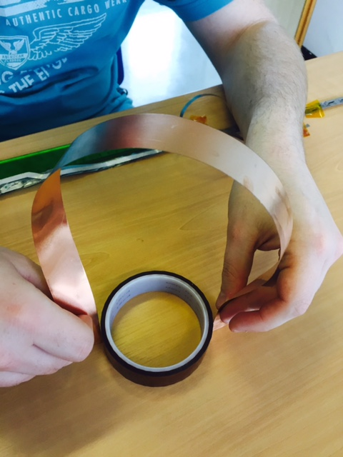
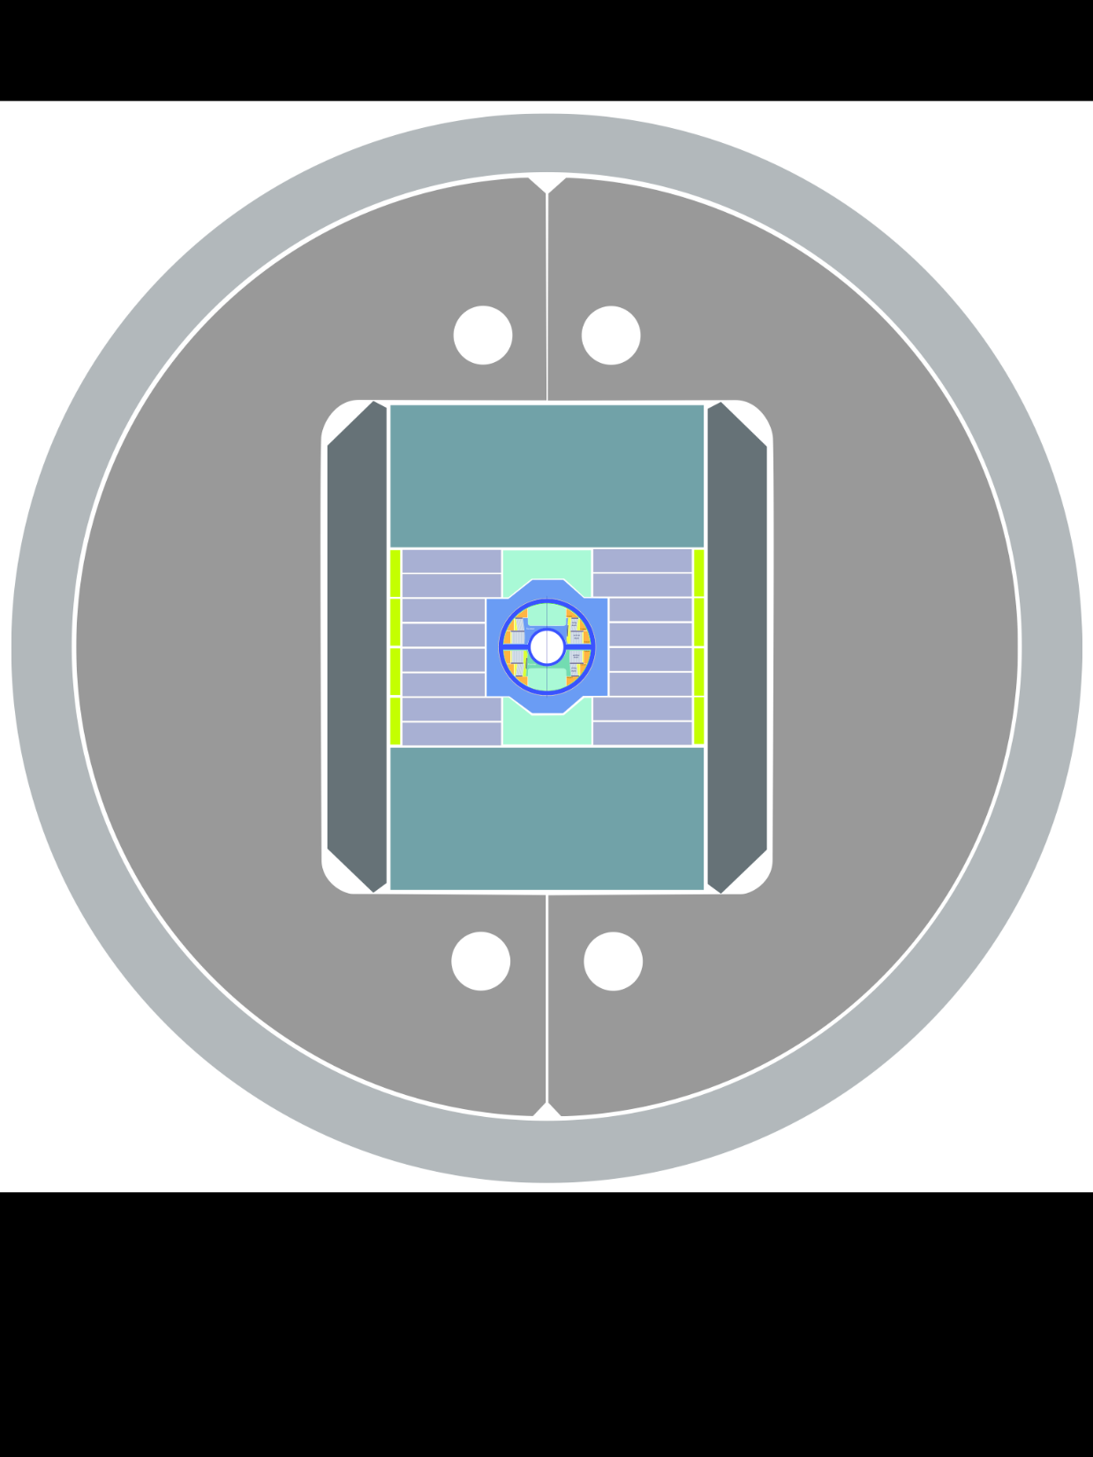
One joint end design,

Slide 24
Joint between poles
Copper Heat exchanger
tape joints

Slide 25
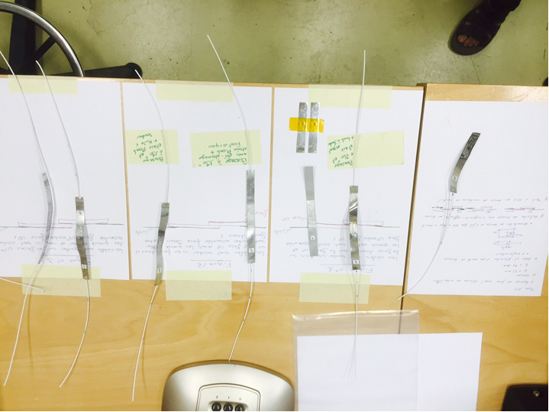
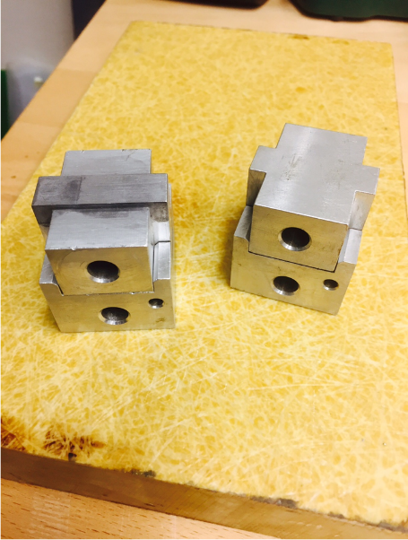
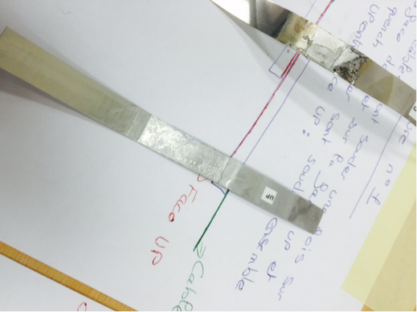
Joint tests

Slide 26
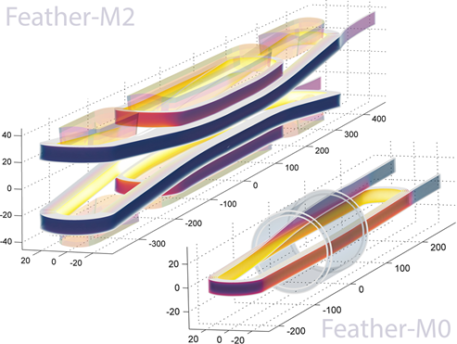
Aligned block Feather0, development foe Eucard2 5-20T
~1000 m REBCO tape
~70 m of cable
~100 m REBCO tape
~6 m of cable

Slide 27
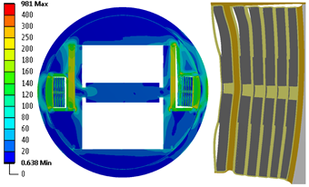
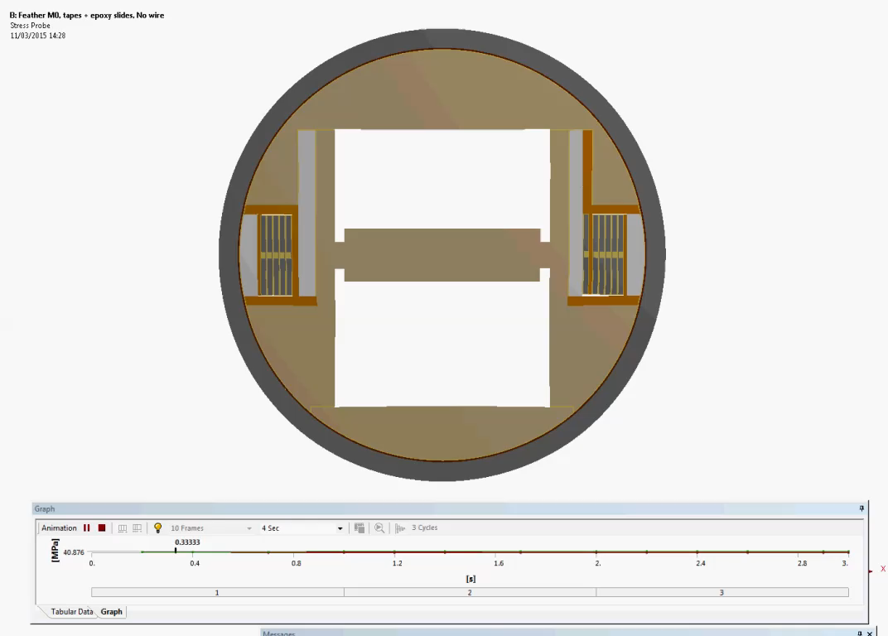
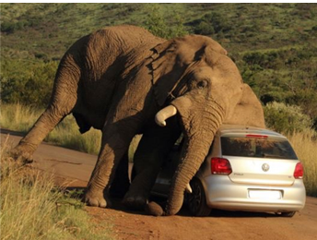
Feather 0 FEA,
Feather zero Finite element analysis of magnet assembly, cool down and powering in 10 Tesla background field. magnified coil pack deformation during powering, 3.6 micron deflection.

Slide 28
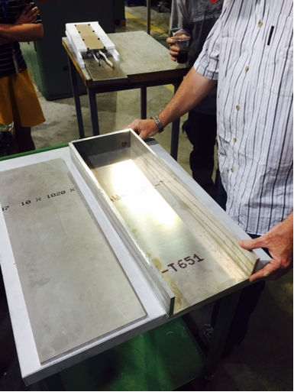
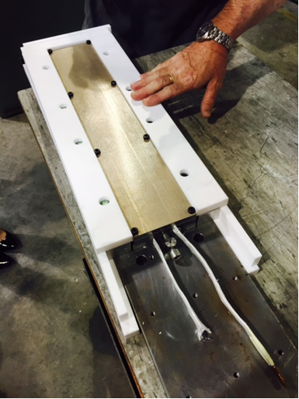
First impregnation, bucket “open mould design”

Slide 29


Closed mould design

Slide 30



Short cable, so added one extra cable.
Feather zero needs 6 m of cable but the first real REBCO cable that we have is 5 m. So we tested adding a dummy cable to test assembly.
Extra dummy cable

Slide 31

Spacer extra turn

Slide 32


Cable geometry
Section through part of Feather0 dummy stst coil
Individual tapes can be transversely up to 200 um out of position!
And tape cross overs vary by the available gap.

Slide 33




Cable impregnation
Above filed resin CTD101G test
Thanks to Stephane Langeslag for the sample preparation for the cable images

Slide 34

Cable support

Slide 35



Internal cable supports, to add with tape positioning
Two possible solutions have been foreseen to hold the tapes in the correct geometry:
Bracelets that wraparound each side individually.
Or
2) Two independent tapes woven into the cable .
The solutions also adds with supporting the cable during handballing.
Provisional European patent application is EP15179513.5.

Slide 36



Feather0

Slide 37

Feather 0

Slide 38




Feather 0 removal from impregnation mould

Slide 39







Measurement and Analysis of AC-loss in ReBCO Roebel Cables
Jeroen Van Nugteren

Slide 40








Measured at the Universities of Twente & Southampton
Loads of beautiful data as function of temperature
Harder to compare since Jc dependence on temperature in model not so accurate (not measured
Transient heating seen as expected.

Slide 41



Modelling of Current distribution in cable
Magnetisation in cable displayed only one tape
But all tapes are powered.
Feather2 in 16T background field
Current ins only flowing at the edges of the tapes

Slide 42



Dynamic Field quality
Cos theta design
Aligned Block design
  “b3, 60 unit’s variation at low field
  reducing to < 20 units at high field.
  b5 and b7 we see ~ 10 units variation,
  then converge to low values at high field.”*
First simulation give b3 , 3units at low field
Decreasing at high field 20 T
However modelling assumption assume perfect cable geometry and zero thickened REBCO layer (reality 0.001mm)

Slide 43






External field for EuCARD2 HTS magnets
CERN/CEA Fresca2 and HL-LHC KEK D1
Fresca2 | 13 -16 Tesla | 100 mm aperture
D1 KEK | 5 - 6 Tesla | 150 mm aperture
D1
D1
Test station Fresca 2 under construction
Fresca2
Test assembly fresca2
Thanks to Tatsu @ KEK for the images
Fresca2 reacted Nb3Sn coil

Slide 44





Spot heater, square wave pulse,

Slide 45






Quench Detection
HTS is very different to LTS when it comes to quench behavior.
Minimal Quench Energy is high (stable)
  Normal Zone Propagation Velocity is low (hard to detect)
  Roebel cable 15 tapes!
Also due to the alignment of the blocks the operating current density can be very high (> 600 A/mm in block)
Feather zero will test
  Voltage taps
  Pickup-coils
  Temperature sensor array
  Acoustics
  Optics Fiber
Temp sensor array
Hall
Acoustic
Mr. voltage tap
Optics
NI-DAQ
Pickup Coils
[1] J. van Nugteren, “Normal Zone Propagation in a YBCO Superconducting Tape”, graduation thesis University of Twente, 2012

Slide 46

Acoustics
Thanks to Maxim,
M. Marchevsky et al. “Acoustic emission during quench training of superconducting accelerator magnets” Cryogenics 69 (2015) 50–57

Slide 47


Quench analysis
At 4.2 K and 7100 A, the minimum temperature margin is 8.6 K, the lowest margin is there where the field is the most perpendicular to the cable
The blue volumes.
Thanks to : Erkki Härö, Tiina Salmi, Antti Stenvall

Slide 48



Temperature sensor array quench detection
Iout
V
Ueq
Iin
Spot heater
Sensor + Thermal grease

Slide 49

Tests to select spacing between temp sensors

Slide 50



CCS temp sensors

Slide 51

Fibers mounted in Feather zero

Slide 52






Fiber optic sensors based on Fiber Bragg Grating technology
FBG: longitudinal periodic variation of the refractive index in the optical fiber core
FBG temperature sensitivity
8 - 12 pm/K @ room T
< 0.1 pm/K below 40 K
Bare FBG no suitable for cryogenic temperature!
Cladding
Broadband light
Core
Variation of the reflected λB with changes in ε and T
Bare FBG
ΔλΒ (Τ, ε)
Coated/Embedded FBG
Host materials improve the sensitivity at cryogenic temperature
Zhang H. et al. Development of Strain Measurement in Superconducting Magnet Through Fiber Bragg Grating, IEEE TRANSACTIONS ON APPLIED SUPERCONDUCTIVITY, VOL. 18, NO. 2, JUNE 2008;

Slide 53


Slide 54







CLIQ – Coupling-Loss Induced Quench (EU Patent EP13174323.9, June 2013)
E. Ravaioli, "CLIQ", PhD thesis University of Twente, 2015. http://doc.utwente.nl/96069/
CLIQ test on LHC dipole
EU Patent EP13174323.9, June 2013.
G. Kirby,V. Datskov, E. Ravaioli,
QXF IR HL LHC

Slide 55



  Protection: Coupling Loss Induced Quench applied to HTS
Quench heater are too slow for HTS cable in Feather2
We hope to detect and turn off before quench.
CLIQ simulation for long magnet 5 m long , 16T HTS coil gives rapid quench 2ms quench the cross over tapes full coil on 20 ms.
Promising result if we protect by quenching?
Hysteresis losses
2 ms in to a CLIQ pulse tape cross overs are normal.

Slide 56

Planning

Slide 57
Conclusion
Modelling of the current in the REBCO tapes and cable has given unexpected good outlook on achieving future good dynamic field quality.
  We will start on fin-tuning coil design, now that we have good working model with current distribution.
First Feather zero coils have been wound and impregnated. More tests to come!
Feather2 development coil test winding started.
  Need good impregnation system
  Need to test joint designs.
Feather2 design advanced! Ordering parts.

Slide 58

The End
Thankyou for your attention
VERY close to the first
Accelerator type HTS magnet

Slide 59



3 spot heaters impregnated into Feather coil
On top of straight section
Inner wide face at end
On wide face of straight section

