Slide 1


HTS magnet quench criteria
3rd Workshop on Accelerator Magnets in HTS (WAMHTS-3)
thibault.lecrevisse@cea.fr
September, 11th 2015

Slide 2
Overview
Physics of a Quench
  Principle
  “Danger”
  Issue with HTS
HTS Quench protection criteria
  Heat balance and adiabatic hot spot
  “quench capital” vs “quench tax”
  Increase the quench capital
  Lower the quench tax :
    Fast detection
    Accelerate the dump
    Winding adaptation
Conclusion

Slide 3

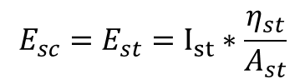

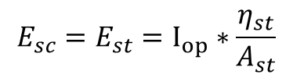
Physics of quench: Principe
Definition of a quench: resistive transition in a superconducting magnet leading to appearance of voltage, temperature increase, thermal and electromagnetic forces (and cryogen expulsion).
T<T_{cs}
T_{cs}<T<T_{c}
Stabilizer
Superconductor
current sharing
$$E_{sc}=E_{st}=0$$
$$E_{sc}=E_{st}=I_{st}∗\frac{η_{st}}{A_{st}}$$
T>T_{c}
T_{cs,REBCO}: 5-92 K
T_{c,REBCO}: 92 K
quenched
HTS resistivity over T_{c}
$$E_{sc}=E_{st}=I_{op}∗\frac{η_{st}}{A_{st}}$$
$$η_{YBCO}\sim 1000−10000× η_{cu50}$$

Slide 4
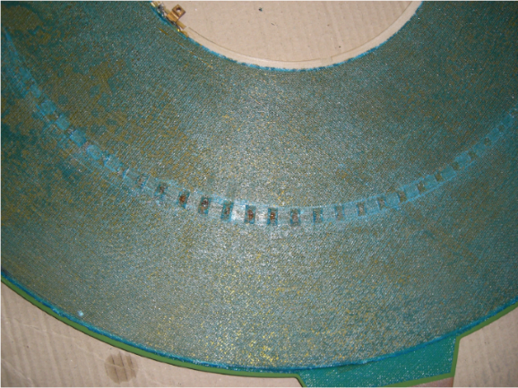
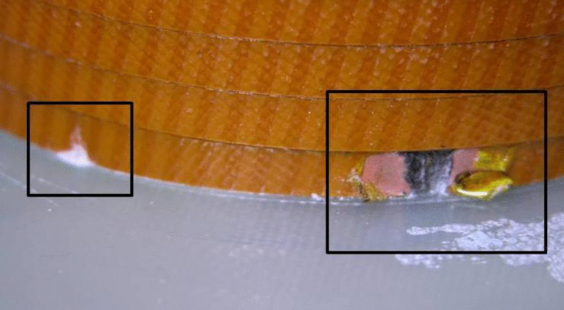

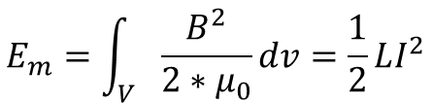
Physics of quench: “Danger”
Why is it a problem ?
The magnetic energy is transformed in heating through the resistive volume
$$E_{m}=\int_{V}{\frac{B^{2}}{2∗μ_{0}}dv=\frac{1}{2}LI^{2}}$$
is converted in
$$R_{q}I^{2}$$
L
+
Not a problem up to ~ 40 T if it happen uniformly in all the winding.
(REBCO tape from 4 K to 300 K : E_{m}= 7·10⁸ J/m³ B_{max} = 41 T)
V
-
R_{q}
BUT : it does not happen uniformly (low quench velocity) and less than 1 % of the total magnet mass might absorb the total energy → large damage potential
S. Matsumoto et al., IEEE Trans. Appl. Supercond., vol. 22, no. 3, pp. 9501604, June 2012
BSCO impregnated pancake, by courtesy of P. Tixador and A. Badel
REBCO dry wound coil

Slide 5
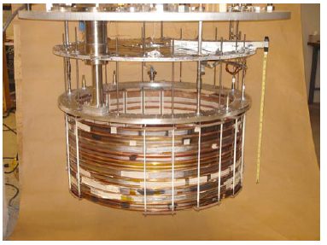
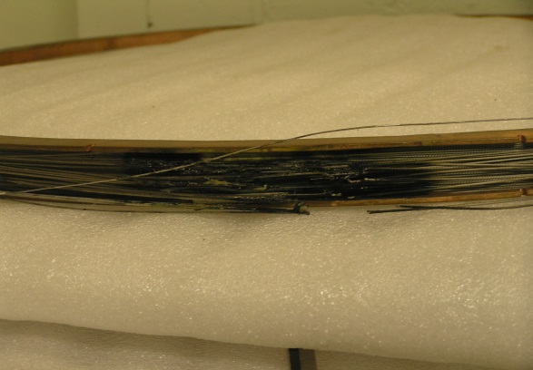
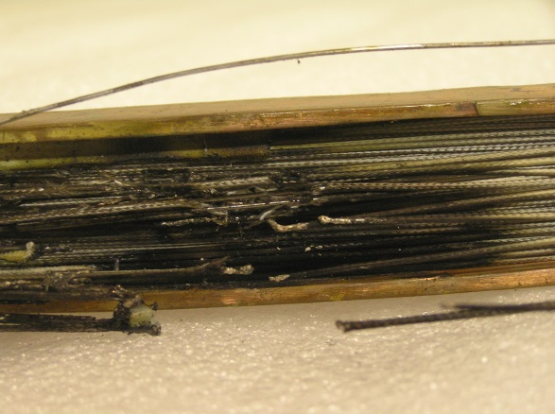
Physics of quench: “Danger”
A 0.5 T / 773-mm Cold Bore MgB₂ Magnet
(FBML, 2007)
An unscheduled quench (top coil)
⇒ Permanent damage
MgB₂ coil, by courtesy of Yukikazu Iwasa (FBML, 2007)

Slide 6
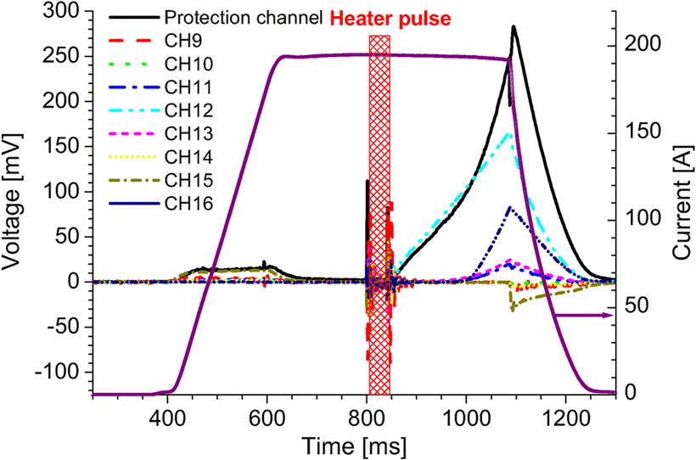
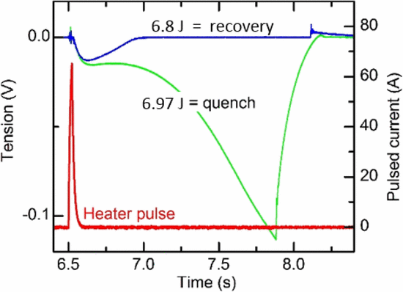
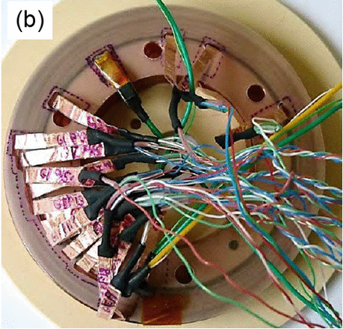
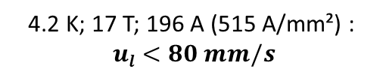

Physics of quench: Issue with HTS
Issue with HTS:
Very low quench propagation in a winding typical few tens of mm/s (2-3 order of magnitude lower than LTS) → Small volume dissipating E_{m}
→ Need an Active protection or another dumping method.
4.2 K; 17 T; 196 A (515 A/mm²) :
$ul<80 mm/s$
10 K; 8 T; 280 A (286 A/mm²) :
$$ul\sim 45 mm/s$$
T. Lécrevisse et al., IEEE Trans. Appl. Supercond., vol. 23, no. 3, June 2013
Y. Miyoshi et al., IEEE Trans. Appl. Supercond., vol. 25, no. 3, June 2015

Slide 7
Physics of quench: Issue with HTS
Issues to be considered (LTS/HTS):
Temperature increase and temperature gradients (thermal stresses)
Voltages within the magnet, and from magnet to ground (whole circuit)
Forces caused by thermal and electromagnetic loads during the magnet discharge transient
Cryogen pressure increase and expulsion (liquid cooling)
A quench invariably requires detection and, in case of HTS, definitively needs actions to safely turn-off the power supply and discharge the magnet.

Slide 8
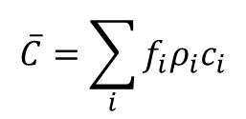
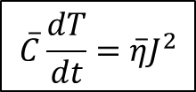

HTS Quench protection criteria: Heat balance and adiabatic hot spot
T_{hot-spot} : < 200 K, Safe ; <300 K, risky ; >300 K, very risky (*, pp.470)
Heat equation (*, pp. 352):
$$\overline{C}\left(T\right)\frac{∂T}{∂t}=∇∙\left(\overline{k} (T)∇T\right)+ \overline{η}\left(T\right)J^{2}\left(t\right)+{ g}_{d}\left(t\right) −\frac{f_{p}P_{D}}{A_{cd}}g_{q}(T)$$
Conductor’s thermal energy
Thermal conduction into the conductor
Joule heating
non-Joule heat generation
Cooling by cryogen
adiabatic heat balance (simplest and conservative approach) :
$$\overline{C}=\sum_{i}{f_{i}ρ_{i}c_{i}}$$
$$\overline{C}\frac{dT}{dt}=\overline{η}J^{2}$$
Average heat capacity
$\overline{η} =1/(\sum_{i}{\frac{f_{i}}{η_{i}}})$
Average resistivity
*Yukikazu Iwasa, Case Studies in Superconducting Magnets, Second Edition, Springer, 2009

Slide 9

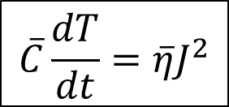
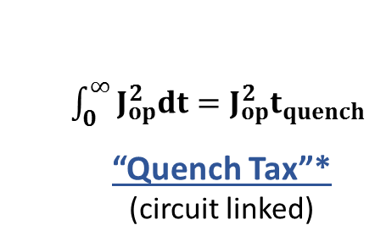
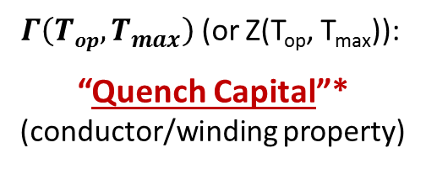
HTS Quench protection criteria: “quench capital” vs “quench tax”
$$\overline{C}\frac{dT}{dt}=\overline{η}J^{2}$$
$$\int_{T_{op}}^{T_{max}}{\frac{\overline{C}}{\overline{η}}dT}= \int_{0}^{∞}{J^{2}dt}$$
Can be integrated:
$Γ\left(Top, T_{max}\right)$ (or Z(T_{op}, T_{max})):
“Quench Capital”*
(conductor/winding property)
$\int_{0}^{∞}{J_{op}^{2}dt=J_{op}^{2}t_{quench}}$
“Quench Tax”*
(circuit linked)
* L. Bottura, Magnet Quench 101, WAMSDO CERN proceedings 2013

Slide 10
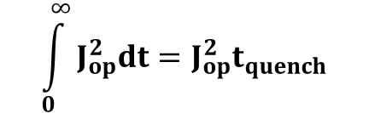
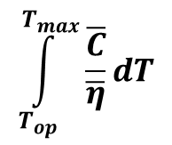

HTS Quench protection criteria: “quench capital” vs “quench tax”
“Quench Capital”*
(conductor/winding property)
“Quench Tax”*
(circuit linked)
$$\int_{T_{op}}^{T_{max}}{\frac{\overline{C}}{\overline{η}}dT}$$
$$\int_{0}^{∞}{J_{op}^{2}dt=J_{op}^{2}t_{quench}}$$
$$=$$
- Winding (shunt ratio)
- Materials
what t_{quench}?
→ Detection
→ Protection
Enhance the protection by either increasing the quench capital and/or lowering the quench tax.

Slide 11
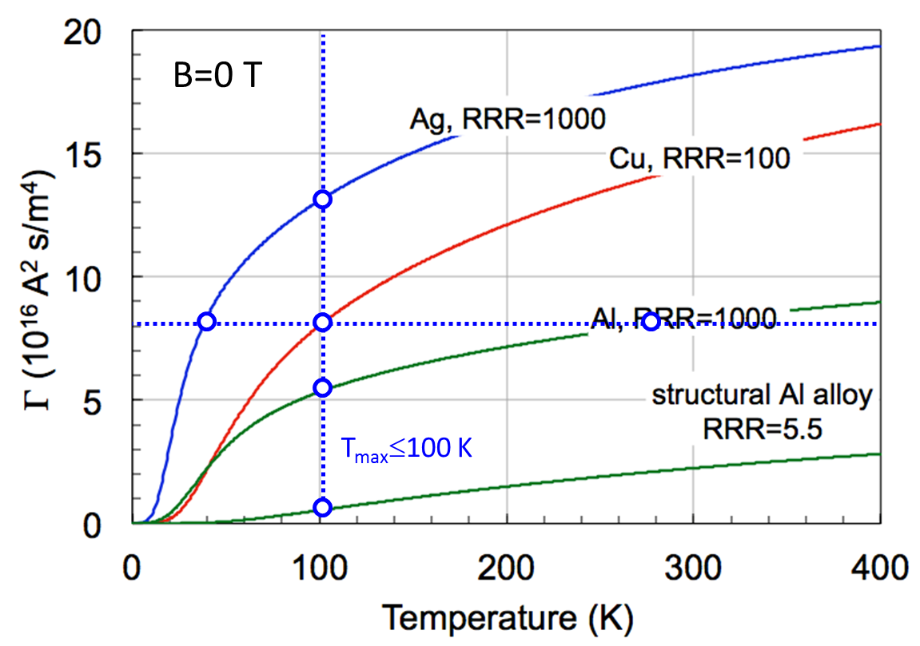


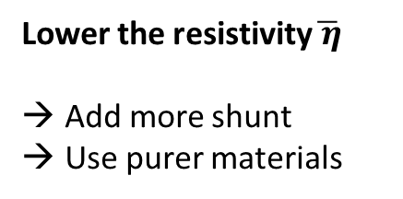
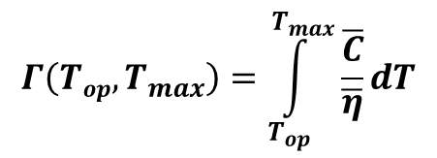
HTS Quench protection criteria: Increase the quench capital
Quench Capital
$$Γ\left(Top, T_{max}\right)=\int_{T_{op}}^{T_{max}}{\frac{\overline{C}}{\overline{η}}dT}$$
Lower the resistivity$\overline{ η}$
Add more shunt
Use purer materials
L. Bottura, Magnet Quench 101, WAMSDO CERN presentation
Issue: $V_{NZ}=\int_{L_{NZ}}{\overline{η}j_{op}dl}$
Lower$\overline{ η}$ → lower voltage (increase t_{detection})

Slide 12
HTS Quench protection criteria: Increase the quench capital
Increasing the quench capital by adding some low resistance shunt
Simulation (SCS4050-AP with 2x20 µm Cu)
If only adiabatic longitudinal propagation: 4.2 K, 14 T (// ab), 340 A/mm²
Voltage at T_{hot-spot}= 250 K > 200 mV
Time at T_{hot-spot}= 250 K > 400 ms
V_{detection}?
t_{detection}?
t_{dump}?
OK but are we able to detect and dump in 400-800 ms?
T. Lécrevisse et al., IEEE Trans. Appl. Supercond., vol. 23, no. 3, June 2013
(Quench Tax)

Slide 13


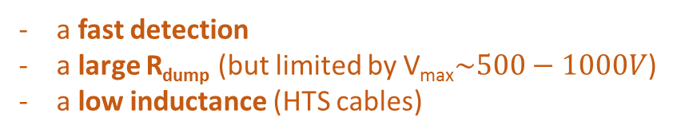



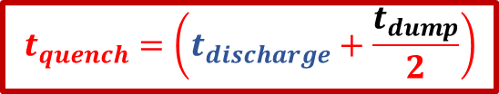
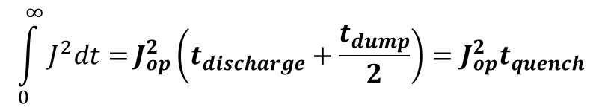
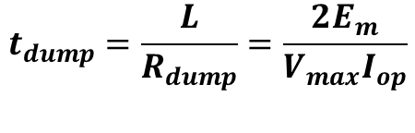
HTS Quench protection criteria: protection enhancement by lower the “quench tax”
Constant external dump: ${ R}_{dump}≫R_{quench}$
L
$$t<tdischarge$$
$${J=J}_{op}$$
PS
R_{dump}
$${J=J}_{op}e^{−\frac{t−t_{discharge}}{t_{dump}}}$$
R_{quench}
$$t≥tdischarge$$
$$\int_{0}^{∞}{J^{2}dt=}J_{op}^{2}\left(t_{discharge}+\frac{t_{dump}}{2}\right)=J_{op}^{2}t_{quench}$$
$$t_{dump}=\frac{L}{R_{dump}}=\frac{2E_{m}}{V_{max}I_{op}}$$
$$t_{quench}=\left(t_{discharge}+\frac{t_{dump}}{2}\right)$$
$$t_{discharge}=t_{detection}+t_{delay}+t_{switch}$$
Protection can be enhanced by:
a fast detection
a large R_{dump} (but limited by V_{max}$\sim 500−1000V$)
a low inductance (HTS cables)

Slide 14
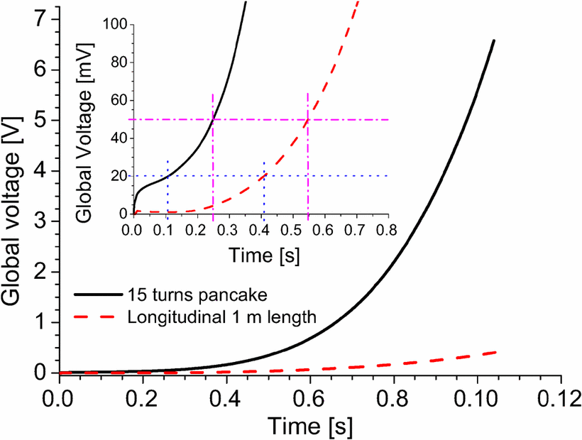


HTS Quench protection criteria: Fast detection
Simulation (SCS4050-AP with 2x20 µm Cu)
SCS4050-AP, 4.2 K, 14 T (// ab), 150 µm Cu added, 20 µm Mylar insulation, 340 A/mm²
$$t_{quench}=(t_{detection}+t_{delay}+t_{switch}+\frac{t_{dump}}{2})$$
t_{250K, pancake} = $\sim 90$0 ms
t_{detection, 20mV} = 100 ms
t_{detection,} _{50mV} = 250 ms
t_{delay}= 10 ms ; t_{switch}= 30 ms
t_{dump}/2 ~620-770 ms (pancake 50 mV-20 mV)
T. Lécrevisse et al., IEEE Trans. Appl. Supercond., vol. 23, no. 3, June 2013
Improve the turn to turn thermal contact * → increase the voltage
Develop fast detection system
Be careful: Simulation is a very simple case (same // field, same I_{c}, adiabatic, …)
250 K is an high T_{hot-spot} for protection
* H. Bai et al., IEEE Trans. Appl. Supercond., vol. 23, no. 3, June 2013

Slide 15
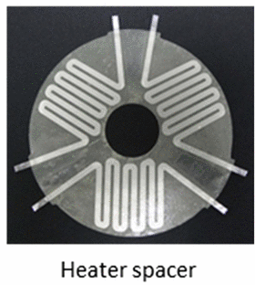
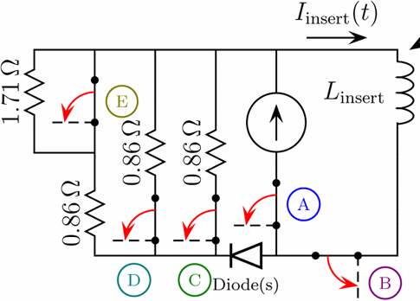
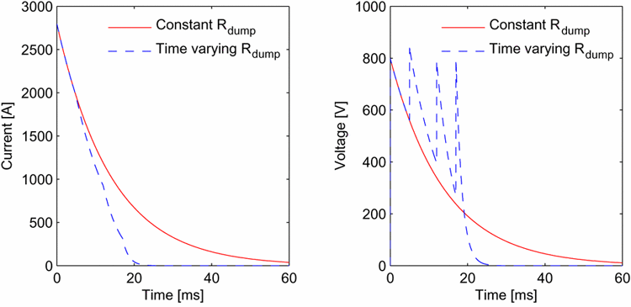
HTS Quench protection criteria: Accelerate the dump
Active Protection Heaters (NHMFL)
Variable R_{dump} (EUCARD HTS insert study)
32 T magnet : 52 disks
f_{heater}~45 %
P_{heater}=50 kW
heating time : ~0.8 s
quench delay: ~0.1-0.6 s
H.W., Weijers et al., IEEE Trans. Appl. Supercond., vol. 24, no. 3, pp. 1-5, June 2014
E. Haro et al., IEEE Trans. Appl. Supercond., vol. 23, no. 3,
pp. 4600104, June 2013

Slide 16
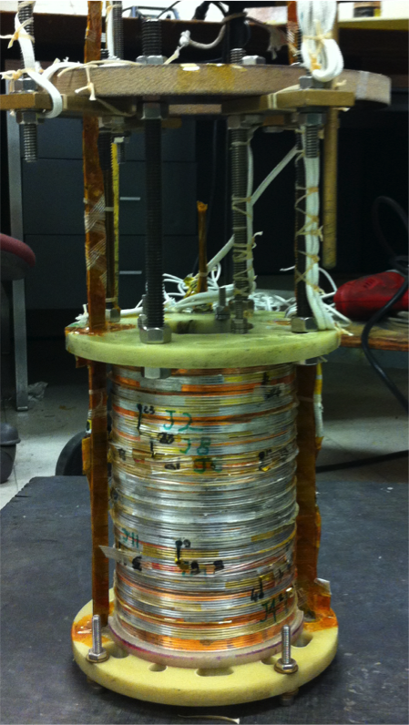

HTS Quench protection criteria: Winding adaptation
No-Insulation Multi-Width: self-protection
Metal-as-Insulation
When a quench occurs in DP9 ($\sim 900 A/mm²)$, all DPs quenched in $\sim 400$ms.
All Energy (> 30 kJ) is discharged under constant voltage mode (PS limitation) in $\sim 360 ms.$
NO protection, NO damage.
Metal tape co-wound with REBCO tape during a quench at 77 K, PS constant voltage mode.
T. Lécrevisse, Y. Iwasa, “A(RE)BCO Pancake Winding With Metal-as-Insulation”, presented at EUCAS2015
Y. Song et al., "Over-Current Quench Test and Self-Protecting Behavior of a 7-T / 78-mm Multi-Width No-Insulation REBCO Magnet at 4.2 K," to be published in Supercond. Sci. Technol., 2015.

Slide 17
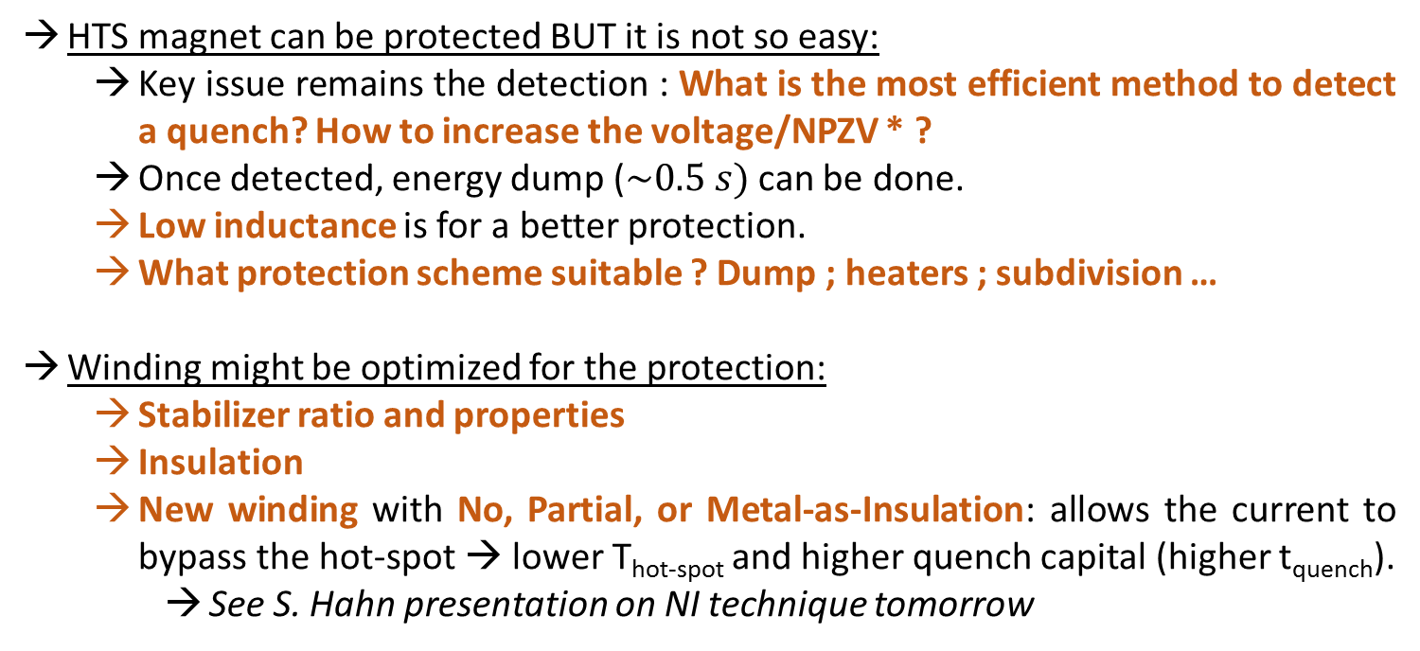
Conclusion
HTS magnet can be protected BUT it is not so easy:
  Key issue remains the detection : What is the most efficient method to detect a quench? How to increase the voltage/NPZV * ?
  Once detected, energy dump ($\sim 0.5 s)$ can be done.
  Low inductance is for a better protection.
  What protection scheme suitable ? Dump ; heaters ; subdivision …
Winding might be optimized for the protection:
  Stabilizer ratio and properties
  Insulation
  New winding with No, Partial, or Metal-as-Insulation: allows the current to bypass the hot-spot → lower T_{hot-spot} and higher quench capital (higher t_{quench}).
    See S. Hahn presentation on NI technique tomorrow
* C. Lacroix and F. Sirois, “concept of a current flow diverter for accelerating the normal zone propagation velocity in 2G HTS coated conductors,” vol. 27, 035003 (10pp), 2014

Slide 18
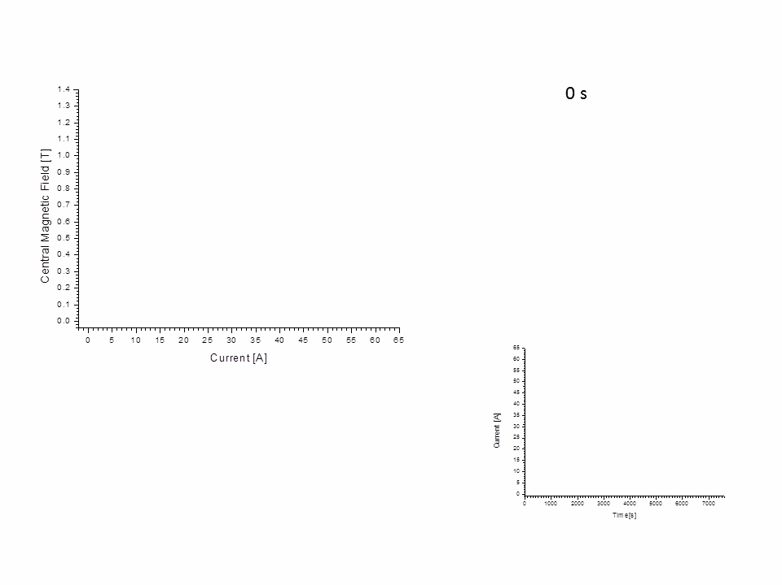

Slide 19
Thank You

Slide 20
Back-up slides

Slide 21
NI-MW
Constant voltage mode
Protection by :
Bypassing current
PS constant voltage mode
BUT : low resistance and still high current
→ need to shut down the PS (not an issue)

Slide 22
NI-MI
Over-current behavior
Below I_{c} :
low (NI) and almost no (MI) I_{R}.
beginning of Field saturation (NI)
NI near and over I_{c}:
I_{R} increase (over 0.5·I_{coil} at 2.2·I_{c})
“Low” voltage
MI quench at “low” over current:
Quench at about 1.06·I_{c}
No Field saturation up to the quench.
almost no (MI) I_{R}

Slide 23
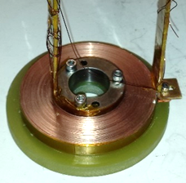
Metal-as-Insulation

Slide 24
Metal-as-Insulation

Slide 25
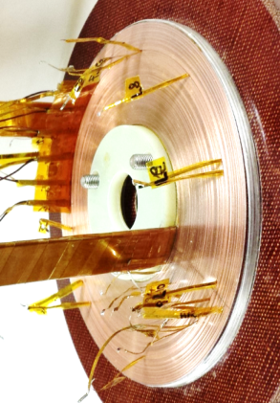
Metal-as-Insulation
Voltage name | Turns number | Conductor length [cm]
Radm8 (inner part) | 40 | 709
Radm7 | 40 | 863
Radm6 | 30 | 748
Radm5 | 20 | 547
Radm4 | 5 | 143
Radm3 | 5 | 145
Radm2 | 5 | 147
Radm1 | 4 | 120
Heated Turn | 1 | 30
RadP1 | 10 | 307
RadP2 | 30 | 978
RadP3 (outer part) | 16.5 | 575
Coil | 206.5 | 5312

Slide 26

Metal-as-Insulation
T. Lécrevisse, Y. Iwasa, “A(RE)BCO Pancake Winding With Metal-as-Insulation”, presented at EUCAS2015

