Slide 1
REVIEW OF
QUENCH DETECTION METHODS IN SUPERCONDUCTING MAGNETS
Felix RODRIGUEZ MATEOS
CERN, Geneva

Slide 2
OUTLINE
Short recall on quench detection factors
An overview on quench detection methods
ITER and LHC: some relevant aspects from their quench detection systems
Conclusions & Outlook

Slide 3
Short recall on quench detection factors

Slide 4
Factors playing a role in quench detection from an electronics designer point of view
Detection level and Time (integration, validation, reaction)
Sensitivity and accuracy, bandwidth
Environmental conditions (magnetic induction, radiation)
Perturbing signals – noise, e.m. coupling
Rejection and compensation
Appropriate signals – cabling, routing, compensation at source
Voltage withstand, separation and common mode rejection
Reproducibility
Dependability
And above all: simplicity
And above all (2): have good diagnostics and remedy tools

Slide 5
Factors playing a role in quench detection from a magnet designer point of view
Volume and magnetic field, inductance and current
Superconductor margins (B, J, T)
Enthalpy at low temperature (stabilizer)
T limit at quench for integrity (how good do we know the real limits of our magnets?)
Voltage limits to ground and internal (idem)
Frequency of quenches
Thermal cycling
Aging and fatigue
How to instrument the coils and the bus bars and the leads in compatibility with design? (and with proper quench detection)?

Slide 6
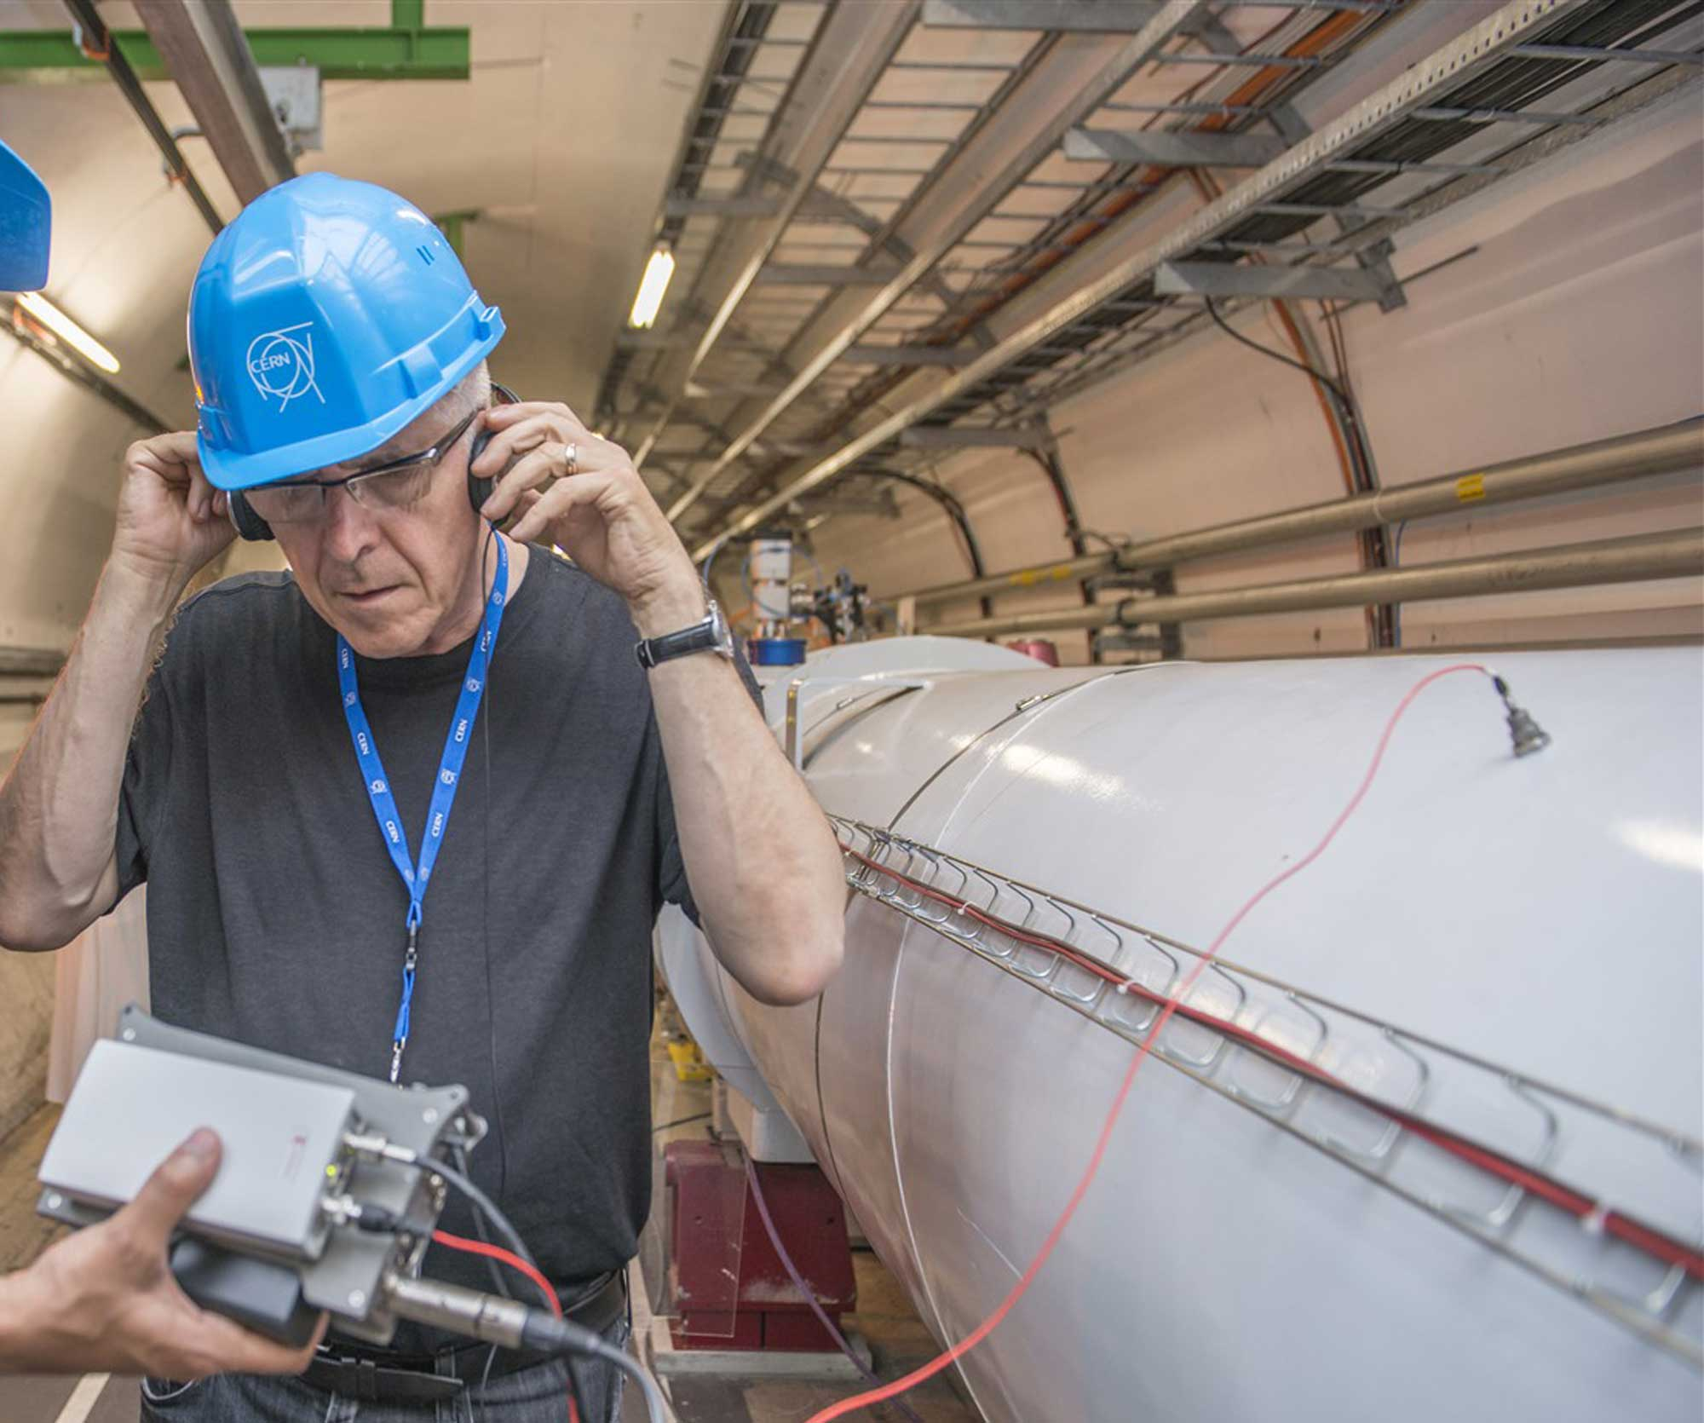
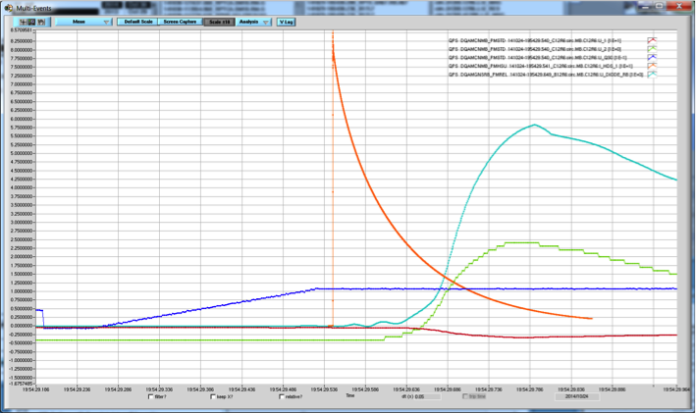

And later, the role of a quench detector
Trigger if needed
Not trigger if not needed
Don’t wait too long
But make sure it’s a quench
… And please send a clear picture of what happened
Bill Fontana, © CERN
M. Marchevsky @ WAMSDO 2013
Courtesy MP3, CERN

Slide 7
The building blocks for quench detection
Instrumentation
+
Analog inputs
ADC(s)
Logic Device
Actuator(s)
Analog front end, filter, attenuate/amplify/level/shift signal to fit ADC requirements.
Analog to digital conversion. Resolution 16..24 bit.
Key component in design.
Logic device. Performs quench detection algorithm:
Filtering
Inductive compensation
quench detection
Includes interface to local crate controller.
Actuator reacts when quench is detected
Usually current loops are cut. Different implementations with relay (slow)
PhotoMOS (fast).
Jens Steckert, Reiner Denz (CERN), CAS Poster

Slide 8
An overview on quench detection methods

Slide 9
A (non-exhaustive) list of methods
Electromagnetic (the art of compensation)
  Potential measurements (direct contact, taps)
    Balanced bridge (quasi-cancellation)
    Differential (dI/dt compensated)
    Co-wound tape (self-compensated)
    MIK (“fully” compensated)
  Magnetic measurements (no direct contact)
    Quench antenna
    Hall sensors
  Mixed methods (no direct contact)
    Poynting’s vector
Thermal (direct) and thermo-hydraulic (indirect)
    Direct coil temperature (e.g. optical fibers)
    Coolant temperature, pressure, flow
Mechanical
  Acoustic emission
    (see talk by Dr. Kawagoe-san)
    (see talk by Pr. Schwartz)
    (see talk by Dr. Marchevsky)

Slide 10
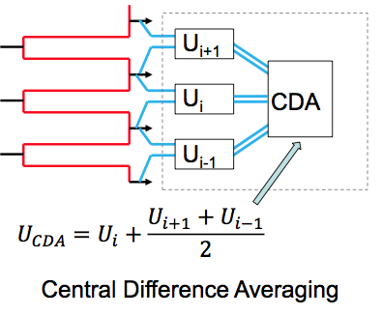
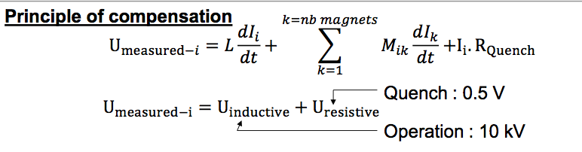
Basic Memento on QD voltage methods (1)
Balanced Bridge
Differential, compensated
U1
U2
U_{mag}
I_{dcct}
U_{res}=U₁ - U₂
Ures = Umag + L * dI/dt
Central Difference Averaging
MIK
M.A. Hilal et al., 1994 (see ref.)

Slide 11
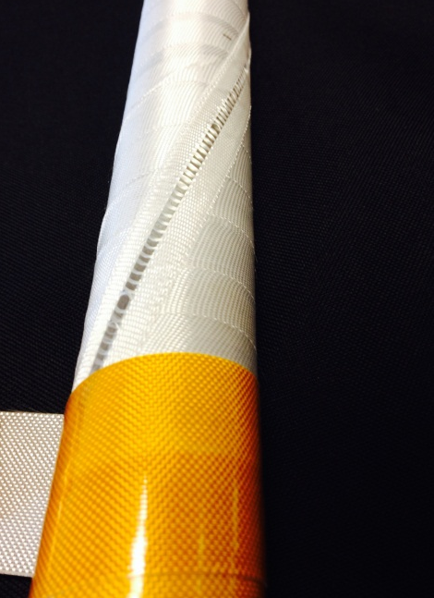
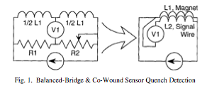
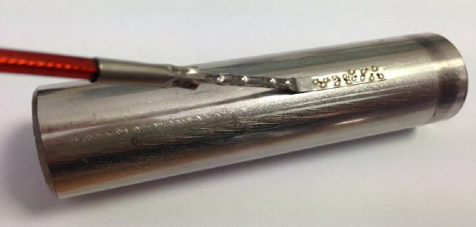
Basic Memento on QD voltage methods (2)
Co-wound tape compensation
Half-joint to adjacent DP
Voltage tap
V_{i}
Conductor
CWT/ Jacket

Slide 12
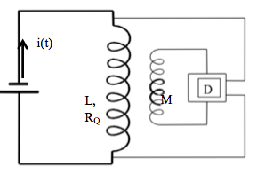

Basic Memento on QD voltage methods (3)
Pick-up coil/quench antenna
When L=M, the voltage is not a function of di/dt anymore
It is equivalent to the CWT when the pitch is adapted to cancel out the difference of radius

Slide 13
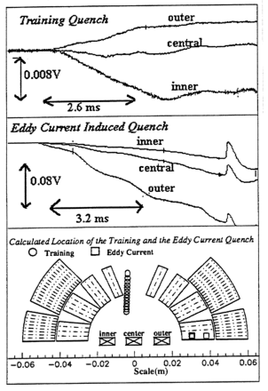
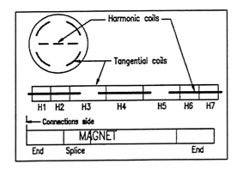
Basic Memento on QD voltage methods (3bis)
Pick-up coil / quench antenna
Pick-up coils within the coil bore
Sensitivity / timing performance
D. Leroy et al. (see ref.)

Slide 14
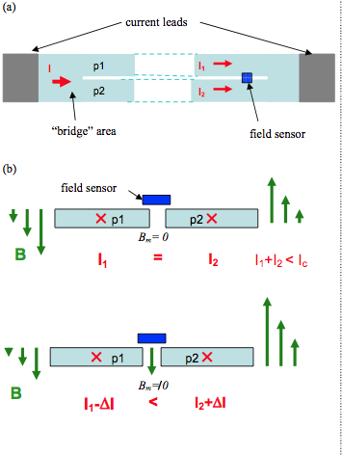
Basic Memento on QD voltage methods (4)
Hall Sensor
Current balance detector applied to 2G HTS wires
Hall sensor sensitivity is 7*10⁻⁵ V/Gauss
M. Marchevsky et al. (see ref.)
Signal to noise ratio improved by factor of 100 compared to voltage measurements
Detection works also for pre-quench conditions (thermal degradation of the critical current by application of heat pulses)

Slide 15
Optical fibres and acoustic emission
Very briefly, two talks on these subjects by world experts!

Slide 16
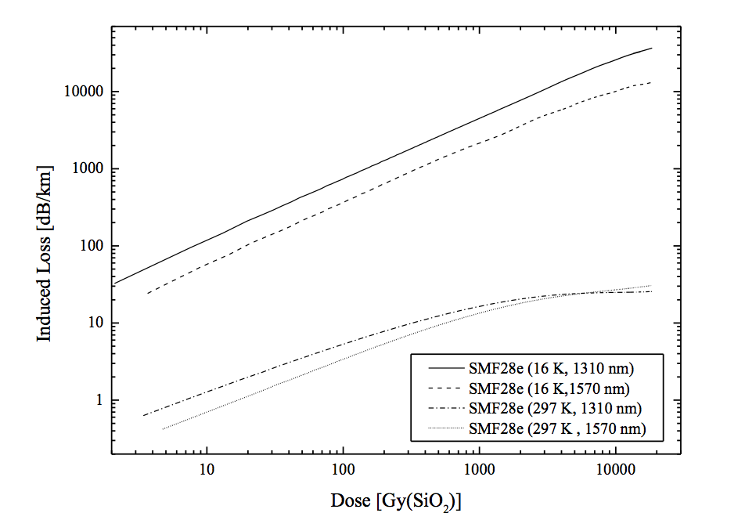
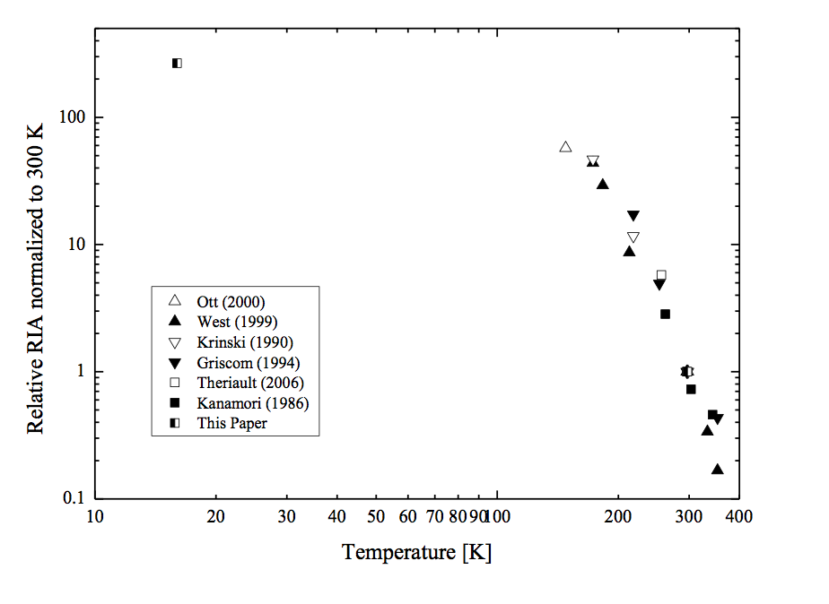
Radiation aspects in optical fibres
J. Kuhnhenn et al., see references
Irradiations done at the TK1000A Co-60 gamma facility at Fraunhofer Institute (Germany)
Tests on Ge-doped fibres at 1312 nm and 1570 nm
For 1312 nm, loss was 2.6dB (100m) at room temperature while 36.6 dB (1 m) at 16K. Even for small lengths of fiber the attenuation is dramatic
First time results of irradiation done at T down to 16 K have been presented

Slide 17
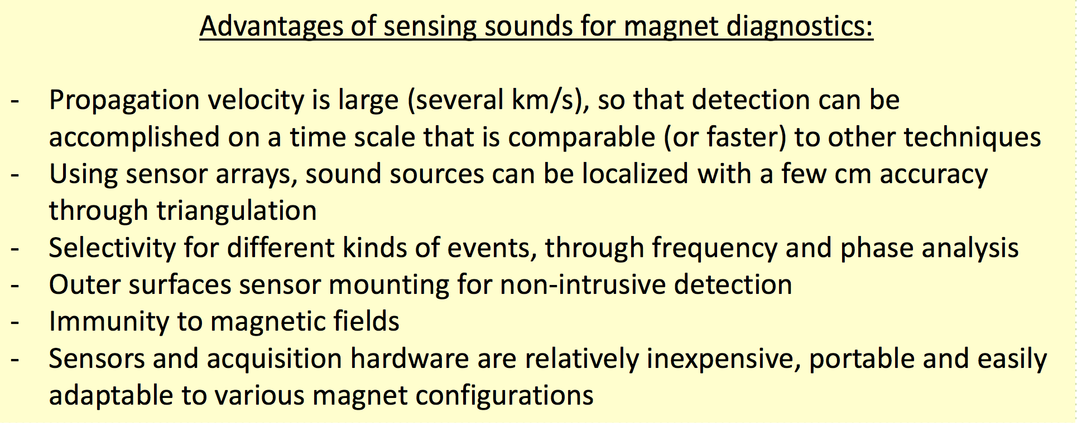
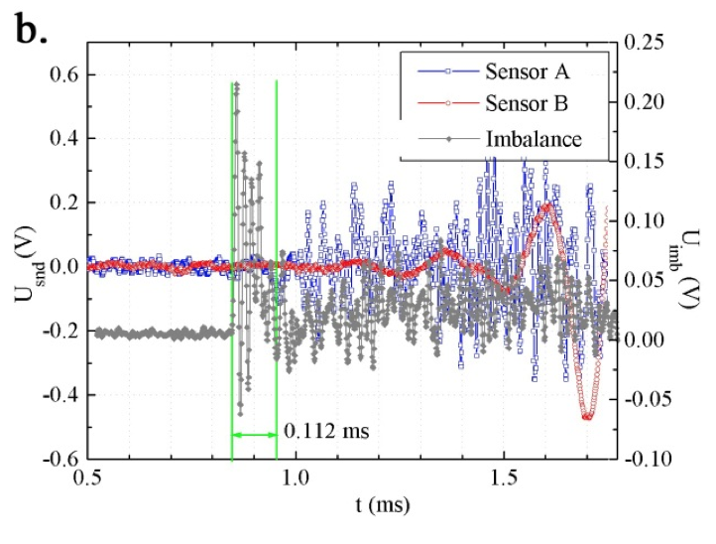
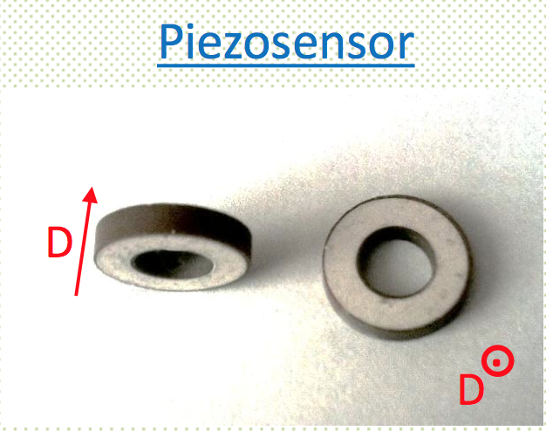
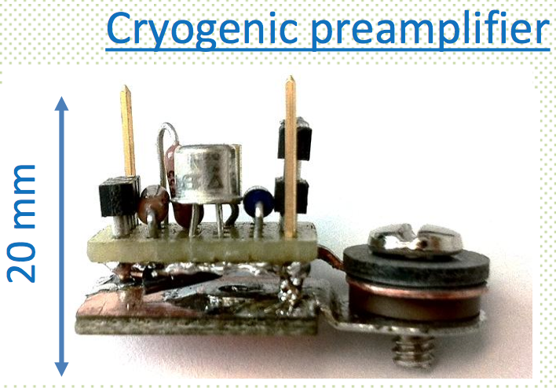
Acoustic emission
Slide with inputs from M. Marchevsky, WAMSDO, CERN, 2013 and M. Marchevsky et al., see references
I=10036 Ain LARP HQ01
“Further development of the acoustic technique is needed, focusing on improving sensitivity and selectivity to small signals, developing instrumentation and software for precise localization of the sound sources and quantifying energy release in the detected acoustical events”

Slide 18
Thermo-hydraulic quench detection

Slide 19
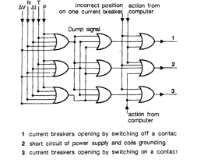
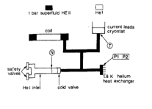
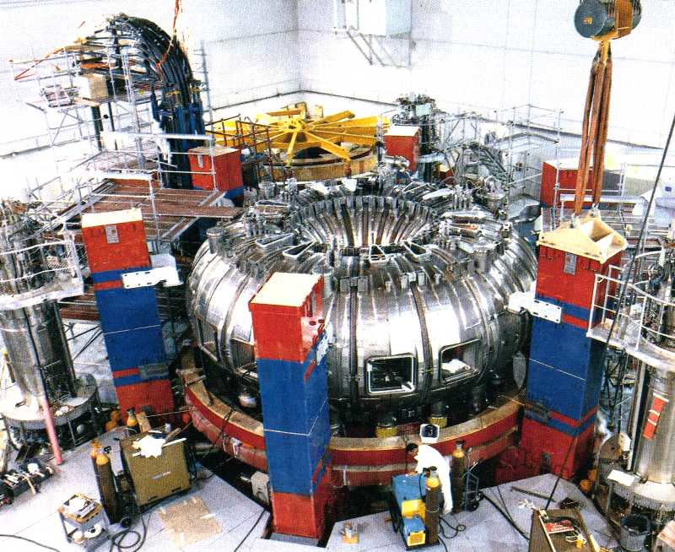
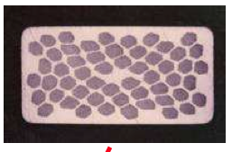
The case of Tore-Supra
Voltage detection (ΔV) : each full coil is compared to two others
Liquid ejection (N) : T sensor detects abnormal cooling in cold valve
Ground current detection (ΔI)
Temperature (T)
Over-pressure detection (p) Two p sensors in 1.8K ensure fast detection

Slide 20
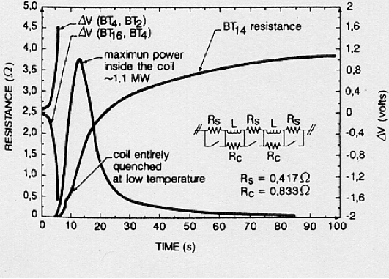
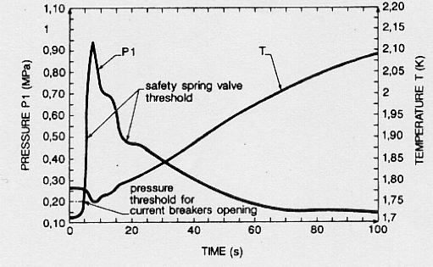
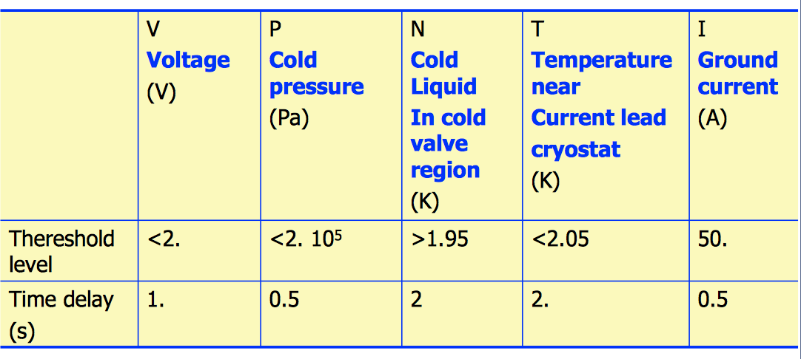
A quench in coil BT4 . . .
Detection thresholds
channel | V | P | N | T | I
Detection time [s] | 1. | 0. | 0.8 | 81.6 | 16.9
Chronology of detection
J.L. Duchateau et al., see references

Slide 21
Quench detection in ITER

Slide 22
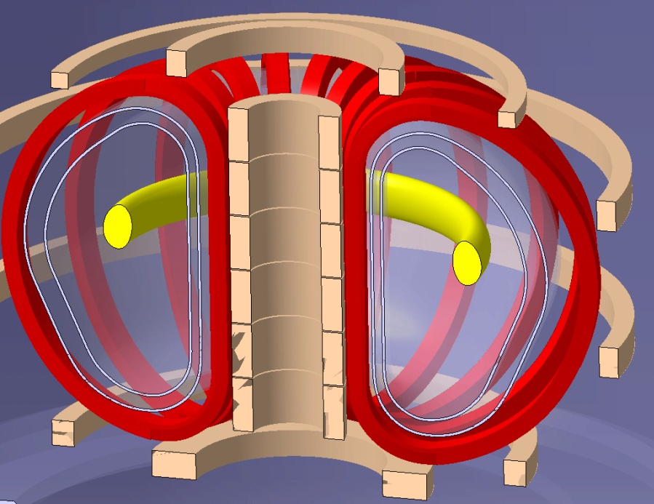
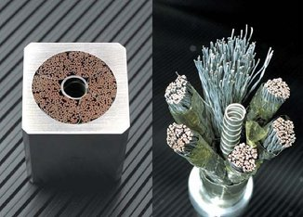
Methods case study : the ITER QDS
TF
MAIN MAGNETIC SYSTEMS OF THE ITER MACHINE
CS
PF

Slide 23
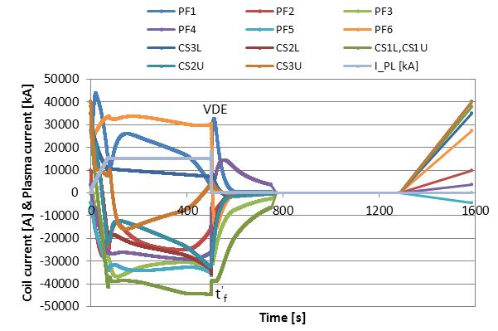
Perturbations inherent to a tokamak like ITER
  The plasma is shaped and confined by magnetic fields
  Strong coupling between a) pulsed magnet systems, b) plasma and magnets, and c) structures and magnets
CS Module | 11 kV | Normal operation | Induced/applied
TF coil | 4.0 kV | In fast discharge | Induced/applied
PF coil | 9 kV | During plasma event | Induced/applied
Quench | 0.5 V | Typically | Resistive
The quench voltage must be distinguished among the time-dependent outweighing inductive signals:
holding time > perturbation time
τ_{h}
Quench detectors trigger a Fast Discharge in all three systems (TF, PF and CS)
Aim of quench detection: Limit the heat generation
How ? Dump the energy of the magnet: Fast discharge
Where ? In external resistors

Slide 24
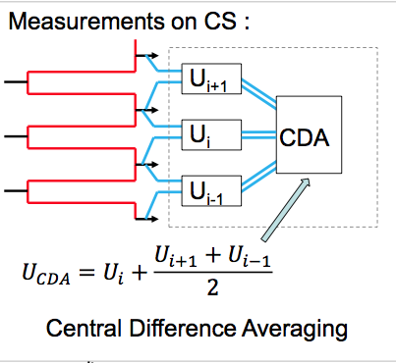
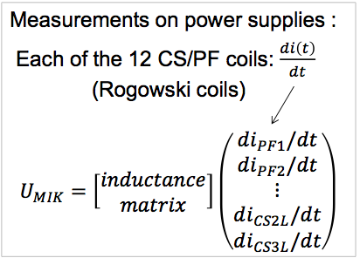

QD principles applied for ITER’s CS

Slide 25
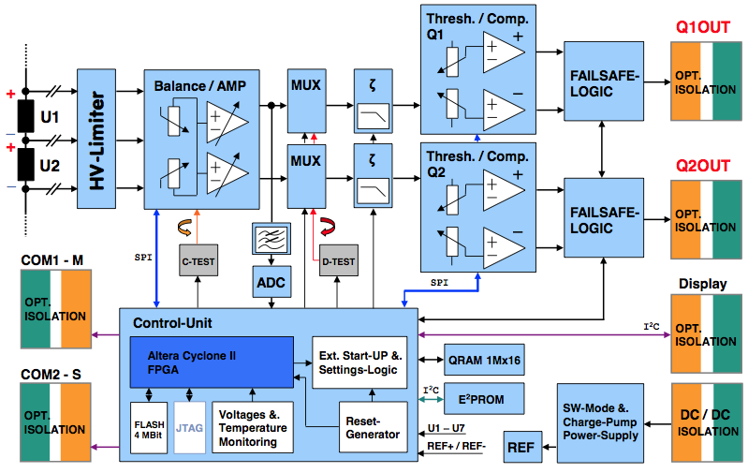
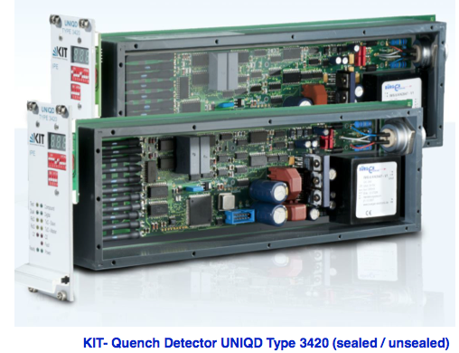

Potential separation to ground: an example
Integrated FPGA design
Fully floating, separation given by the DC/DC converter
Remote interface control
High flexibility (parameterization, calibration, diagnostics)
All-in-one Windows®
Interface for remote control by host
Potential separation to GND up to 30 kV
Maximum differential input 500 V
Threshold down to 5 mV
Courtesy K. Petry (KIT)
Patented in EU by

Slide 26
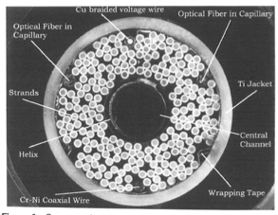
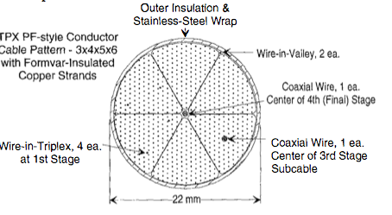
More on noise rejection
QUELL @ CRPP, CH
NRE @ LLNL, USA
CWT has the higher rating as a quench detector in CICC (400 times better NR than standard taps)
Internal T detection by optical fibres provides a reliable method
Extraction of sensors was not problematic
Thermo-hydraulic detection are not recommended in CICC applications
NR factors better than 10⁴ for transverse fields were obtained, depending on positions of the CWT and pattern of fields
Final recommendation was to use a CWT at the center of the first stage of the cable (triplex)
S. Pourrahimi et al., see references
N. Martovetsky et al., see references

Slide 27
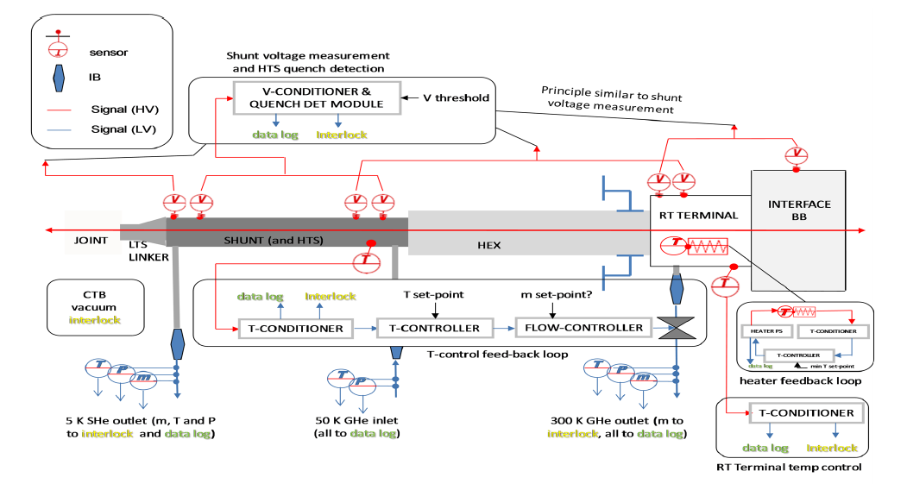
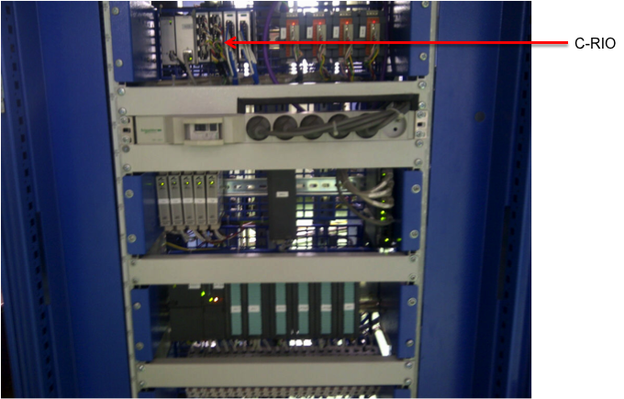
HTS quench detectors in ITER (CL tests)
A system was designed by a team in ITER for the current leads test bench in ASIPP, Hefei, China based on industrial, commercially available solutions
The quench detector part was implemented using NI-cRIO controllers which directly interface the power supply
There was no HV issue and 300V galvanic separation was provided by the NI chassis
Recent tests of the first leads have been successful
This solution can’t be envisaged for the final ITER machine but has given satisfactory results so far at the ASIPP test station

Slide 28
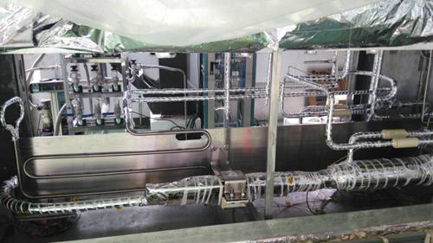
First results
Slide courtesy P. Bauer (ITER) and Dr Ding (ASIPP)
ITER TF HTS Prototype Test Results from ASIPP/China
QDS threshold set to 3 mV during TF prototype test;
Quench event at 64 kA during LOFA test: voltage allowed to rise further to 100 mV to measure so called overheating time (=time at full current until temperature reaches 150 K in the HTS)
Top: Test cryostat and cubicles
Bottom: Leads inside CTB
Quench in the HTS following a LOFA test . Temperature at warm end of HTS and HTS voltage.

Slide 29
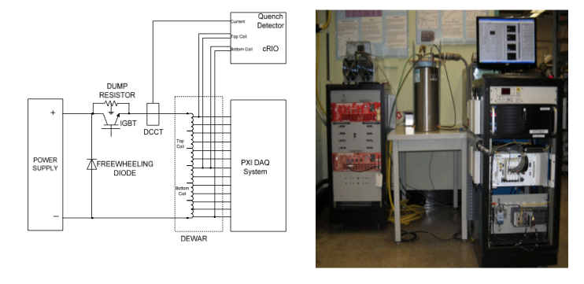

Similar QD system developed at BNL
Patented!
Bridge QD
L*dI/dt compensation
50 μs to 100 μs FPGA loop time for discrete filtering
Filter response time 250-500 μs
NI CRIO backplane powered by reconfigurable Field Programmable Gate Array (FPGA) technology
Real time controller
DAQ module with 4 channel
50KS/s simultaneous sampling
16 bit A/D
16 channel fast digital IO module
300V channel to channel isolation and 300V channel to ground isolation
Threshold : 1 mV (0.1 μV/cm)
Detection time : 2 - 3 ms
“Novel Quench Detection Method for HTS coils”; P. Joshi, S. Dimaiuta, G. Ganetis, R. Gupta, et al.; Proceedings of 2011 PAC, NY, USA

Slide 30
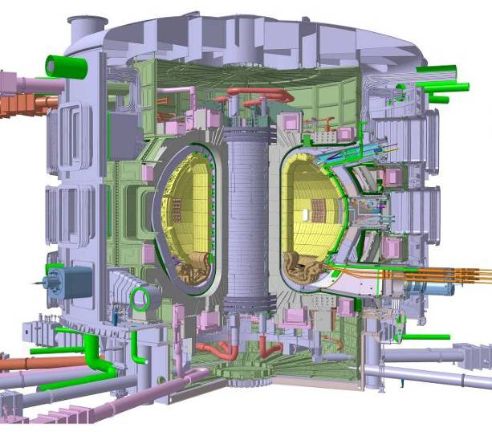
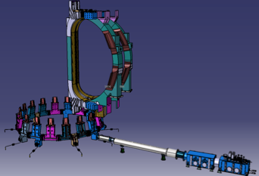
Secondary (Safety) QD in ITER’s TF coils
CTB
Cryogenic instrumentation (all flow-meters and pressure sensors and most of the temperature sensors are located at the extremity of the cryostat extensions, within the so-called Coil Terminal Boxes)
Variations in pressure and in flow during quenching inside of the coils are measured and monitored at the CTB’s instrumentation
This can constitute a second line detection method, the so-called Safety QD which does not protect the coils against overheating, but avoids rupture of the plasma containment walls in case a quench goes undetected by the primary, electromagnetic method(s)

Slide 31
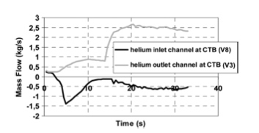
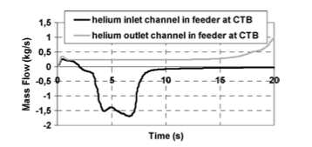
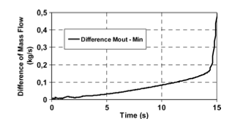
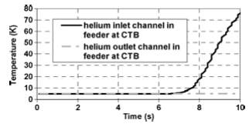
How to detect a quench not seen by the e.m. QD?
Quench and disruption
Undetected
Mass flows at CTB
Differential mass flow at CTB
Temperatures at CTB
For a threshold of Δm= 0.1 kg/s detection is feasible within 10 s from the quench initiation (ultimate limit is set to 25 s)
S. Nicollet et al., see references

Slide 32
Quench detection in LHC
Please see :
“State-of-the-art and future challenges for the quench detection and protection of accelerator superconducting magnet circuits” by A. Siemko, at the 2014 Kyoto Workshop on HTS Magnet Technology for High Energy Physics – WAMHTS-2

Slide 33
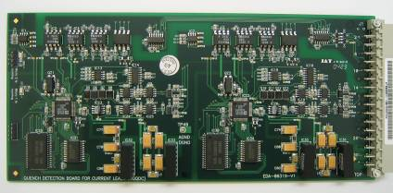
HTS quench detectors in LHC
Based on ADuC834™microcontroller with integrated 24 Bit ∑Δ analog to digital converter ADC
  High resolution < 15 nV @ +/-12.5mV
  Minimum reaction time t_{EVAL} = 100 ms
Originally developed for the protection of hybrid HTS current leads, these detection systems are meanwhile also in use for the protection of the bus-bar splices in the LHC main circuits (3266 redundant systems installed in total)
  Reliable operation with detection thresholds as low as 500 μV
  Measurement of bus-bar splice resistance with ΔR ≤ 1 nΩ
  Programmable gain based version used for circuit protection and diagnostics during the Copper Stabilizer Continuity Measurement (CSCM) campaigns
Courtesy Denz/Siemko/Steckert, CERN

Slide 34
Conclusions & Outlook

Slide 35
Future developments in fast and high resolution digital electronics will bring increasing capabilities for fast detection at every time lower levels
Coil / bus bar / current lead’s sensors are an integral part of a quench detection system, so the design has to be done by putting together from the beginning the magnet engineer, the electronics engineer and the future operators/analysts
Never forget that magnets are always part of circuits and electrodynamics of quench protection can be tricky when going to the circuit level (power supplies, by-passes, environmental constrains, couplings, noise, transmission line effects, etc)
Radiation has to be limited to systems which become the more and more complex
Contacts across disciplines is fundamental to keep innovation and inventiveness alive!
New methods for the future are going to be hybrid and with adaptive threshold filters
When will we see the breakthrough of a new detection method ?

Slide 36
References:
“Engineering Superconductivity”; edited by Peter J. Lee, May 2001, Wiley-IEEE Press
“Superconducting Accelerator Magnets”; KH. Mess, P. Schmüser, S. Wolff, World Scientific, 1996
“Quench Observation in LHC Superconducting One Meter Long Dipole Models by Field Perturbation Measurements”, D. Leroy et al., IEEE Transactions in Applied Superconductivity, Vol. 3 (1993)
“Electromagnetic Quench Detection in ITER Superconducting Magnet Systems”, F. Rodriguez Mateos et al., ASC 2014, Charlotte, USA
“Detection of the Normal Zone with Cowound Sensors in Cable-in Conduit Conductors”, N. N. Martovetsky and M. R. Chaplin, 1997, IEEE Transactions in Applied Superconductivity, pages 451-454
“Quench Detection System for the ITER HTS Current Lead Test”; P. Bauer, C.Y. Gung, S. Lee, D. Carrillo, A. Vergara and F. Rodriguez Mateos, Technical Specification,
“Monitoring and Controlling Tore Supra Toroidal Field System: Status after a year of operation experience at nominal current”; J.L. Duchateau et al., IEEE Transactions on Magnetics, Vol 27, No. 2 , March 1991
“Contribution à l’Etude des aimants supraconducteurs utilisant des matériaux supraconducteurs à haute température de transition”; PhD Thesis of Thibault Lecrevisse, Université de Grenoble/CEA/IRFU, December 2012
“Lectures on Applied Superconductivity Beyond Nb-Ti”; Martin Wilson
“Novel Quench Detection Method for HTS coils”; P. Joshi, S. Dimaiuta, G. Ganetis, R. Gupta, et al.; Proceedings of 2011 PAC, NY, USA

Slide 37
References (cont’d):
“Thermal Behavior and Quench of the ITER TF System During a Fast Discharge and Possibility of a Secondary Quench Detection”; S. Nicollet et al., IEEE Transactions on Applied Superconductivity, June 2012
“Development of the TF Safety Quench Detection System at ITER”; Y. Chu et al., ITER Org. Internal Report BHS3DB, January 2013
“State-of-the-art and future challenges for the quench detection and protection of accelerator superconducting magnet circuits”; A. Siemko, Workshop on HTS Magnet Technology for High Energy Physics – WAMHTS-2, Kyoto (Japan), 2014
“Acoustic Detection In Superconducting Magnets For Performance Characterization And Diagnostics”, M. Marchevsky at al.,
“Detecting mechanical vibrations in superconducting magnets for quench detection and diagnostics”, M. Marchevsky , WAMSDO, CERN 2013
“Quench Detection of Multiple Magnet System”; M.A. Hilal et al., IEEE Transactions on Applied Superconductivity, Vol. 4, September 1994
“Quench detection method for 2G HTS wire”; M. Marchevsky et al., EUCAS 2009
“The ITER –QUELL experiment, a quench propagation experiment on long length CICC with central channel”; A. Anghel et al.
“Performance of the US Quench Detection Systems in the QUELL Experiments”; S. Pourrahimi et al., IEEE Transactions in Applied Superconductivity, Vol. 7, June 1997
“Irradiation tests on Optical Fibers Below 20 K”; J. Kuhnhenn et al., International Conference on Space Optics, Tenerife (Spain), Oct 2014
“Multipurpose Fiber Optic Sensors for High Temperature Superconducting Magnets”; M. Turenne et al.,

Slide 38
Acknowledgment
Sources of information, advice and discussions:
Amalia Ballarino (CERN)
Pierre Bauer (ITER)
Luca Bottura (CERN)
Marc Coatanea-Gouachet (ITER)
Reiner Denz (CERN)
Glyn Kirby (CERN)
César Luongo (Jefferson Lab)
Klaus Petry (KIT)
Andrzej Siemko (CERN)
Jens Steckert (CERN)
Antonio Vergara (ITER)

Slide 39
Many thanks for your attention …

