Slide 1
Optical Fibers for Quench Detection
Justin Schwartz, North Carolina State University with collaborators
Wan Kan Chan, Federico Scurti, Sasha Ishmael and
Gene Flanagan, Muons Inc.
WAMHTS3
11 September 2015
Lyon, France
Partially supported by DoE, Office of Science STTR Grant No. DE-SC0006251

Slide 2
Outline
Motivation for
  Distributed sensor → optical fibers → Rayleigh scattering interrogation
Thoughts on integrating distributed sensing into quench detection
Results w/Rayleigh-scattering Interrogated Optical Fibers (RIOF)
Practical challenges
Near term plans
Conclusions

Slide 3
Why do we need a new detection technology?
Normal zone propagation is slow … very slow …so
  V=∫E(x).dl
  The shapes of E(x) & T(x) roughly match
  Slow propagation → same V results from peaked or broad E(x), T(x)
  So higher T_{max} and T for the same voltage as LTS
    Allowable T_{max} in REBCO not resolved; may vary between manufacturers, with slitting/cutting of strand, and strain-state from bending, Lorentz forces, etc.
    Bi2212 degradation begins at ~400 K, fairly independent of J_{c}
  Fast, distributed sensing is needed
Ultimately quench protection is a question of time
  time to detect & protect versus time to degrade
Mr. Voltage Tap puts HTS magnets at risk
Δ

Slide 4
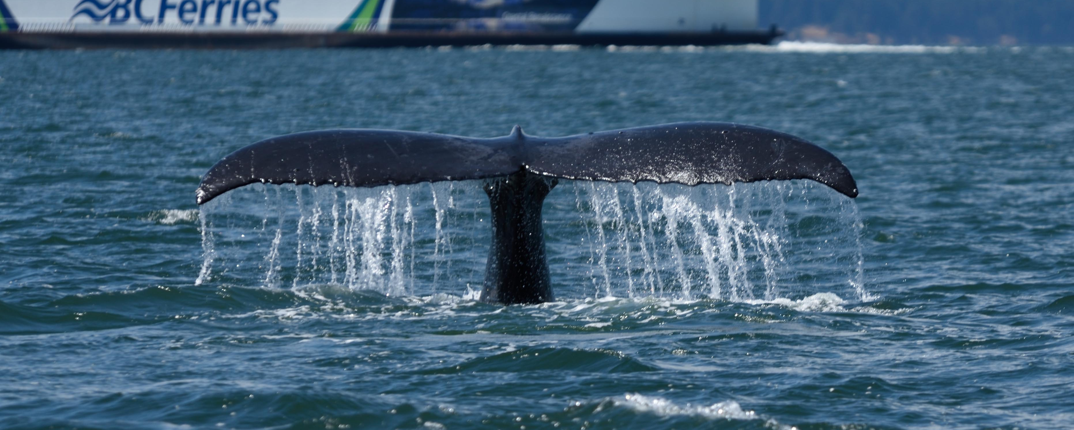
Why optical fibers?
Slow propagation → high spatial resolution required
Optical fibers:
  are inexpensive with COTS options
  are reasonably strong and flexible (but fine & thus breakable)
  can be tailored to specific needs (e.g. geometry) with modest investment
  can be coated to modify/protect their surface and behavior
  are immune to electromagnetic noise and unrelated voltage pick-up
  technologies under development for many applications
    though at times this can be limitation as well because of varying foci
    quench detection may pose most challenging demands of optical fiber sensor applications
Small signals can mean big things

Slide 5
Optical fibers require “interrogation”
Fiber Bragg gratings → point measurements, easy to have multiple points per fiber
  But locations are fixed once fiber is manufactured
  Success very unlikely with PMP Bi2212 (gratings may disappear)
Brillouin scattering → sensitivity problems at desired temperatures
Rayleigh scattering (Rayleigh-scattering Interrogated Optical Fibers (RIOF)
  Caused by random fluctuations of the index profile along the fiber length; essentially an infinite number of intrinsic FBGs on an ordinary optical fiber
  Truly continuous, distributed sensor

Slide 6
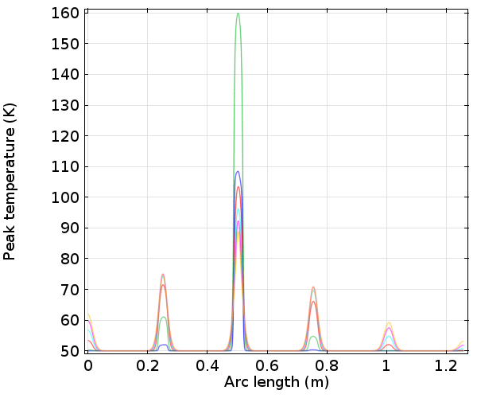
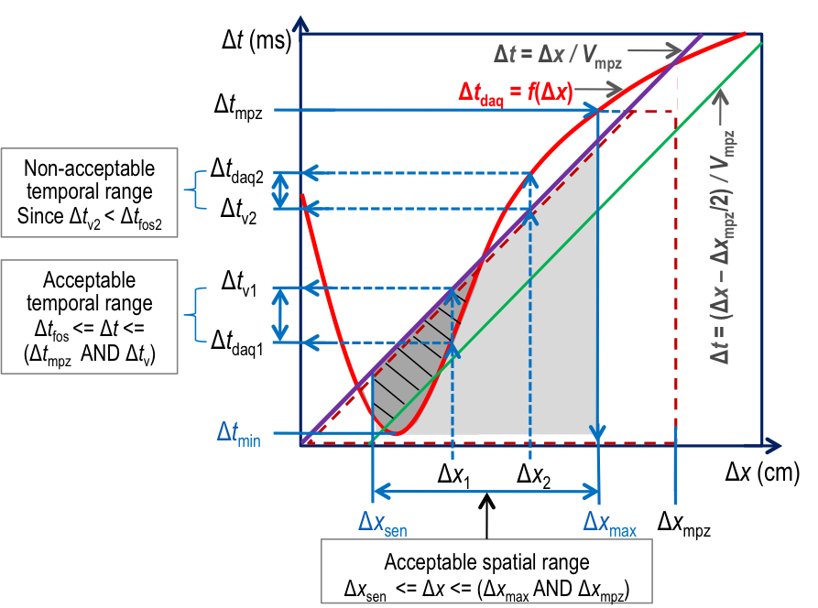
RIOF based quench detection
“Spectral shift” in reflected spectrum translated into local T & strain variation by comparison to reference scan, giving temperature/strain profile along entire fiber
Can redefine “t=0” anytime via new reference scan
Potentially enormous volume of data
  Spatial resolution ultimately limited by wavelength of light and scale-length of defects
  Temporal resolution limited by data acquisition and analysis
“Capture” MPZ real-time with sufficient temporal and spatial resolution
Match DAQ technology with coil behavior
Turn N
Peak temperature
Turn N-1
Turn N+1
Fiber length

Slide 7
E.g., real-time detection logic flow for RIOF & MPZ criterion
Scan T with
Δx and Δt
Spatial resolution and ROI can vary real-time
Scan for and remember
true hot-spot locations
Scan normal zone size
(NZ) for T > T_{mpz}
True hot spot region
T = 200 K = T_{limit}
MPZ detection threshold
No
NZ >= MPZ ?
Turn #(N-1)
Turn #N
Turn #(N+1)
YES (Quenched)
Initiate
Quench protection
Once NZ >= MPZ, it remains so and quench happened.
Stop

Slide 8
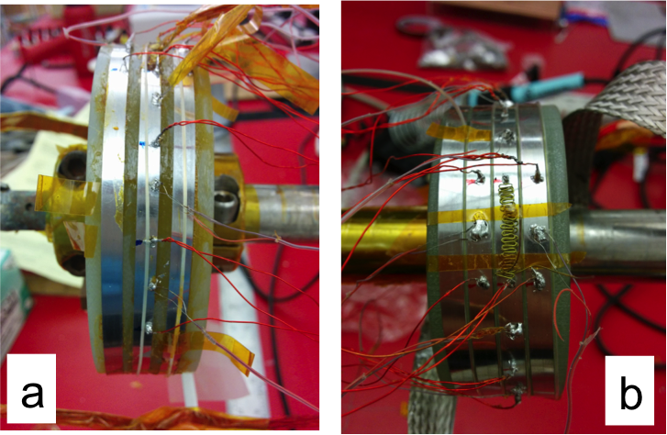
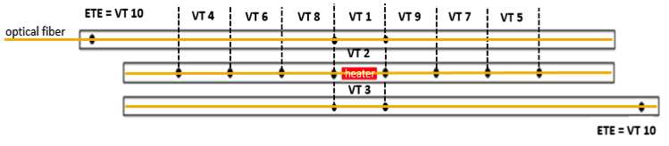
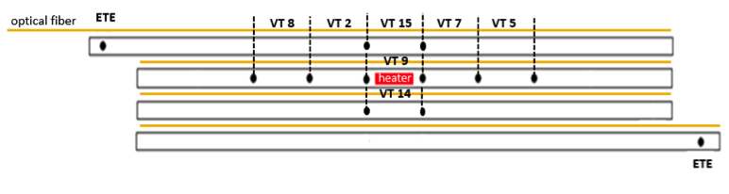
Two demonstration coils
Fiber-on-top & fiber situated as turn-to-turn insulation
Also instrumented with voltage taps, thermocouples, embedded heater
Fiber glued with GE-Varnish – no impregnation
Tested at self-field, in LN₂ & vapor-cooled
0
0
heater
heater
-20

Slide 9
Experimental approach
Test procedure
time
Transport current ramp up
Steady superconducting state
Heat pulse
VTs and TCs readings
Optical fiber interrogation
VTs and TCs readings: voltage vs time; temperature vs time
Optical fiber interrogation: spectral shift vs time ; hot-spot location vs time
Hot-spot: location where the fiber experiences maximum spectral shift

Slide 10
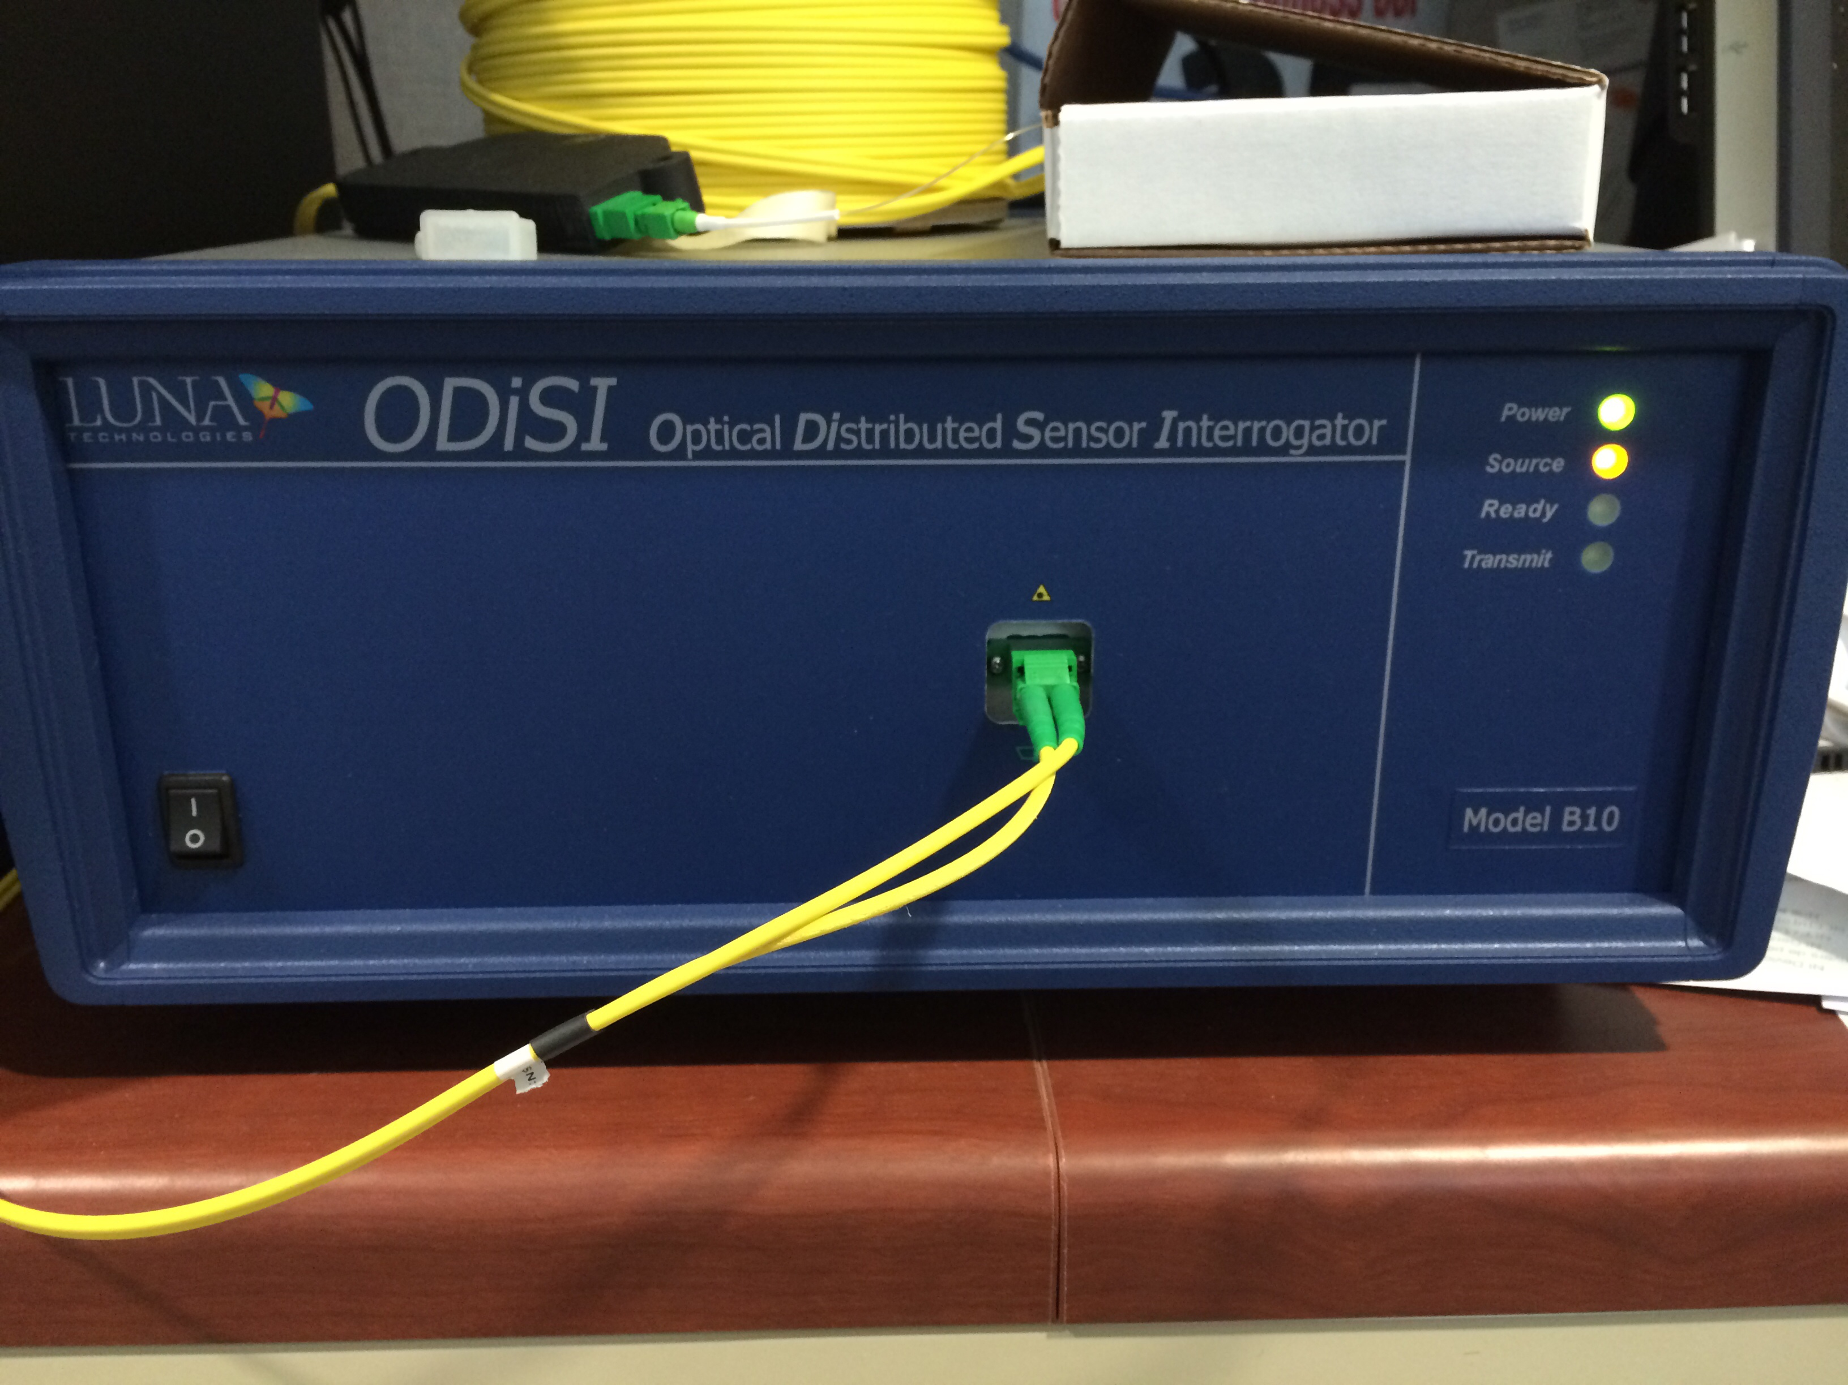
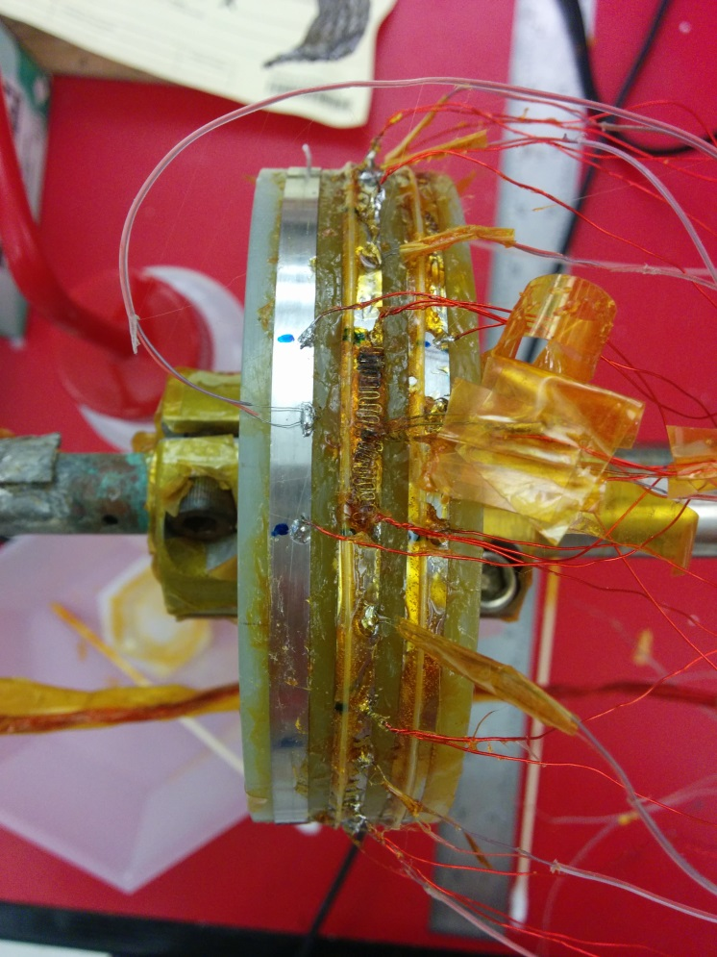

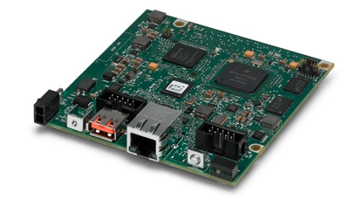
What happens to the signals?
Rayleigh interrogator
from Luna Technologies
Voltage/Thermocouple/Power supply info
Fiber optic data in (raw)
Fiber “hot spot regions” for decision algorithm
and combination with analog data sent to board.
sb-RIO used to monitor timing and error status of fiber system
Data paths, analog and fiber, combined and algorithms run on FPGA
Algorithm checks fiber scan for segment with maximum change, also the 5 neighboring around it to calculate normal zone evolution. “Focuses” on a normal zone
Additional normal zones on unused segments (i.e. not included in previous normal zone) are also identified
This data is combined with analog voltage data (using FPGA) → calculated evolution of the normal zone is correlated spatially with voltage data

Slide 11
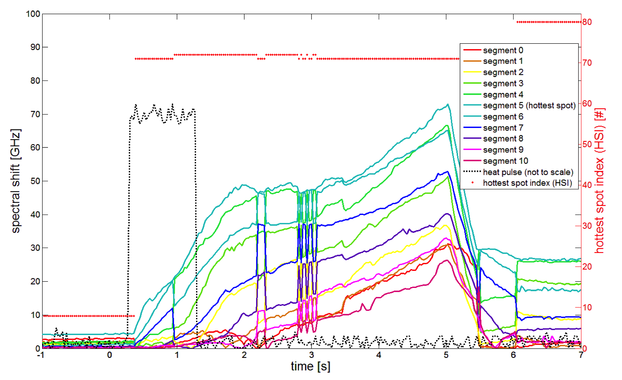
Typical spectral shift v time during a quench
Heat pulse
Not noise
~immediate signal
Spectral shift at 11 locations along the optical fiber, each location 5 mm from the next. Clear spectral signals begin as soon as the heat pulse begins, without no time delay whatsoever.

Slide 12
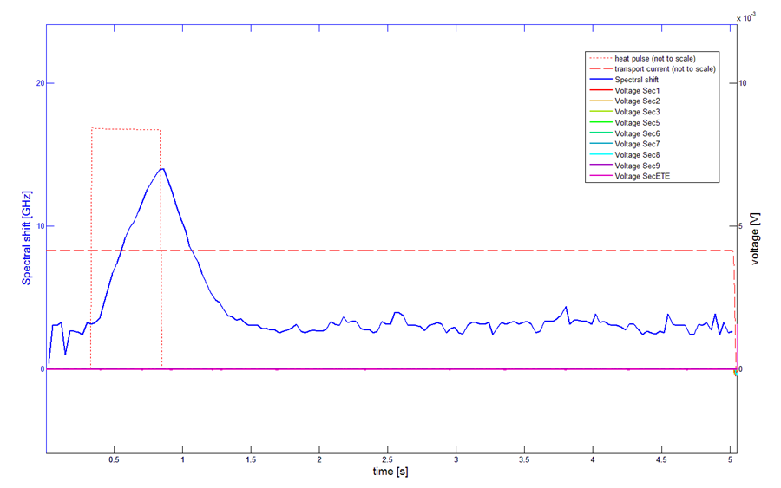
Even with T<T_{cs}…yet a clear signal from the fiber
Spectral shift and voltage versus time for a case in which the heat input was insufficient to cause a quench. Note the clear spectral signal and the lack of voltage signal.

Slide 13
Results - Fiber at the edge (90%I_{c})

Slide 14
Location of largest spectral shift (hotspot)
0
heater
-20

Slide 15
Results - Fiber atop
0
heater

Slide 16
Timing is everything!
Time from onset of heat pulse to a signal greater than background noise, voltage v spectral shift
Δt (ms)
(other conditions variable)

Slide 17
Intrinsic advantages of RIOF over voltage
Signal onset well before T>T_{cs}
  Advantage increases as I/I_{c} decreases
Immunity to electromagnetic noise
Distributed sensing with variable & controllable spatial resolution
Precise location of hotspots
Sensing continues after I → 0
When “too much data” is your biggest problem…

Slide 18
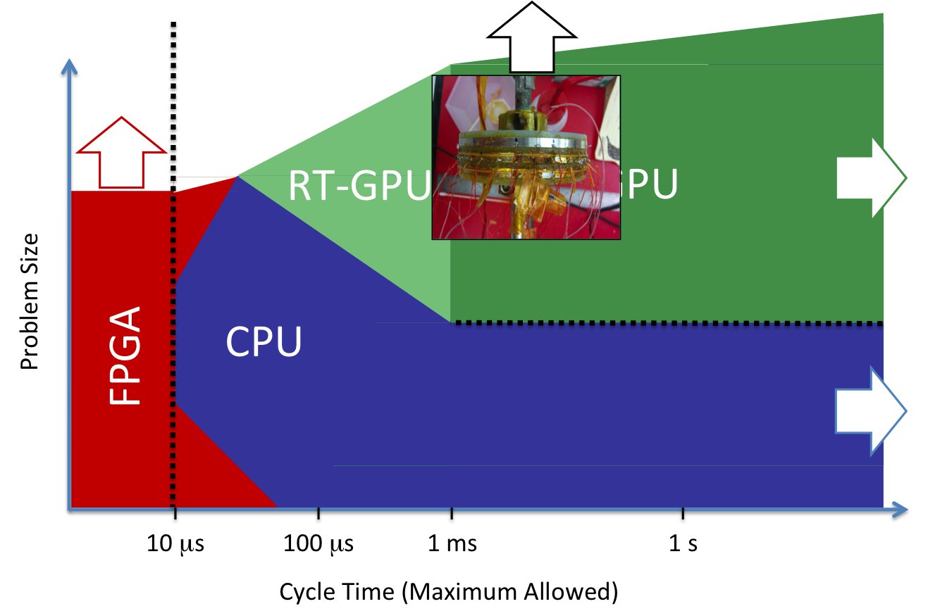
Practical challenges – “intrinsic” questions
Volume of data and real time data analysis/logic
  All the information is there… just need to manage it!
  FPGAs
    Monitor error status and GPU timing
    Precise timing control
    Enables multiplexing w/synchronization
Applicability to Bi2212
  Primarily a question of fiber surviving the heat treatment
  Compatibility from Bi2212 perspective demonstrated w/FBGs
Low temperature sensitivity needs quantification
  perhaps signal amplification

Slide 19
Practical challenges - strain
Do we need to distinguish strain and temperature perturbations?
In particular, do we need to identify strain component during ramping
Strain distribution measurements can be an advantage too
Multi-fiber approaches may facilitate decoupling of strain and temperature but it again becomes a data analysis/timing issue

Slide 20
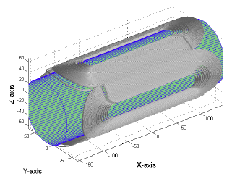
Practical challenges - integration
Signal delay is ONLY related to “transmission” from conductor to fiber
Co-wound as insulation in CC magnets (as shown here)
In the “spaces” in RW Bi2212 magnets?
Embedded within a CC?
How to integrate into cables? (Roebel, CORC, Rutherford, etc.)
Surface winding option for coils of small build?

Slide 21
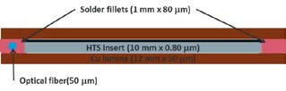
Some near term plans @NCSU
New Phase I STTR w/AMSC (funded by DoE Office of Fusion Energy); contract completed last Friday
Quantify sensitivity versus temperature
Lower temperature (and higher current) operation in a REBCO wound coil
Co-wind & heat treat with Bi2212

Slide 22
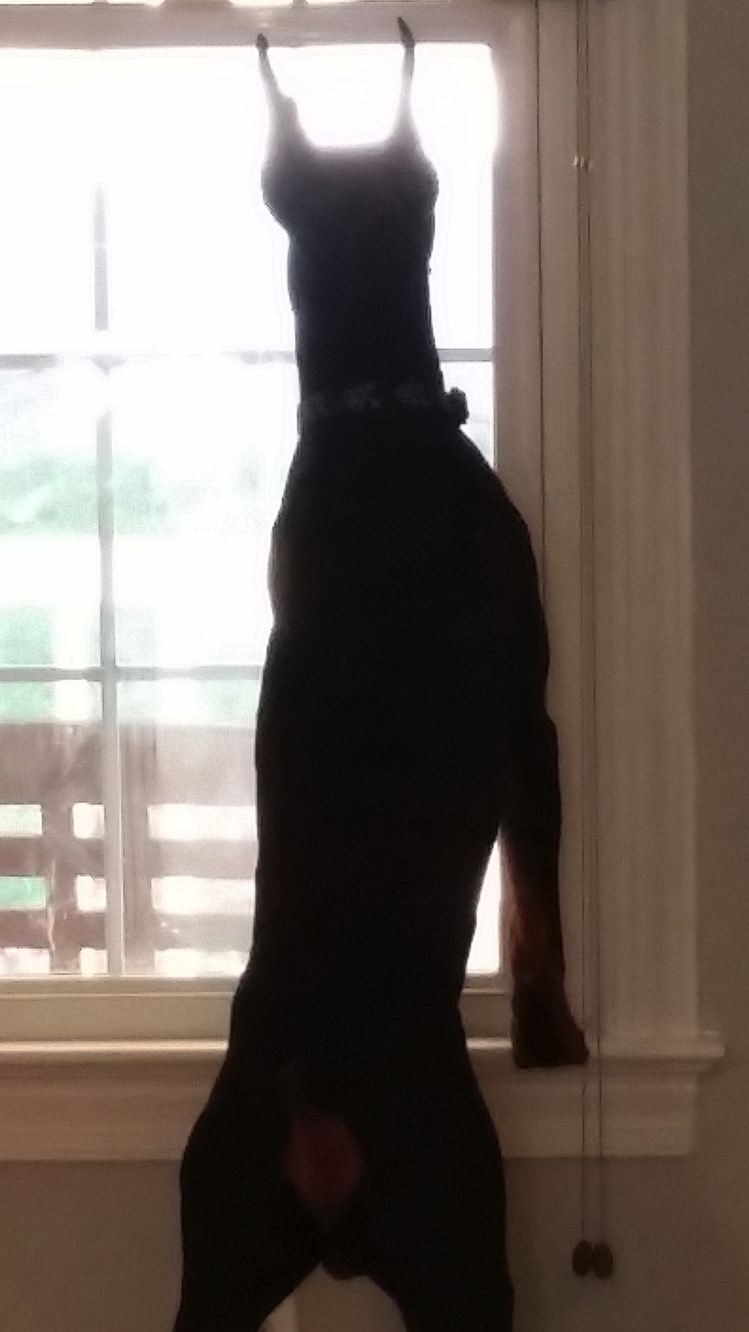
Conclusions
Proof-of-principle for Rayleigh scattering based optical fiber quench detection is established
Many intrinsic advantages
  Signal onset well before T>T_{cs}
  Immunity to electromagnetic noise
  Distributed sensing with variable & controllable spatial resolution
  Precise location of hotspots
  Sensing continues after I → 0
  When “too much data” is your biggest problem…
Many remaining challenges but none are fundamental questions
Highly sensitive sensing, and fast too!

Slide 23
Commercially available fibers
Core/cladding interface needed for total internal reflection
All other layers are optional for Rayleigh scattering interrogation
Coatings provide protection and easy handling (with only core and cladding fiber is very brittle composite)
Standard cladding diameter 125 µm.
40 µm smallest cladding commercially available
Usual coatings: acrylate, polyamide. Metals available but less common
Luna interrogators require connection and termination
8 µm
cladding
coating
jacket
Typical structure of a single mode optical fiber (not to scale)
Luna fiber (core + cladding + polyamide coating)

