Slide 1
Quench detection and protection for HTS accelerator magnets
M. Marchevsky, LBNL

Slide 2
Outline
Quench in HTS magnet: the basics
  Conductor properties: HTS vs LTS
  Protection time margin
  Simulation of quenching in HTS under adiabatic conditions and consequences for protection
Quench protection in HTS: recent activity highlights
  Conductor modification
  Detection techniques
  Protection techniques
Split conductor for detection and protection

Slide 3
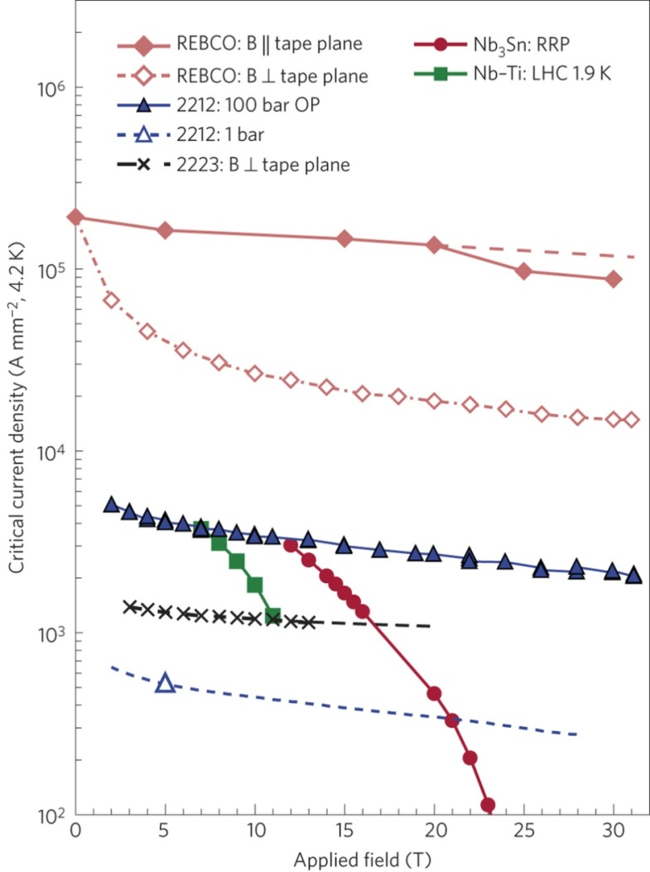
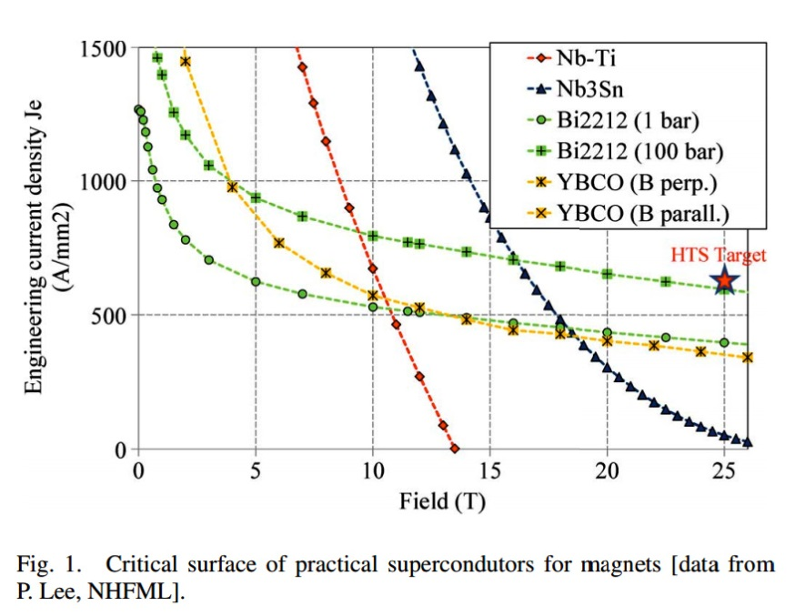
Magnet prospective using HTS conductor
20 T field with 400 A/mm² overall current density has been considered in “Malta Design” (E. Todesco, F. Zimmermann, “The High-Energy LHC”, CERN Rep. 2011-3, p. 13-16)
HTS target: 500 A/mm²
E. Todesco, L. Bottura, G. De Rijk, L. Rossi , ”Dipoles for High-Energy LHC”, IEEE Trans. Appl. Supercond., 24, 4004306, (2014)
D. C. Larbalestier et al., “Isotropic round-wire multifilament cuprate superconductor for generation of magnetic fields above 30 T”, Nature Materials 13, 375–381 (2014)

Slide 4
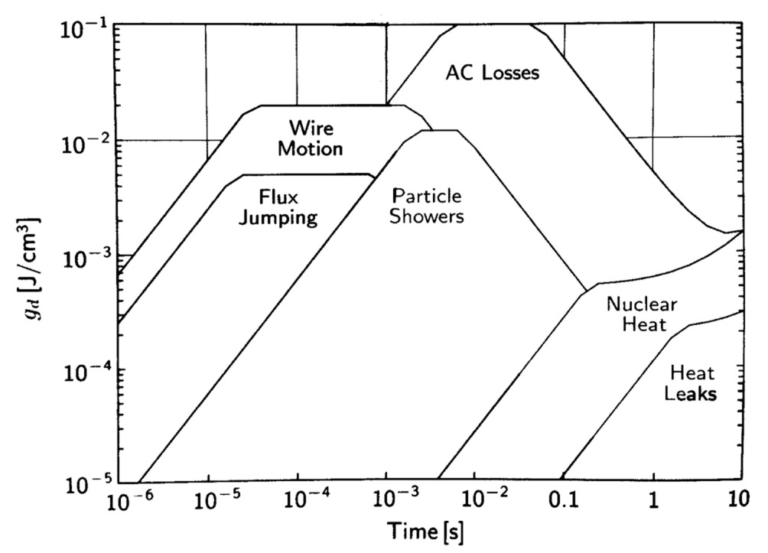
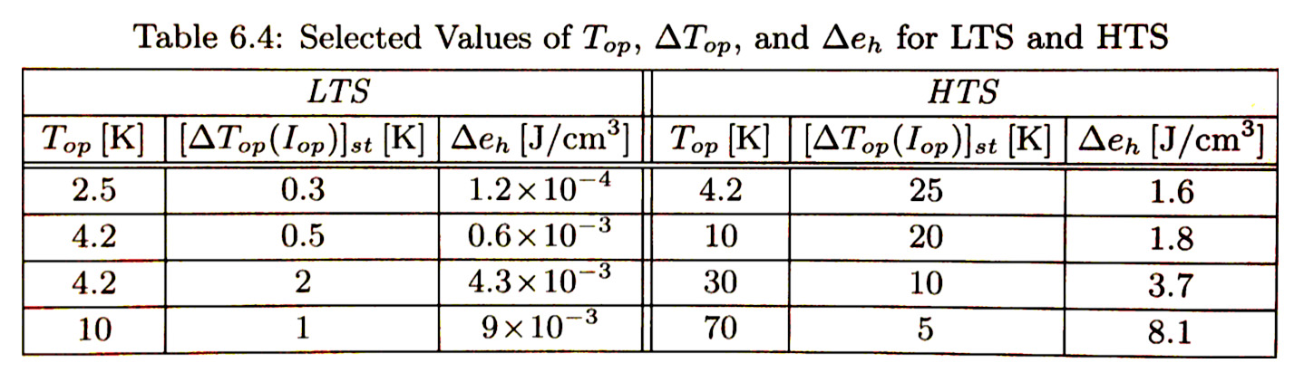
Disturbance spectra and stability margin
Mechanical events associated with conductor motion and/or impregnation material fracturing – a major source of quenching in LTS accelerator magnets are not likely to cause quenching in HTS.
Minimal quench energies in HTS are 2-3 order of magnitude larger than those in LTS !
Y. Iwasa, “Case Studies in Superconducting Magnets”

Slide 5
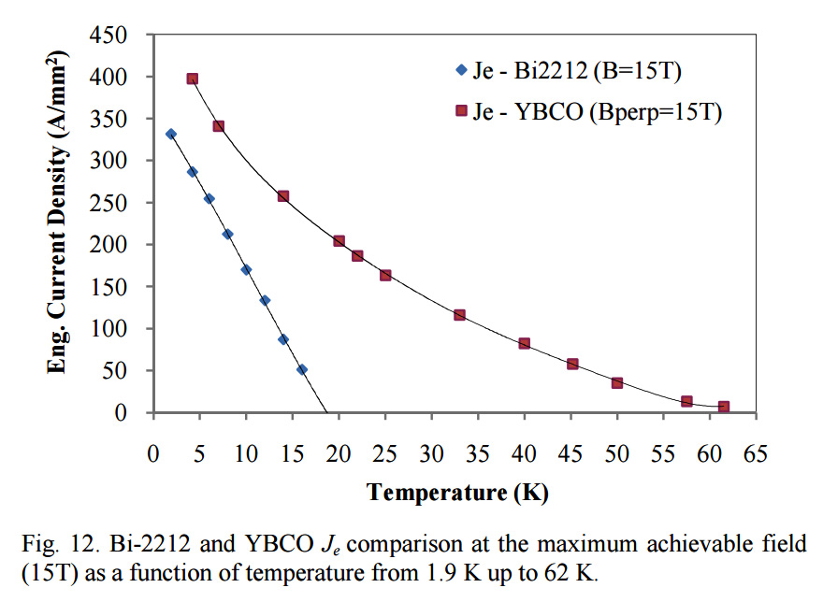
Temperature dependence of J_{e}
Large temperature margin combined with increase in heat capacity with temperature should guarantee high stability with respect to quenching
Nb₃Sn
V. Lombardo et al., “Critical Currents of YBa₂CuO_{7-delta} Tapes and Bi₂Sr₂CaCu₂O_{x} Wires at Different Temperatures and Magnetic Fields” IEEE Trans. Appl. Supercond., 21, pp 3247 – 3250 (2011)

Slide 6



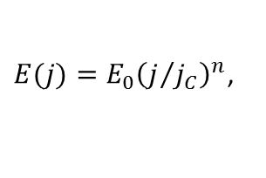
LTS vs HTS conductor
n value:
LTS
$$E=E_{0}{\left(\frac{J}{J_{c}(T)}\right)}^{n}$$
HTS
“True” n-value is related to a thermally-activated flux creep exponent, as
$E(j)=E_{0}{\left(j/{j_{C}}\right)}^{n}$,
where
$$n=U_{0}/T$$
and $U_{0}$
is the creep activation energy.
n ∼ 50-80
n ∼ 15-40
Sharp “on-off” depinning: all current flows in the superconductor at J<J_{c}(B, T_{cs})), and switches fully into a normal metal stabilizer at J>J_{c}(B, T_{cs}), with Ohmic relation between E and J.
No “flux-flow” regime!
As transition at J_{c} is more gradual, superconductor can carry a portion of the current in the resistive (flux-flow) regime, while the rest flows into a stabilizer. Current is thus shared between superconductor and stabilizer over an extended (B,T) interval.
Uniformity
Local I_{c} variations can be large (10-15%) along the conductor, causing a pre-defined pattern of weak spots.
Uniform I_{c} of the conductor, modulated with magnetic field profile. Quench locations are usually defined by external factors.
Caveat: low n measured in practice in fact result from local J_{c} degradation along the conductor

Slide 7
So why would an HTS magnet quench?
Over-heating: insufficient cooling resulting in a thermal runaway
Over-current: current density goes overcritical, either locally due to:
- conductor inhomogeneity
- degradation due to stress (delamination, hairline cracks, edge defects - in REBCO; micro-cracks - in Bi 2212
- quench in the LTS outsert of a hybrid magnet

Slide 8
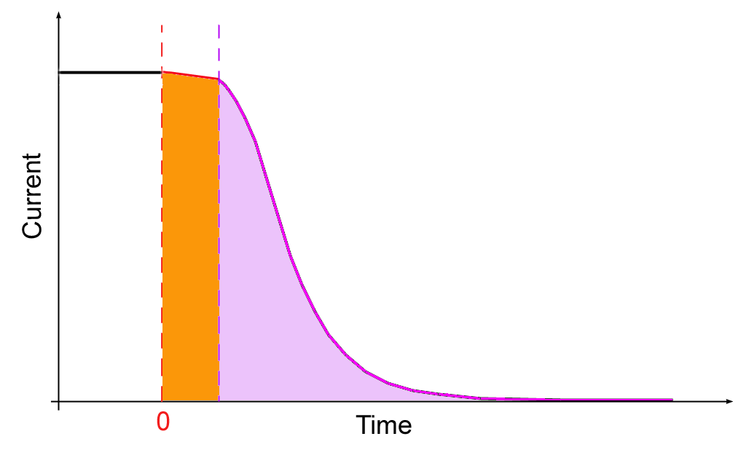

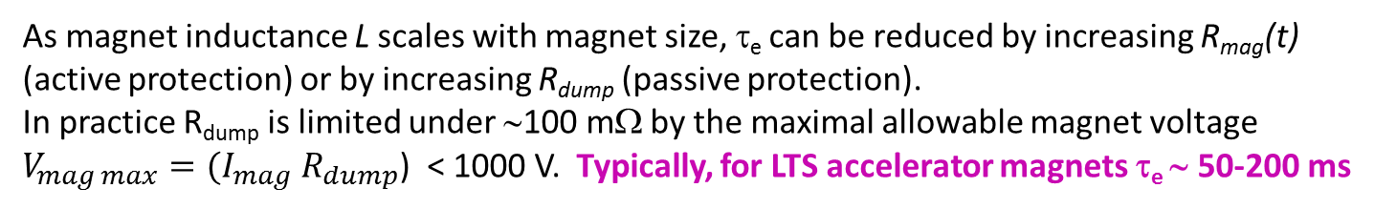
Current decay and energy extraction
Detection time t_{d} depends upon sensitivity and thresholds of QDS. “Validation time” t_{v} is typically defined by the hardware. Typically, for LTS accelerator magnets (t_{d}+t_{v} ) ∼ 7-15 ms
t_{d}+t_{v}
Quench detection and validation
I_{mag}
Characteristic extraction time τ_{e} depends upon magnet inductance and the sum of magnet and resistance and dump resistance:
τ_{e}
Energy extraction
$${I\left(t\right)=I_{0}e^{−t/{τ_{e}}}=I_{0}^{}e}^{\frac{− t(R_{mag}\left(t\right)+R_{dump})}{L}}$$
As magnet inductance L scales with magnet size, τ_{e} can be reduced by increasing R_{mag}(t) (active protection) or by increasing R_{dump} (passive protection).
In practice R_{dump} is limited under ∼100 mΩ by the maximal allowable magnet voltage $V_{mag max}=(I_{mag} R_{dump}$) < 1000 V. Typically, for LTS accelerator magnets τ_{e} ∼ 50-200 ms

Slide 9




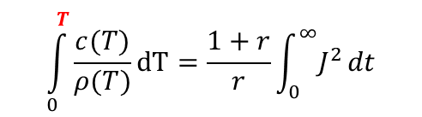

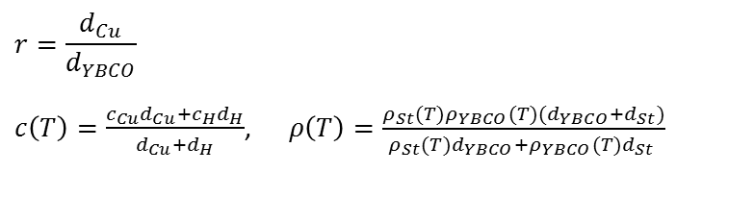



Hot spot temperature and time margin
Hot spot
$$\int_{0}^{T}{\frac{c(T)}{ρ(T)}}dT=\frac{1+r}{r}\int_{0}^{∞}{J^{2}}dt$$
- adiabatic approximation
N.M. Wilson, “Superconducting Magnets”, Plenum Press, 1983.
d = 0.8 mm
w = 4 mm
r = 1.2
Cu
$$d_{YBCO}=1.3 μm$$
YBCO
$d_{Cu}$= 40 $μm$
Nb₃Sn
Hastelloy
$$d_{H}=50 μm$$
Cu
$$T_{c}\left(15 T\right)=65 K$$
w
RRR_{Cu} = 25
$E_{0}=$ 1 $μ$V/cm
$$r=\frac{V_{Cu}}{V_{NbTi}}$$
$$c\left(T\right)=\frac{c_{Cu}{(T)V}_{Cu}+c_{NbTi}{(T)V}_{NbTi}}{V_{Cu}+V_{NbTi}}$$
$ρ\left(T\right)=ρ_{Cu}(T)\frac{V_{Cu}+V_{NbTi}}{V_{Cu}}$ ( > T_{cs})
$$ρ_{St}\left(T\right)=\frac{ρ_{Cu}(T)ρ_{H}(T)(d_{H}+d_{Cu})}{{ρ_{Cu}(T)d}_{H}+ρ_{H}(T)d_{Cu} }$$
$$r=\frac{d_{Cu}}{d_{YBCO}}$$
$c\left(T\right)=\frac{c_{Cu}d_{Cu}+c_{H}d_{H}}{d_{Cu}+d_{H}}$, $ρ\left(T\right)=\frac{ρ_{St}(T)ρ_{YBCO}(T)(d_{YBCO}+d_{St})}{{ρ_{St}(T)d}_{YBCO}+ρ_{YBCO}(T)d_{St} }$
$$n=30$$
*
${\text{where}\text{: }ρ}_{YBCO}\left(T\right)=\frac{E_{0}{wd}_{YBCO}}{I_{c}(T)}E_{0}{\left(\frac{I}{I_{c}(T)}\right)}^{n−1}$, and $I_{c}\left(T\right)=I_{c0}\left(1−{\left(\frac{T}{T_{c}}\right)}^{1.7}\right)$
*
A.A.R. Fernades et al., Appl. Phys. Lett 61, 3181 (1992)
At quench at T_{cs}=T_{c}(B) all current switches into the stabilizer
Current is shared between superconductor and stabilizer (in parallel) across the entire temperature range

Slide 10
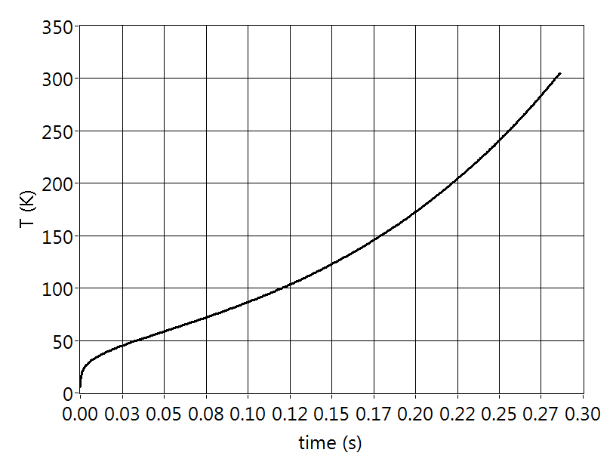
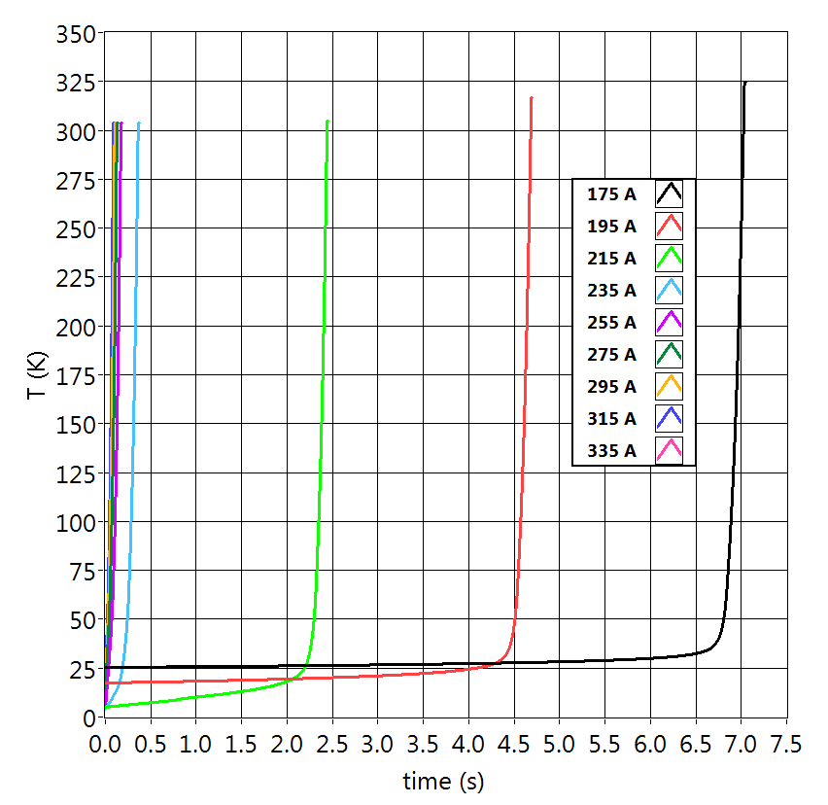
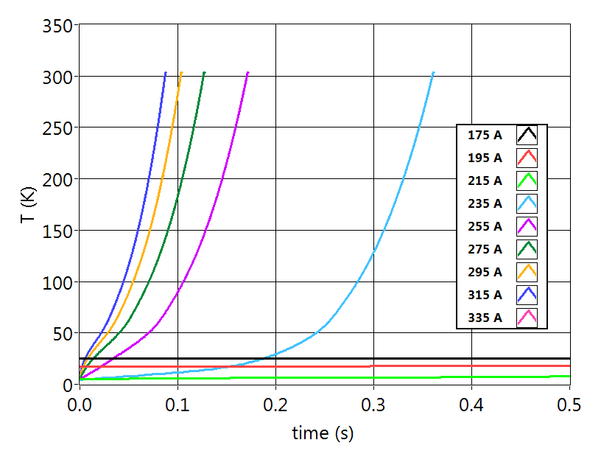
Simulation 1: over-heating
Let us assume that:
Both conductors have same J_{e}=600 A/mm² at 4.2 K, 15T
Both are operated at I_{0.8} = 0.8 I_{c}(4.2 K, 15 T)
The initial hotspot temperature T_{x} is such that
I_{c}(T_{x}) = I_{0.8} resulting in:
I_{0.8} = 241 A
I_{c}(4.2 K, 15 T) = 301 A
Nb₃Sn
T_{x} = 5.63 K for Nb₃Sn => T margin is ∼ 1.4 K
T_{x}= 25.2 K for REBCO => T margin is ∼ 21 K
I_{0.8} = 175 A
I_{c}(4.2 K, 15 T) = 218 A
safety margin
REBCO
I_{0.8} = 175 A
I_{c}(4.2 K, 15 T) = 218 A
Pre-quench
delay is a strong function of I/I_{c}
With minimal cooling, HTS coil can exhibit a stable hotpot!
107.8% of Ic₀
116.9% of Ic₀
Slow temperature rise is followed by a quick runaway

Slide 11
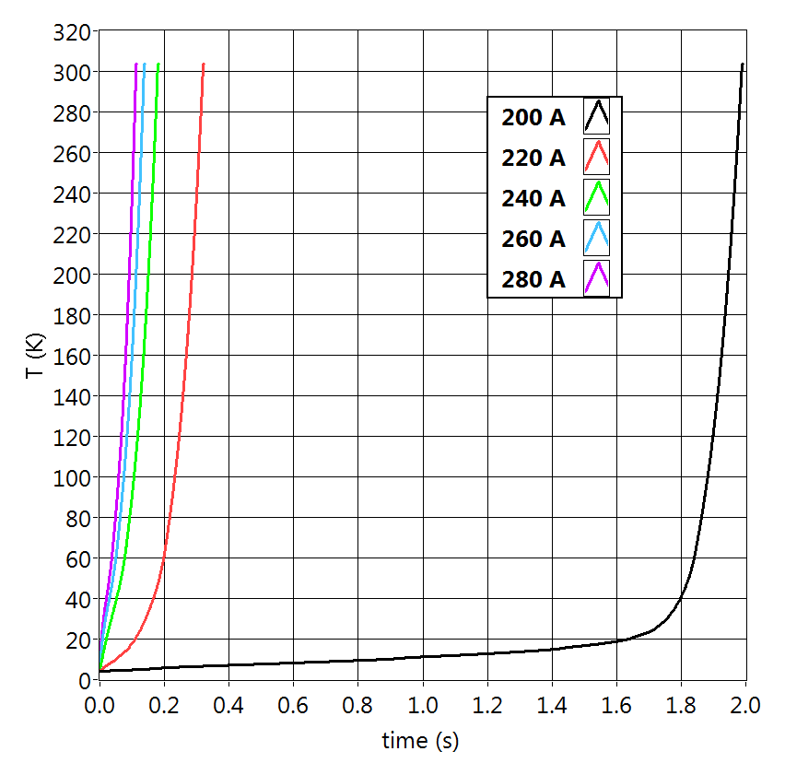
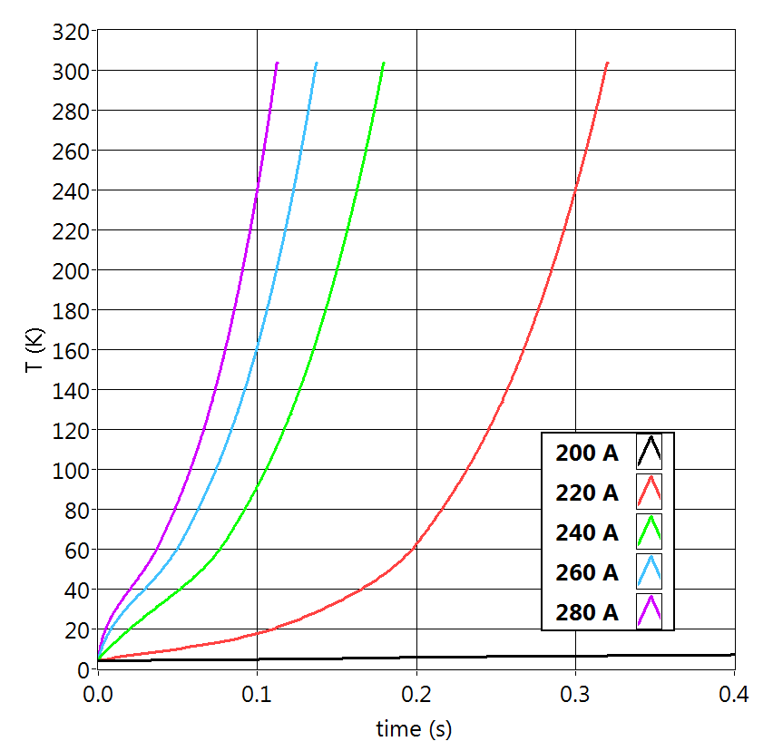
Simulation 2: over-critical current
I_{c}(4.2 K, 15 T) = 200 A
I_{c}(4.2 K, 15 T) = 200 A
REBCO
ΔT=250 K
ΔI/I_{c} = 0.1
Temperature rise is very sensitive to the over-critical current magnitude.
10% difference in current may lead to as much as 250 K temperature variation!
Same result holds if I_{c} is varied while transport current is kept constant => localized hot spots will form at the limiting points in the conductor, even if ΔI/I_{c} variations are just 5-10%...

Slide 12
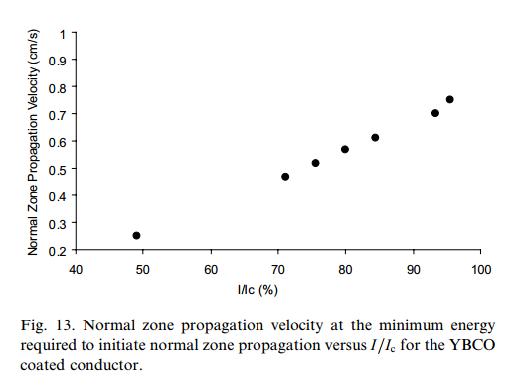
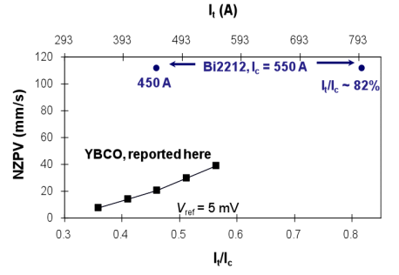
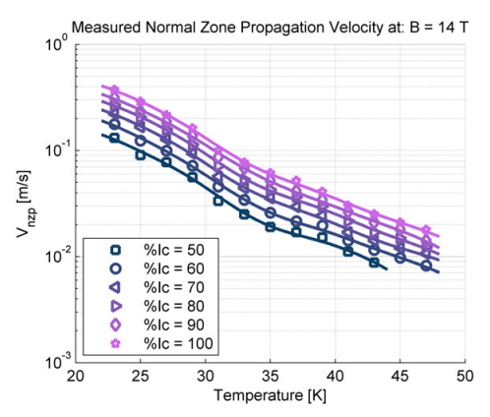
Quench propagation studies
F. Trillaud et al., “Normal zone propagation experiments on HTS composite conductors”, Cryogenics 43 271–279, (2003)
H. H. Song and J. Schwartz, "Stability and Quench Behavior of YBa2Cu3O7-x Coated Conductor at 4.2 K, Self-Field," IEEE Trans. Appl. Supercond., 19, pp. 3735-3743, (2009).
J. van Nugteren, “Normal Zone Propagation in a YBCO Superconducting Tape” MSc Thesis, Univ. of Twente, 2012

Slide 13
Quench propagation: LTS vs HTS
Transverse propagation
LTS
Hot spot
Resistance develops mainly due to quench propagation: normal zone grows in size
Longitudinal propagation
10-40 m/s
HTS
Transverse propagation?
Resistance develops mainly due to heating of a hot spot: normal zone heats up
Longitudinal propagation
1-10 cm/s
NZPV is 2-3 orders of magnitude lower in HTS compared to LTS (even in high fields!). Isolated hot spots may be generated around various local conductor defects

Slide 14
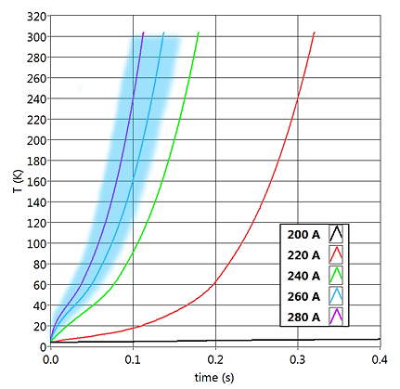

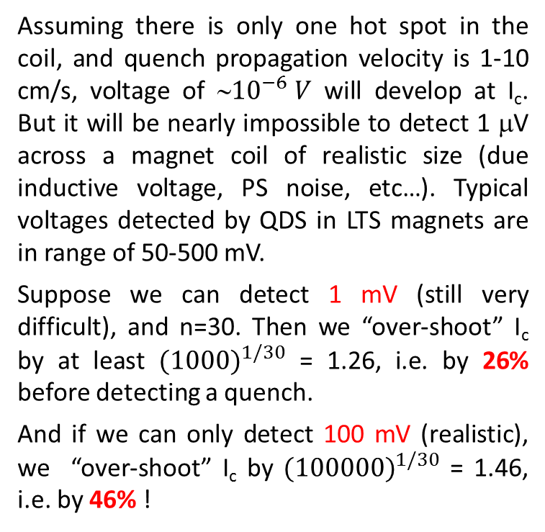
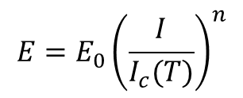
Do we have enough sensitivity to detect a quench?
I_{c}(4.2 K, 15 T) = 200 A
Assuming there is only one hot spot in the coil, and quench propagation velocity is 1-10 cm/s, voltage of ∼${10}^{−6} V$ will develop at I_{c}. But it will be nearly impossible to detect 1 μV across a magnet coil of realistic size (due inductive voltage, PS noise, etc…). Typical voltages detected by QDS in LTS magnets are in range of 50-500 mV.
Suppose we can detect 1 mV (still very difficult), and n=30. Then we “over-shoot” I_{c} by at least $({1000)}^{1/30}$ = 1.26, i.e. by 26% before detecting a quench.
And if we can only detect 100 mV (realistic), we “over-shoot” I_{c} by $({100000)}^{1/30}$ = 1.46, i.e. by 46% !
$$E=E_{0}{\left(\frac{I}{I_{c}(T)}\right)}^{n}$$
This leaves a very narrow time margin of ∼100 ms.
A limiting factor for building large HTS magnets…
$E_{0}$=${10}^{−6} V/cm$
Detection is a key to protection!

Slide 15
So, what can be done?
Modify the conductor:
Increase amount / conductivity of the stabilizer
Improve heat transfer
Increase interfacial resistance
Alternative detection techniques:
- optical (interferometric, Rayleigh scattering, FBG)
- acoustic (passive and active)
New / improved protection techniques:
Passive protection: use non-insulated conductor
Active protection
- heaters to create a larger normal zone
- coupling loss-induced bulk heating (CLIQ)
- ac loss (hysteretic + eddy current) heating

Slide 16
Conductor modification

Slide 17
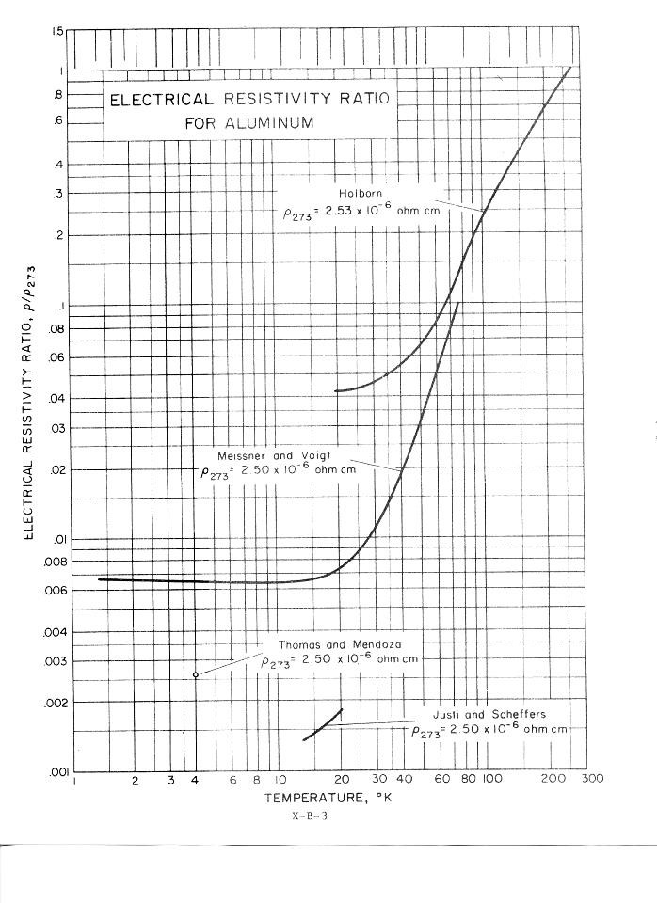
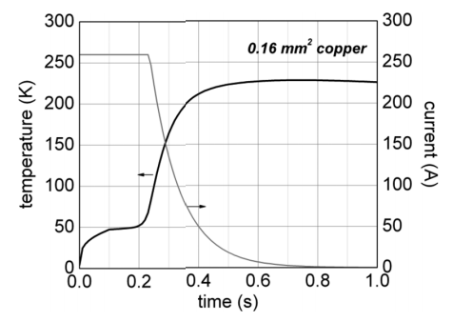
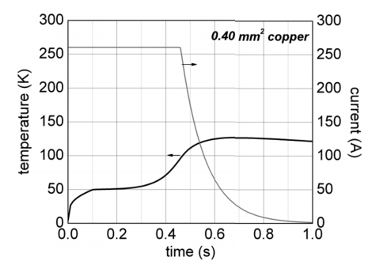
Adding thicker (or different) stabilizer
Increased thickness of the stabilizer helps to reduce quench temperature…
Alternative approach: use a stabilizer material with higher RRR.
D. Uglietti and C. Marinucci, “Design of a Quench Protection System for a Coated Conductor Insert Coil”, IEEE Trans. Appl. Supercond., 22, 4702704 (2012)
High-purity Al can reach RRR of > 1000
3 mm of 99.999% Al is equivalent by resistivity to 40 mm of electroplated Cu at T<20 K
RRR∼700
…but also reduces J_{e}
If anodized, Al can also provide an efficient electrical insulation of the conductor.
J. H. Bae et al., Thermal Characteristics of 2G HTS Tape With Anodized Aluminum Stabilizer for Cryogen-Free 2G HTS Magnet”, IEEE Trans. Appl. Supercond.,25, 6605704 (2015)
Evolution of YBCO tape temperature and current during the entire quench. Current dump started when the voltage drop reached 100 mV

Slide 18
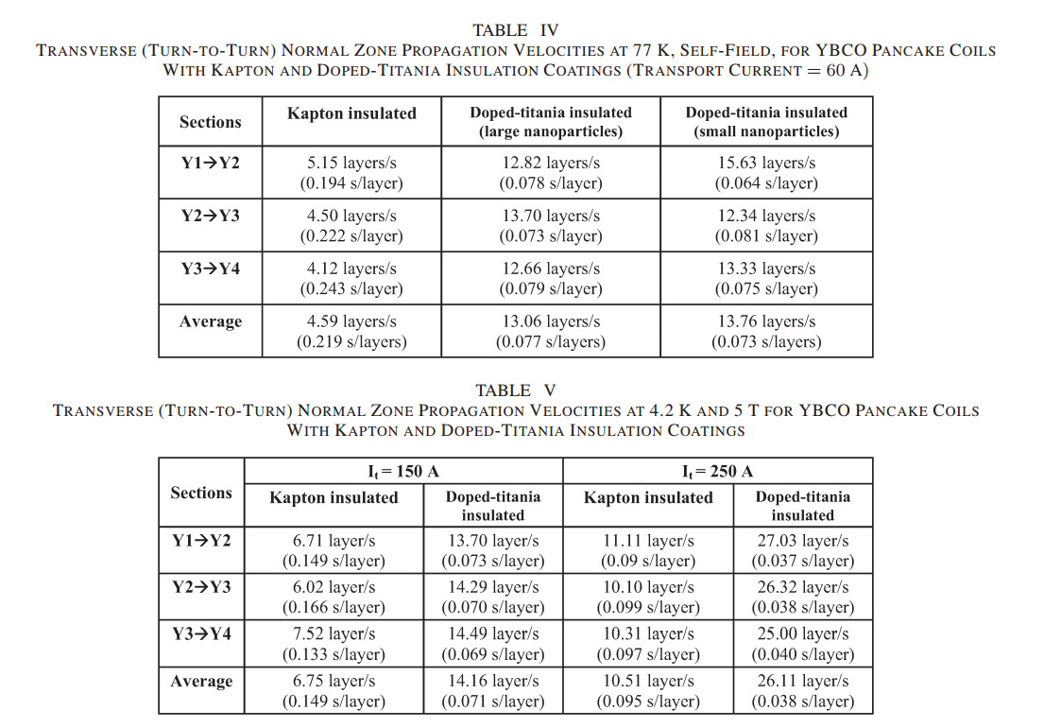
Improving heat transfer
Coating the conductor with a high thermal diffusivity compound
S. Ishmael et al., “Enhanced Quench Propagation in Bi₂Sr₂CaCu₂Ox and YBa₂Cu₃O_{7−x} Coils via a Nanoscale Doped-Titania-Based Thermally Conducting Electrical Insulator”, IEEE Trans Appl. Supercond. 23, 7201311, (2013)
Pro: somewhat improved NZPV (several times). Can actually induce inter-layer propagation within the acceptable time margin
Con: may be still insufficient for convention style quench protection relying on normal zone propagation

Slide 19
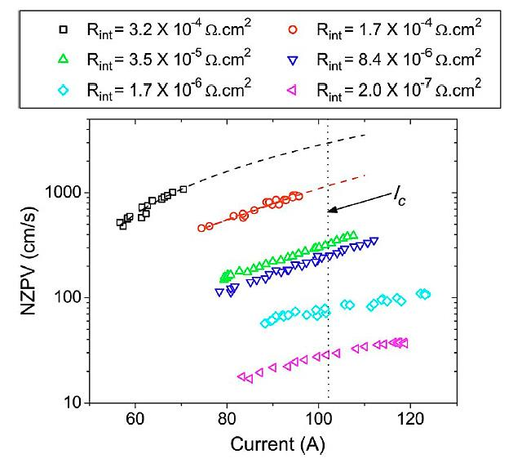
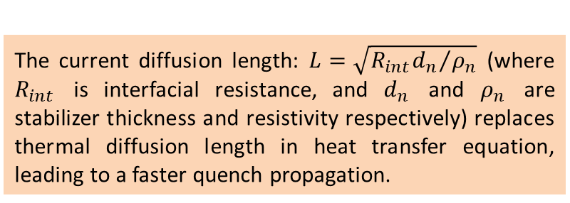
Interfacial resistance
Increase interfacial resistance between superconductor and stabilizer (G.A. Levin et al., ”The effects of superconductor–stabilizer interfacial resistance on the quench of a current-carrying coated conductor”, Supercond. Sci. Technol. 23 014021, (2010))
“What is the advantage of having coated conductor with high stability margins?... Reduction of the stability margins in coated conductors accompanied by increasing NZP speed increases their value from the applications point of view…”
The current diffusion length: $L=\sqrt{{R_{int}d_{n}}/{ρ_{n}}}$(where $R_{int}$ is interfacial resistance, and $d_{n}$ and $ρ_{n}$ are stabilizer thickness and resistivity respectively) replaces thermal diffusion length in heat transfer equation, leading to a faster quench propagation.
C. Lacroix et al., “Normal Zone Propagation Velocity in 2G HTS Coated Conductor With High Interfacial Resistance”, IEEE trans. Appl. Supercond., 23, 4701605 (2013)
Pro: quench propagates at velocities comparable to those of LTS => all conventional quench protection schemes can be applied
Con: reduces stability. This may in fact be OK… provided superconductor layer is fairly uniform
Needs further studies!

Slide 20
New detection techniques

Slide 21
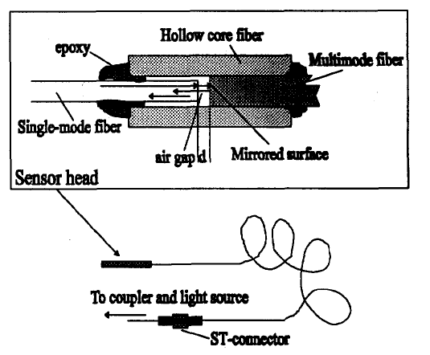
Optical techniques
Optical sensing: based on detecting local stresses generated by a hot spot
Fiber-optic interferometer
J.M. van Oort, R.M. Scanlan and H.H.J ten Kate., “A Fiber-optic Strain Measurement and Quench Localization System for Use in Superconducting Accelerator Dipole Magnets”, IEEE Trans. Appl. Supercond. 5, 882 (1995)
The sensitivity of the fiber optic sensors for absolute readout is in the order of 50-100 nm, which yields a strain resolution of the order of 10x10⁻⁶ in the longitudinal and radial direction. The pressure resolution in the transverse direction is in the order of 5 MPa.
W.K. Chan, G. Flanagan and J. Schwartz, “Spatial and temporal resolution requirements for quench detection in (RE)Ba₂Cu₃O_{x} magnets using Rayleigh-scattering-based fiber optic distributed sensing”, Supercond. Sci. Technol. 26 105015 (2013).
Rayleigh scattering
Fiber Bragg gratings (FBG)
F. Hunte et al., “Fiber Bragg optical sensors for YBCO applications”, Proceedings of PAC09, Vancouver, BC, Canada
Pro: immune to EM interference. High sensitivity. Proven to work on small coils.
Con: requires co-winding optical fiber with the conductor + an increasingly powerful data processing for detecting quenches in long coils. Detection time is ∼1s.

Slide 22
Passive acoustic sensing
Acoustic emissions (AE) in magnets appear due to epoxy cracking, delamination, slippages, or rapid heating of the normal zone volume (quench). When quench is triggered by a conductor motion (LTS), AE is always a precursor.
O. Tsukamoto, J.F. Maguire, E.S. Bobrov, and Y. Iwasa, Identification of quench origins in a superconductor with acoustic emission and voltage measurements", Appl. Phys. Lett. 39, 172 (1981)
O. Tsukamoto and Y. Iwasa, “Sources of acoustic emission in superconducting magnets”, J. Appl. Phys. 54, 997 (1983).
“Acoustic emission triangulation of disturbances and quenches in a superconductor and a superconducting magnet”, Appl. Phys. Lett. 40, 538 (1992)
Y. Iwasa, “Mechanical Disturbances in Superconducting Magnets-A Review”, IEEE Trans on Magn., 28 113 (1992)
H. Lee et al., “Detection of ‘Hot Spots’ in HTS Coils and Test Samples With Acoustic Emission Signals”, IEEE Trans. Appl. Supercond. 14, 1298 (2004)
M. Marchevsky, G. Sabbi, H. Bajas, S. Gourlay, “Acoustic emission during quench training of superconducting accelerator magnets”, Cryogenics 69, 550-57, (2015)
But is there a criterion that would allows differentiating AE of quenches from other events?
Yes, we believe such criterion exists.

Slide 23
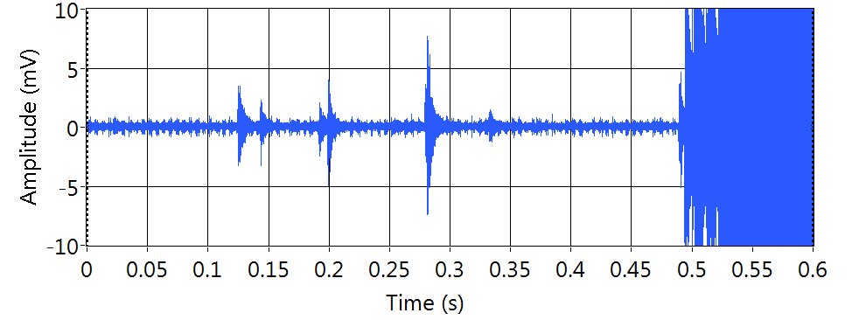
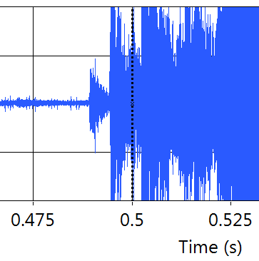
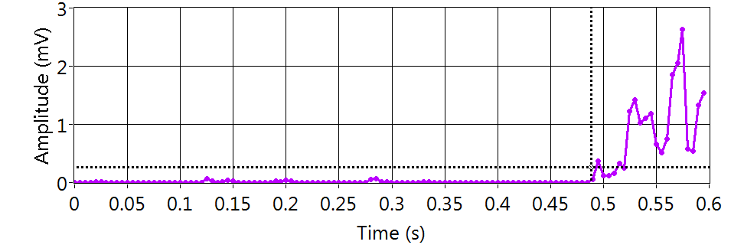
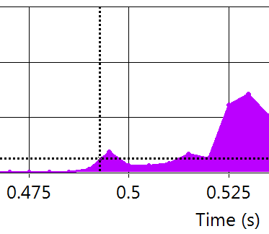
Example of passive AE quench detection
Quench in CCT2, a NbTi magnet
Quench
QDC trigger
Raw acoustic signal
AE events
Processed acoustic signal
Work in progress…
AE quench trigger

Slide 24
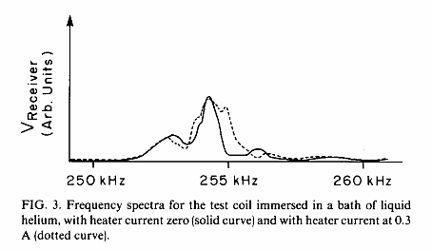
Active (heat-specific) acoustic detection
Monitoring changes in acoustic transfer function and structural resonances due to a local heating within the windings
O. Tsukamoto and Y. Iwasa, “Correlation of acoustic emission with normal zone occurrence in epoxy impregnated windings: An application of acoustic emission diagnostic technique to pulse superconducting magnets”, Appl. Phys. Lett. 44, 922-924 (1984)
T. Ishigohka et al., “Method to detect a temperature rise in superconducting coils with piezoelectric sensors”, Appl. Phys. Lett. 43 (3), pp. 317-318 (1983)
A. Ninomiya et al., “Quench detection of superconducting magnets using ultrasonic wave”, IEEE Trans. Magn. 25, v2 pp 1520-1523 (1989)
T. Ishigohka et al., “Method to detect a temperature rise in superconducting coils with piezoelectric sensors”, Appl. Phys. Lett.43, 317 (1983)
A. Ninomiya et al., “Monitoring of a superconducting magnet using an ultrasonic technique”, Fusion Eng. Design 20, 305-309, (1993)
To be usable for quench detection, these techniques require mechanical modeling of the coil eigenfrequencies and transfer function that are experimentally validated prior to actual QD.

Slide 25
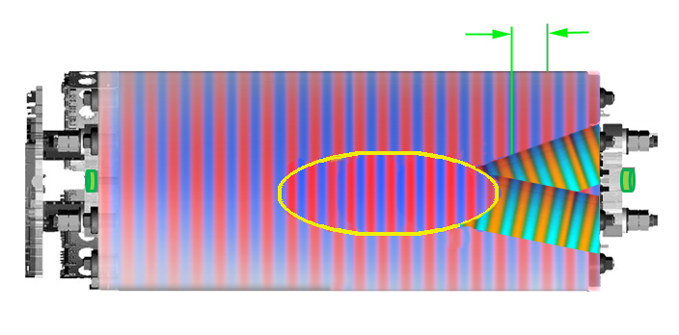
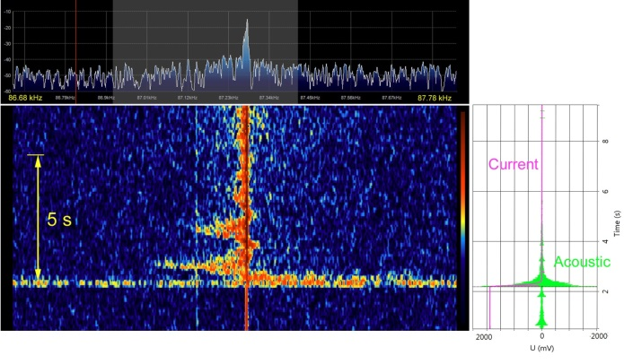
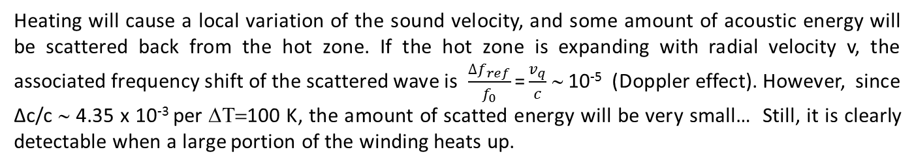



Acoustic detection of a propagating hot zone using “Doppler” effect
MM, “Active ultrasonic quench diagnostics for the superconducting magnets”, ASC 2014
Phase shift
$$\frac{dθ}{dt}\sim v_{q}$$
US Emitter
US wave propagation
c
c-Δc
time
f₀
$$v_{q}$$
Sensor
“Hot” zone
f₀,
(f₀ ±${ ∆f}_{ref})$
Heating will cause a local variation of the sound velocity, and some amount of acoustic energy will be scattered back from the hot zone. If the hot zone is expanding with radial velocity v, the associated frequency shift of the scattered wave is $\frac{{∆f}_{ref}}{f_{0}}\text{=}\frac{v_{q}}{c}$ ∼ 10⁻⁵ (Doppler effect). However, since Δc/c ∼ 4.35 x 10⁻³ per ΔΤ=100 K, the amount of scatted energy will be very small… Still, it is clearly detectable when a large portion of the winding heats up.

Slide 26
Protection methods

Slide 27
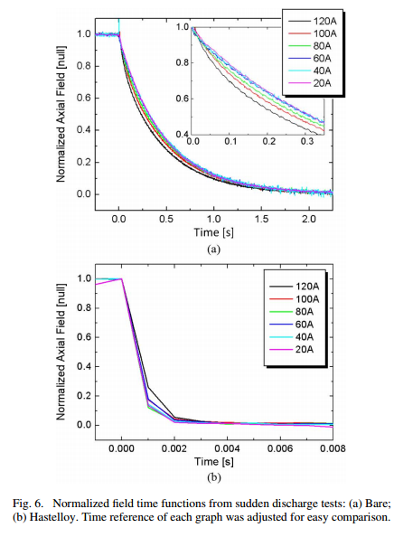
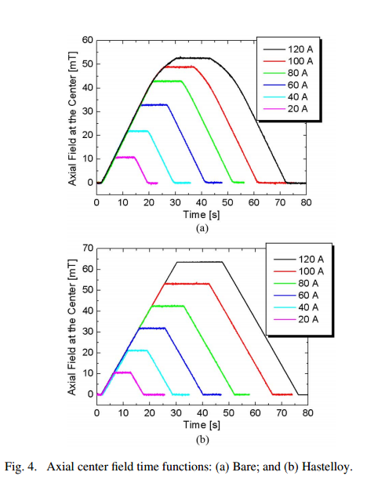
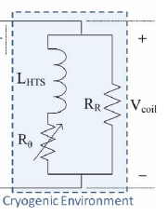
Passive protection: non-insulated coils
Non-insulated coils can be a viable option for protection:
The NI coil was shown to carry 2.7 I_{c} without burning
Fast current decay for over-critical currents
S. Hanh et al., “HTS pancake coil without turn-to-turn insulation”, IEEE Trans Appl. Supercond., 21 1592 (2011)

Slide 28
Active protection: surface heaters
heating stations
Heat diffusion
Insulation
conductor
Duet to a very low NZVP in HTS, one can not rely on quench propagation between heating stations (unless they are just a few cm apart)
Continuous heater coverage is possible (and was demonstrated for small coils). But covering the entire conductor length is not very practical (unless maybe it is co-wound with the conductor, which will reduce J_{e}).
P.D. Noyes et al, “Protection heater development for REBCO coils”, IEEE Trans. Appl. Supercond. 22 4704204, (2012)

Slide 29
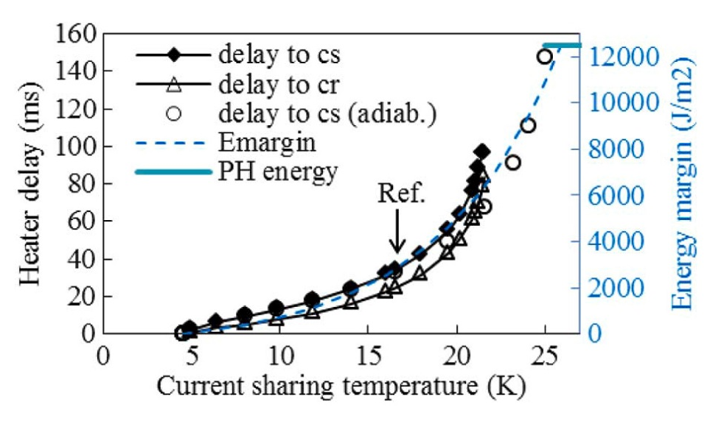
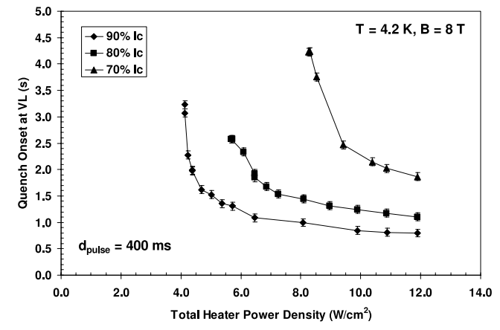
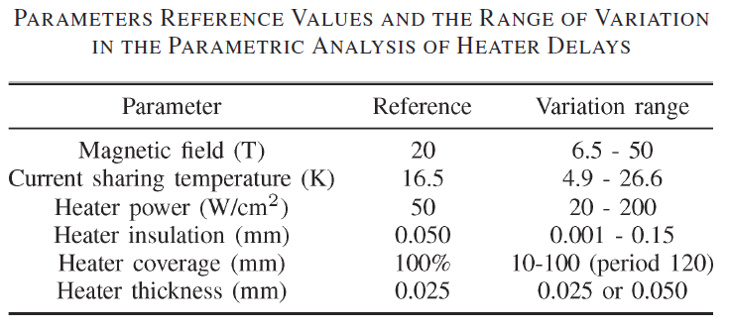
Heater delay vs current and temperature margin
T. Salmi et al., “Modeling Quench Protection Heater Delays in an HTS Coil”, IEEE Trans. Appl, Supercond. 25, 0500205 (2015)
U. P. Trociewitz et al., “Quench studies on a layer-wound Bi₂Sr₂CaCu₂O_{x}/Ag_{X} coil at 4.2 K”, Supercond. Sci. Technol. 21 025015, (2008)
Coil can be quenched with low heater power, but the delay times are long…
T. Salmi and A. Stenvall, “Modeling Quench Protection Heater Delays in an HTS Coil, IEEE Trans. Appl, Supercond., 25, 0500205, (2014)
Heater delay increases with quench margin. Use of heaters becomes increasingly problematic at low (< 15 T) fields.

Slide 30
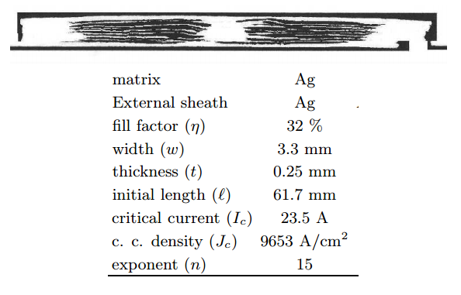
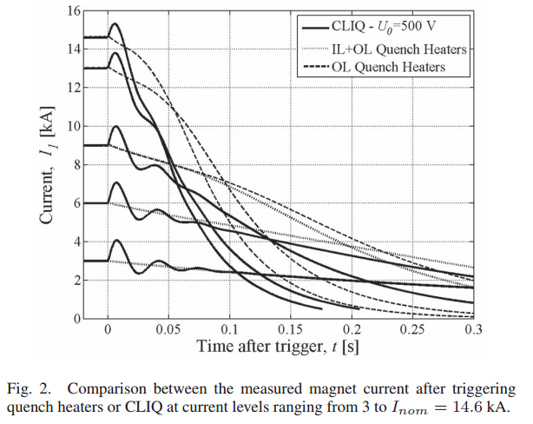
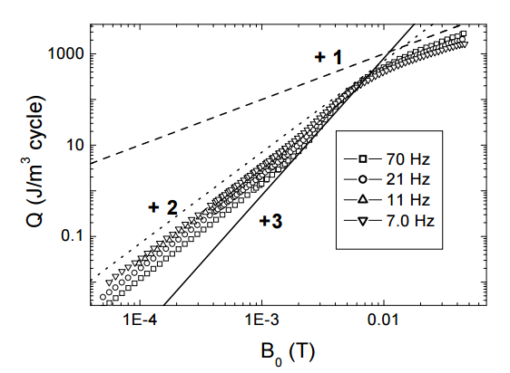
Active protection: bulk heating using coupling losses (CLIQ)
Coupling loss induced quenching (CLIQ) heats up the conductor in the bulk, and therefore is superior to the surface heating technique. It has been very successful in application to LARP magnets, and is to be used for protection of the future MQXF quadrupole at LHC
Coupling losses in a BSCCO tape conductor.
E. Ravaioli et al., “Protecting a Full-Scale Nb₃Sn magnet with CLIQ, the New Coupling-loss Induced Quench System, IEEE Trans. Appl. Supercond., 25, 4001305 (2015)
Are coupling losses in round or striated HTS conductors sufficient to realize CLIQ given the large temperature margin?
Time margin?
Optimization in frequency and amplitude?
D Zola, “A study of coupling loss on bi-columnar BSCCO/Ag tapes through ac susceptibility measurements”, Supercond. Sci. Technol., 17, 501 (2004).
E. Ravaioli (next talk)

Slide 31
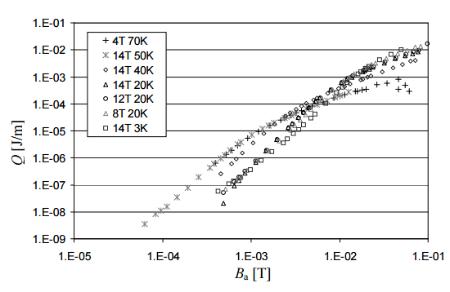
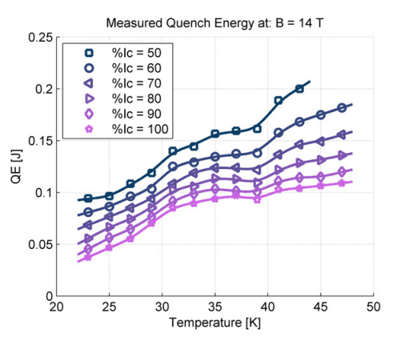
AC loss in REBCO tape and protection?
AC field normal to the tape surface:
]
E. Seiler and L. Frolek , “AC loss of the YBCO coated conductor in high magnetic fields”, Journal of Physics: Conference Series 97 , 012028, (2008)
AC losses per meter of the coated conductor (per cycle) in dependence on the AC magnetic field amplitude B_{a} measured at different temperatures and superimposed DC magnetic fields.
Assuming protection operates at ∼ 100 Hz, ac loss heating is about 1 W/m, or ∼2.5 W/cm³ when re-calculated with tape dimensions.
In the same range as typical MQEs!
J. van Nugteren, “Normal Zone Propagation in a YBCO Superconducting Tape” MSc Thesis, Univ. of Twente, 2012

Slide 32
Detection + protection using split conductor

Slide 33
Split conductor for detection…
Quench detection using split wire or otherwise two conductors following same geometrical path and electrically separated from each other except at the ends.
current leads
I
p1
I₁
p2
I₂
Pro:
Sensitivity is in 10⁻¹² Ohm range for superconducting end joints, and ∼10⁻⁸-10⁻⁹ Ohm for non-superconducting joints - way superior to voltage detection!
The technique can sense heating at I<<I_{c} (!) - through increased flux creep rate in the conductor leading to a change in the current balance
Fast and applicable to long magnets, as inductance of the coil is (almost) cancelled out
“bridge” area
field sensor
field sensor
p1
p2
B_{m}= 0
B
I₁
=
I₂
I₁+I₂ < I_{c}
p1
p2
B_{m}= 0
Con:
Field sensors must be placed well away from the magnet bore
Imbalance due to ac losses (ramp-rate dependent) is possible
B
/
I₁-DI
<
I₂+DI
M. Marchevsky et al. “Quench detection method for 2G HTS wire”, Supercond. Sci. Technol. 23 034016 (2010)

Slide 34
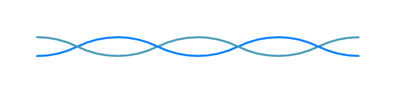
…quench location sensor…
SC wire bridge
I
current
monitor 1
SC wire loop (continuous, no joint)
0
heater 2
L
x
heater 1
hot spot
twisted pair of non-insulated
stabilized SC wires
current
monitor 2
non-SC joint
superconductor (NbTi or Nb₃Sn)
No low-level voltage measurements are necessary
Inter-core resistance is measured through a current balance against a fixed resistance formed by the two normal joints connecting a superconducting wire bridge. Length of the joints is tuned to provide for a resistance of ∼10x-30x of the core-to core resistance of the twisted pair from end to end.
r2
Sn-Ag-Cu solder
stabilizer (Cu-Ni)
M. Marchevsky et al. “Linear quench localization sensor”, to be published.

Slide 35
…and protection
Same conductor configuration was proposed for magnet protection!
Upon detecting a quench, a current pulse (in excess of I_{c}) is applied to the central taps connected to the branches of a split conductor.
I_{pulse}
I
p1
I₁
p2
I₂
T. Wakuda et al. “A Novel Quench Protection technique for HTS Coils”, IEEE Trans. Appl. Supercond. 22, 4703404 (2012)
½ length
Inductance in cancelled out along the conductor path => applicable to long magnets
The principle can be realized in various configurations, such as:
REBCO ROEBEL cable with half of its strands electrically insulated from another half
Two electrically insulated tape stacks
Pair of insulated and twisted multi-filamentary Bi 2212 wires
Compensated inductance enables use of high-frequency currents for coil protection.
This can potentially enable novel protection mechanisms (“ac shaking”, eddy currents, etc…) that are presently incompatible with long magnets due to their inductive impedance.

Slide 36
Thank you!

