Slide 1
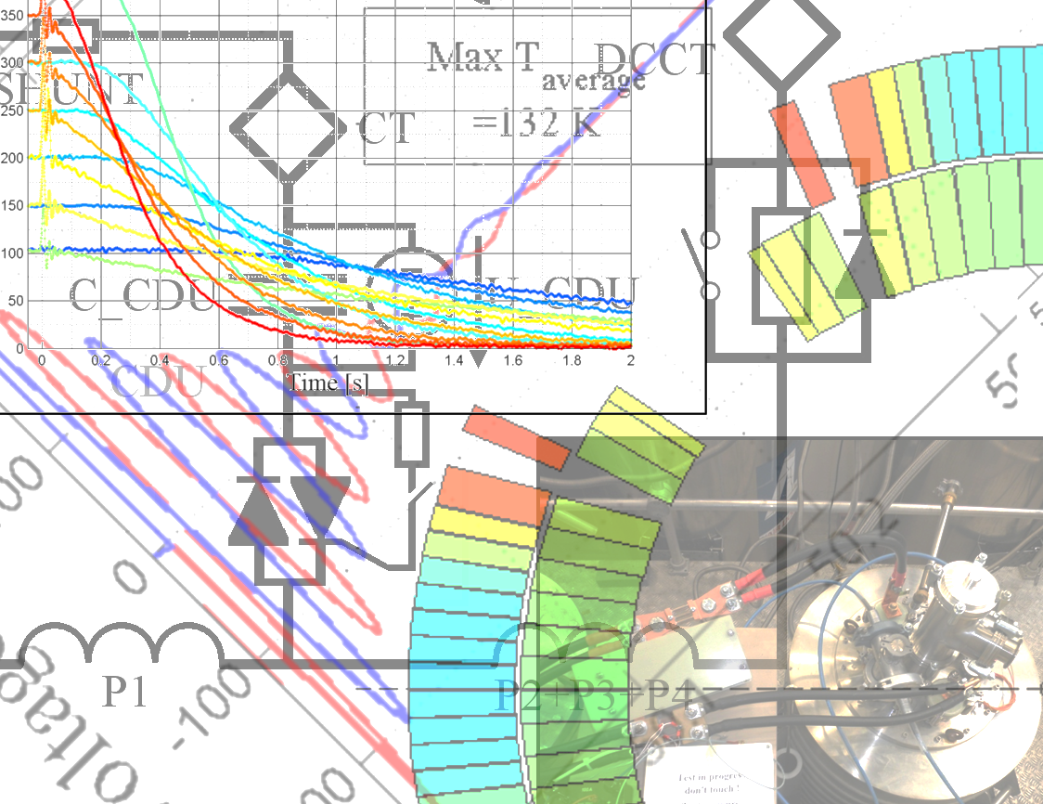


Optimisation of
CLIQ for HTS
11 September 2015
Emmanuele Ravaioli (CERN, University of Twente)
Jeroen Van Nugteren (CERN, University of Twente)
Thanks to H.H.J. ten Kate, G. Kirby and A.P. Verweij

Slide 2

Before we begin..
I am not an expert of HTS!
What is CLIQ
AC loss in HTS
CLIQ optimization (valid for any magnet)
Possible
game changers
First study case of CLIQ on HTS
(Ravaioli &
Van Nugteren)
CLIQ with external excitation coils
Emmanuele Ravaioli, Jeroen Van Nugteren Optimisation of CLIQ fot HTS WAMHTS-3 – 11 September 2015

Slide 3
HTS – Challenges for effective quench protection
Very low normal-zone propagation velocity (~cm/s): bad for detection, bad for protection
Very high margin to quench (~J/cm^3):
good for stability, bad for protection
Slower quench detection
Faster rise of the hot-spot temperature
Less homogeneous transition to the normal state: Thermal stress (?), Less uniform coil-to-ground voltages
Emmanuele Ravaioli, Jeroen Van Nugteren Optimisation of CLIQ fot HTS WAMHTS-3 – 11 September 2015

Slide 4
What is CLIQ
What is CLIQ
AC loss in HTS
CLIQ optimization (valid for any magnet)
Possible
game changers
First study case of CLIQ on HTS
(Ravaioli &
Van Nugteren)
CLIQ with external excitation coils
Emmanuele Ravaioli, Jeroen Van Nugteren Optimisation of CLIQ fot HTS WAMHTS-3 – 11 September 2015

Slide 5
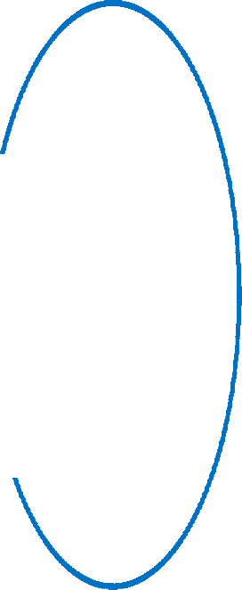
Current change
Patent EP13174323.9
CLIQ – Coupling-Loss Induced Quench system
Magnetic field change
Transitory losses (Heat)
Temperature rise
QUENCH
Emmanuele Ravaioli, Jeroen Van Nugteren Optimisation of CLIQ fot HTS WAMHTS-3 – 11 September 2015

Slide 6
What CLIQ offers…
A different mechanism for depositing heat in superconductors with respect to QH
(in multi-filamentary LTS strands, this mechanism is very effective)
An electrically robust system, mainly external to the coil, hardly interfering with the coil winding technology
…and what it requires
Study of complex interdependent electro-magnetic and thermal effects, on very different scales (filaments, strands, tapes, cables, main circuit)
Additional terminals connected to the coil to protect
…and “fast” transitory losses!! (i.e. with small time constant)
Emmanuele Ravaioli, Jeroen Van Nugteren Optimisation of CLIQ fot HTS WAMHTS-3 – 11 September 2015

Slide 7
AC loss in HTS
What is CLIQ
AC loss in HTS
CLIQ optimization (valid for any magnet)
Possible
game changers
First study case of CLIQ on HTS
(Ravaioli &
Van Nugteren)
CLIQ with external excitation coils
Emmanuele Ravaioli, Jeroen Van Nugteren Optimisation of CLIQ fot HTS WAMHTS-3 – 11 September 2015

Slide 8
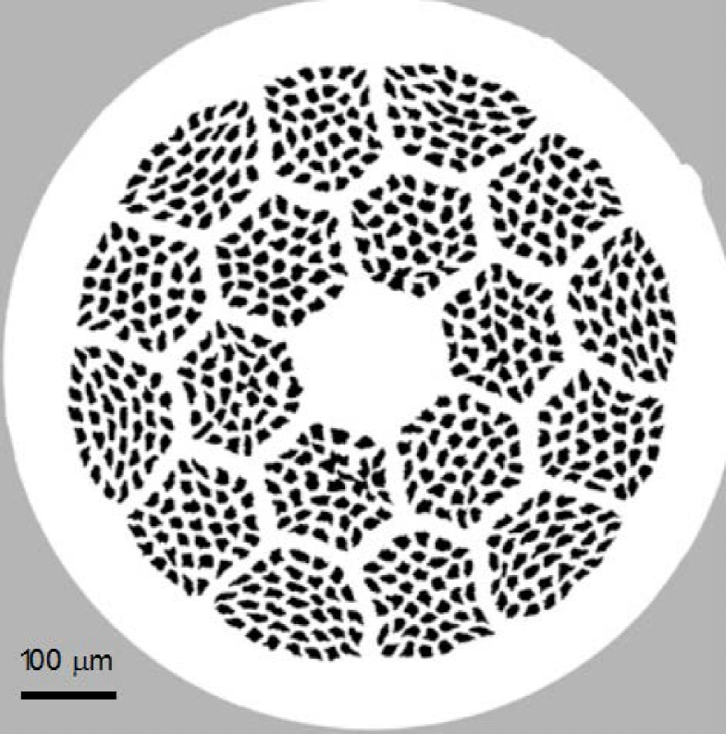
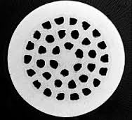
HTS strands/tapes
YBCO tape
MgB₂ strand (Cu matrix)
B-2212 strand (Ag matrix)
Figures and information from Luisa Chiesa’s plenary talk at ASC 2014
Emmanuele Ravaioli, Jeroen Van Nugteren Optimisation of CLIQ fot HTS WAMHTS-3 – 11 September 2015

Slide 9
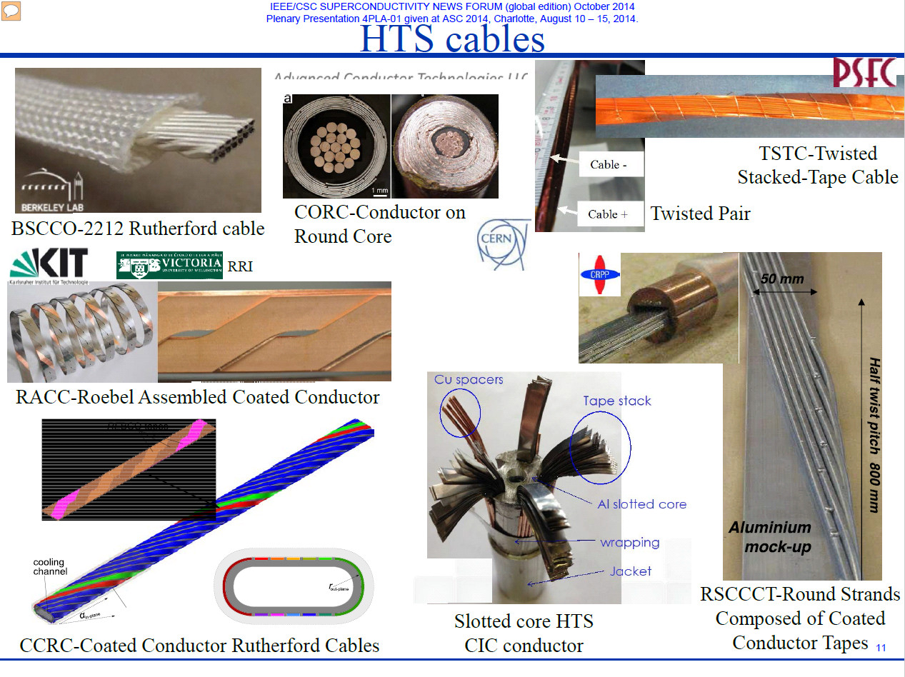
HTS cables (Slide from Luisa Chiesa’s talk at ASC2014)
Emmanuele Ravaioli, Jeroen Van Nugteren Optimisation of CLIQ fot HTS WAMHTS-3 – 11 September 2015

Slide 10
Transitory losses in HTS conductors
The target of a CLIQ-based protection system is generating enough transitory losses to transfer most of the coil to normal state in 10-20 ms
Hence, “fast” losses are needed
Inter-filament coupling loss: Usually features an ideal time constant for heating up the superconductor very effectively with a CLIQ discharge
…but not present in tapes, by definition! (if not striated)
Inter-strand or inter-tape coupling losses: Whilst often higher in amplitude, they are typically too slow for heating up the coil in <20 ms
Too slow
Hysteresis losses (intentionally unspecific term here):
No time constant involved, potential for effective mechanism, but the amplitude of the oscillating field must be high
To measure and/or model on a case-by-case basis
Emmanuele Ravaioli, Jeroen Van Nugteren Optimisation of CLIQ fot HTS WAMHTS-3 – 11 September 2015

Slide 11
CLIQ optimization (valid for any magnet)
What is CLIQ
AC loss in HTS
CLIQ optimization (valid for any magnet)
Possible
game changers
First study case of CLIQ on HTS
(Ravaioli &
Van Nugteren)
CLIQ with external excitation coils
Emmanuele Ravaioli, Jeroen Van Nugteren Optimisation of CLIQ fot HTS WAMHTS-3 – 11 September 2015

Slide 12
Some rules of thumb for CLIQ power and energy deposition
Coupling losses per unit volume are proportional to (dB/dt)^2
Hysteresis losses per unit volume are dependent on ΔB (α ΔB^3?)
dB/dt is proportional to U₀
ΔB is proportional to U₀
dB/dt is proportional to N_{CLIQ}
ΔB is proportional to (N_{CLIQ})^0.5
dB/dt is proportional to 1/L_{eq} and
L_{eq} can be reduced by 10+ times by optimizing the discharge circuit
ΔB is proportional to (1/L_{eq})^0.5 and L_{eq} can be reduced by 10+ by optimizing the discharge circuit
dB/dt is independent of C
ΔB is proportional to C^0.5
dB/dt distribution can be optimized
ΔB distribution can be optimized
In any case, the total energy delivered to the coil is < 0.5 N_{CLIQ} C U₀^2
CLIQ typically introduces up to dB/dt~10²-10³ T/s and ΔB~10⁻¹-10⁰ T
and orientation very different from the field lines when powering in DC
Emmanuele Ravaioli, Jeroen Van Nugteren Optimisation of CLIQ fot HTS WAMHTS-3 – 11 September 2015

Slide 13
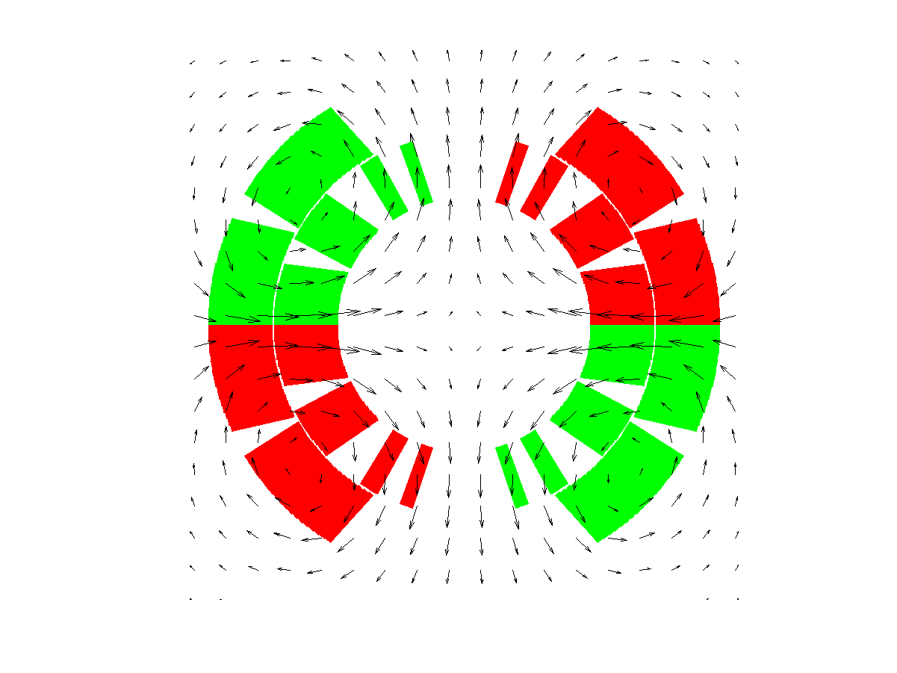
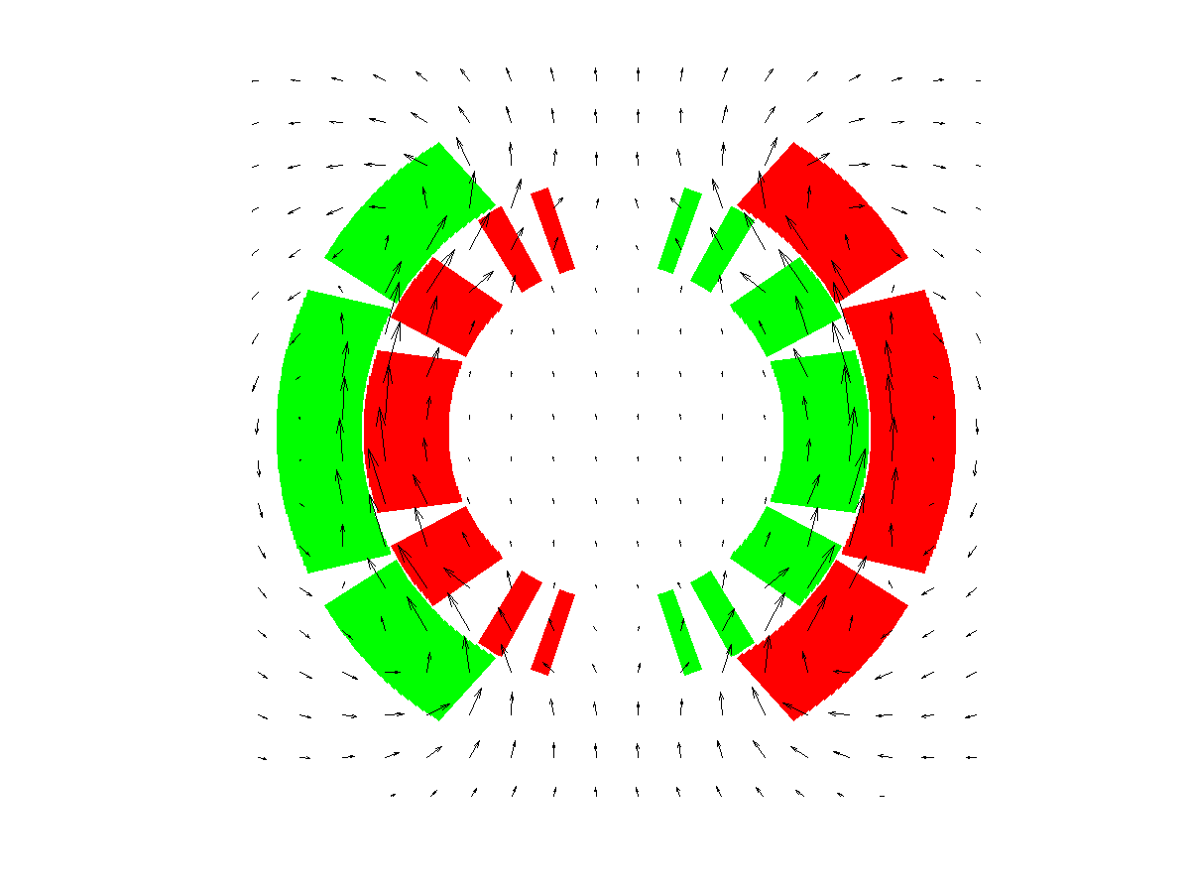
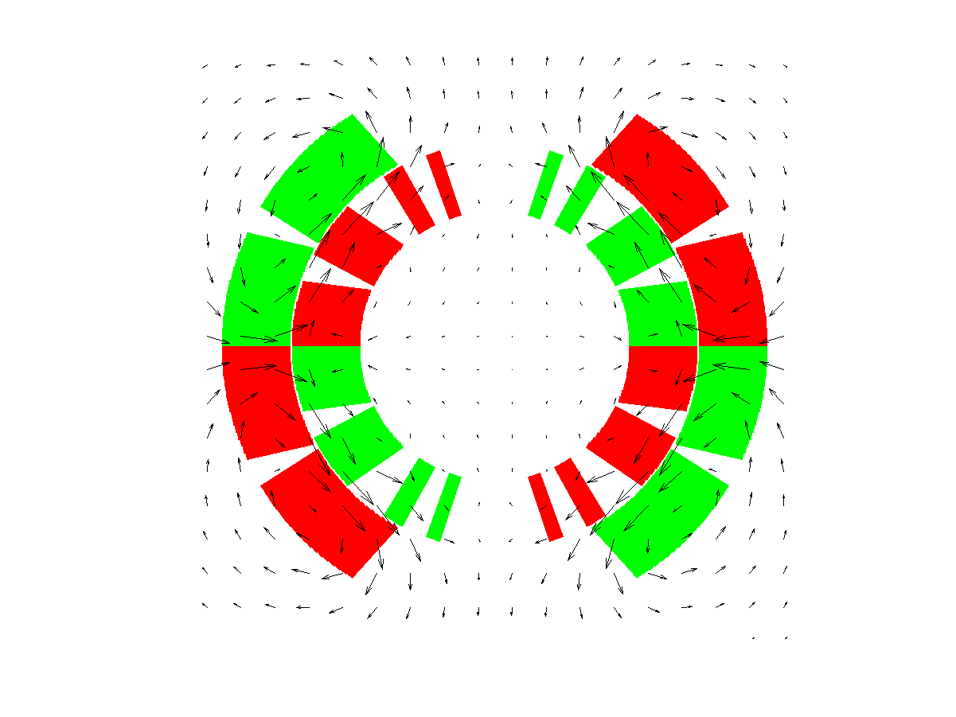
Example of CLIQ optimization (Dipole geometry)
Emmanuele Ravaioli, Jeroen Van Nugteren Optimisation of CLIQ fot HTS WAMHTS-3 – 11 September 2015

Slide 14
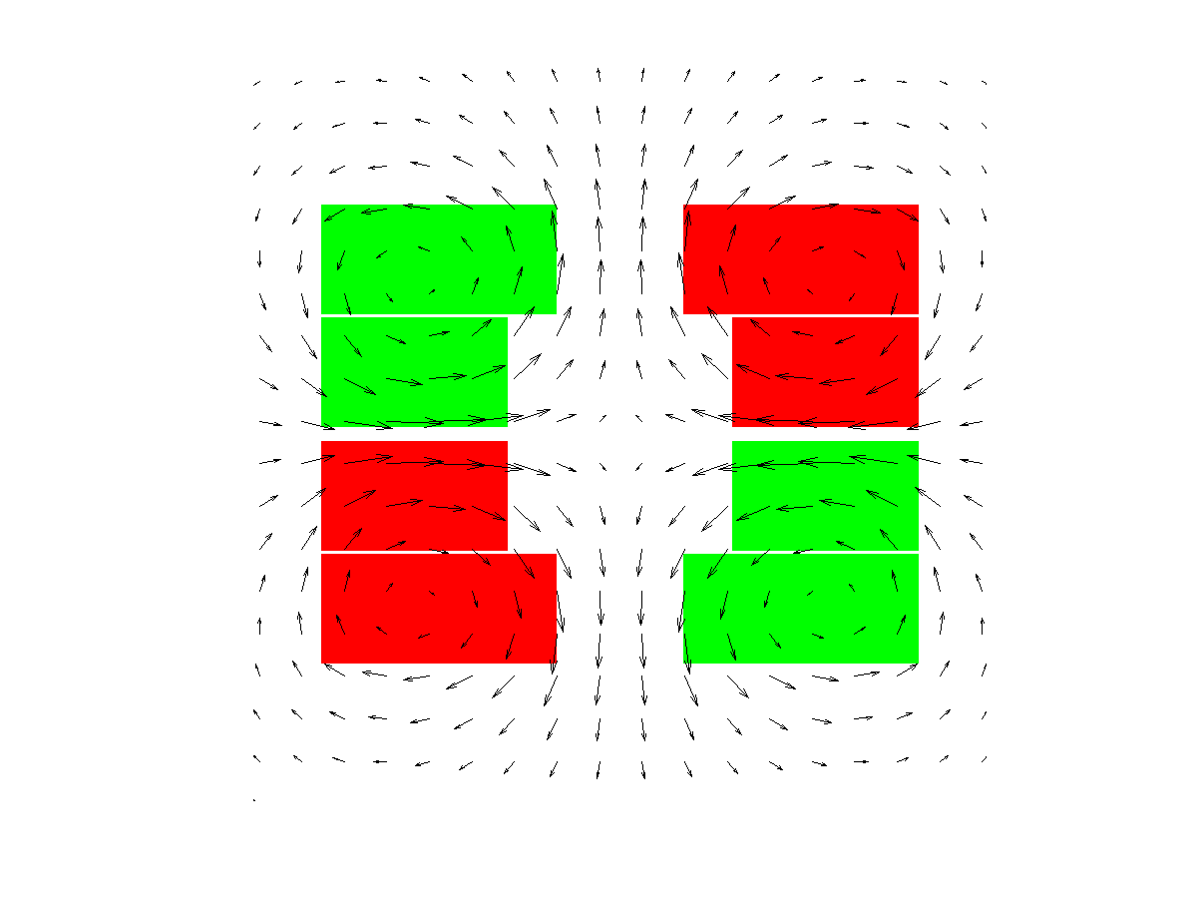
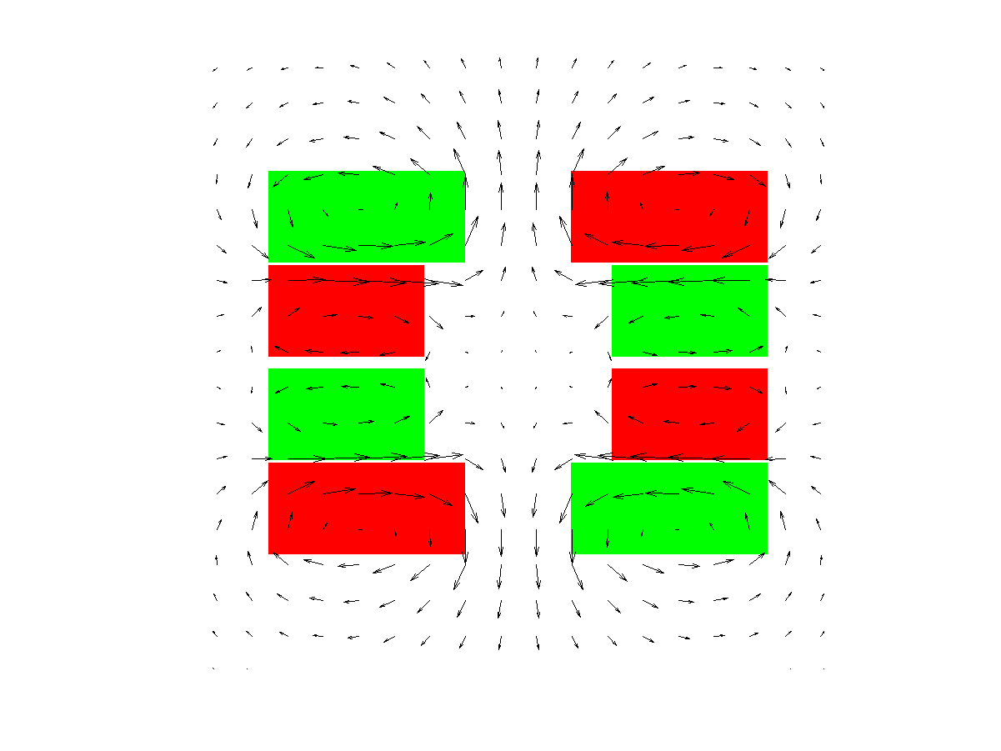
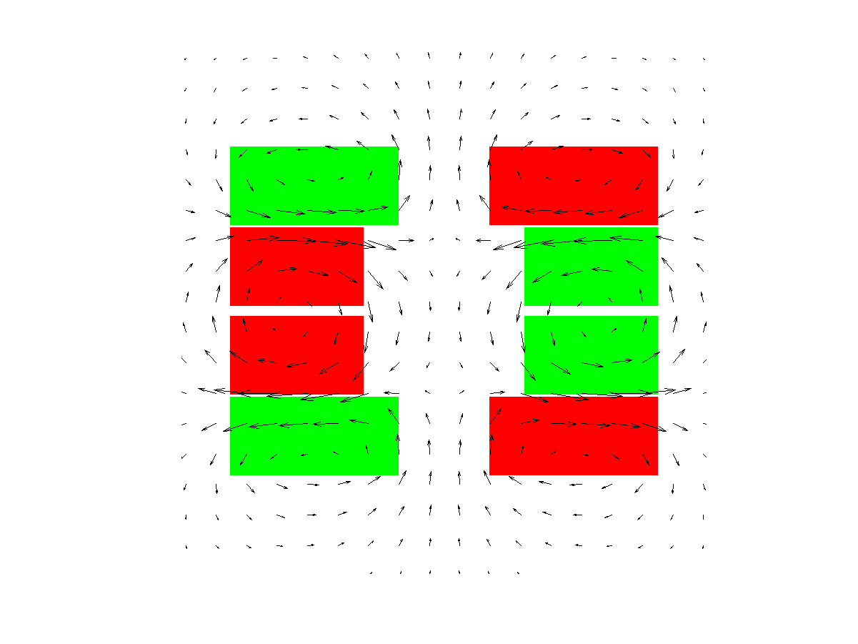
Example of CLIQ optimization (Block-coil geometry)
Emmanuele Ravaioli, Jeroen Van Nugteren Optimisation of CLIQ fot HTS WAMHTS-3 – 11 September 2015

Slide 15
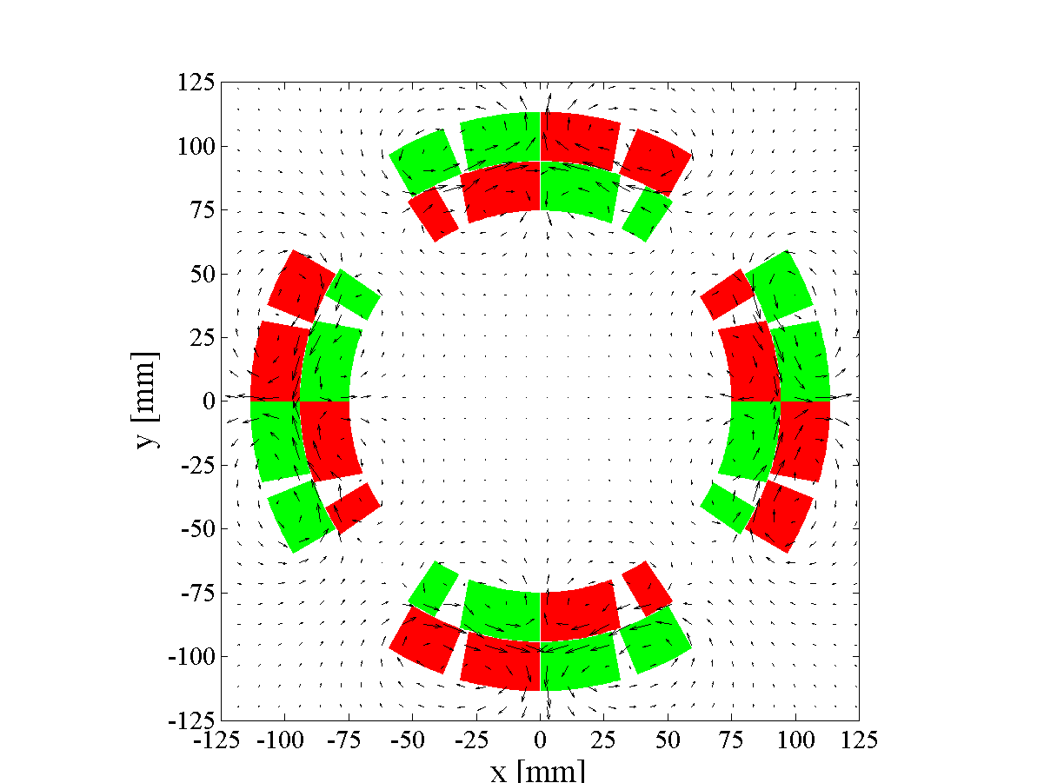
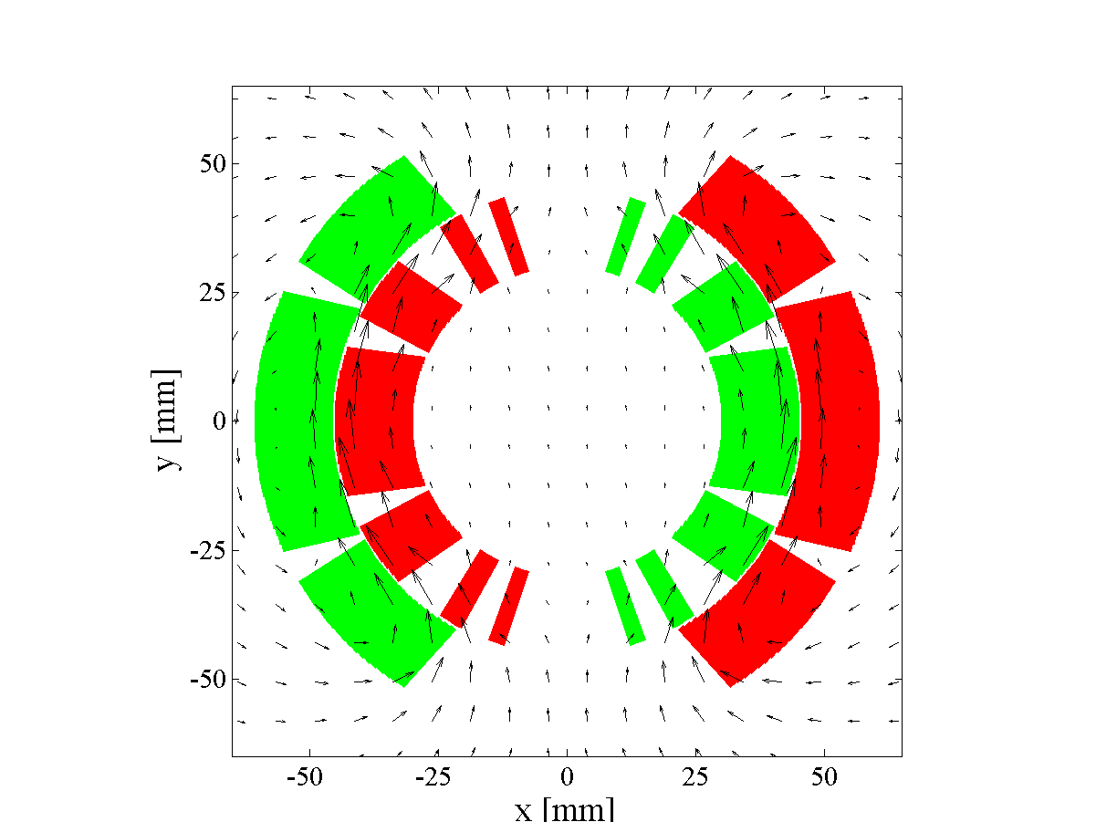
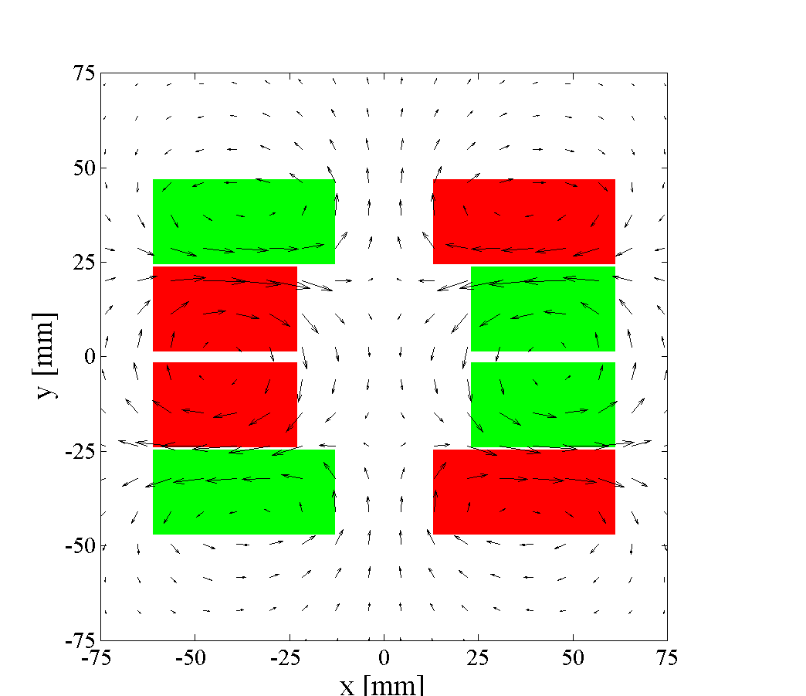
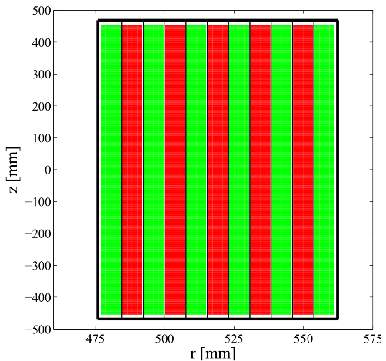
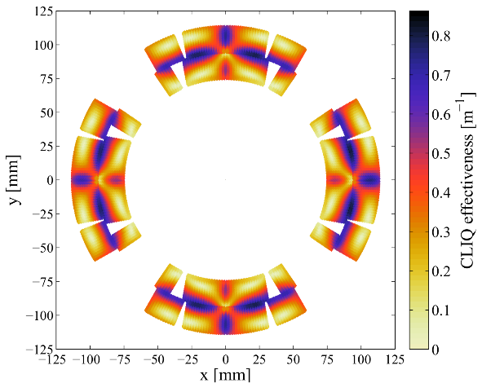
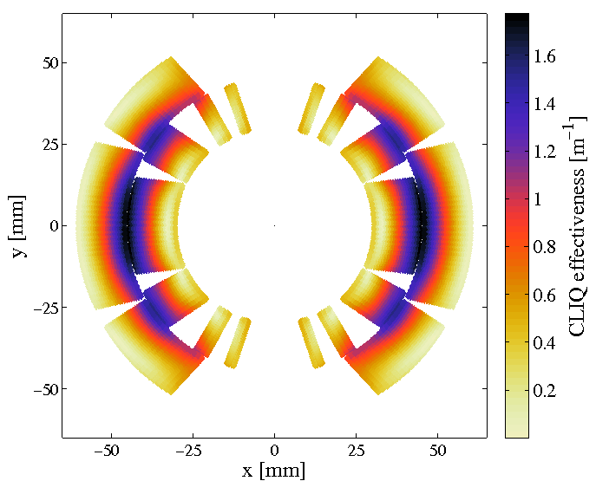
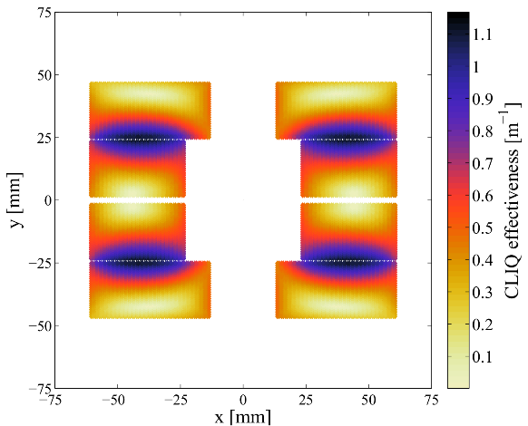
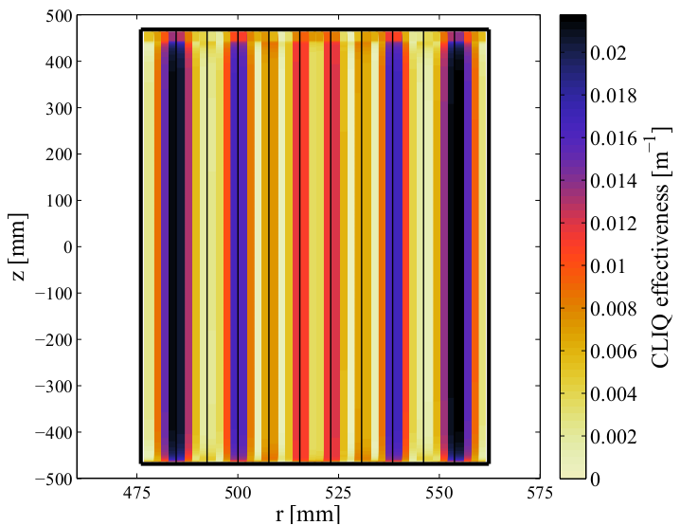
Optimizing CLIQ – Different magnet geometries
Quadrupole
Dipole
Block coil
Solenoid
Golden rules
Subdividing the coil in multiple sections
Introducing opposite current changes in coil sections
that are physically adjacent
Emmanuele Ravaioli - CLIQ PhD defense - University of Twente - 19 June 2015

Slide 16
This looks beautiful… but where’s the catch?
Increase of U₀
Increase of peak voltages to ground in the circuit (<1 kV?)
Addition of CLIQ units
Needs additional CLIQ terminals
Optimization of the discharge circuit (positioning of CLIQ leads, order of the coil sections, etc)
Typically requires addition of CLIQ terminals between magnet layers (less obvious to manufacture)
No real bottleneck for increasing dB/dt introduced with CLIQ by 10+ times, i.e. increasing coupling loss by 100+ times with respect to present CLIQ systems achieving very good performance on LTS coils
…providing the rules of
the game don’t change! →
Emmanuele Ravaioli, Jeroen Van Nugteren Optimisation of CLIQ fot HTS WAMHTS-3 – 11 September 2015

Slide 17
Possible game changers
What is CLIQ
AC loss in HTS
CLIQ optimization (valid for any magnet)
Possible
game changers
First study case of CLIQ on HTS
(Ravaioli &
Van Nugteren)
CLIQ with external excitation coils
Emmanuele Ravaioli, Jeroen Van Nugteren Optimisation of CLIQ fot HTS WAMHTS-3 – 11 September 2015

Slide 18
Game changers
If filaments are present, but matrix has very high transverse resistivity, compensate with longer filament twist-pitch
If filaments are present, but matrix has very low transverse resistivity, not possible to compensate with shorter filament twist-pitch (IFCL time constant too large), compensate with filament-matrix barrier (?)
If filaments are not present, no inter-filament coupling loss
If very low/high hysteresis losses are generated for a given ΔB, performance can change dramatically (you’ll see an example soon)
If current density depends on the magnetic-field direction, the transition to the normal state can be achieved with smart field-changes
Use a different type of CLIQ system based on external excitation coils (see last part of the presentation)
Emmanuele Ravaioli, Jeroen Van Nugteren Optimisation of CLIQ fot HTS WAMHTS-3 – 11 September 2015

Slide 19
First study case of CLIQ on HTS
(Ravaioli & Van Nugteren)
What is CLIQ
AC loss in HTS
CLIQ optimization (valid for any magnet)
Possible
game changers
First study case of CLIQ on HTS
(Ravaioli &
Van Nugteren)
CLIQ with external excitation coils
Emmanuele Ravaioli, Jeroen Van Nugteren Optimisation of CLIQ fot HTS WAMHTS-3 – 11 September 2015

Slide 20
Study case: 7 T block-coil dipole insert, YBCO Roebel cable
Block-coil
4 layers
R=25 mm aperture
5 meter long
Nom current 4880 A
Peak dipole field ~7 T
Background field 13 T
Insulation 0.1 mm
YBCO, Roebel cable
15 tapes
12x0.8 mm^2
Je=400 A/mm^2
Study jointly performed by
E. Ravaioli and J. Van Nugteren
Emmanuele Ravaioli, Jeroen Van Nugteren Optimisation of CLIQ fot HTS WAMHTS-3 – 11 September 2015

Slide 21
Current and magnetic-field changes introduced by CLIQ
Only 1 CLIQ unit and 2 CLIQ terminals
U₀=1 kV (±500 V to ground)
C varying between 1 and 128 mF
CLIQ configuration optimized to maximize the magnetic-field changes in the direction perpendicular to the cable broad faces
Study jointly performed by
E. Ravaioli and J. Van Nugteren
Emmanuele Ravaioli, Jeroen Van Nugteren Optimisation of CLIQ fot HTS WAMHTS-3 – 11 September 2015

Slide 22
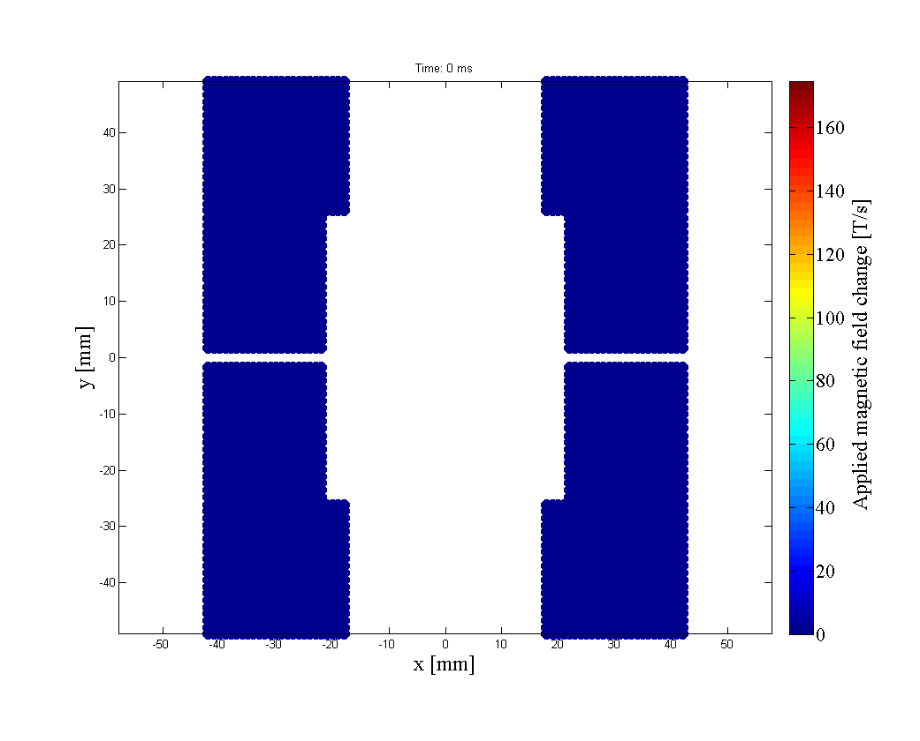
Magnetic-field changes introduced by CLIQ
1 CLIQ unit
U₀=1 kV
C=10 mF
Study jointly performed by
E. Ravaioli and J. Van Nugteren
Emmanuele Ravaioli, Jeroen Van Nugteren Optimisation of CLIQ fot HTS WAMHTS-3 – 11 September 2015

Slide 23
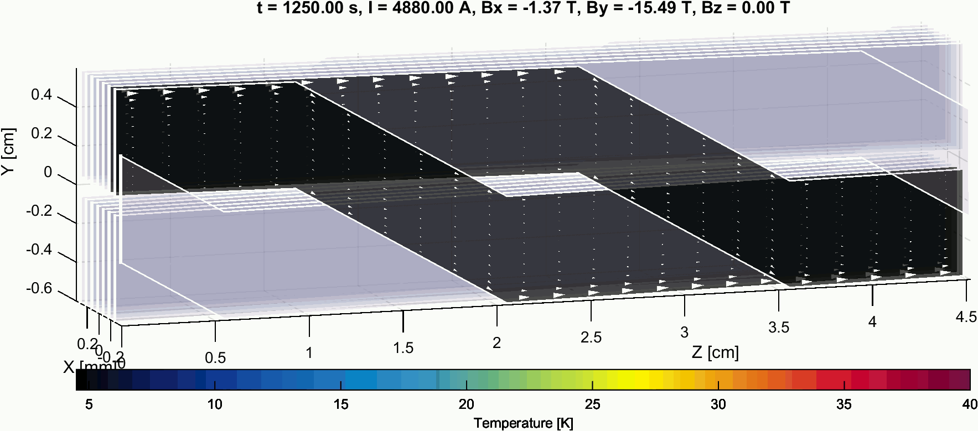
Temperature profile in two adjacent tapes
1 CLIQ unit
U₀=1 kV
C=10 mF
Study jointly performed by
E. Ravaioli and J. Van Nugteren
Emmanuele Ravaioli, Jeroen Van Nugteren Optimisation of CLIQ fot HTS WAMHTS-3 – 11 September 2015

Slide 24
Deposited loss (Hysteresis+Ohmic) and Temperature
U₀=1 kV (±500 V to ground)
C between 1 and 128 mF
With reasonable charging voltage and capacitance, this HTS coil can be effectively quenched by CLIQ in <20 ms
...with only
1 CLIQ unit and
2 CLIQ terminals!
Study jointly performed by
E. Ravaioli and J. Van Nugteren
Emmanuele Ravaioli, Jeroen Van Nugteren Optimisation of CLIQ fot HTS WAMHTS-3 – 11 September 2015

Slide 25
Next steps to conclude the analysis
Study the interaction between stacked cables
Run similar simulations for tapes in different locations of the coil
Complete electro-thermal simulation
(Loss → Temperature → Quench → Resistance → Magnet discharge)
Study the effect of losses on the differential inductance
For LTS, all steps done and model validated
For HTS, some work is still needed…
Emmanuele Ravaioli, Jeroen Van Nugteren Optimisation of CLIQ fot HTS WAMHTS-3 – 11 September 2015

Slide 26
CLIQ with external excitation coils
What is CLIQ
AC loss in HTS
CLIQ optimization (valid for any magnet)
Possible
game changers
First study case of CLIQ on HTS
(Ravaioli &
Van Nugteren)
CLIQ with external excitation coils
Emmanuele Ravaioli, Jeroen Van Nugteren Optimisation of CLIQ fot HTS WAMHTS-3 – 11 September 2015

Slide 27
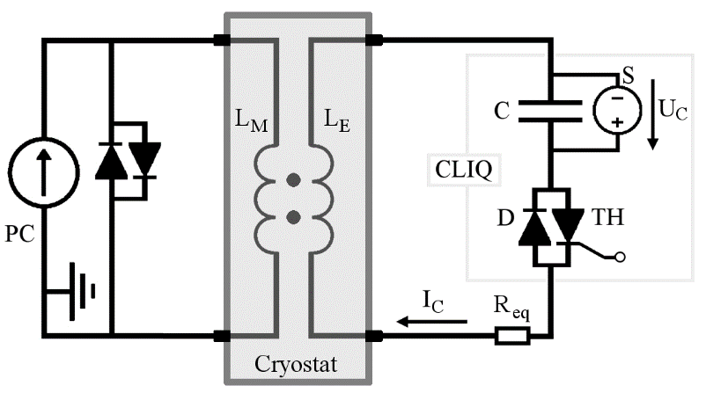
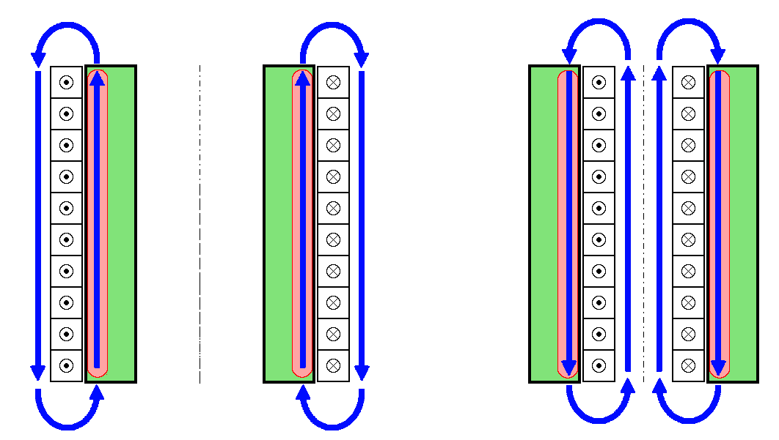
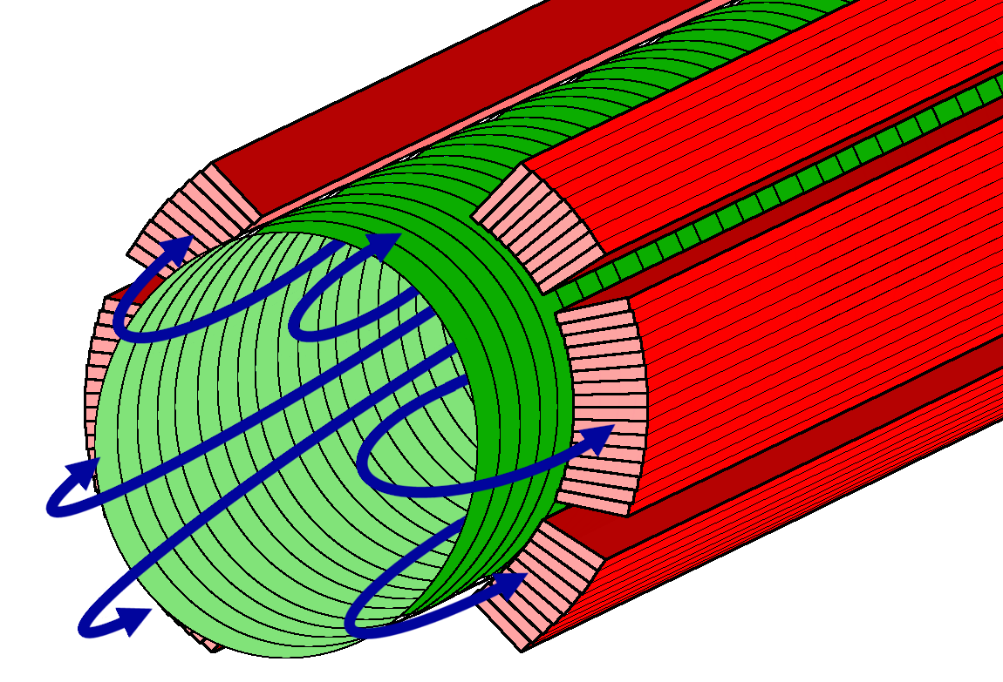
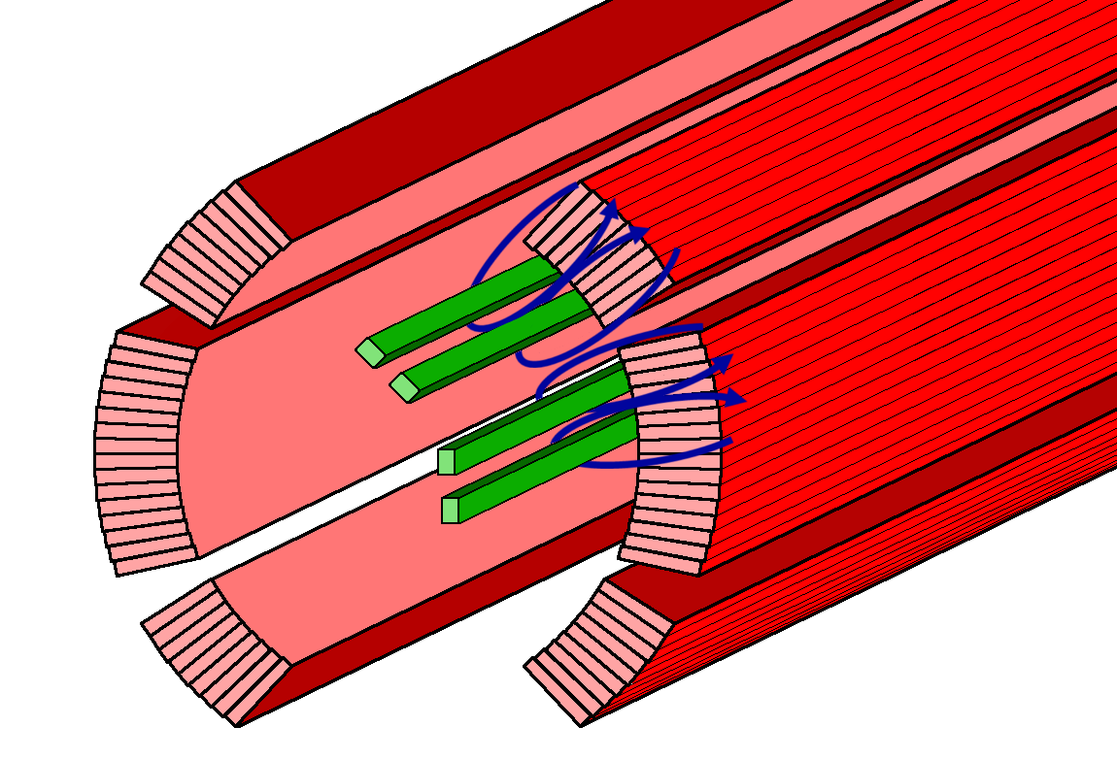
CLIQ with external excitation coils
External or internal to the coil, or between layers
Tested in 2013 on LTS
Advantages: Galvanically separated from the coil, High voltages can be introduced
Solenoid coil
Multipole coil
Emmanuele Ravaioli, Jeroen Van Nugteren Optimisation of CLIQ fot HTS WAMHTS-3 – 11 September 2015

Slide 28
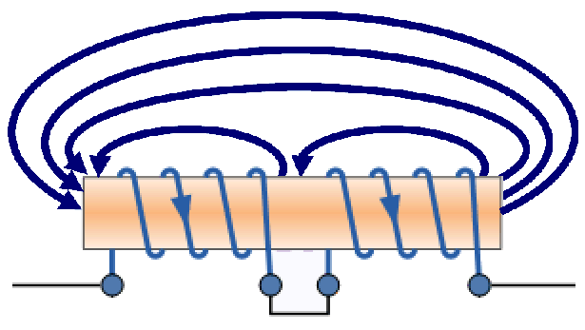
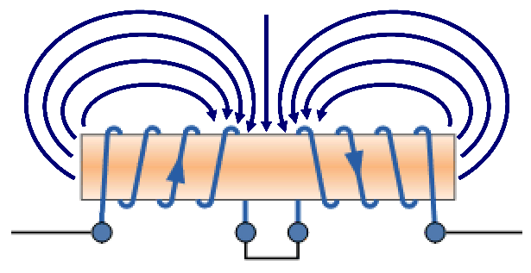
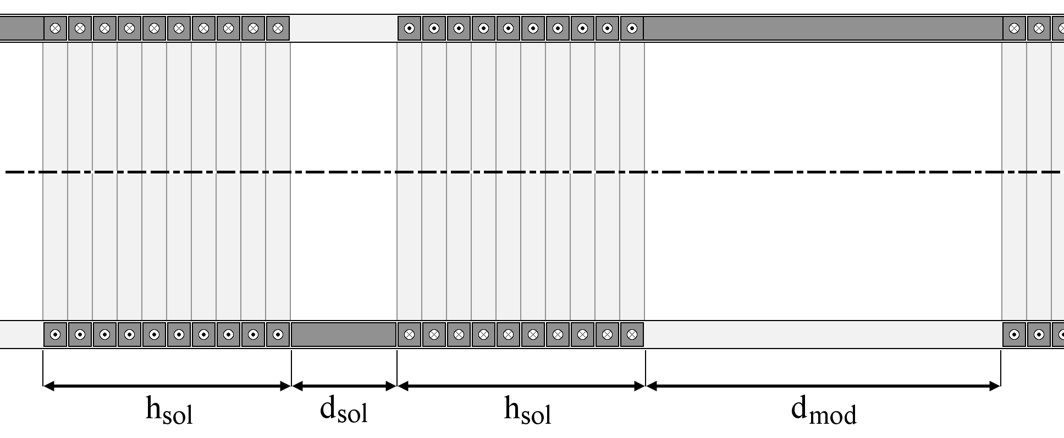
CLIQ with external excitation coils – Multi-Solenoid
Emmanuele Ravaioli, Jeroen Van Nugteren Optimisation of CLIQ fot HTS WAMHTS-3 – 11 September 2015

Slide 29
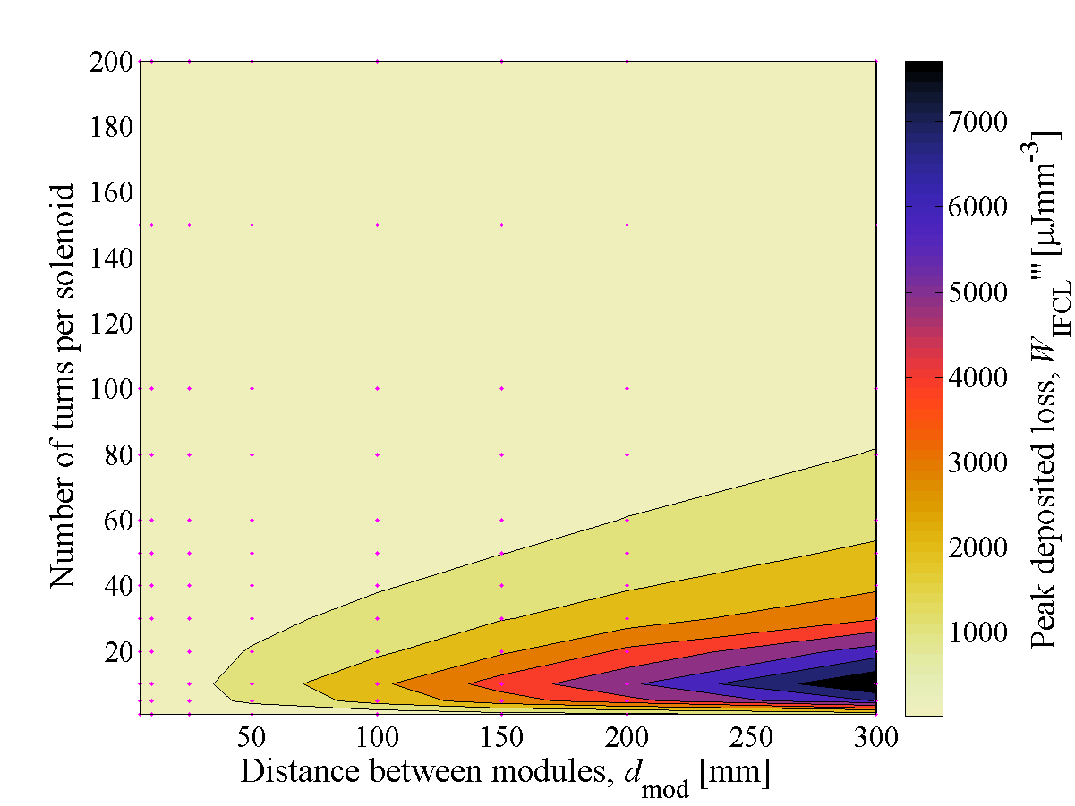
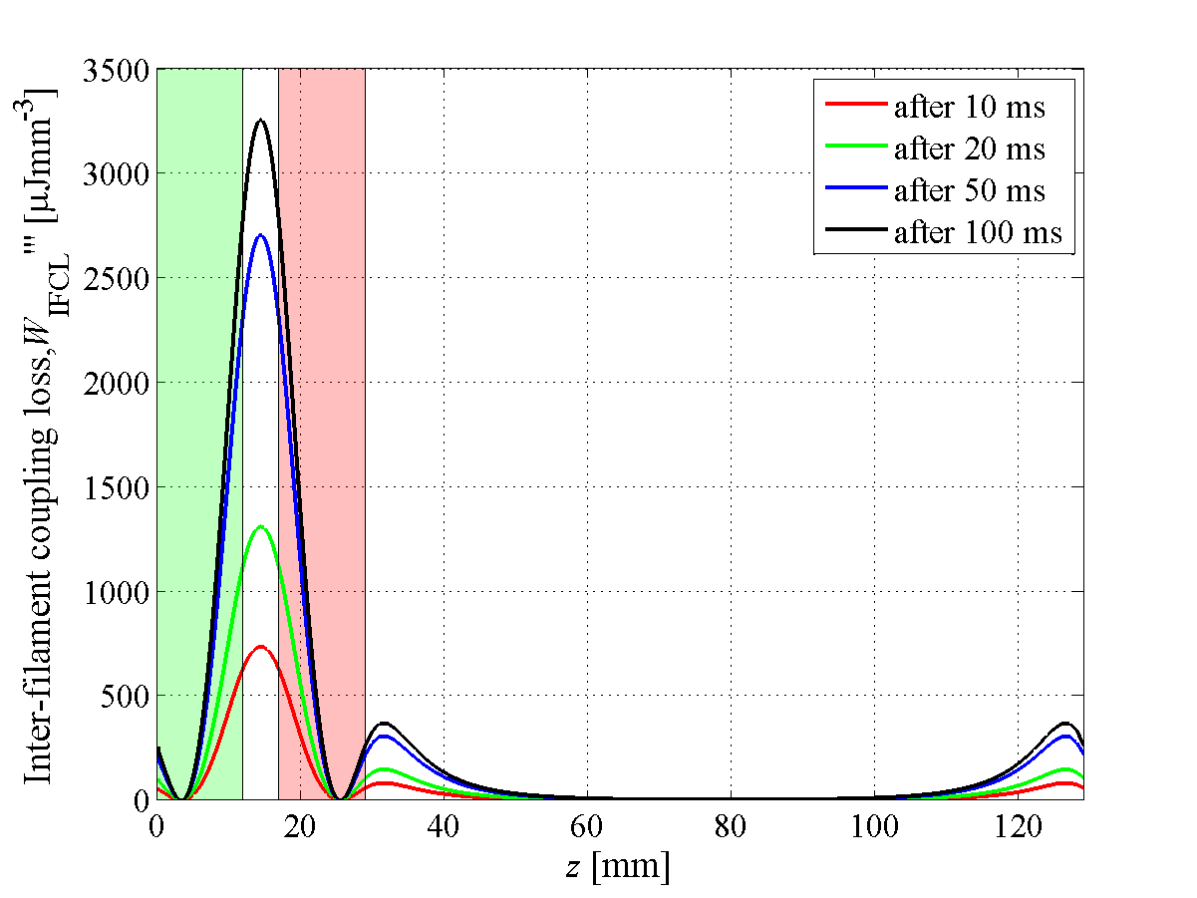
In my humble opinion, this seems a subject for a very interesting PhD..
CLIQ with Multi-Solenoid excitation coil
Very high energy deposition achieved in effective “inductive heating stations”
(~J/cm^3 in <20 ms)
Emmanuele Ravaioli, Jeroen Van Nugteren Optimisation of CLIQ fot HTS WAMHTS-3 – 11 September 2015

Slide 30
Very promising!
Conclusion and outlook
CLIQ: Mature technology for LTS magnets
Optimization methods presented (U₀, N_{CLIQ}, terminal positioning, C, excitation coils)
With inter-filament coupling loss, increasing the CLIQ power deposition by 100+ times with respect to present systems are within reach
Different loss mechanisms (particularly in cables) could be game changers (either way..)
Way to go: Collaborations between experts of CLIQ protection and AC losses in HTS
(loss measurements, modeling, CLIQ optimization, circuit simulations,…)
Emmanuele Ravaioli, Jeroen Van Nugteren Optimisation of CLIQ fot HTS WAMHTS-3 – 11 September 2015

Slide 31
QUESTIONS?
Emmanuele.Ravaioli@cern.ch
My PhD thesis can be downloaded here http://doc.utwente.nl/96069/

Slide 32
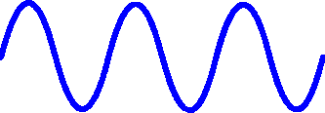
Multi-filamentary wires/strand: inter-filament coupling loss
Same physics as
inter-filament coupling loss in LTS, but different material properties
Filament twist-pitch and effective transverse resistivity of the matrix are the key parameters
SC
Cu or Ag
Emmanuele Ravaioli, Jeroen Van Nugteren Optimisation of CLIQ fot HTS WAMHTS-3 – 11 September 2015

Slide 33
Hysteresis loss
Emmanuele Ravaioli, Jeroen Van Nugteren Optimisation of CLIQ fot HTS WAMHTS-3 – 11 September 2015

