Slide 1



Protection Experience and HTS Magnets at BNL
Ramesh Gupta
Brookhaven National Laboratory
September 11, 2015

Slide 2
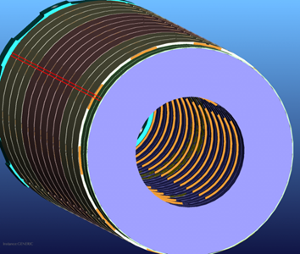
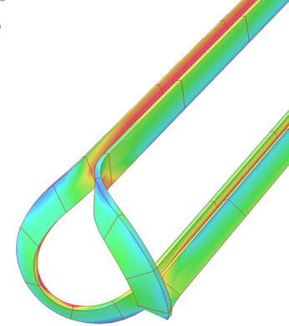
Contents
Quench Protection
  Strategy
  Experience
HTS high field magnet program
  (a brief discussion)
  Based on the ReBCO tape(s)
  Complementary geometry to European program, thanks to common coil design

Slide 3
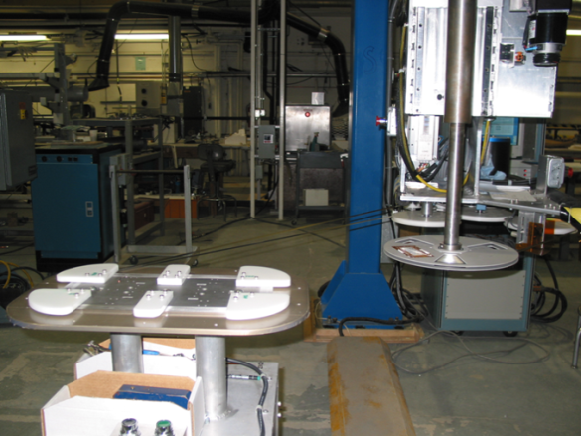

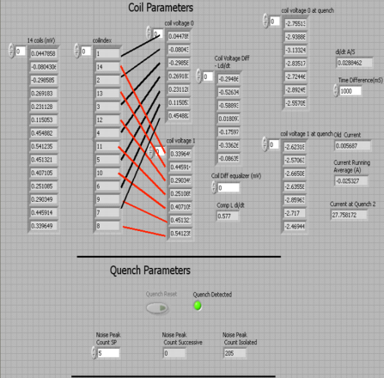
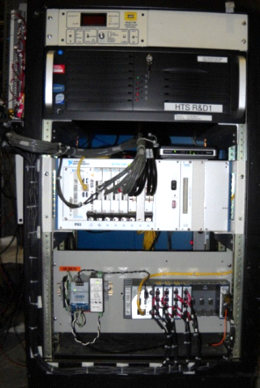
Quench Protection Strategy at BNL
BNL has relied on a multi-prong approach for quench protection in a large number of HTS coils/magnets built and tested to date
Stainless steel (metallic) turn-to-turn insulation to spread energy after the quench
Inductively coupled copper disks to transfer energy instantaneously out of HTS coils, heat up coils and reduce current to provide extra margin at a critical time
Sensitive electronics to detect resistive voltage quickly at the pre-quench phase
Fast energy extraction with electronics that can tolerate high voltage stand-off
Quench heaters (used in LTS magnets, not yet implemented in HTS magnets)

Slide 4
1.Co-winding with Stainless Steel Tape
SS tape is in between no-insulation and traditional insulation and may be a desired compromise/optimization in some cases
Quench propagation is significantly different between coils wound with traditional insulations (such as kapton) and wound with ss tape
In case of quench, it spread faster in transverse direction
By spreading energy, it may also partially act as quench heaters
BNL has used SS insulation in many HTS magnet projects with a positive experience

Slide 5
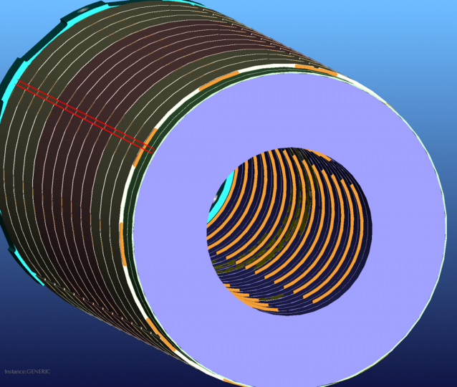
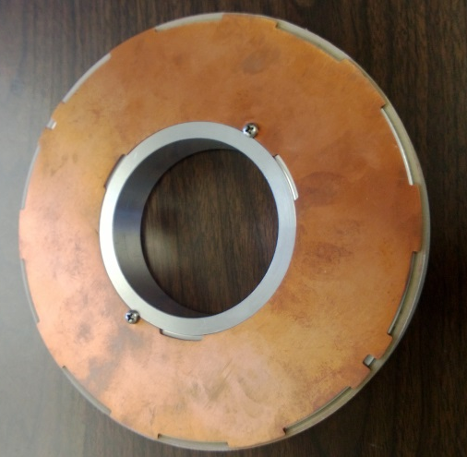
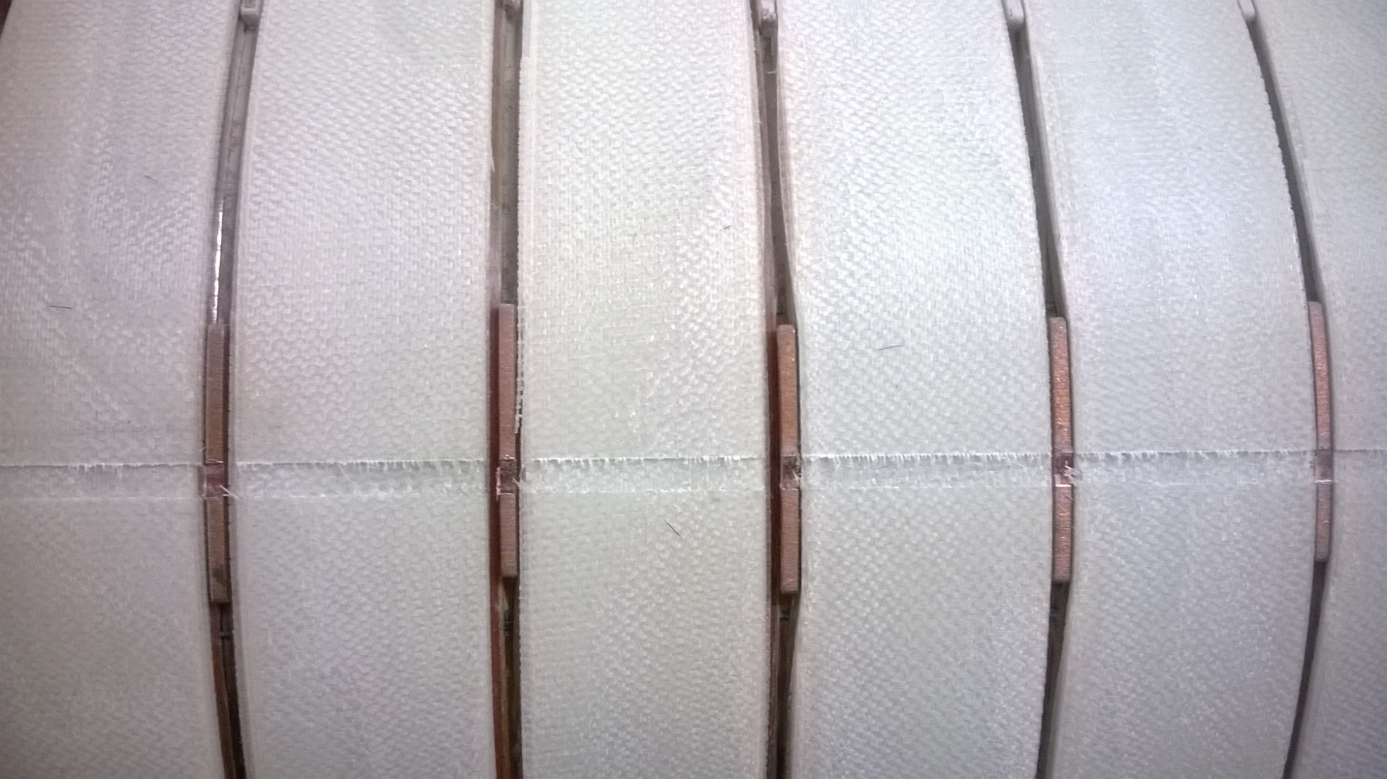
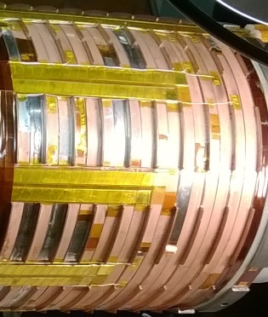
2a. Inductively-coupled Copper Discs between the Double Pancakes
Copper discs are used for providing uniform cooling across coils to reduce thermal strain during cooldown
They are coupled inductively to the coils which helps in fast energy extraction
High Field Solenoid for SMES (details at MT-24)

Slide 6
2b. Copper Disc for Initial Energy Extraction
Cu discs between the pancakes are inductively coupled to them
~ half energy removed
I²
12 pancake test at 4 K
(~12 T, ~120 kJ, 100 mm)
I²
When the current is brought down, it is first transferred to copper discs (fast drop) before the L/R decay. This
(a) removes significant energy quickly, (b) warms up copper discs and HTS coils (like quench heater) and
(c) gives extra current margin to coil at a critical time
Most action
in milliseconds

Slide 7

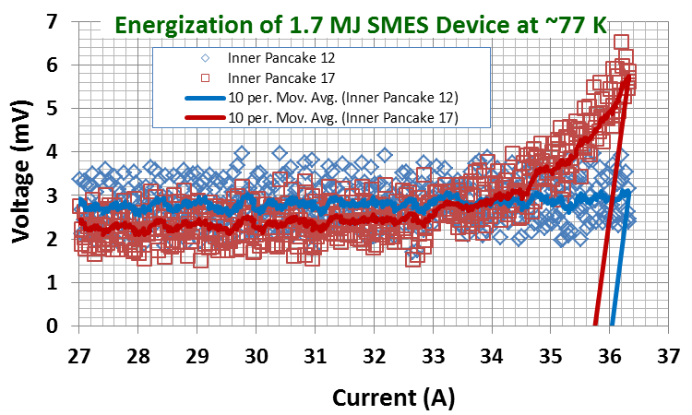
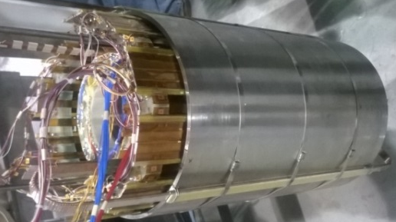
3.Detection of the Pre-quench Phase
In HTS, there is a long pre-quench phase during which the coil can be safely operated with a small resistive voltage.
We detect this pre-quench phase and initiate our quench protection action during that time.
This requires detecting small resistive voltage in presence of large noise and inductive voltage.
This is accomplished with the modern hardware and software where we made significant progress.
Pre-quench phase

Slide 8
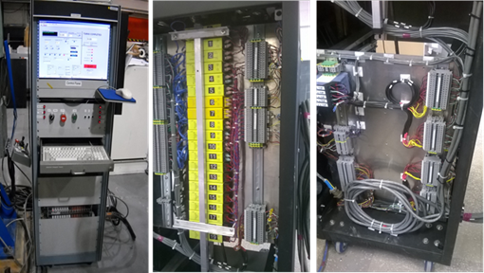
3. & 4. Advanced Quench Protection Electronics with High Isolation Voltage
Detect onset of the pre-quench phase at < 1mV
Fast energy extraction with high isolation voltage > 1kV

Slide 9
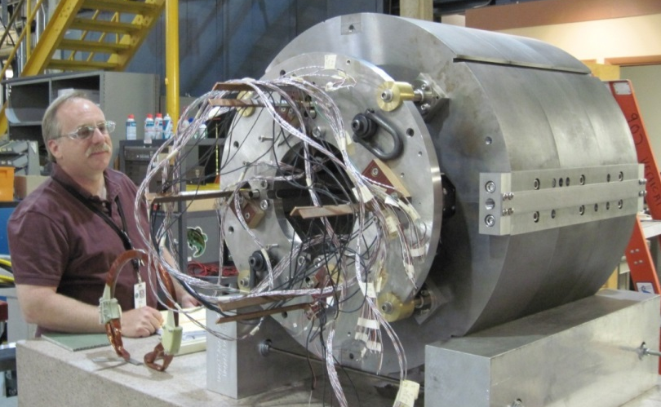
(a) Accident – A Real Life experience
(b) Event Near Short Sample
(c) Operation at High Threshold
Protection Experience in
HTS Quad for FRIB
FRIB: Facility for Rare Isotope Beams (under construction in Michigan, USA)

Slide 10
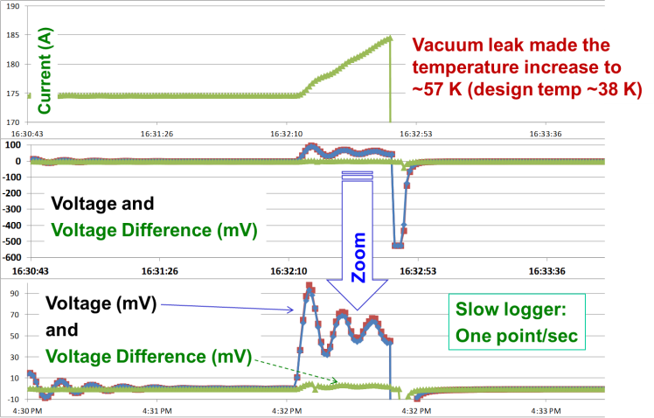
(a) Vacuum Leak
Operational Accident Near Design Current
Design: 210 A in SP Coils
185A
175A
Ringing in power supply made situation worse
90mV

Slide 11
(b) Event Near Short Sample
Current (A)
ASC Coils were held at 382 A at 50 K
(design: 310 A at 38 K)
Shut-off
Coil Voltages
(mV)
Shut-off
Zoom
Slow logger:
One point/sec
Coil Voltages
(mV)
Events prior
to Shut-off

Slide 12
Summary of Protection Experience
We had a variety of incidences while operating HTS quadrupole for FRIB
No damage or degradation in performance was observed after those events
There was even a local defect in one coil, which didn’t seem to deteriorate
The multi-prong approach was able to protect the FRIB HTS coils in all cases
We also have experience with several other HTS magnets (including 4K test with high current densities and stored energy in coil, such as those for muon collider and SMES). There were cases when HTS coils got damaged but none due to quench or runaway situation with an active quench protection on
Caveat: Most of these tests, however, were done in a project manner – where the focus was to demonstrate, rather than find out the limits of the approach

Slide 13
High Field Magnets for Accelerators

Slide 14
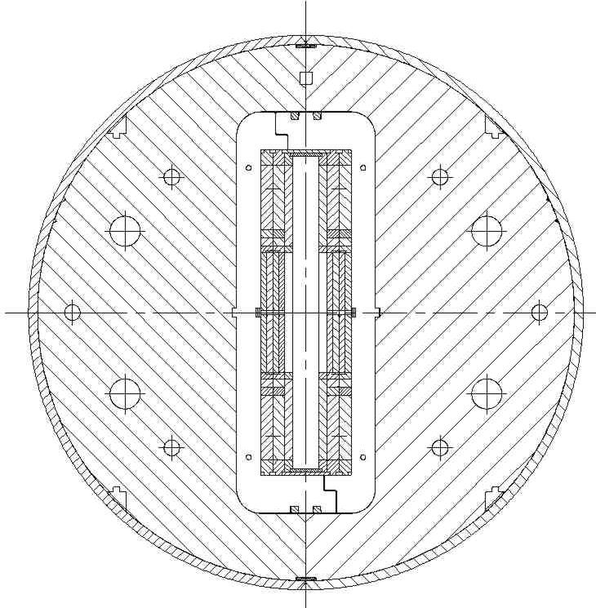
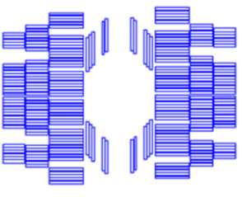
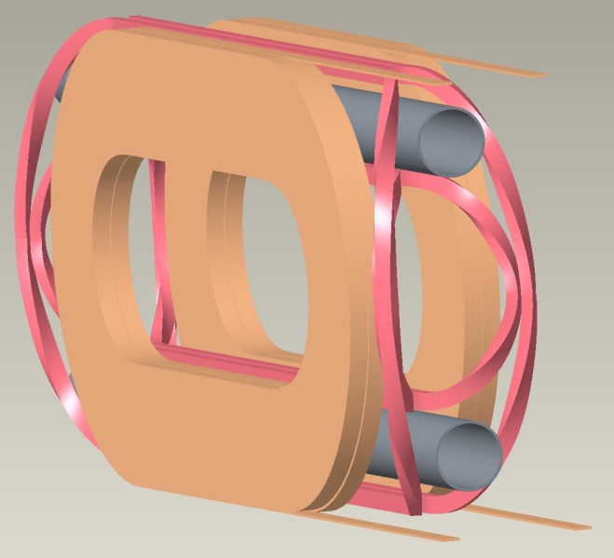
Windings for Lower Magnetization
Narrow side of the HTS tape aligned perpendicular to the field produces lower magnetization (proportional to the width) and higher critical current
In 2-in-1 common coil design, conductor in
HTS coils bends in easy direction
Common coil design provides easy segmentation between HTS & LTS

Slide 15
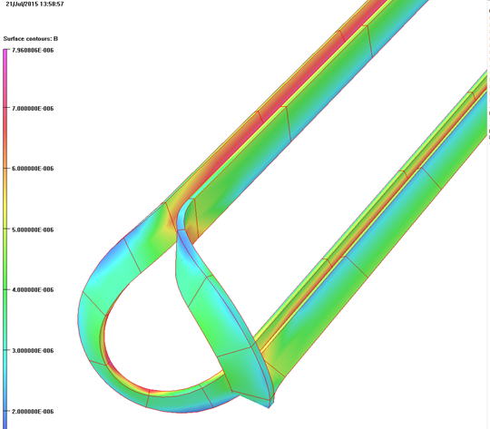
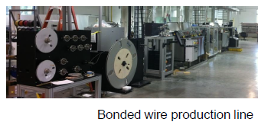
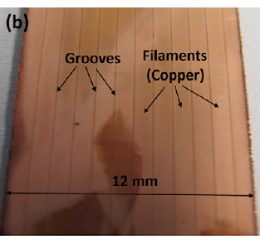



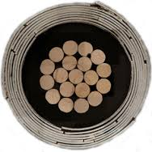
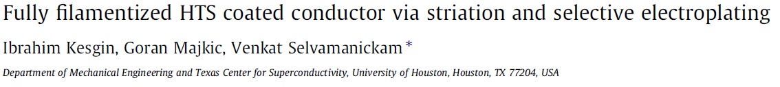
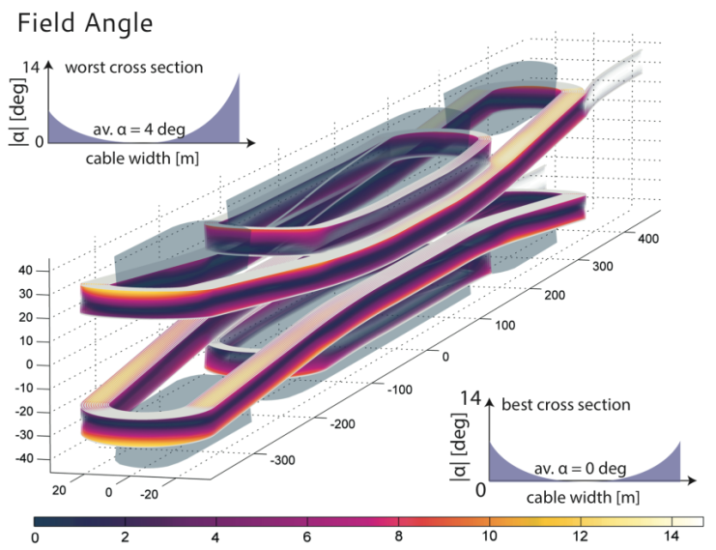
Complementary Nature of BNL and CERN HTS Magnet Programs
BNL Design
Cable options
BNL and CERN are both pursuing ReBCO technology, but with very different designs
BNL bends tape in easy direction in ends (allowed by common coil design); CERN bends in hard direction
BNL is exploring/proposing simple multi-tape (multi-tape for higher current and reliability) and striation to further reduce magnetization) or CORC cable (since large radii allowed in common coil); CERN is focusing on Roebel cable (both for > 10 kA current)
CERN Design

Slide 16
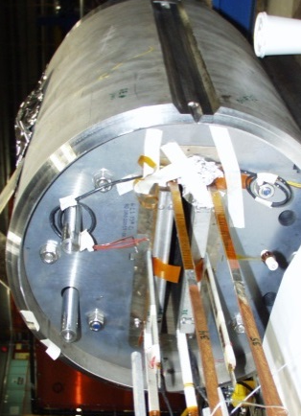
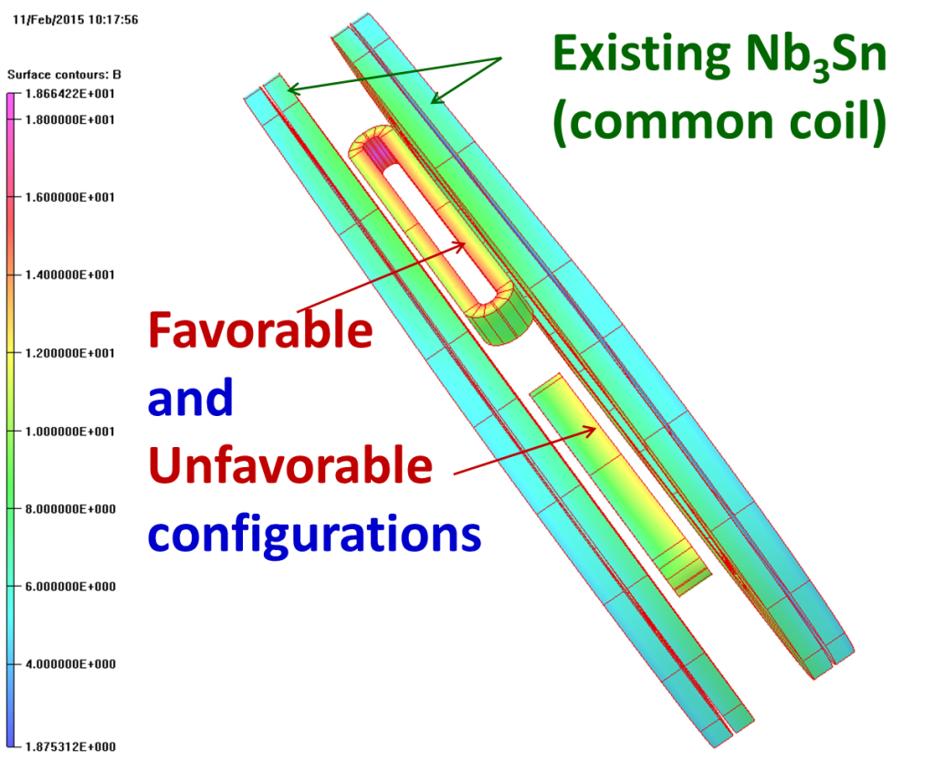
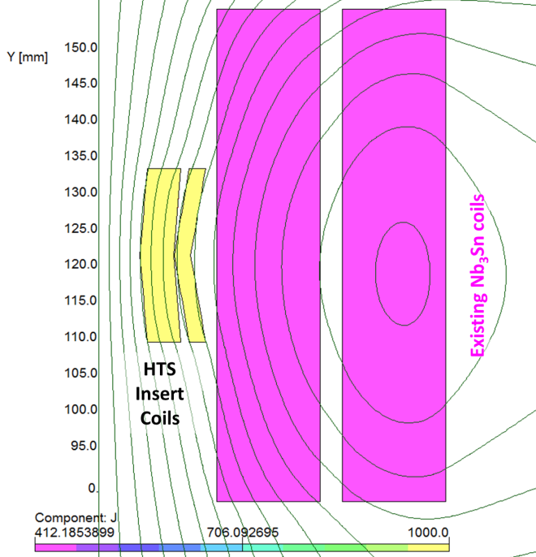
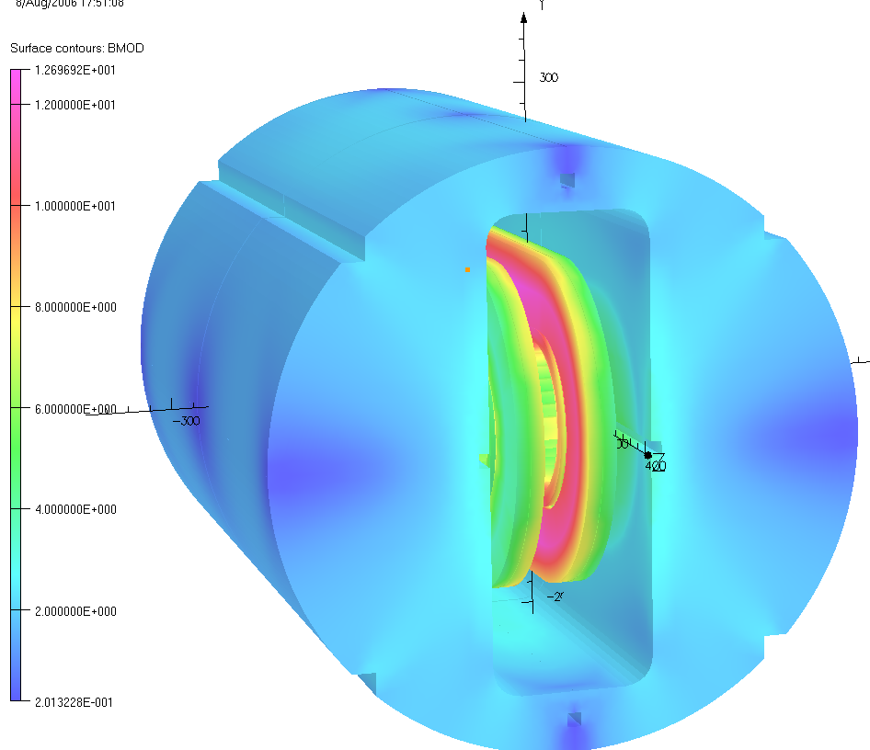
Test of Principle in A Real Magnet
(measure and compare magnetization in two configurations)
BNL Common Coil Dipole with a large open space
HTS coils can be inserted without opening the magnet
PBL/BNL Phase II STTR
Goal: Measure magnetization due to HTS coils in two configurations

Slide 17
SUMMARY
Quench protection is a major challenge in HTS magnets.
A multi-prong approach (metallic insulation, sensitive electronics for pre-quench action, inductive energy transfer out of coil and fast energy extraction with electronics that can tolerate high voltage) has worked in a number of R&D magnets tested at BNL.
These approaches, however, needs to be further tested, expanded, and supplemented by other techniques to provide sufficient protection for large high stored energy magnets.
With a reliable quench protection system and magnet designs that make efficient use of HTS and produce tolerable field errors (such as those discussed in this presentation), there is a potential of making very high field HTS/LTS hybrid accelerator magnets.

Slide 18
Backup Slides

Slide 19
1.Co-winding with Stainless Steel Tape
Benefits of Stainless Steel (metallic) insulation in HTS coils:
  Radiation resistant (critical for high radiation environment)
  Extra support structure (critical for high field magnets – e.g. SMES)
  Quench protection – spread energy (critical for HTS magnets)
Quench propagation is significantly different between coils wound with traditional insulations (such as kapton) and wound with ss tape
SS tape is in between no-insulation and traditional insulation and may be a desired compromise/optimization in some cases
For R&D magnets, natural surface resistance has been adequate but for machine magnets providing controlled surface may be desired
BNL has used SS insulation in many HTS magnet projects with a positive experience

Slide 20

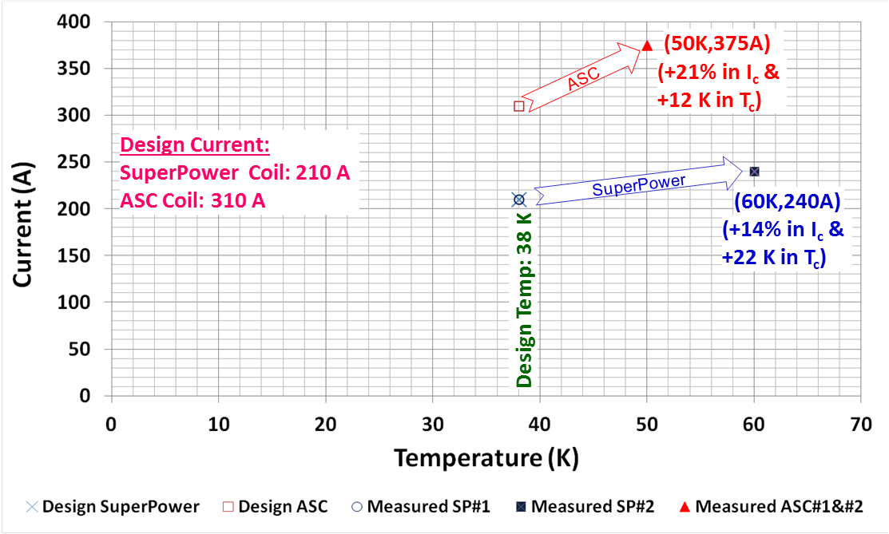
HTS Quad for FRIB
Large Temperature Margins
(only possible with HTS)
YBCO from two vendors ASC and SuperPower
HTS provides robust operation against local and global heat loads

Slide 21
Snap Shot of the Event in ASC Coils
(individual and difference voltages)
This event appear to be a sign of flux jump
Exceeded quench threshold, triggered shutoff & energy extraction
Fast data logger
One point/msec
Difference Voltage
Shut-off

Slide 22
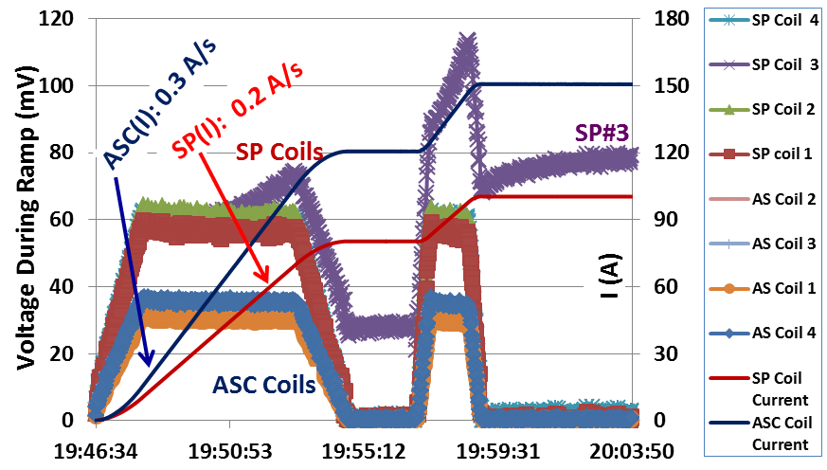
Operation at the High Detection Threshold Voltage
Operated at about two order of magnitude beyond the quench detection threshold (>100 mV instead of < 1mV initially planned)
Test temperature: ~67 K
(ASC to 150 Amp; SP to 100A)

Slide 23
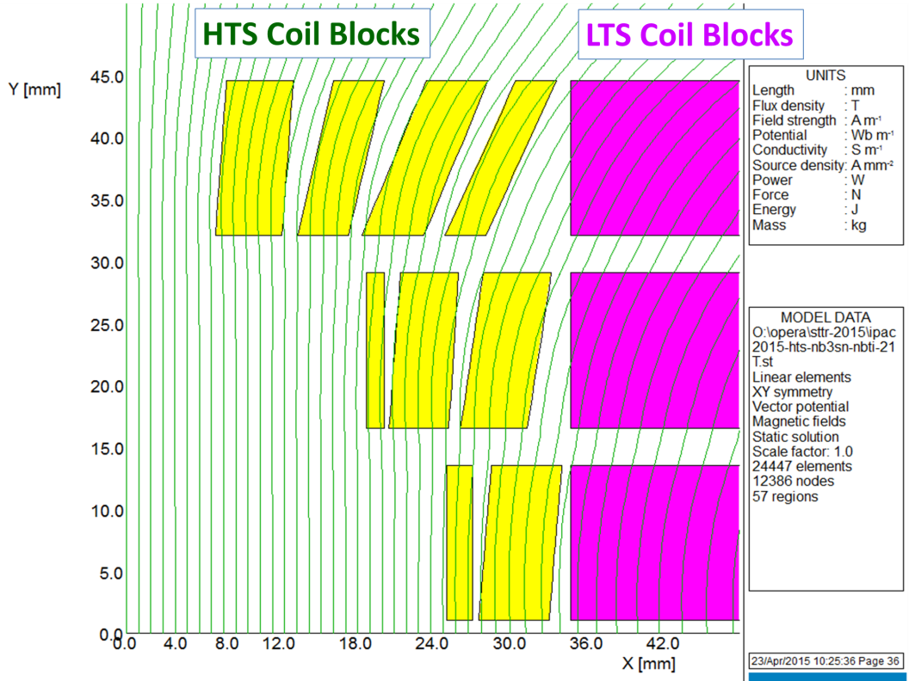
Design Technique to Reduce Magnetization
Design Technique to Reduce Magnetization Effects:
Align the tape conductor (thickness few μm) such that primarily the
    “narrow side sees the perpendicular field ”
It is possible to align HTS tape to a good extent in hybrid designs
    “by carefully designing the coil (both HTS and LTS conductor blocks)”
Effective filament size of 12 mm reduces
to a few mm in an ideal design
Magnetization in an actual magnet will depend on the level of optimization and on how things work in real world (beyond computations)

Slide 24
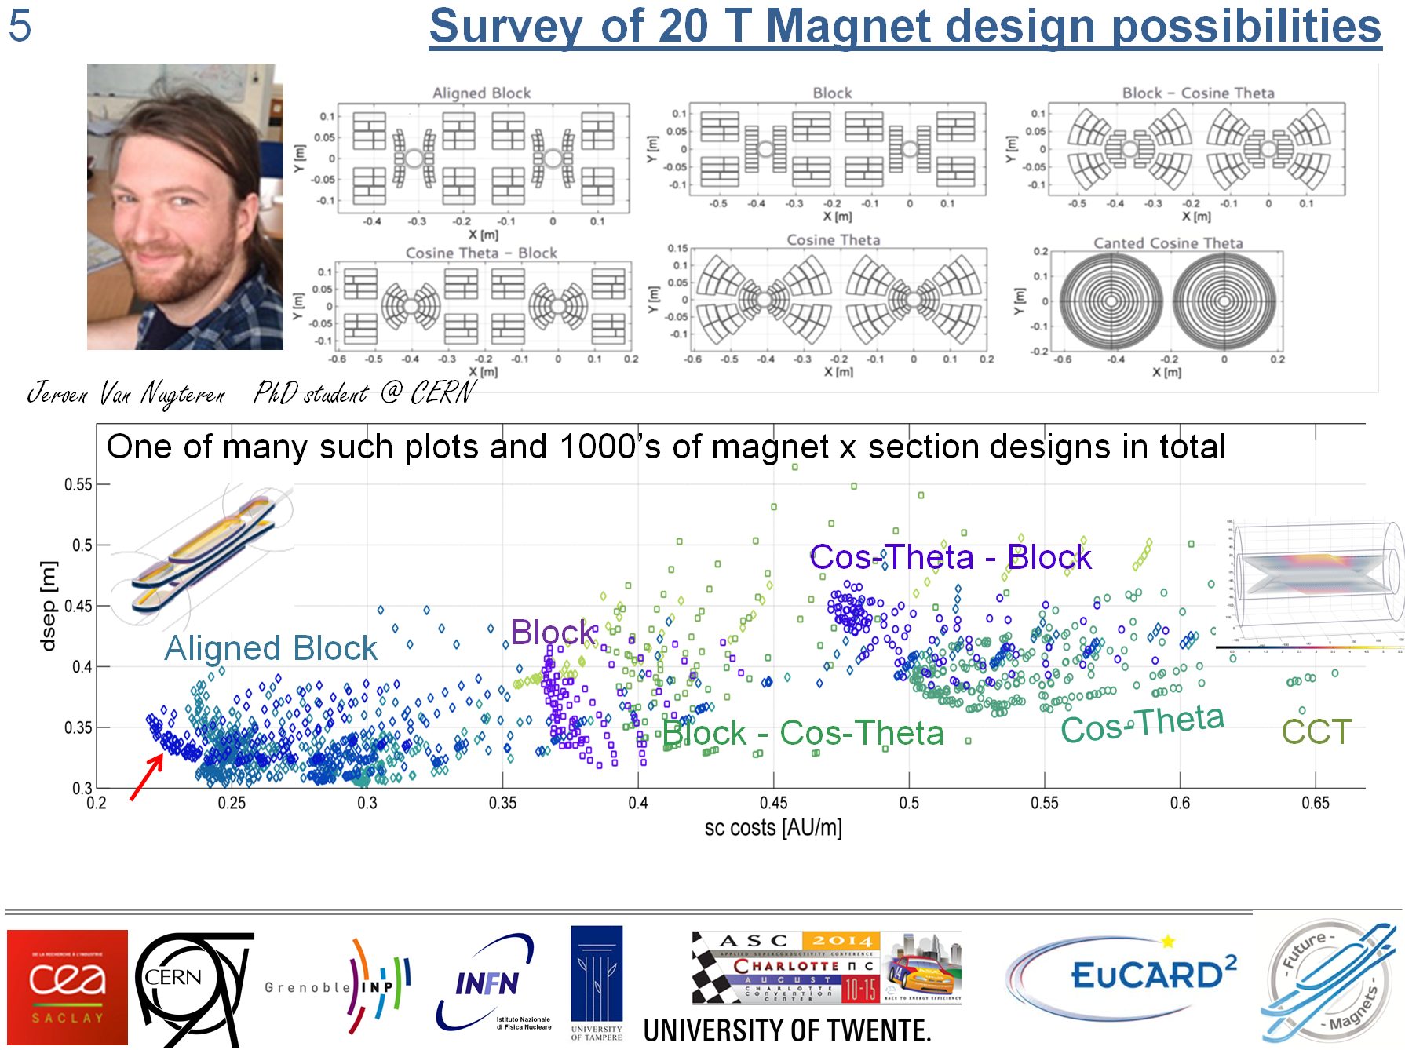
Another Major Benefit of the Aligned Tape Design (conductor efficiency)
Courtesy:
J. Van Nugteren
CERN

