Slide 1


Performance and Advanced Data Placement Techniques with Ceph’s Distributed Storage System

Slide 2
Outline
Motivation
Previous Work
Architecture of Ceph
Ceph features / capabilities
Testing and applicability
SSDs vs HDDs (w/o Ceph), alternative approach
Conclusion

Slide 3
Motivation
STAR has been interested in reusing our online cluster as a multipurpose storage system
  Move some (fast) processing toward online domain requires storage (Online QA, real-time calibration, …)
  Users can store and recover data to a local storage while running jobs – “a” global space helps share results across processing nodes
  Distributed file system & aggregators exists (Xrootd, Object storage, …) – users most familiar with standard FS.
CephFS offers
  A familiar POSIX interface
  Redundancy and shown to be crash tested safe [doi:10.1088/1742-6596/664/4/042031]
  Open source software that can be leverage to repurpose older hardware
  An agile and simple architecture that ensures no single point of failure

Slide 4
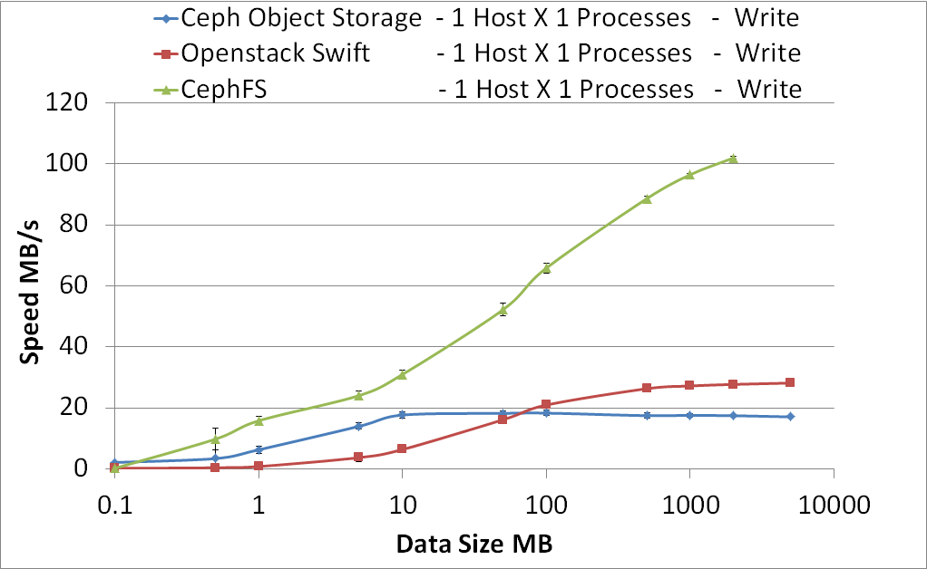
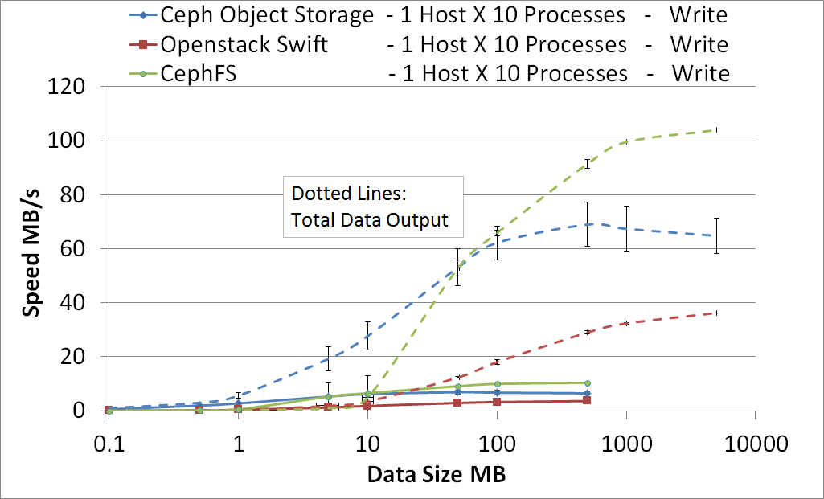
Previous Work
Presented at CHEP 2015
  M. Poat, J. Lauret, W. Betts – “POSIX and Object Distributed Storage Systems - Performance Comparison Studies With Real-Life Scenarios in an Experimental Data Taking Context Leveraging OpenStack Swift & Ceph” ”, J. Phys.: Conf. Ser. 664 042031 doi:10.1088/1742-6596/664/4/042031 (2015).
Performance comparison study
  Studied Openstack Swift object storage and Ceph Rados object storage
  Investigated the performance and benefits of the CephFS distributed file system
Ceph decreases the risk of single point of failure (no proxy server like Swift)
CephFS outperformed both OpenStack Swift & Ceph object storeafe due to its striping layer on top and breaking down files into 4MB chunks distributed to nearly all storage nodes simultaneously

Slide 5
Issues found (and fixed?) since
Stability
  The STAR Ceph cluster has proven to be stable for beyond test use from 5/1/15 – present.
  Survived a “DNS meltdown” – 48/80 OSDs were down due to unstable DNS service. After DNS was restored, OSDs were able to come back in and recovered. No Data was lost.
Identified problems & lessons learned
  Nightly condor jobs are run on the cluster reading OSG software from Ceph. Running Kernel 3.10.82 ~1x per month users reporting Jobs fail on one node due to missing OSG software. Kernel 3.18.24 contains latest modules (moral of story, run newest kernel).
  Do not remove 3 OSDs from 3 separate nodes at once from Ceph. Probability of data loss ~0.0012%
Experience
  Once running Ceph requires little to no daily maintenance.
  If a drive fails, Ceph will reshuffle the data to maintain replication 3. The drive can be replaced at earliest convenience.

Slide 6
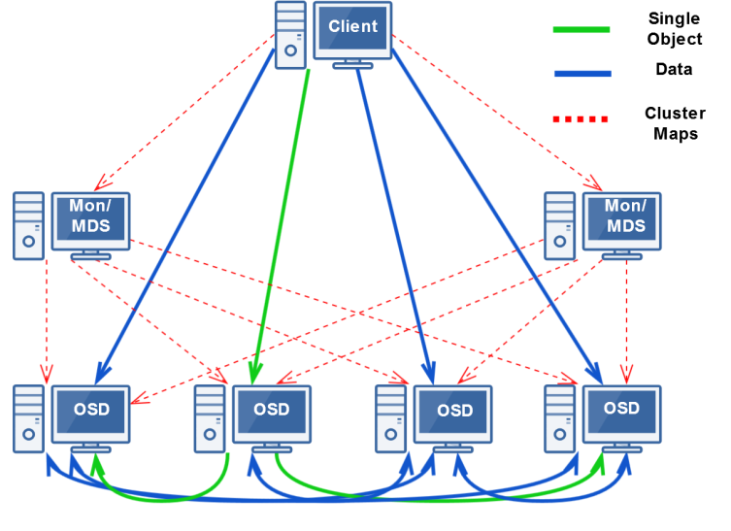
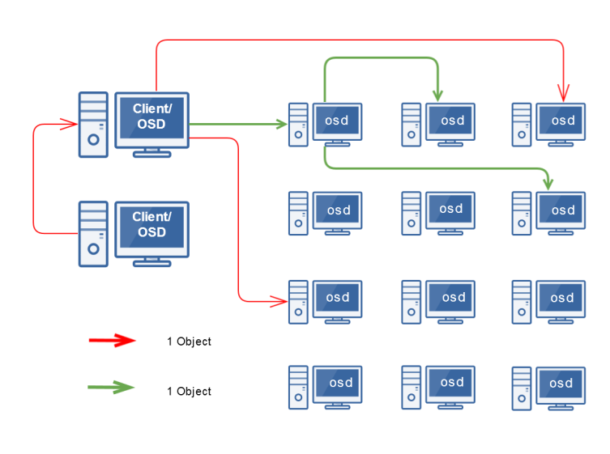
Architecture of Ceph
Ceph is composed of three components:
  Storage nodes (host individual OSDs),
  Monitor Nodes (Mon), & Metadata Nodes (MDS).
Ceph clients write data directly to the storage nodes
  Many storage systems use a proxy or middleman which
  can cause bottlenecks.
The monitors distribute cluster maps to
the clients and storage nodes.
  Cluster map contains the cluster topology comprised five
  individual maps (Monitor, OSD, PG, CRUSH, and MDS)
The metadata servers are required for CephFS
Ceph Communications
Example: Total 20 Storage nodes. 2 nodes acting as both Ceph clients and storage nodes (OSD’s)
2/20 (10%) chance “a” storage node will receive data from that client (but IO is spread)
Replication 3 means 2 more stream of data will be sent => additional probability of 2/20 * 2 = +20% to receive data
Total data output increases by 20% in this example

Slide 7


Production system (β)
Monitoring
20 Dell PowerEdge 2950
6 – 2TB Seagate SAS drives
  4 Drives per node used for storage
  XFS File System
1 HDD replaced with an SSD (per node)
Intel Xeon QC E5440 – 2.83GHZ
Scientific Linux 6.7 x86_64
Kernel: 3.18.24 (needed to mount CephFS)
  Kernel: 2.6.32 is the latest version released by SL6
1 Gb Public Network, 10Gb Private Network
Icinga Infrastructure monitoring
Ceph specific plugins have been built by the community
Monitoring of Ceph OSDs, Metadata servers, & Monitor servers.
Configuration
Configuration Management
Ceph
Ceph Hammer 0.94.5 (LTS)
80 OSD (20 nodes)
3 Monitor Server & 3 Metadata Servers (failover)
Using Replication 3
CFEngine Configuration Management Tool
Deploy Ceph Packages
Set Configurations
Deploy necessary Ceph files
Detect and repair problems
  Configuration drift, OSD service running, etc.

Slide 8

Ceph features

Slide 9
Data Placement Techniques
OSD Pool Mapping
  Ceph allows you to set specific OSDs to specific storage pools by customizing the CRUSH map.
  You can modify the placement of data based on redundancy or performance, the combinations are endless.
Primary Affinity
  Specify which OSDs will be the primary OSDs when a client reads/writes data. This would ensure the client always contacts the primary OSD as the first OSD in the acting set.
Ceph OSD Journals on SSD
  When a client writes into Ceph, Ceph will write twice, first to the OSD journal and once to the OSD filesystem (with XFS).
Cache Tiering
  Cache tiering leverages OSD Pool Mapping by creating a pool of fast drives (SSD’s) configured to act as the cache tier with a backing pool of slower drives (Currently does not work with CephFS)

Slide 10
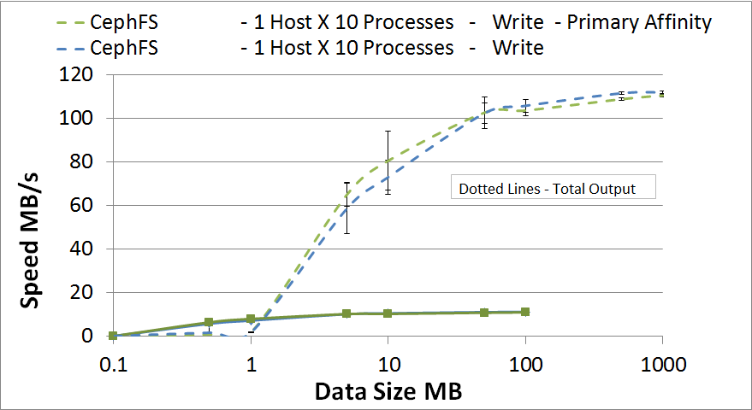
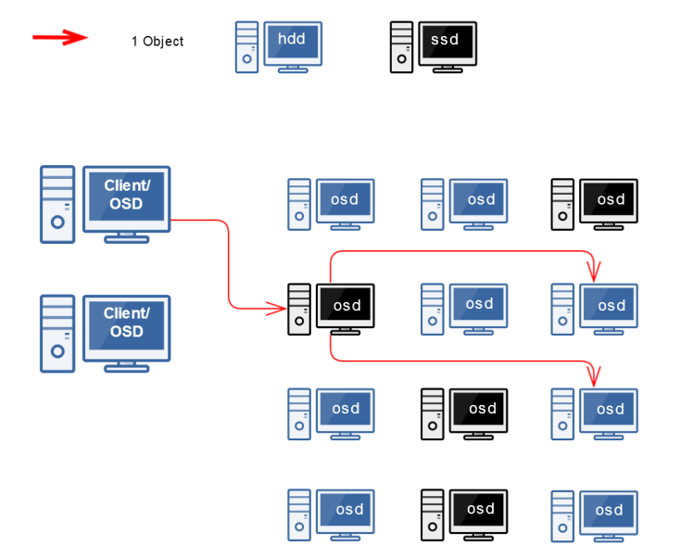
Primary Affinity with SSD OSDs
Replace 1 HDD OSD per node with 1 SSD drive.
Set the primary affinity on the SSDs to 1.0
while all other OSDs are set to 0.0
  Theory is that the SSD OSDs will be accessed 100%
  for initial writes and HDD OSDs will be accessed 0%
  If Primary Affinity is set to 1.0 on SSD OSDs &
  0.5 on HDD OSDs: SSD should be accessed 75%
  and HDD will be access 25%
After testing multiple PA configurations
the performance was unchanged
Each OSD has individual weights per drive
(determines the fill ratio)
  OSD weights are taken into account when using PA
  and may cause a skew in the expected performance
  STAR’s Ceph cluster (2TB HDD & 1TB SSD – 2:1 fill ratio)
Possible explanation
  The SSDs may be finished but still waiting for the HDD
  to sync causing no performance gain.

Slide 11
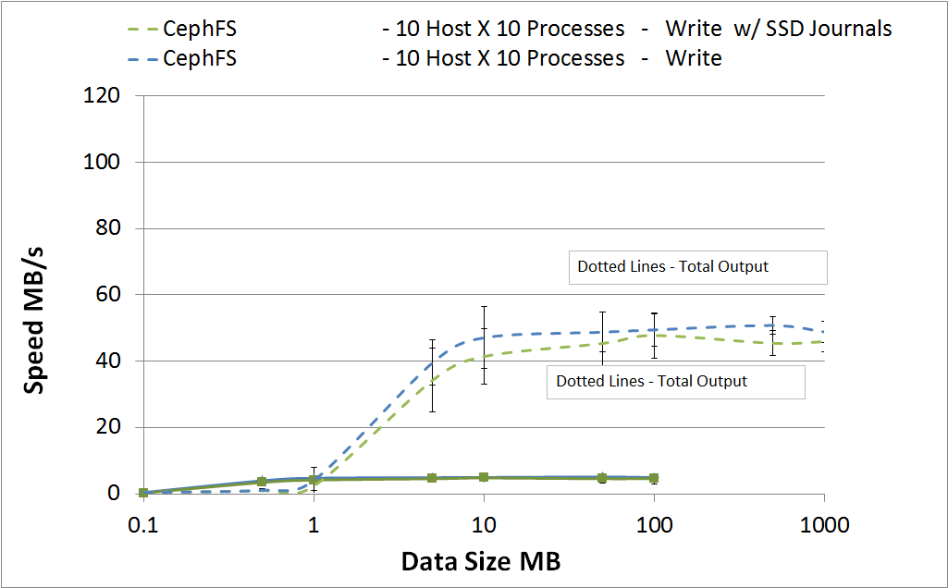
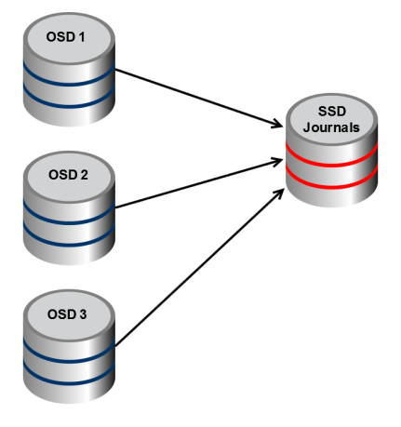
Mount Ceph OSD Journals on SSD
Ceph OSDs writes twice to the disks (not simultaneously), first to the journal and second to the filesystem (with the XFS filesystem format).
Lots of I/O would cause lots of journal operations (and small IO, possibly becoming random with process concurrency)
Test: All nodes have their journal operation set
to occur on SSDs, all other IOs to HDD
Results
No performance gain seen with the OSD journals mounted on SSD
We know Ceph performs journal operations using D_SYNC and O_DIRECT – this should however not influence IO over multiple threads (and the random access caused by concurrency)
10 processes for 10 clients (100 simultaneous writes) may not be enough to see a difference

Slide 12
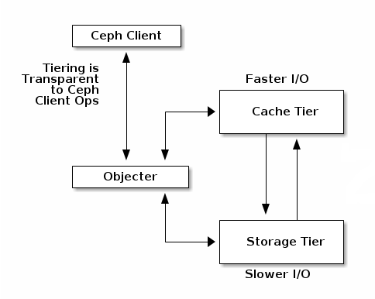
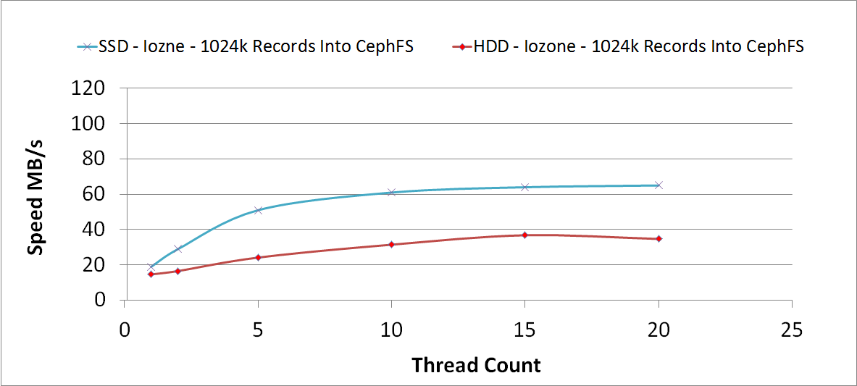
Cache Tiering
Cache teiring is configured where a small pool of
fast drives (SSD) is overlaid on top of a larger
slower pool (HDD)
A cache tiering storage pool is represented as one
storage pool to the user
The client will write into the fast pool, as the pool
begins to fill to a specified percentage the fast pool
will release cold data (old data/ data not accessed often)
Cache tiering is not implemented in CephFS yet,
however the speed gain should be seen in a “only SSD” / “only HDD” CephFS storage comparison

Slide 13
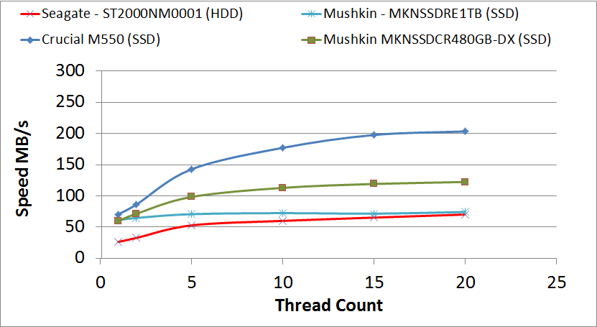
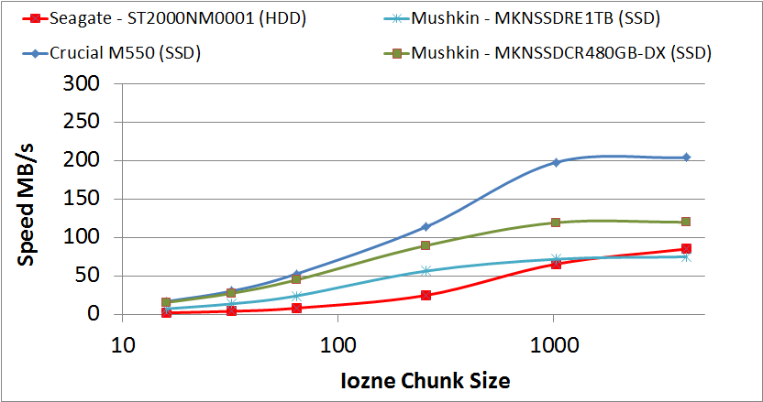
Use of SSD
Manufacture Spec
We have obtained a few different models
of SSD drives (4 x 1TB Crucial M550,
20 x 1TB Mushkin MKNSSDRE1TB, &
4 x 480GB Mushkin MKNSSDCR480GB-DX)
Iozone test were performed to define
raw performance of drives
Drive | Write MB/s | Read MB/s | IOPS Write | IOPS Read
Crucial M550 | 500 | 550 | 80,000 | 90,000
Mushkin MKNSSDRE1TB | 460 | 560 | 76,000 | 74,000
Mushkin MKNSSDCR480GB-D | 455 | 540 | 42,000 | 42,000
With large block size (1024KB) the SSD outperforms the HDD as the number of threads increase
With small IO, even at 15 threads the performance between the drives are the same.
As the chunk size increase the SSD outperforms the HDD
1024KB Records Iozone Writes
15 Thread Iozone Writes

Slide 14
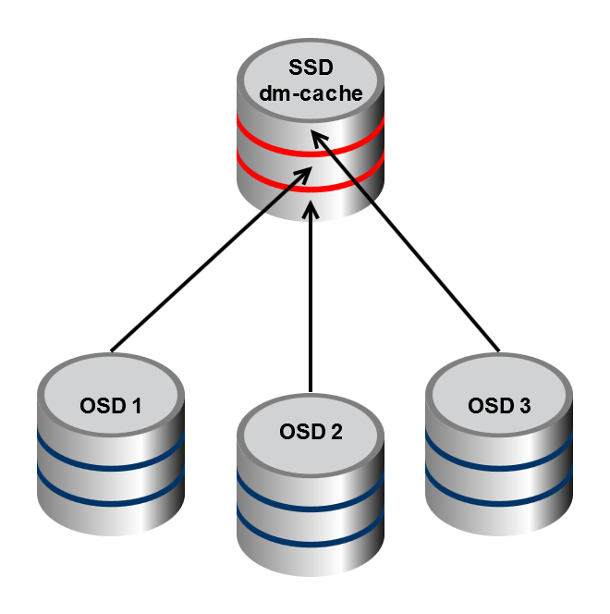
dm-cache – an alternative to recover performance
dm-cache is one example of a disk caching framework which is not part of the Ceph features
  dm-cache allows a (fast) SSD drive to act as a cache for regular (slower) HDDs.
  The two drives are paired to act as one volume and will have faster I/O due to the SSD acting as cache
  dm-cache deploys their own policy on how/when to write data to the backing HDD
Would circumvent the “affinity” and “weight”
mechanism as Ceph would have no ideas of
the presence of SSD
Pro: dm-cache handles at low level the caching and
migration, Ceph IO always goes first to SSDs
Cons: if the SSD dies, we lose 3 OSDs
dm-cache has not yet been tested in our cluster If our IO test
results (previous slide) are right, applying the this technique
should create the performance impact / benefit we seek.

Slide 15
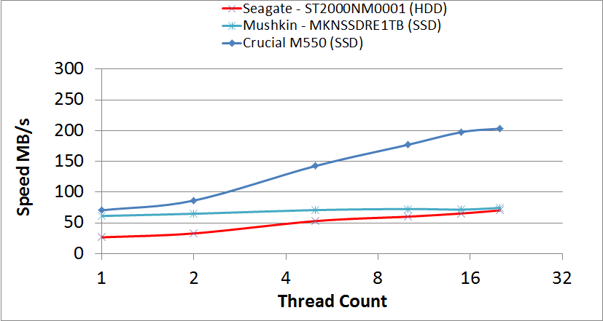
Cost Comparisons
Crucial M550 1TB SSD: $500 per drive
Mushkin 1TB SSD: $270 per drive
Seagate SAS 2TB HDD: $180 per drive
CRUCIAL: Cost impact ~1:2.1
performance increase ~1:2.5
MUSHKIN: Cost impact ~1:1.5
performance increase ~1:2
Drive | Size | Cost | Cost per TB
Seagate SAS | 2TB | $180 | $90
Crucial M550 | 1TB | $500 | $500
Mushkin MKNSSDRE1TB | 1TB | $270 | $270
Drive | Cumm. Size | Cumm. Cost | Cost per TB | Cost % over base | Perf % over base
4 X Seagate SAS Per node | 8TB | $720 | $90 | ___ | ___
3 X Seagate SAS & 1 x Crucial SSD Per node | 7TB | $1040 | $192 | 115% | 160%
3 X Seagate SAS + 1 x Mushkin SSD Per node | 7TB | $810 | $135 | 50% | 100%

Slide 16
Conclusion
What we have learned
The process in which Ceph writes to the OSDs brings difficulty when only replacing a portion of slow hardware with faster hardware – asymmetric size increase confusion (battle between weight and affinity)
Journaling could help but in very specific (and large scale concurrency) cases
Not all SSDs fall from the same tree – test carefully first
Cache teiring (composed of SSD pools) may be the only Ceph option to see a performance increase – not available in CephFS
dm-cache appears to be a promising solution, combining “cache tier-like” features while providing a POSIX FS to users (CephFS on top)
Outcomes & Future work
dm-cache may be our only solution for performance increase with current hardware allocations. Testing on the way (unfortunately, was not ready for this conference)
Our cluster has been running for ~ 1 year and has served as a successful distributed storage system for our users and has thus far delivered consistent data

