Slide 1



ENERGY DEPOSITION STUDIES
Maria Ilaria Besana & Francesco Cerutti
2015 June 1st

Slide 2
WHAT WE ARE DOING
Radiation impact on the triplet
peak power density (which quench limit?) and dose in the Nb₃Sn coils
as a function of the tungsten (INERMET) inner shielding thickness
preliminary (not conservative) assumption: continuous shielding along the InterConnects, no beam screen
explored L*=36 and 61.5m technical report in preparation
Effect of operation condition optimization
regular swap of the vertical crossing angle sign (and of the crossing plane), as suggested by S. Fartoukh
Radiation levels in the detector
maps of dose, 1MeV neutron equivalent fluence, high energy hadron fluence, charged particle fluence
Outside this scope:
beam-gas interaction impact on the arc cell
see Besana’s talk in Washington

Slide 3
RADIATION IMPACT ON THE TRIPLET
150
~40 MGy after 3ab⁻¹, present insulation limit taken at ~30 MGy, goal of 30ab⁻¹ …

Slide 4
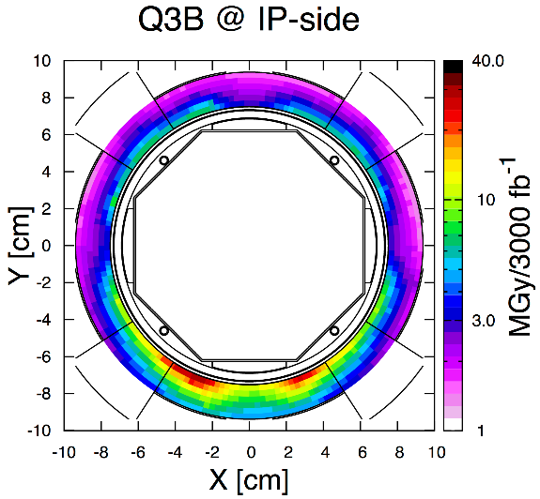
OPTIMIZING OPERATION MODE
+295 urad half vertical crossing angle (upwards)
HL-LHC
what about running half of the time at inverted angle? [S. Fartoukh]
for a –y reduction of a factor x (=5), peak dose gain of (x-1)/2x (=40%) and integrated lumi increase of (x-1)/(x+1) (=67%)

Slide 5
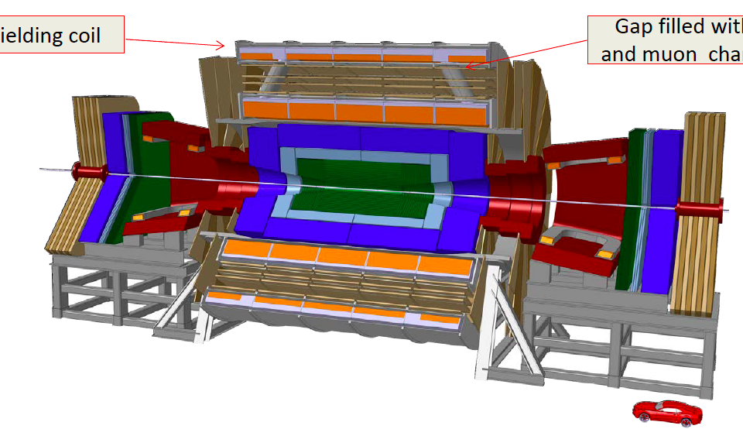
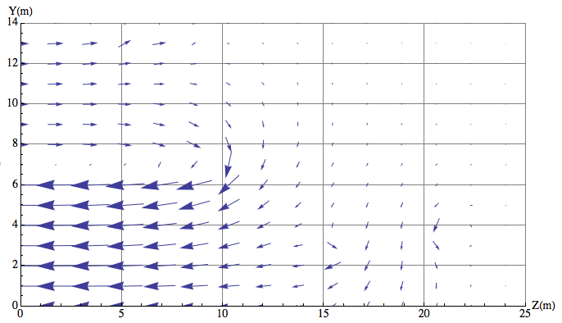
RADIATION CHARACTERIZATION IN THE DETECTOR
solenoid and dipole field [H. Ten Kate]
Tracker
ECAL
HCAL
Coil
Muon system
input through the MDI group
[W. Riegler]
Beampipe and Forward part to be defined

