Slide 1
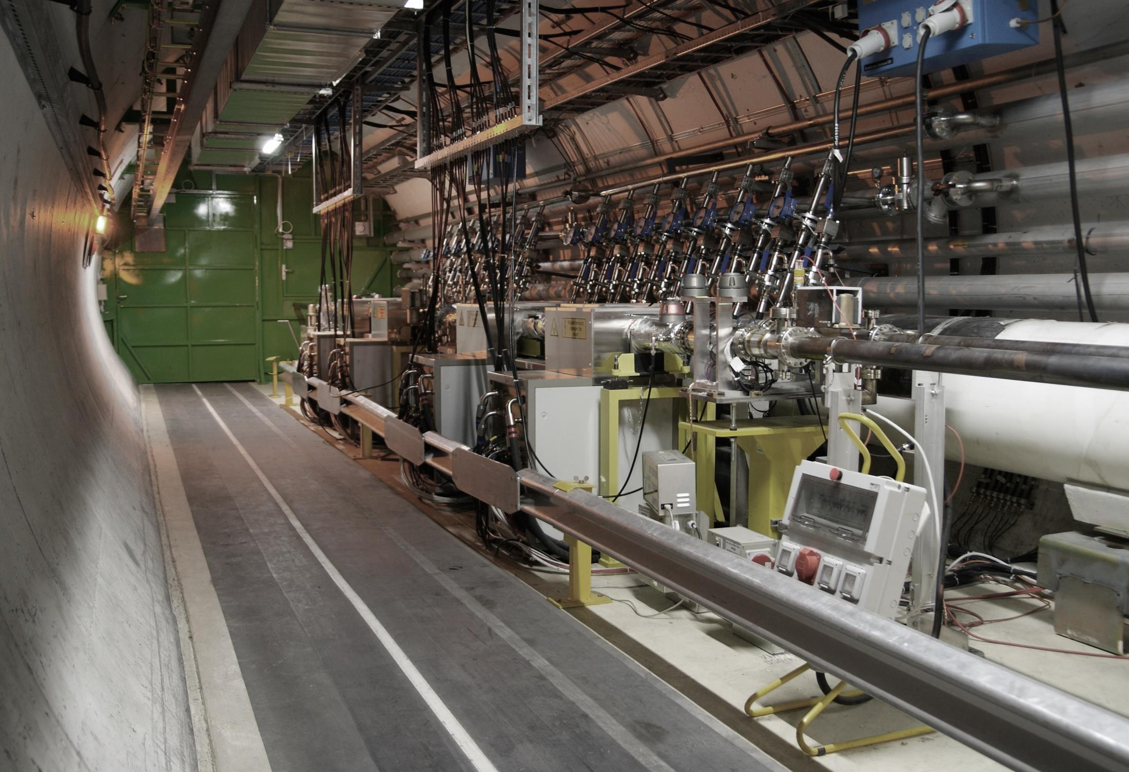
ADT Transverse Feedback & Gap Cleaning
Readiness for MJ Beams
June 2015
Wolfgang Hofle, CERN BE-RF for ADT Team

Slide 2
LHC Transverse Damper (ADT)
  Initially designed for
    Injection oscillation damping
    Feedback during ramp (coupled bunch instabilities)
  LHC Physics Run 1 (2010-2013)
    Providing stability at all times in the cycle
    (including with colliding beams !)
    Diagnostic tool to record bunch-by-bunch oscillations
    Abort gap and injection cleaning
    Blow-up for loss maps and aperture studies
    Tool to produce losses for quench tests
    Tune measurement (under development)

Slide 3
Overview of ADT System
Lowlevel
system
Power system
Pick-ups
Pick-ups
Lowlevel
system

Slide 4
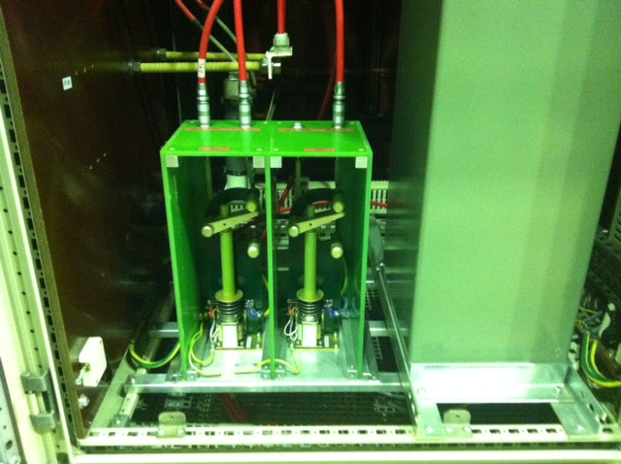
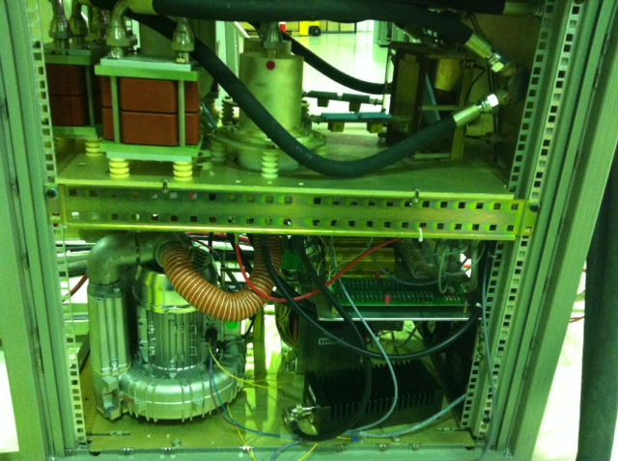
Status of changes with respect to Run 1
  Power system (increased reliability and availability)
    Maintenance of tetrode power amplifiers (16 + 4 spares)
    Maintenance of 32 driver amplifiers (200 W)
    Improvement of amplifier to kicker connection and new loads
    Vacuum interlocks (to minimize risk of false interlocks)
    Exchange of flow meters for water cooling interlocks
    Installation of HV switches in power converters to take one amplifier off if needed, and HV maintenance (done)
    Migrate controls of power system to FESA3 (to be done)
All operational and ready for MJ beams
    HV switch
    Tetrode amplifier
Team E. Montesinos

Slide 5
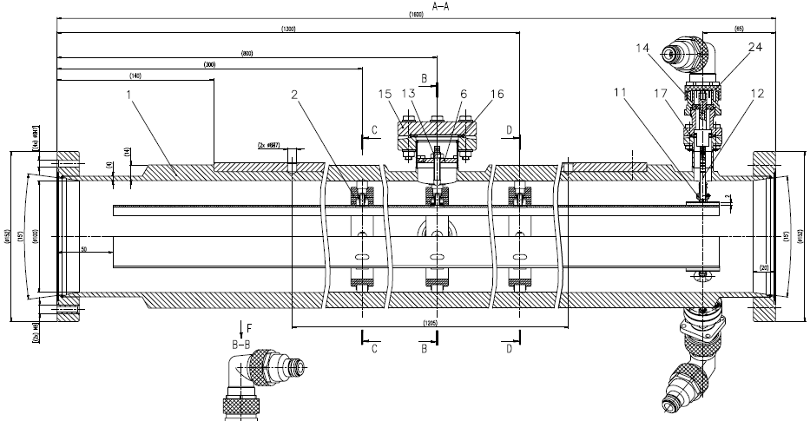
ADT kicker (16 x)
HOM port 1
(H front)
(V top)
signal can be observed (kick and beam !)
beam
tank: 1.6 m length
electrodes: 1.5 m length, supported by 3 ceramic rings
centering is achieved by accurately machines tank and ceramic rings
longitudinal expansion of electrodes possible by design
HOM port 2
(H back)
(V bottom)

Slide 6
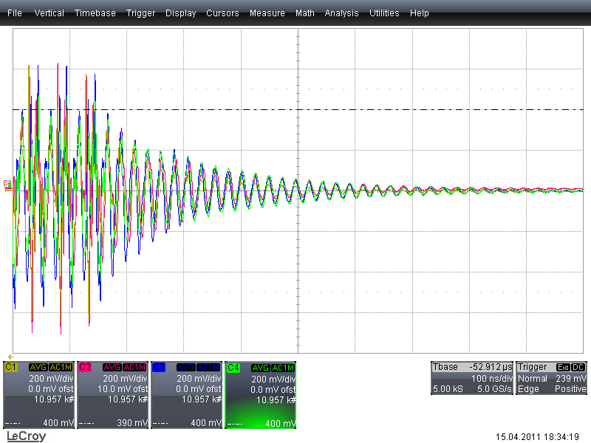
Beam induced signal on kicker
Resonance: close to 40 MHz
Q = 600, tau = 210 ns
~ 200 V induced by nominal beam
Watch this for
Intensity increase
with 25 ns
100 ns / div [10 div]
end of batch of 36 bunches @50 ns
15.04.2011; ok for next intensity step

Slide 7
Status of changes with respect to Run 1
  Lowlevel System (increased performance, flexibility)
    X-change of cables (8 pick-ups plus 8 new pick-ups) → done, but electronics for new pick-ups deferred to YETS 2015/2016
    New cables for 8 drive signals from surface (SR4) to UX45 (better pulse for AGC) → done
    New VME electronics for beam position detection → deferred to YETS 2015/2016 following experience in SPS with new mixers, production of hardware ongoing
    New VME mDSPU (signal processing) with independent gain control functions for cleaning and damping (4 independent DACs, analog outputs combined) → done
    Number of FGC functions increased → done
    Diagnostics: Instability trigger network → deployed, working on “last mile” to ADT
    Observation BOX → under development, first roll-out for long. plane
    New developments are in FESA 3 (e.g. abort gap and injection gap cleaning)

Slide 8
Pickups available for ADT after LS1 effectively no change in 2015 with respect to Run 1
B1 horizontal | Q10L | Q9L | Q7L | Q7R | Q9R | Q10R
 | β = 28 m | β = 127 m | β = 112 m | β = 78 m | β = 16 m | β = 158 m
 |  | existing | existing | new |  | new
B1 vertical | Q10L | Q9L | Q7L | Q7R | Q9R | Q10R
 | β = 172 m | β = 25 m | β = 52 m | β = 127 m | β = 138 m | β = 38 m
 | new |  | new | existing | existing
B2 horizontal | Q10L | Q9L | Q7L | Q7R | Q9R | Q10R
 | β = 164 m | β = 17 m | β = 60 m | β = 173 m | β = 106 m | β = 30 m
 | new |  | new | existing | existing
B2 vertical | Q10L | Q9L | Q7L | Q7R | Q9R | Q10R
 | β = 36 m | β = 140 m | β = 169 m | β = 23 m | β = 34 m | β = 181 m
 |  | existing | existing | new |  | new
New pick-ups to be made operational in YETS 2015/2016

Slide 9
Reasons for change: “DSPU”
Run 1
need to combine four pick-ups
Separate control for all features with high resolution calls for independent output DACs
digital links to future diagnostics HW
adequate number of spares missing
Run 2
work ongoing
vision
@end of Run1

Slide 10
New VME mDSPU for ADT signal processing
Status:
Installed and operational
New LSA functions for control operational
New firmware, FESA classes, including for cleaning and blow-up
SPS as testbed:
Board is also in use in SPS since 2014 run
G. Kotzian, T. Levens, D. Valuch

Slide 11
ADT during the cycle
Run 1 damping times:
Run 2: We can increase FB gain at flat-top (witness bunches with low gain)

Slide 12
Commissioning status: Done
  Set-up for probe, nominal and 50 ns trains
  Transverse blow-up (loss maps etc.)
  Functions in ramp: values programmed
  Cohabitation with BBQ with low gain on witness bunches
  Link for chirp sent from BI
  Abort Gap cleaning: Basic set-up for 450 GeV
  Injection Oscillation display
  Logging (under verification, some issues)
  Damping gain measurement and optimization, calibrations
    < 50 turns at 450 GeV, single bunch
    < 100 turns at 6.5 TeV, single bunch ?

Slide 13
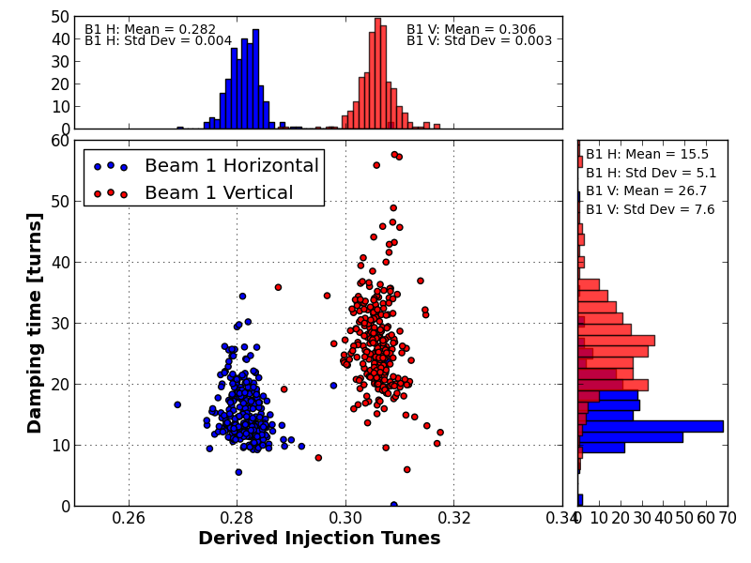
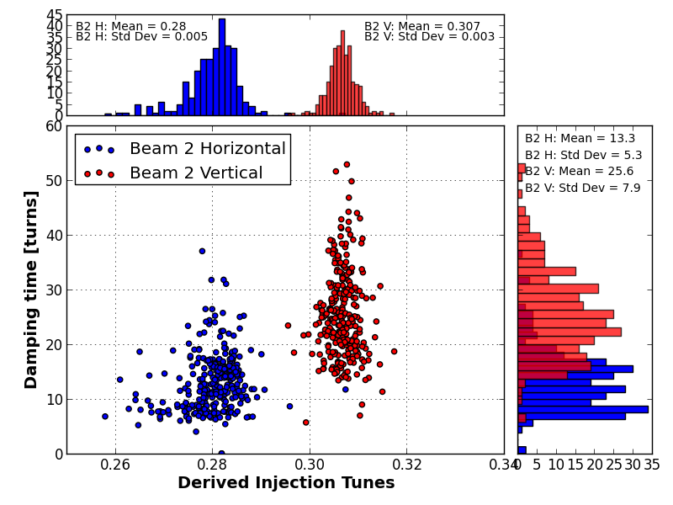
Run 1 performance with 50 ns trains
(1st bunch of injected train)
Need to recover this
Beam 2
H: 13 turns
V: 26 turns
V
H
V
H
Beam 1
H: 16 turns
V: 27 turns
Macpherson
CERN BE-OP & BE-RF
(first bunch of train)

Slide 14
Commissioning status: To do
(musts for MJ in red)
Injection gap cleaning (needed to inject long bunch trains)
Abort gap cleaning at 6.5 TeV
  Commission procedures linking abort gap cleaning to abort gap monitor (automatic switch-on was planned)
  Pulse shape is bipolar, optimization of edges to limit effect outside gap
50 ns trains: frequency response and hold algorithm to push gain
Bunch trains 25 ns → full set-up of fine delay
  > 20 MHz BW commissioning, frequency response optimization
  25 ns trains can be injected with the 50 ns basic settings (bandwidth will be limited to 10 MHz)
verify post mortem
  concurrent use of post mortem buffer for observation during scrubbing run

Slide 15
Commissioning status: To do
(including “exotics”)
Settings switching between probe and nominal
  joint development between OP and RF (Daniel, Reyes)
Flat frequency response in squeeze and collide Beam Process
Scrubbing doublet beam set-up and commissioning
  first test with trains during first scrubbing run
Deployment of “observation box” to collect ADT data for studies and potentially tune feedback
Connect, configure and commission triggering via the instability trigger network
  First application of instability trigger network in BI: connection of headtail monitor and BBQ

Slide 16
State Machine for Intensity Switching
will be extremely useful to have probes visible
can be extended to automatic switching between settings for bunch spacing
needs thorough check before roll-out
R. Alemany, D. Valuch

Slide 17
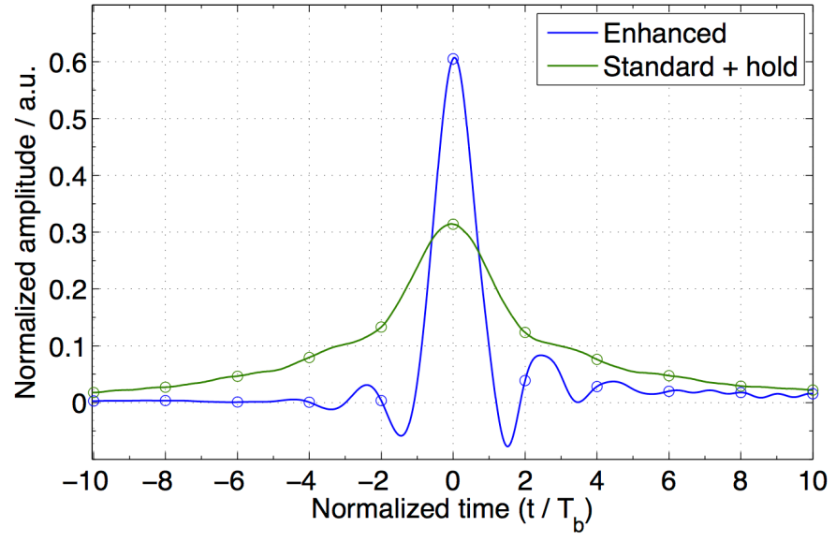
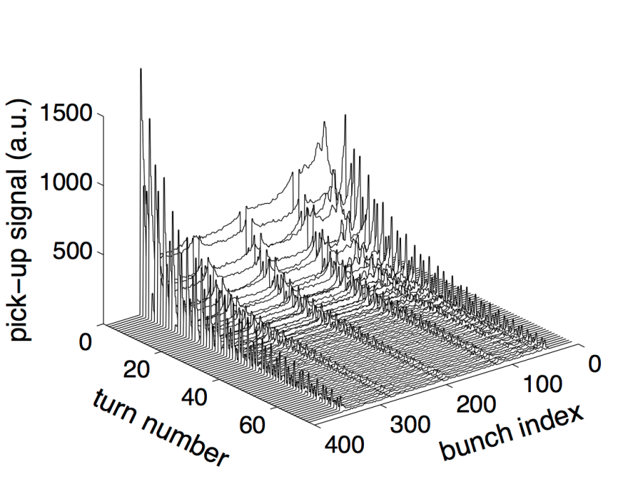
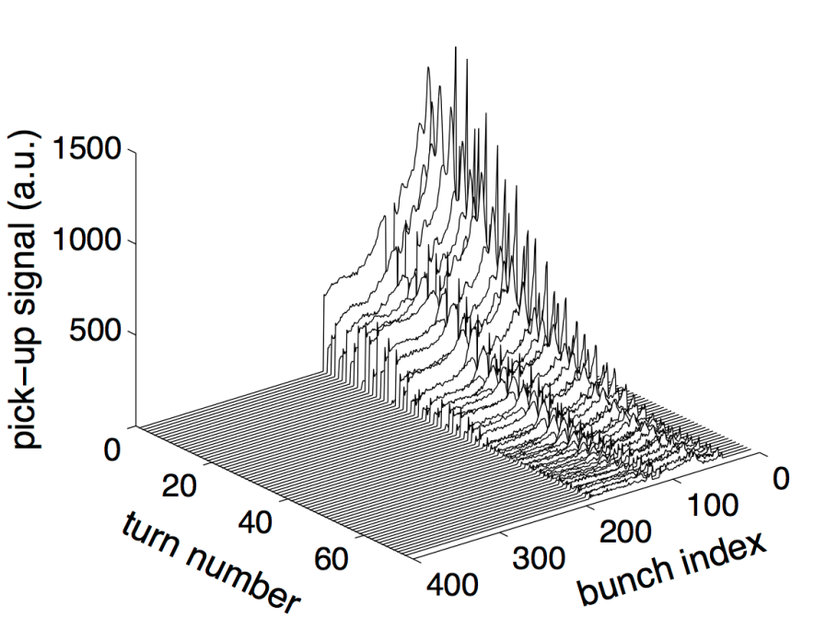
Towards 25 ns operation in 2015
For 2015:
response of ADT→
continue optimization
for 25 ns running
50 ns bunch spacing
standard + hold
144 bunches (4x36)
25 ns bunch spacing
enhanced bandwidth
144 bunches (2x72)
Injection
oscillation
damping
LHC ADT 2012 performance
IPAC’13, WEPME43

Slide 18
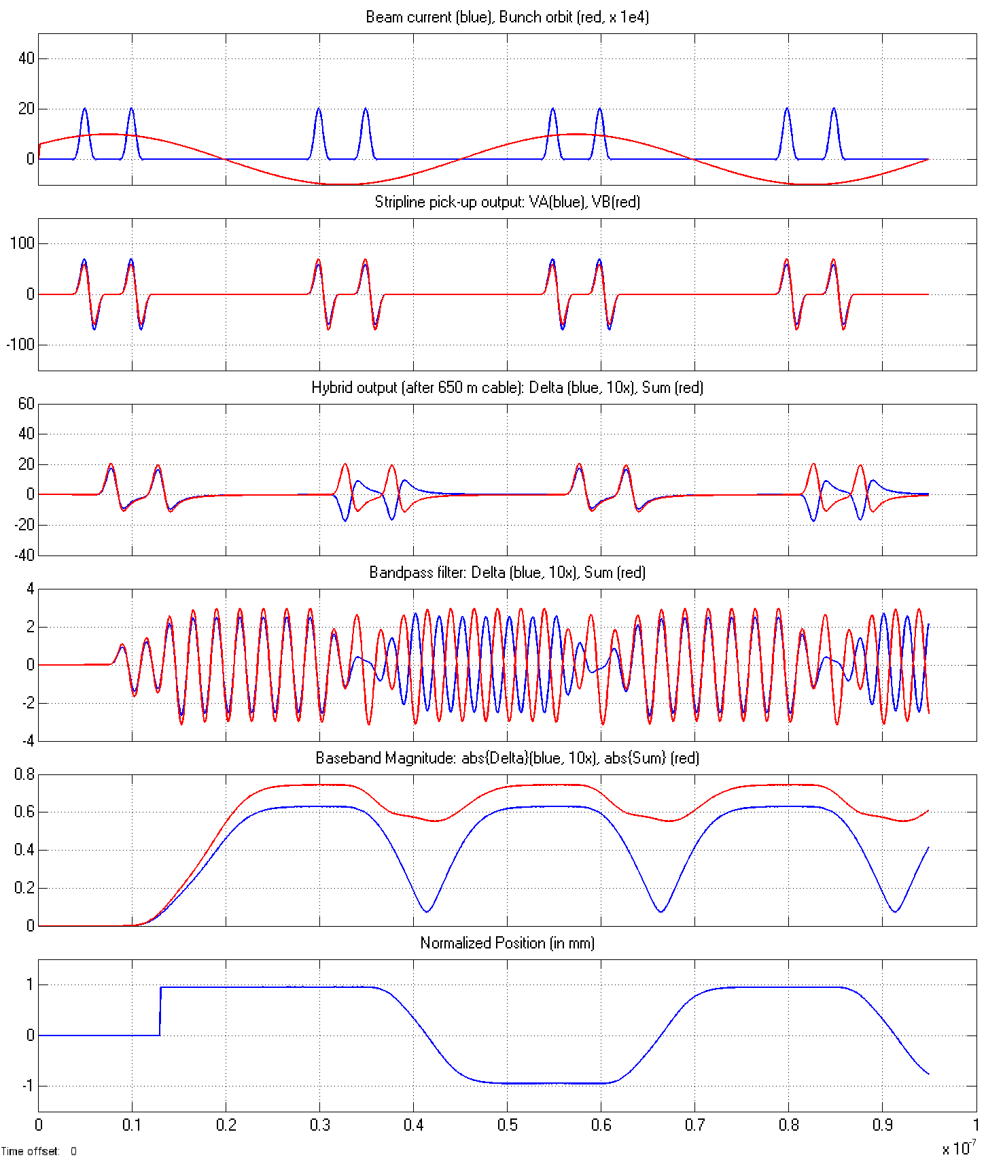
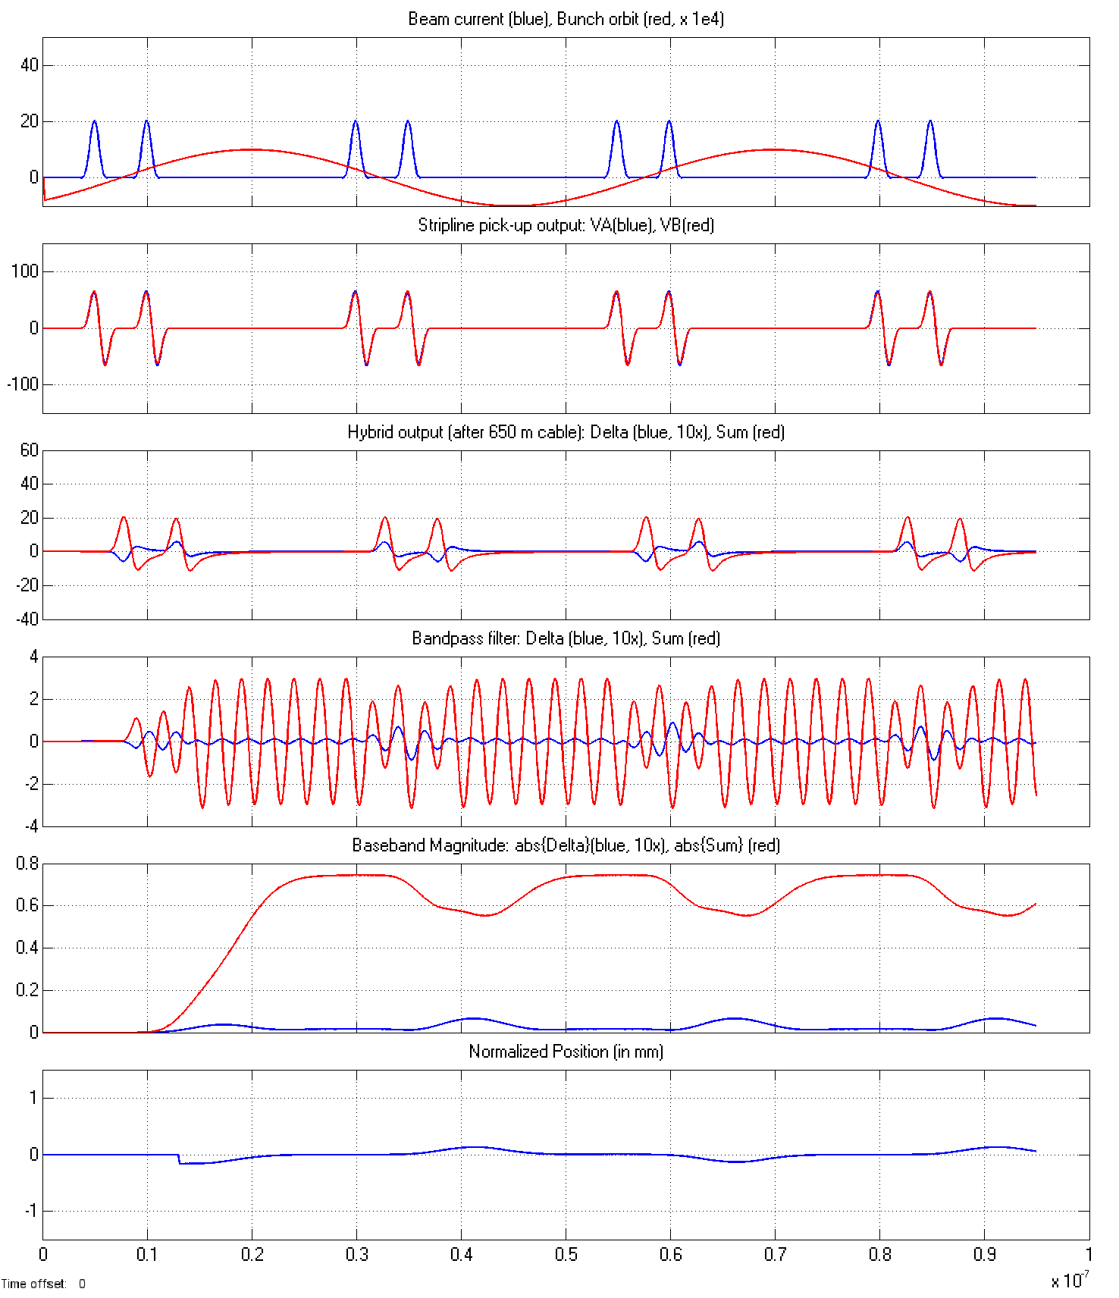
LHC ADT BPOS: Readiness for scrubbing beam
centre of gravity oscillation (even parity)
within bunchlet oscillation (odd parity)
20 MHz odd mode: no movement of COG
down
up
up
leads to cancelation
down
→ odd mode invisible
G. Kotzian @LBOC 26.11.2013
x10⁻⁷
current and future LHC ADT HW ready for 5 ns bunchlets
requires separate set-up (fine delays for clocks)

Slide 19
Conclusions
ADT hardware and software - for power and lowlevel - are ready for MJ beams
Commissioning is well advanced
Abort gap and injection gap cleaning a must for MJ beams, need commissioning time, commissioning of abort gap cleaning started with 450 GeV, to do 6.5 TeV
Bunch trains at 25 ns and 50 ns as well as doublet beams need set-up time
Recovering Run 1 performance and reacting to requirements from tune feedback and to fight instabilities is an iterative optimization process

