Slide 1
MPP Workshop:
Injection System
C. Bracco on behalf of ABT
Acknowledgments: STI, ABP, BI,LHC and SPS OP

Slide 2
Outline
TL steering and IQC
Injection losses
LSS6 extraction
Injection protection collimators (Optics_ID)
TDI limits
MKI risetime

Slide 3
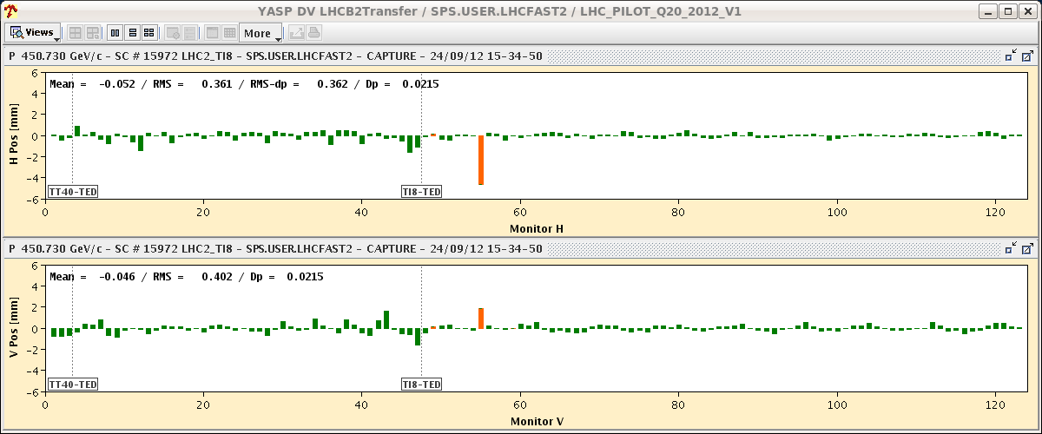
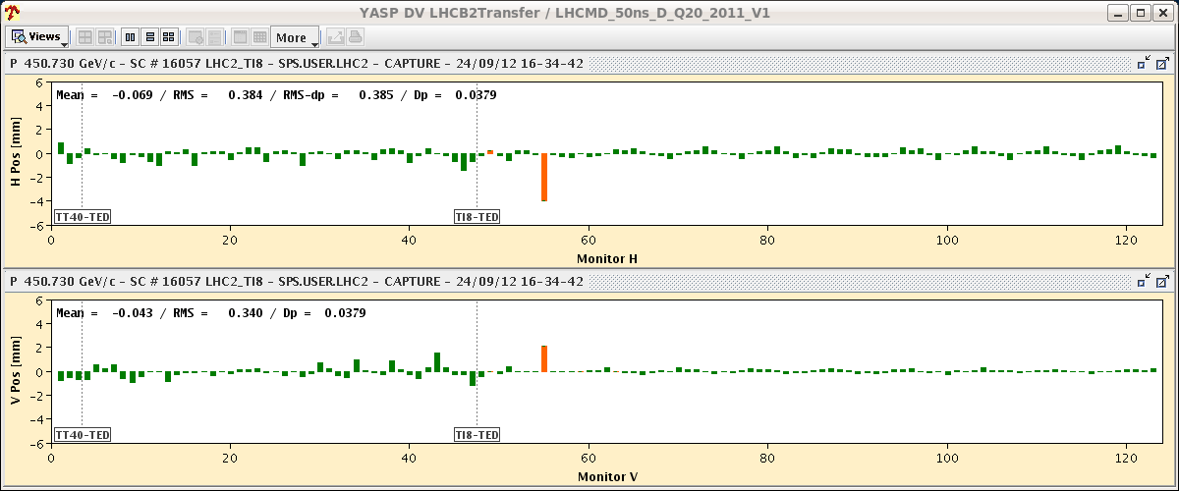
TL Steering
Known issue: different trajectories for fast-PILOT and slow-INDIV/25ns cycles (slower ramp and different magnetization ➔ “different” extraction)
PILOT
INDIV

Slide 4
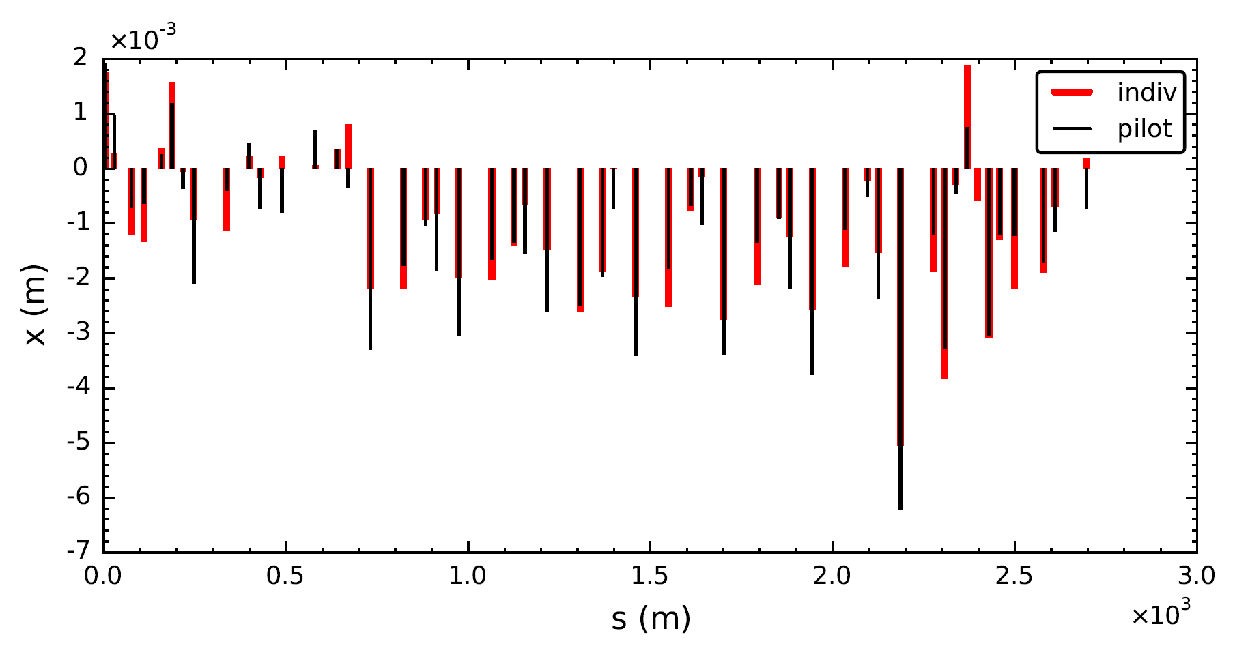
TL Steering
Known issue: different trajectories for fast-PILOT and slow-INDIV/25ns cycles (slower ramp and different magnetization ➔ “different” extraction)
GOLDEN trajectory defined with INDIV
TCDI setup and validation done with PILOT beam
“Bad” trajectory for PILOT beam in operation
At the beginning of Run 2 the INDIV beam was on the FAST cycle ➔ almost same trajectory and injection oscillations for both beams (only difference due to BPM sensitivity) ➔ GOLDEN trajectory established with INDIV on FAST ➔ TCDI setup and validation done with this reference
Moved to INDIV on SLOW beam process ➔ need to steer back to GOLDEN reference and a larger difference (>1mm) between PILOT and INDIV was observed wrt Run 1
Check difference in trajectory at TCDI < 0.5 σ
TI 8 H plane
F. Velotti

Slide 5
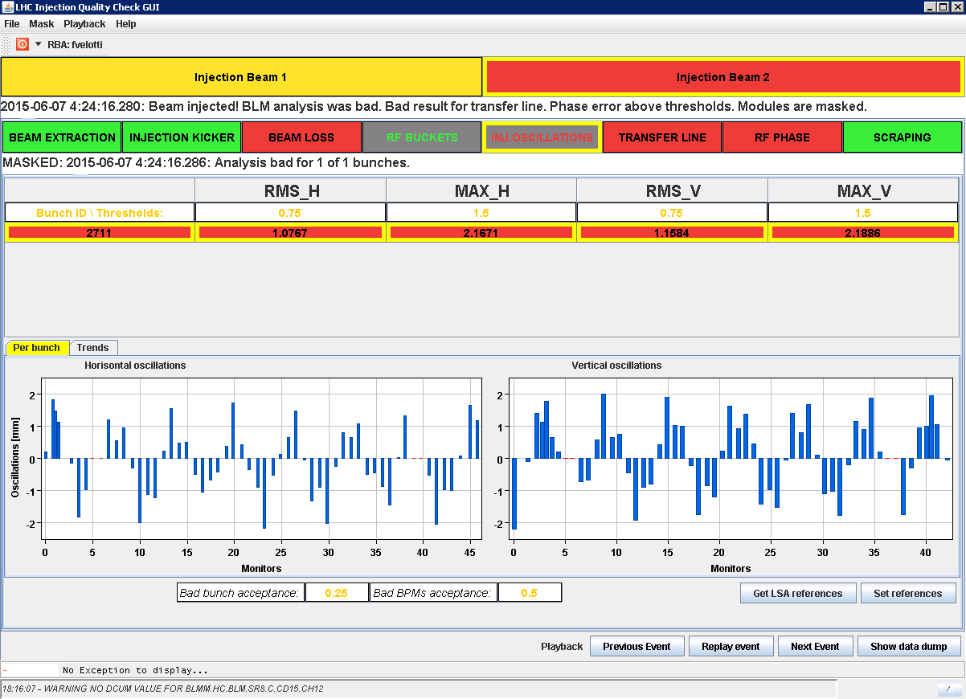
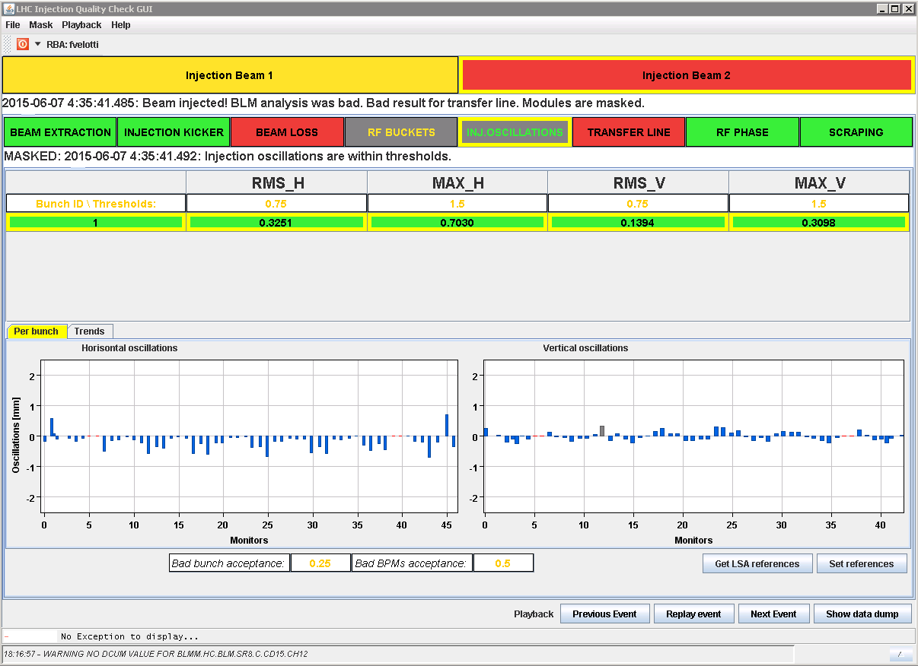
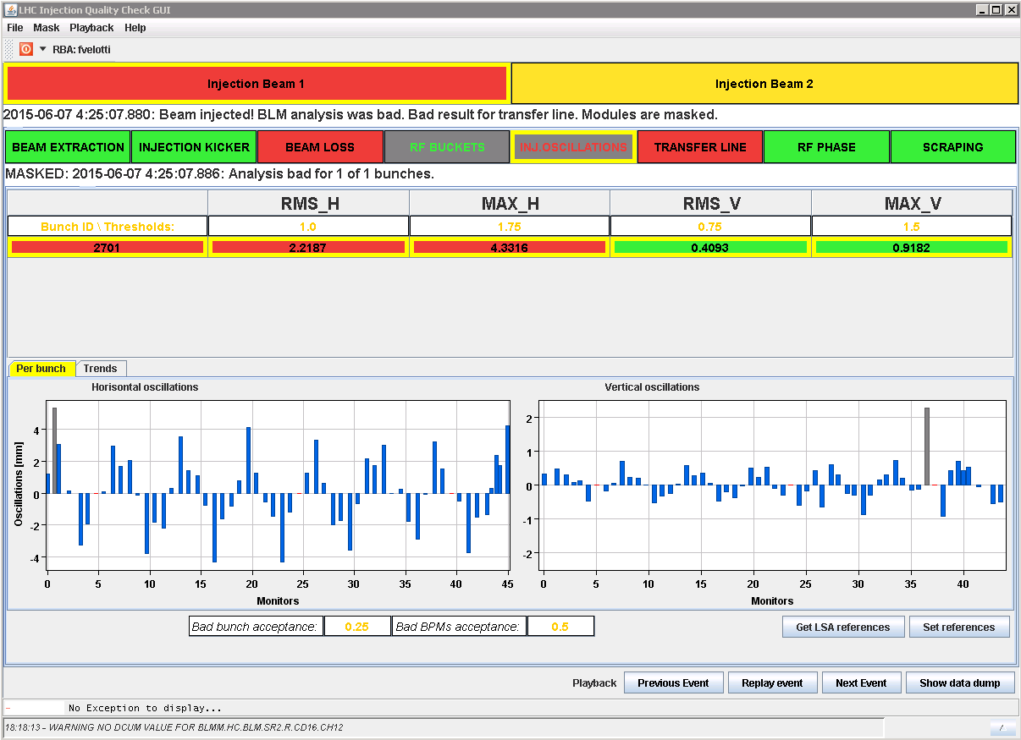
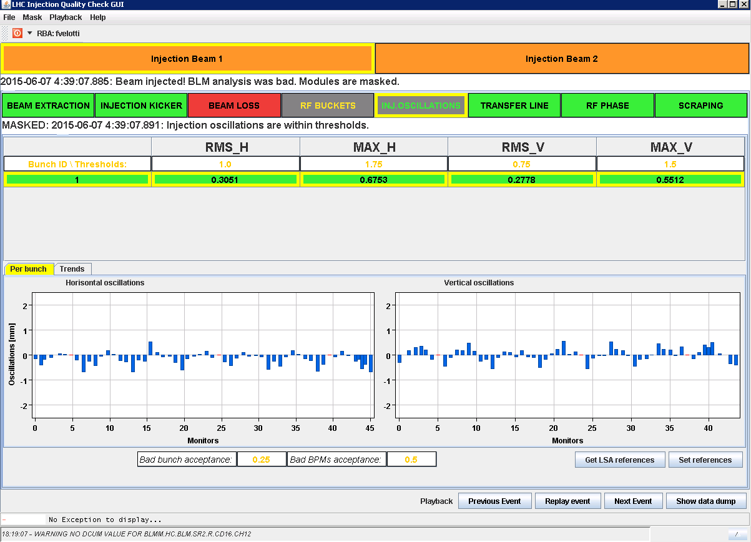
PILOT Beam vs INDIV
Beam 2 Peak to peak injection oscillations:
Pilot H = 3.8 mm
V = 4.1 mm
INDIV H = 1.3 mm
V = 0.6 mm
PILOT
INDIV
Beam 1 Peak to peak injection oscillations:
Pilot H = 8.4 mm
V = 1.6 mm
INDIV H = 1.2 mm
V = 1.2 mm
PILOT
INDIV

Slide 6
PILOT Beam vs INDIV
Beam 2 Peak to peak injection oscillations:
Pilot H = 3.8 mm
V = 4.1 mm
INDIV H = 1.3 mm
V = 0.6 mm
PILOT
INDIV
Not critical for high intensity injections but
LHC setup done with a huge probe beam and IQC always failing.
Possible solution: PILOT on SLOW cycle
Beam 1 Peak to peak injection oscillations:
Pilot H = 8.4 mm
V = 1.6 mm
INDIV H = 1.2 mm
V = 1.2 mm
PILOT
INDIV

Slide 7
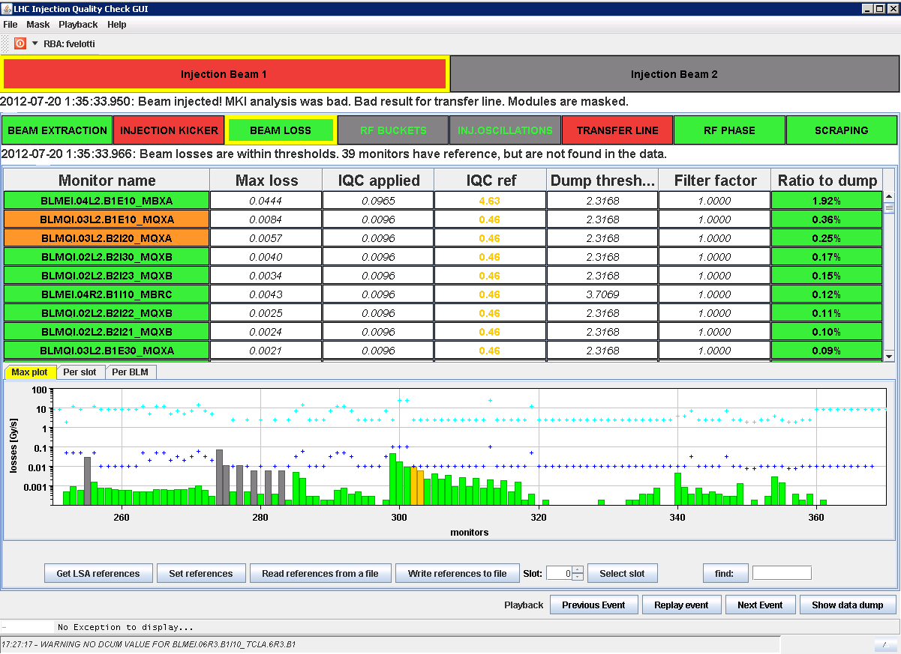
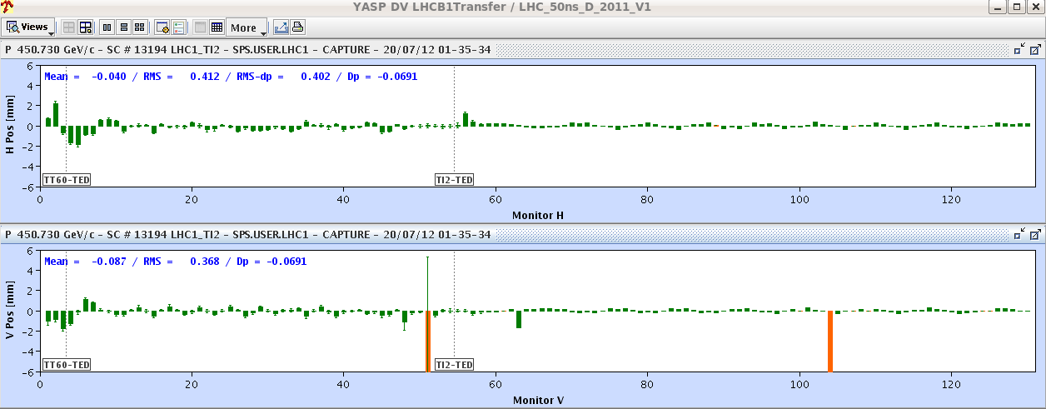
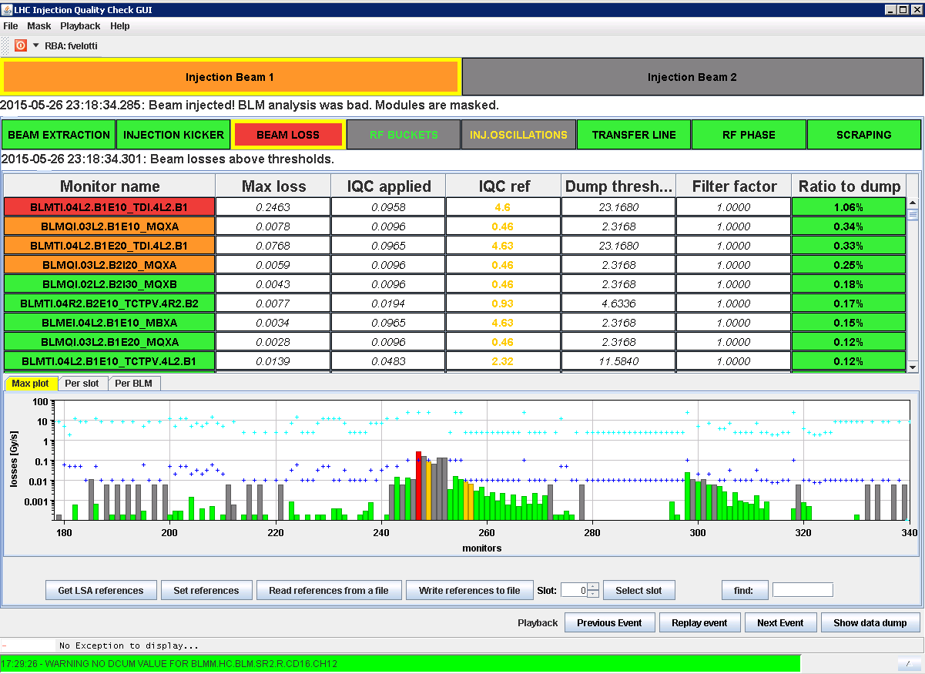
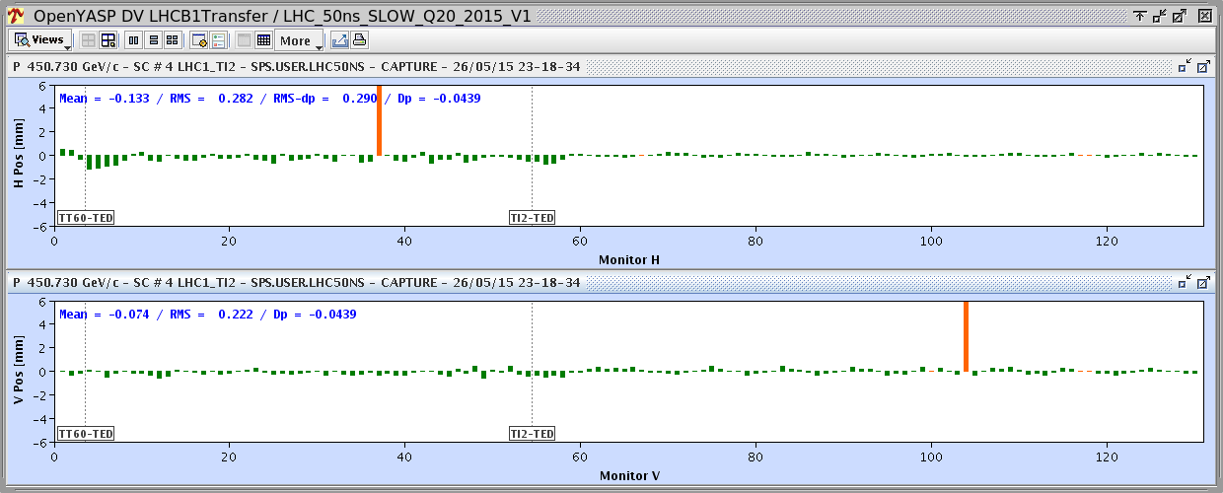
6 Bunches Injection Beam 1
Run 1 - 6 bunches
1.92%
Run 2 - 6 bunches
1.06%

Slide 8
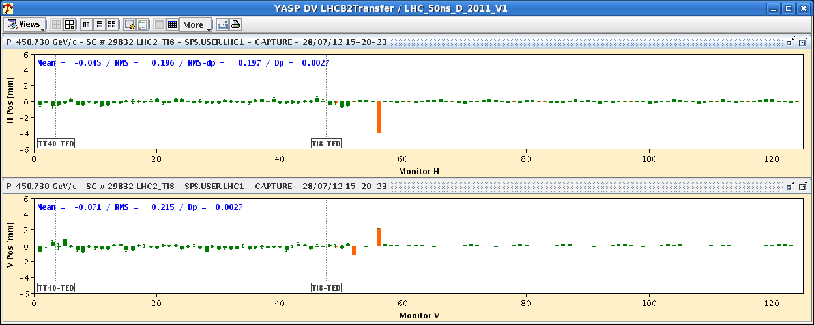
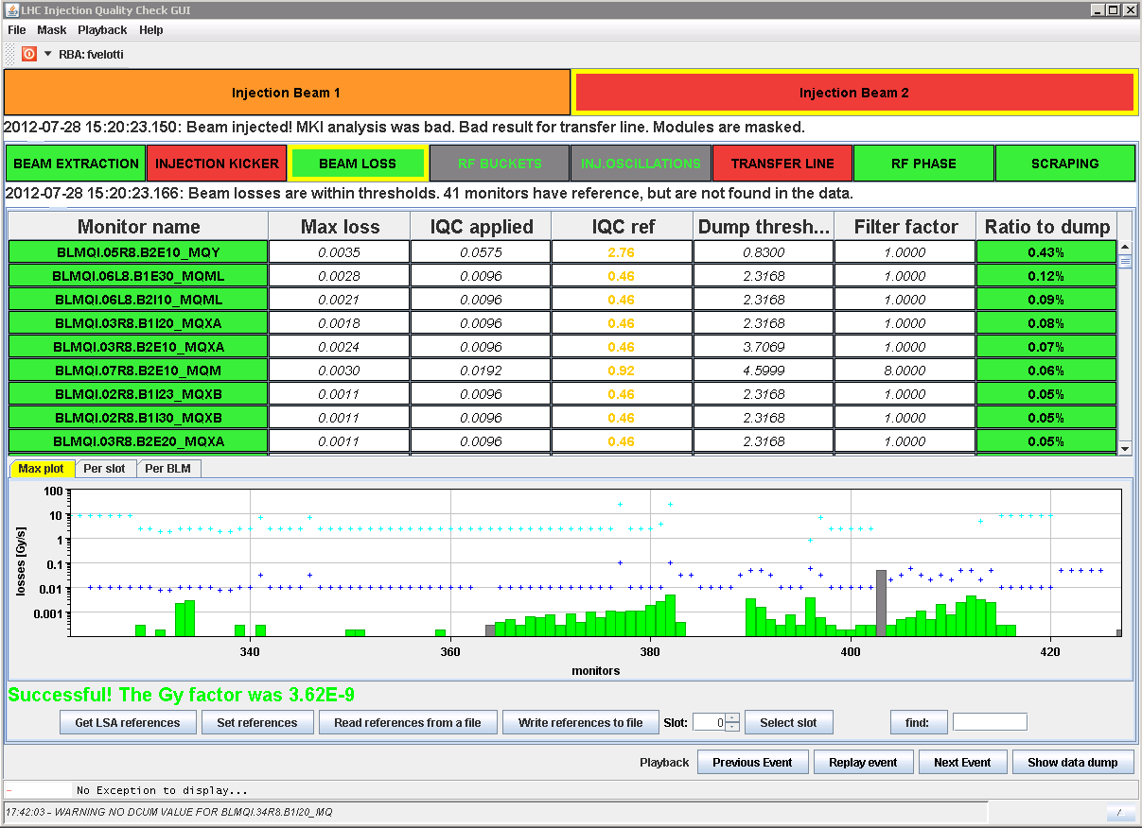
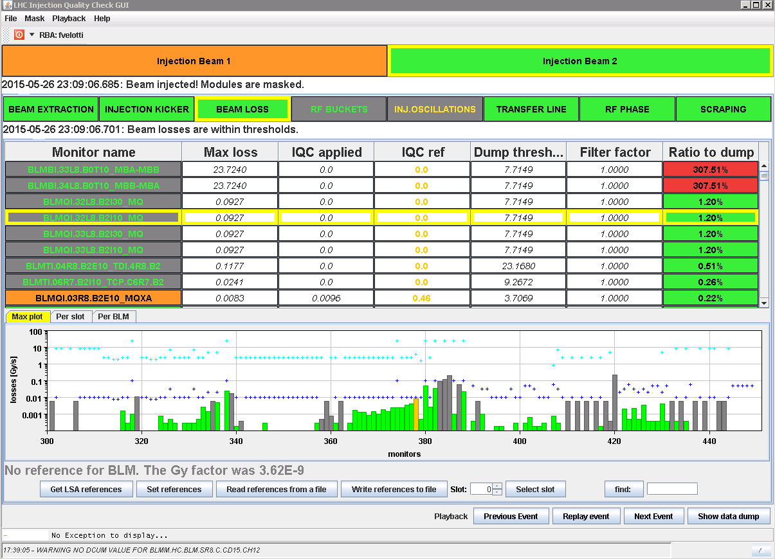
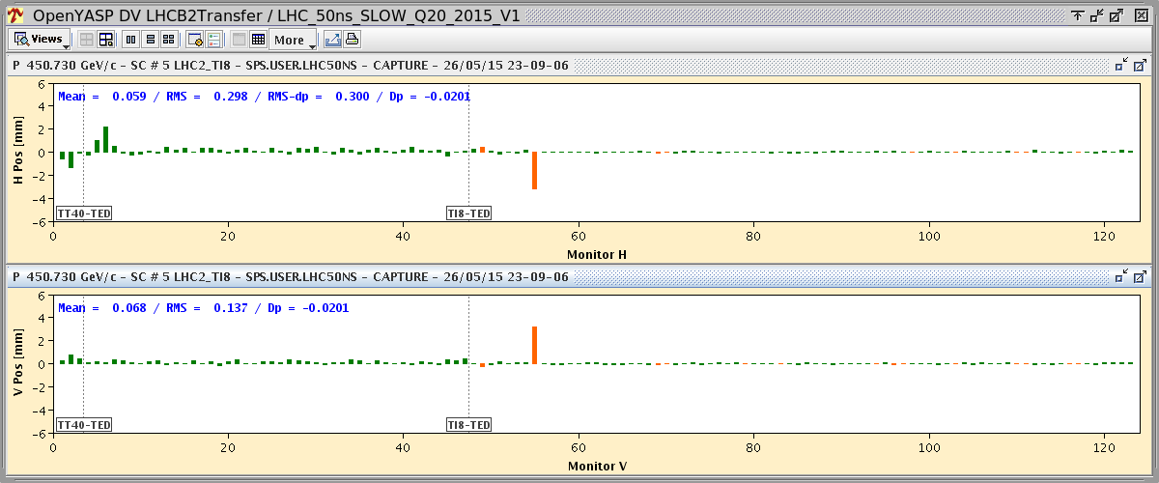
6 Bunches Injection Beam 2
Run 1 - 6 bunches
Not in injection region and unphysical, to be checked!
0.23%
1.20%
Run 2 - 6 bunches

Slide 9
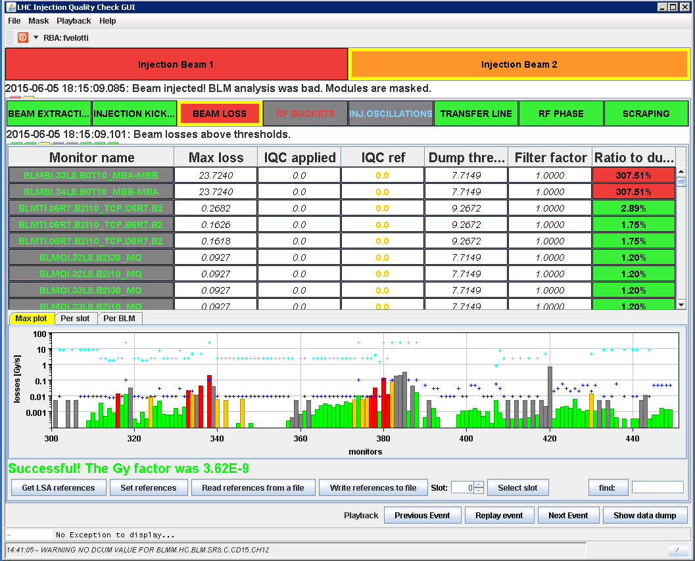
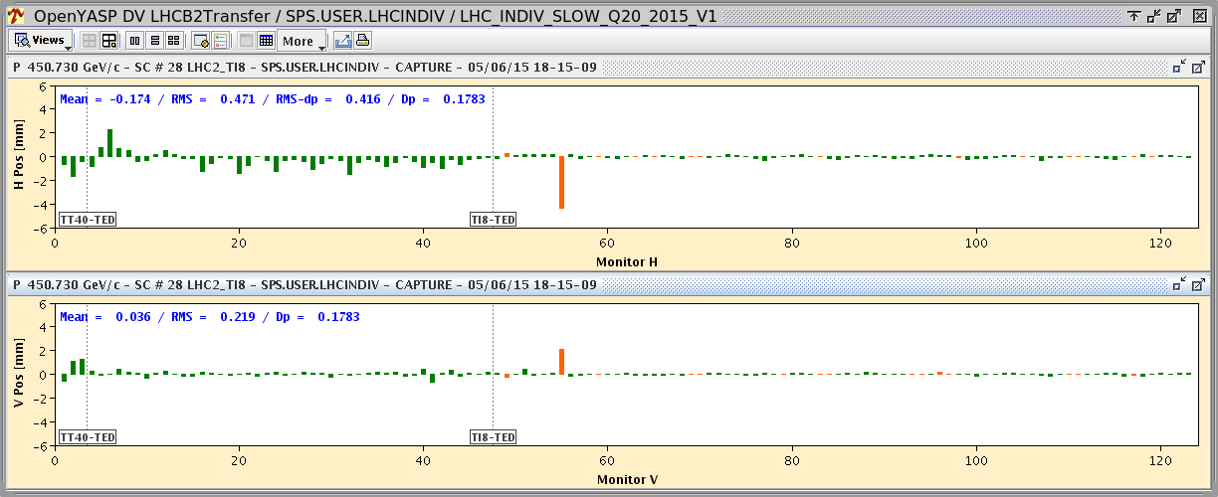
Bend Repaired in TI8
To be further investigated!!
From LHCOP logbook 03/06/2015 14:41:
- SPS: bend repaired in TI8. RBI in TI8 changed by 4 A*. To be checked next injections.
Start loosing in IR7
Best achievable steering in TI 8 to minimize injection oscillations
1.20%
TL Collimators
* Intervention on Acquisition card to correct a 4 A offset (0.04%) between the DAQ and the Power converters to solve a FEI issue

Slide 10
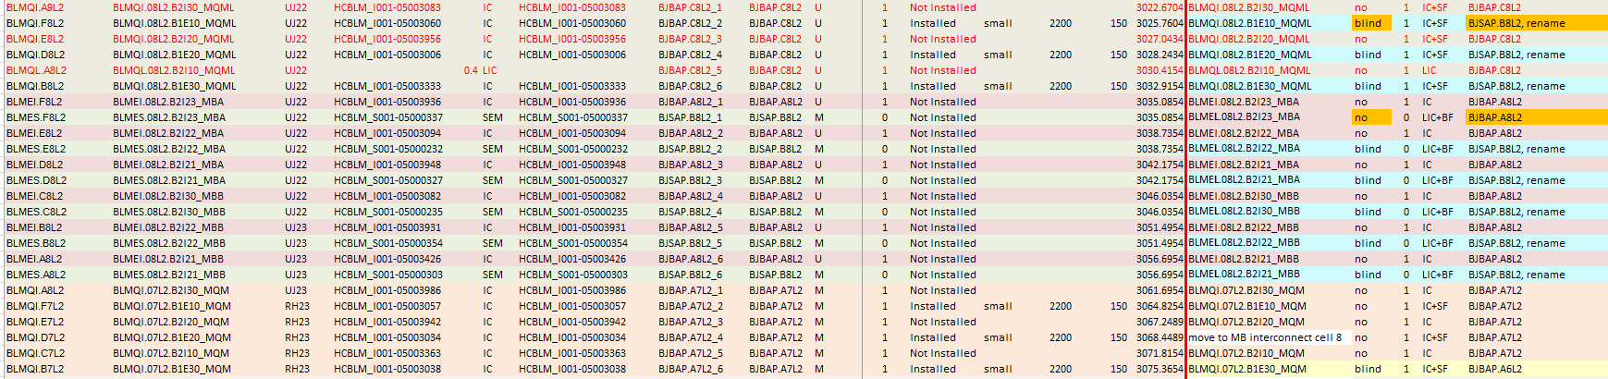
Injection Losses: LIC vs IC
Only up to 6 bunches injected ➔ low intensity and statistics!
Mainly LIC+Big filters installed instead of the SEM
IC+Small filters preferred in the injection region in view of possible need to blind most critical BLMs (removing filter!)
Before LS1
After LS1

Slide 11
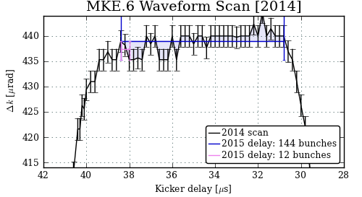
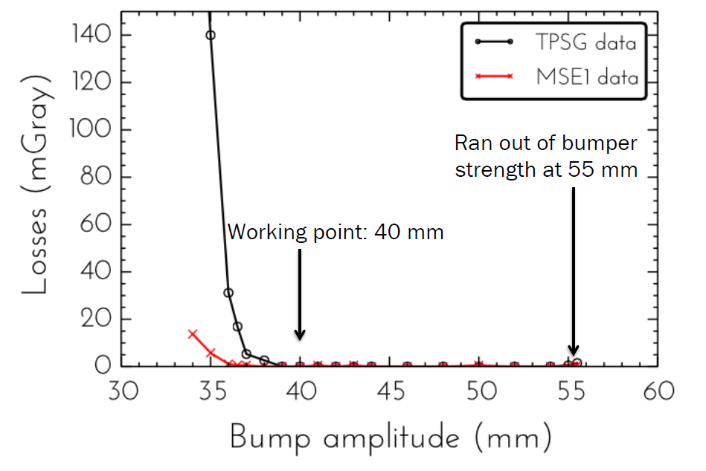
Extraction Issues in LSS6
High losses when extracting HiRadMat beam (12 bunches)
Found out:
  Not optimum delay between Beam and MKE pulse (40 instead of 38.5 μs) ➔ corrected
  Drift of the orbit at the extraction point by 2.5 mm ➔ corrected and extraction bump from 40 mm to 42 mm
Proposed delay 38.5 μs

Slide 12
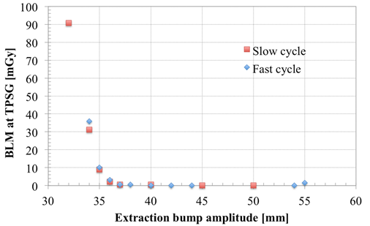
Extraction Issues in LSS6
High losses when extracting HiRadMat beam (12 bunches)
Found out:
  Not optimum delay between Beam and MKE pulse (40 instead of 38.5 μs) ➔ corrected
  Drift of the orbit at the extraction point by 2.5 mm ➔ corrected and extraction bump from 40 mm to 42 mm
This did not solve the extraction problem and we realised that losses were only present for nominal bunch on LHC25ns cycle but not on PILOT cycle
  Measure extraction aperture for both cycles ➔ no difference
  Measured MKE delay for both cycles ➔ no difference

Slide 13
Extraction Issues in LSS6
High losses when extracting HiRadMat beam (12 bunches)
Found out:
  Not optimum delay between Beam and MKE pulse (40 instead of 38.5 μs) ➔ corrected
  Drift of the orbit at the extraction point by 2.5 mm ➔ corrected and extraction bump from 40 mm to 42 mm
This did not solve the extraction problem and we realised that losses were only present for nominal bunch on LHC25ns cycle but not on PILOT cycle
  Measure extraction aperture for both cycles ➔ no difference
  Measured MKE delay for both cycles ➔ no difference
Found out that main problems:
  LHC25ns was not fully set up: uncaptured beam kicked out by longer rise time of MKE6 wrt MKE4➔ corrected
  The MKP generators not properly adjusted and 250 ns rise time not yet possible ➔ not possible to extract 4 batches on the LSS6 flattop waveform (too short: 8 us) ➔ possible to increase MKE6 flattop during Xmas stop (also in view of 80 bunches and BCMS)
  HiRadMat beam-MKE synchronization ➔ corrected

Slide 14
Extraction Issues in LSS6
High losses when extracting HiRadMat beam (12 bunches)
Found out:
  Not optimum delay between Beam and MKE pulse (40 instead of 38.5 μs) ➔ corrected
  Drift of the orbit at the extraction point by 2.5 mm ➔ corrected and extraction bump from 40 mm to 42 mm
This did not solve the extraction problem and we realised that losses were only present for nominal bunch on LHC25ns cycle but not on PILOT cycle
  Measure extraction aperture for both cycles ➔ no difference
  Measured MKE delay for both cycles ➔ no difference
Found out that main problems:
  LHC25ns was not fully set up: uncaptured beam kicked out by longer rise time of MKE6 wrt MKE4➔ corrected
  The MKP generators not properly adjusted and 250 ns rise time not yet possible ➔ not possible to extract 4 batches on the LSS6 flattop waveform (too short: 8 us) ➔ possible to increase MKE6 flattop during Xmas stop (also in view of 80 bunches and BCMS)
  HiRadMat beam-MKE synchronization ➔ corrected
Orbit drifts at extraction point are still a non fully understood issue ➔ strong impact on TL stability (BPCE resolution not enough for fine interlock)
Possible solution: beam position at BPCE extrapolated from SPS orbit in IQC ➔ monitor orbit drift and improve TL and injection diagnostics in case of problems

Slide 15
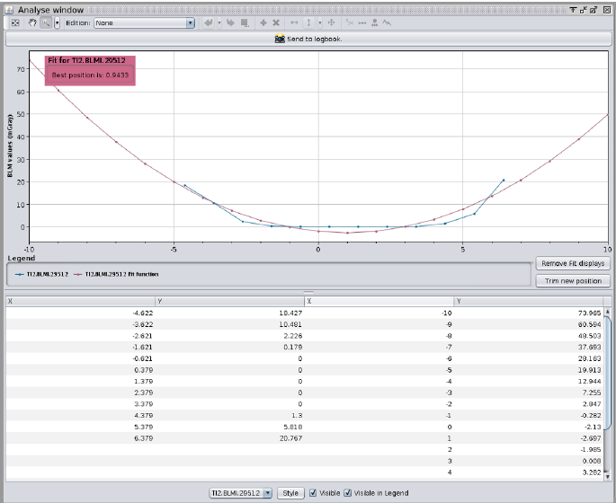
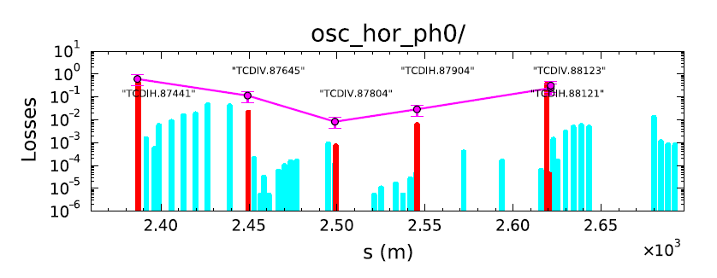
Injection Protection Collimators
TDI, TCLIA/B and TCDI are set up and fully validated
Now straightforward procedures for setup and validation
Effective time (PROVIDED BEAM AVAILABILITY) reduced from 1 shift per TL down to 3 hours
“Position” and “Energy” dump thresholds set up to:
  TDI and TCLIA/B: position±0.25σ, gap+1σ
  TCDI: position±0.5σ, gap+1σ
TDI BETS interlock thresholds set to gap±1.5σ
Y. Le Borgne
TCDI automatic setup tool
F. Velotti

Slide 16
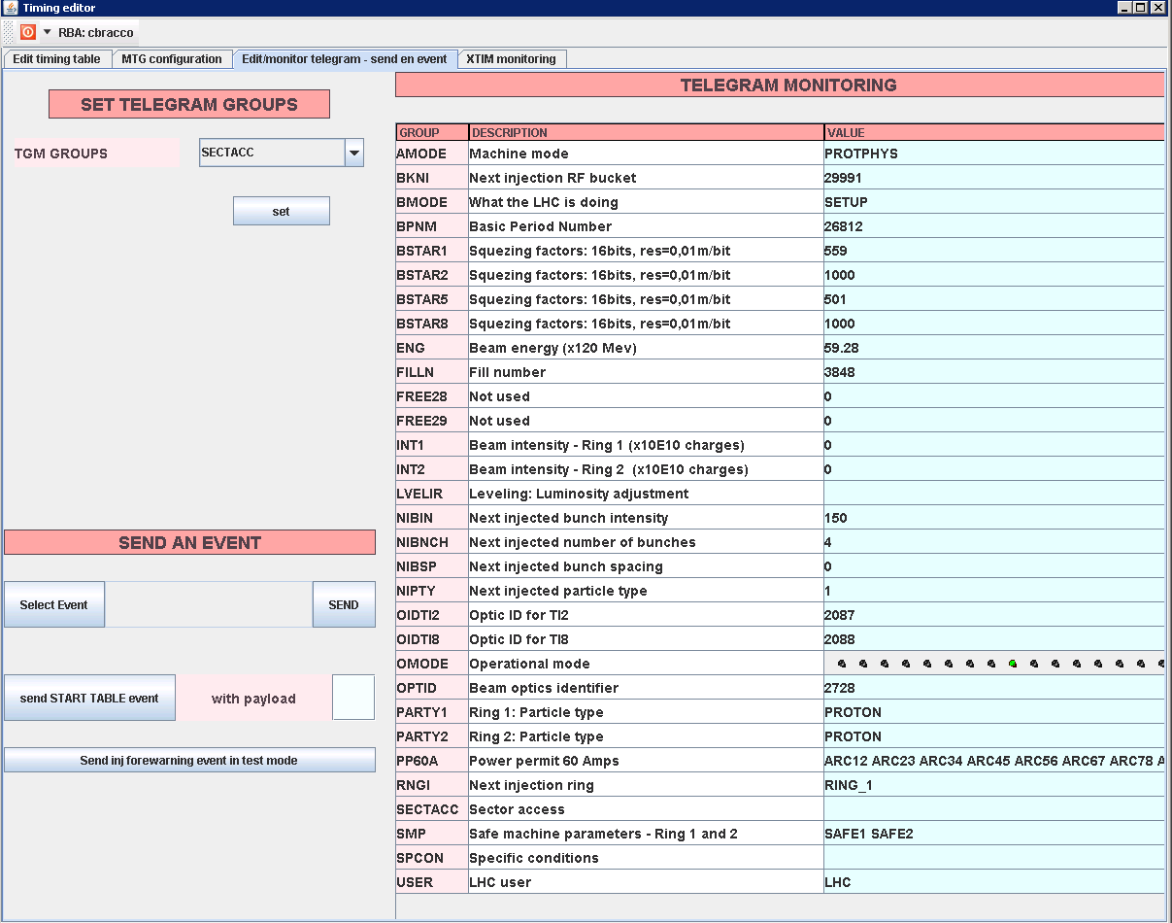
Optics ID for TCDI
Aim: check the TL optics and verify that TCDI settings are correct for that optics
Proposed to adapt β* interlock used for the ring collimators:
  All/some TL quad currents defined as critical settings in LSA Ѵ
  Associate a unique ID Ѵ
  Distribute it through timing system Ѵ
  Define TCDI thresholds and specifications X
  Control implementation X
The FESA class has to be modified: a new “Active_IP” has to be added which checks the OIDTI2/8 telegram instead of the BSTAR1/2/5/8 telegram ➔ impact on ring collimators ➔ repeat MP checks also for them!
Not ready to be implemented in TS1

Slide 17
Missing Optics ID Critical for High Intensity?
TCDI settings (aperture) depend on the TL optics
In the past when changing from Q26 to Q20 optics it was not caught that the optics change was affecting the region were TL collimators are ➔ one TCDI with gap larger than 5 σ ➔ poorer protection
Now system setup, validated and reference defined ➔ protection for injection of high intensity beam is granted (other checks are performed and prevent extraction if magnet currents are wrong).
Still important to implement this interlock in view of future possible optics changes. When? TS or Xmas stop? It has to be defined which MP checks have to be repeated: all? Only β*? For all ring collimators or a sample?

Slide 18
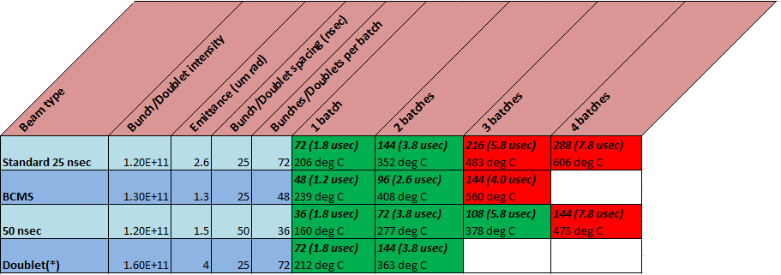
TDI Limits
TDI hBN block cannot withstand temperatures higher than 450 ◦C (B₂O₃ reactant melting temperature) ➔ limit the maximum number of bunches which can hit the TDI (maximum allowed temperature = 400 ◦C )
J. Uythoven & A. Lechner

Slide 19
TDI Limits
TDI hBN block cannot withstand temperatures higher than 450 ◦C (B₂O₃ reactant melting temperature) ➔ limit the maximum number of bunches which can hit the TDI (maximum allowed temperature = 400 ◦C )
Consequences:
  Limit number of injected bunches
  Increase number of injection
  Limit maximum number of circulating bunches (maximum reachable with 25 ns beam: 2448 instead of 2736, B. Gorini LMC 13/05/2015)
  How to insure that no more than 144 bunches hit the TDI when operating with 25 ns beam?
    Reduce length of injection kicker to 3.8 μs (erratic on circulating beam)
    Reduce length of the SPS flat-bottom of LHC cycle
A new TDI with graphite instead of hBN will be installed during the next Xmas stop.

Slide 20
TDI Limits
TDI hBN block cannot withstand temperatures higher than 450 ◦C (B₂O₃ reactant melting temperature) ➔ limit the maximum number of bunches which can hit the TDI (maximum allowed temperature = 400 ◦C )
Consequences:
  Limit number of injected bunches
  Increase number of injection
  Limit maximum number of circulating bunches (maximum reachable with 25 ns beam: 2448 instead of 2736, B. Gorini LMC 13/05/2015)
  How to insure that no more than 144 bunches hit the TDI when operating with 25 ns beam?
    Reduce length of injection kicker to 3.8 μs (erratic on circulating beam)
    Reduce length of the SPS flat-bottom of LHC cycle
A new TDI with graphite instead of hBN will be installed during the next Xmas stop.
Critical topic: flip between 25 ns and 50 ns configuration!

Slide 21
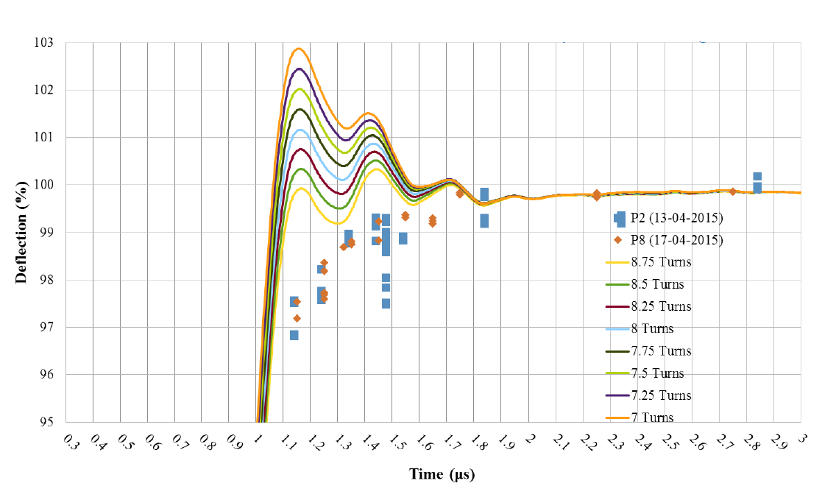
MKI Waveform
Measured an MKI rise time, both in IR2 and IR8, longer than nominal (1.2 μs instead of 0.9μs) and thus a shorter flattop (possible to adjust)
The number of the MS end turns were increased in April 2010 from 8.25 to 8.75 to reduce the overshoot
Wrt to LS1 the TMR resistance is reduced and the number of screen conductors increased ➔ undershoot
New calculations were done taking into account all these effects and the optimum number of MS end turns calculated (7.25)
This change will be implemented during TS1
A new waveform scan will have to be performed

Slide 22
Summary
Large difference between PILOT and INDIV/25ns ➔ bad trajectories and injection oscillations for PILOT (used to set up the LHC): Not critical for MP but not ideal for operation. Proposal: put PILOT on SLOW cycle
Injection losses of the same order of Run 1 (only 6 bunches injected!). Still too low intensity to draw conclusions about LIC and need of BLM blinding.
Large trajectory drift in H plane after fixing a DAQ problem for TI 8 bends. Not critical for MP, no increase in injection losses (but losses appearing in IR7) and possible to steer on injection oscillations. Not reassuring for operation: GOLDEN reference could be no more valid if this happens again!
Orbit drifts of few mm affect the SPS extraction point and have a big impact on TL stability. Not critical for MP but frequent steering is expected to be needed. Proposal: monitor losses and orbit drifts in IQC to improve diagnostics (possible future interlock on next extraction)
All injection protection collimators set up and validated. Optics_ID for TCDI not yet in place (need to modify FESA class and revalidation also for ring collimators). Not critical for MP since needed only in case of optics change.
TDI hBN block fragility limits the number of injected (and circulating) bunches. Critical for MP since an adequate strategy has to be put in place to insure the correct flip between 25 ns and 50 ns settings (MKI pulse and SPS flat-bottom length)
MKI rise time will be restored to its nominal value after TS1, to be checked with measurements.
Ready to start with high intensity beams with some care!

Slide 23
Thanks a lot for your attention!

Slide 25
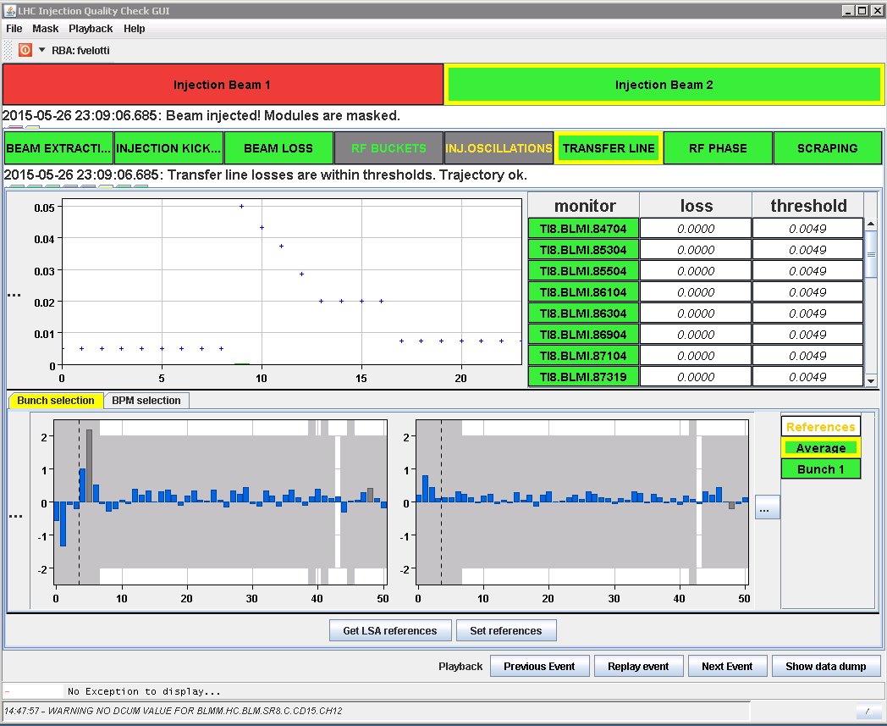
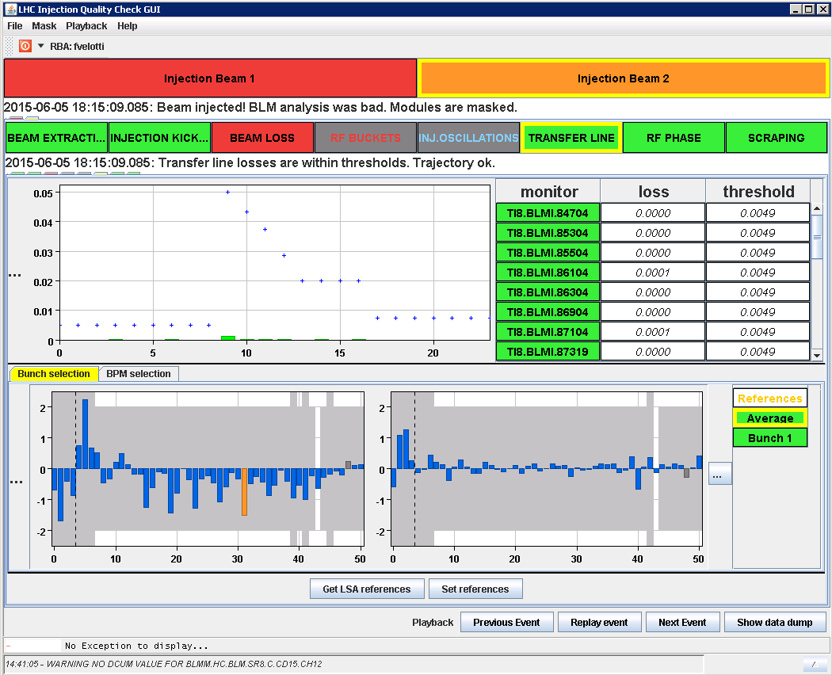
TL Comparison
Before RBI change
After RBI change
Cutting at TCDIH.87441

Slide 26
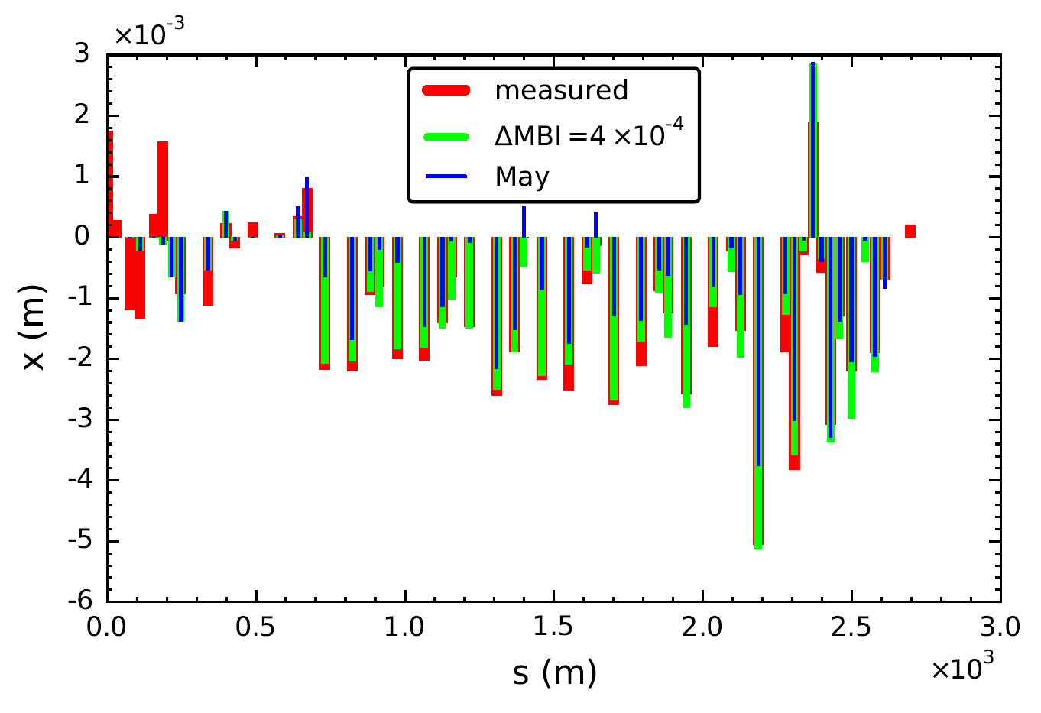
Real 4 A Current Change?

Slide 27
Proposal for TCDI Threshold Tables
TI 2
TI 8
Optics_ID | GU_IN [mm] | GD_IN [mm] | GU_OUT [mm] | GD_OUT [mm]
2086.9 | 9.5 | 9.5 | 10.5 | 10.5
2087 | 9.5 | 9.5 | 10.5 | 10.5
2087.1 | 9.5 | 9.5 | 10.5 | 10.5
Optics_ID | GU_IN [mm] | GD_IN [mm] | GU_OUT [mm] | GD_OUT [mm]
2087.9 | 9.5 | 9.5 | 10.5 | 10.5
2088 | 9.5 | 9.5 | 10.5 | 10.5
2088.1 | 9.5 | 9.5 | 10.5 | 10.5
For simplicity it is assumed 1 σ = 1 mm (thresholds = gap +/-0.5 σ)

