Slide 1
LHC/MP Review
The RF system
P. Baudrenghien, BE-RF

Slide 2
Content
Klystron trip
HOM power

Slide 3
Klystron trip

Slide 4
When a klystron trips…
When a klystron trips, the beam passing in the idling cavity induces a voltage. If too high, this voltage may cause an arc in the cavity
The beam creates an E.M. wave that crosses the coupler, travels through the waveguide in the reverse direction, crosses the circulator and ends in the load. If too high this wave may break the coupler (arcing) or burn the load.
The sudden reduction of the bucket creates particle loss (debunching). The debunched beam drifts in the machine and populates the abort gap. As it is not focused by the RF anymore, this debunched beam looses energy through synchrotron radiation and drifts to the momentum collimator.

Slide 5
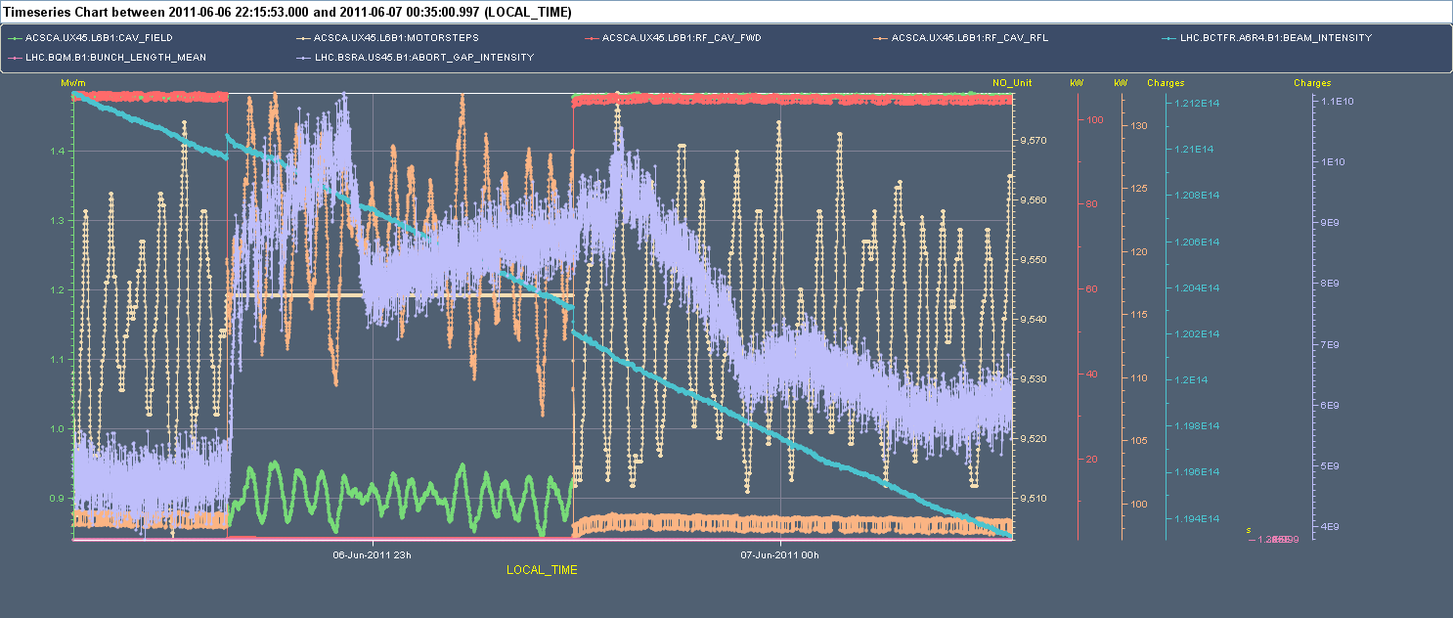
Surviving a trip: Run 1, Fill 1855, June 6th2011
After 6 hours in physics, 1102b, 0.22 A DC
0.9 MV beam induced voltage (green)
110-130 kW “reflected” power (orange)
Abort gap population jumps from 5E9 to 1.1E10, then is reduced to 8E9 after 15 min (3.5 TeV). If is further reduced to 6E9, ~ 15 min after we switch the RF back ON (violet)
No noticeable loss on BCT, only bunch length effects (blue)
The dissipated 110-130 kW is compensated by an increase of 10 kW in all remaining 7 klystrons. The missing 50 kW comes from a reduction of the reflected power due to the non-zero stable phase

Slide 6
Nominal LHC conditions Run 2:
  6.5 TeV
  1.1E11 p/bunch
  2808 bunches, 25 ns spacing
  1.2 ns 4σ bunch length
  Assume CosineSquare longitudinal line density -> f_{b}=0.86
  0.56 A DC, 0.96 A average RF component, 1.06 A peak RF
  12 MV total (8 cavities), QL=60k
3000 W synchrotron radiation (5 keV/turn)
190 kW, fully reflected

Slide 7
One klystron trip
The beam induces 1.75 MV in the idling cavity
The required energy come from the remaining 7 cavities
  Stable phase goes to 174.5 degree
  Each of the 7 klystrons gives 80 kW to the beam
This EM energy flows out of the cavity at the 560 kW rate
It is dissipated in the load of the circulator of the tripped klystron
The load is rated 300 kW -> destruction…but
We dump the beam in three turns
The energy deposited in the load is only 200 J. OK
230 kW, of which 80 kW are passed to the beam
The beam induces 1.75 MV in the idling cavity
The beam receives 560 kW from the 7 klystrons on
The energy deposited by the beam flows out at 560 kW rate
Starting in Summer 2011, we dump the beam following a klystron trip
No risk to damage RF equipment
No risk of debunching
The 560 kW are dissipated in the load.
Destruction…

Slide 8
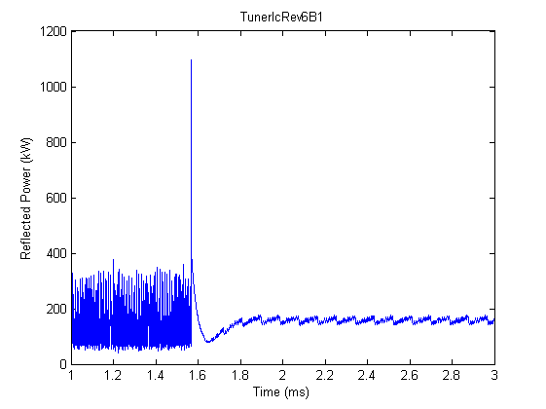
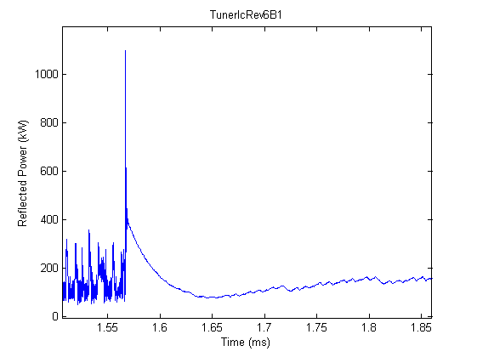
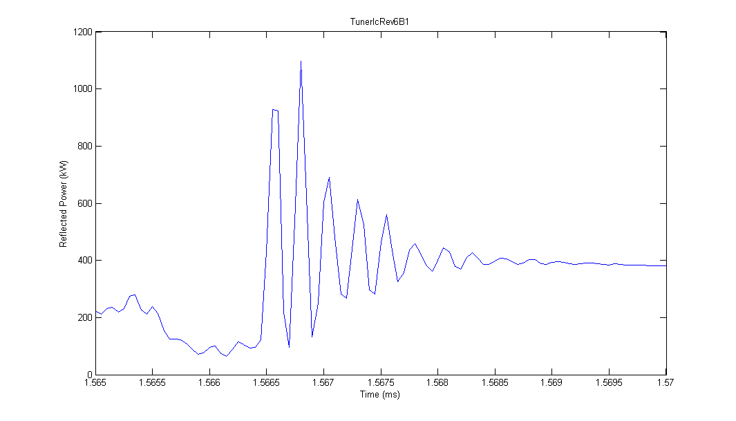
“Reflected” power transients (1102b,2011)
We observe a very large spike peaking at 1.1 MW, followed by a decaying transient with 20-30 microsec time constant, then a slow decay to reach the steady level
  The 20-30 microsec time-constant decay starts at 400 kW level and disappears in ~50 microsec. This power spike is the dumping of the cavity stored energy (~10 J), not a large energy. Frightening peak but it cannot damage the coupler. The measurement fits perfect with calculations (RF power spikes on the reflected wave at a transmitter trip, J. Tuckmantel, 2011, unpublished). It is independent of beam current
  The 1.1 MW peak actually is a ~4 MHz ringing that decays in 2 microsec. It corresponds to the discharge of the klystron bunching cavity (around 405 MHz). Again frightening but very short -> 1 J ->no damage
The transients are not an issue. Only the “baseline” can damage coupler or load when increasing intensity… but we dump the beam in 3 turns
See also
Cavity-Beam-Transmitter Interaction Formula Collection with Derivation, J. Tuckmantel, CERN-ATS-Note-2011-002 TECH

Slide 9
HOM Dampers

Slide 10
An RF cavity is designed to optimize the accelerating mode
But it will also resonate at other frequencies, usually above the accelerating (main) mode. These are called Higher Order Modes (HOMs)
The klystron is narrowband and will not excite the HOMs
The beam current has high frequency components, whose amplitude scales as the inverse bunch length-> important with short bunches
The beam will excite the Higher-Order modes. These will induce wakefields and can cause instabilities
The HOM fields do not couple to the main coupler that is optimized for the fundamental (400 MHz)
Dedicated couplers must be added to “extract” the HOM energy from the cavity and dissipate it in a load outside the cryostat. These are called HOM couplers
HOM coupler design is delicate. It must not couple to the fundamental
The main HOMs in are at 500, 534, 779, 1184 and 1238 MHz
Each cavity has 4 HOM couplers of two different makes: NarrowBand (NB) that couple the first two modes strongly, and WideBand (WB) for the higher frequencies

Slide 11
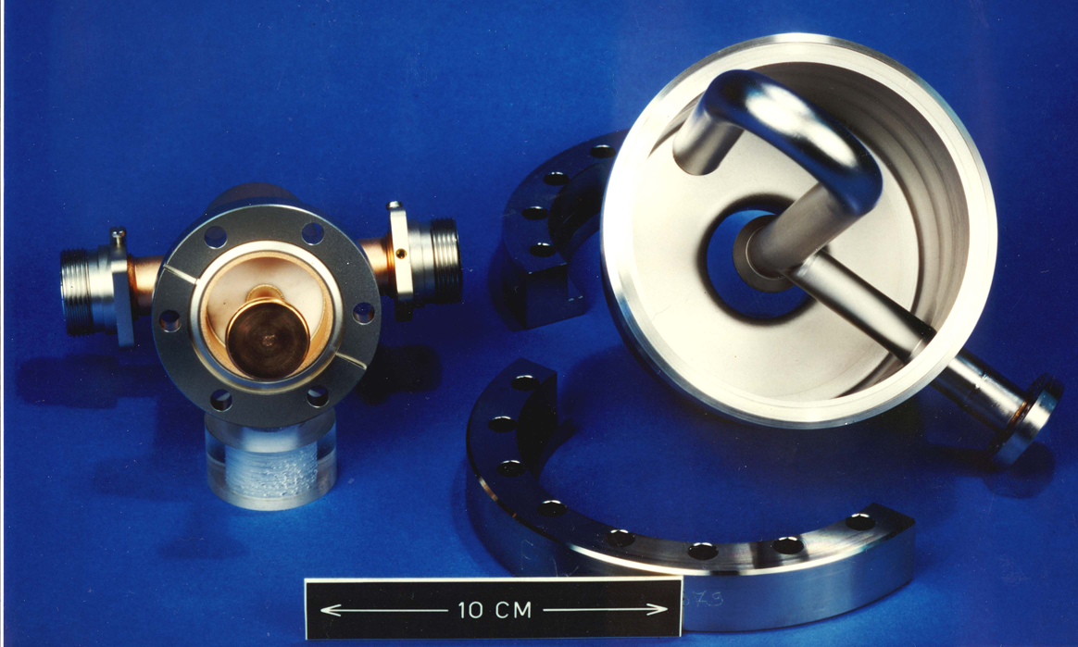
NarrowBand HOM coupler
Made in Nb, cooled with liquid He
“Notch” at 400 MHz
LHC WideBand coupler (left) and NarrowBand coupler

Slide 12
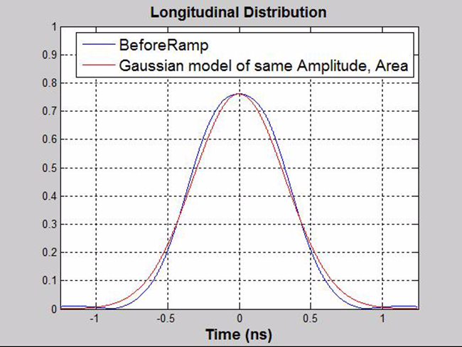
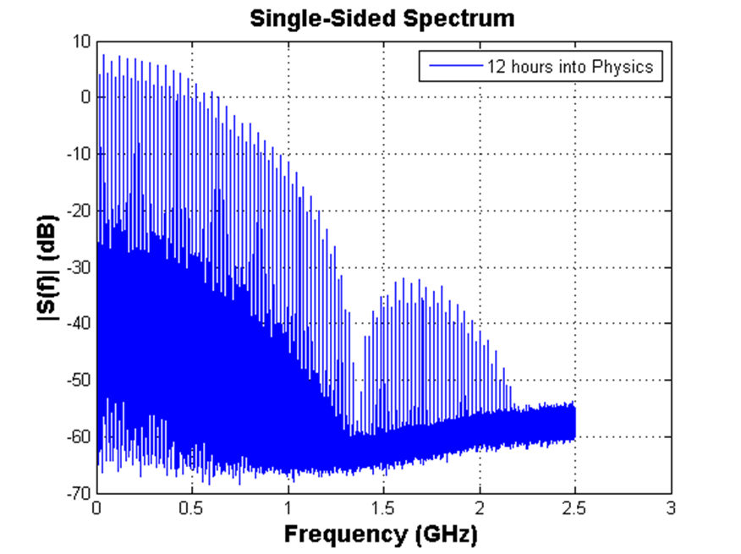
The power “extracted” by an HOM coupler scales with the power of the beam current at the mode frequency
We had no problem with 0.35 A DC and 50 ns spacing in 2012
With 25 ns spacing the main spectral lines of beam current are at harmonics of 40 MHz (they were at harmonics of 20 MHz with 50 ns spacing)
Smaller Frev sidebands caused by the gaps in beam currents (abort gap, injection kicker risetime)
The HOM have been designed for Qe < 1000, so that
  0.85 A DC current
  40 MHz line on the HOM resonance
gives 1 kW power that can be dealt with by the coupler
Estimation of the High-order Mode Power in the 400 MHz Superconducting Cavities of the LHC, Z.T. Zhao, SL-Note 97-10

Slide 13
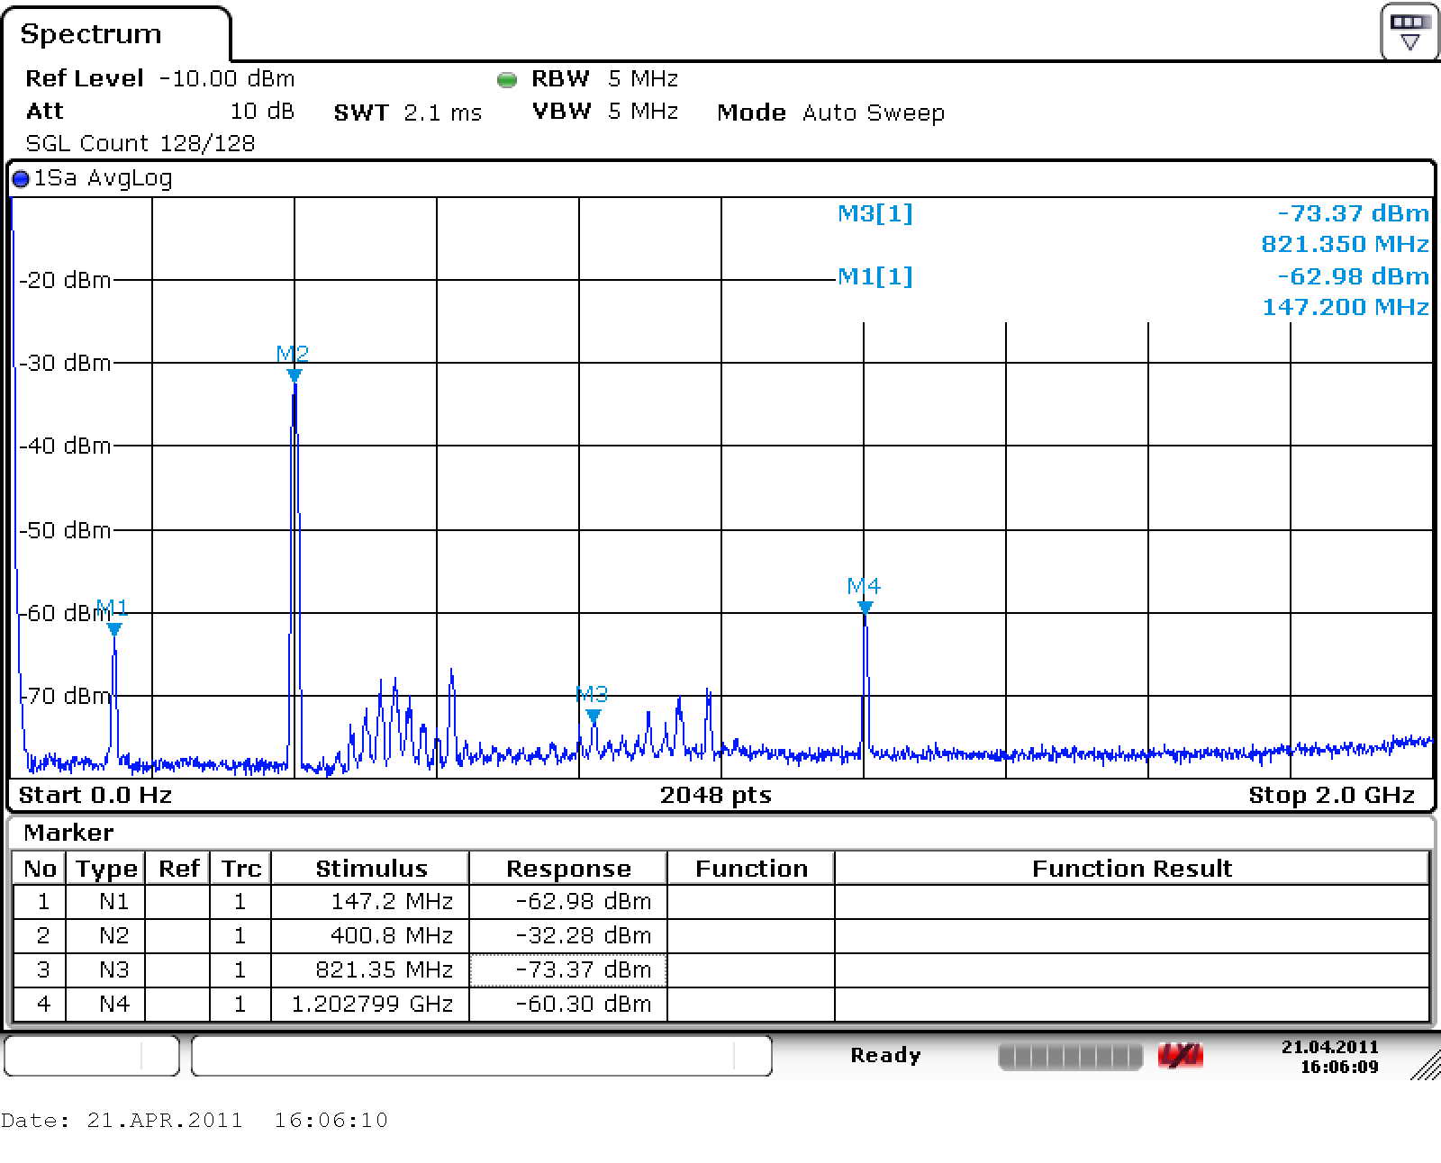
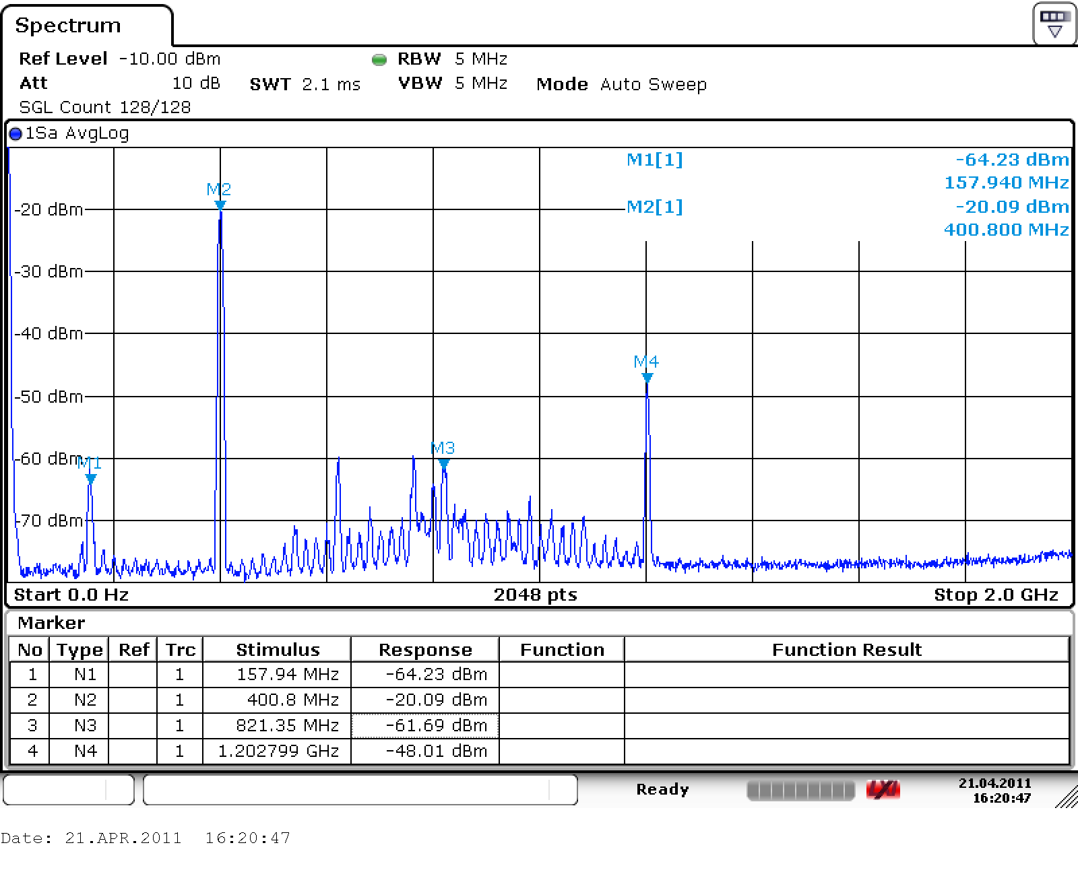
Spectra were measured with 50 ns spacing (408b below)
Spectrum of the power extracted by NarrowBand coupler (left) and WideBand coupler

Slide 14
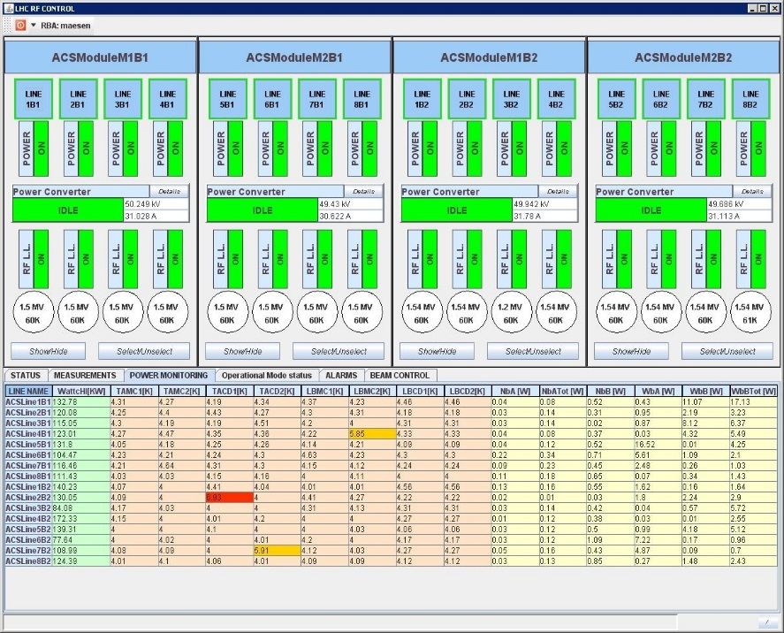
We monitor and interlock HOM couplers temperatures and power (below 1236b)

Slide 15
Conclusions

Slide 16
Following a klystron trip, the power dissipated in the load would cause damage with nominal beam (560 kW) but the RF interlock dumps the beam in 3 turns -> OK
The HOMs have been designed for worst-case conditions and 0.86 A DC. It is a good policy to monitor them as we increase the beam current (M1B2 is new). This is the only RF item on the ramp-up check list. We have an RF interlock on both coupler temperature and power -> OK
Thank you for your attention

