Slide 2
Ongoing activities
LHC instabilities
E-cloud
Impedance
PySSD
RFQ simulations
Implementation of dispersion

Slide 3
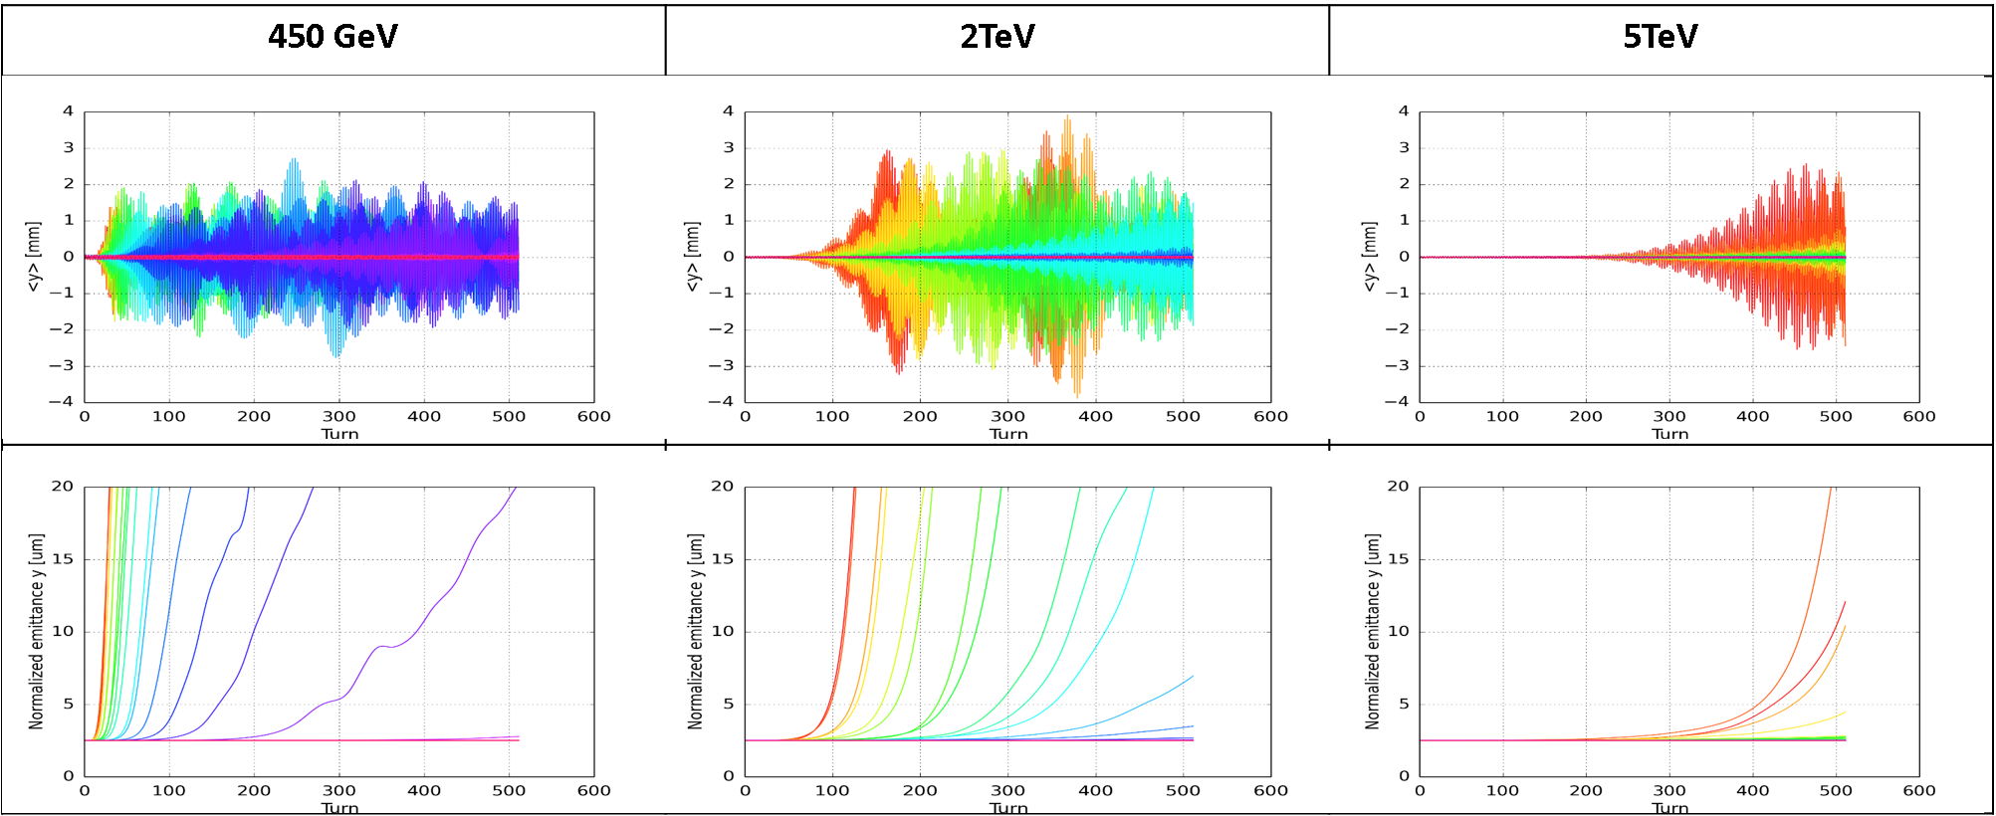
PyHEADTAIL-PyECLOUD simulations for LHC
E-cloud instability simulations for LHC started – see E-cloud Meeting #21
Simulations for arcs and quadrupoles
Instability thresholds
vs. beam intensity
vs. energy
Dipoles

Slide 4
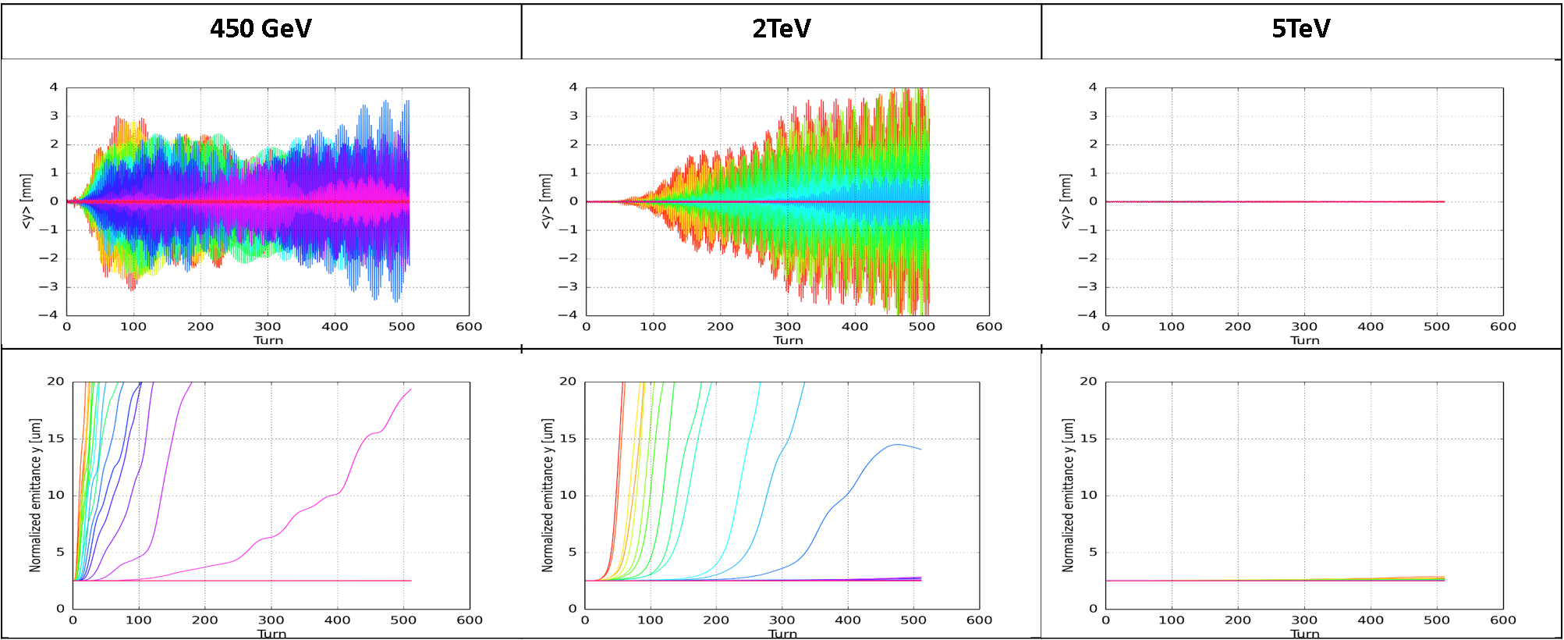
PyHEADTAIL-PyECLOUD simulations for LHC
E-cloud instability simulations for LHC started – see E-cloud Meeting #21
Simulations for arcs and quadrupoles
Instability thresholds
vs. beam intensity
vs. energy
Quads

Slide 5
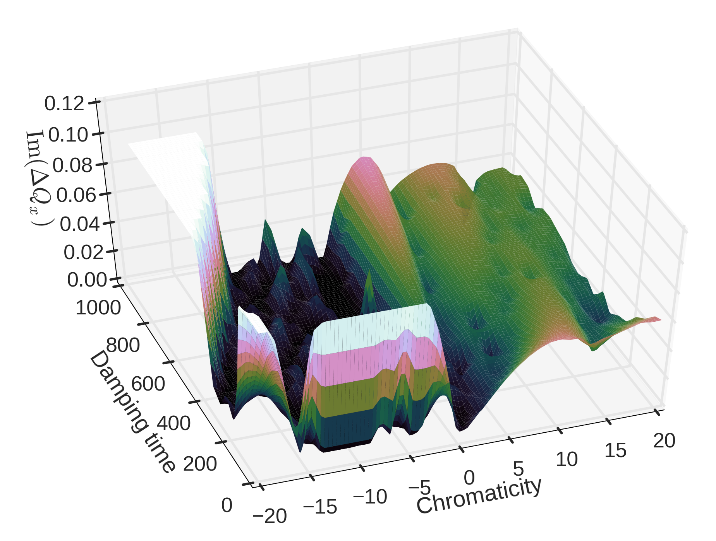
LHC instabilities – impedance
LHC impedance model at 6.5 TeV – NHTVS predictions compared with PyHEADTAIL
PyHEADTAIL
NHTVS

Slide 6
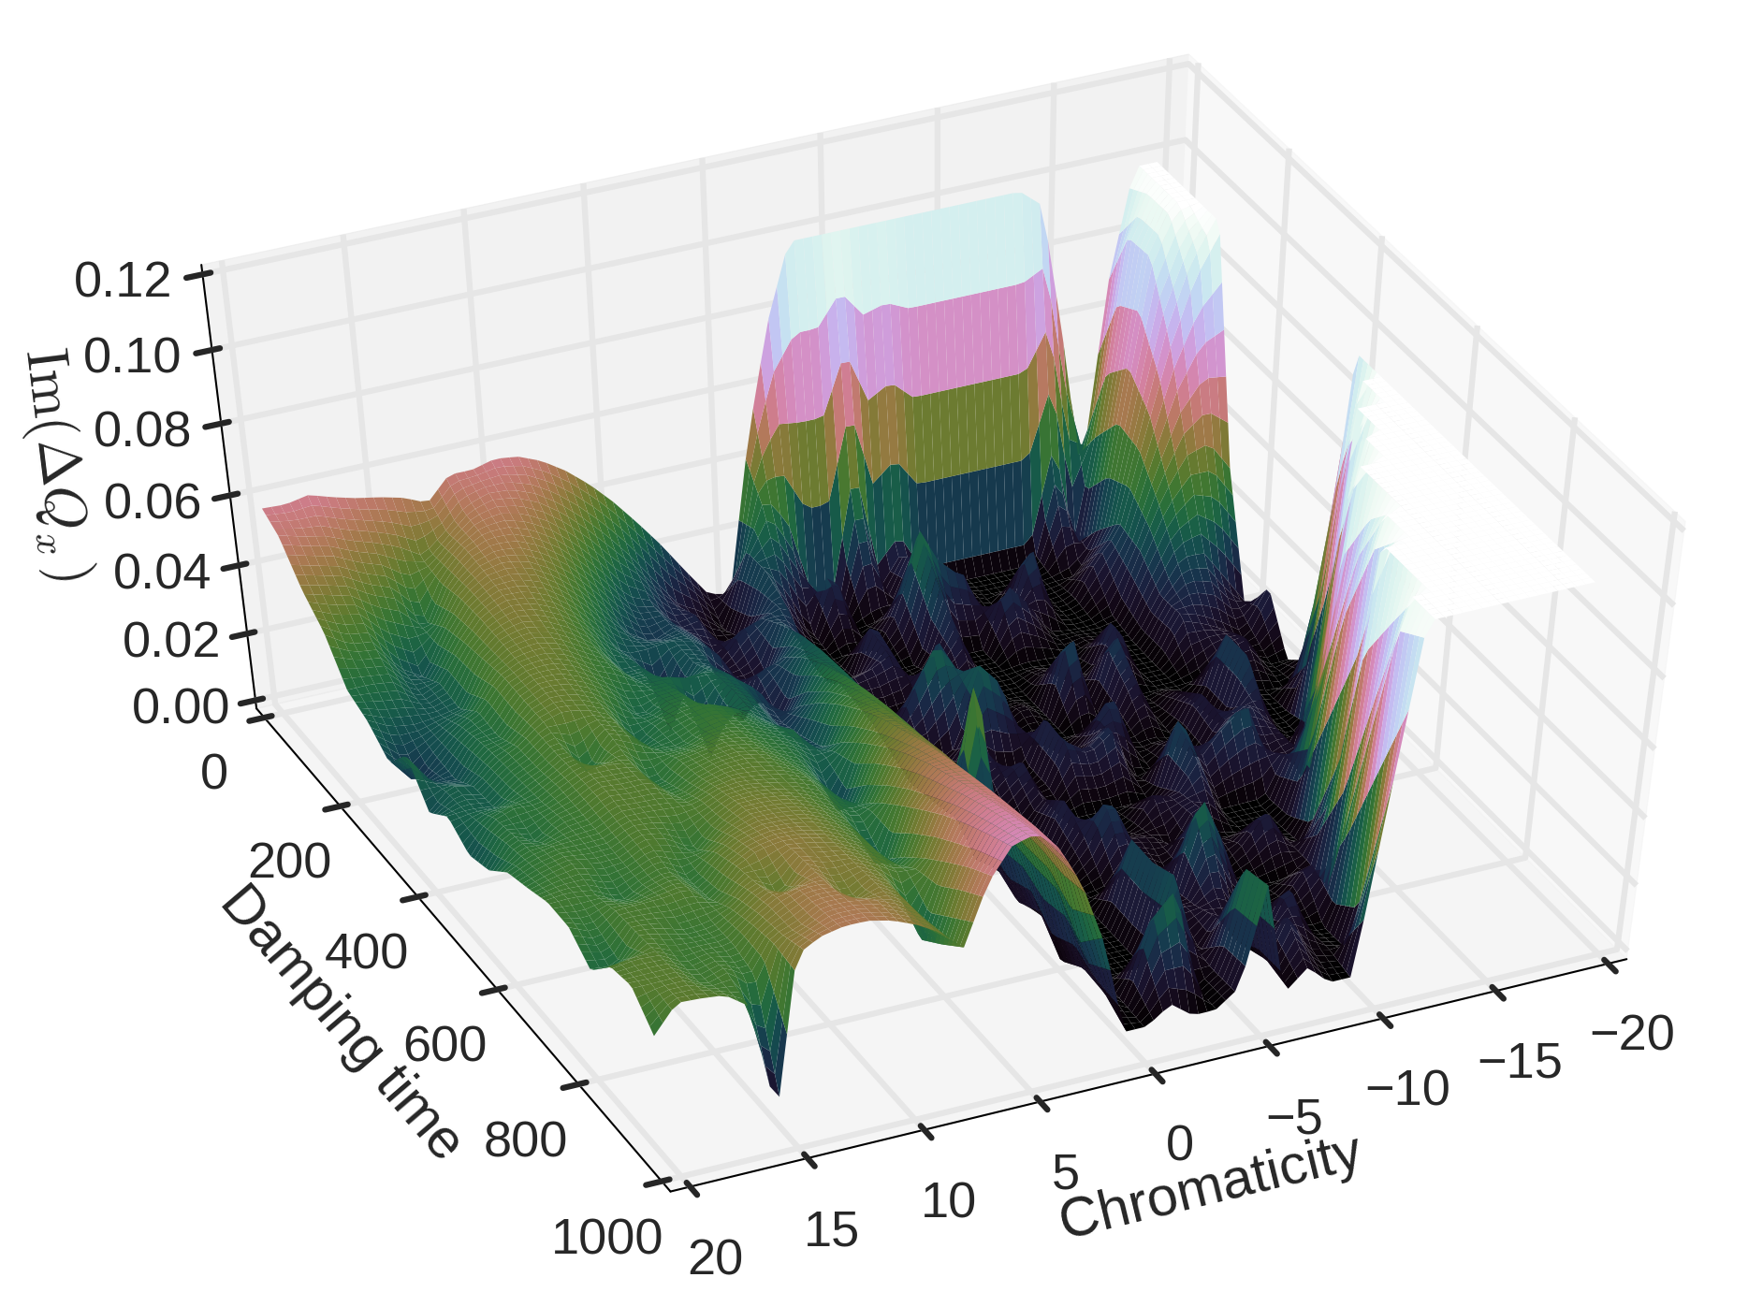
LHC instabilities – impedance
LHC impedance model at 6.5 TeV – NHTVS predictions compared with PyHEADTAIL
Reverse side

Slide 7
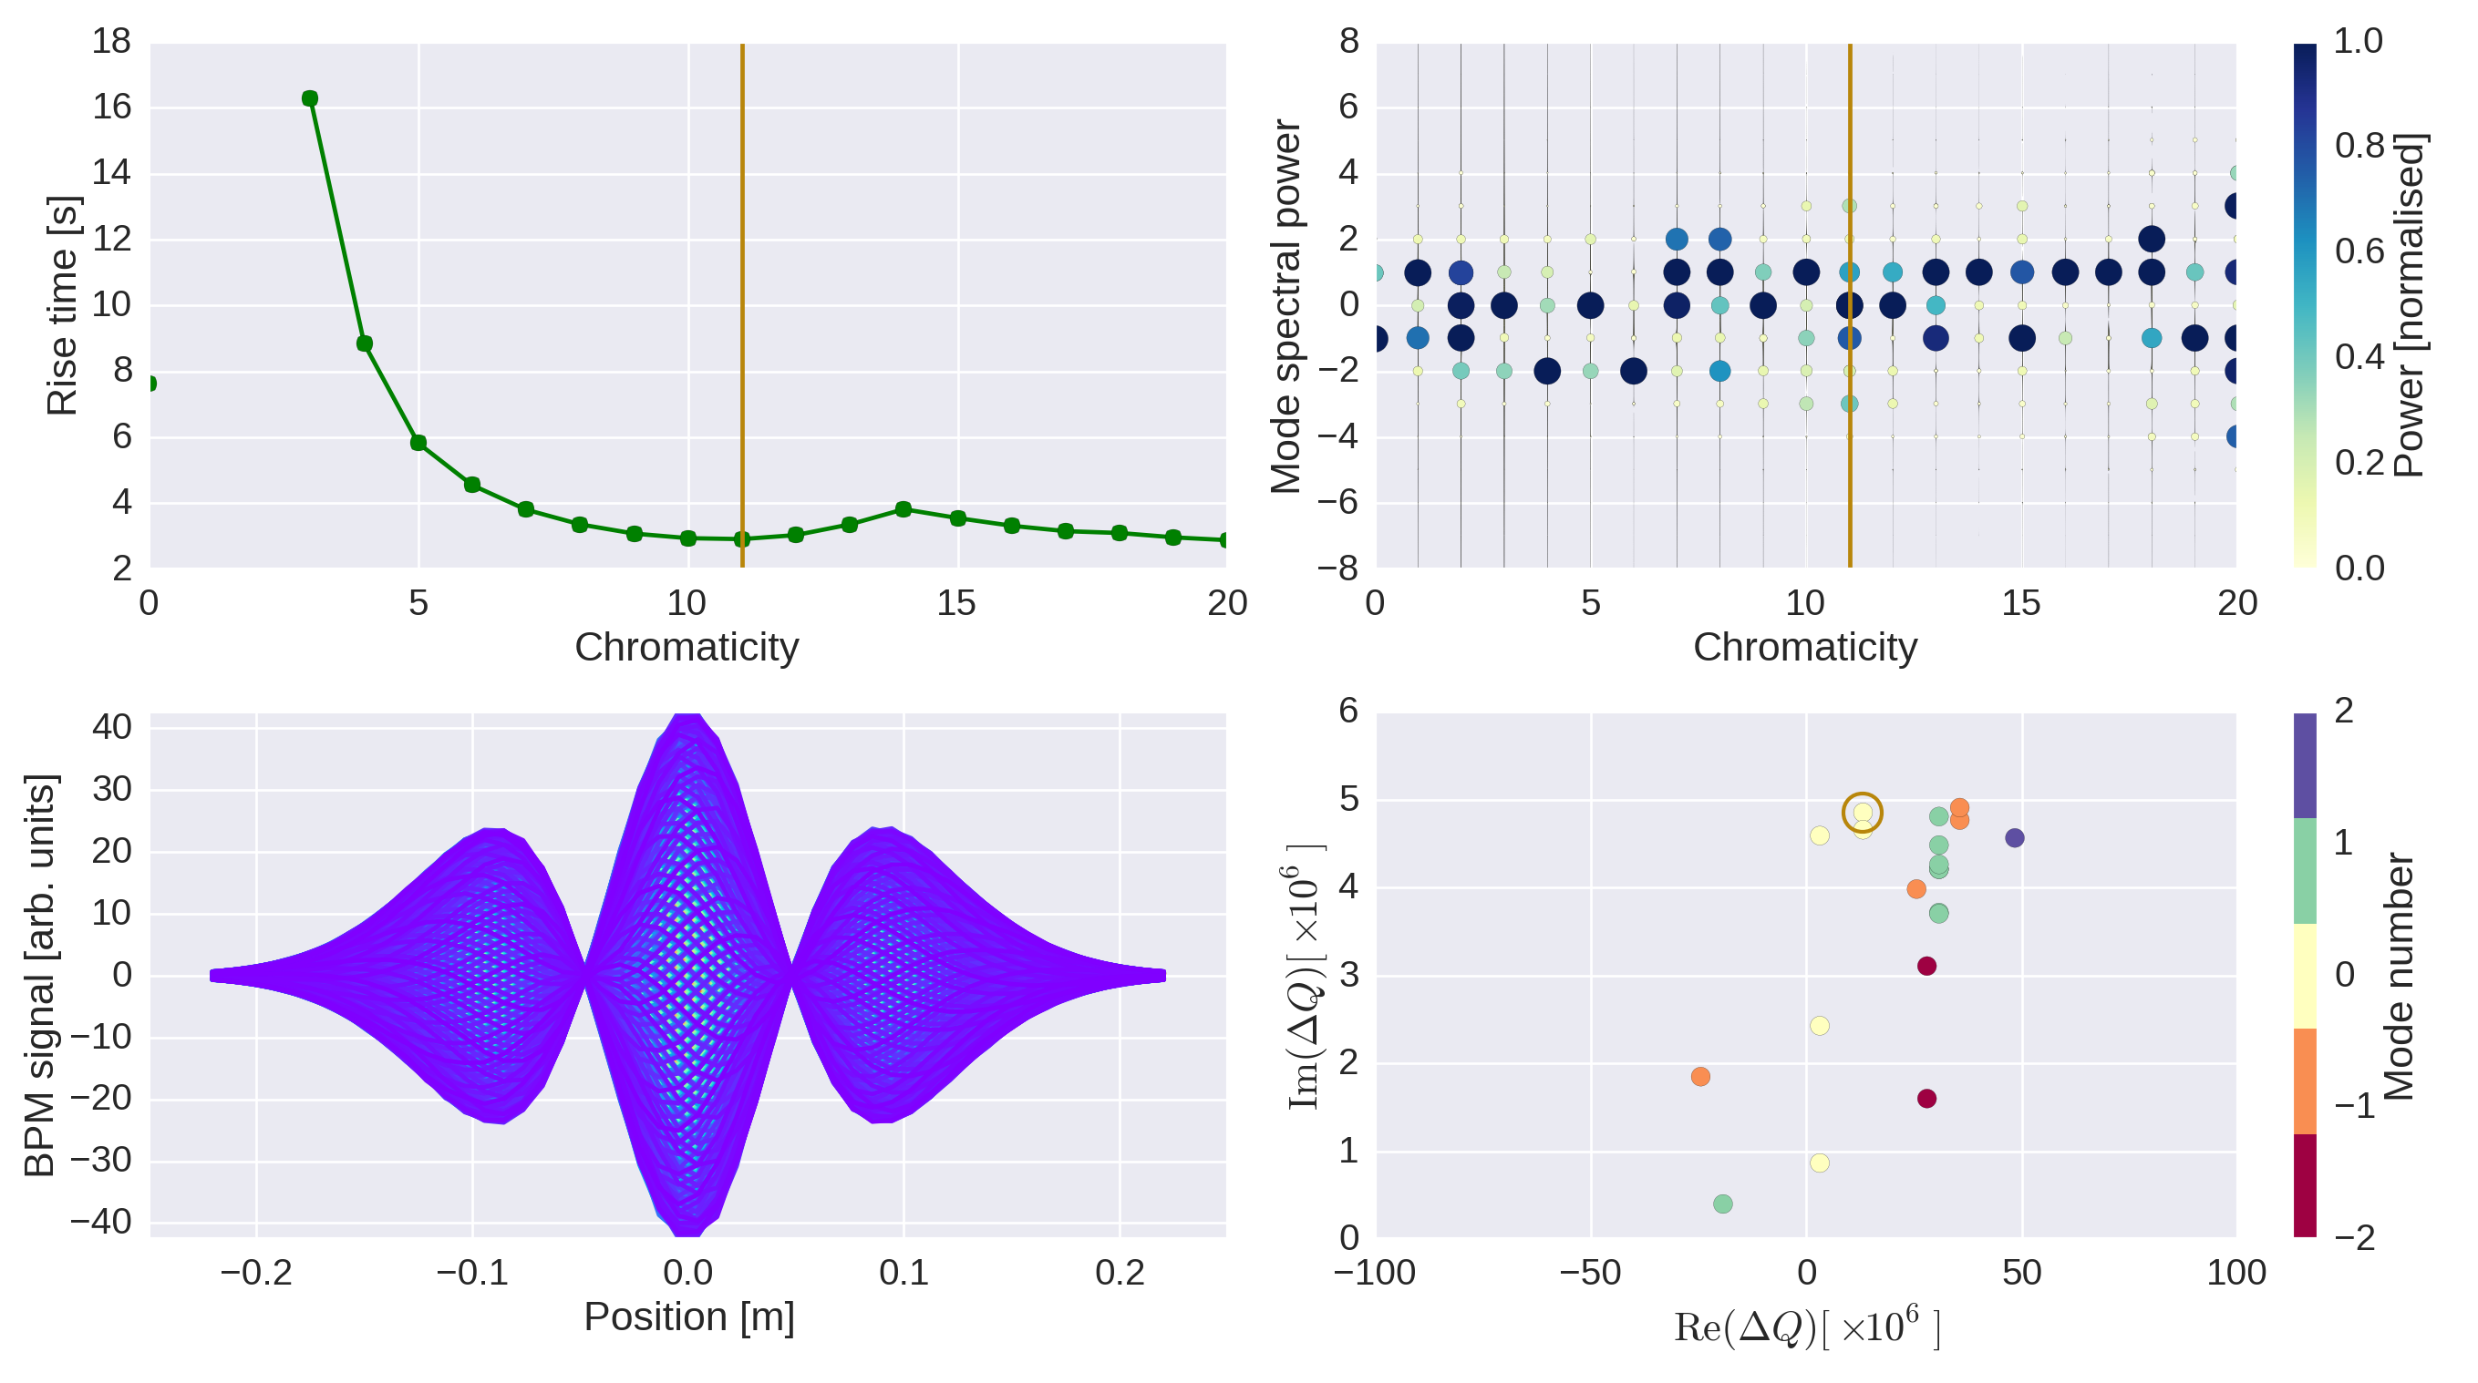
LHC instabilities – impedance
LHC impedance model at 6.5 TeV – dashboard plot
Horizontal

Slide 8
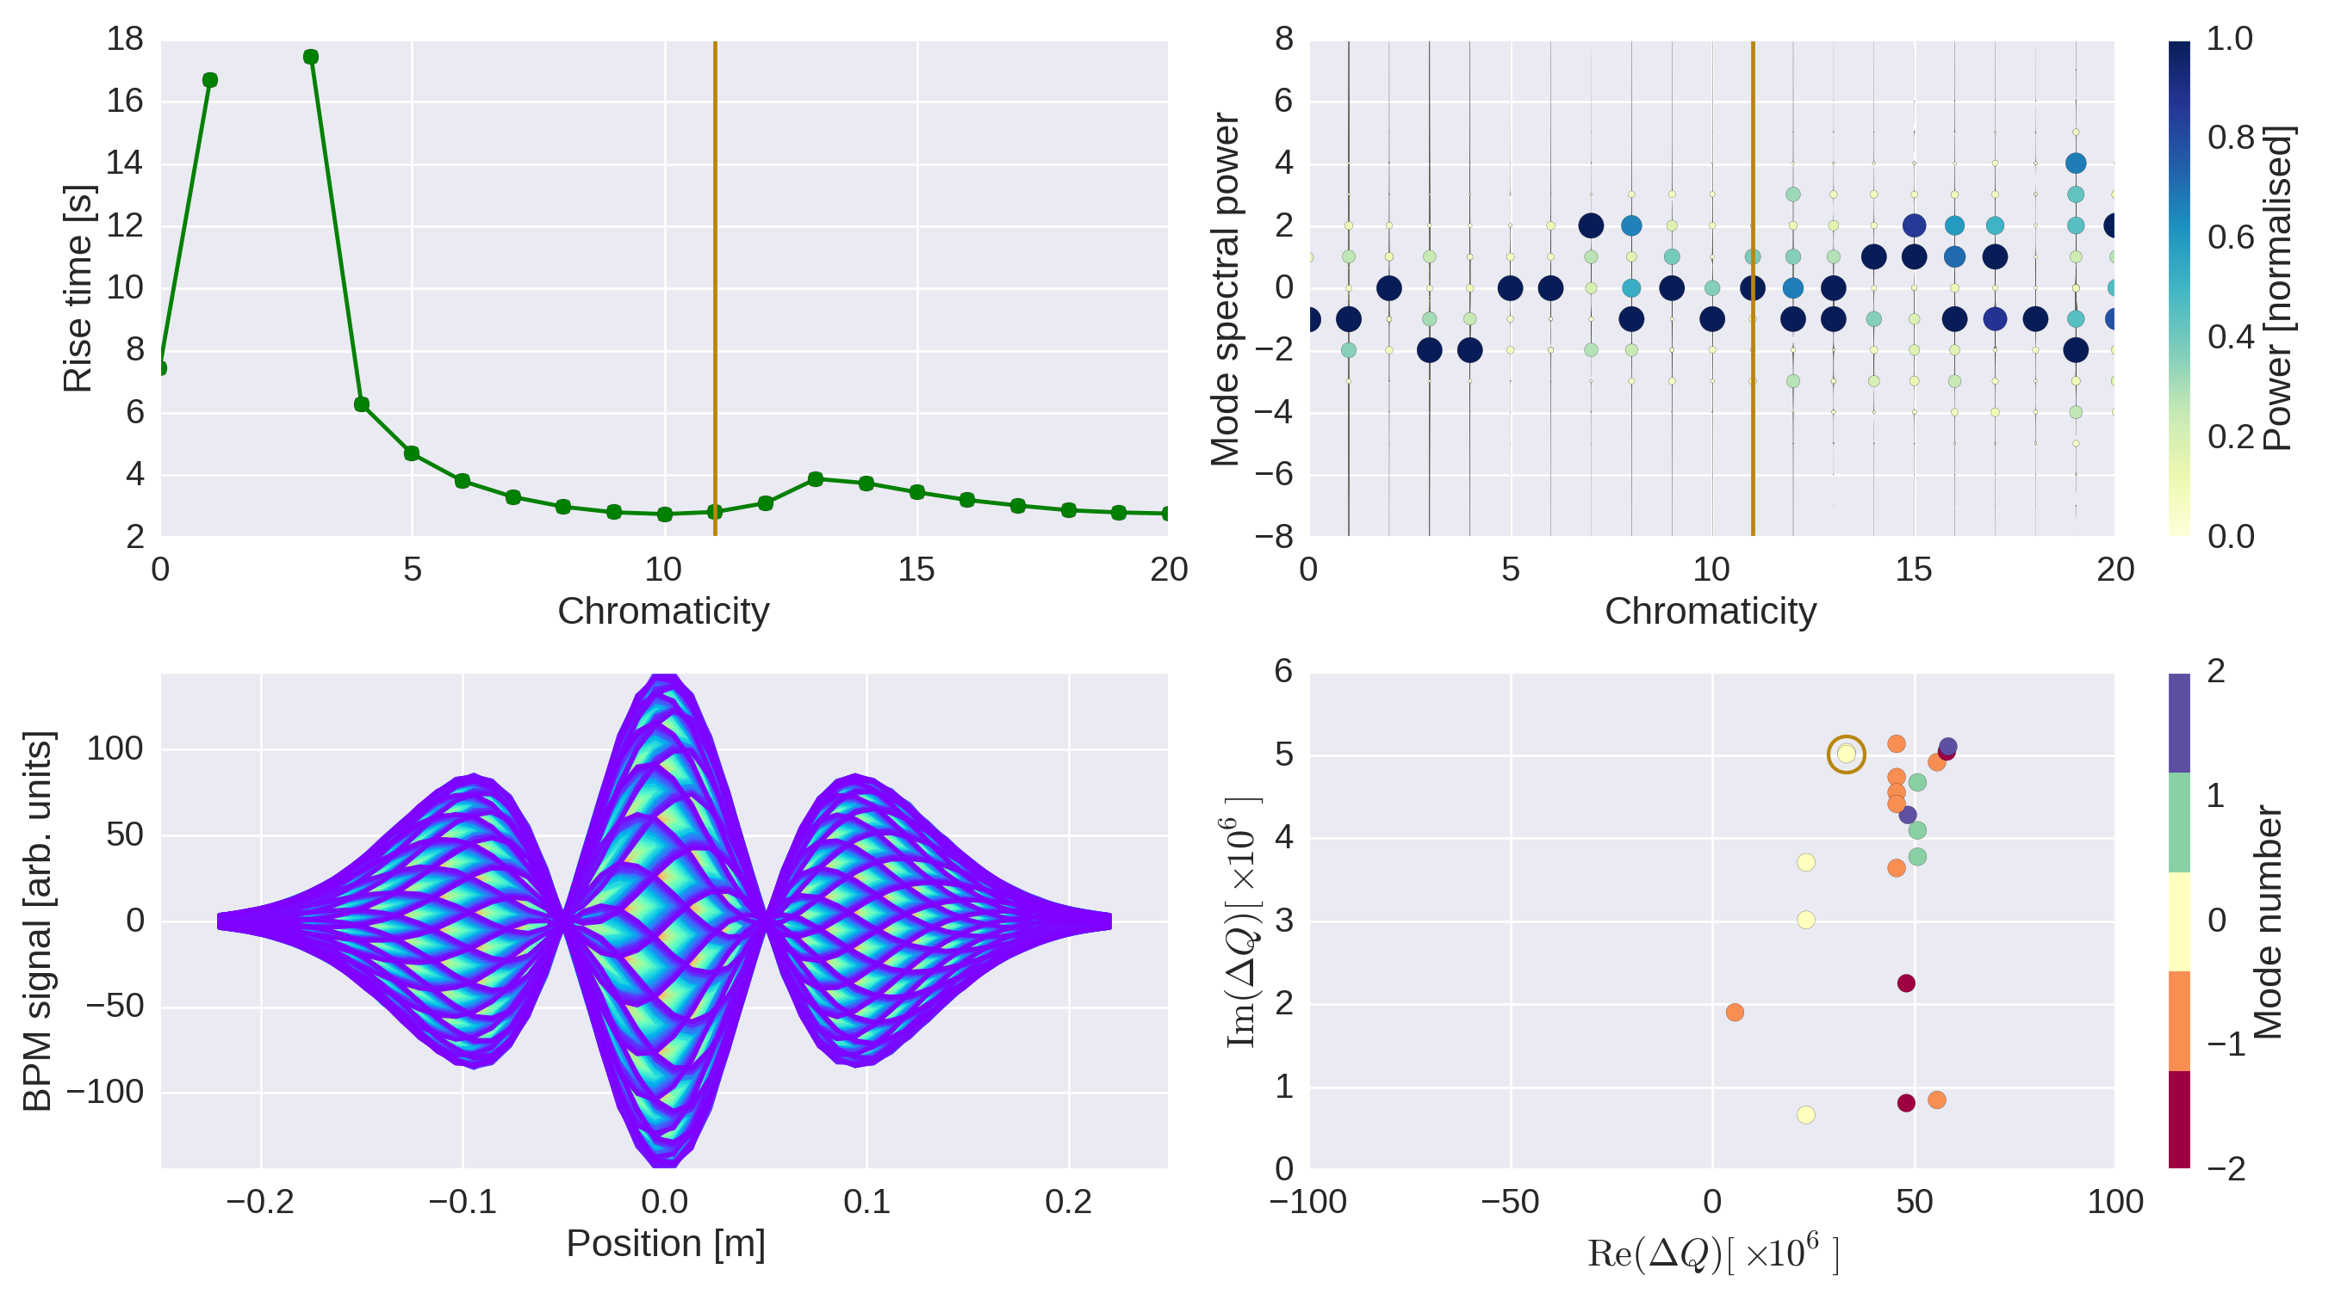
LHC instabilities – impedance
LHC impedance model at 6.5 TeV – dashboard plot
Vertical
If now we could get a stability diagram on top of this,
we could investigate Landau damping without having to do the scans

Slide 9
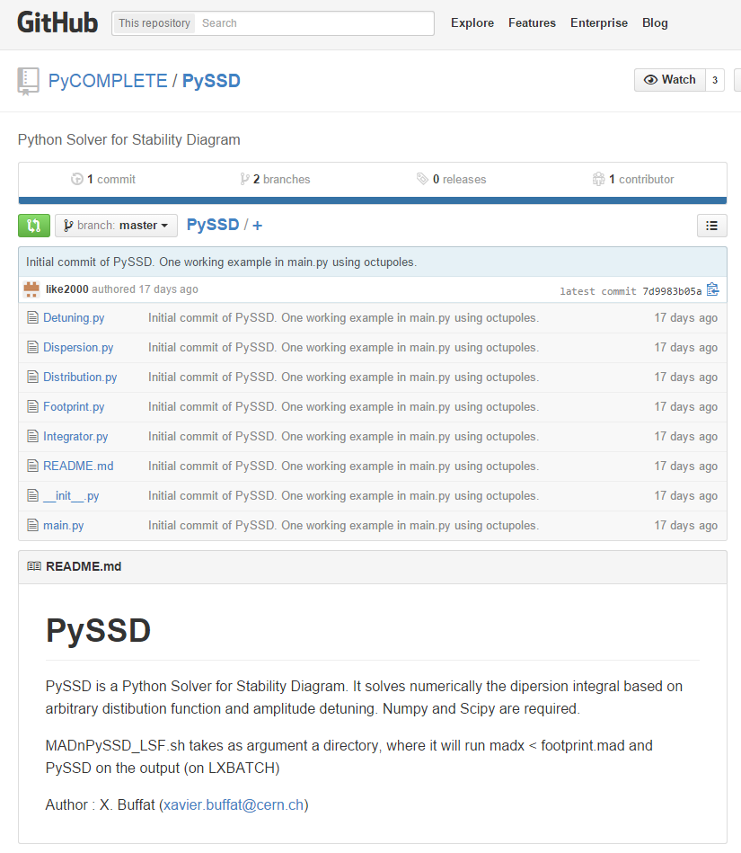
PySSD on PyCOMPLETE
Xavier agreed to add PySSD on our github repository – thanks Xavier!
Some minor work and optimization done on the code – next bigger step will be the implementation of an RFQ

Slide 10
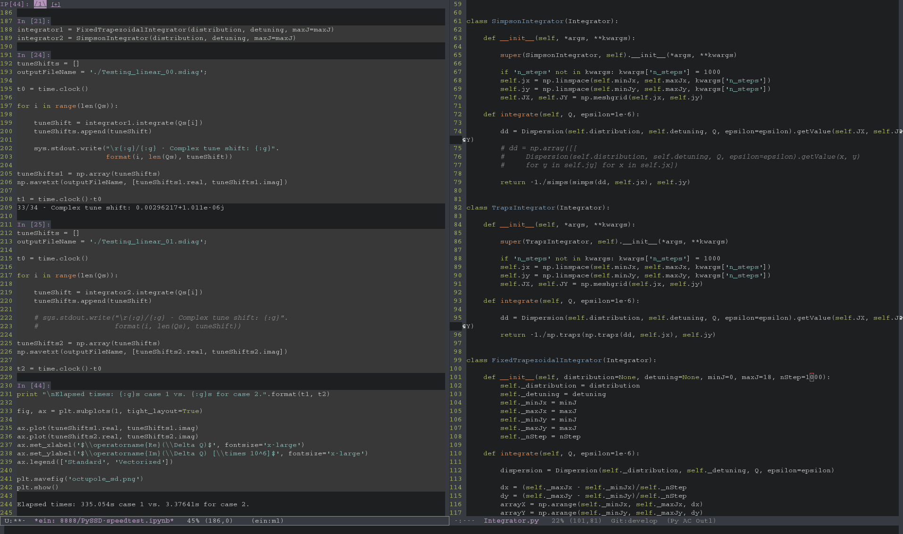
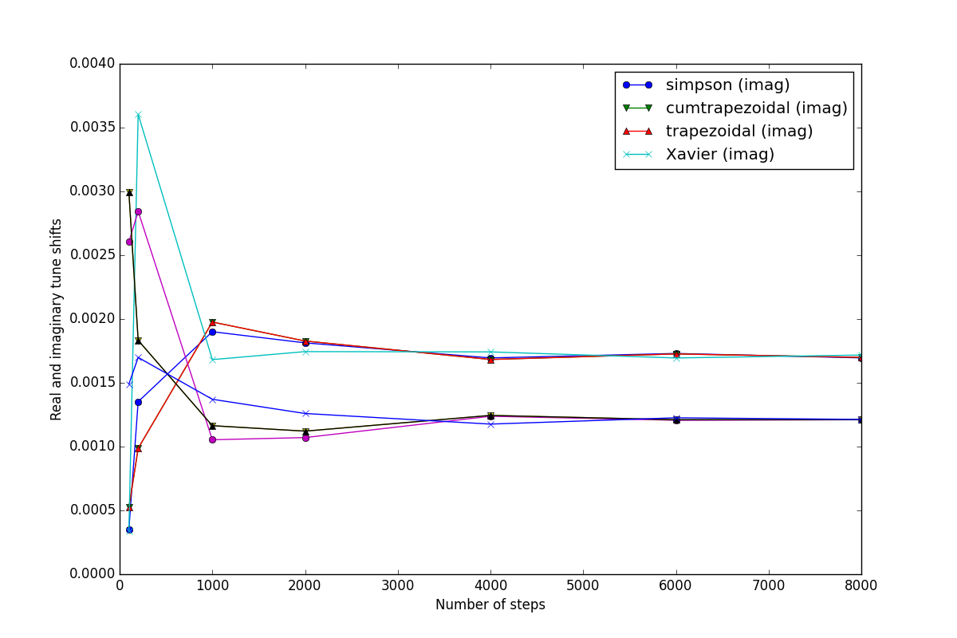
Did different checks – convergence studies
and optimisations. So far, PySSD looks fine…
just a little slow

Slide 11
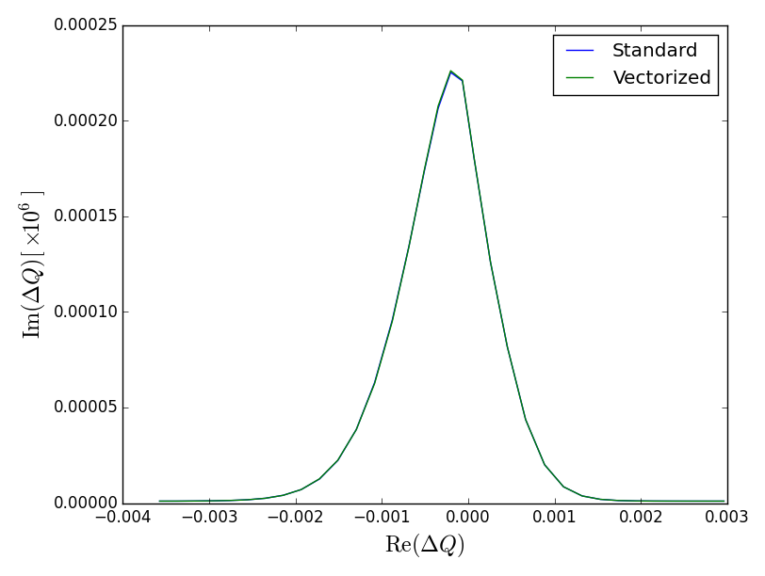
Factor 99.23 speed-up identical output
→ acceptable

Slide 12
RFQ activities
Optimisation of RFQ frequency for SPS cases
Working on extracting a stability diagram
Understanding the instabilities for high RFQ strengths

Slide 13
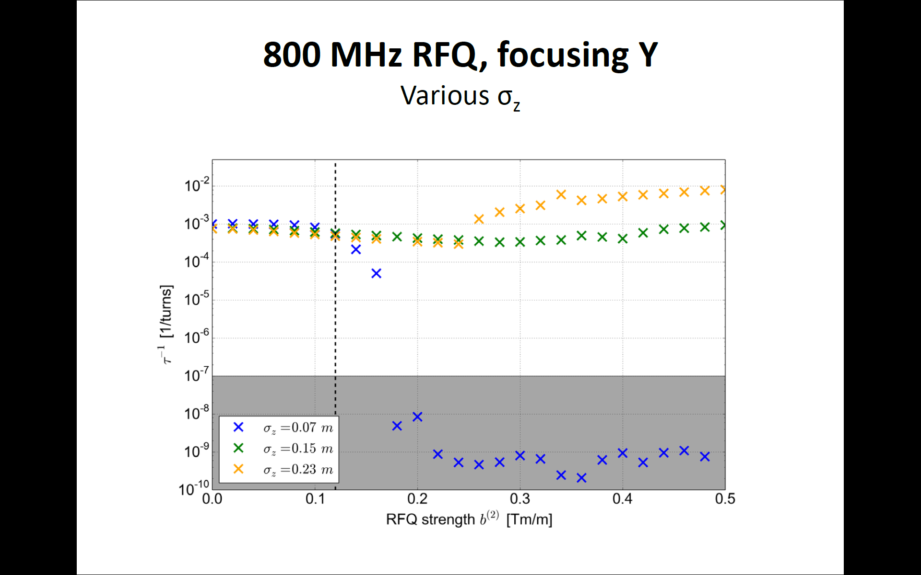
Michael’s slides

Slide 14
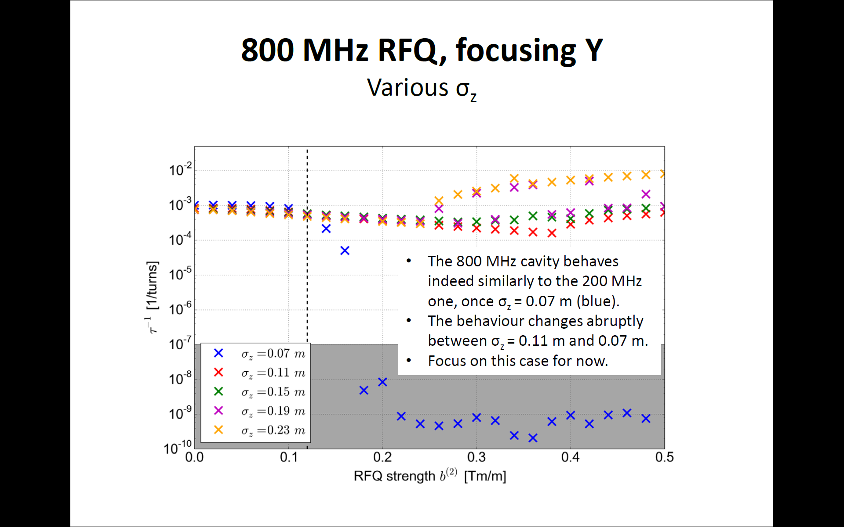
Michael’s slides

Slide 15
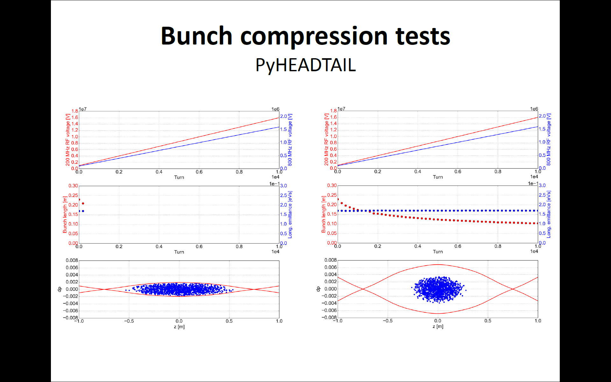
Michael’s slides

Slide 16
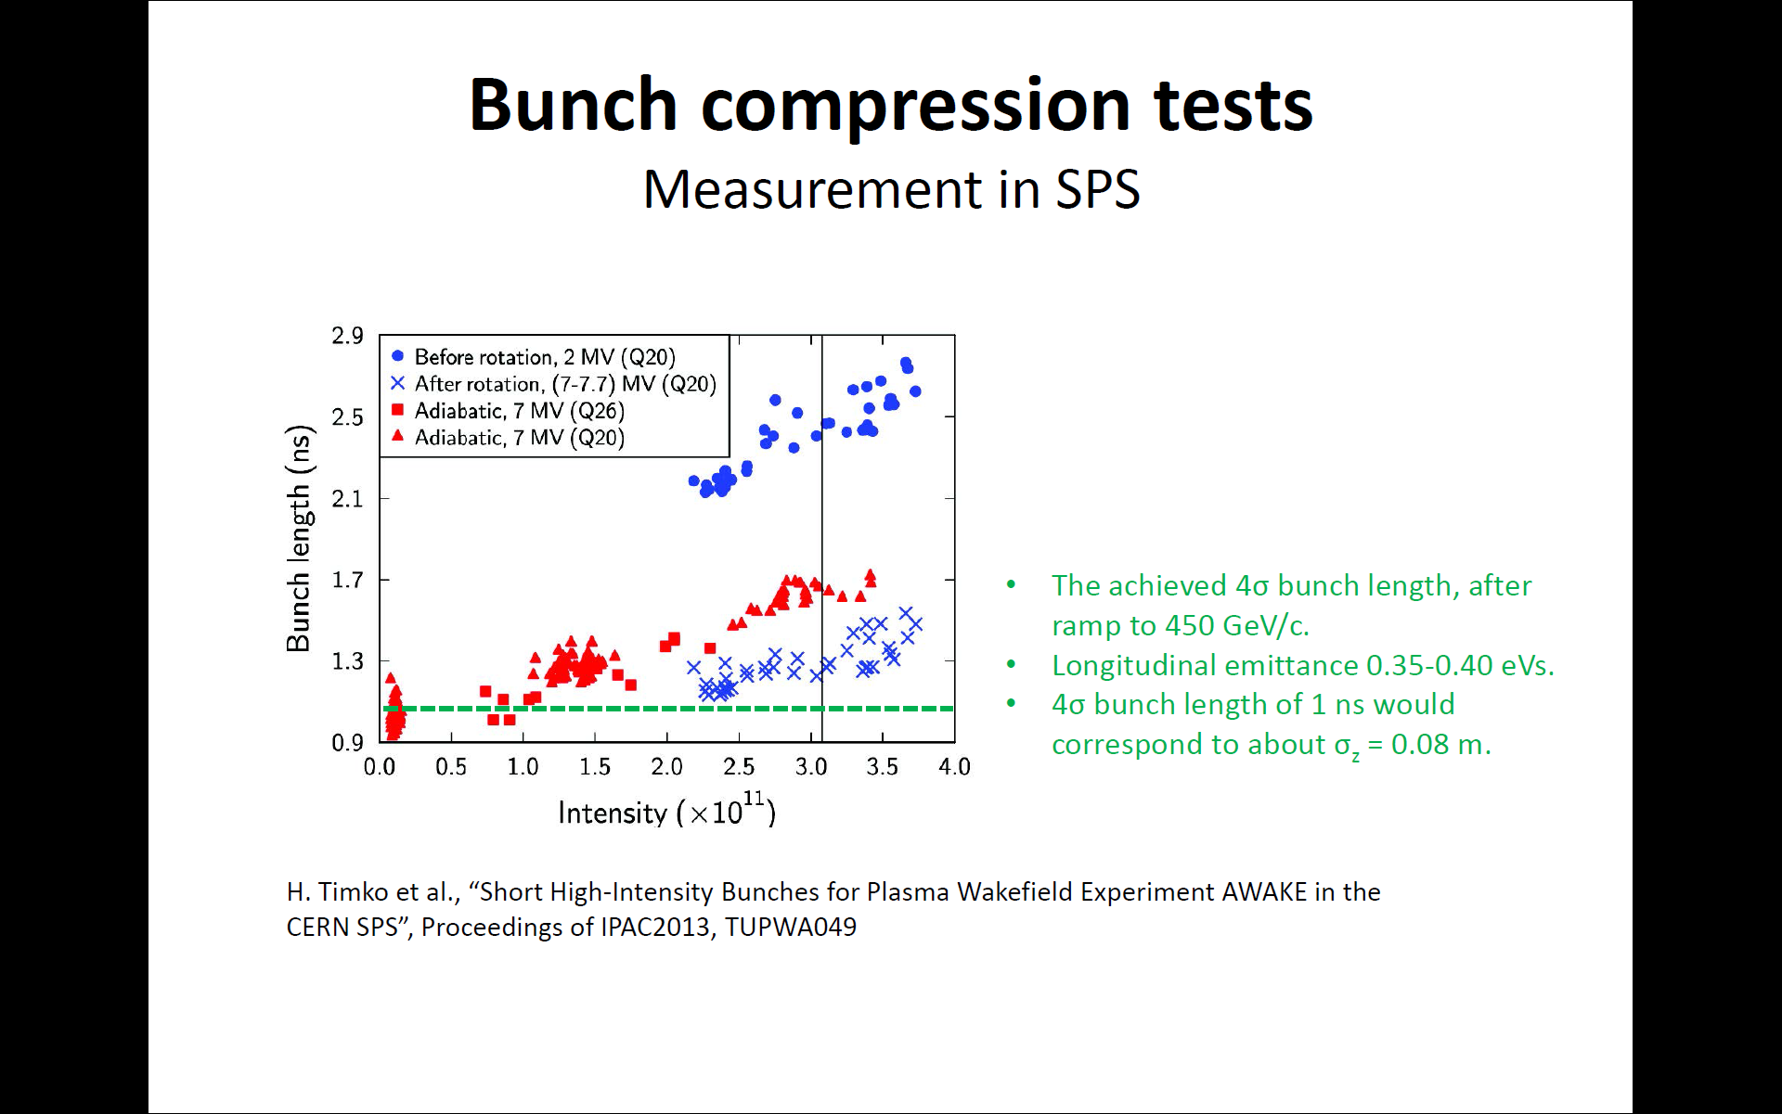
Michael’s slides

Slide 17
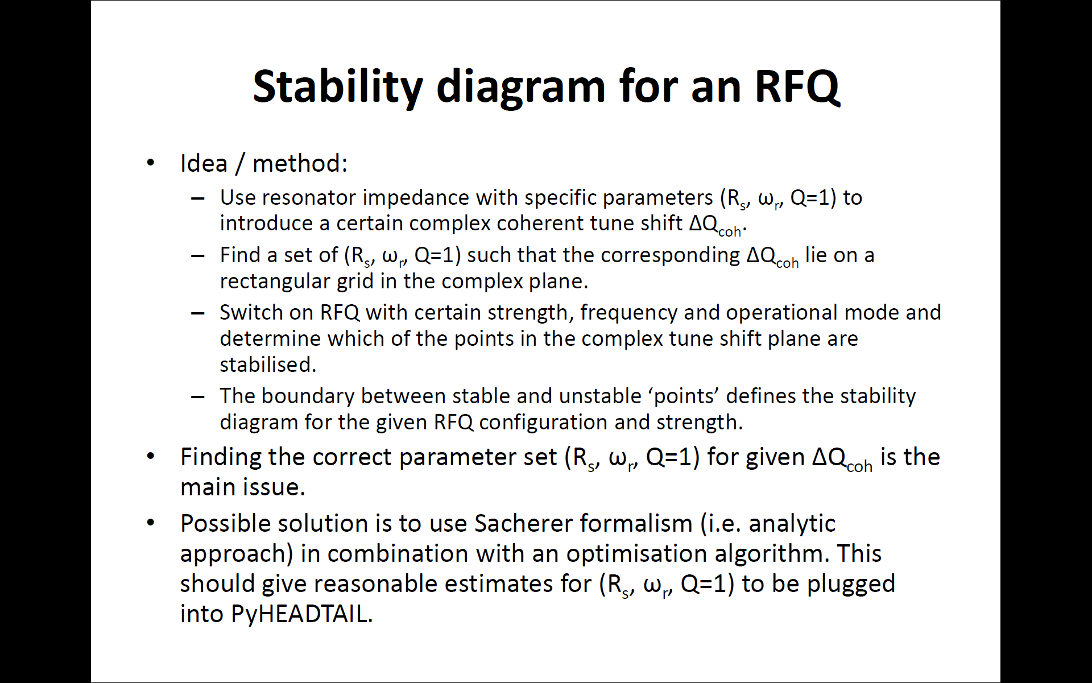
Michael’s slides

Slide 18
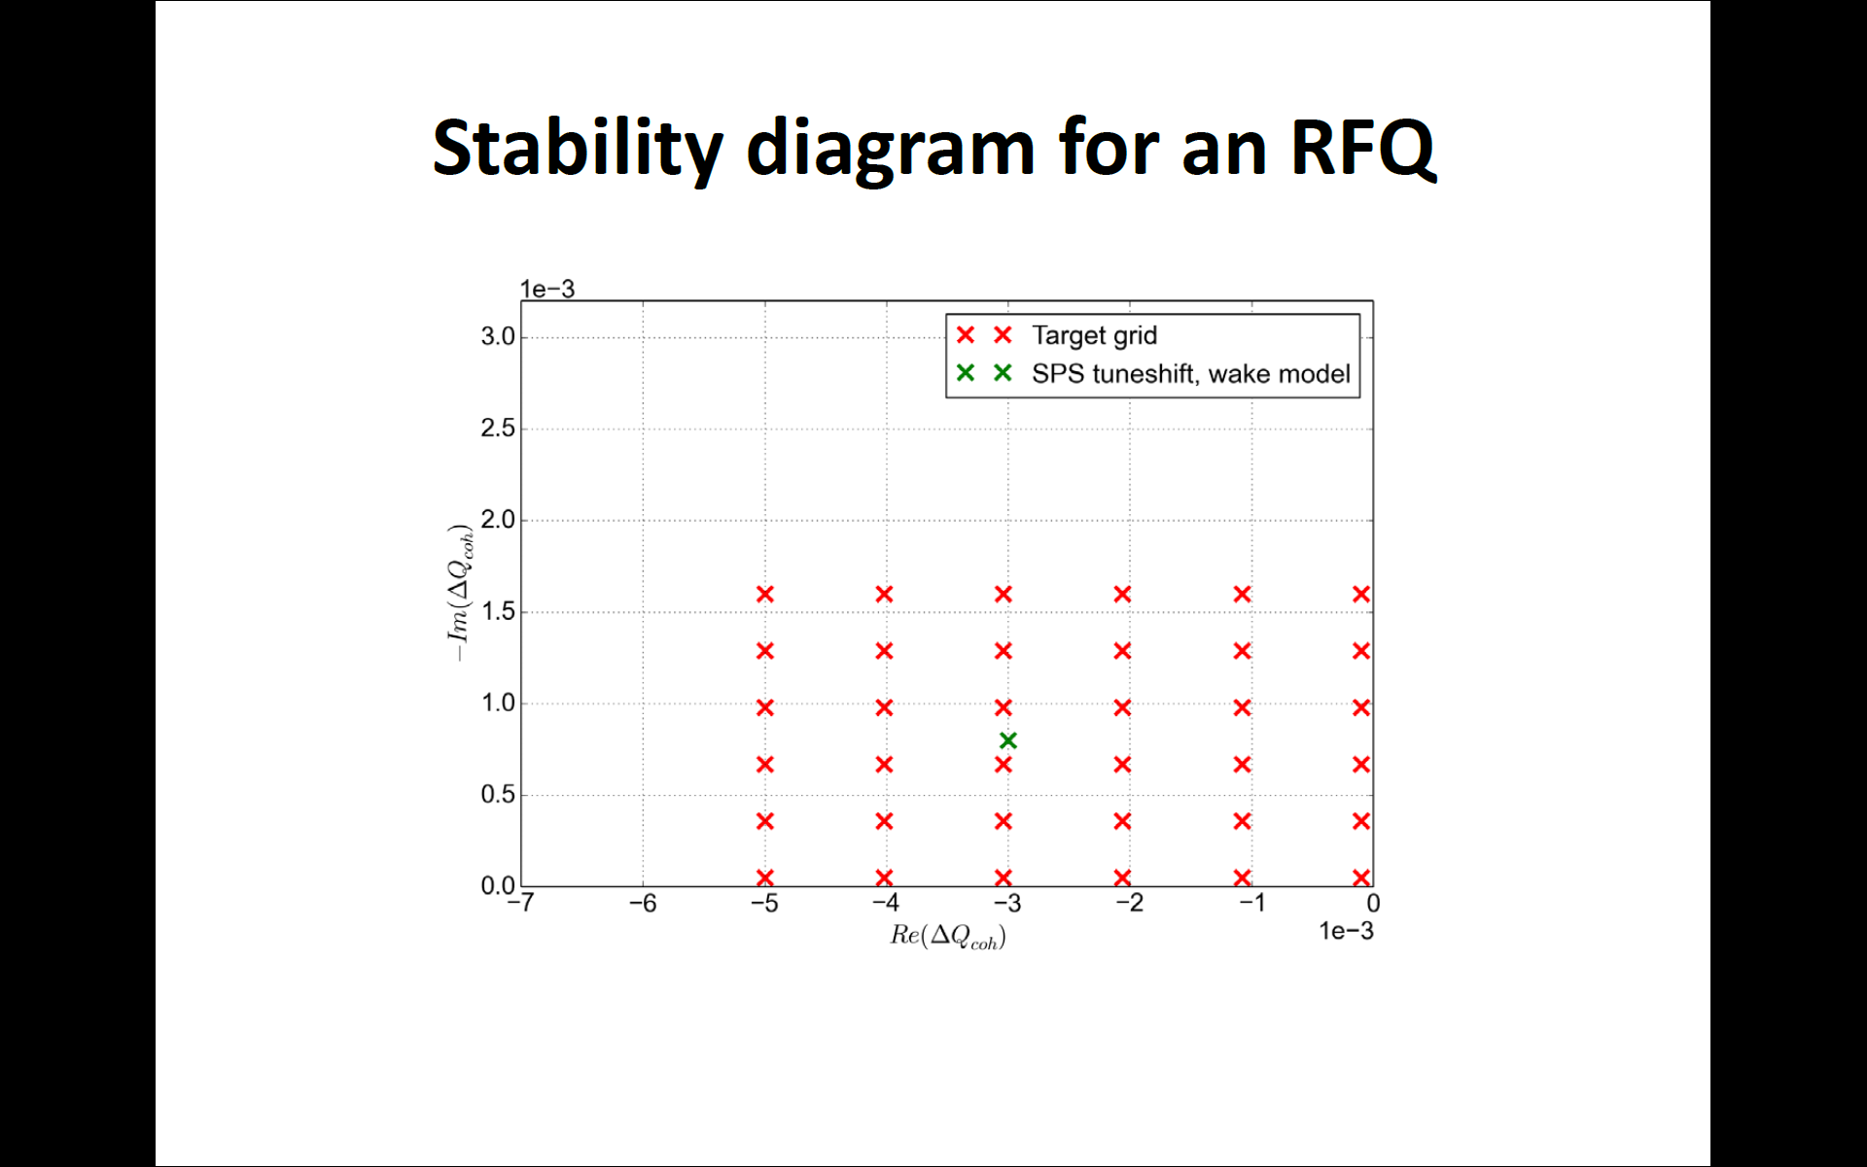
Michael’s slides

Slide 19
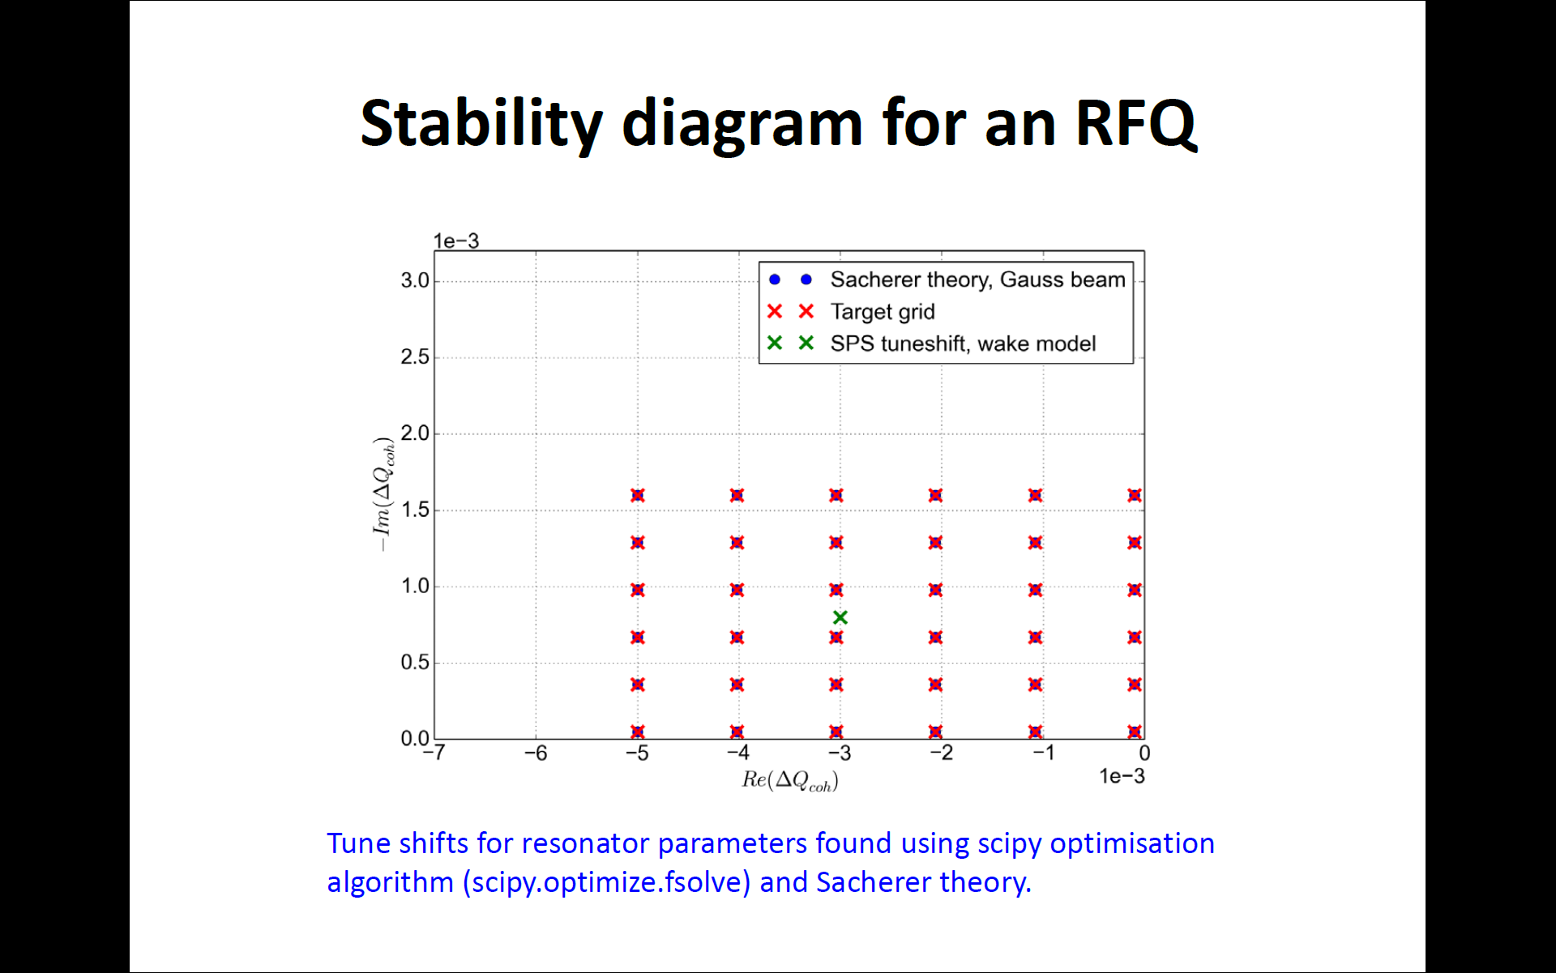
Michael’s slides

Slide 20
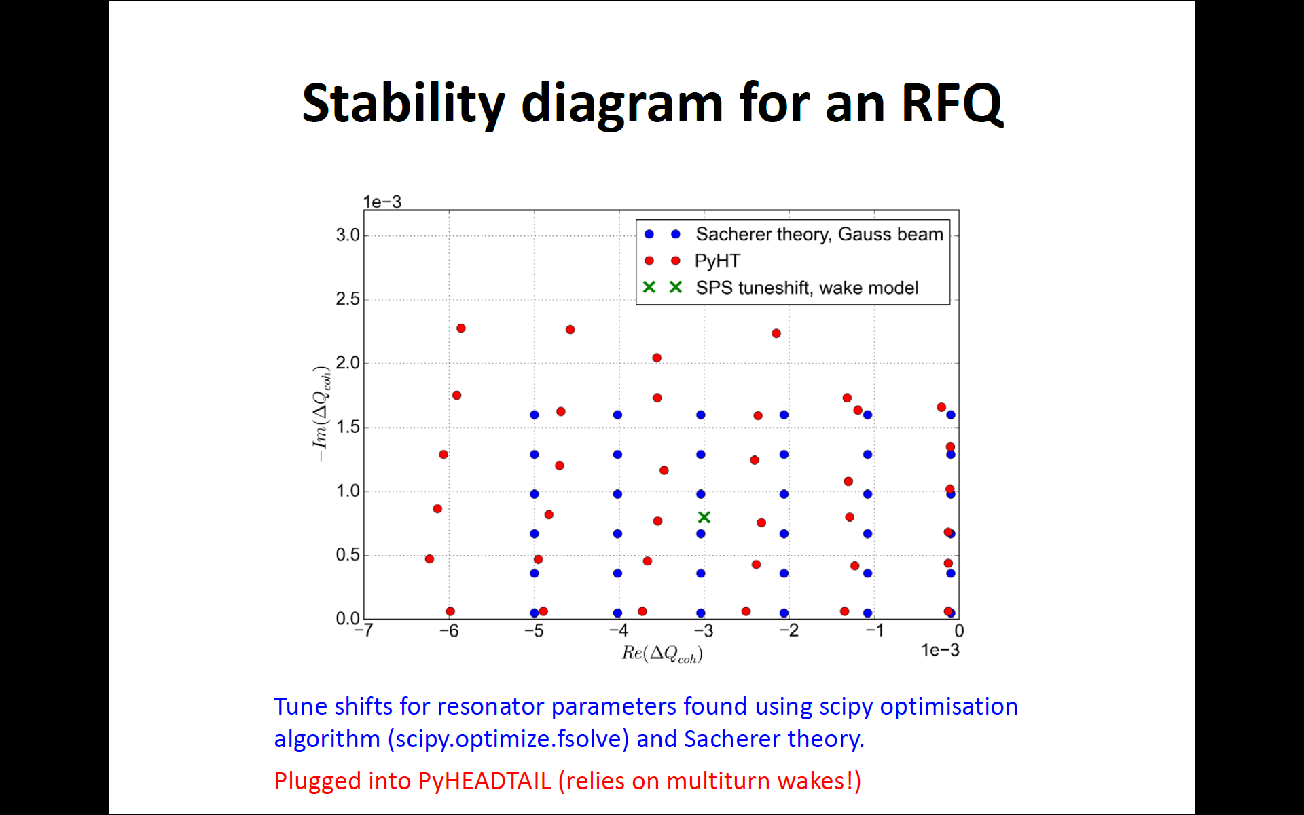
Michael’s slides

Slide 21
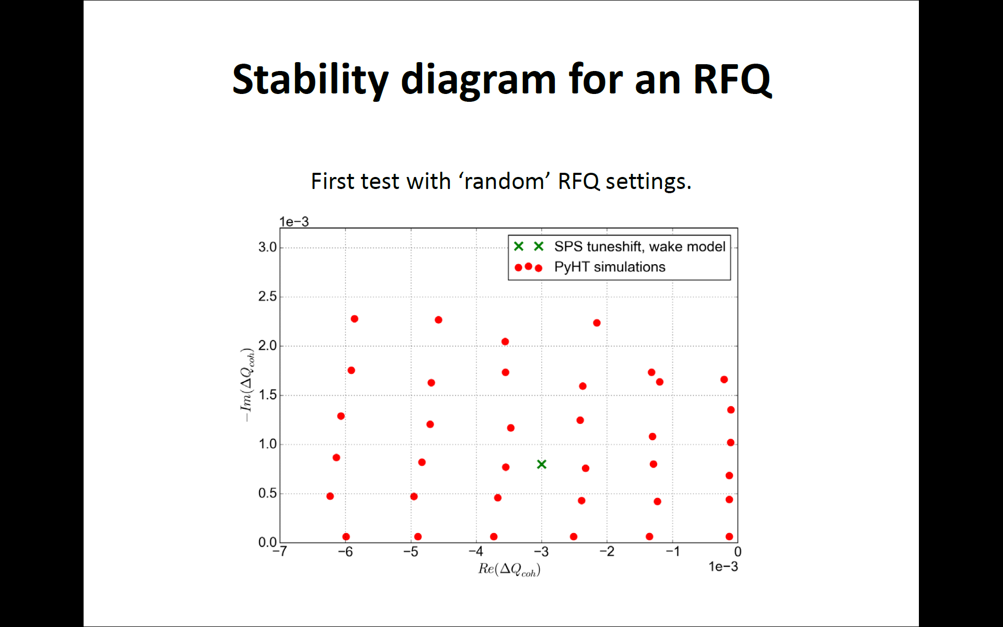
Michael’s slides

Slide 22
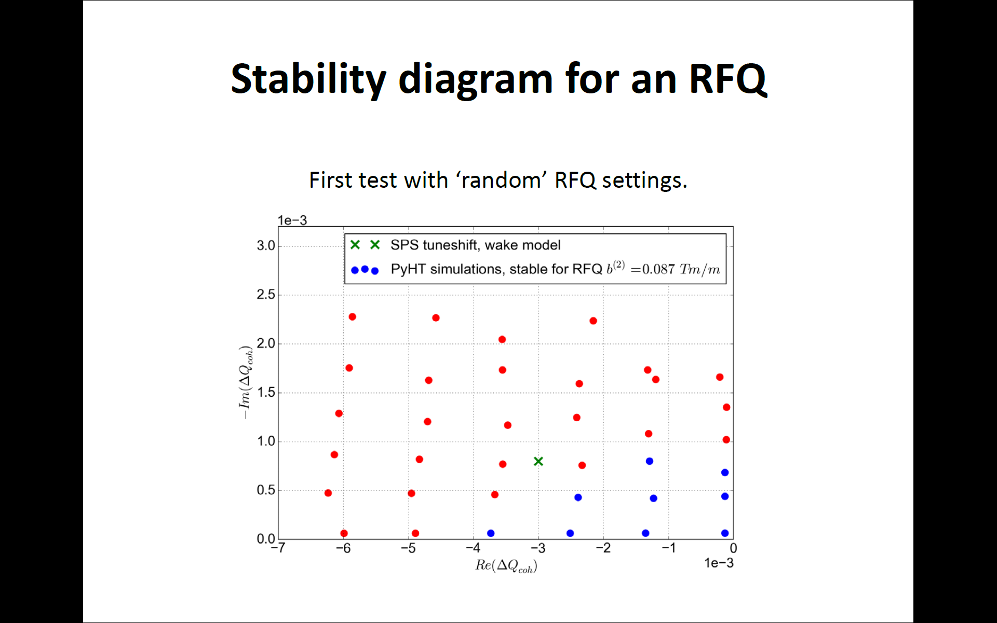
Michael’s slides

Slide 23
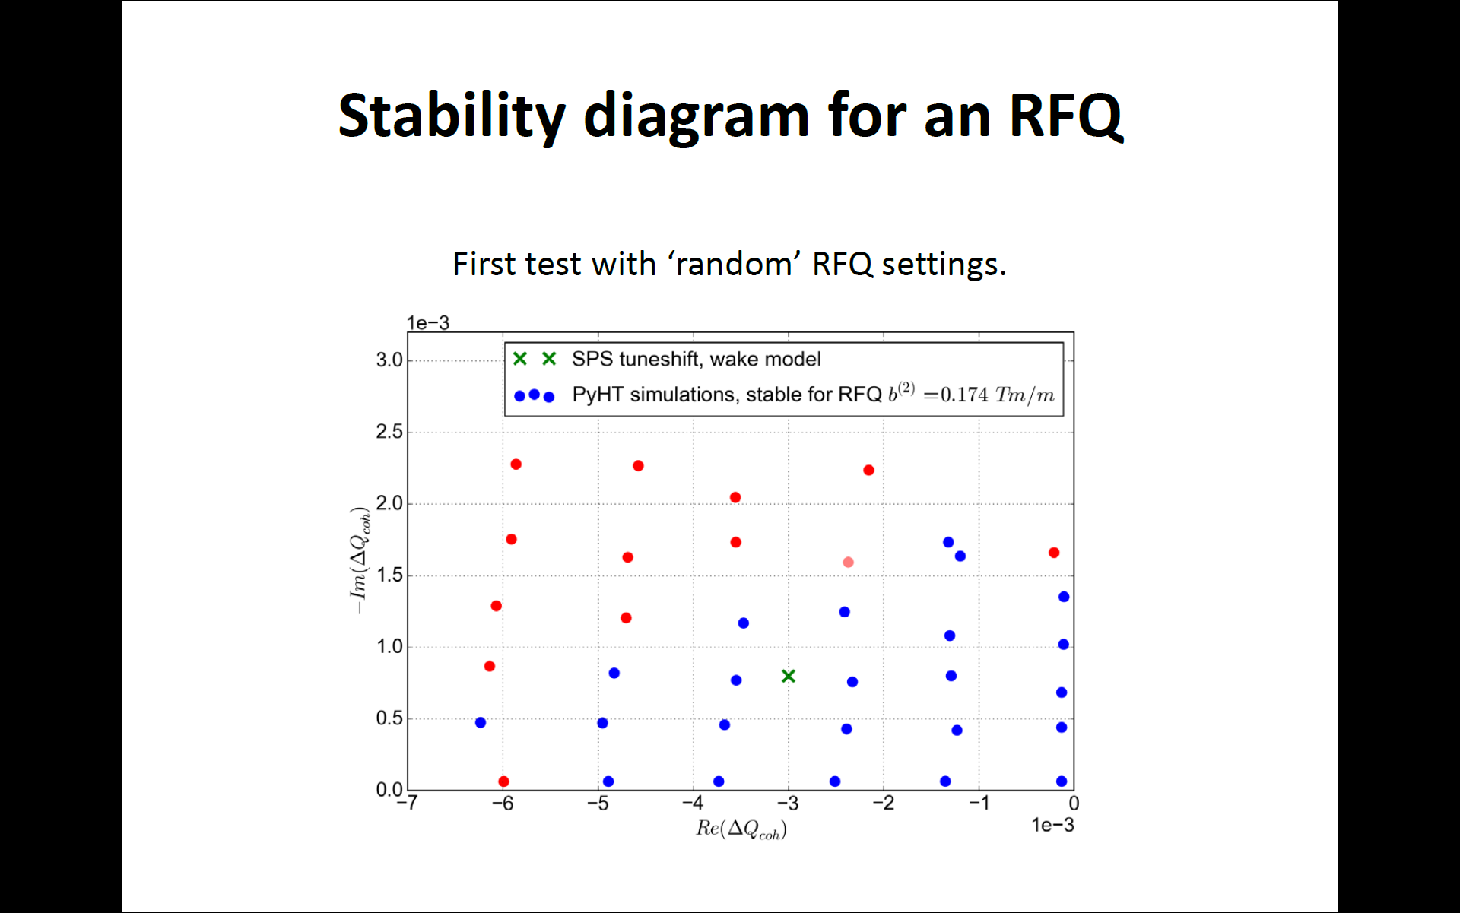
Michael’s slides

Slide 24
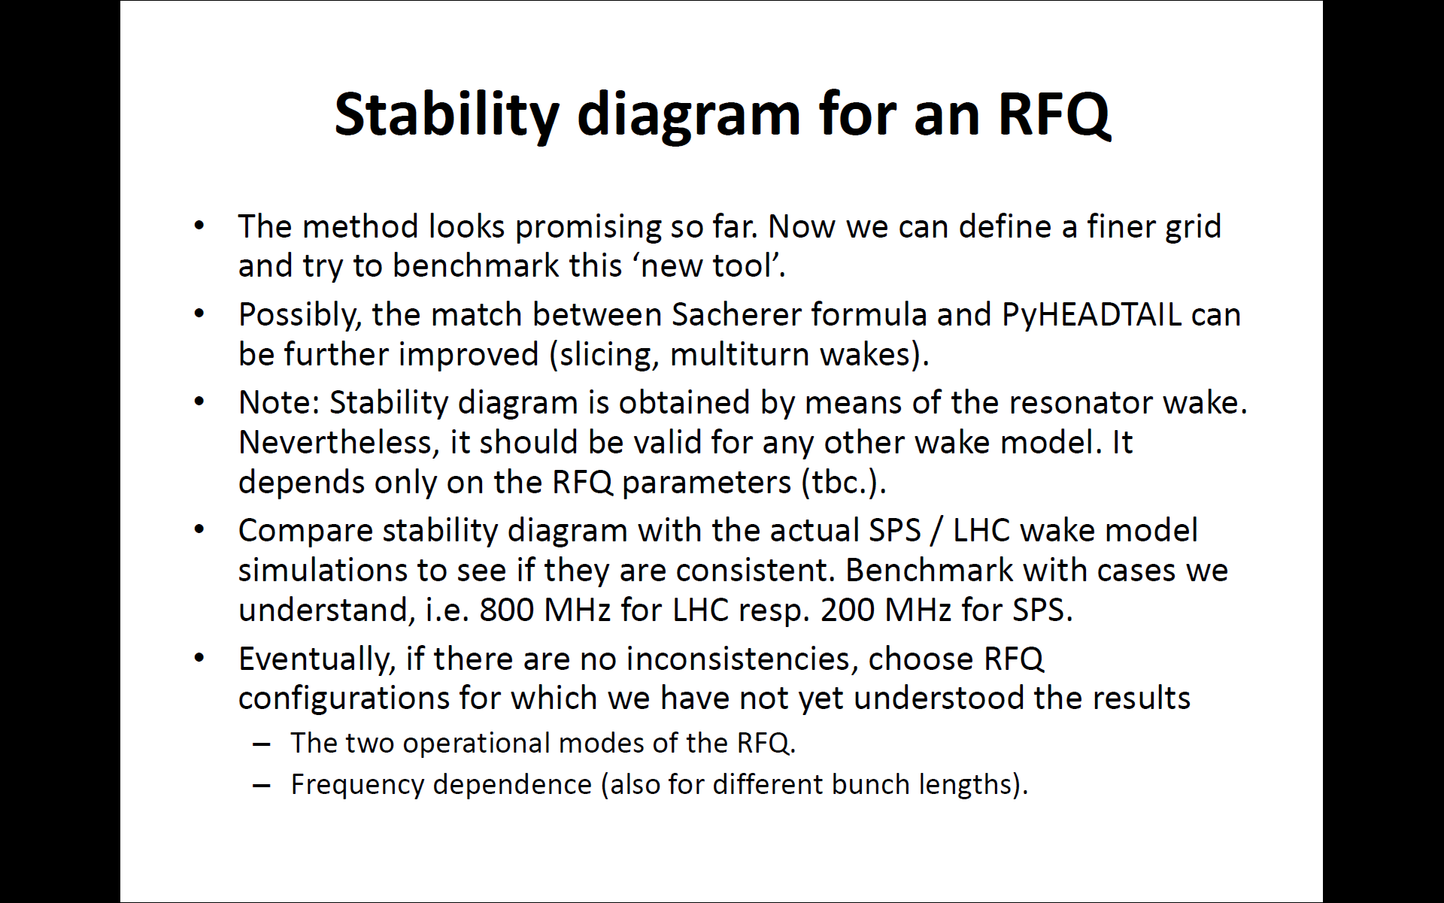
Michael’s slides

Slide 25
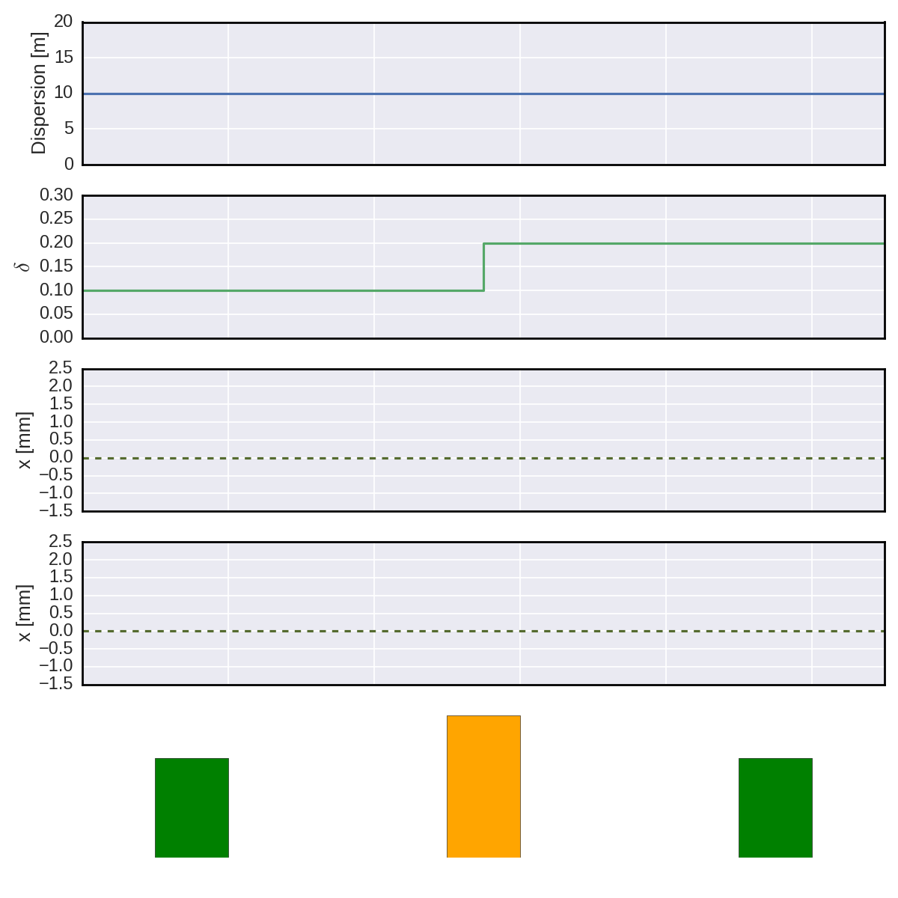

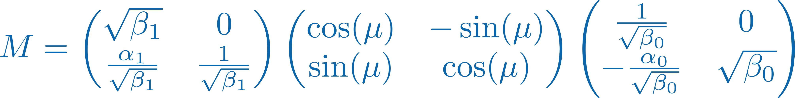
Implementation of dispersion – hickups
Dispersion in cavities can lead to inconsistencies
This was realized when implementing emittance without dispersive part
Observed strong synchro-betatron coupling – is it real?
Reference orbit
Transverse map Cavity Transverse map

Slide 26
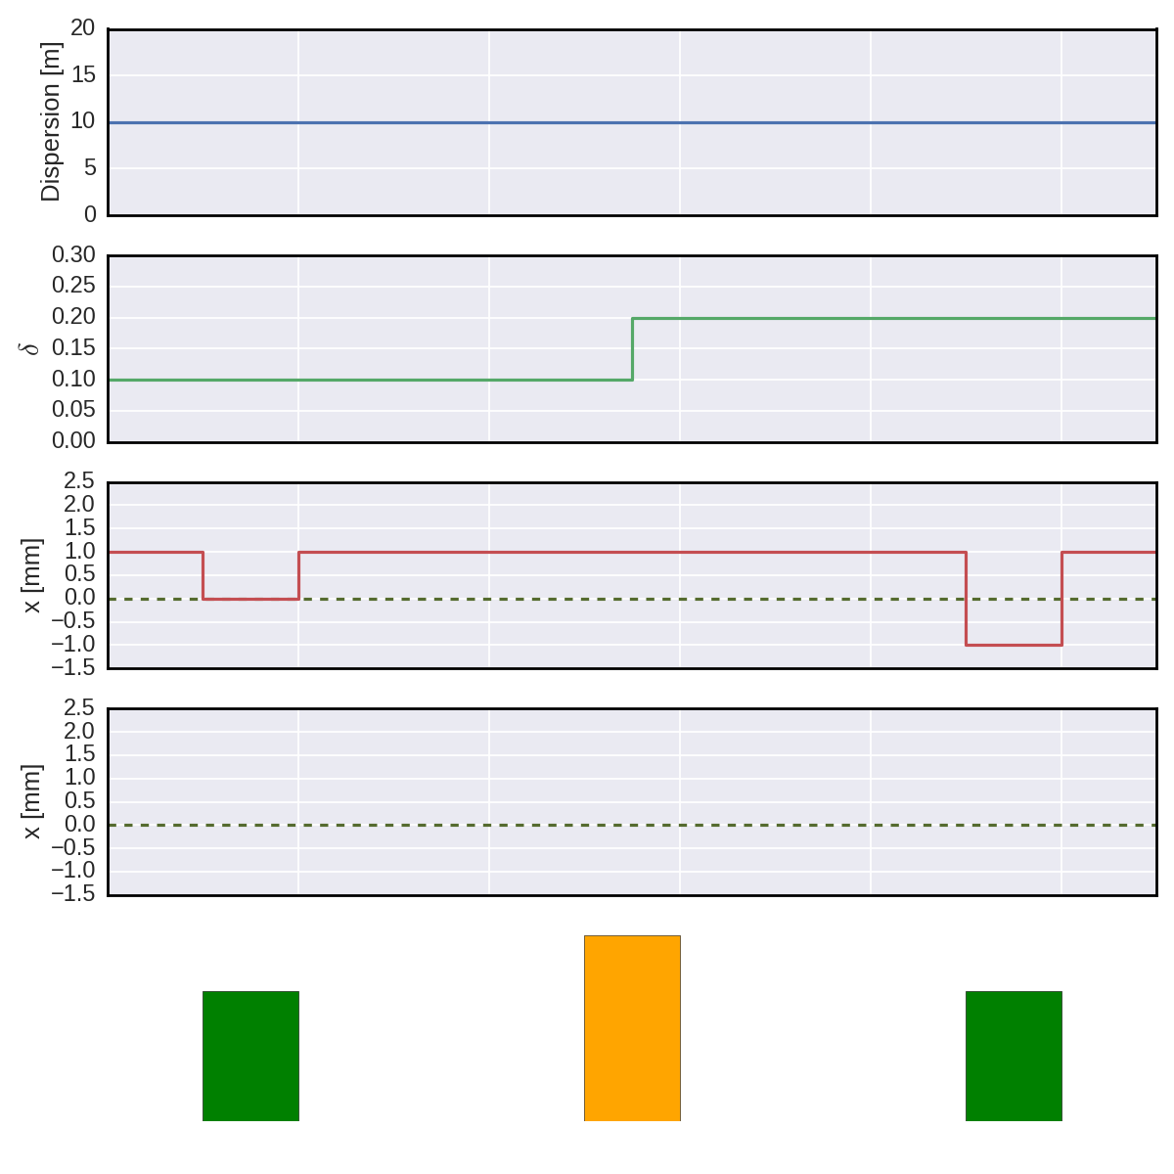
Implementation of dispersion – hickups
Dispersion in cavities can lead to inconsistencies
This was realized when implementing emittance without dispersive part
Observed strong synchro-betatron coupling – is it real?
Old way
Reference orbit
Problem!
Transverse map Cavity Transverse map

Slide 27
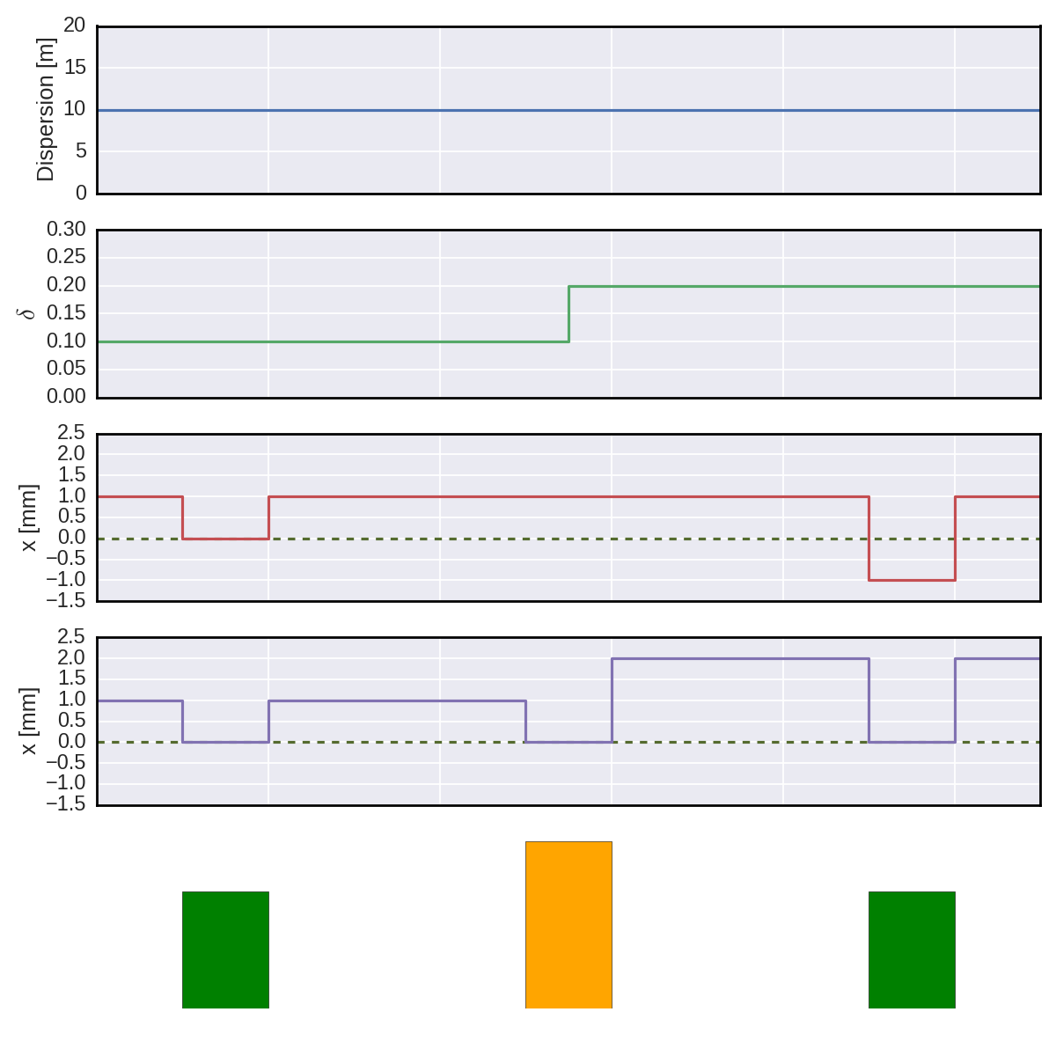
Implementation of dispersion – hickups
Dispersion in cavities can lead to inconsistencies
This was realized when implementing emittance without dispersive part
Observed strong synchro-betatron coupling – is it real?
We need to be aware of the dispersion in the cavity and apply, along with the momentum kick, a dispersive kick also in the transverse plane
Good!
New way
Reference orbit
Transverse map Cavity Transverse map

Slide 28
Implementation of dispersion – hickups
Design barbarism in tracking elements:
Consistency of maps up to the user although already clear at simulation setup → ugly!
Idea of instantiating discrete elements and have an external class manage connectivity (similar to unstructured grids)
This is likely to lead to a significant change of interface → we’ll keep this for PyHEADTAIL 2
New way
Transverse map Cavity Transverse map

