Slide 1

How does a synchrotron radiation source work?
Rolf Landua
CERN

Slide 2

Main chapters of my talk
What is SESAME?
Production of synchrotron light
SESAME components
Synchrotron light spectrum for experiments
Later today:
SESAME - Status/Prospects (Chris Llewellyn-Smith)
CERN-SESAME parallels and differences (Herwig Schopper)

Slide 3
What is SESAME?
Production of synchrotron light
SESAME components
Synchrotron light spectrum for experiments

Slide 4
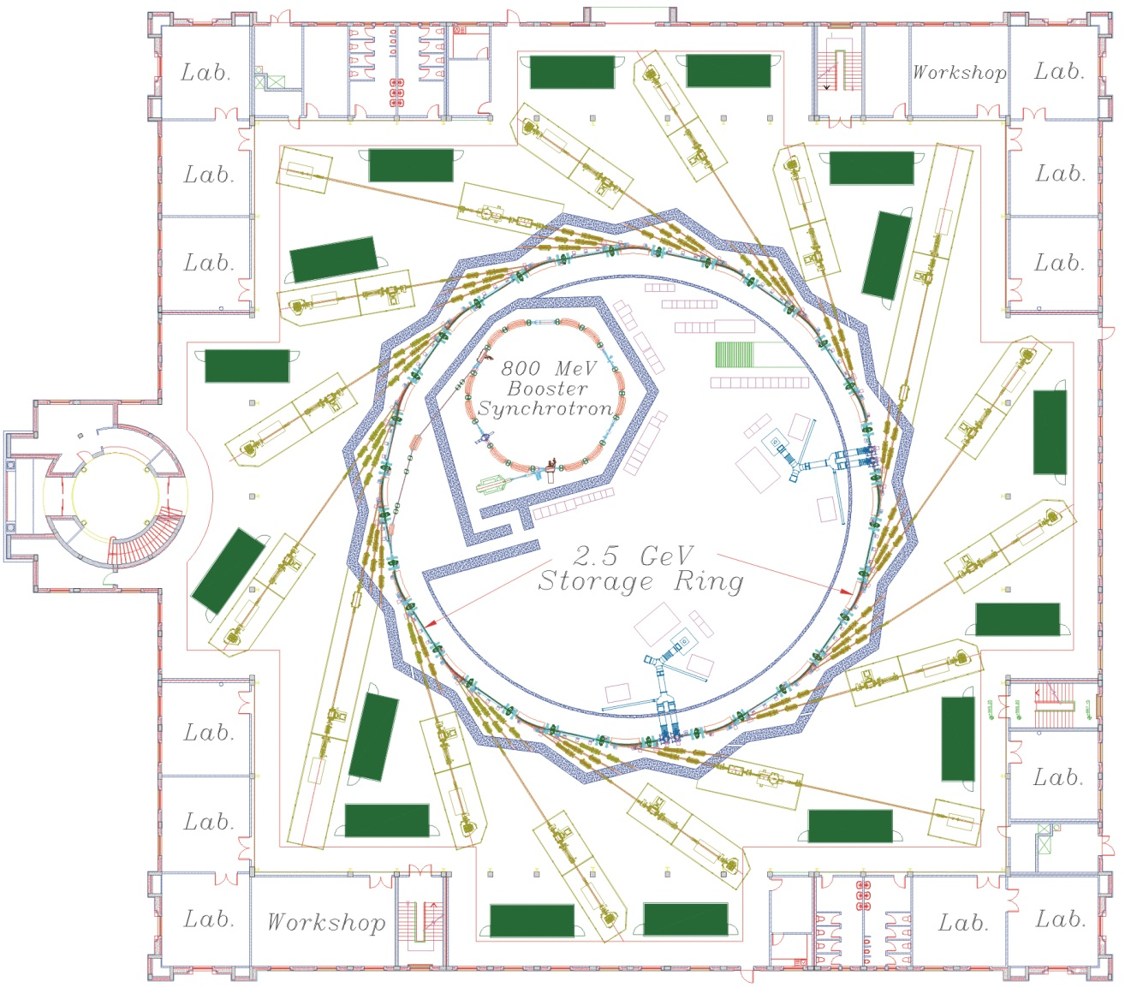


SESAME is an ‘electron synchrotron’
Energy = 2.5 GeV
Circumference = 133.2 m
Magnet strength = 1.455 T
Max. current = 400 mA (3·10¹² e)
Very intense beams of X-rays*, infrared and UV light (billion times brighter than Sun)
Allows to study objects that are much smaller than 1 µm (~ cell size)

Slide 5
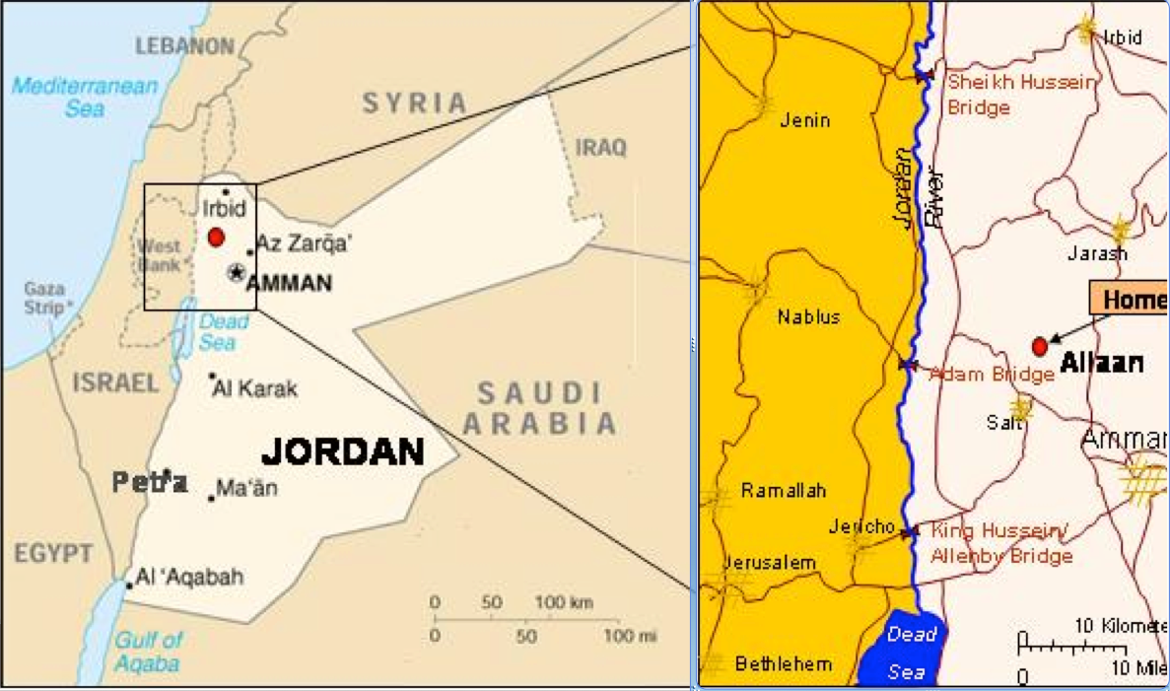
Synchrotron Light for Experimental Science and Applications in the Middle East
A “CERN” in the Middle East
http://www.sesame.org.jo/sesame/

Slide 6
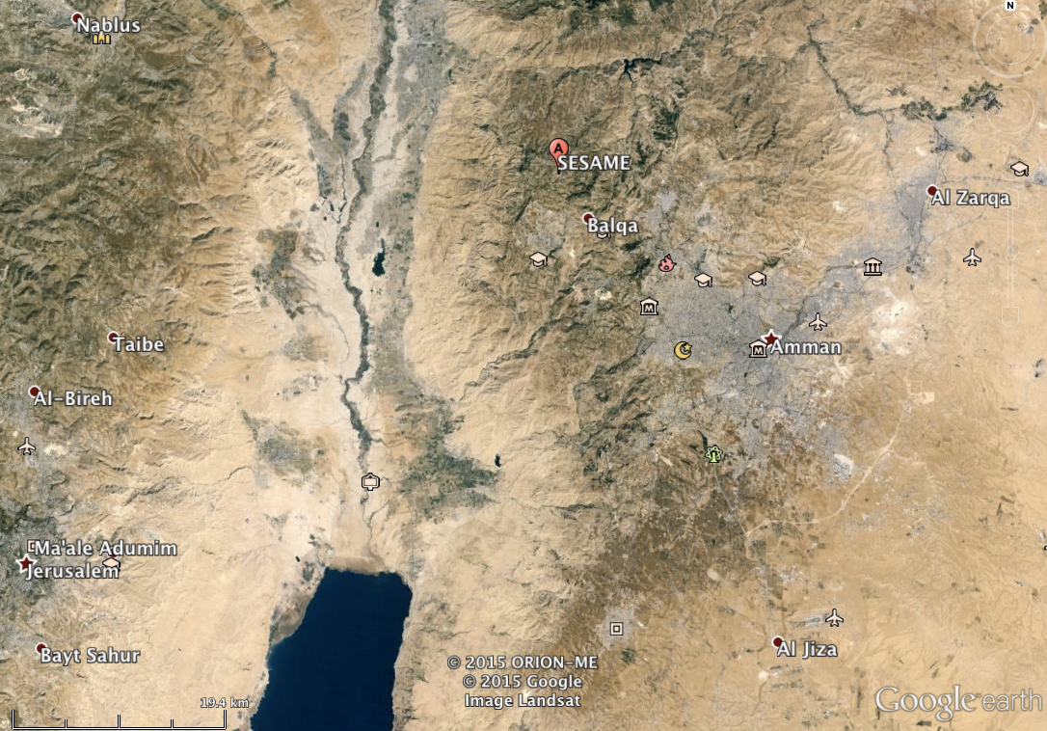
SESAME on ‘Google Earth’
Dead
Sea

Slide 7
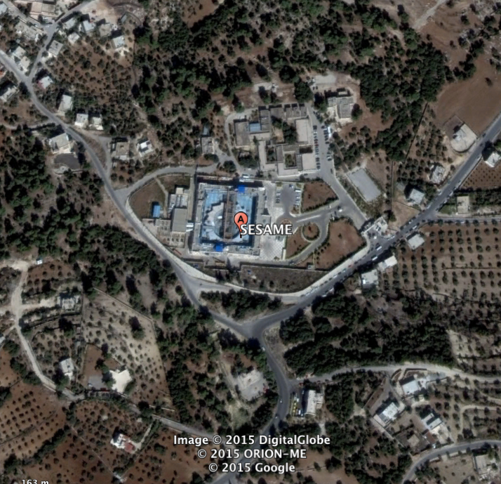

SESAME on ‘Google Earth’

Slide 8
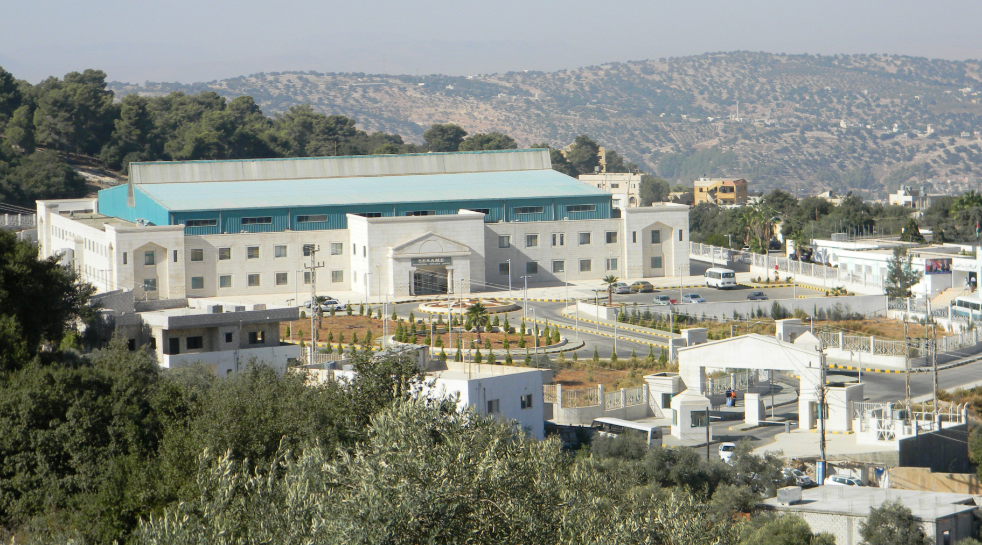
SESAME building

Slide 9

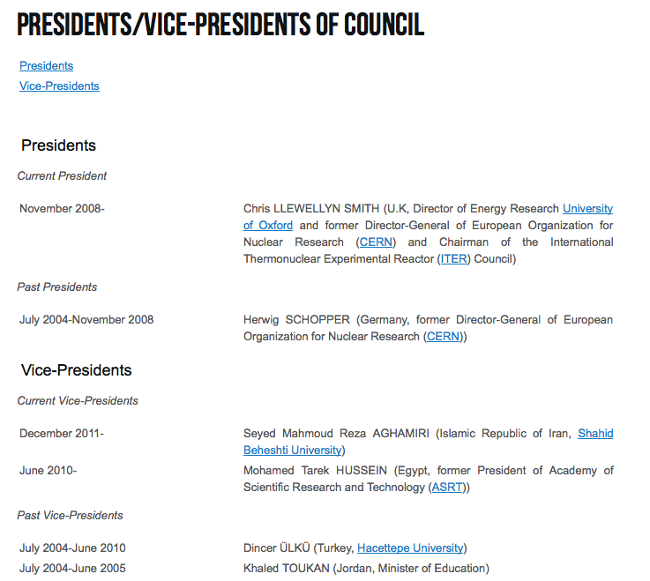

Slide 10
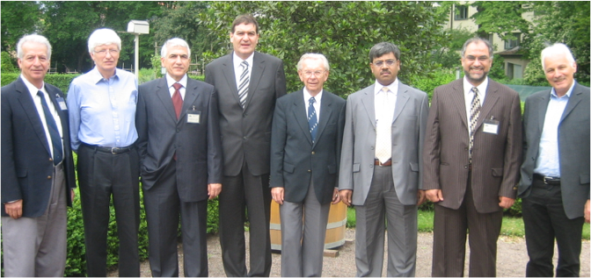
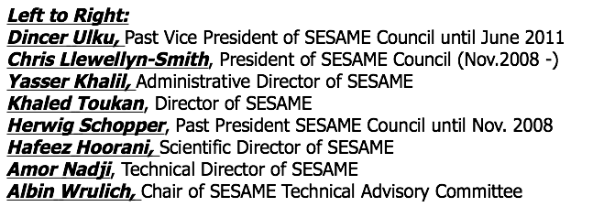
Chris Llewellyn-Smith
President SESAME council
Former CERN DG
Herwig Schopper
Former president SESAME council
Former CERN DG

Slide 11

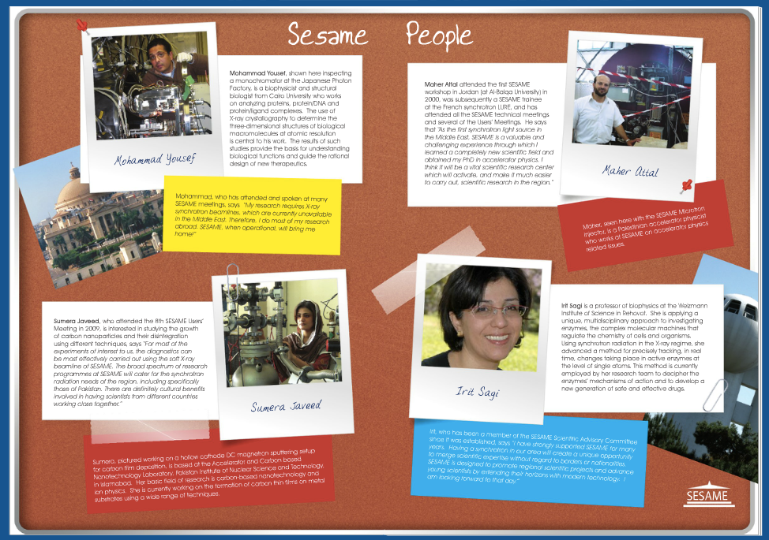
SESAME people: who is already working there?
http://mag.digitalpc.co.uk/fvx/iop/esrf/sesamepeople/

Slide 12
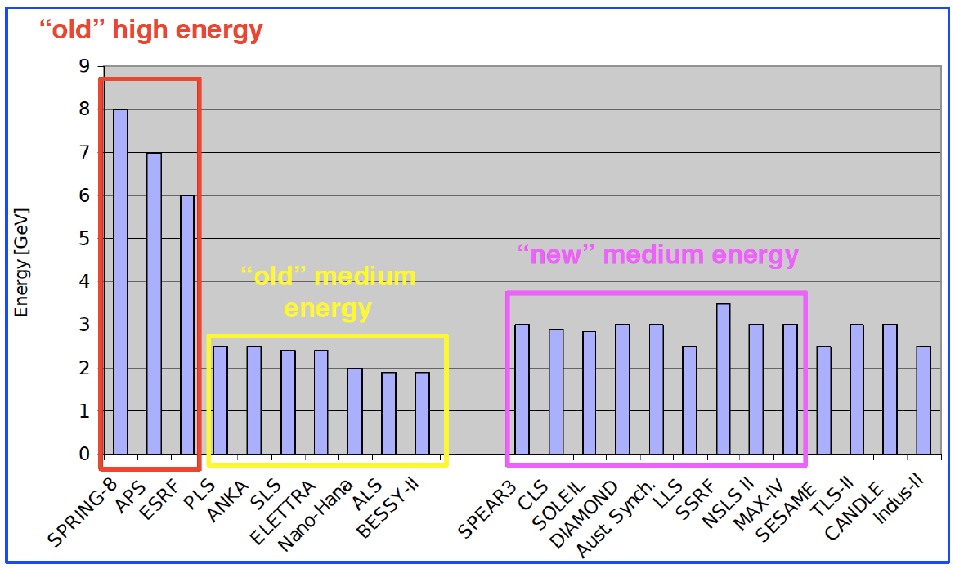
Comparison of synchrotron light sources world-wide
SESAME

Slide 13
What is SESAME?
Production of synchrotron light
SESAME components
Synchrotron light spectrum for experiments

Slide 14
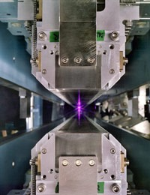
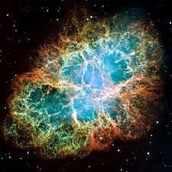
Synchrotron light: artificial and natural sources
Synchrotron
Crab nebula (neutron star)
Notes:
Synchrotron radiation is the name given to the radiation which occurs when charged particles are accelerated in a curved path or orbit. Classically, any charged particle which moves in a curved path or is accelerated in a straight-line path will emit electromagnetic radiation. Various names are given to this radiation in different contexts. For example, when is occurs upon electron impact with a solid metal target.
The Crab pulsar is slowing at the rate of about 10⁻⁸ sec per day, and the corresponding energy loss agrees well with the energy needed to keep the nebula luminous. Some of this luminosity takes the form of synchrotron radiation, requiring a source of energy for accelerating charged particles.

Slide 15
Two important concepts about electromagnetism
-
+
Electric force on electron (with charge q) in the direction of
the electric field E
e⁻
F = q · E (Coulomb force)
Electric fields increase kinetic energy
N
Magnetic force on electron (with charge q) is perpendicular
to the direction of the magnetic field B
e⁻
F = q · v · B (Lorentz force)
S
Magnetic field change the direction

Slide 16
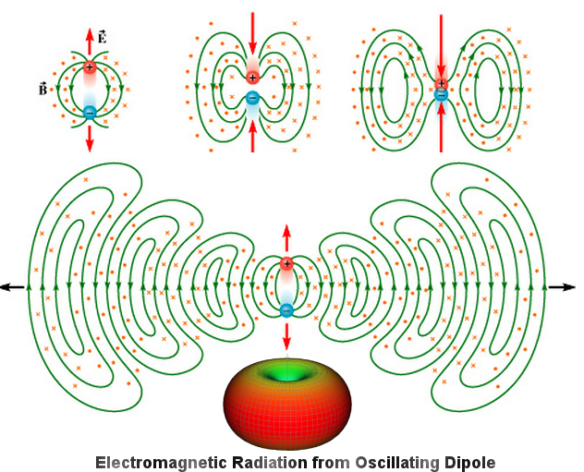
And what about accelerated charges ?
Whenever a charged particle accelerates it emits electromagnetic waves
Principle of radio station / antenna

Slide 17
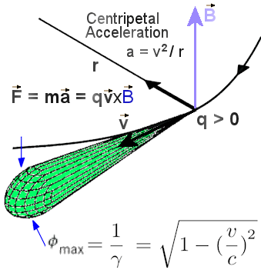
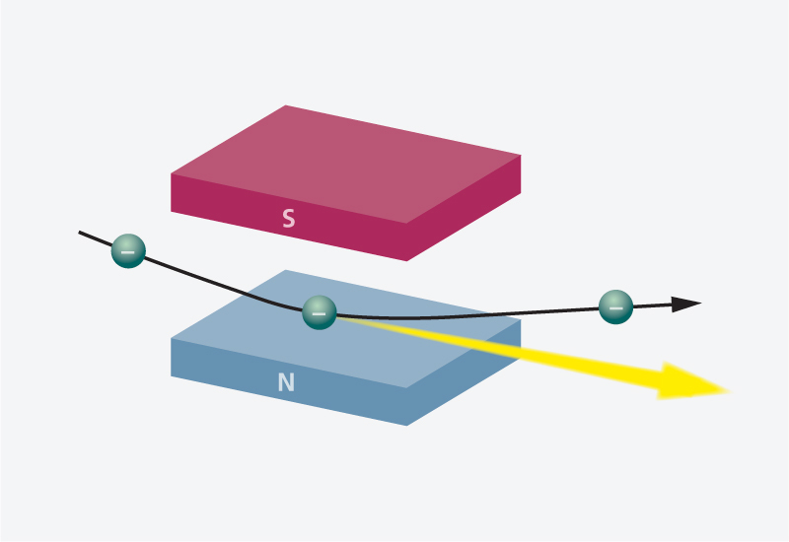
Electrons in a synchrotron emit radiation
Acceleration by magnetic dipole field
SESAME: 𝛾 ~ 5000

Slide 18
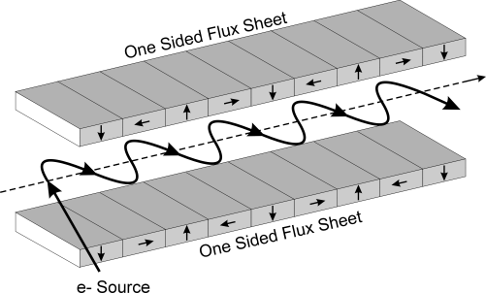
How to increase synchrotron radiation intensity ?
Wiggler
Array of magnets
Lateral deflection of electrons
Broad and incoherent emission spectrum
Higher intensity and energy than
inside a bending magnet

Slide 19
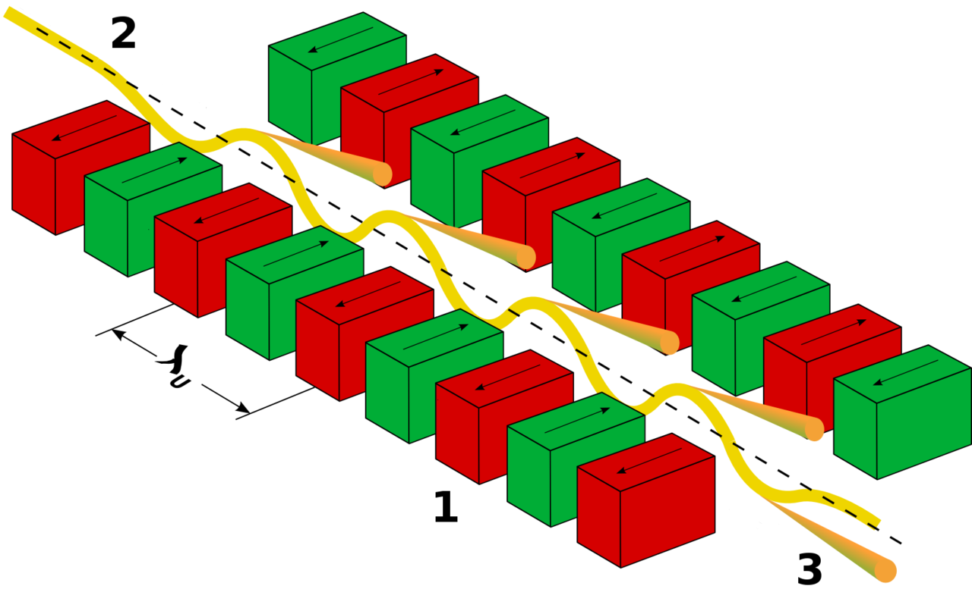
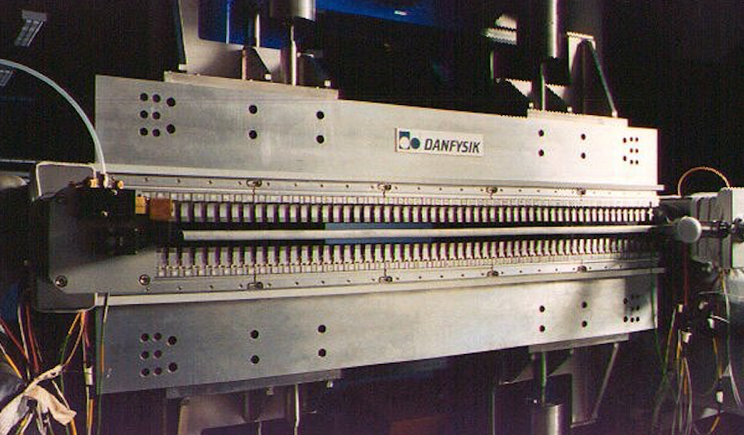
Undulator
Less powerful magnets —> gentler undulations
Match transverse motion to transit speed:
      constructive interference !
Frequency tuneable (alter gap between magnets)
Narrow and coherent emission spectrum

Slide 20
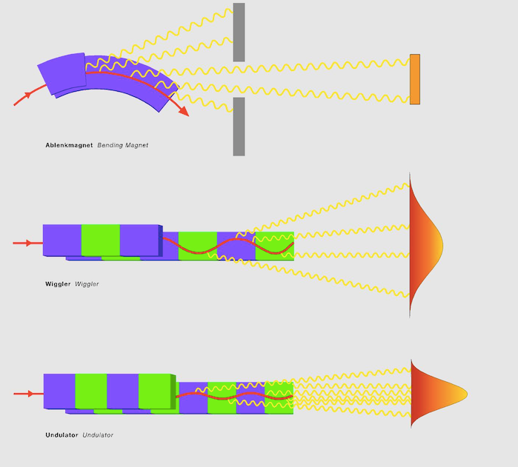
Overview: Dipole magnet, Wiggler, Undulator

Slide 21
What is SESAME?
Production of synchrotron light
SESAME components
Synchrotron light spectrum for experiments

Slide 22
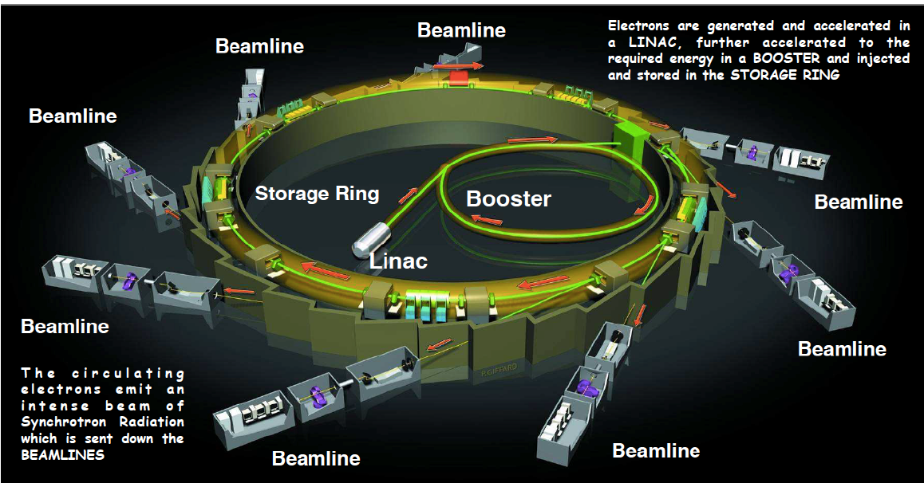
Schematic overview of a Synchrotron Radiation Source

Slide 23
Layout of the SESAME complex
Material science
Bio-medical
Booster
Microtron
Storage Ring
Environmental science
Archeology
Physics

Slide 24
Main steps of SESAME
Electrons are generated in an electron gun (like cathode ray tubes in old TVs)
Acceleration in three steps:
Microtron (= linear accelerator, up to 22 MeV)
Booster synchrotron (22 - 800 MeV)
Storage ring (800 - 2500 MeV)
2500 MeV
Energy
SESAME Storage Ring
800 MeV
Booster
22 MeV
t
Microtron

Slide 25

Overview: Synchrotron light source animation

Slide 26
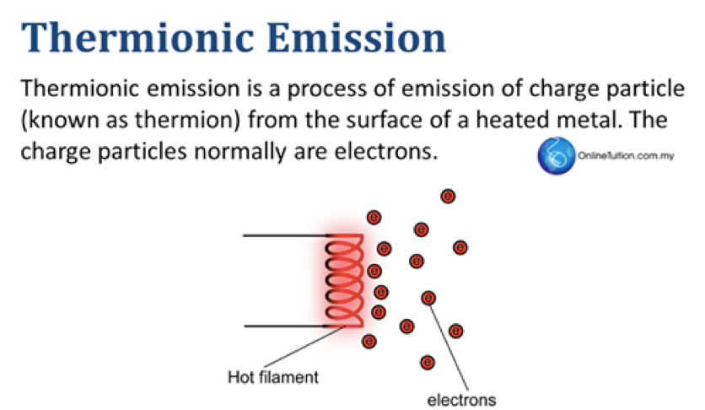
Step 1a - electron gun

Slide 27
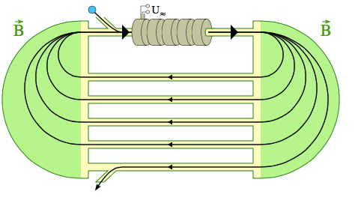
Step 1b : the Microtron (up to 22 MeV)
linear accelerator
Bending magnet
Bending magnet

Slide 28
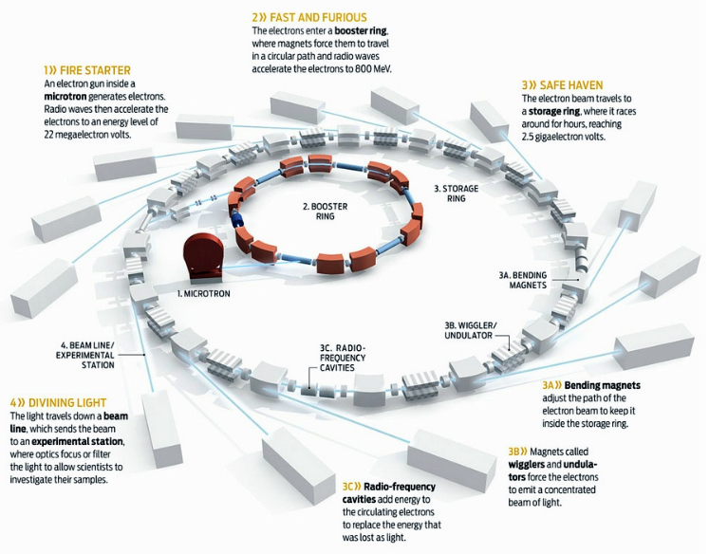
Step 2 : the Booster (up to 800 MeV)
Booster = BESSY I 0.8 GeV synchrotron
decommissioned at BESSY, Berlin, Germany in 1999
donated to the SESAME project

Slide 29
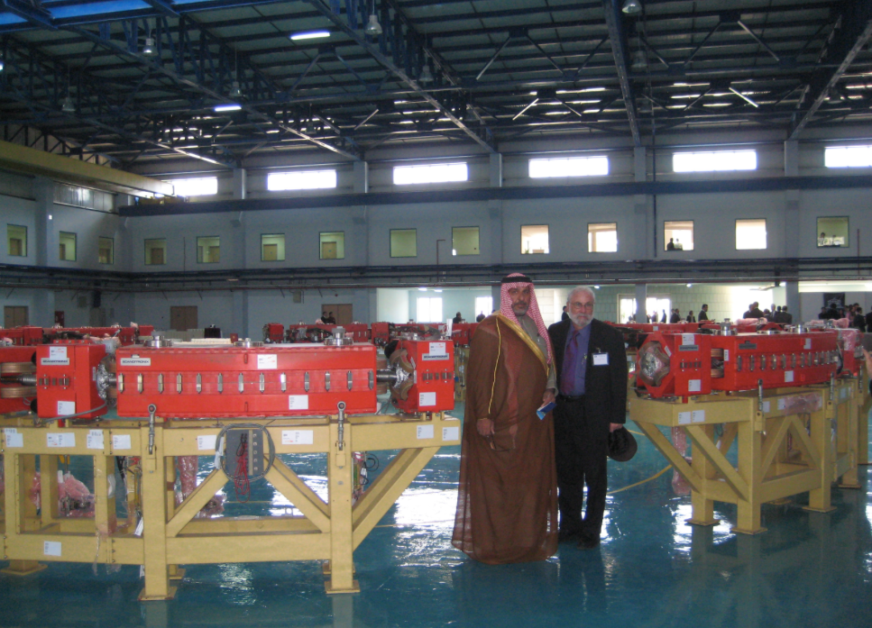
Step 2 : the Booster (up to 800 MeV)
Mr. Salameh, Mayor of Salt City, Jordan, and Herman Winick (SLAC)

Slide 30
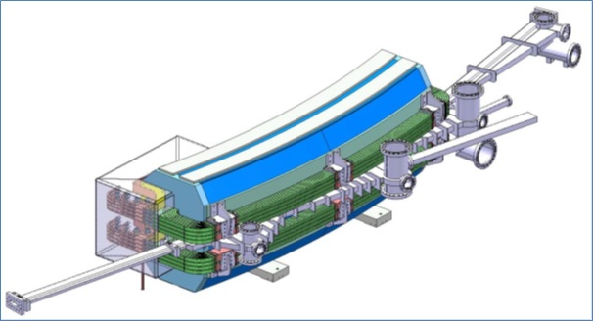
Step 3 : the Storage Ring (up to 2500 MeV)
CESSAMAG project: European Union grant €5 million
CERN supplies magnetic system allowing for the completion of the main ring
CERN is the main contractor, coordinates the delivery of the magnet system.
16 Dipole magnets (CERN)
+ 64 quadrupole magnets
+ 64 sextupole magnets

Slide 31
Other important components
RF cavities
(compensate for lost energy)
Vacuum pumps
(no scattering)

Slide 32
What is SESAME?
Production of synchrotron light
SESAME components
Synchrotron light spectrum for experiments

Slide 33
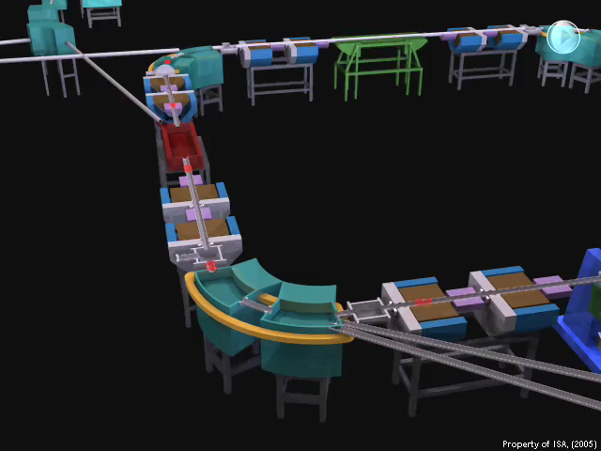
Animation: emission of synchrotron radiation

Slide 34
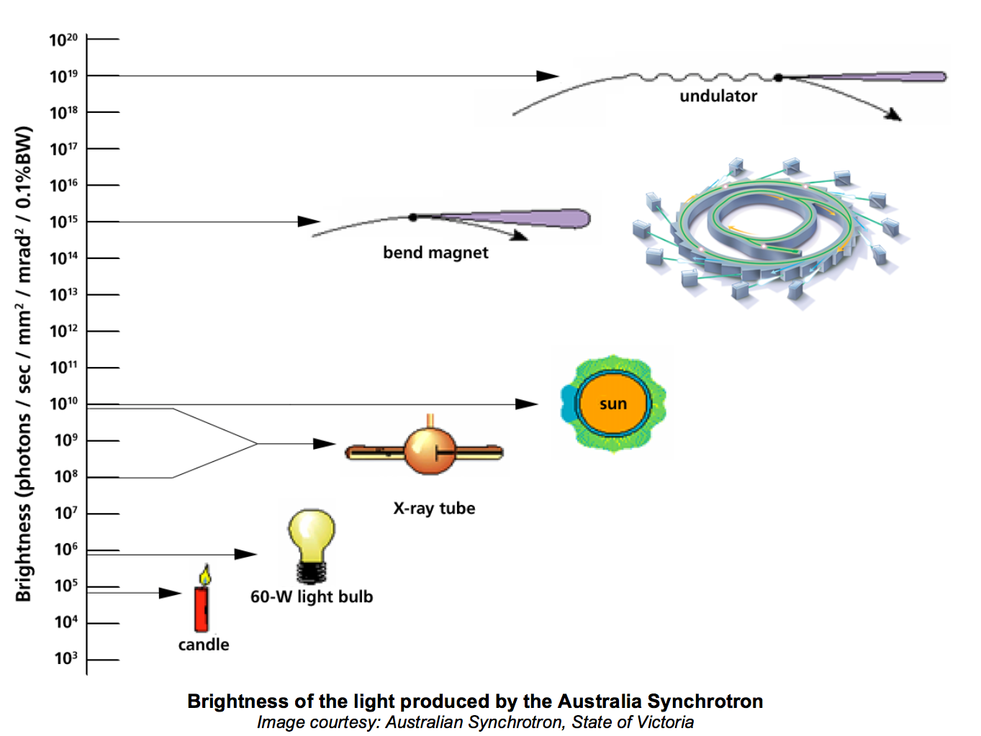
Synchrotron light is very, very bright
x 1,000,000,000

Slide 35
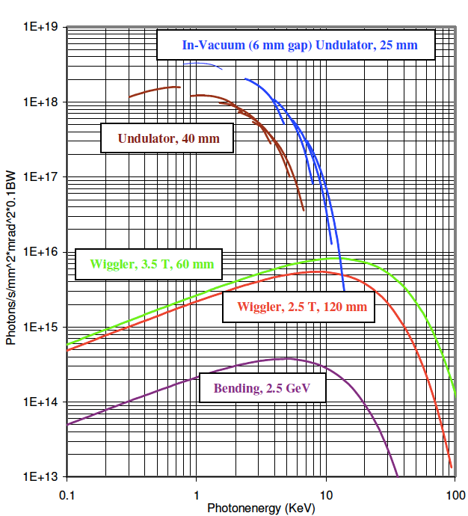
Brilliance (“concentration”) of SESAME light

Slide 36
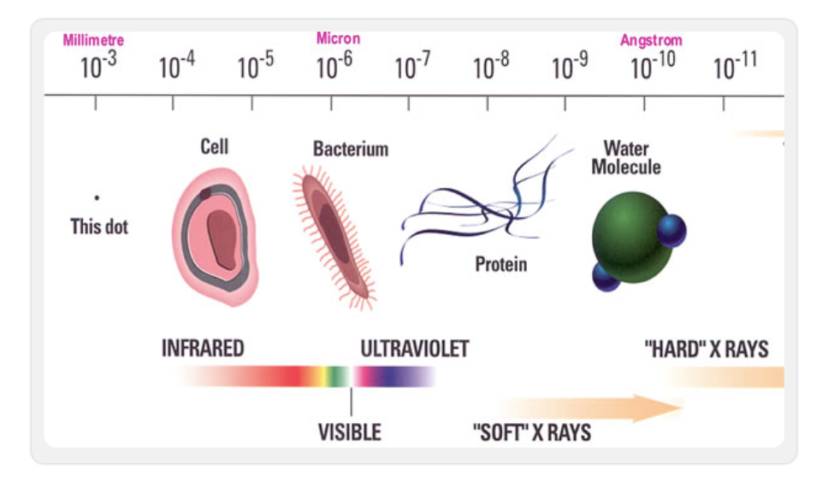
Synchrotron “light” covers a wide range of wavelengths
WIDE RANGE OF EXPERIMENTS:
Material science
Molecular biology
Archeology
Medicine
Environmental studies
AND MANY OTHERS

Slide 37
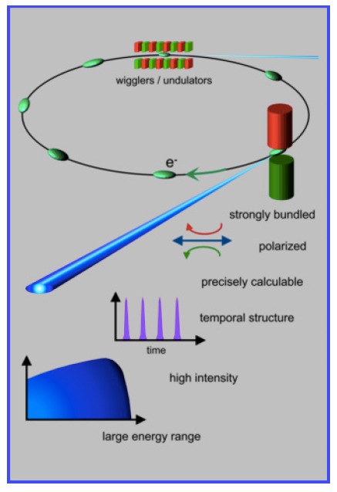
Advantages of synchrotron light sources

Slide 38
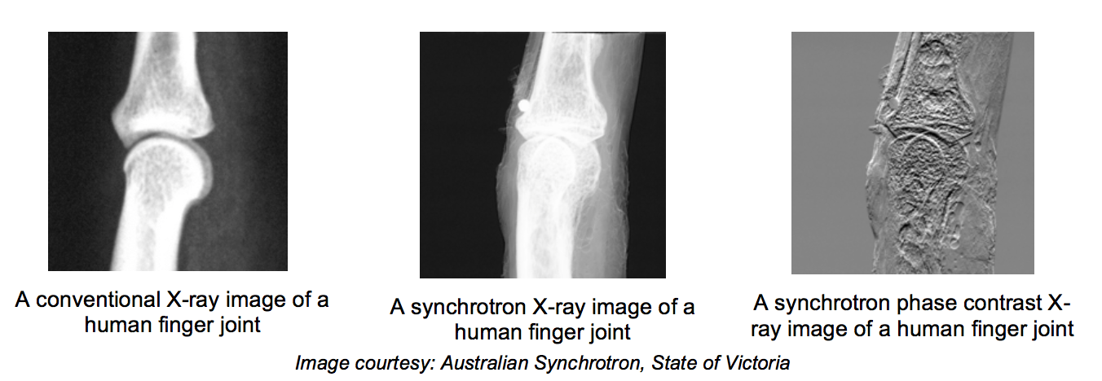
… incredibly detailed pictures

Slide 39
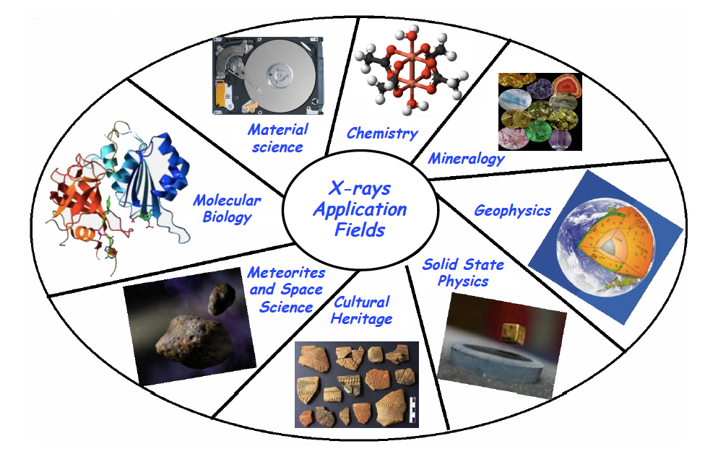

World-class tool for many fields of science
(Talk by H. Abualrob)

