Slide 1
Experiments, Schedule & Access to the hall
.
Magdalena Kowalska

Slide 2
Experiments
Activities at existing setups (NICOLE – see talk):
COLLAPS
  DAQ room in b508 ready and in use
  Laser lab almost ready, commercial interlock system being installed
  Preparations for Ca beamtime: selective charge exchange and detection in beta activity
CRIS
  DAQ room in b508 ready and in use
  Laser lab almost ready, commercial interlock system being installed
  Cu beamtime just finished
GLM/ GLM
  Labs in b508 ready and operational, chemical lab almost ready
IDS
  Safety clearance granted in April
  Preparations for neutron experiments
ISOLTRAP
  Use of b508 DAQ room
  Soon - installation of a positive-sensitive detector behind 2nd trap
MINIBALL
  Done: support structure, frame and target chamber; cable supports and electricity
VITO
  Connection to ASPIC under way
  Stable beam in June with up to 80% transmission

Slide 3
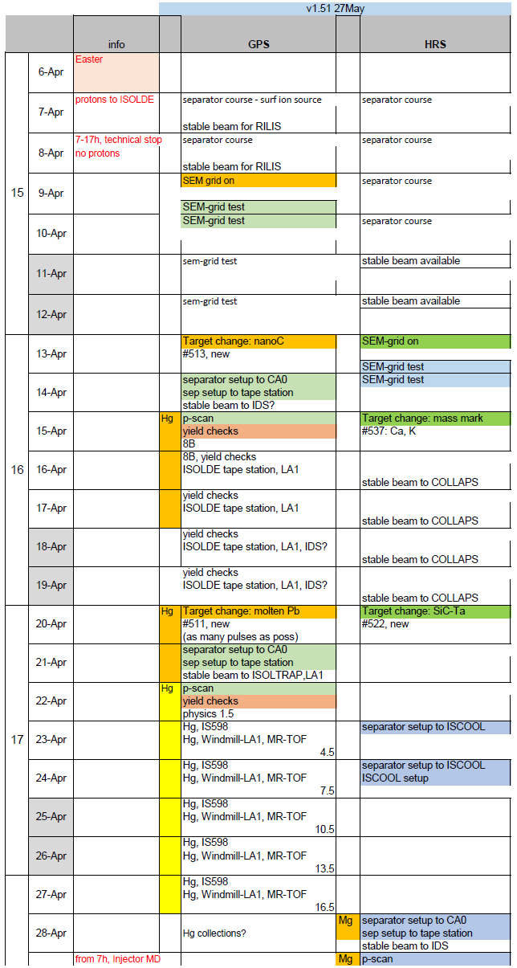
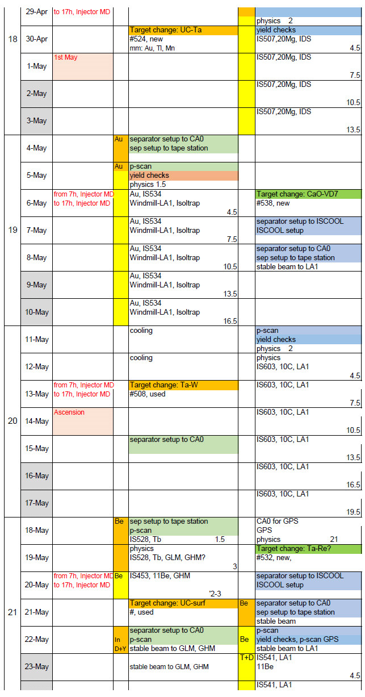

ISOLDE schedule
V1.0 – Mar 9th, Apr-Jun
V1.51 – May 27th, July-mid-Oct
470 low-energy shifts requested
About 390 scheduled:
  27 wks
  38 IS exp., 4 LOIs
In-source laser spectroscopy on Hg and Au (RILIS + WINDMILL + ISOLTRAP)
IDS: decay of 20Mg
LA1: decay of 10C
GLM: Tb tests
LA1: 11Be βp emission

Slide 4
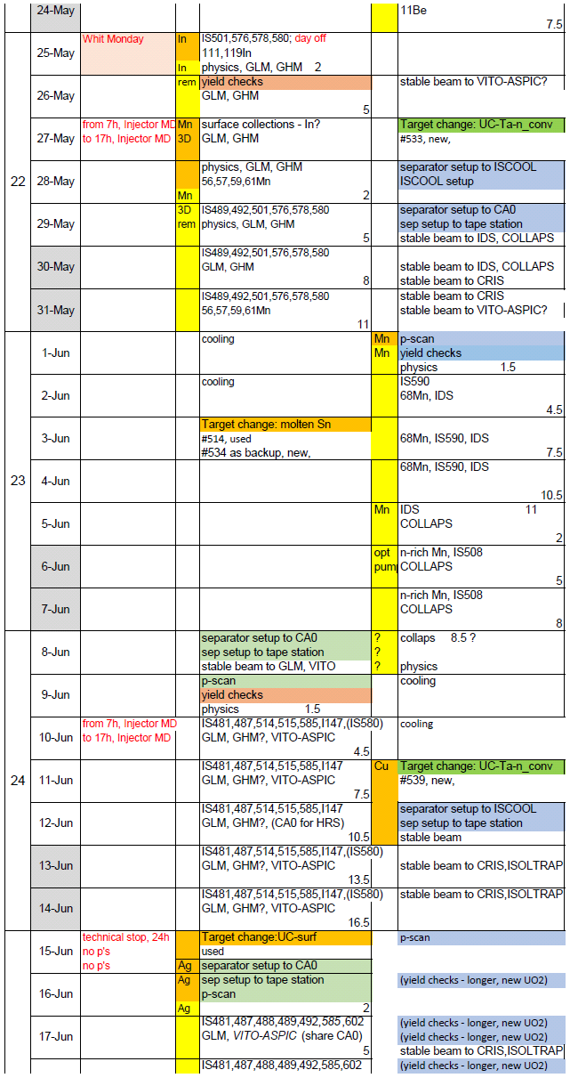
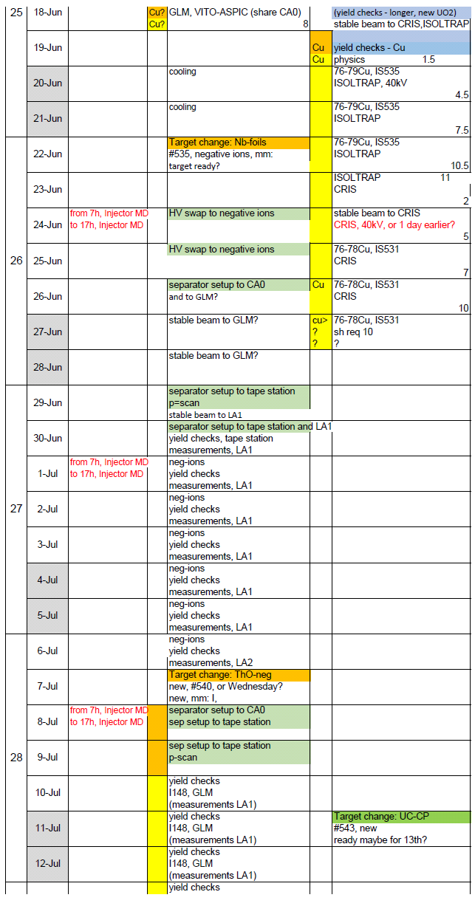
ISOLDE schedule
SSP: In and Mn for Mosbauer and EC
68Mn to IDS
N-rich Mn to COLLAPS
SSP: Cd for PAC
Biophysics: Ag
N-rich Cu from new UC batch:
  ISOLTRAP
  CRIS
Coming now: yields of negative ions on GPS

Slide 5
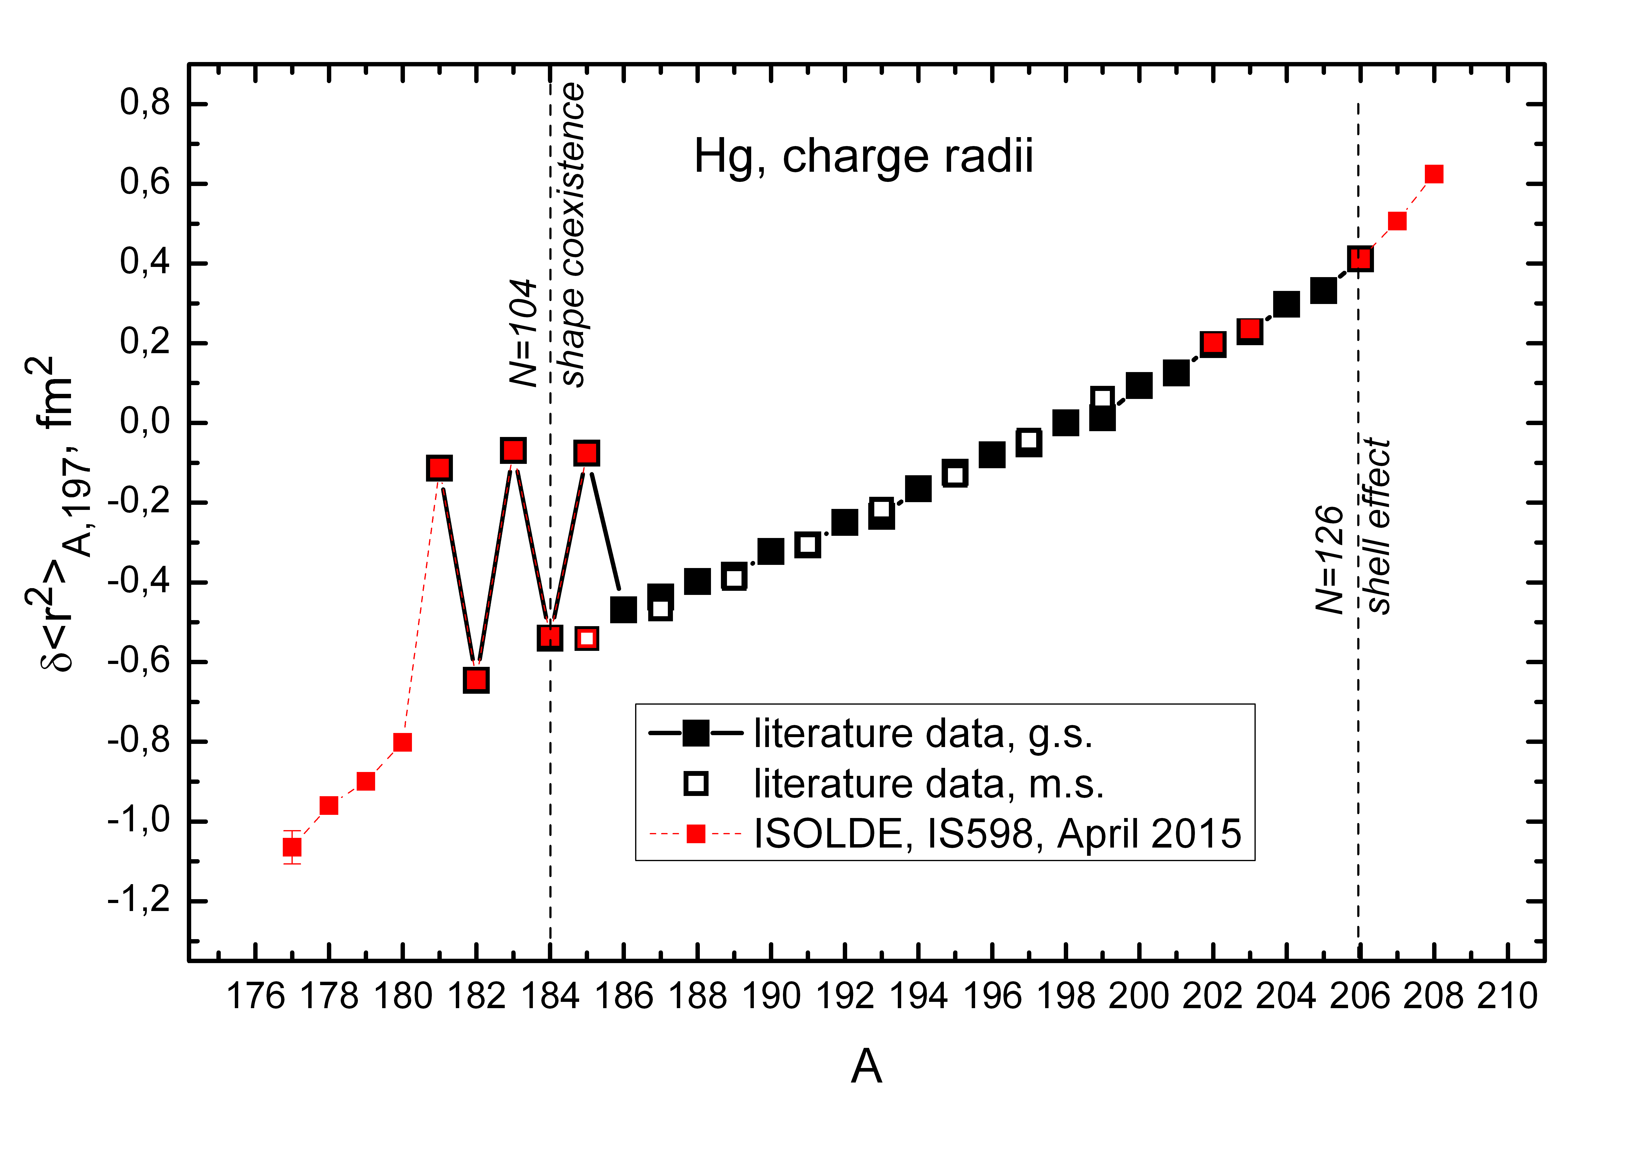

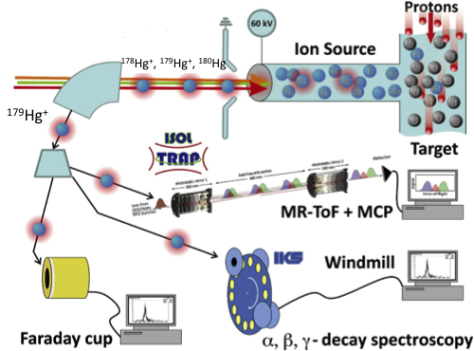
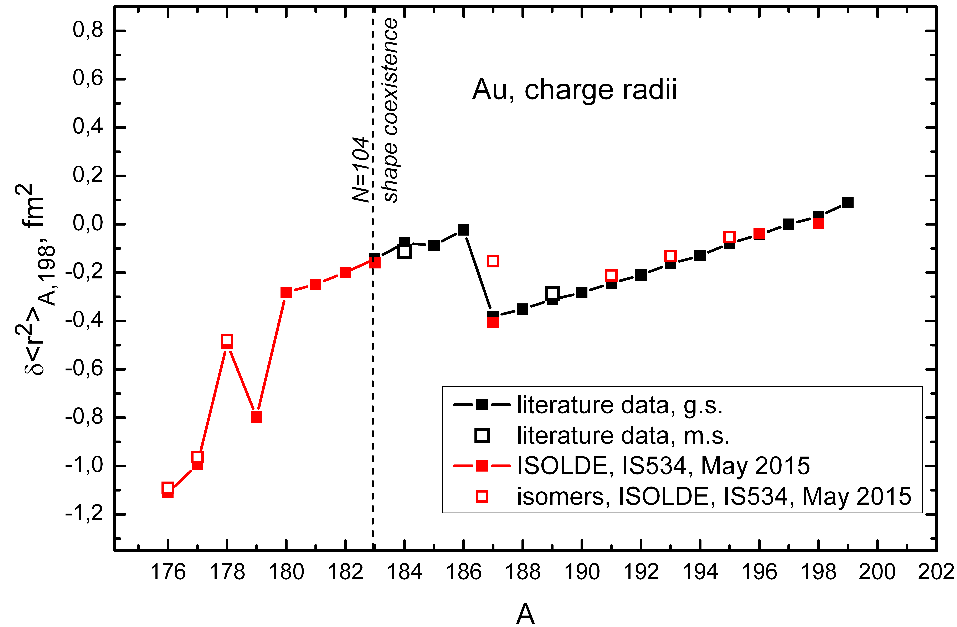
Physics example: n-def Hg & Au isotopes
RILIS, Windmill, ISOLTRAP teams
Several techniques combined
RILIS lasers to probe the hyperfine structure of Hg & Au isotopes
Detection:
  Alpha spectroscopy with Windmill
  Selective ion counting in MR-ToF
Bonn et al., PLB38 (1972) 308
Ulm et al., Z Physik A 325 (1986) 247
Au
5

Slide 6
ISOLDE schedule
Coming until mid-October:
IDS – neutron-delayed emission from Cd and Ca
Tb medical isotopes
COLLAPS – 53-54Ca
ISOLTRAP: Po, 34Mg
CRIS: Ga
IDS – 68Mn rescheduled, 34Mg
Preliminary:
  Pb to IDS
  Ni to COLLAPS
From mid-October till mid-Nov:
HIE-ISOLDE runs:
  Coulex of 74-80Zn
  Coulex + SPEDE – Hg or Pb
  Run at 2nd beamline?
SSP run on Hg

Slide 7
Access to ISOLDE
Users with and without dosimeter: (www.cern.ch/isolde/get-access-isolde-facility)
No temporary dosimeters possible
To obtain dosimeter:
  Follow online courses on general safety (as before)
  Follow online RP course on Supervised Areas (as before)
  Follow ISOLDE online RP course – introduced July14, Tuesdays at 15h
  Present RP form signed by home institute – this year modified version
To access ISOLDE:
  Follow 2-h RP ISOLDE practical course – introduced July14, Tuesdays at 15h
To do by December:
  Follow 2-h ISOLDE electrical practical course - introduced April15, Tuesdays at 13h
NOTE for online courses: soon – registration min 1 week before, only via EDH (new users- preregistration via email, but once registered: also via EDH)

Slide 8
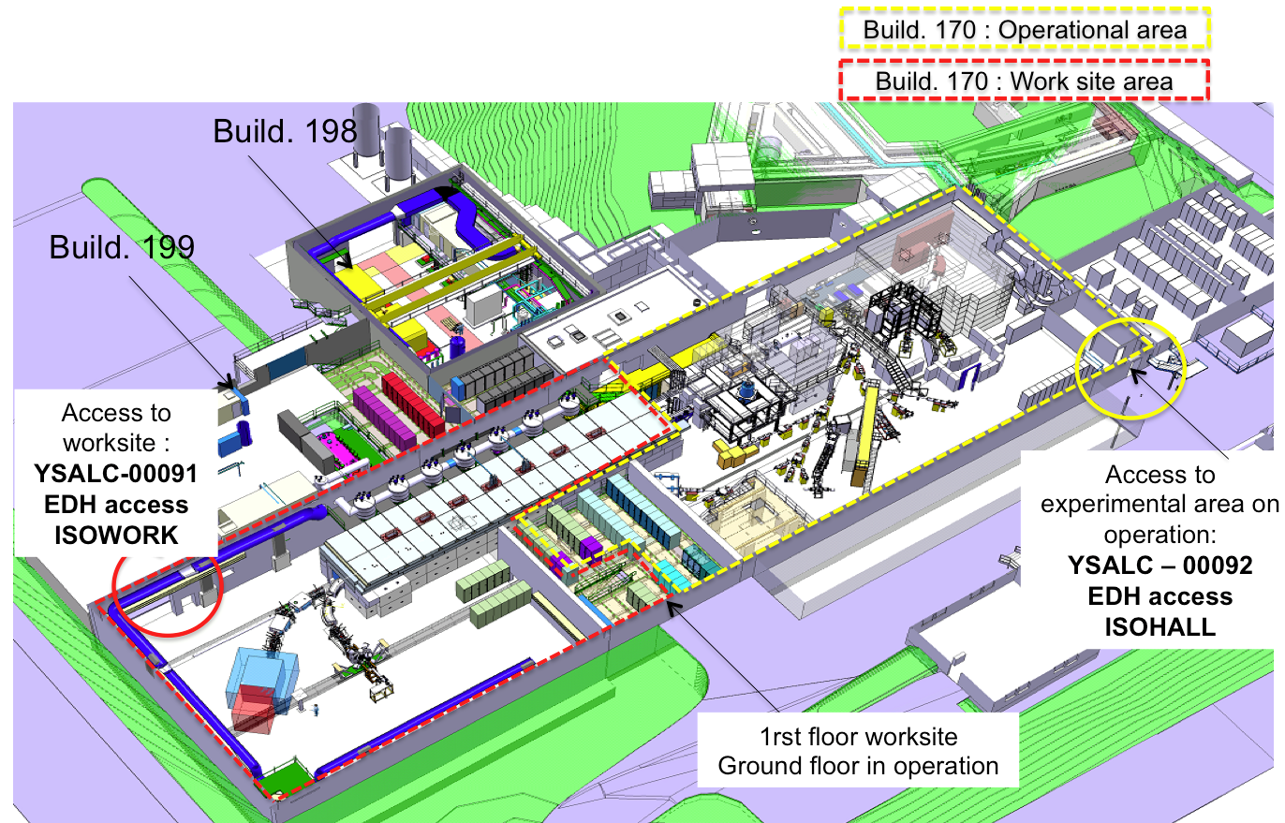
Access to ISOLDE
Access to HIE-ISOLDE worksite: STILL only local physicists when moving equipment
Access for users from Jura side for all, from May 2015:
  NEW: Tourniquet operational, opens via dosimeter
  ISOLDE door opens with CERN card (to be changed soon)
  Soon: card reader inside b508

Slide 9
Visits to ISOLDE
RP watching more closely
ISOLDE as Controlled RP area:
Only professional visits allowed
  Our suggestion – university students, uni and school teachers, VIPs
Non-professional visits access on case-by-case basis
  High-school students above 16y
  Private-public visits: friends, family
No visits when opening beamlines or making high-intensity collections
All visits
  announced to myself, Richard, or Kara
  Included in weekly schedule
  discussed and (not-)approved in Tuesday Isolde technical meeting
Up-to date procedure under preparation by myself

