Slide 1








University of Tennessee
NICOLE preparation status
T.Ohtsubo, S. Roccia, M. Madurga
and the NICOLE Collaboration
University of Surrey
University of Novi Sad
Notes:
1

Slide 2
HISTORY
Vacuum problem, developed in 2011 -2012 was repaired by ICE-Oxford and returned to CERN at the end of 2013
Reinstallation had to include adaptation to necessary changes at the ISOLDE Hall during and after the construction work:
More disassembly was required than needed for the leak repair
The NICOLE supporting frame was moved from its original position
The mezzanine originally used for NICOLE operation was rebuilt
Important connections (water, air, He return line) were disconnected

Slide 3
Situation at the end of 2014
Two installation sessions – May and August 2014
Thanks for support from the ISOLDE team!
Solved tasks:
Cryostat re-assembled and tested for leaks at 77 K.
No leaks were found.
Tasks remaining:
Construction, delivery and installation of new liquid He system.
The old one cannot be used because of the changes in the
layout of the mezzanine so no liquid He leak test was
possible
II. Work on the 4K tail (mechanical)
III Reconnection of the water, compressed air and He return lines

Slide 4
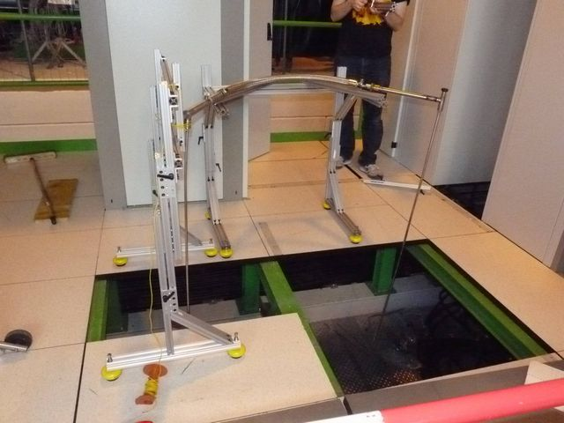
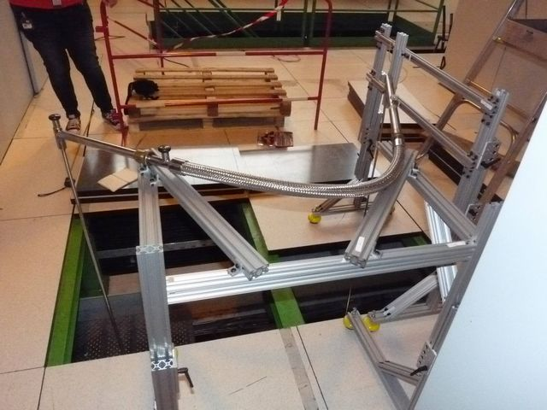
Situation at the beginning of 2015
New support frames for He transfer were made at the University of Tennessee and installed on the mezzanine
Notes:
4

Slide 5
Situation June 2015
Third installation session May 2015
Solved tasks:
Repeated vacuum test at LN2 temperature : OK
Check the new He transfer tubes: OK
New problems found:
misalignment of inside parts of the fridge
II work needed on the inner vacuum can tail and the
superconducting magnet
III. Important lines still disconnected

Slide 6
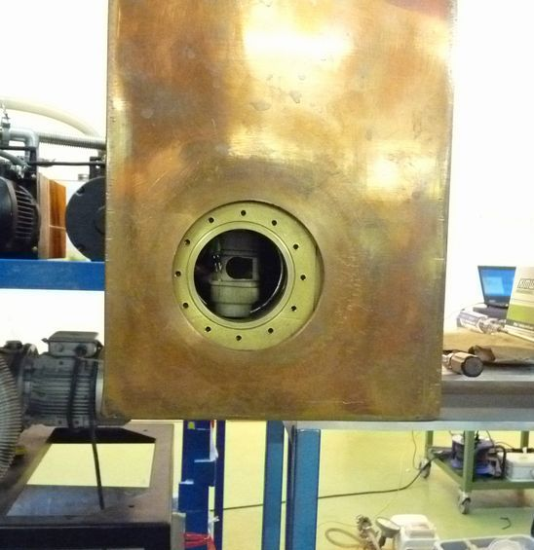
Misaligment problem
NICOLE was moved (because of the construction)
the inner part
(mechanically connected to the vacuum cabinet)
is tilted
with respect to the outer part (mechanically connected to the black frame)
Main Bath
Notes:
6

Slide 7
Plan for Summer 2015 - Spring 2016
Three milestones:
Fridge test the He Temperature
and cooling to mK temperature
Solving the misalignment problem
and connecting the fridge to the beam-line
Test cooling to mK temperature in
on-line (beam line connected) conditions

Slide 8
Time-line:
Three (four if necessary) installation sessions:
October and December 2015, possibly January 2016
(Milestones I and II)
Spring 2016 (Milestone III) scheduled in time to be
considered for scheduling experiment)
NECESSARY TO HAVE ALL THE CONNECTIONS RESTORED

Slide 9
PHYSICS AT NICOLE:
Two approved experiments
IS460 Magnetic dipole moments of High-K isomeric states in Hf isotopes
IS575 Beta-delayed neutrons from oriented ^{137,139}I and ^{87, 89}Br nuclei
Two new directions under discussion:
Application to medical physics: (Ulli Koester)
The observation of angular distribution of gamma rays can yield accurate multipole mixing ratios. This knowledge may be the best way to estimate conversion electron and Auger transition intensities, data required for cancer therapy.
Time-reversal (TR) non-conservation (Jose J. V. Dobon, Legnaro and J.R.Stone)
The polarization detection efficiency could be increased by ~order of magnitude if, instead of traditional detection of Compton scattered polarized photons from oriented nuclei, recoil electrons were detected as well and Compton event electronically reconstructed. This could be achieved if high-pressure noble gas detectors were used. This new technology would bring back interest in (TR) experiments.
Notes:
9

Slide 10
Summary:
The re-installation Of the NICOLE fridge is realistic to be completed
by Spring 2016.
NICOLE is the only facility in the world which, in combination with the
unique selection of radioactive beams from spallation at ISOLDE,
can provide data that cannot be obtained anywhere else.
When POLAREX in Orsay gets on-line at ALTO, it will complement,
NOT RIVAL NICOLE, as the selection of isotopes from fission products
would be different.

Slide 11
Back-up slides

Slide 12
NICOLE preparation status

Slide 13
Situation
The vacuum problem in IVC was fixed by ICE-Oxford.
NICOLE system was moved slightly because of ISOLDE constructions.
Also some important lines were disconnected.
The layout on the platform is changed. We need to consider the new layout for He transfer.

Slide 14
Work on NICOLE (2014. August)
Recovery the NICOLE system to the beam line roughly.
Connect the circulation lines.
Put the repaired IVC and assemble the main unit.
Leak test at room temperature and LN2. (not completely for LN2 temperature)

Slide 15
Work on NICOLE (2015.May)
Assemble the new IVC tail with 77K shield.
We found some problems.
  misalignment inside parts
  renewal thinner windows
  disconnection of thermometer lines
Vacuum test at LN2 temperature: OK
Check the new He transfer tubes: OK

Slide 16
future plan for preparation
Connections:
  Put the He rate meter and connect the He recovery line.
  Connect the water cooling line for 3He circulation vacuum pumps
  Connect the high-pressure air line
Cooling test with He.
Alignment and connect to the beam line.

Slide 17
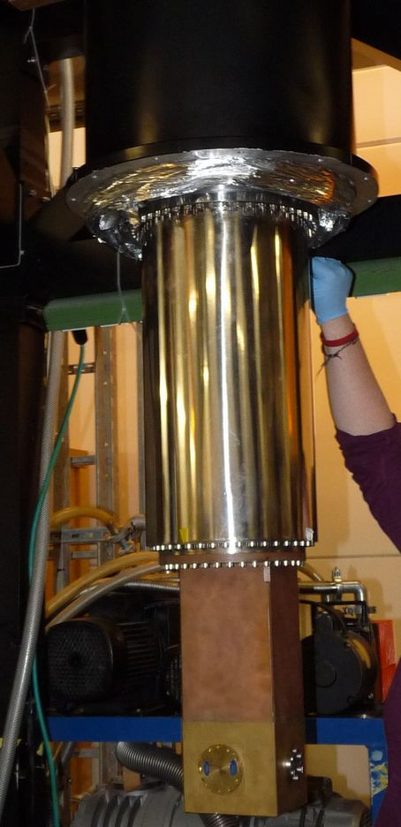
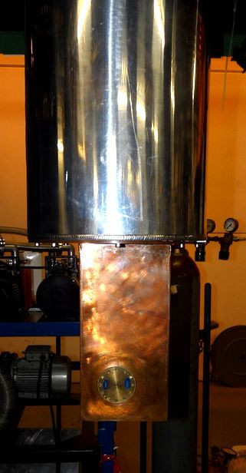
Misalignment 77K shield
Main Bath
77K shield
misalignment between IVC and 77K shield
4K tail window
Some heli-coil inserts on 77K shield stick out slightly.
We fix it with inserting a spacer
New 4K tail

Slide 18
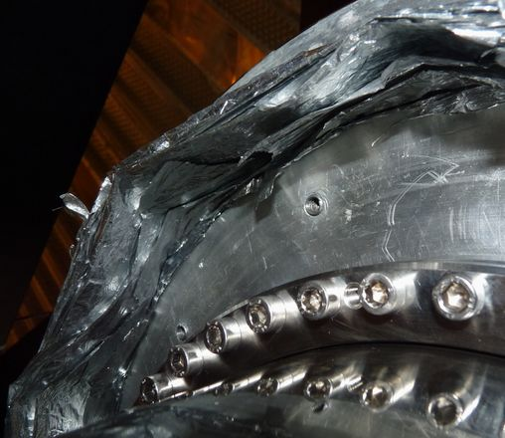
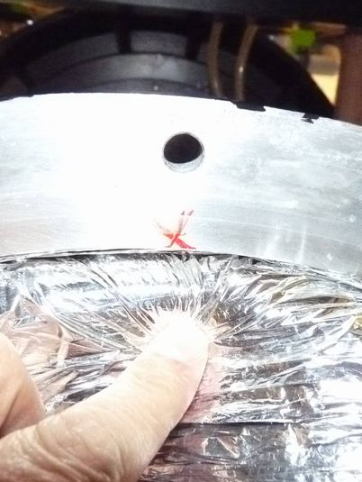
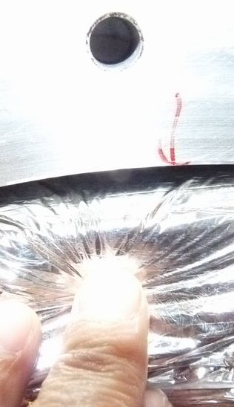
Misalignment of 77K shield
Some heli-coil inserts on 77K shield stick out.
Some of heli-coil inserts are broken, so we will exchange them.
It can make misalignment for 77K shield.

Slide 19
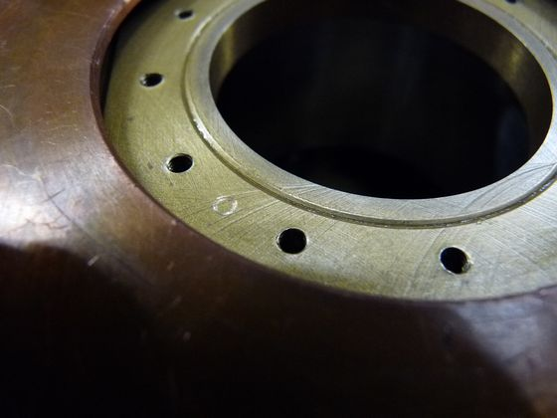
small leak at windows
There are some scratches on the window planes. We checked the leak level at LN2, and the level is acceptable.
However it would be better to do milling.

Slide 20
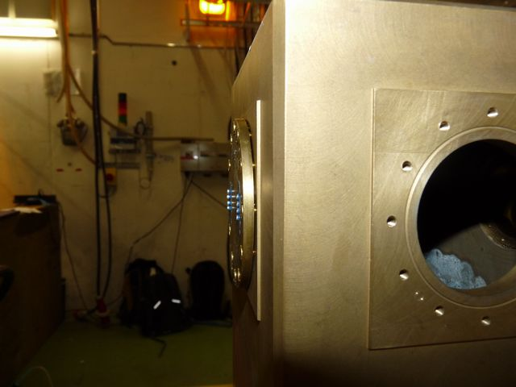
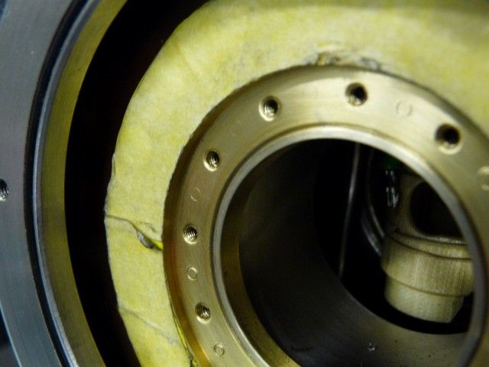
Thinner windows for new 4K tail
Because of the change of 4K tail, we will make new thinner windows.
New 4K tail
Old 4K tail
Window plane is same in surface level.
Window plane is difference in surface level.

Slide 21
New He transfer system
Because of the new layout on the platform, we make new support frames for He transfer.

Slide 22
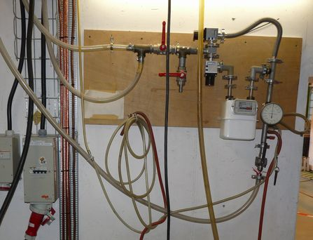
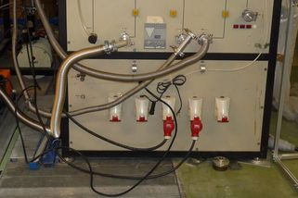
Connections
He recovery panel
to He recovery line
Pump exhaust line
High pressure air line
Cooling water line

Slide 23
alignment and connection to beam line
End of beam line
transit
Alignment to beam line
Connect to beam line

Slide 24
NICOLE preparation status
Notes:
24

Slide 25
Situation
Initial vacuum problem solved by ICE-Oxford
and reassembly
Adaptation to the new layout of the
mezzanine
Connection lines
Misaligment problem

Slide 26
A leak was observed
Cryostat was heavily dismonted (dilution unit taken apart)
Leak repared in England (Ice-Oxford) and tested at 4K
Cryostat was remounted and tested at 77K
Notes:
26

Slide 27
Situation
Initial vacuum problem solved by ICE-Oxford
and reassembly: Solved
Adaptation to the new layout of the
mezzanine
Connection lines
Misaligment problem

Slide 28
New He transfer system
Because of the new layout on the platform, we make new support frames for He transfer.
Notes:
28

Slide 29
Situation
Initial vacuum problem solved by ICE-Oxford
and reassembly: Solved
Adaptation to the new layout of the
mezzanine: Done
Connection lines
Misaligment problem

Slide 30
NICOLE needs
Power lines (partly disconnected during construction but available now)
Compressed air (disconnected)
Water (disconnected)
He recovery line (disconnected)
Solutions for reconnections are being
prepared with the support of ISOLDE (thanks !)
Notes:
30

Slide 31
Situation
Initial vacuum problem solved by ICE-Oxford
and reassembly: Solved
Adaptation to the new layout of the
mezzanine: Done
Connection lines: On going
Misaligment problem

Slide 32
Misaligment problem
NICOLE was moved (because of the construction) the inner part (mechanically connected to the vacuum cabinet) is tilted with respect to the outer part (mechanically connected to the black frame) → Observed in May 2015
Main Bath
Notes:
32

Slide 33
Situation
Initial vacuum problem solved by ICE-Oxford
and reassembly: Solved
Adaptation to the new layout of the
mezzanine: Done
Connection lines: On going
Misaligment problem: To be fixed

Slide 34
Timeline
Reopen the cryostat to study the misalignment problem (summer 2015)
The He recovery line has to be installed
The cryostat is closed; leak tests up to 4K (fall 2015)
Compress air and water cooling is back at NICOLE
Cold test to mK temperature using the Orsay DAQ (spring 2016)
Connection to the beam line (spring 2016)

