Slide 1
Commissioning of REX
Jose Alberto Rodriguez, BE-OP-PSB (167538)

Slide 2
Content:
Hardware commissioning (of the NC linac)
Commissioning with beam
Summary
73rd ISOLDE Collaboration Committee meeting - 2015/06/30
Jose Alberto Rodriguez, BE-OP-PSB (x167538)

Slide 3
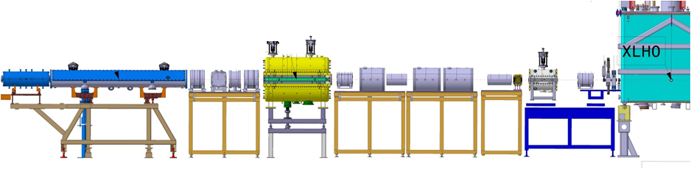
Hardware commissioning: RF systems
Maintenance and refurbishment of amplifiers for RFQ, buncher, IH structure and 7 gap structures completed
Remote controls functional
Connections to the new HIE-ISOLDE RF reference line completed
IH structure:
First RF in the structure delayed to wk 27
Recalibration and long RF tests delayed to wk 28
9 GAP structure:
Temporary 9gap amplifier stable at 1Hz, 300 us, 45 kW
Final 9gap amplifier scheduled to arrive in week 31. Commissioning will be completed by week 35
RFQ:
RFQ recalibrated
Stable at 10 Hz, 1 ms / 40 kW pulses
7 GAP structures:
RF power in 7 gap structures for a short period of time
Recalibration and long RF tests delayed to wk 28
Buncher:
Stable at 10 Hz, 1 ms / 1.4 kW pulses
73rd ISOLDE Collaboration Committee meeting - 2015/06/30
Jose Alberto Rodriguez, BE-OP-PSB (x167538)

Slide 4
Hardware commissioning: Other systems
Power converters and magnets:
New power converters for quads (19 units) fully functional
New cooling water circuits for all the quads operational
Electrical short in last triplet repaired and triplet refurbished
Additional tests and measurements in other quadrupoles completed (thermal switches characterized, temperature rise measured…)
Diagnostics:
FC, MCP and collimator wheel in REX diagnostics box commissioned
FC and Si detector in first HIE-ISOLDE diagnostics box will be installed and commissioned this week
Vacuum:
Scheduled maintenance completed. Faulty turbo pumps, controllers and gauges replaced
Fast Penning gauges for fast acting valve to protect cryomodule installed
Update/upgrade of the control software scheduled for the winter shutdown
Controls:
New low level controls functional (new power converters, RF amplifiers…)
High level applications currently being updated (working sets and equipment arrays ready)
73rd ISOLDE Collaboration Committee meeting - 2015/06/30
Jose Alberto Rodriguez, BE-OP-PSB (x167538)

Slide 5
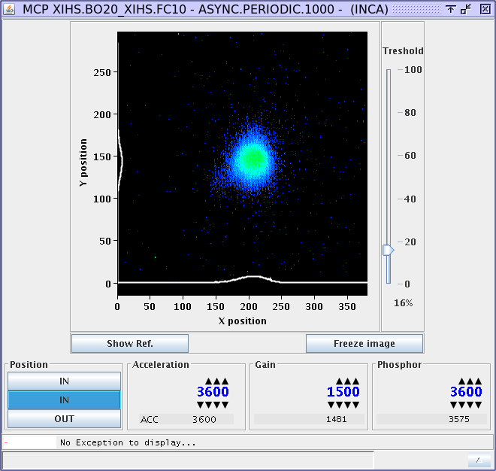
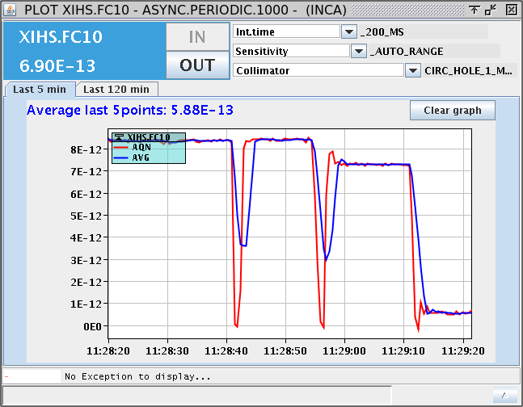
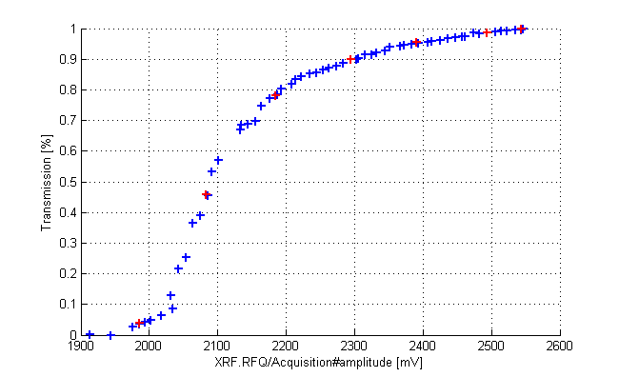
Commissioning with beam
Commissioning with beam started on week 25
Beam with an A/Q=4.0 has been accelerated to 0.3 MeV/u (RFQ output energy)
We have reached the first diagnostic box and commissioned the FC, MCP and collimator wheel
Beam transmission through RFQ for different power levels
Evaluating the possibility of using quad scans to measure beam properties
Next steps:
Commissioning of first HIE-ISOLDE diagnostics box once installation is completed (week 27/28)
Phasing of the NC cavities (weeks 28 to 31)
Beam transmission thru the RFQ vs RF power for A/Q=4.0
Beam in FC after RFQ for different collimator aperture sizes (15, 5, 3 and 1 mm)
MCP image of the beam after the RFQ
Diagnostics boxes
73rd ISOLDE Collaboration Committee meeting - 2015/06/30
Jose Alberto Rodriguez, BE-OP-PSB (x167538)

Slide 6
Summary
Hardware Commissioning:
A few weeks behind with the hardware commissioning of several RF systems
So far, it has not affected the commissioning with beam. But, it may if run into problems with any the amplifiers or the cavities
New 9 gap amplifier will arrive on week 31. It will take a few weeks to commission it.
Hardware commissioning of all other systems in the linac is completed
Commissioning with beam:
Commissioning with beam started on week 25
So far, beam accelerated through the RFQ and into first diagnostics box
Commissioning will continue this week once components of the diagnostics box before CM1 are installed
73rd ISOLDE Collaboration Committee meeting - 2015/06/30
Jose Alberto Rodriguez, BE-OP-PSB (x167538)

Slide 7
Additional slides

Slide 8
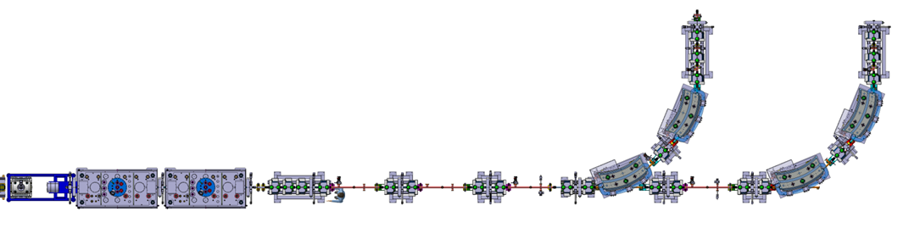
Commissioning with beam
Next steps (as soon as the hardware commissioning of CM1 is completed):
Commissioning of the diagnostics boxes in XT00 and XT01 with A/Q=4.0, E=2.85 MeV/u beam (wk 36/37)
Commissioning with beam of magnets in XT00 and XT01 : quads, steerers, dipoles and solenoid (wk 38)
Delivery of first stable A/Q= 4.0, E=2.85 MeV/u to users for commissioning of experimental station in wk 38 if compatible with the rest of the commissioning activities. Beam may be available in late evenings and nights.
Phasing of SRF cavities (wk 39/40)
Measurements of the energy gain in each of the cavities using dipole and Si detectors (wk 39/40)
Tests of the scaling of the linac (wk 41)
Preparation for first experiment (wk 41)
First radioactive beam in linac. Beam preparation for first experiment (wk 42)
Start of experimental program (wk 43)
XT01 line
XT02 line
CM1 (2015)
XT00 line
9gap
CM2 (2016)
Diagnostic boxes
73rd ISOLDE Collaboration Committee meeting - 2015/06/30
Jose Alberto Rodriguez, BE-OP-PSB (x167538)

