Slide 1
Status of HIE-ISOLDE Commissioning
Walter Venturini Delsolaro
on behalf of the HIE ISOLDE Commissioning team
ISCC meeting, 30 June 2015

Slide 2
Outline
HIE ISOLDE roadmap for 2015
HEBT hardware commissioning
  XT00
  XT01
  XT02
Status of CM1 commissioning

Slide 3
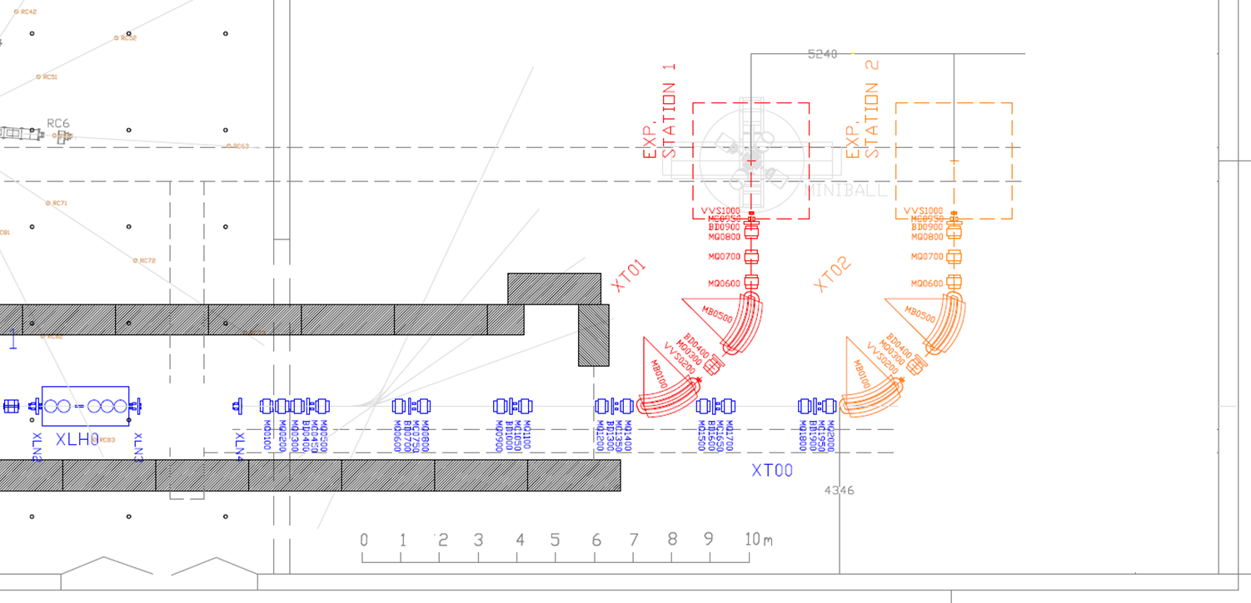

Components to be commissioned
XT01
XT02
CM1
XT00
Cryogenics distribution
Cryogenics facilities

Slide 4
HIE ISOLDE roadmap in 2015

Slide 5
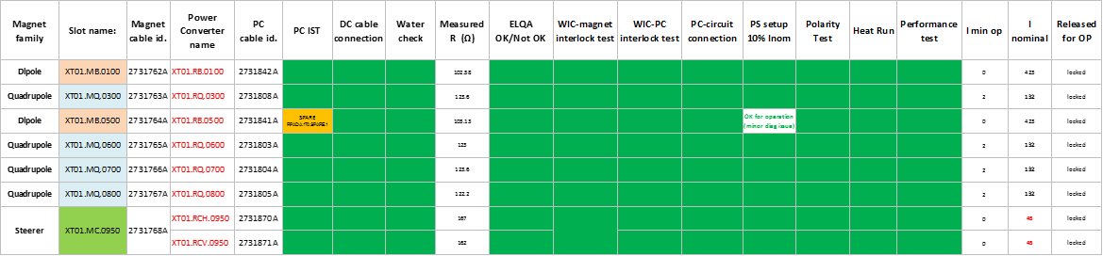
HW commissioning of XT00 and XT01
3 Steerers still to commission inside tunnel (will be done together with XT02)
XT02 campaign starting end of this week

Slide 6
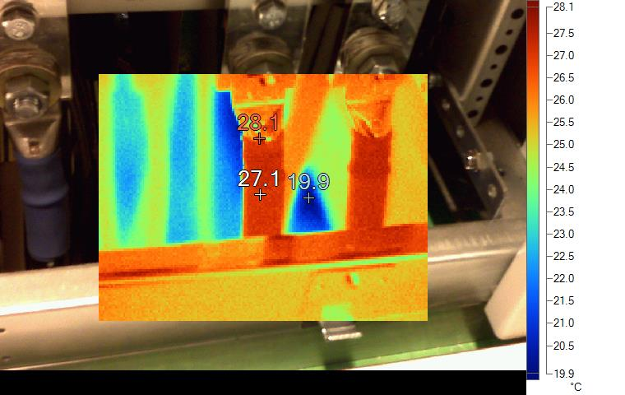
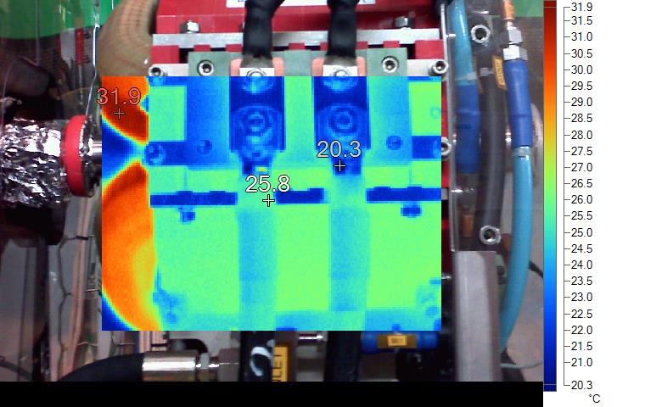
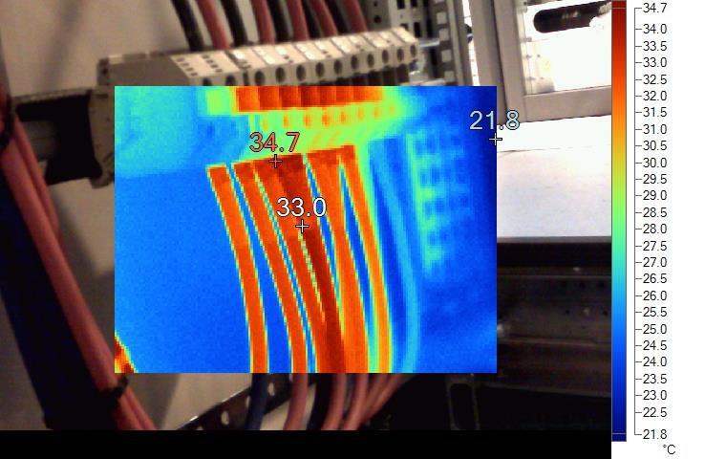
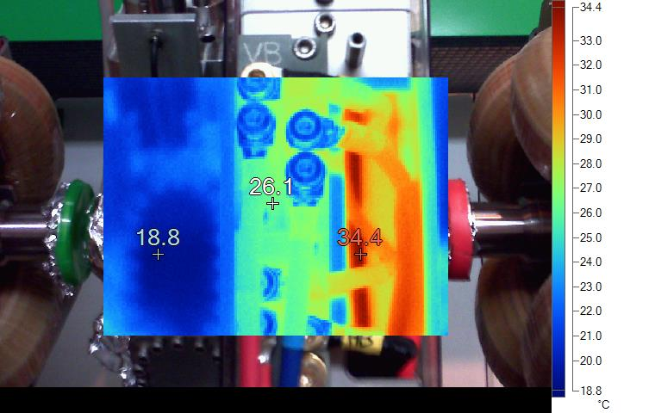
IR pictures from 13 hrs heat run

Slide 7
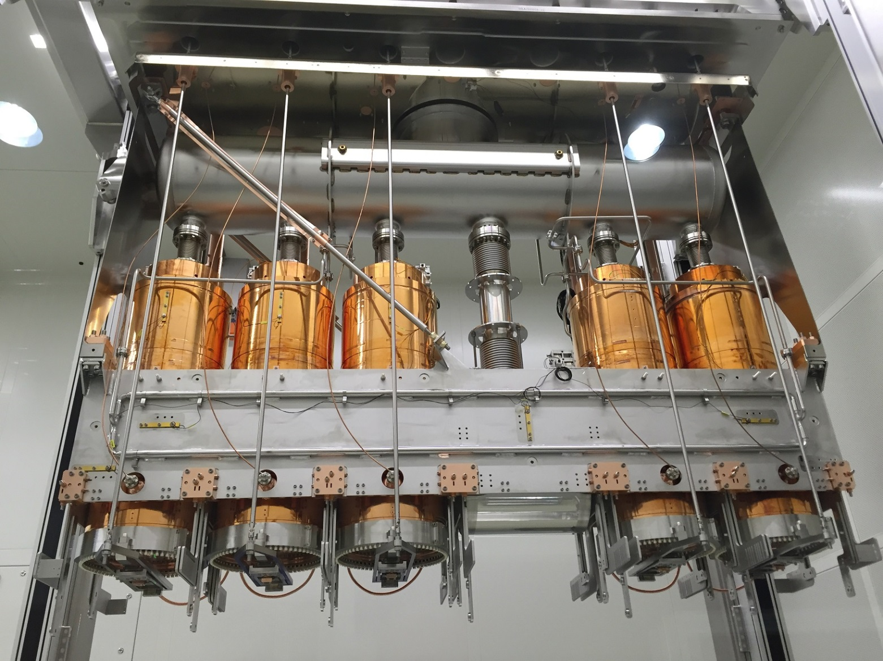
CM1
HIE ISOLDE Cryomodule 1
Thermal shield top plate
SC solenoid
QS3 (C1.5)
QS1 (C1.4)
QS4 (C1.3)
QP3 (C1.2)
QP2 (C1.1)

Slide 8
CM 1 main commissioning steps
Interlock tests
Slow pump down
RF, Instrumentation, ELQA tests before cool down
Low Level RF tests
Cool down
RF conditioning above Tc
RF tests at 4.5 K
SC solenoid test
Survey and Alignment
Heat load measurements
Thermal cycles

Slide 9
CM1 test planning
Ongoing: RF tests at 4.5 K
This week: access for installation of LDB1 and SC solenoid test preparation
Original planning: 9 weeks + 2 weeks contingency
~ 1 week behind schedule after 5 weeks from start

Slide 10
Cryogenics synoptic

Slide 11
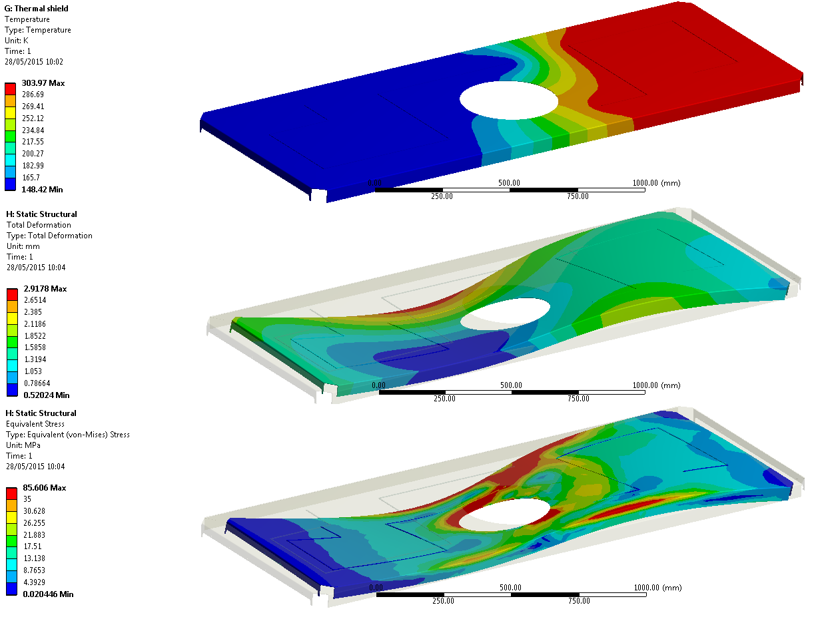
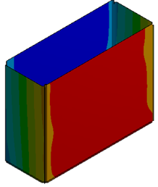
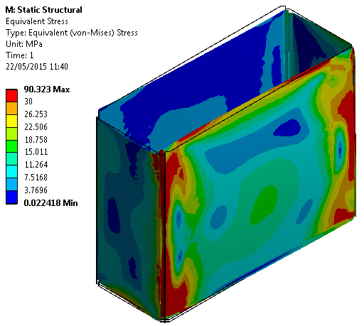
Constraints on temperature gradients during cool down
 | ΔTmax [K]
Thermal Shield | 50
Supporting Frame | 40
Frame and Helium reservoir | 100
ΔTINLET-OUTLET > 50K
70K
300K
L. Valdarno

Slide 12
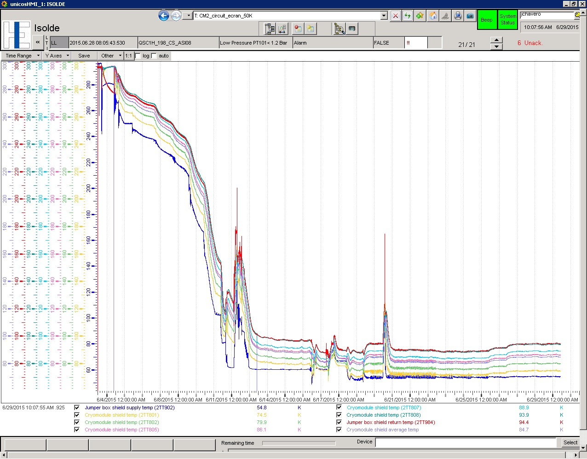
Cool down history (thermal shield)

Slide 13
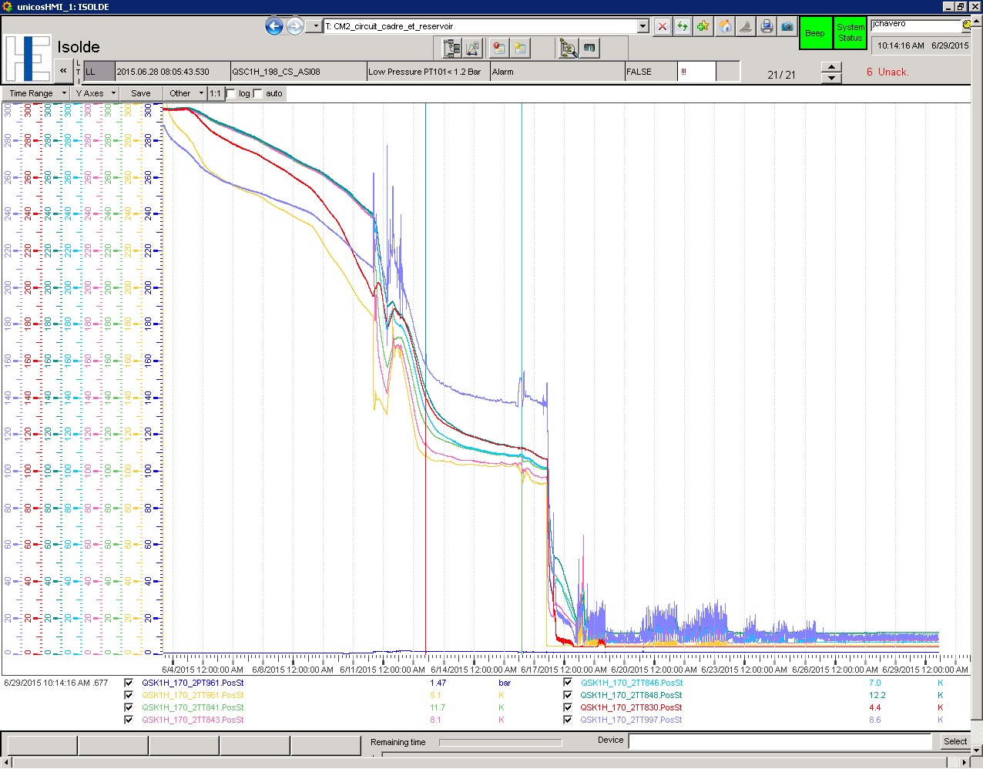
Cool down history (cavities)

Slide 14
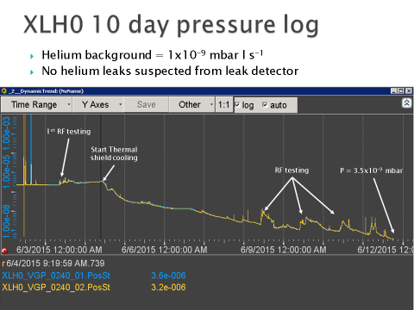
Vacuum
Today: < 10⁻¹⁰ mbar!
J. Somoza & A. Harrison

Slide 15
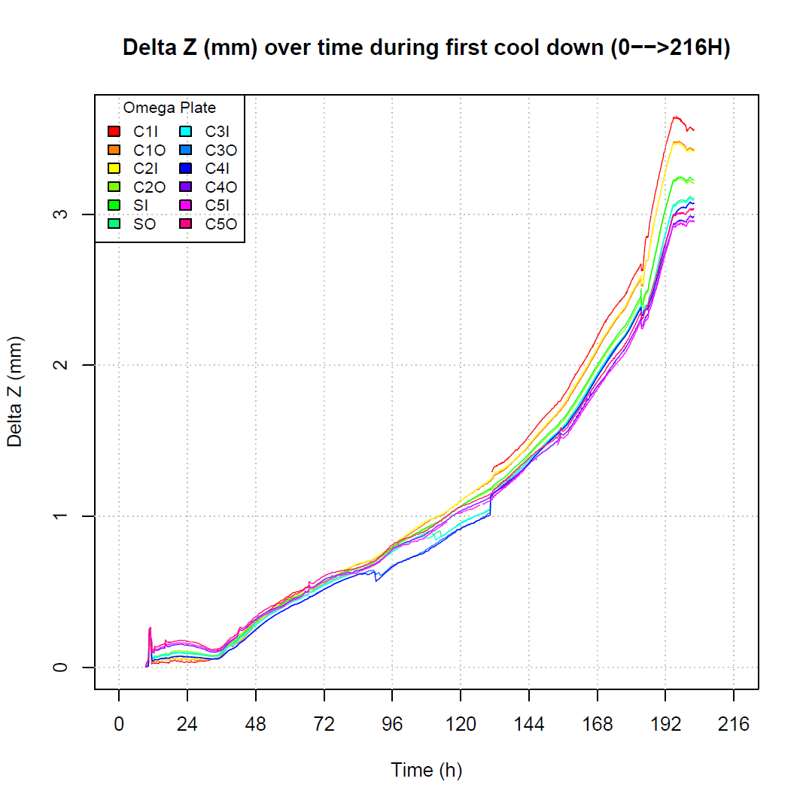
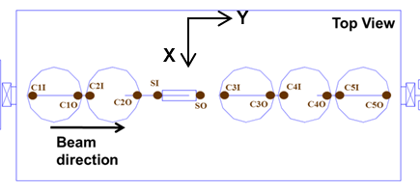
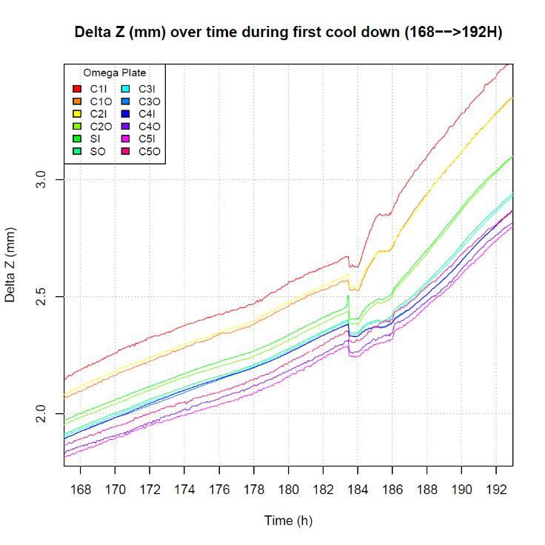
    Monitoring positions of the active elements
    during cool down of thermal shield and supporting frame
All thermal contractions of cool-down have taken place
No cold leaks!
Active elements ended up ~ 1 mm above the beam line
1 mm
G. Kautzmann

Slide 16
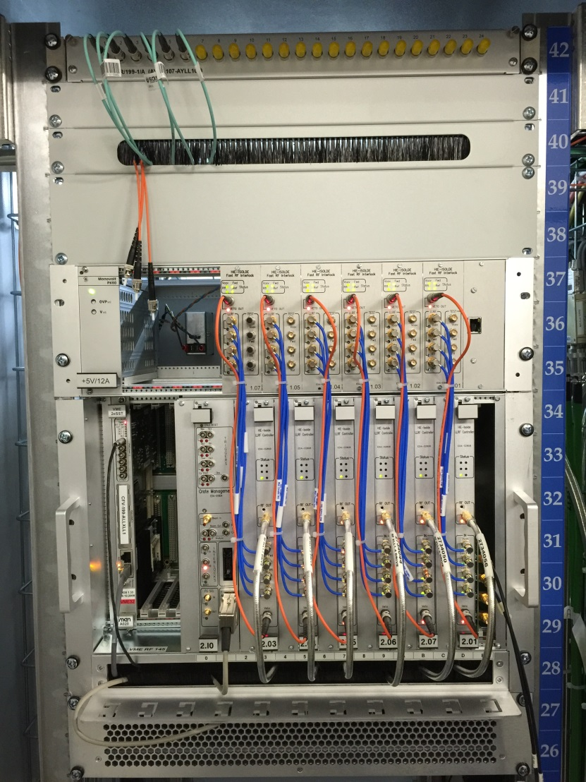
RF systems
RF systems worked well from day 1:
Controls operational for RF veto, power, couplers and tuners
LLRF: Cavities start up and power on Self Excited Loops
Measurement sequences operational
Calibrations checks ongoing

Slide 17
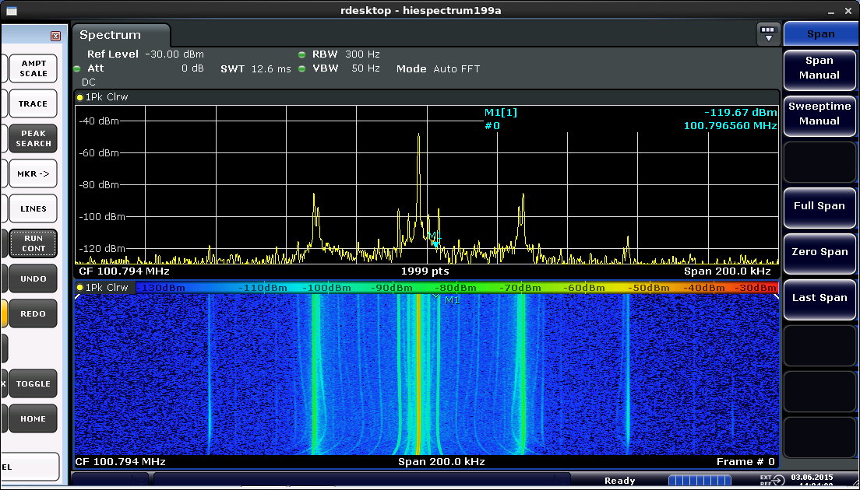
Low field multipacting

Slide 18
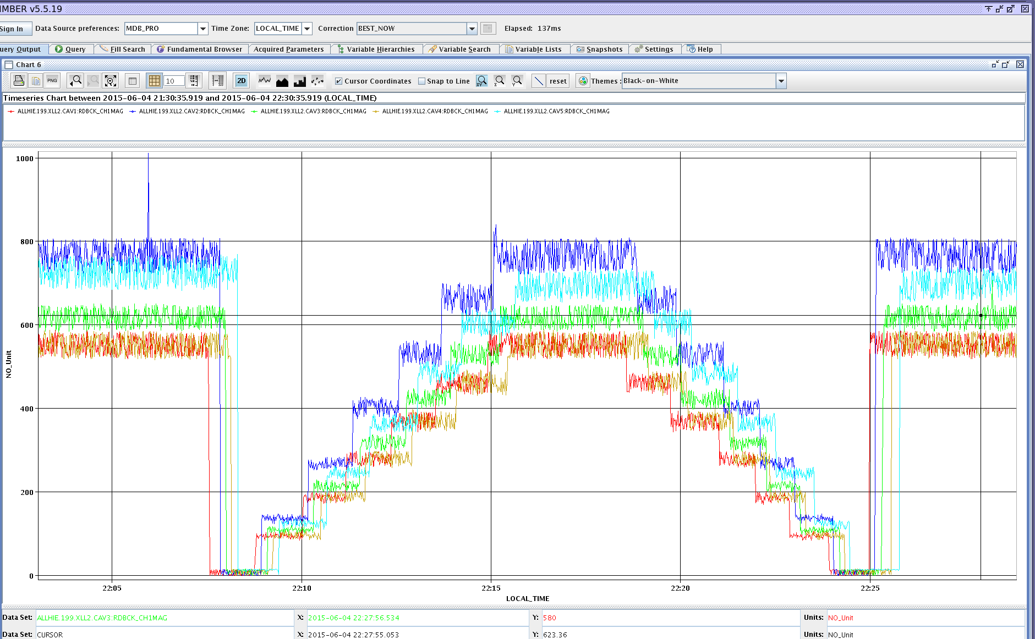
Low field multipacting cleared

Slide 19
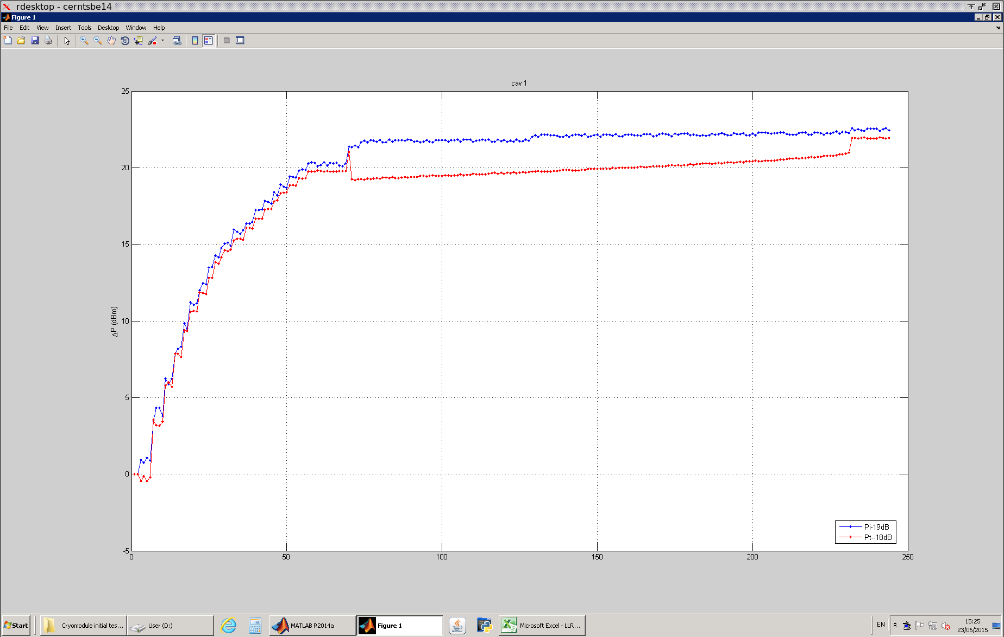
High field (1.5 MV/m) multipacting

Slide 20
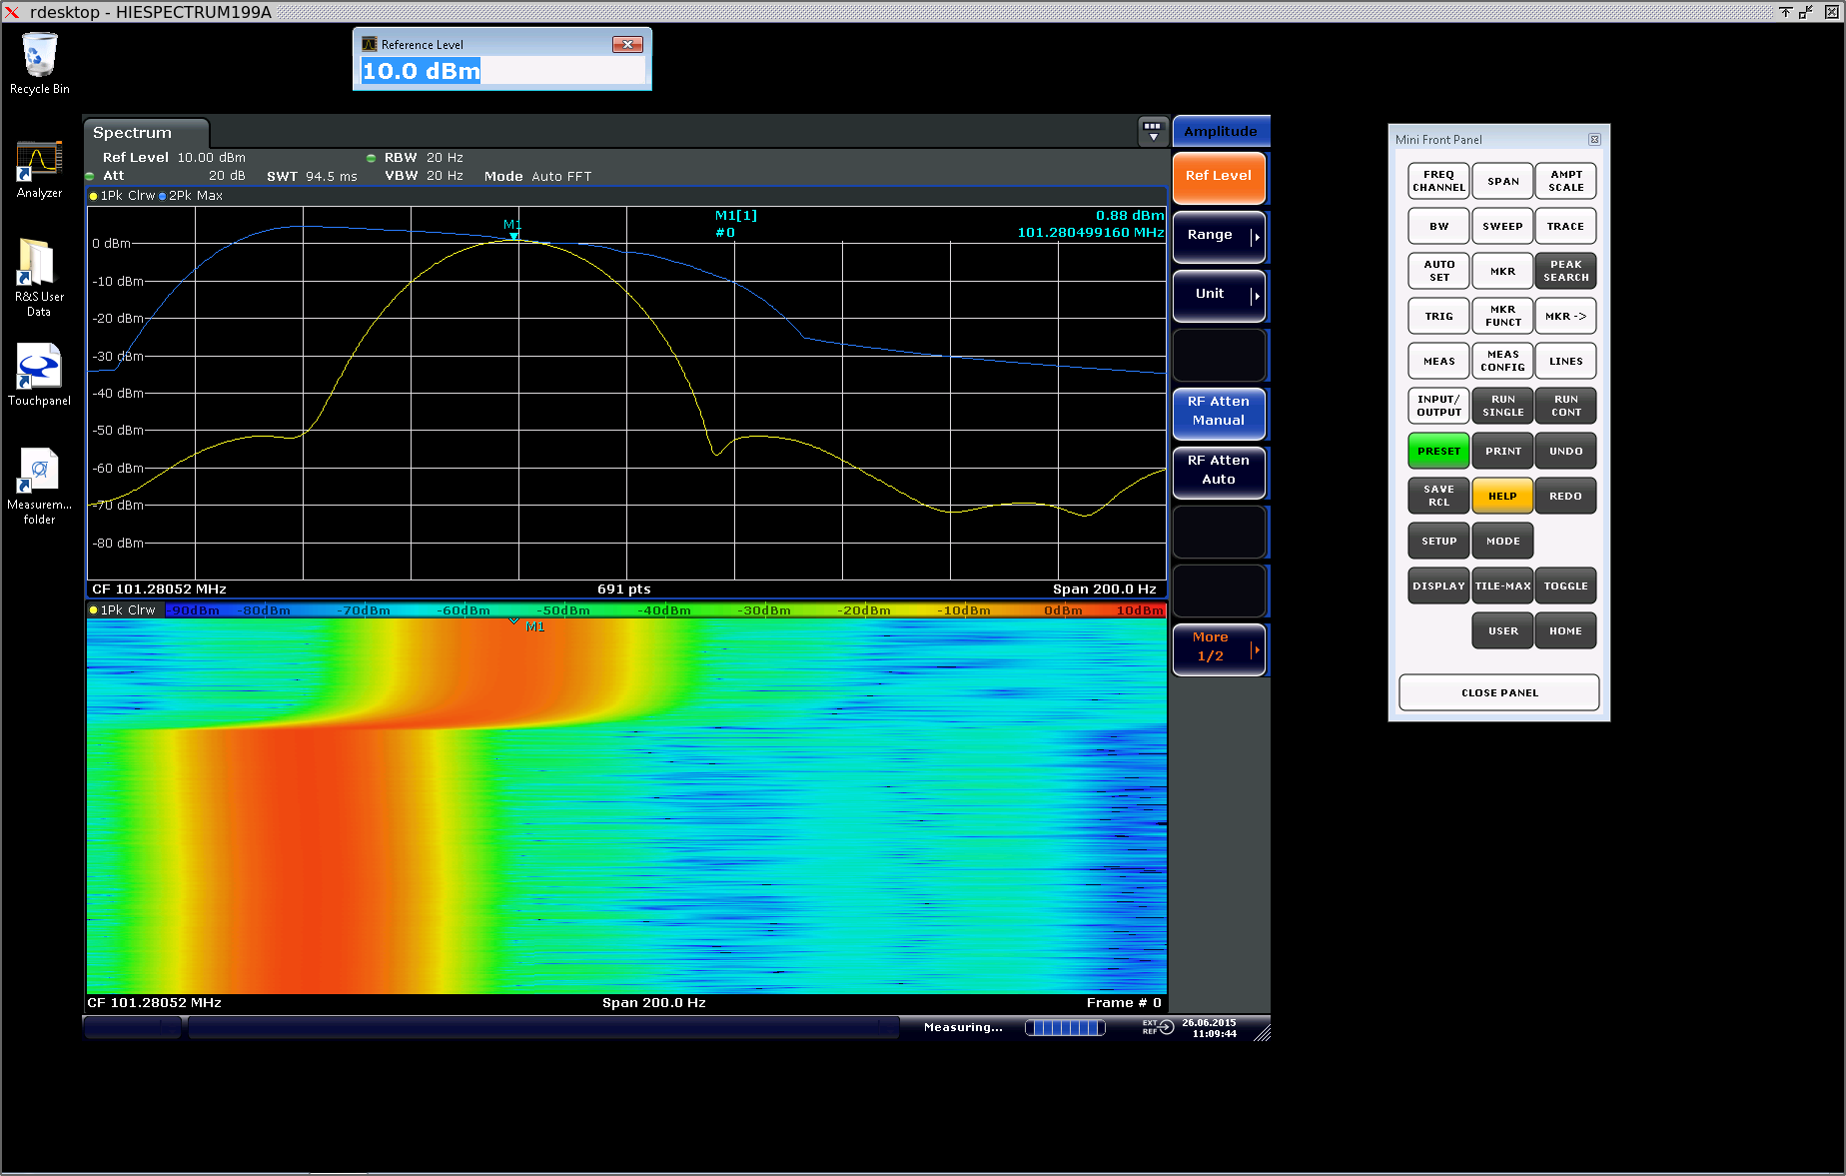
Lorentz detuning

Slide 21
Concerns
CAV5 coupler axis: anomalous friction since before cool down. It was manually set to operational BW, no showstopper, requiring attention
At high forward power, observed drift in resonance frequency and field. Investigation in progress
Vibrations from primary vacuum pump→ microphonics
LVDT (position sensors) calibration, for cold alignment
Cryogenics: stability of thermal shield temperature and helium pressure.

Slide 22
Summary (I)
So far on track on the roadmap presented at the previous ISCC
All Hardware is installed (least LDB1)
HEBT “hardware commissioned”: XT00 and XT01.
XT02 will be done in the next two weeks
Cryomodule 1 was successfully cooled down, with no cold leaks found at the end of the thermal contraction phase
CM vacuum is exceptionally good (< 10⁻¹⁰ mbar)
Cold alignment will be required (~ 1 mm down)

Slide 23
Summary (II)
SCRF cavities: all multipacting levels are conditioned
All cavities tuned close to Linac frequency: tuning range OK.
CAV1-CAV4: no field emission up to 5 MV/m, CAV5 tbc
Preliminary measurement of microphonics very encouraging
Working out precise calibrations
Issue with stability at large (10 Hz) BW: being addressed
Delicate steps ahead: solenoid training, unison powering, cold alignment
Beam commissioning planning and modus operandi to be worked out in details

