Slide 1

Technical news and operation of the facility
Richard Catherall
ISOLDE Technical Coordinator
73rd ISCC meeting 30th June 2015

Slide 2
Outline
Target and Ion Source Development
  ISBMWG
REX Low Energy
RILIS
Separators
  Tape Station
  Beam Diagnostics
  HRS cycling
  Target water cooling panel
Class A labs and Target Area
  Ventilation
  Coupling Issues
  Robot incident
IEFC news
  2 GeV @ ISOLDE
  Magnet consolidation

Slide 3




New Ion Source (and beam manipulation) Development Team
Ion Source development and Beam Manipulation (ISBM)
EN/STI
LP
Scheme
development
Target
development
EN/STI
RBS
Ion
source &
ion beam
manipulation
R&D
To tackle
subjects such as
Laser
development
Target
construction
HRS upgrade
RILIS
operation
Target operation
ToFLIS
Technical
coordination
of ISOLDE
FEBIAD optimzation
Laser
spectroscopy
VADLIS
LIST
A highly effective
means of improving ISOLDE performance
ISCOOL upgrades
There is room for improvement of
Fast beam gating
Efficiency
Selectivity
Beam quality
Reliability
RILIS selectivity
Ion beam multiplexing
With reduced radioactive waste inventory
(essential for HIE ISOLDE)
Optical pumping

Slide 4
REX Low Energy
At REXEBIS has a new control system for the timing signals and the function generators. CO supported, but now lacking an interface application.
Carried out some promising high intensity tests at REXTRAP and REXEBIS, so well prepared for intensity upgrades. Presented at EURORIB.
Performed transverse emittance measurements of beam after REX separator. Agrees with measurements after the linac. To be followed up and verified after this year's runs.

Slide 5
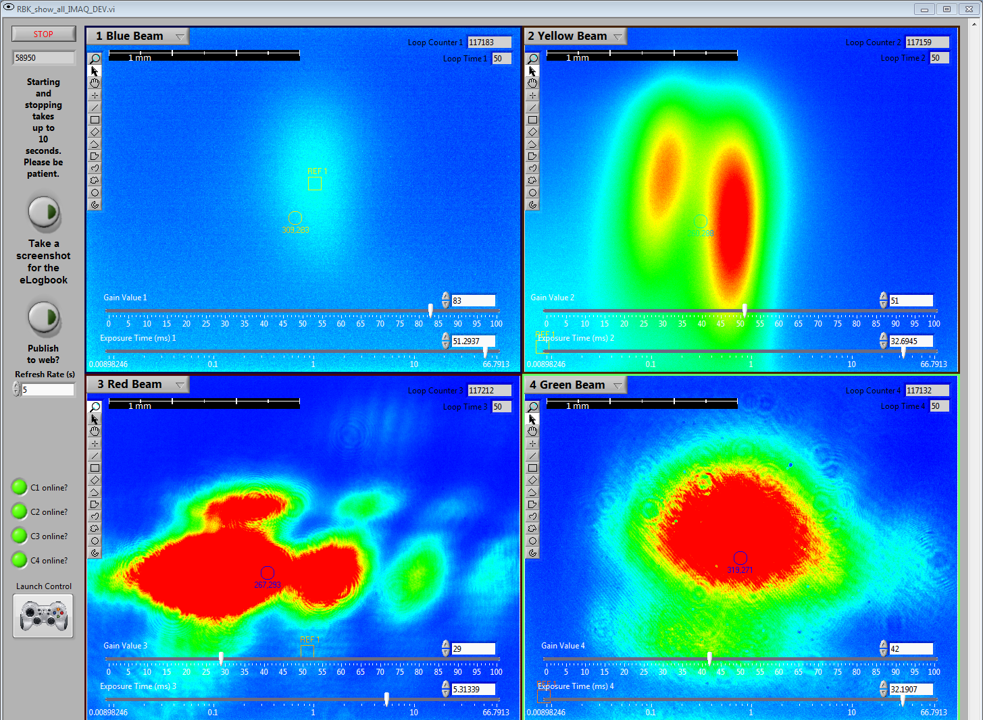
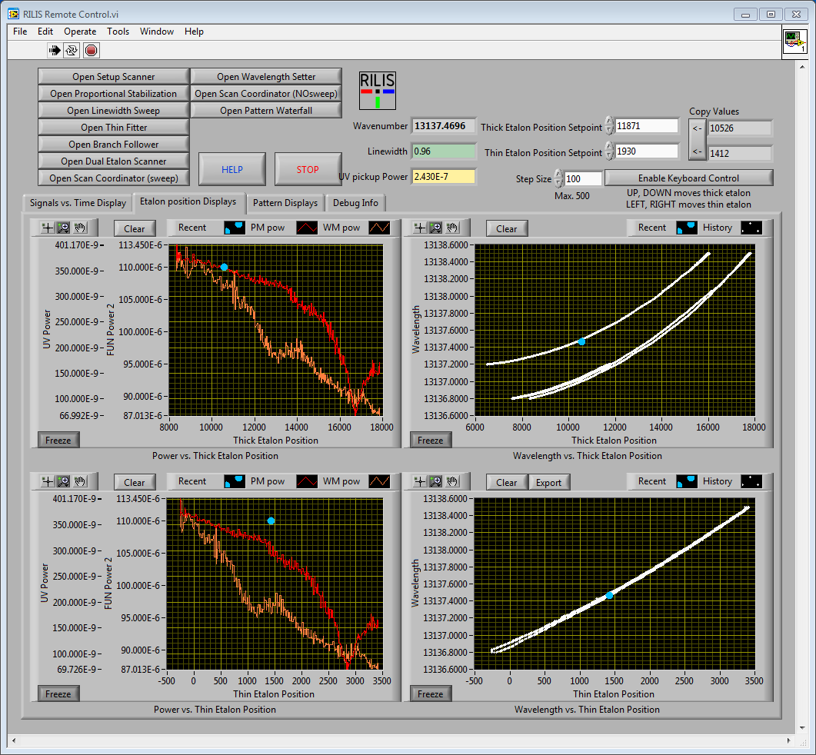

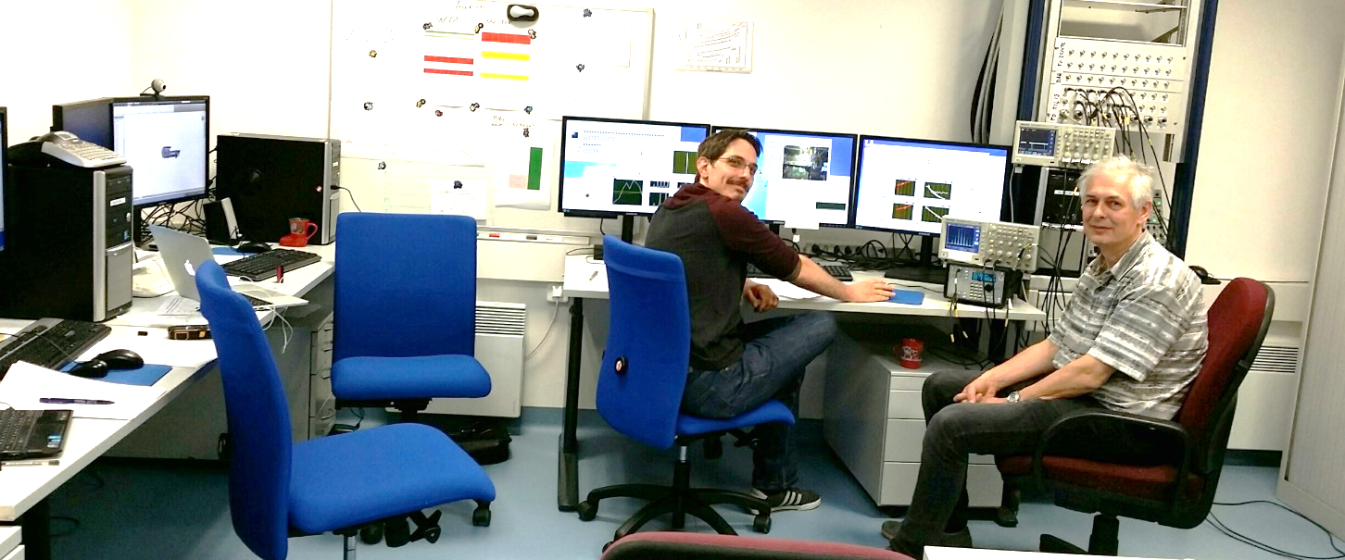
New RILIS Remote Control Room
RILIS @ Building 508
NB:Tisa
doi:10.1016/j.nimb.2013.08.058
Improved scanning software & DAQ
https://cds.cern.ch/record/2014923
Hg (April ‘15, IS598)
Au (May ‘15, IS534)
‘On-call’ for most RILIS runs.
M.Sc. Thesis of R.E. Rossel
RILIS Equipment Acquisition Control Tool (REACT) is being developed by Ralf Rossel.

Slide 6
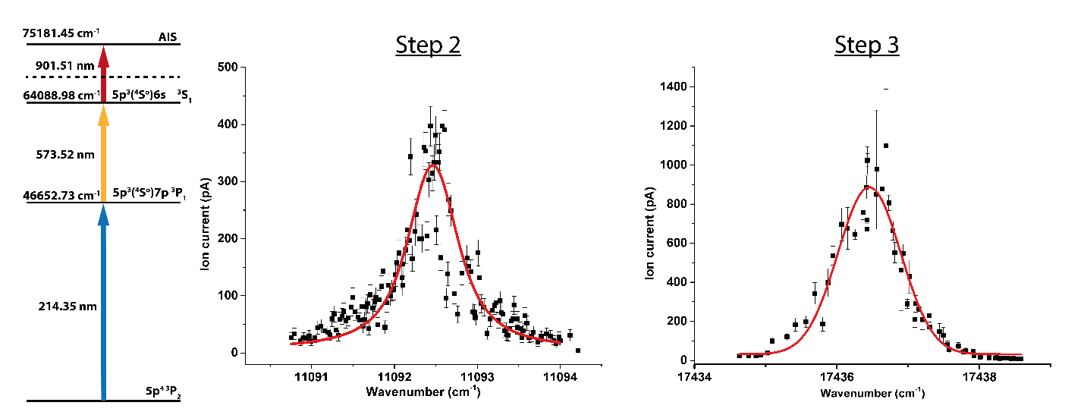
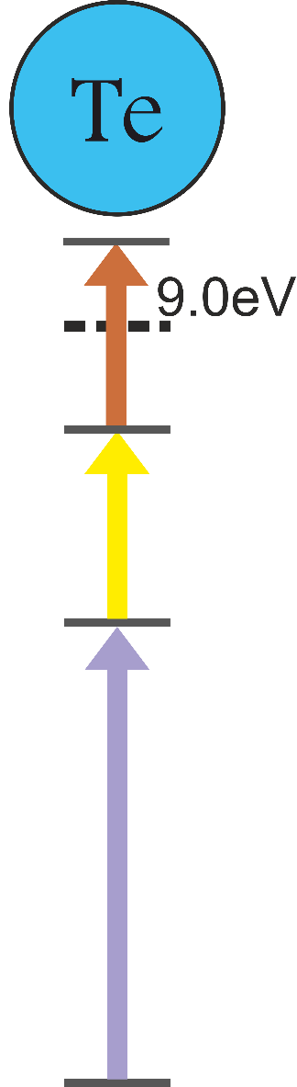
New ionization scheme for Te
New possibility of clean tellurium beams at ISOLDE
902 nm
new AIS!
For:
HIE-ISOLDE
¹¹⁶⁺¹¹⁸ Te
Coulomb excitation
574nm
http://cds.cern.ch/record/1319097/files/INTC-P-296.pdf
+ others
214 nm
PhD work: T. Day Goodacre

Slide 7
VADLIS: demonstrated for Ga, Ba, Ba²⁺, Hg, Cd
First on-line RILIS ion beams from liquid targets (Cd from Sn and Hg from Pb)
Up to 2x efficiency improvement observed for Hg and Cd (compared to VADIS only)
Higher purity Ba beams compared to Surface + RILIS source
http://ecos-eurisol14.sciencesconf.org/conference/ecos-eurisol14/pages/Marsh_RILIS_FEBIAD_BM_1.pdf

Slide 8
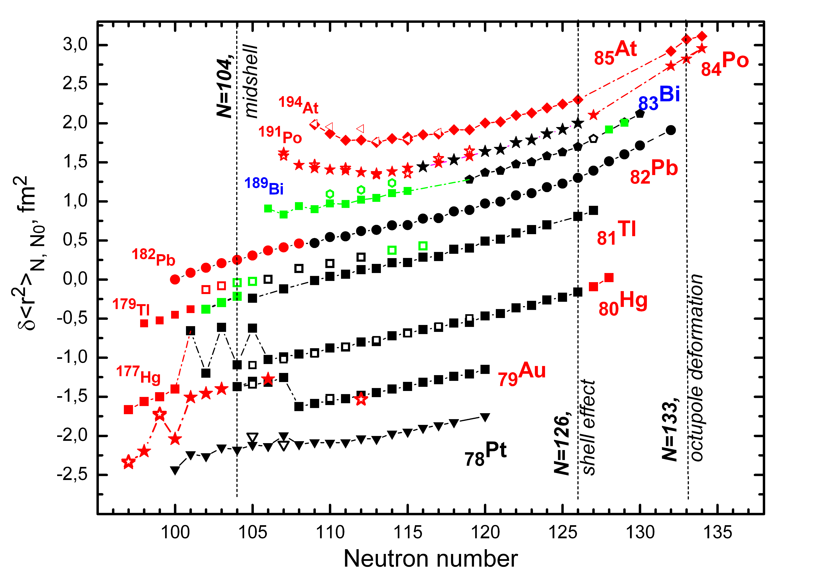
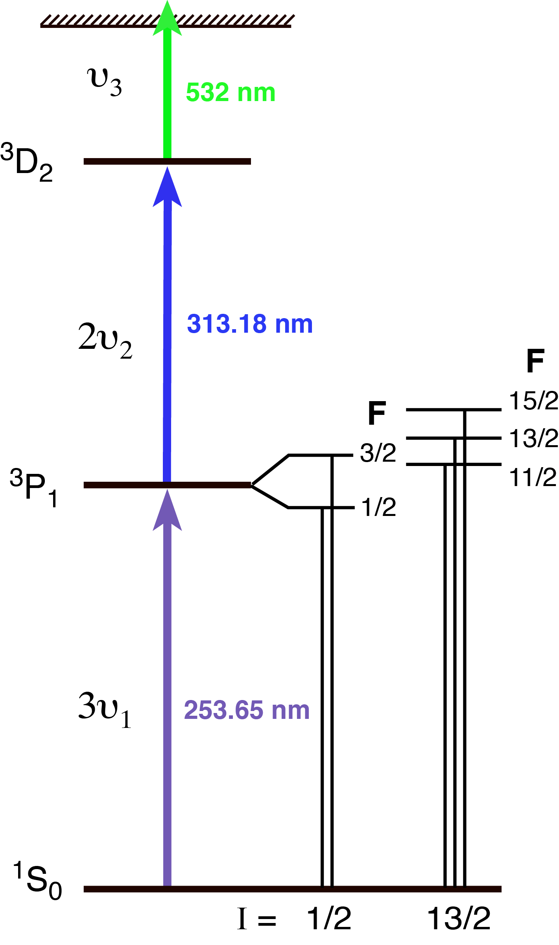
In-Source Resonance Ionization Spectroscopy
Completion of the study of Hg and Au isotopes
IS598 Hg
IS534 Au
  1st RILIS runs controlled from B.508!
New Hg ionization scheme
1st
On-Line RILIS coupled to molten Pb target
(VADLIS)
Windmill
MR-TOF
MR-TOF
Windmill
Provided by A. Barzakh

Slide 9
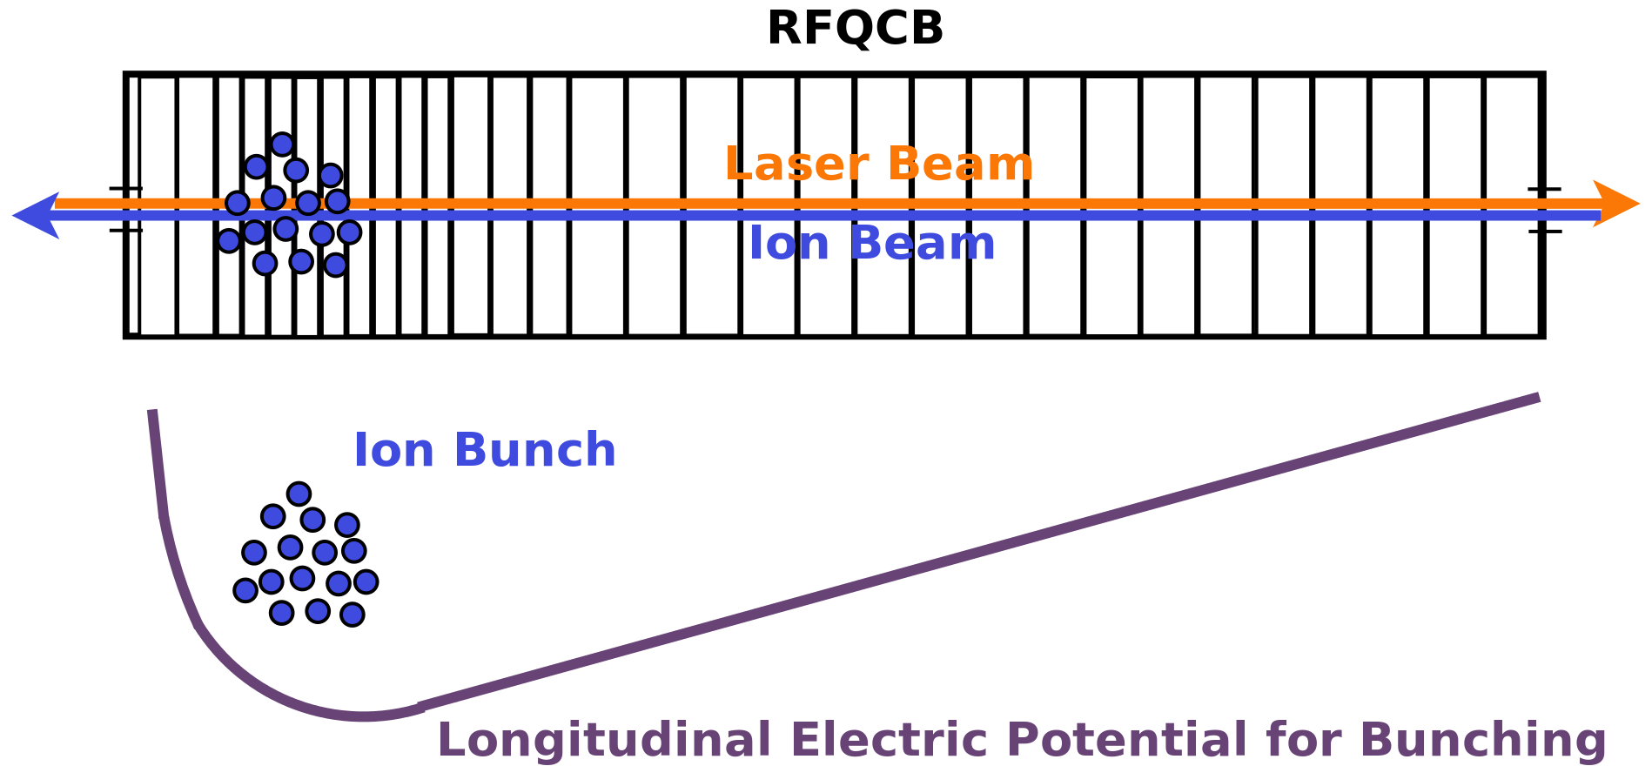
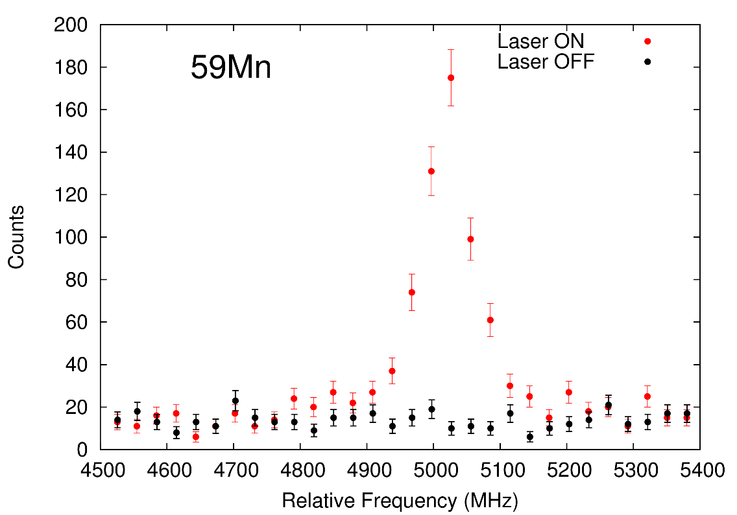
Optical Pumping with ISCOOL
Optical pumping achieved by laser-ion overlap in the cooler
A hyperfine peak of 59Mn with lasers on and off, from the first OP physics case at ISOLDE

Slide 10
Separators: Tape Station
There will be 2 tape stations
The prototype will be installed at the end of the beam line (LA2) in Jan 2016
  To be calibrated against existing tape station
Number 2 prototype will be used as a spare and for improvements
  Could eventually be installed elsewhere at ISOLDE.
Consolidation budget request for 250kCHF
Procurement will start this month
Excellent support from across the EN department.
See presentation by Tim

Slide 11
Separators: Beam Diagnostics
ISOLDE is suffering from numerous issues related to the BI
  Readback, mechanical, vacuum, electronics etc
Lack of spares
  Partly due to the unavailability of the Class A laboratories due to ventilation modifications
BI section leader has been contacted
  Electronics upgrade planned for September
  ISOLDE beam diagnostics part of a recent review
  Spares are now under repair.
A more long term strategy is required.

Slide 12
Separators: HRS Cycling FESA CLASS ISSUES
PROBLEM | CAUSE | ACTIONS
MARCH
Longer time needed to perform a cycle or not able to reach the desired value | Noise at 0.09T (lower limit of the range) cause the NMR to be stuck (it cycles around that value instead of searching the real field) | A loop check has been added to the control system and a strategy to break it up has been implemented
Steady state precision lower than 1e-5 and steady state instabilities | Power supply fine control LSB not properly calibrated (too small) | Control system tuned and LSB fixed at 5mA (6uT) (the power supply seemed not able to react to a lower current than 3/4 mA causing steady state instability) Coils installed on the HRS magnets to measure their dynamic behaviour
JUNE
Sometimes the FESA class seems to be frozen and it is not possible to change the isotope | Problem connected to FESA Real time action timing? | Log monitoring on going. The FESA support has been contacted to verify the situation.
Steady state value have sometimes an error (small than 3uT) | LSB regulation (March) and/or power supply limitation? | Power supply responsible contacted to verify the minimum current available
M. Colciago

Slide 13
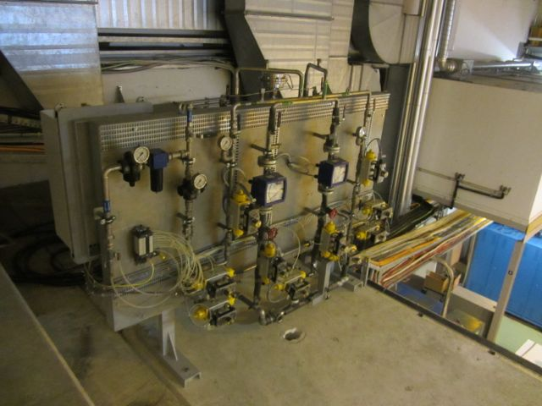
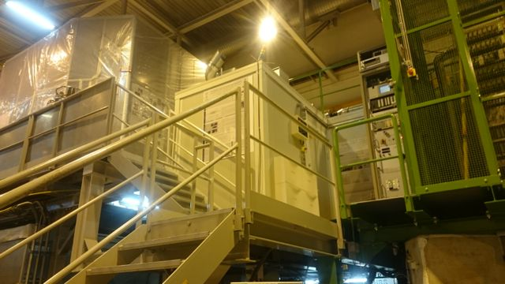
Water Cooling Panel
Water panel moved above the GPS separator for safety reasons
  Dose rate in the vicinity, notably in the RILIS barrack
  Required modification of tubing
A-P Bernardes

Slide 14
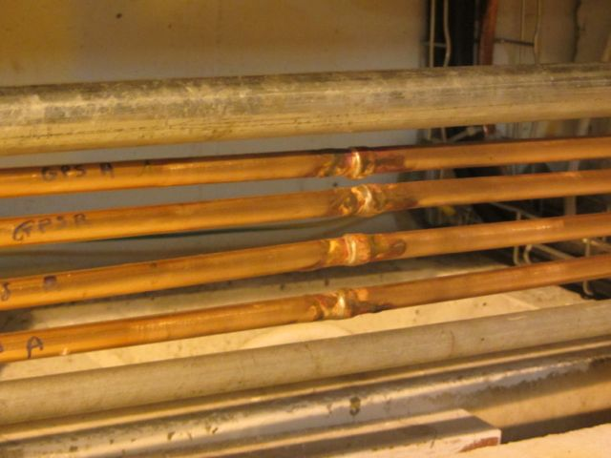
Water Cooling Panel
Saturday BE/OP were called because water was leaking into the RILIS room and HRS separator
DGS-RP called (on-call service). The water had to been sampled and analysed for tritium and gamma spectrometry before release
Reported to the PS-CSAP for clarification x2
Water pressure in pipe 4 bars
No pressure tests requested and made (overpressure on target not suitable)
XRay not standard procedure on brazed small copper tubes
A-P Bernardes

Slide 15
Class A Labs: Ventilation
Class A labs (and soon MEDICIS labs) are separated from the tunnel ventilation.
Huge undertaking within a limited time frame
Required declassification of labs and removal of target production equipment
Class A labs now operational
  Working group assessing implications and solutions for ensuring a dynamic confinement in the case of a fire.
Airlock, target transport and “Blind Access” mode working well.

Slide 16
Target Area: Robot Incident HRS 27th May
Target #533 sent to exchange point instead of Frontend
Recuperated in “mid-flight” and sent to FE
Collision with FE breaking one feedthrough and tripping robot axis#5
Target #506 used to check operation of FE but it unknowingly had a rubber cover on cone
  Failed to couple and cover remained on FE
Used Telemax to recuperate situation and target was repaired.
Initial collision due to difference in virtual axes for FE and exchange point

Slide 17
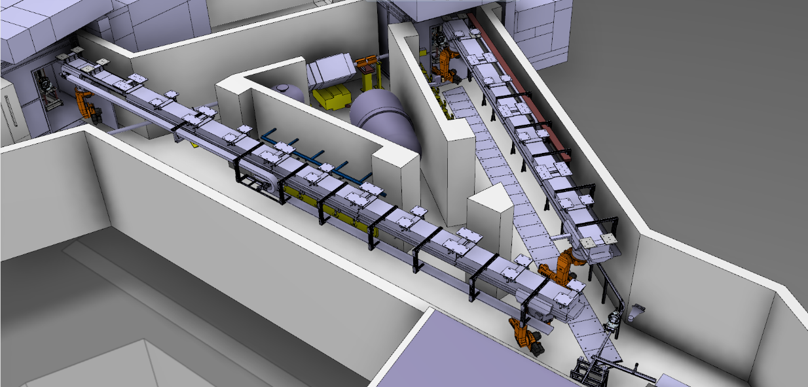
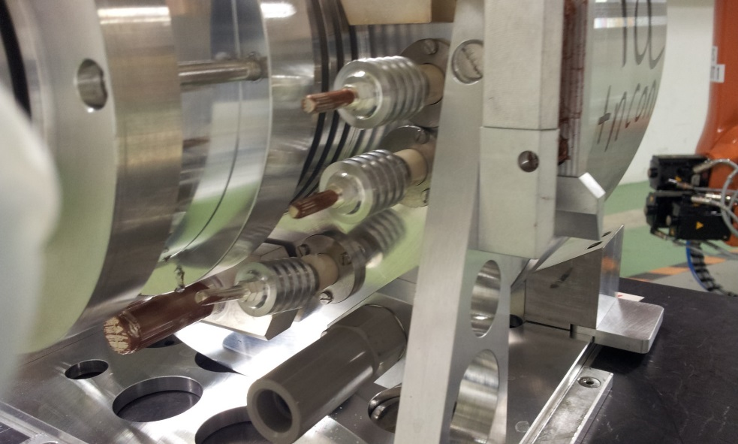
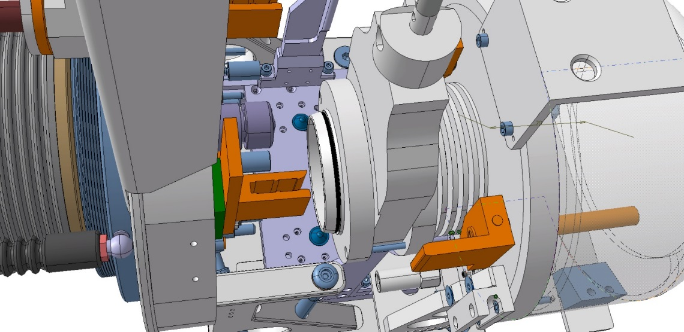
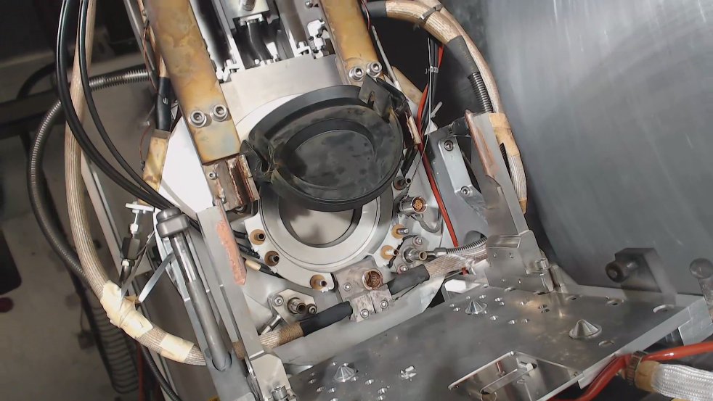
Cause and Consequences

Slide 18
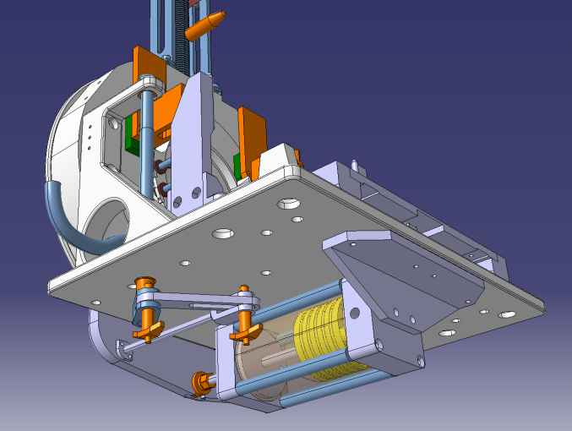
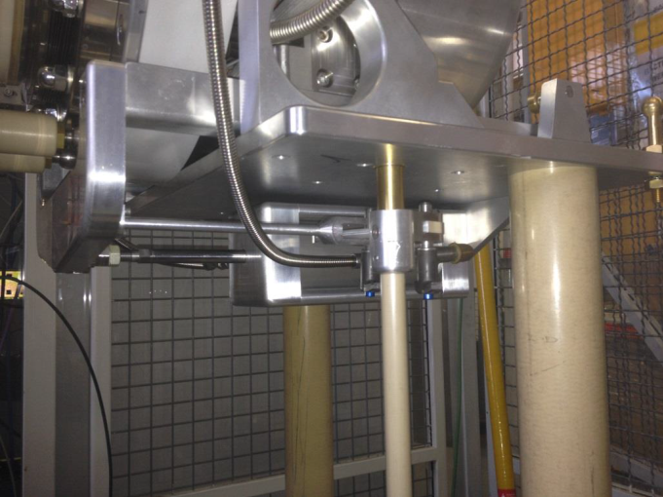
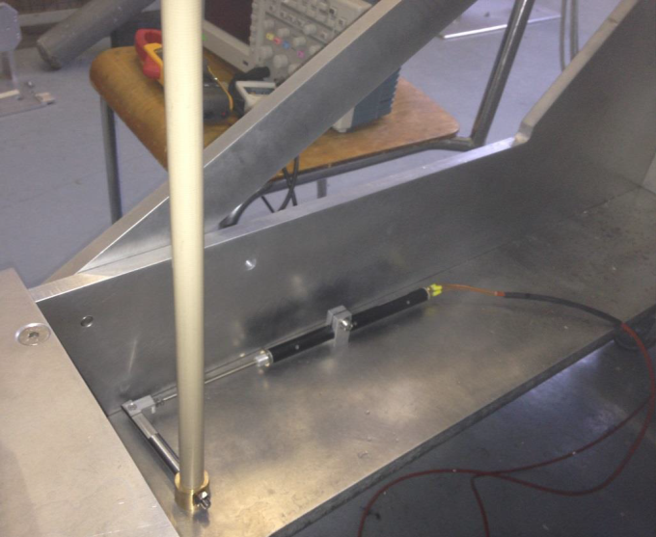
Target Area: Coupling Issues
Used existing mechanics to implement potentiometer movement
A lot of “play/hysteresis ” in mechanics
Potentiometer needs to be recalibrated to account for this play
  Rely upon STI-ECE for re-calibration.
  Try to keep potentiometer tolerances to a minimum.

Slide 19
IEFC News
Injector and Experimental Facilities Committee
Accelerator Sector Executive Committee
Reports to Directorate
2GeV @ ISOLDE 20th March 2015
Magnet Consolidation 26th June 2015

Slide 20
2 GeV proton beams and intensity upgrade for ISOLDE
Summary of presentations by R. Catherall & K. Hanke
132nd IEFC meeting 20th March 2015

Slide 21
Base line parameters
Linac 4
  Linac 4 will be able to provide 5 x 10¹³ ppp = 1.25 x 10¹³/ring
    Based on 40mA from the ion source
  Could possibly go beyond this value with a combination of different options
    Increase in source current output
    An increase in pulse length
    Chopping factor
  All need to be in place for testing
Booster RF upgrade
  CO2/CO4 upgrade would limit protons to 1.4 x 10¹³/ring
    Could be increased with a power amplifier upgrade after LS2
  Finemet upgrade (+MOSFET amplifiers) = 2.5x10¹³/ring
  Depends on the upgrade solution chosen
Protons/pulse | Intensity (µA) | Energy (GeV) | Cycle (s) | Power (kW)
3.3x10¹³ | 2.2 | 1.4 | 1.2 | 3.1
5.0x10¹³ | 3.3 | 1.4 | 1.2 | 4.7
5.6x10¹³ | 3.7 | 1.4 | 1.2 | 5.2
1x10¹⁴ | 6.7 | 1.4 | 1.2 | 9.3
1x10¹⁴ | 6.7 | 2.0 | 1.2 | 13.3
Based on 50% of available protons for ISOLDE

Slide 22
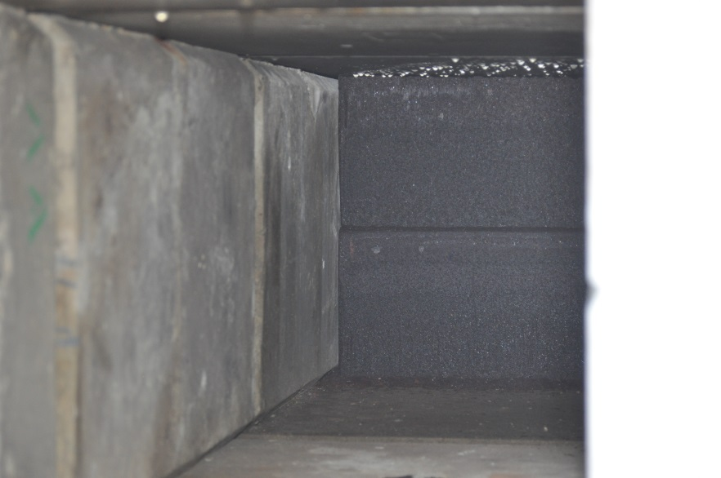
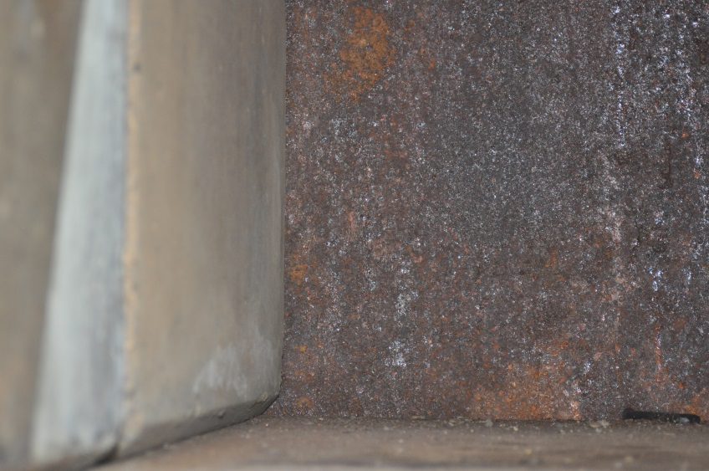
ISOLDE Beam dumps
Beam dumps not according to drawings
  GPS in 2 parts
  Little cooling by convection
  Clear signs of corrosion
  Condensation problems
GPS beam dump
HRS beam dump
Photos taken at the end of LS1

Slide 23
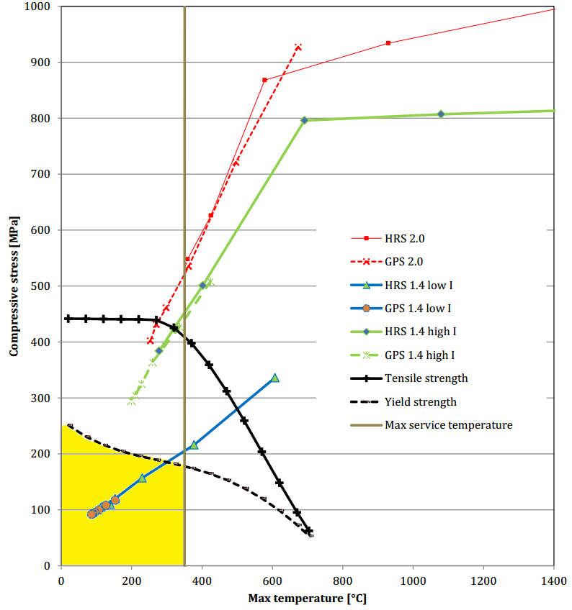
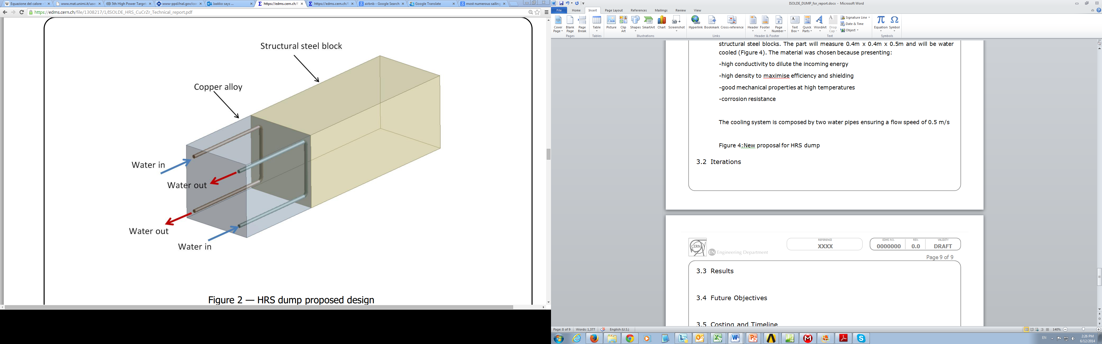
ISOLDE Beam Dumps
Estimations made for different heat transfer coefficients
New design based on PSB design
Valentina Venturi

Slide 24
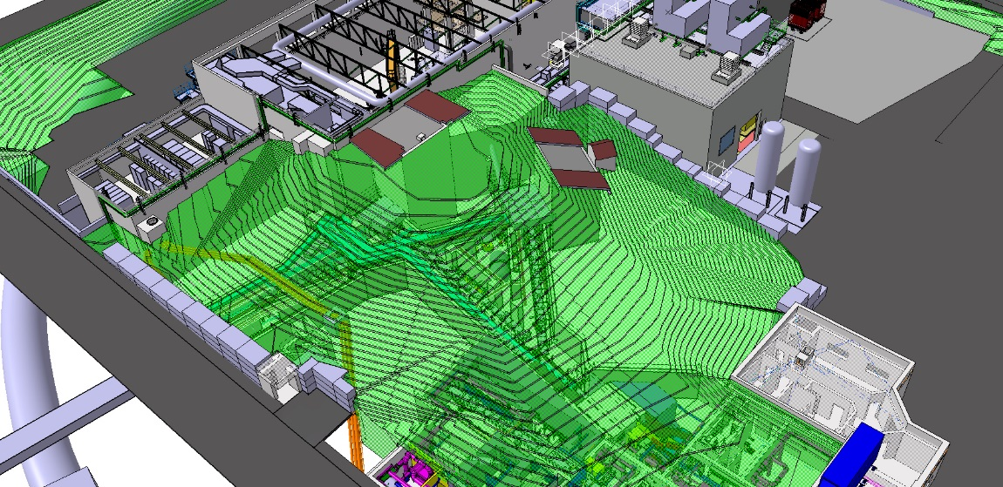
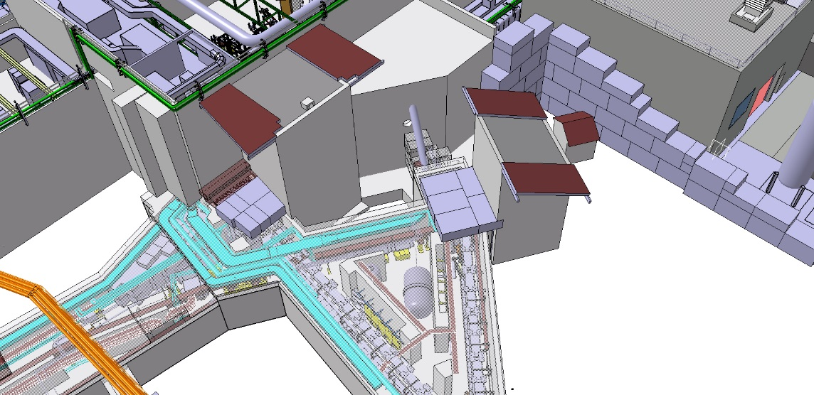
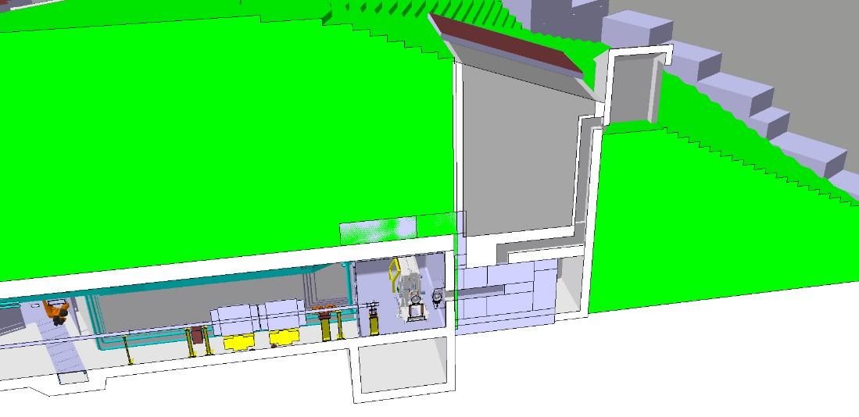
Bored Pile Shafts: a proposed solution
A possible solution to minimize the amount of earth to be removed
  300m³ instead of 3500m³
Chicane for the passage of cooling tubes and other services.
Optimize collimation in front of beam dump
Improved access for eventual long term disposal

Slide 25
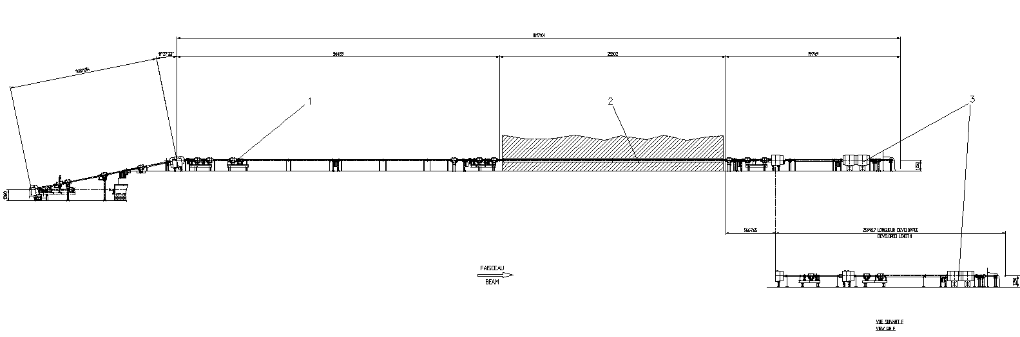
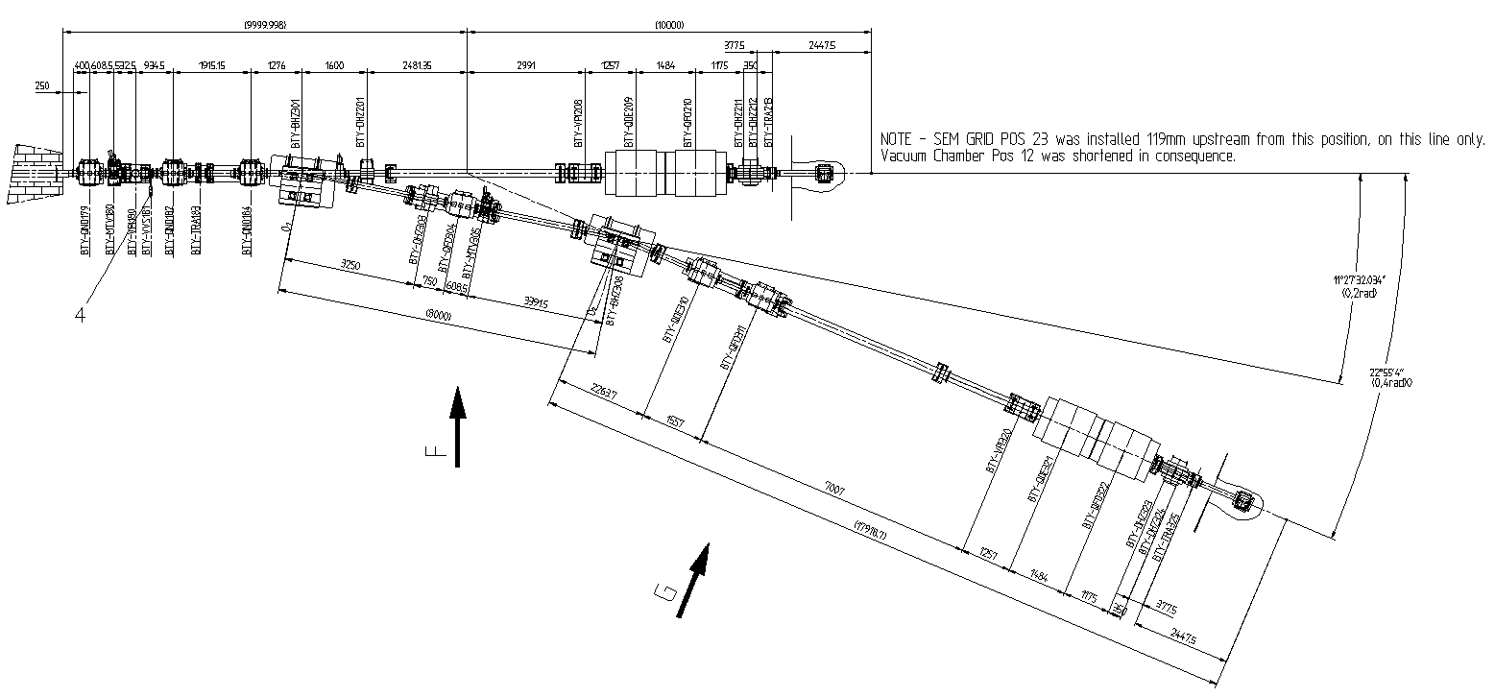
BTY Line Lay-out
BTY.BVT116
BTY.BVT101
Rte.
Democrite
GPS
BTM line
HRS
BT line
Assumptions
keep beam optics and geometry unchanged
keep1.2 s repetition rate
only 1.4 and 2 GeV beams available (no more 1.0 GeV beams!)
consider BTY line (BT and BTM anyway part of LIU)
upgrade of Front-Ends and beam dumps covered by HIE-ISOLDE design study
BTY.BHZ301
BTY.BHZ308
GPS + HRS lines inside target area
IEFC 20/03/2015
K. Hanke

Slide 26
BTY @ 2GeV
Will require 4 new dipole magnets
  May be a problem of integration due to their length
Some quadrupoles will require testing in ppm mode
  Required to eliminate need for cooling upgrades
7 new power converters required
General refurbishment of magnets
K. Hanke

Slide 27
Summary and Comments
Upgrade of the BTY line to ppm operation between 1.4 / 2.0 GeV is feasible; no show stoppers identified
Cost estimate approximately 3 MCHF, but several items not covered. Would need to be reviewed in more detail
  Beam instrumentation etc…
Only a very first unofficial study has been done; since then on hold; it is not part of LIU, nor of any other project. No mandate and no resources associated with this, not even to study…
Money is one point, manpower is another issue. The coming YETS, EYETS and LS2 are heavily (over-)booked with LIU activities
This activity is on hold since 2013. Shall this study should be continued/refined (who? when?), and under which umbrella ??
IEFC 20/03/2015
K. Hanke

Slide 28
2 GeV proton beams and intensity upgrade for ISOLDE: Latest news
Beam dump consolidation (along with other ISOLDE consolidation requests for LS2) was presented in a dedicated session at the Chamonix workshop Sep2014.
  No further news except that all requests for LS2 work should be inserted into PLAN (a project software tool for LS2)
After a seemingly urgent request to present 2GeV @ ISOLDE in the IEFC last March
  A working group should be set up but no further news with the exception for a request for further cost estimates last week.
LS2 will now start in December 2018 and will last
  2 years for the LHC
  ~15 months for the injectors

Slide 29
Consolidation Requirements for the AD and ISOLDE magnets
Antony Newborough TE/MSC
IEFC 26th June 2015

Slide 30
ISOLDE – BTY (PSB > Target)
BTY Transfer line magnets – 32 Magnets (4 Families)
4* Bending – PXMBXFBCWP – 2* Spares (1 Certified)
15* Quadrupoles – PXMQNCDNWP – 1 Certified Spare
4* Quadrupoles – PXMQNEETWC – 19* Spares (1 Certified)
9* Corrector PXMCCAAWAP – All spares need new coils (4 sets planned for PSB consolidation ~ 50 kCHF) (As per AD)
General situation good, however the magnets in the target area are showing signs of radiation damage and a preventative change of magnets may be performed during LS2.

Slide 31
ISOLDE – Separators (HRS,GPS)
HRS – 2 Magnets – PXMDSFACWC (60 Deg), PXMDSGACWC (90 Deg).
Zero Spares
Minimum consolidation action spare coils ~ 200 kCHF (to be approved)
GPS – 1 Magnet – PXMDSEAHWC
Zero Spares (No Documentation at Hand)
Minimum consolidation action spare coils ~ 100 kCHF (to be approved)
IT IS NOT POSSIBLE TO REMOVE THE MAGNETS FROM THE ZONE!
“A possible change to the layout is being considered but not before LS3 at the earliest” – R. Catherall

Slide 32
ISOLDE - REX
REX > HIE ISOLDE – 22 Magnets (11 Families)
1* Bending – PXMBXCAHWC – Zero Spares, ~120 kCHF (to be approved)
1* Quadrupole Doublet – PXMQDAAFWC – Zero Spares*, ~60 kCHF (to be approved) *An alternative magnet may be suitable TBC.
2* Quadrupole Triplet – PXMQTAAFWC, PXMQTABFWC – Zero Spares,
~60 kCHF (to be approved)
2* Quadrupole Triplet - PXMQTACFWC, PXMQTADFWC – Zero Spares, ~60 kCHF required (to be approved)
1* Quadrupole Triplet - PXMQTAGFWC, PXMQTAHFWC – 2* Spares
1* Quadrupole Triplet - PXMQTAEFWC, PXMQTAFFWC – Zero Spares,
Inside cavity, no access, 100 kCHF + spare cavity? (to be approved)
1* Corrector – PXMCCAQWAC – 4* Spares (1 Certified)

Slide 33
ISOLDE - Summary
Possible spending plan
ITEM | Status | Total (kCHF) | 2015 (kCHF) | 2016 (kCHF) | 2017 (kCHF) | 2018 (kCHF)
HRS Separators | to be approved | 200 |  | 40 | 160
GPS Separator | to be approved | 100 |  | 20 | 80
REX Bending | to be approved | 120 |  | 24 | 96
REX Triplet Quadrupoles | to be approved | 120 |  | 24 | 96
REX Triplet Quad (inside cavity) | to be approved | 100 |  |  |  | 100
TOTAL |  | 640 | 0 | 108 | 432 | 100

