Slide 1

CERN-MEDICIS : An update
Thierry Stora, EN-STI

Slide 2
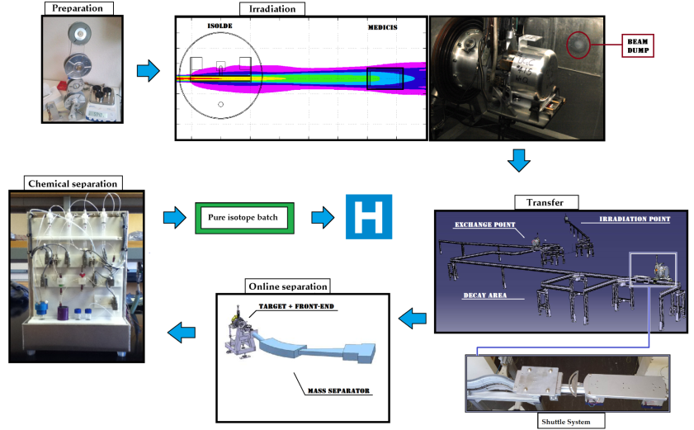
Why CERN-MEDICIS could be done * (1) ?
* Without an additional proton driver
Offline separation

Slide 3
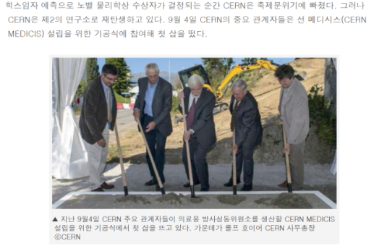
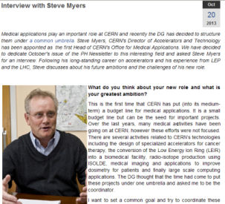
Why CERN-MEDICIS could be done (2) ?
CERN, as an institution, has decided to streamline medical applications;
Good news: CERN-MEDICIS is an approved project in the EN dept.

Slide 4
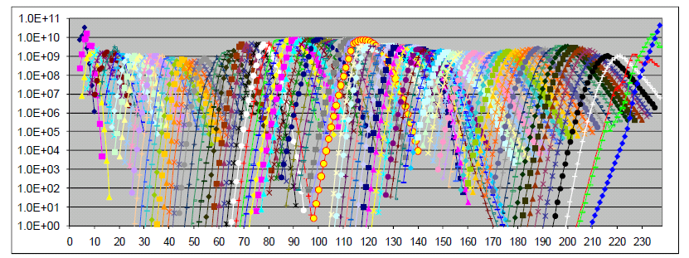
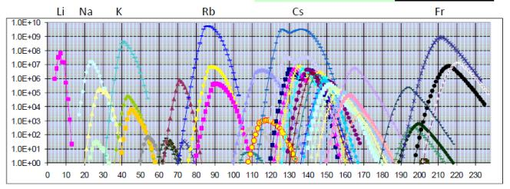
The « ISOL » filter
Isotope mass separation online
In-target production rate
1000+ isotopes
(for 73+ elements) “online”
I[pps] ~ Φ[pps] σ[barn] N[g/cm2] ε [ goal 100%]
A=83
A=152
Intensity
Purity
Beam production rate
(Mass separation filter)

Slide 5

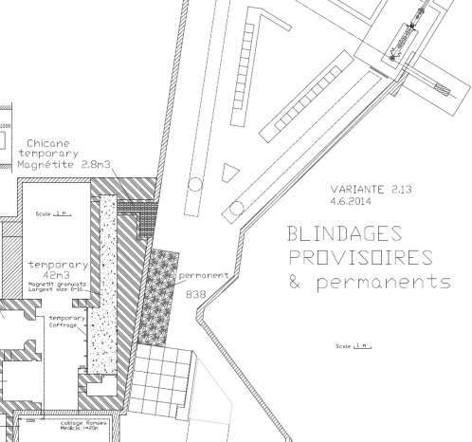
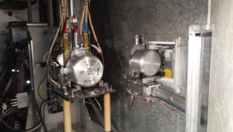
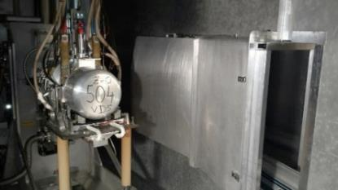
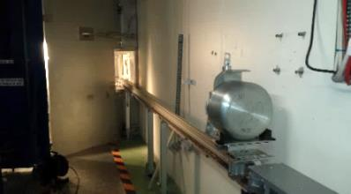
Irradiation station commissioned with beam
M. Vagnoni (EN-STI fellow), et al.
Proton Beam
50 60 kV
Cover grounded
Tests with protons:
Done successfully !

Slide 6
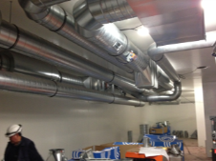
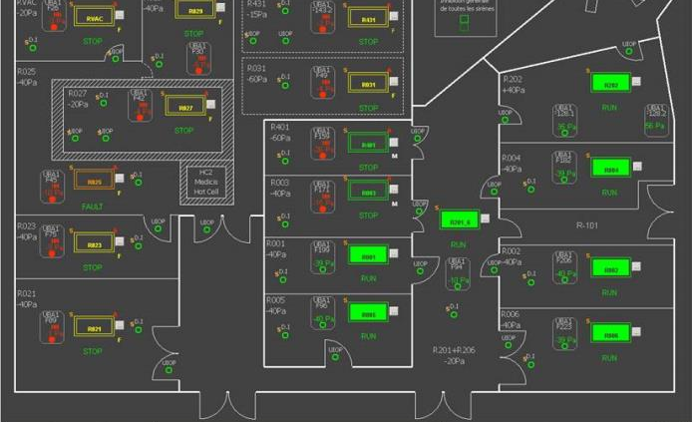
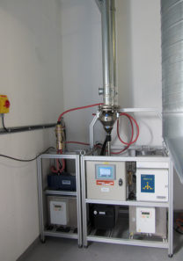
Class A laboratories ventilation (A Bernardes, EN-CV)
Ready:
Class A labs back to operation
MEDICIS ventilation ready
Environmental monitoring operational
To be done:
Ventilation fire mode to be put into service
Ventilation process to be commissioned and put into service
UPS

Slide 7
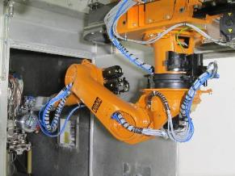
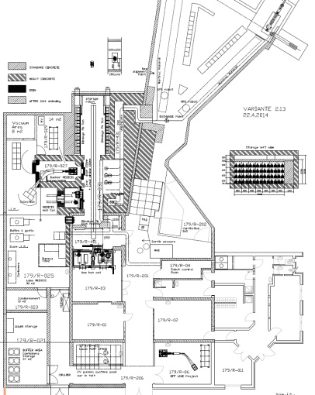
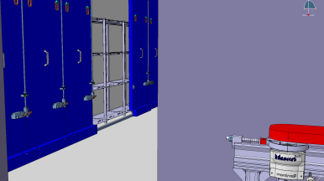
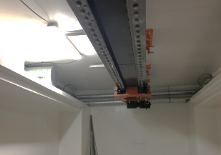


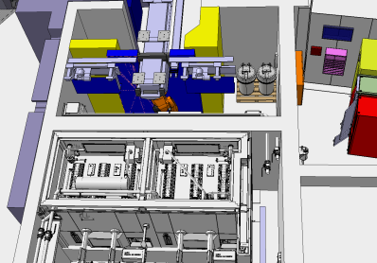
Robots and shielded doors
J.L. Grenard, K, Kershaw et al.
Storage shelves (V. Barozier & Y. Garvrikov)
Robot Rail
Shielded doors

Slide 8
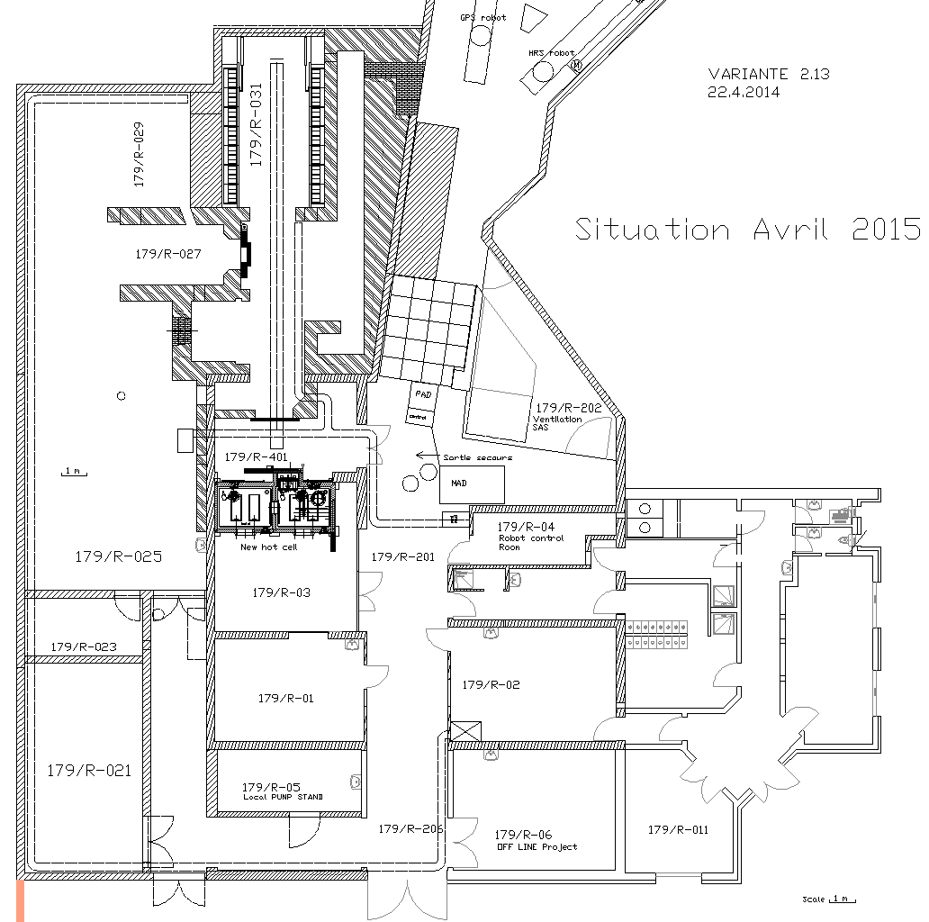
Mise à jour 12.06.2015 - KK, SM
Bat. 179: Planning juin 2015 … février 2016
2. Installation Porte B
10. Portes et Etagères (méc.)
5. Installation et tests ROBOT
7. Sol Résine
Roland
Keith
Yury–Vincent
Jean-Louis
19. Installation MONTRAC mécanique + câblage et mise en service partielle
Matteo
13. Lisol Magnet: Transport B --> CH et modifications
X
16. Installation blindage chicane
Vincent - Yisel
Matteo
12. Installation Porte A
15. Retrait blindage temporaire et peinture murs et sols
Keith
Roland
8. Chemins de câbles 3x
18. Mise en service ventilation SAS
Alexandre
Georgi
Matteo
9a. Porte supply point
17. Création SAS ventilation 2 portes
Vincent
Matteo
9. Découpe mur supply point
11. Installation blindage decay point
Roland
Matteo
3. Eclairage définitif
14. Réfection sol Résine
René
Roland
4. Tirage Eau-air-Argon
20. Système d’accès MEDICIS
Franck
Eva
6. Réfection sol Lino
21. General safety MEDICIS
Roland
Ana-Paula
1- Fermeture temporaire
22. Radioprotection MEDICIS
Roland
Joachim
14. Peinture de sol corridor
3. Upgrade réseau secouru et UPS
Roland
René

Slide 9
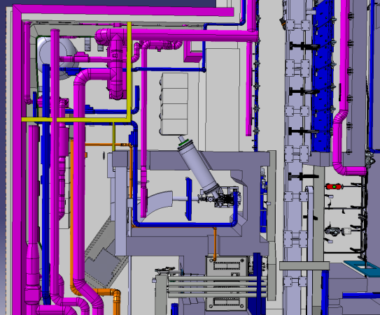
Front End, isotope separator, HT, vac: for 2016
Vacuum &
Gas storage
Power supply & HV
Controls
FE & separator

Slide 10
External partners
Dr. Forni (Clin. Carouge, Geneve)*
Prof. Morel, Prof. Buehler, Prof. Y. Seimbille, Prof. Ratib (HCUGE, Geneve)*
Prof. D. Hanahan (ISREC, EPFL, Lausanne)
Prof. F. Buchegger, Prof. J. Prior (CHUV, Lausanne)*
Prof. M. Huyse, prof. P. van Duppen, prof. T. Cocolios (KUL, Univ. Leuven)
Prof. S. Lahiri (SINP, Kolkata)
Prof. I. dos Santos, prof P. Vaz (CT2N, Lisbon)*
Prof. E. Piperkova (Nucl. Medicine, Sofia)
Prof. F. Haddad (ARRONAX)*
JRC-ITU
S. Buono (AAA)
Prof. K. Wendt (JGU)
Myrrha
ESS
NPL (UK)

Slide 11
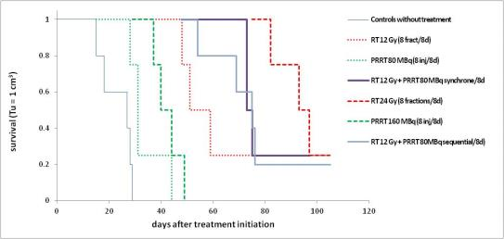
Systemic (intravenous) and external radiotherapy F. Bucchegger et al., CHUV
A
B
C

Slide 12
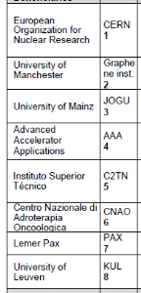
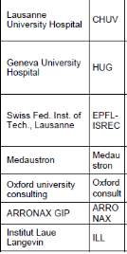
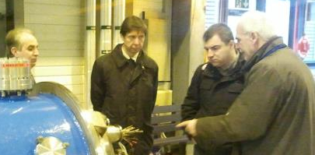
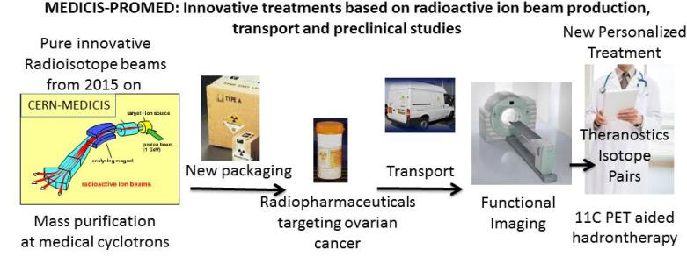
Marie-Curie ITN MEDICIS PROMED
Working with Prof. Novozelov :
Graphene as protective layer on metal foil
targets

Slide 13

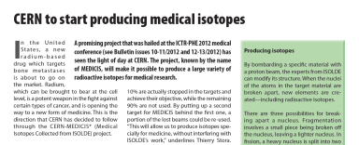
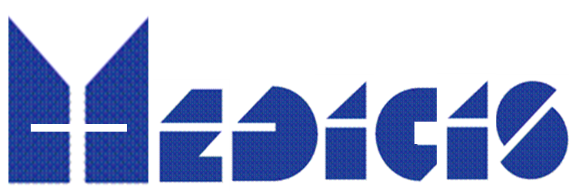

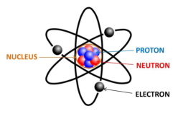






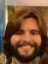

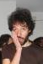

Thank you !
Core CERN-MEDICIS nucleus
And many others

