Slide 1

Target and Ion Source Development
Thierry Stora

Slide 2
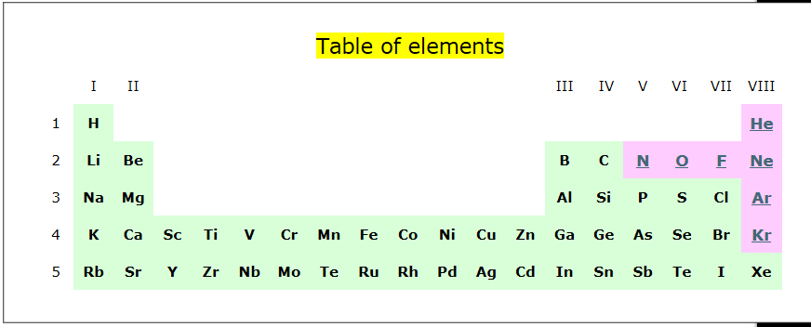
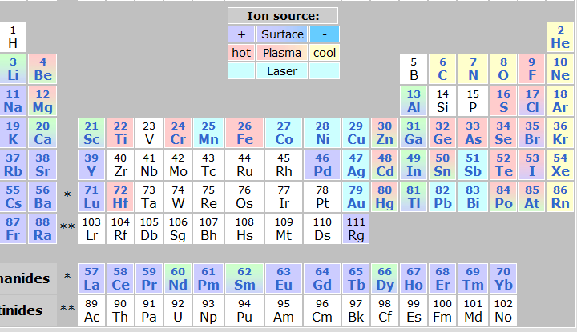
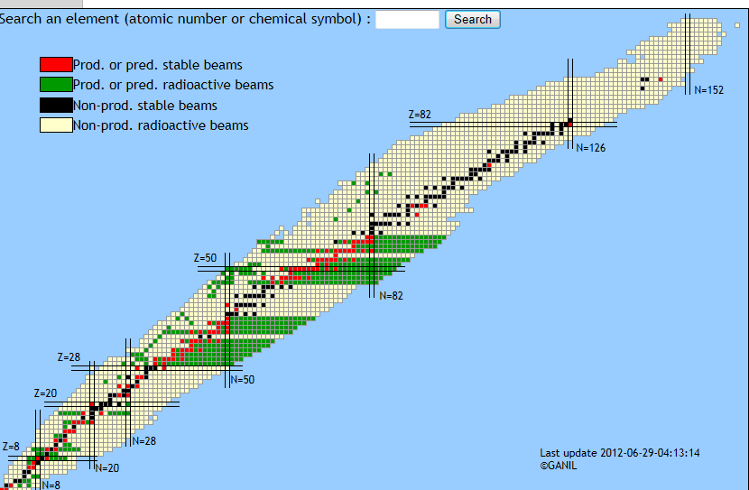
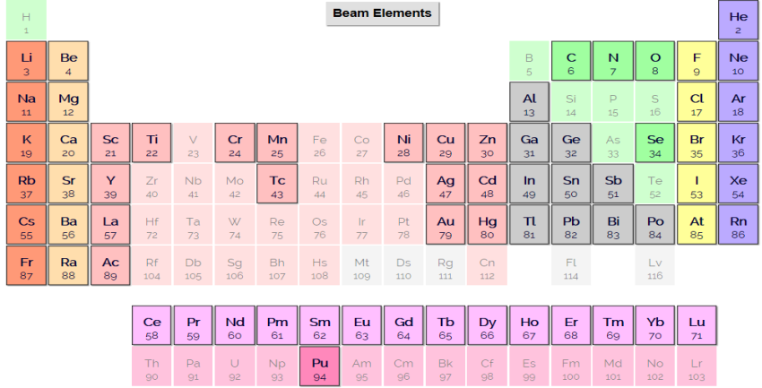
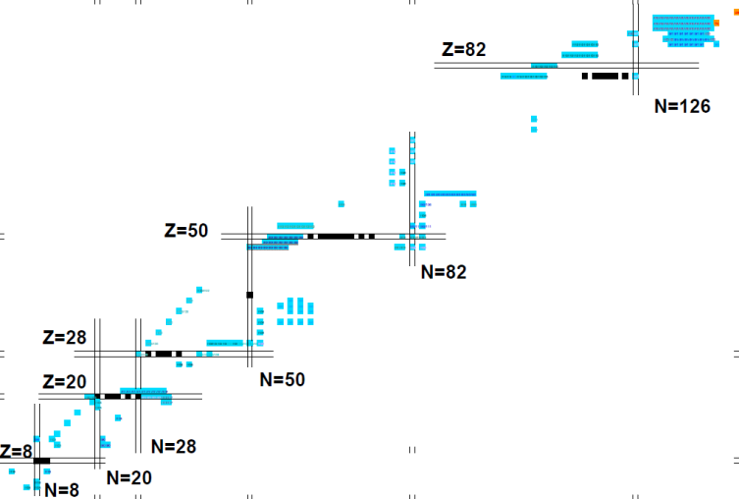
Beams at ISOL facilities*
GANIL-SPIRAL I
CERN-ISOLDE
(74 elements)
(7 elements)
ISAC-TRIUMF
(67 elements)
GANIL-SPIRAL I (&II)
* 1 development is ~ 2-5 man.year effort
if the technology is within scope
HIE-ISOLDE
(1st proposals to INTC in 2013
Already many more)

Slide 3
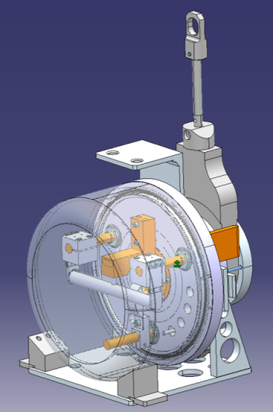
ISOL Beam intensity and availability
Cross
section
Release
Efficiency
Ionization
Efficiency
RIB intensity:
I = Φ σ N ε_{release} ε_{ion}
Material science
(nanostructured
targets, molten salts,…)
Chemistry
(adsorption enthalpy,
molecule formation,…)
Ion sources
(cathode, plasma,…)
Targetry
(secondary reactions
molten metal shower,…)
Proton beam
Intensity
Target
thickness

Slide 4
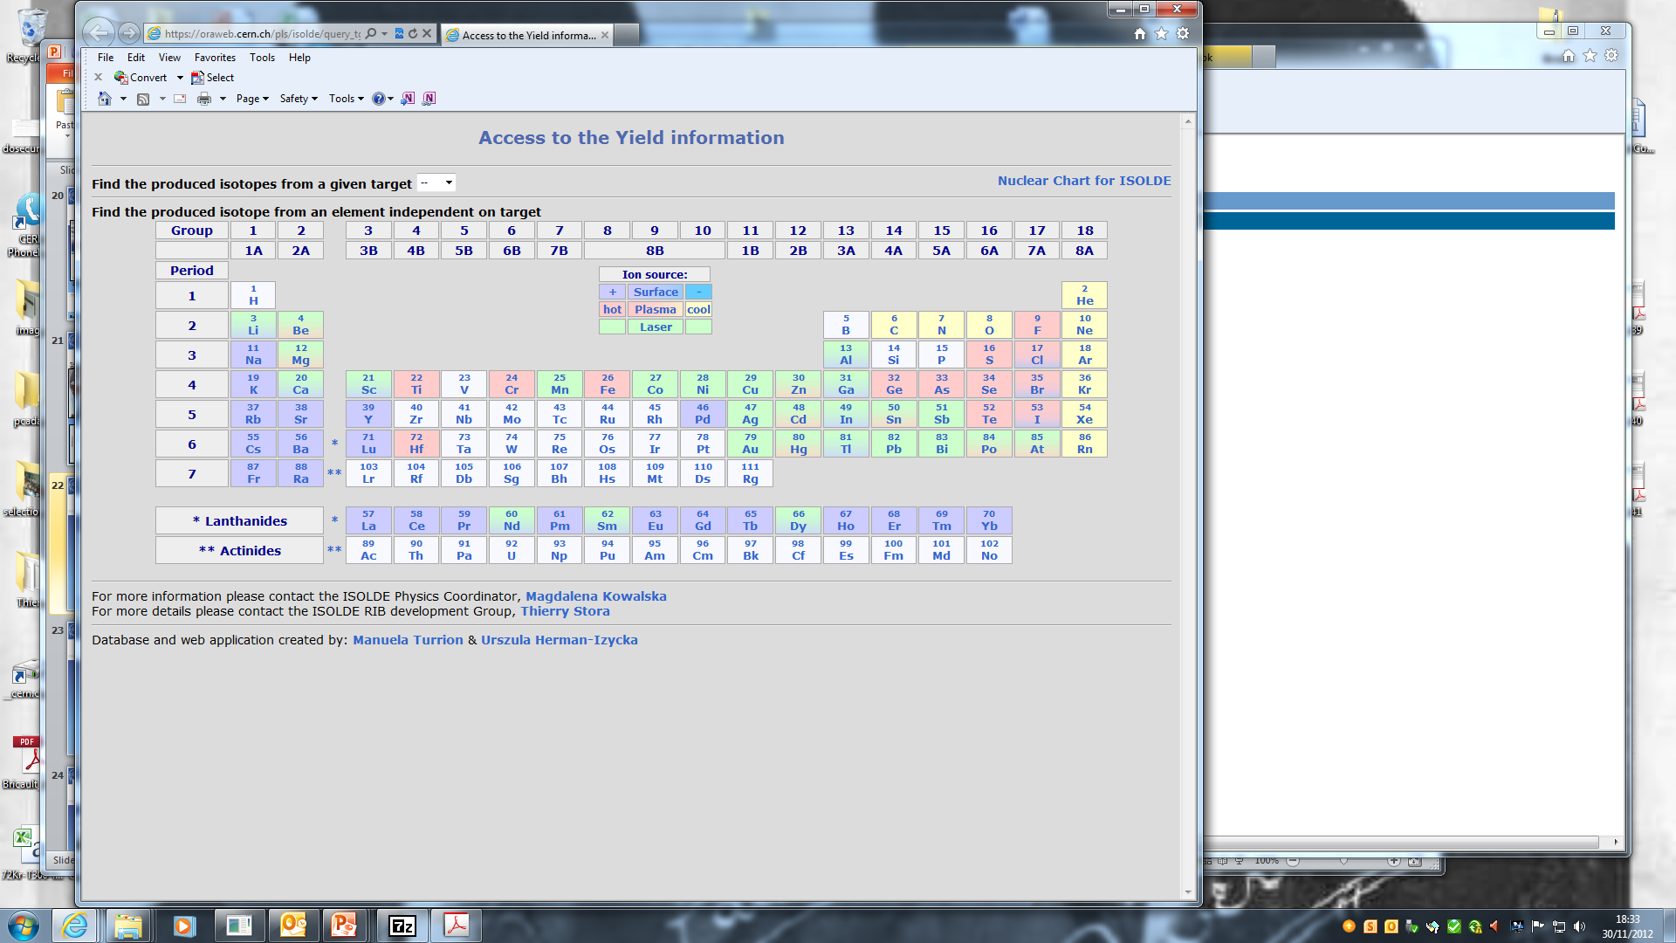
Beam developments in the past 8 years
1^{st 8}B ISOL beams BF₂⁺ from nanotubes
X5 ³⁰Na Re ion source
X10 ^{20,21}Mg
sub-μm SiC
Molten salt
Target
¹¹C as CO⁺
^{9,17}C as CO⁺
Helicon Ion source
⁷⁰⁺Ni beams
Nano UC_{x}
Source
From
PSI
⁴⁴TiF₃⁺
Nano
Y₂O₃
⁴⁸Cr
x250
⁸⁰⁻⁸²Zn,¹³⁰Cd
Purification
with quartz
(ΔHads)‏
⁹Be(n,α)⁶He
Nano
CaO
Target
(Ar)
1st Fe Beams
Au beams
by laser ionis.
X5 VADIS
²⁰⁸Pb(t,3p)²⁰⁸Hg
X3-10
VADIS
Ion source
(72Kr,229Rn)
1st beams@JAEA
New Neutron converter
Purific. of Fr, Ra
with LIST Trap
ThO,
Negative
ion sources
Purification of lanthanide beams ¹⁴⁰Nd, ¹⁴⁰⁻¹⁴²Sm:
GdB₆ ion source cavity + RILIS

Slide 5
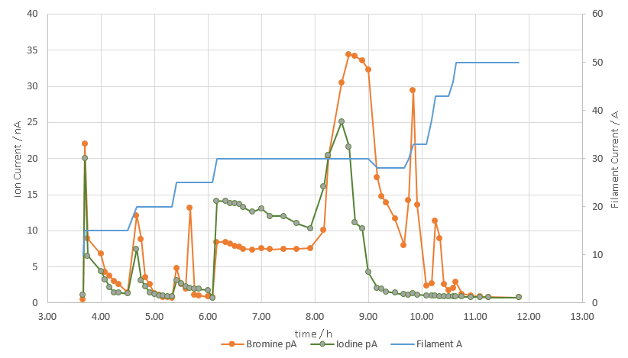
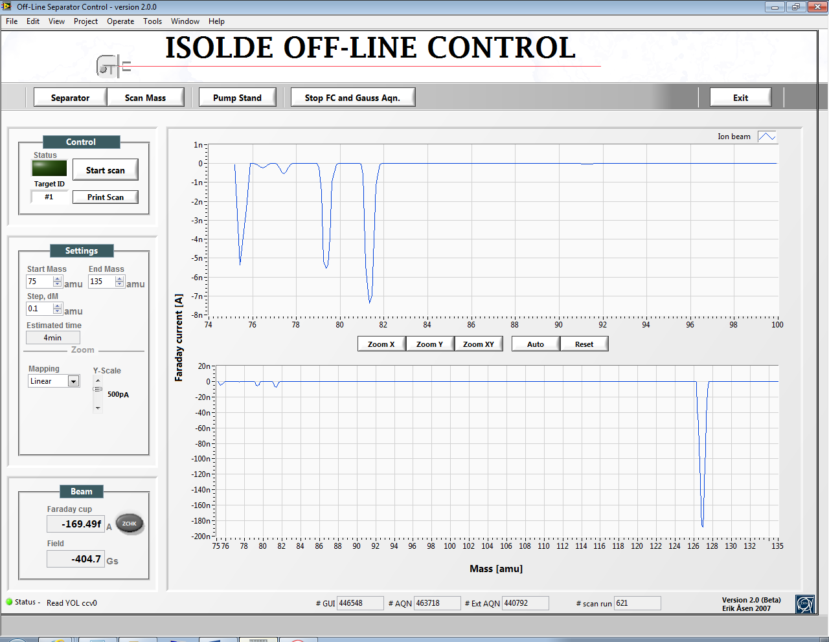
Recent results
Negative beams :
  Negative ion source prototype (GdB6 tub ion, Menna et al. NIMB, 266(2008) 4391)
Offline efficiencies 2015:
ε (Br-,I⁻ ) = 17% @1700C
with some questions remaining
Online TISD with Nb535
and ThO540 targets, starting this week
Y. Martinez, J. Ballof, T. Mendonca

Slide 6
Recent results
LIEBE (Liquid Lead Bismuth target loop for EURISOL)
Prototype construction starting (detailled drawings)
Offline tests foreseen end 2015
Online tests foreseen in 2016

Slide 7
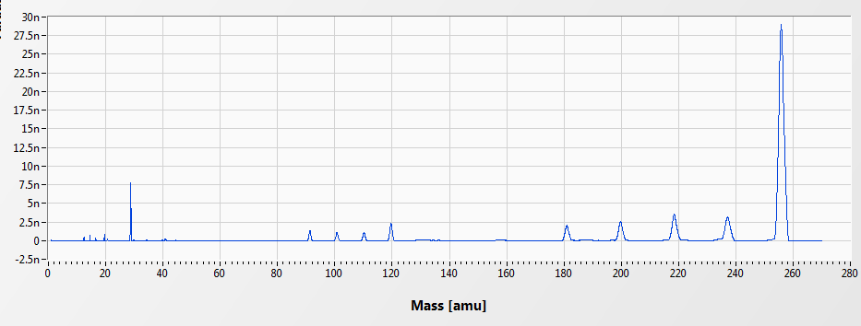
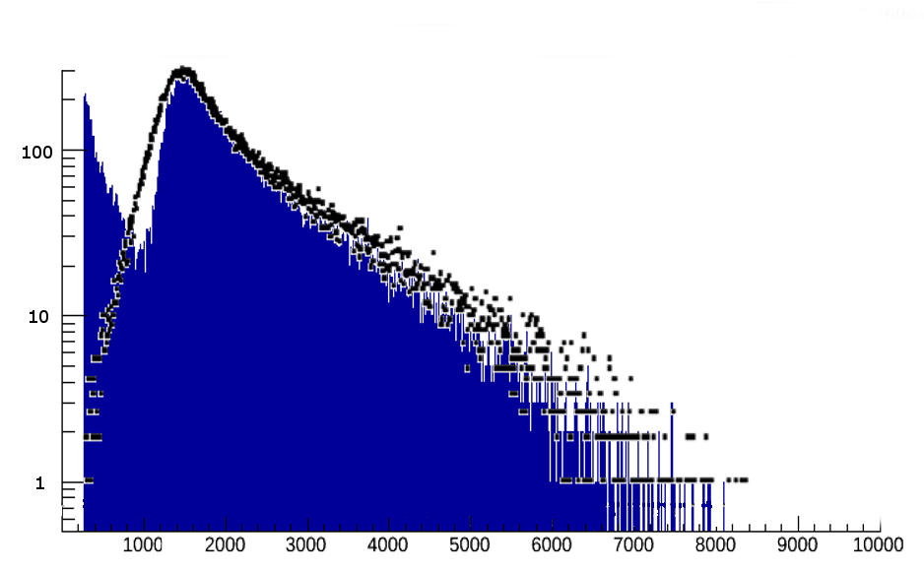
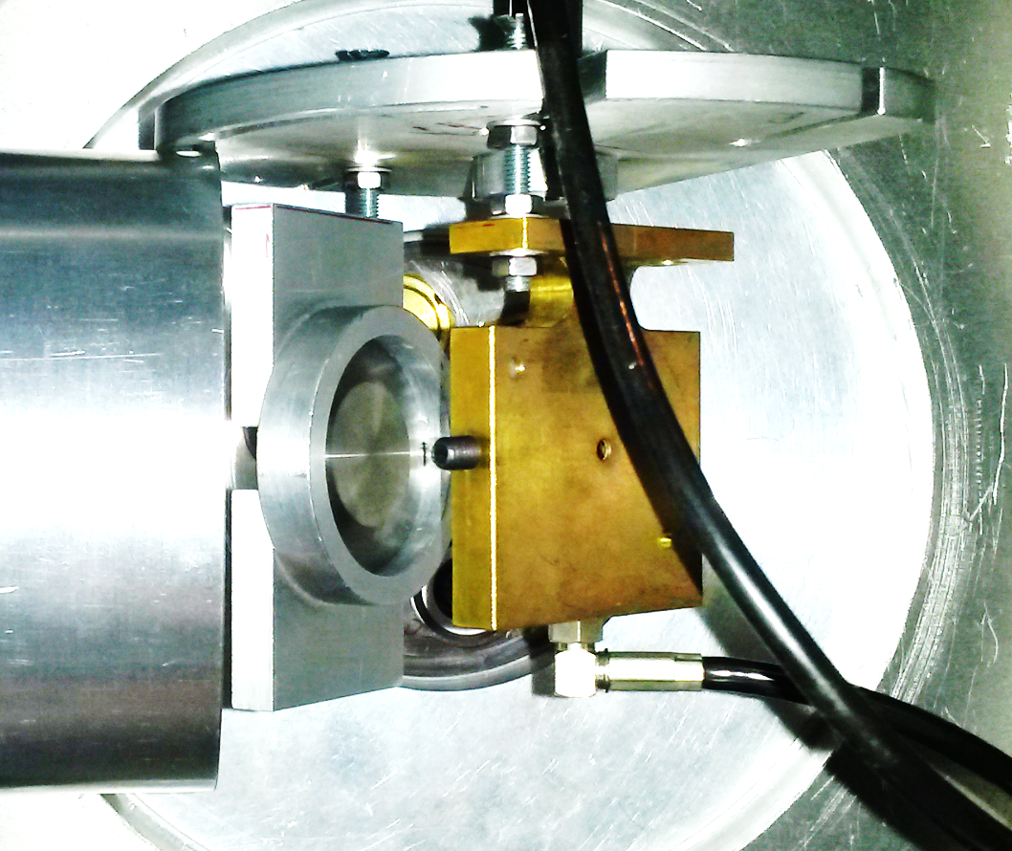
Recent results
8B beams
TaFx⁺ ion beams
Target unit #499:
  Target material: Carbon nanotubes (MWNCT), ρ=0,43 g/cm3
  Standard Ta container, cold transfer line, VADIS ion source
  SF₆ in container,(0,37*10⁻⁴ mbar*l/s, p(SF₆)~1-2 bar)
Release of ⁸B & ISOLTRAP’s MR-ToF:
  No ⁸BF_{n}⁺ (n=1,2,3) or Oxyflourines detected
  Positron activity on A=8 corresponds to 3*10² 1/uC
  Proof that activity originates from ⁸B still pending
Target unit #513 : (Same characterisics as #499,
higher SF₆ injection: 1 10⁻⁴ mbar*l/s, )
Release of ⁸B & LA1 (Tengblad et al.):
  ⁸BFn⁺ (n=1,2) detected this time !
  Positron activity on A=46 corresponds to 310⁴-10⁵/uC (~1nA stable contaminant also detected)
Decay:
⁸B
Positron + 2 Alphas
HPGe
⁸BF_{x}
Si
detector
blue: this work
black: Winter et. al, 2008, PRC
Target
keV
Ch. Seiffert, J. Ballof, M. Delonca, B. C. Gonsalves, W. Hwang, R. Lica, M. Madurga Flores, T.M. Mendonca, J. P. Ramos, T. Stora, O. Tengblad, D. Torresi, K. Riisager, M. Borge, M. Owen,et al

Slide 8
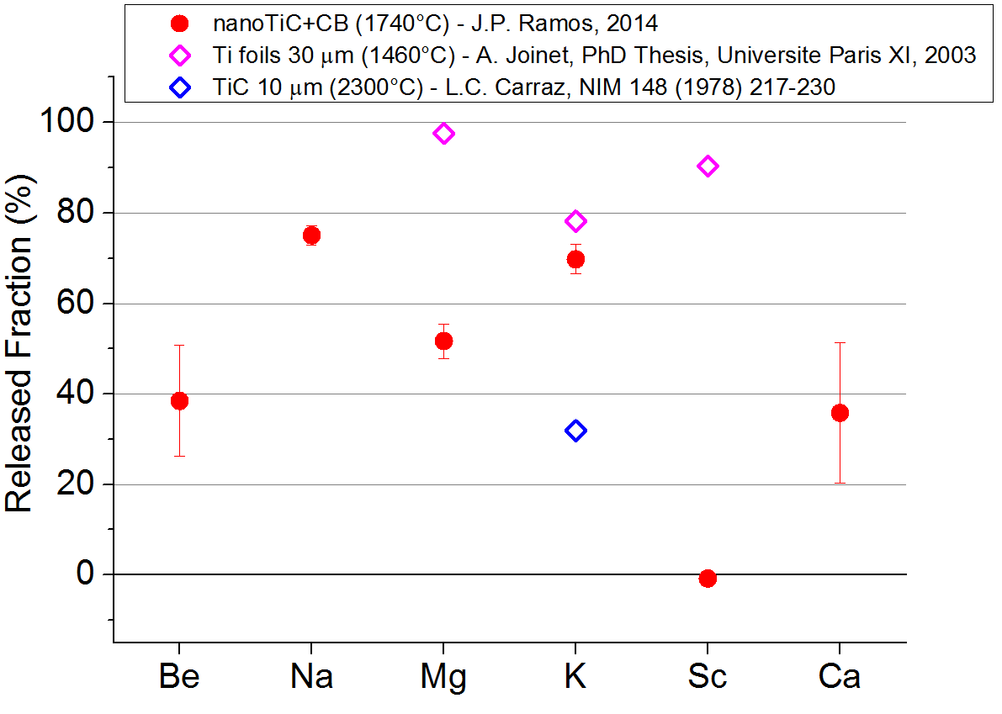
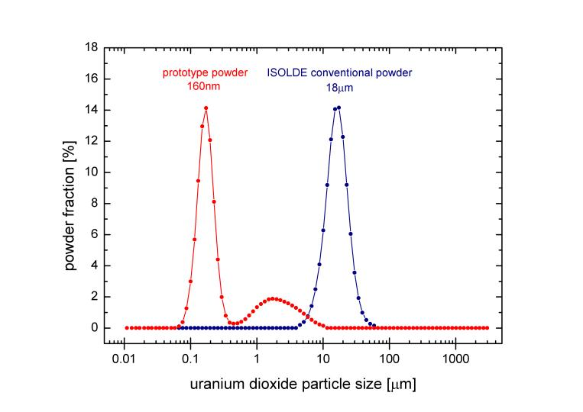
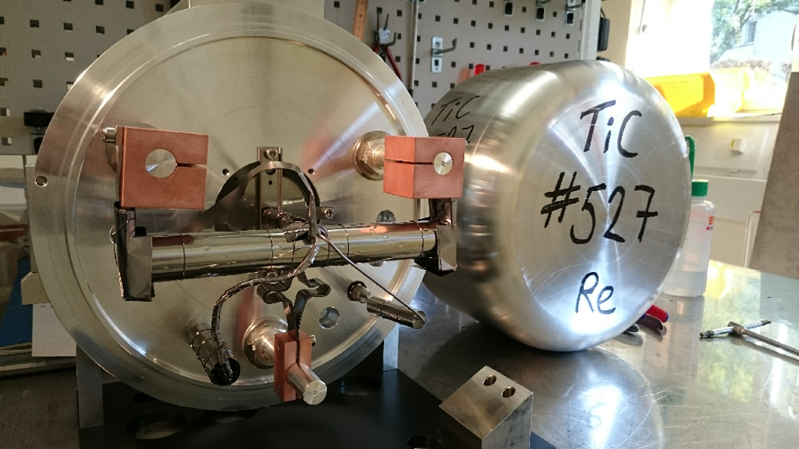
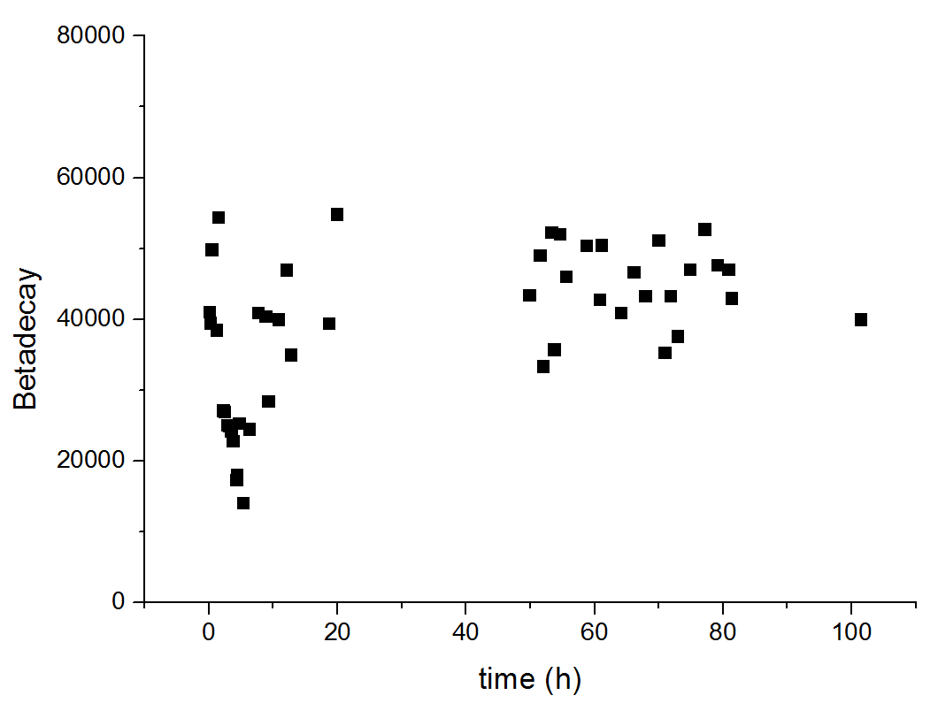
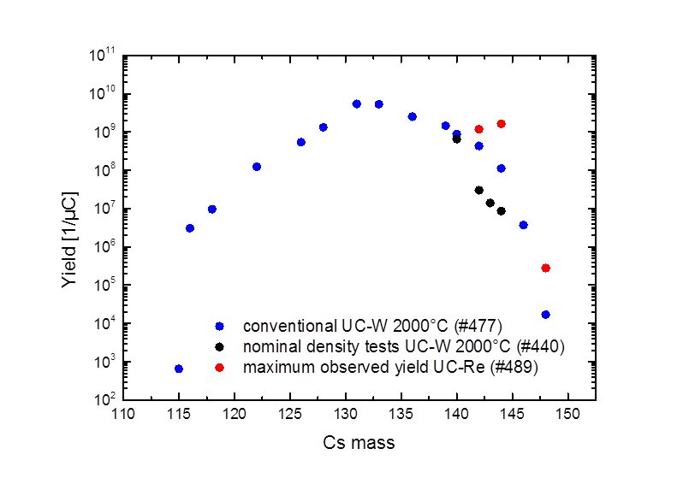
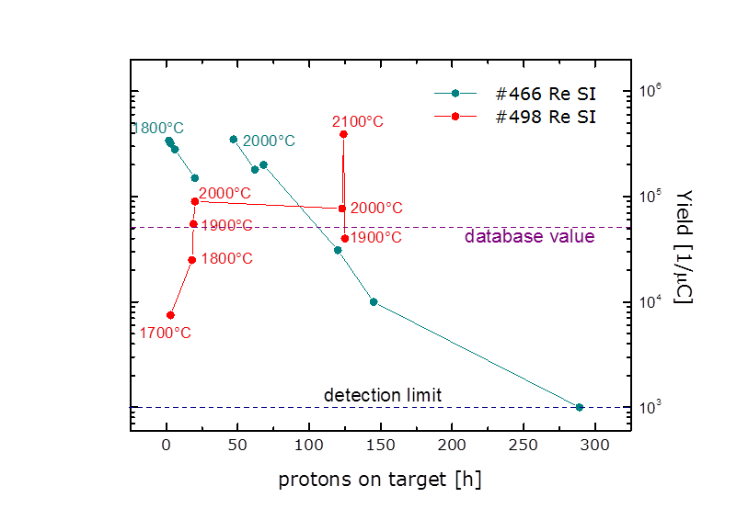
Recent results
Nanomaterials
New UO₂ powder batch : 1st unit UC539
T. Mendonca et al.
NanoUCx+MWCNT (ActILab, ENSAR) has been operated at IPNO-ALTO in Jun 2015
Good and stable yields of n-rich Rb and Cs (99,100Rb, 148Cs)
A. Gottberg et al.
³⁷K beta decay for IS527
Delivered stable 1e6pps 37K
(>8e6 was expected)
J.P. Ramos et al.

Slide 9
Organization
Developments discussed 1x/year at GUI meetings (New website under construction): http://isolde.web.cern.ch/group-upgrade-isolde-gui
Priorities (old):
priority I : approved INTC proposals asking techn. dvlpt + missed scheduled beams
Priority II : LoIS
Priority III : R&D
New Priorities:
Priority I : aproved INTC LoI`s asking for techn dvlpt + missed scheduled beams
Priority II : R&D

Slide 10
Target evolutions
In the past ten years,
the developments have been such that any of the Target and Ion Source units contructed in 2016 won’t be identical to those that were used in 2006.

Slide 11
Team & Collaborations
E. Barbero, B. Crepieux, M. Owen, S. Marzari: (STI-RBS) Target Production, infrastructures
TISD team:
Dr. T. Mendonca : Senior fellow, High power targetry (salt target, LIEBE project) : →Jul 16 (4 months maternity leave)
(Dr.) M. Delonca : LIEBE project : → Feb 17
J. Ballof : molecular beams (8B, carbonyl of refractory elements) : → Dec 17
J. P. Ramos : Target nanomaterials (EPFL) : → Oct 15 +6months
Y. Martinez (KULeuven) : 50% → 2018
WJ Whang (RISP) : → Jul 15
GANIL, IPNO, INFN, (ENSAR2 ?), + TRIUMF, JAEA, Mainz
ITN (neutronics, UCx)
EPFL, Aveiro, (materials)
ESS, CEA, SCK●CEN-Myrrha, SINP, PSI (LIEBE project)
R. Augusto (Fluka team)

