Slide 1

Offline Analysis Framework
OAF
Jean-Jacques Gras, Stephen Jackson, Blazej Kolad

Slide 2
Main Objective
By Automatic Reports [AR] we mean here documents automatically generated on a regular basis from data stored in the Logging/Measurement DB.
The basic principle would be daily Cron tasks, gathering, analysing and synthetizing Beam Instruments records in DB stored during the last 24h, and sending the corresponding summary reports automatically by mail to the corresponding experts or responsible.

Slide 3
Main Objective
By Automatic Reports [AR] we mean here documents automatically generated on a regular basis from data stored in the Logging/Measurement DB.
The basic principle would be daily Cron tasks, gathering, analysing and synthetizing Beam Instruments records in DB stored during the last 24h, and sending the corresponding summary reports automatically by mail to the corresponding experts or responsible.

Slide 4
Main Objective
At the current initial stage, our target is to cover as much as possible all the possible common features in a single process simply based on data set configuration files (as described later).
To do so we are today concentrating on ‘basics’, i.e. Instrument Status Assessments:
  These reports will be targeted to present the ‘current’ status of an instrument family (ie each device of a given family). They should also identify and state clearly any status requiring immediate action and send an alarm (mail) when something looks wrong.
Further step looks possible. We hope to be able to cover properly and commonly instrument aging and calibration. Some examples will also be covered in here.
For the last step, i.e. instrument performance assessment, things become immediately too complicated and specific to justify standardisation effort. We will let this stage to the instrument team by providing them with a way to plug in their code in the framework, already relying on our data extraction, reporting and emailing code. (this door is not yet operational)

Slide 5
Disclaimer
This tool will only look at what happened…
It can only help us to:
  Be aware that something went wrong in our instrument:
    No usage
    Bad usage
    Over usage
    Breakage…
  Be aware that something is aging:
    Calibration evolution
    Status evolution…
It will still be up to us to be proactive with this.

Slide 6
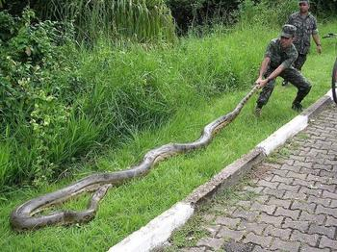
Anaconda & JPyPy:
125+ of the most popular Python packages for science, math, engineering, data analysis ( NumPy, SciPy, Pandas, IPython, Matplotlib, Numba, Blaze, Bokeh..)
Completely free - including for commercial use
Cross platform on Linux, Windows, Mac
Installs into a single directory and doesn't affect other Python installations on your system. Doesn't require root or local administrator privileges
Spyder, Ipython
We use Jpypy for java – python integration
Installed on bdidev2

Slide 7
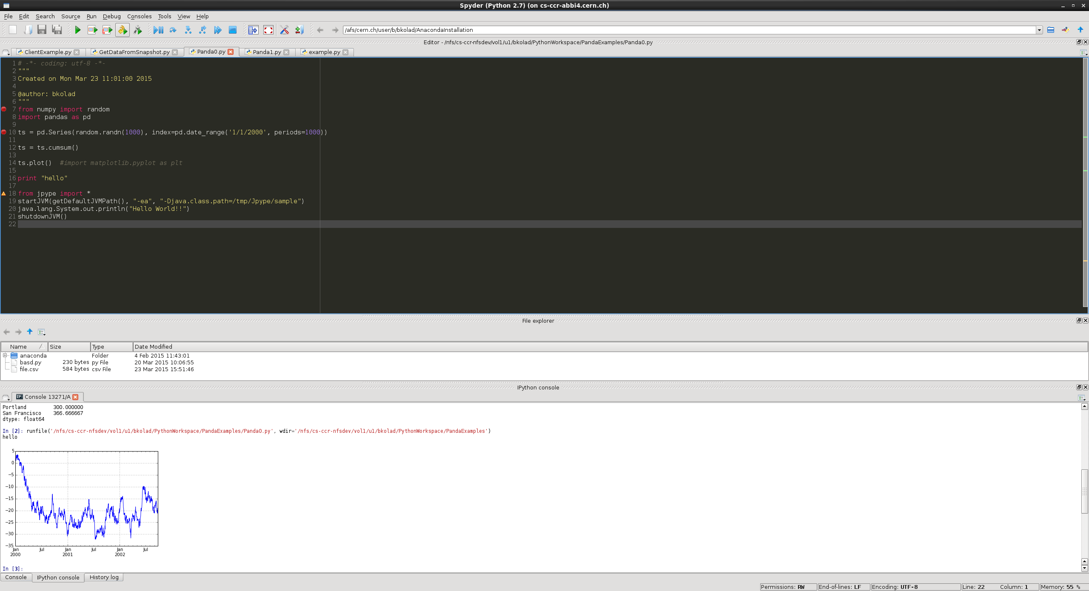

Panda & Spyder

Slide 8
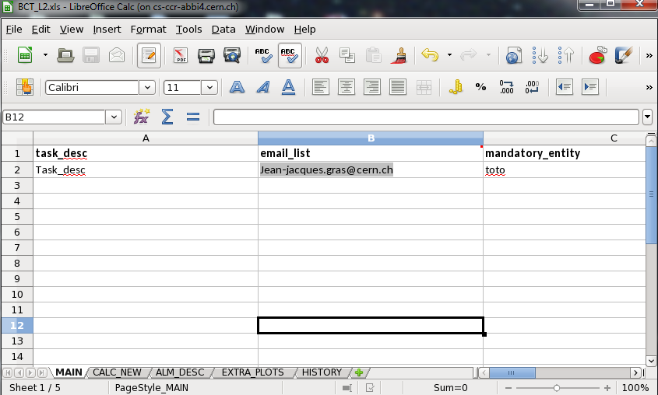
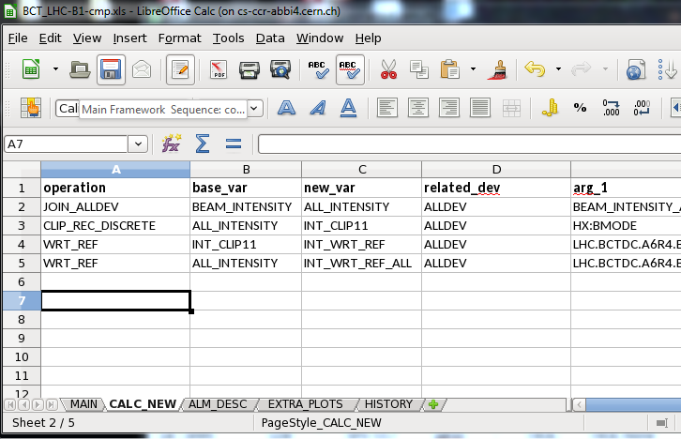
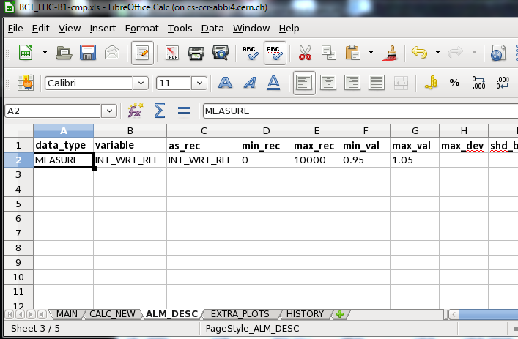
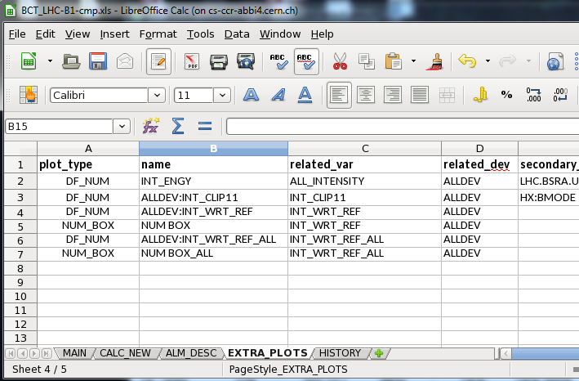
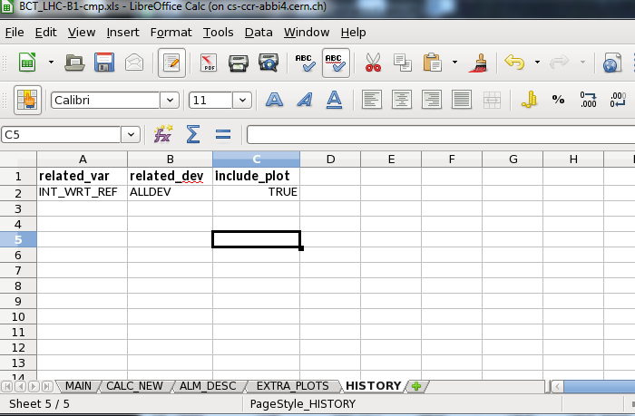
Main Framework Sequence
extract_data() # Get the snapshot data from DB
compute_extra_data() # Compute extra data if any as conf.
make_front_figure() # Make report first common pages
analyse_alarms() # Analyse alarms as conf. (even on extra)
display_alarms() # makes alarm report pages
make_dft_plots() # makes default plot for all variables (opt)
make_ext_plots() # makes extra plots if any as conf.
make_histo() # makes ‘history’ files if any as conf.
run_exp_code() # run expert dedicated code (under disc.)
close_report() # close and save the report file
inform() # send info mail to client as conf.
show_plots() # shows the plot windows (opt)
clean_all() # clean all before to exit.
Green: Based on config file <inst>_<dataset>
Orange: Under internal discussion. Not operational yet

Slide 9
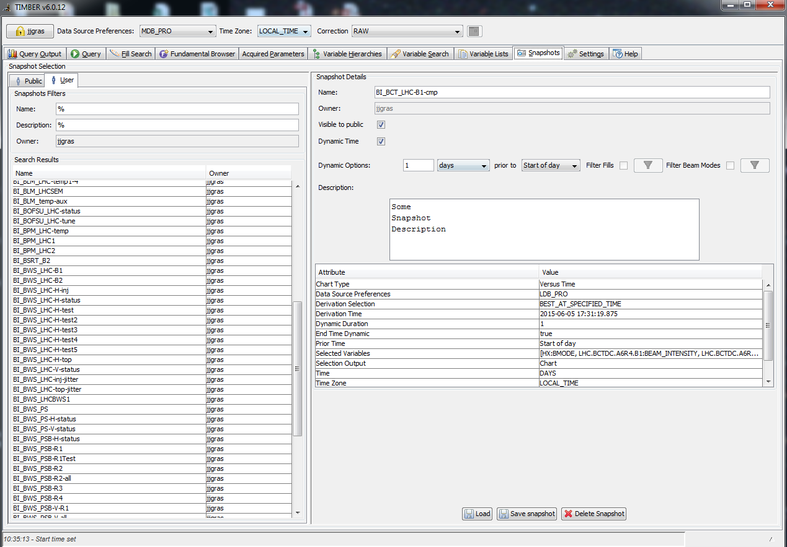
Timber-Snapshots

Slide 10
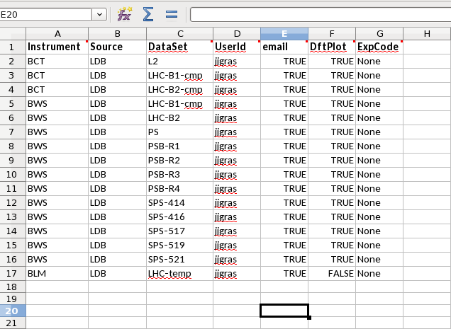
Main Tools: Cron Tasks
The tasks configured in cron task file will be executed sequentially.
We have now cron task sequence executed every morning at 8:00. These are based on dynamic snapshot of DB data covering the full previous day
We could have in addition cron task sequence executed every week or hours if useful…

Slide 11
Main Tools:
Report Repository
Mail sent will contain in addition to a summary of the alarm report:
  A link towards the new report
  A link towards the repository where all reports are stored (http://bewww/~bdisoft/bi_report/)
  A link towards the repository where most recent reports are referred (http://bewww/~bdisoft/bi_report/RECENT/)
  A link towards the repository where most recent reports with alarms are referred (http://bewww/~bdisoft/bi_report/RECENT_WITH_ALM/)
  A link towards the repository where most recent reports without alarms are referred (http://bewww/~bdisoft/bi_report/RECENT_WITHOUT_ALM/)

Slide 12
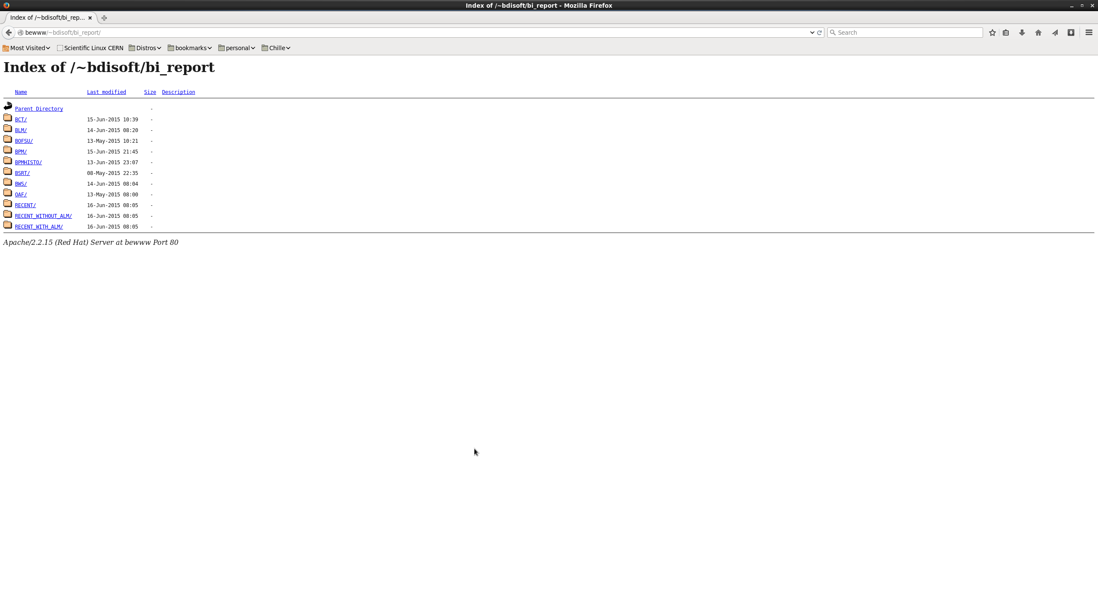
Main Tools:
Report Repository

Slide 13
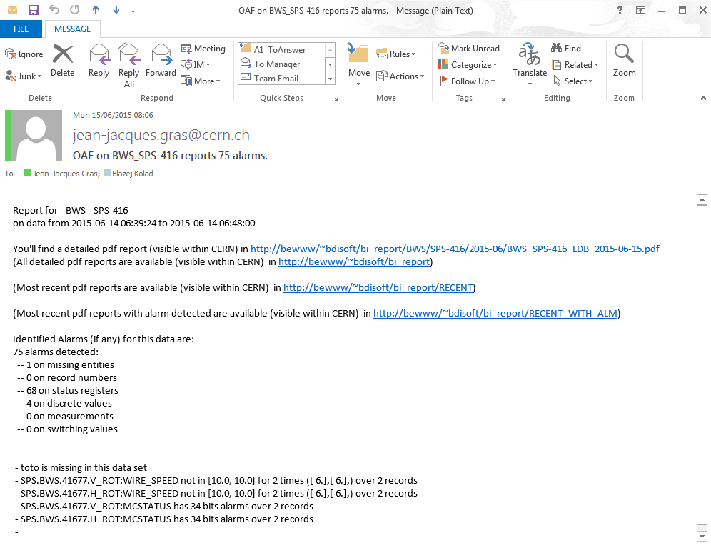
Main Tools: emailing
Once report is done, informative email will be sent to configured recipient with link towards report and summary of alarms

Slide 14
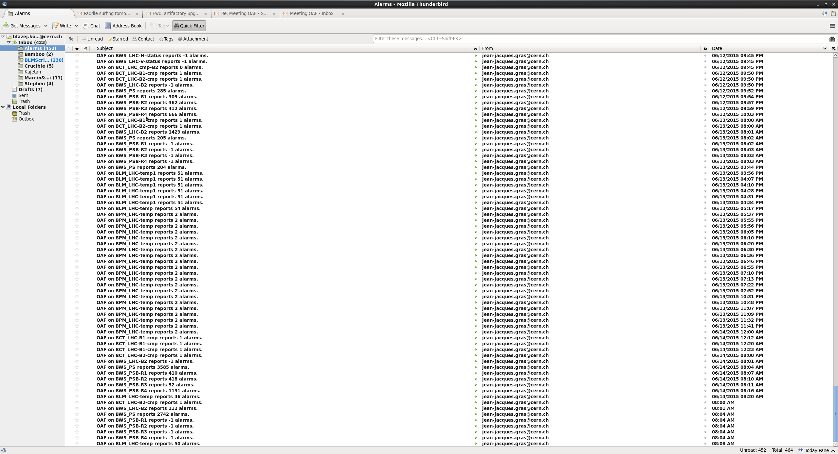
It's working

Slide 15
Coming Next
New stuff, so expect bugs, missing features… but let give it a try and chance as is to cover correctly its first purpose (status and aging) before seeking for more (absolute perf assessment). JJ is available to discuss and implement your wishes for status/aging reports for this first stage. Probably a lot of useful things can already be done there.
Possible complains from CO/DM due to our new activity on their DB.
  We spoke to them. They are aware on our development and methods and will tell us first if they see issues coming on their side. They already also showed that they can help us when we share some interest on the request.
Data extraction prevented by data size
  CO/DM recognize a problem on their side preventing extraction when it should be possible. They are working on it. Some progress done already…
  We should understand on our side that having a lot of details in the DB will slow down or even prevent useful automatic reporting. We should have a good understanding of all the DB configuration features and go for the good compromises.

Slide 16
The Next Steps
Missing and foreseen features:
  History features for easy long term monitoring on NUMERICS and VECTORNUMERICS
  Handling of images (especially with dynamic dimensions)
  Low resolution reports.
  When aging/status reports will be properly covered by a stabilized framework, open the door (via a maintainable/efficient solution) to the configurable introduction of dedicated code by <instr/dataset> developed by expert…

Slide 17
Potential Extra Usage
We could try also to use this tool ‘ONLINE’ during MD
  We could define a short time (ie 15 mn) dynamic DB snapshot to look at the last 15 mn DB recording to check that things are going well
  We could define before the MD a DB snapshot covering the entire MD time frame and play this snapshot during the MD to already see in realtime the data analysis we prepared before.

Slide 18
Reports..

Slide 19
ANNEXES

Slide 21
Main Framework Sequence: make_front_figure
Purpose:
Makes the report front pages with title, description of dataset, list of variables extracted…

Slide 22
Main Tools:
Naming Conventions
In order to make things possible and a little organised, we used (and impose to work with OAF) the following naming conventions.
Each set of data (not when, only what) will be identified by an <instrument ID> and a <data set ID>
<dataSet ID> must not contain the ‘_’ or ‘ ‘ caracters
<instrument ID. Must belong to a predefined list that the OAF team is maintaining
The corresponding Timber ‘snapshot’ (see later) must be ‘Public’ and called: BI_<instr ID>_<dataSet ID>

Slide 23
Main Tools:
Naming Conventions
In order to make things possible and a little organised, we used (and impose to work with OAF) the following naming conventions.
Each set of data (not when, only what) will be identified by an <instrument ID> and a <data set ID>
<dataSet ID> must not contain the ‘_’ or ‘ ‘ caracters
<instrument ID. Must belong to a predefined list that the OAF team is maintaining
The corresponding Timber ‘snapshot’ (see later) must be ‘Public’ and called: BI_<instr ID>_<dataSet ID>

Slide 24
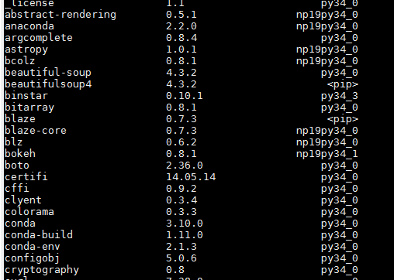
Anaconda packages …

Slide 25
Anaconda packages …

