Slide 1
CERN test-stand for e-lenses
e-beam applications @ CERN (very short)
Test-stand description and options
R&D on beam instrumentation
- overlap monitor
HS – 21-5-2015
BI-TB

Slide 2
Low energy E- beam applications
So far at CERN: electron cooling
- AD, LEIR & ELENA (G. Tranquille et al.)
not further discussed; parameter space is very different,
common technologies + same people
Becoming part of HiLumi baseline
- LHC Halo collimation (S. Redaelli et al.)
Under study for HiLumi
- LHC BBLR (=beam beam long range) compensation (H. Schmickler et al.)
Further request:
- Compensation of space charge effects in SIS18/SIS100
(GSI – FAIR project; P. Spiller et al.)
-> Needs a new feasibility study for CERN:
-> Compensation of space charge effects in CERN PS, PSB
https://accelconf.web.cern.ch/accelconf/p07/PAPERS/THPAN074.PDF
GSI has submitted a request to the German BMBF for funding in order to simulate further details of this compensation. CERN is following (and complementing?) these simulations.

Slide 3
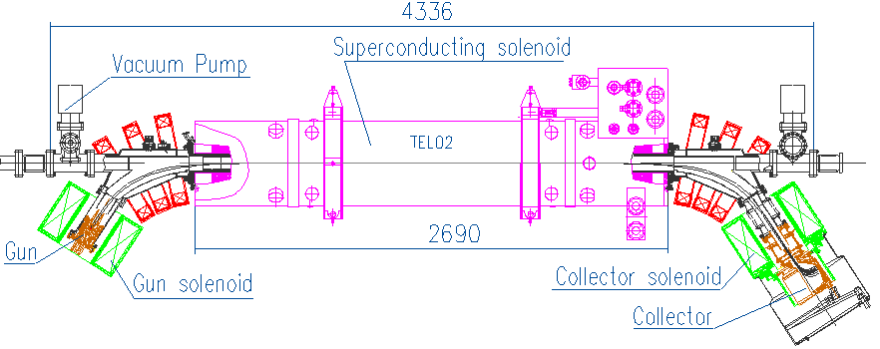
Tevatron electron lens layout
Pulsed, magnetically confined, low-energy electron beam
Tunable transverse halo kicks ~0.1 μrad
6 m total length
superconducting solenoid
1–6 T
protons
electrons
antiprotons
3-m overlap region
collector
Tevatron electron lens
5-kV, 1-A electron gun
thermionic cathode
200-ns rise time
conventional solenoids
0.1–0.4 T
Shiltsev et al., Phys. Rev. ST Accel. Beams 11, 103501 (2008)

Slide 4
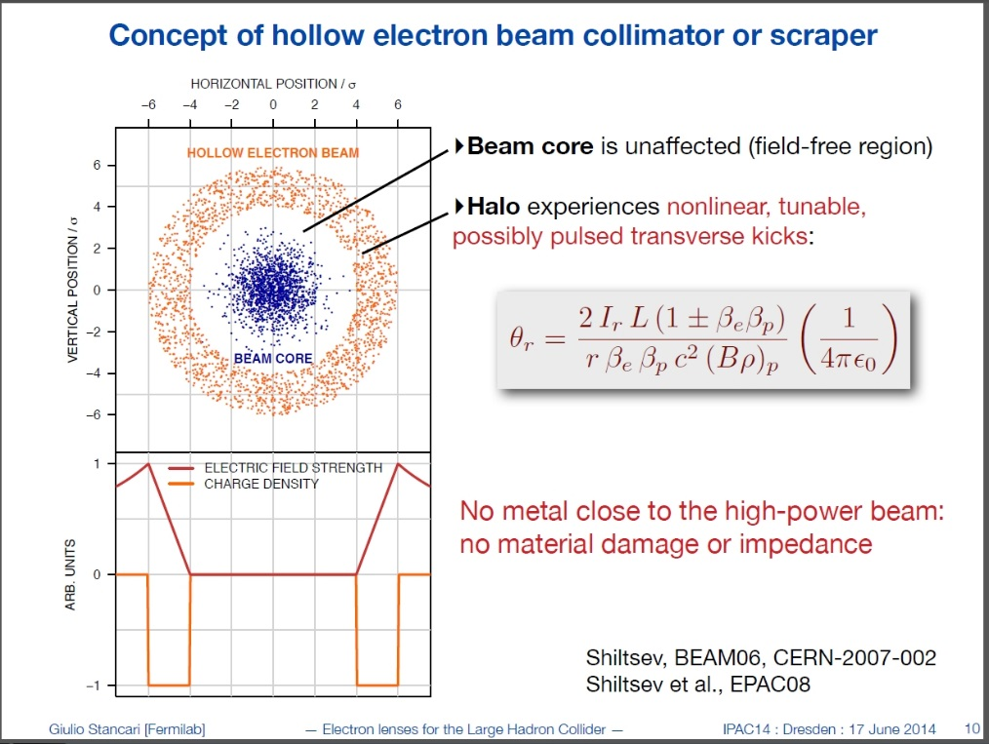
On slide on “LHC halo collimation”
G.Stancari et al., Conceptual Design of LHC Halo Collimation using a hollow electron beam.
Motivation:
Create a in 4-6 sigma of proton beam a depletion zone, by enhancing the diffusion speed onto the primary collimators
Machine protection during crab cavity operation
Safety margin for unexpected accelerator vibrations/
small but frequent earthquakes

Slide 5
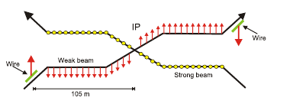
One slide on Long Range Beam-Beam Compensation with a “wire”
Initial proposal based on to J.-P. Koutchouk's note: CERN-SL-2001-048-BI
Four “wire in jaw collimators” will be installed into the LHC during TC 2015/2016. Beam tests will follow in 2016/2017. Effort complemented by Halo monitoring devices in the beam instrumentation group:
- SyncLight coronagraph
- SyncLight High dynamic range observation
Ongoing study to replace physical wire with low energy electron beam.
Conceptual Design expected during 2015 (US-LARP, G.Stancari et al)
Decisions after successful tests with collimators: 2018
Design and implementation for after LS3 operation
~9.3σ

Slide 6
BBLR compensation with «Wire in jaw collimators»
Demonstration project 2015 -2018
2015+2016: will use old wire installations in SPS;
compare simulations with measurements
TS 2016/2017:
Installation of 4 collimators into the LHC with a insulated wire inside the collimator jaw; left&right of IP1, IP5
- will lead to machine experiments
- needs additional instrumentation:
→ coronagraph on one LHC beam
→ high dynamic range camera(s) on same beam or on both beams
→ beam gas profile monitor (10-5…10-6 dynamic range?)
→ Potentially good experimental results plus support from simulations to use BBLR for LHC-Hilumi operation will convert this R&D project into a construction project on the timescale «after LS3»
Decision: expected during LS2
→ Replace physical wirs in collimators by electron beams

Slide 7
Announcement of workshop
November/December 2015
Vicinity of CERN
Small team of beam dynamics experts and beam instrumentation experts
Workshop open for everybody plus speaker invitations
Aim:
Show simulation results on beam-beam effect observables and compare with measurement capabilities of real instruments.

Slide 8
First Primer on workshop contents:
Several presentations on what observables (other than beam lifetime) will be available. Definition of machine experiments (=beam conditions/compatibility with LHC machine protection).
Organized by Sascha Valishev and Yannis Papaphillipou.
T. Mitshuhaski (KEK): a coronograph for LHC for Halo monitoring
A.Fisher (SLAC): Halo monitoring using a HDR camera
B.Dehning (CERN): First results using a beam-restgas interaction monitor for profile measurements.
More to come

Slide 9
E-lens R&D needs for CERN projects
Increase of intensity of electron beam
(presently a few A) by a factor 2 to 5.
Fast modulation of the (DC) electron beam up to 40 MHz
(10% intensity modulation @ LHC for pacman bunches compensation,
intensity modulation following bunch shape for space charge compensation)
Improved diagnostics (e-beam size in the overlap region, overlap of e-beam with p beam)
→ CERN will build a test-stand
a) to do the above R&D
b) to validate the lenses that will be installed into the LHC

Slide 10
Test-Stand: Original plan
Use available space next to the E-cooler test stand at CERN:
(building 236 close to the PS accelerator)
the TEL-2 electron lens gets transported out of the Tevatron to CERN in the second half of 2015:
TEL-2 gets set up as full test-stand for the new overlap monitor, for tests of new e-guns, for intensity increase and for electron density modulation. Experimental program 2-3 years.
In parallel Progress with the design and construction of the Halo cleaning e-lenses, first lens ready for installation during LS2.

Slide 11
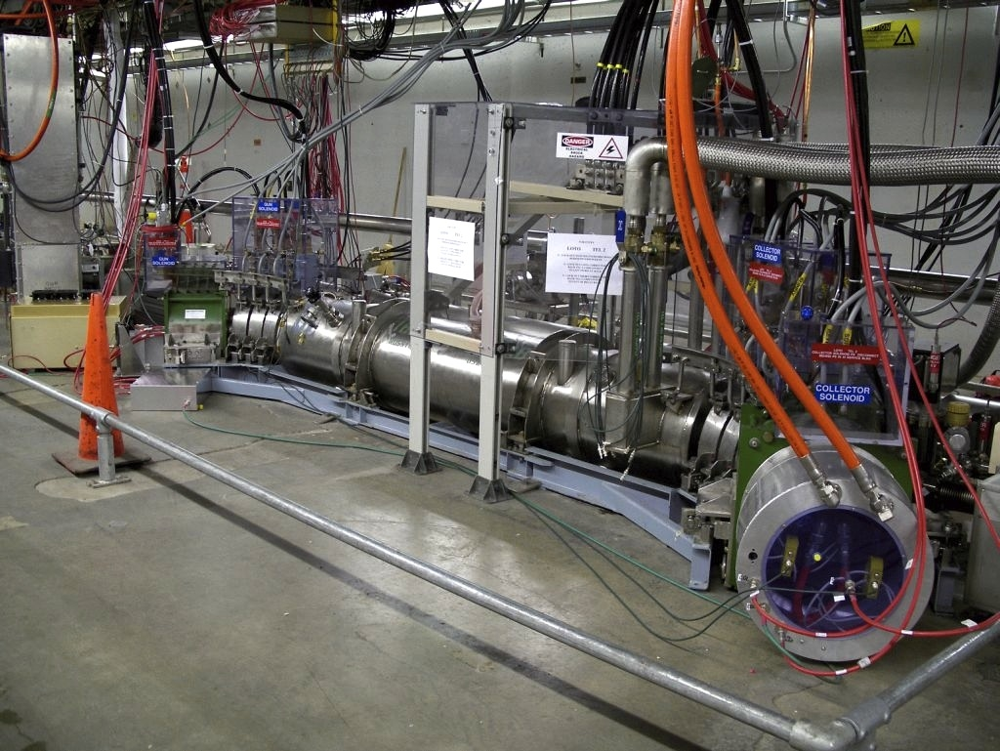

Slide 12
Problems with the original plan:
- Building 236 does not have a cryogenic system. Original hope to work with a local cryo cooler turned out impossible, the nominal 12 Watt cryoload of TEL-2 is very high.
→ but could go to other places at CERN
- TEL2 has been built in Russia, has been approved for safe operation according to US standards, but to get approval in Europe would be a major workload.
Very good preparative study of Paolo Magagnin (CERN, BE-BI-ML)
- Inner bore size of TEL-2 not necessarily compatible with present ideas on overlap monitor devices…more about this later.

Slide 13
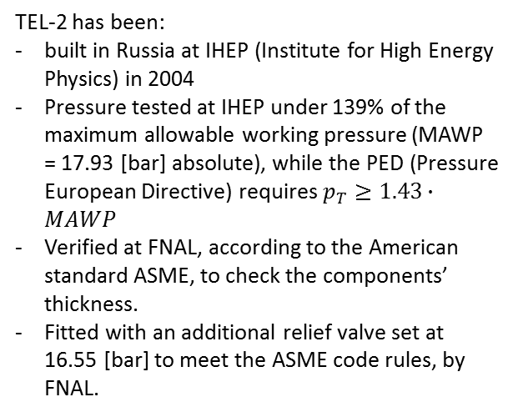
TEL-2: Tevatron Electron Lens
TEL-2 has been:
built in Russia at IHEP (Institute for High Energy Physics) in 2004
Pressure tested at IHEP under 139% of the maximum allowable working pressure (MAWP = 17.93 [bar] absolute), while the PED (Pressure European Directive) requires $p_{T}≥1.43∙MAWP$
Verified at FNAL, according to the American standard ASME, to check the components’ thickness.
Fitted with an additional relief valve set at 16.55 [bar] to meet the ASME code rules, by FNAL.
Notes:
TEL-2 has been built in Russia, operated in the US, and it might be brought to CERN. It has therefore needed the CE marking in order to be used within the European Union.

Slide 14
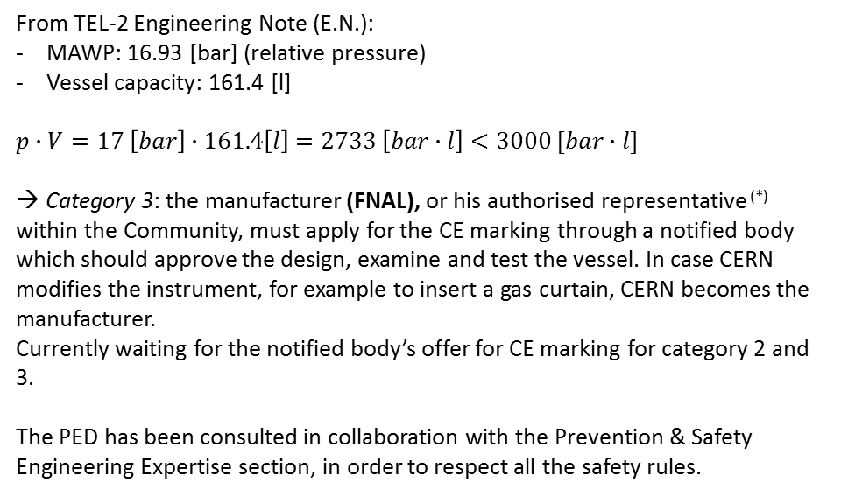
Pressure European Directive 97/23/ED (PED)
At CERN, whenever possible, international standards and norms should be applied.
The PED requires the CE marking of the pressure equipment (if $p≥0.5 [bar]$), and the severity of the conformity assessments depends on the energy stored in the vessel, expressed as $p∙V \left[bar∙l\right]$ and classified in 4 categories.
From TEL-2 Engineering Note (E.N.):
MAWP: 16.93 [bar] (relative pressure)
Vessel capacity: 161.4 [l]
$p∙V=17 \left[bar\right]∙161.4\left[l\right]=2733 \left[bar∙l\right]<3000 [bar∙l]$
→ Category 3: the manufacturer (FNAL), or his authorised representative ^{(*)} within the Community, must apply for the CE marking through a notified body which should approve the design, examine and test the vessel. In case CERN modifies the instrument, for example to insert a gas curtain, CERN becomes the manufacturer.
Currently waiting for the notified body’s offer for CE marking for category 2 and 3.
The PED has been consulted in collaboration with the Prevention & Safety Engineering Expertise section, in order to respect all the safety rules.
Conformity assessment table for not dangerous liquefied gasses.
^{(*)} The authorised representative is someone who has a formal contract with the manufacturer, to represent him within the European Union.

Slide 15
The “cunning” plan
TEL-2 stays in the US
CERN produces a new cryogenic test setup, which will contain only one 1 m long solenoid of nominal strength. This setup will be available after summer 2016.
The full experimental program on electron beam current increase will be the possible on 1m prototype after 2016 (even easier…no bends).
For the first gun developments help from FNAL (teststand with warm solenoid) will be essential.
This R&D setup at CERN will be used as development tool for the length of the projects.
With the experience of this R&D setup CERN will construct the two lenses for beam operation, potentially more lenses later.
Test-stand location to be determined within the next two weeks.

Slide 16
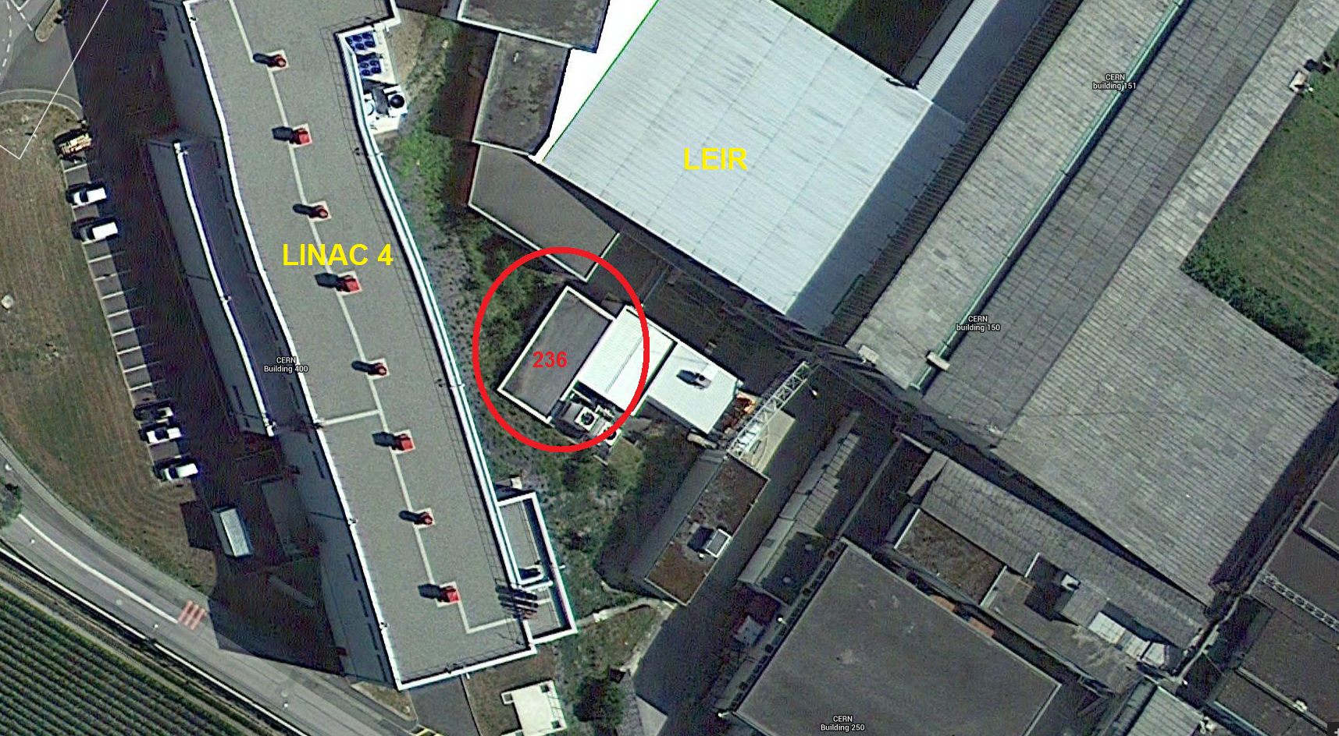
Hall 236
In MEYRIN : Between LINAC4 & LEIR
Notes:
In Meyrin, or: On Meyrin’s site

Slide 17
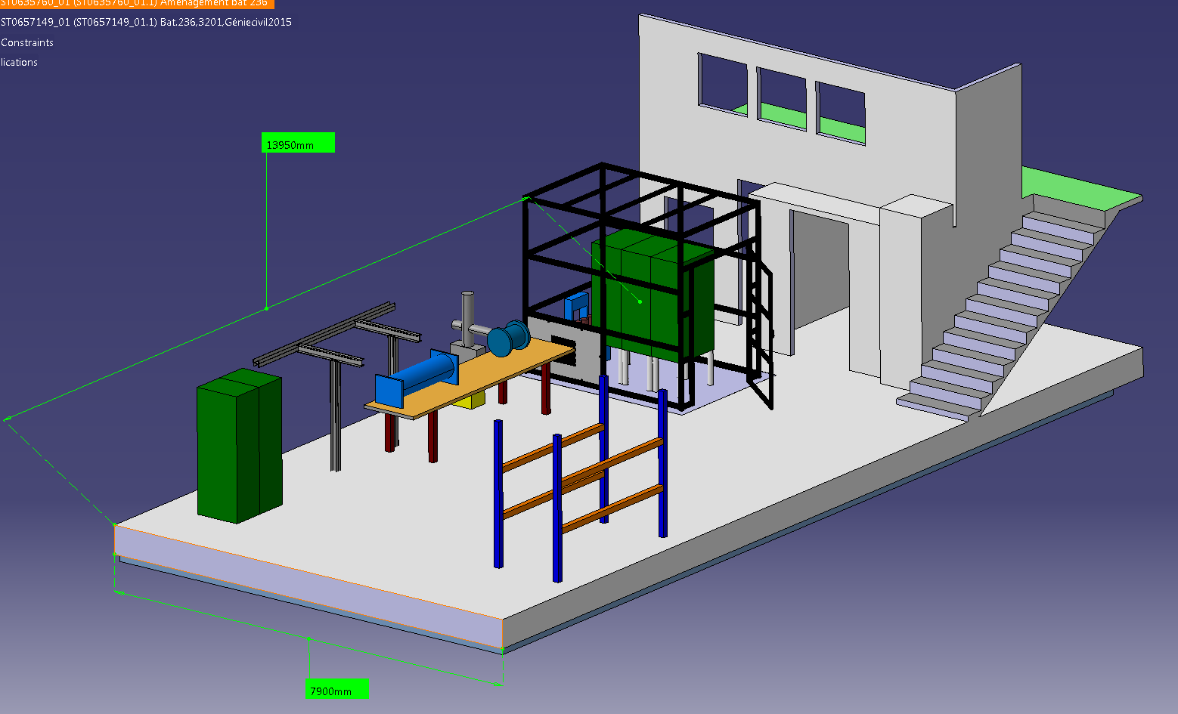
Hall236 with our E-Cooler Test Bench & HV Cage
Notes:
Workshop

Slide 18
Options for test stand location at CERN
Building 236: Local cryo-cooler unfeasible, needs construction of He-recovery line to cryolab. Delivery of cold He in Dewar.
New cryo-plant in Hall 180 (Future test-area for FAIR SIS100 magnets)….will probably not be ready in time for us.
Available space close to CERN’s cryolab. In order to accommodate the testing program, this will likely need an upgrade of the existing cryoplant.
SM18: Ideal, space available, but competition with many other clients.
Buy SC solenoid from industry as “dry magnet” (= no liquid helium) with HTS current leads. All cooled with local compressor→ back to building 236
Decision: Can be expected within next month

Slide 19
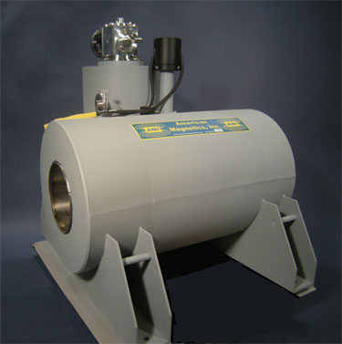
Cryogen-Free Axial Field Magnet System with G-M Cryocooler (from «American Magnetics»)

Slide 20
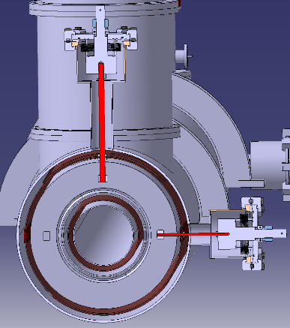
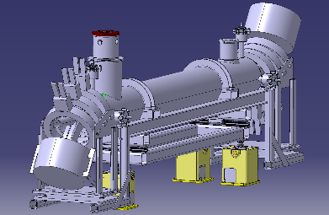
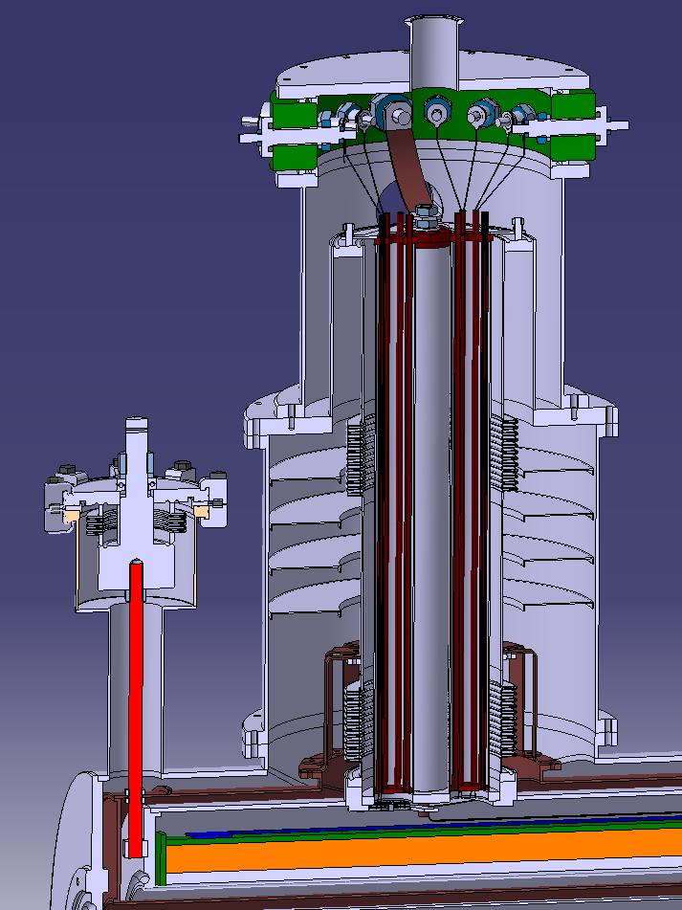
Details on CERN cryo-solenoid: Diego Perini et al. (1/2)
Heat loads (at 4.5 K for a1-m long cryostat + anti cryostat)
Current leads (~250 A) 1 W
Supports 0.5 W
Thermal radiation 0.5 W / m (with superinsulation)

Slide 21
Details on CERN cryo-solenoid: Diego Perini et al. (2/2)
Timeline (order of magnitude)
Winding of one solenoid
Cable procurement:
Tender: 1.5 months
Fabrication: 3.5 months
Winding & curing 1 month
Tests 1 month
TOTAL solenoid 7 months
Construction of one cryostat (in parallel with winding)
Components 2 months
Assembly 3 months
Solenoid into the cryostat
Assembly 3 months
Tests 1 month
Total 1 cryo-solenoid ~ 11 months
(1 year including installation in the test area)

Slide 22
R&D plans
E-beam intensity increase: Has well started with the design of new e-guns… EN-MME
Amplitude Modulation of e- beam. Not started yet
Instrumentation R&D: Overlap Monitor
= measurement of e-beam AND p-beam
Essential: For Halo Collimation: yes, For BBLR compensation: no
- Active element in machine protection: needs independent verification of availability…even part of interlocks
- Halo collimation during machine transitions: acceleration, beta-squeeze: Needs verification (at least post mortem) of overlap. Time resolution: better than 10 seconds. Poor contrast and resolution acceptable.
→ launched MP team to get functional specifications

Slide 23
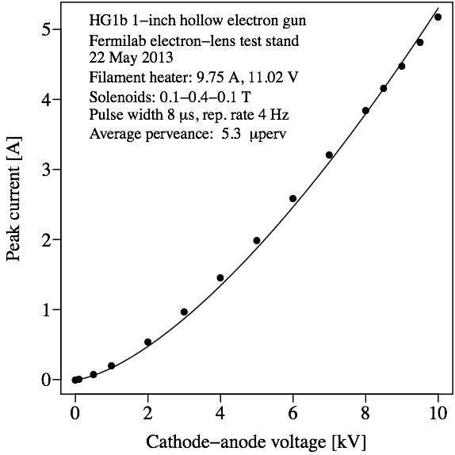
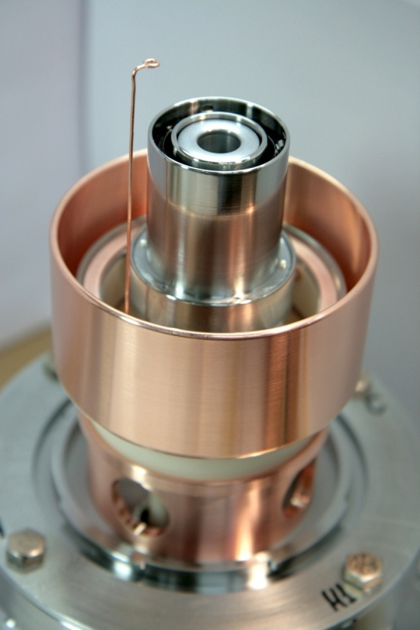
Hollow electron gun (1)
New gun needed for higher current and adjusted electron beam size
First prototype designed, built and tested at Fermilab can provide 5A.
Tungsten dispenser cathode with BaO:CaO:Al2O3 impregnant, 1400 K
First prototype of
hollow cathode
Prototype yields
5 A at 10 kV

Slide 24
Options for Overlap Monitor
Want 2 D imaging: Not only 2 projections (profiles) !
Strong solenoid field excludes all technologies using the observation of charged particles
Electron backscattering a la RHIC? (next slide)
→ due to the spread of back scattered electrons difficult to reconstruct overlap as 2 D image.
Existing monitor yields the overlap integral as a single count rate.
Fluorescence Monitor (Aura borealis inside the LHC)
Can profit from a development made for CLIC = gas jet curtain as “screen” (Adam Jeff et al.; Liverpool University)

Slide 25
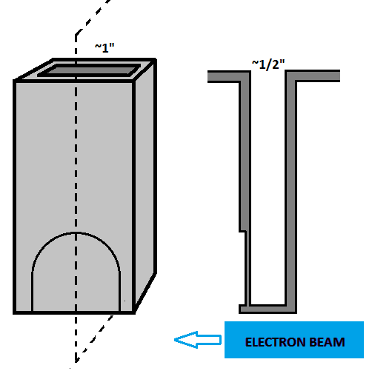
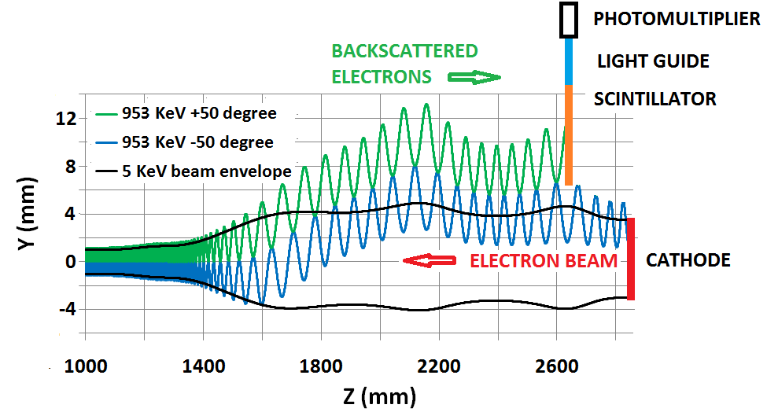
Schematic of the detector and of the electron trajectories, RHIC e-lens overlap monitor
The electrons, scattered in small impact parameter collisions with the ions, reach the detector located close to the gun after traversing a thin vacuum window
~1 to ~20 MeV
The upward trajectory drift is due to the horizontal bend.
ION BEAM
(~5 keV)
End of ~2 m long,
6 T solenoid
5 keV electron beam envelope

Slide 26

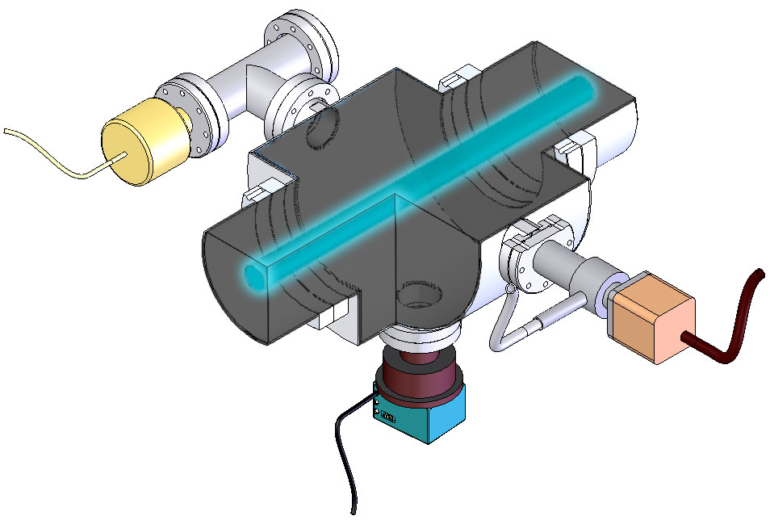
N₂-fluorescent gas
equally distributed
Vacuum gauge
Blackened walls
Valve
150mm flange
Ion beam
Viewport
Lens, Image-Intensifier
and CCD FireWire-Camera
adam.jeff@cern.ch Fluorescence Monitor
Sample schematic of a standard fluorescence monitor
Measures X and Y profiles separately, not 2D beam image
Needs gas concentrated in a thin sheet at an angle towards the particle beams

Slide 27
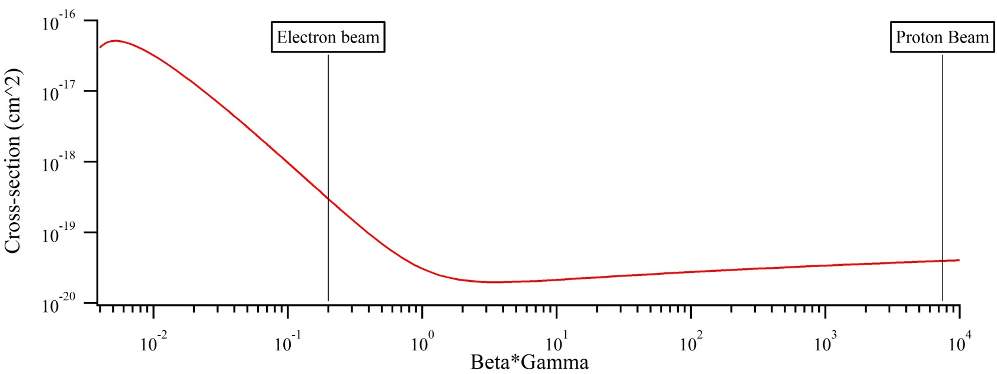
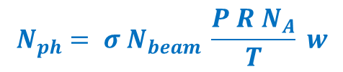
Number of photons produced
gas jet pressure
Number of beam particles
width of gas jet
Number of photons
produced
$$N_{ph}= σ N_{beam} \frac{P R N_{A}}{T} w$$
cross-section
Number density of gas jet
Fluorescence cross-section scales with βγ following Bethe-Bloch curve:
σ = 4x10⁻¹⁹ cm²
σ = 5x10⁻²⁰ cm²

Slide 28
Number of photons produced
gas jet pressure
Number of beam particles
width of gas jet
Number of photons
produced
$$N_{ph}= σ N_{beam} \frac{P R N_{A}}{T} w$$
cross-section
Number density of gas jet
For a gas jet of 10⁻⁶ mbar and 1mm thickness:
 | Proton beam | Electron beam
Beam energy | 7 TeV | 10 keV
Beam intensity | 2748 bunches of 2.2e11 protons | Continuous 5A
Photons produced in 25ns | 1760 | 50 000
Photons produced in 20ms | 1.1e9 | 4e10

Slide 29
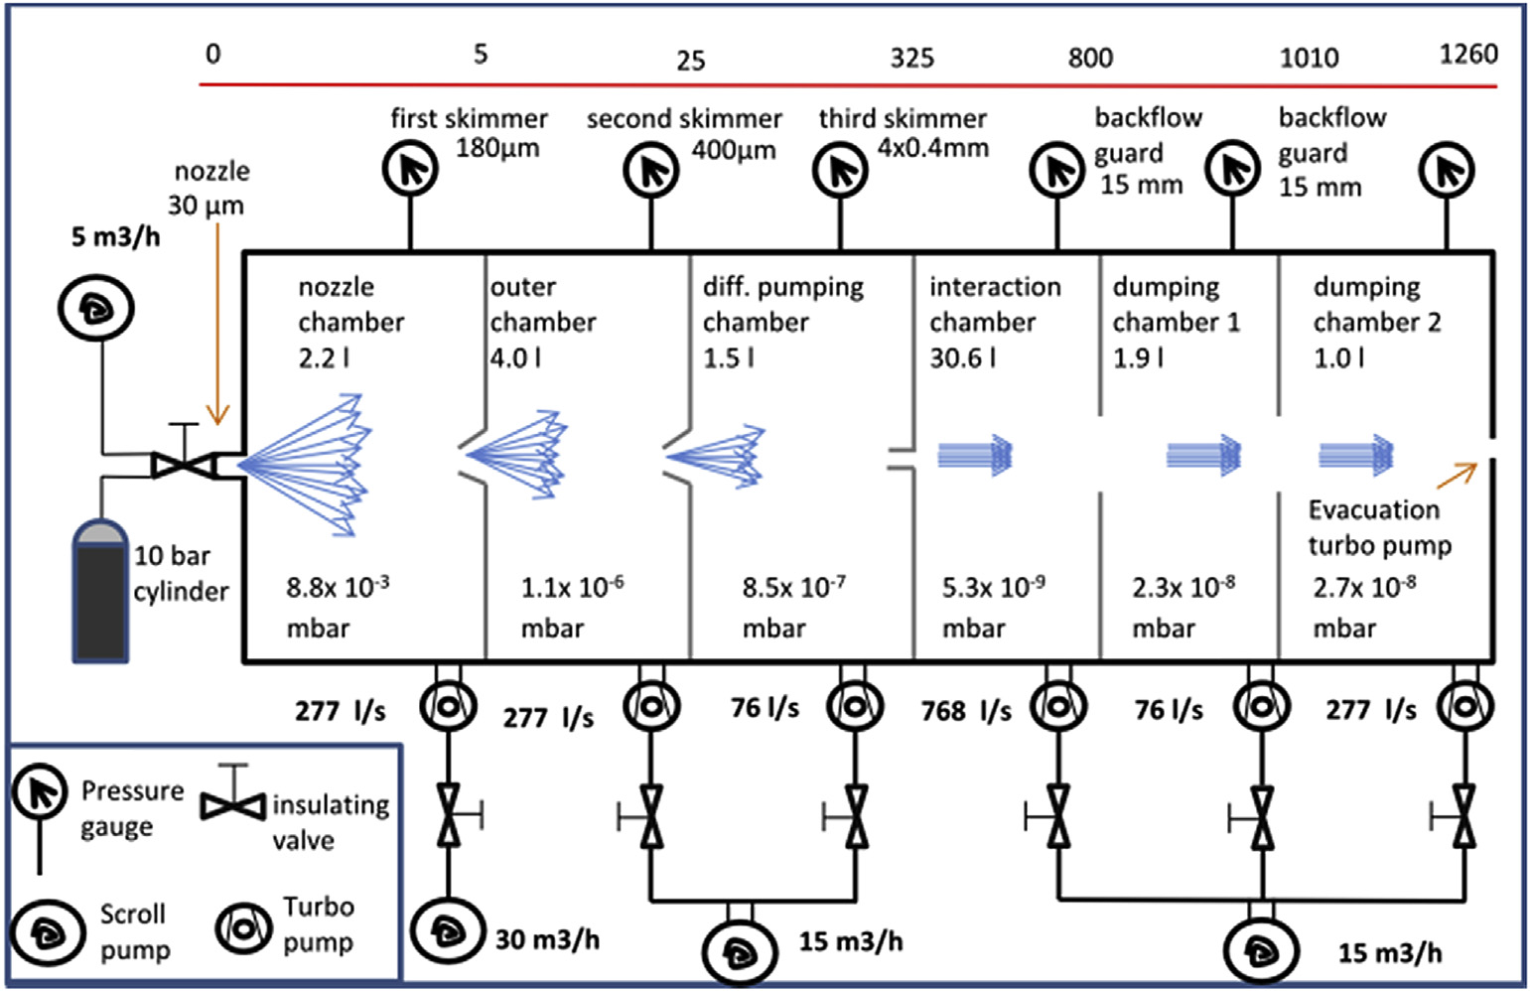
adam.jeff@cern.ch Gas Jet Monitor
Differential pumping for 12 orders of magnitude
Gas jet collected on opposite side of beam pipe – minimal load to vacuum system
Curtain-shaped jet acts as a screen for 2D beam imaging

Slide 30
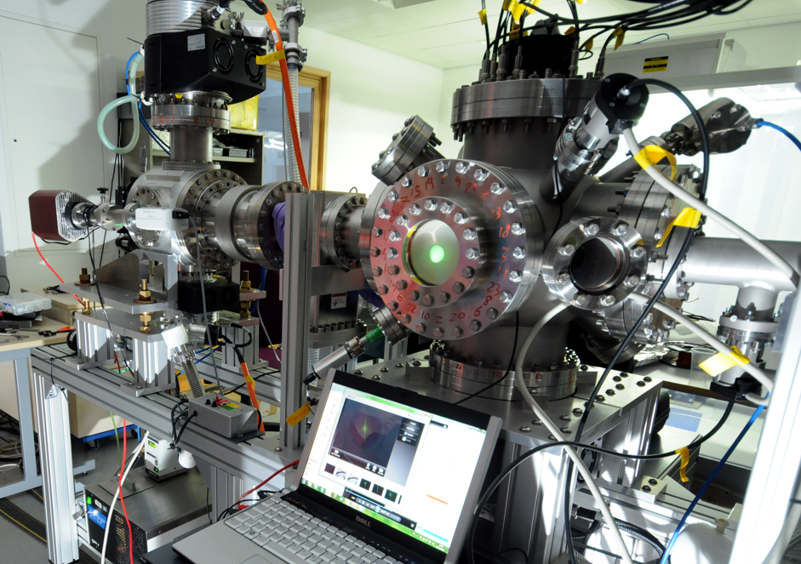
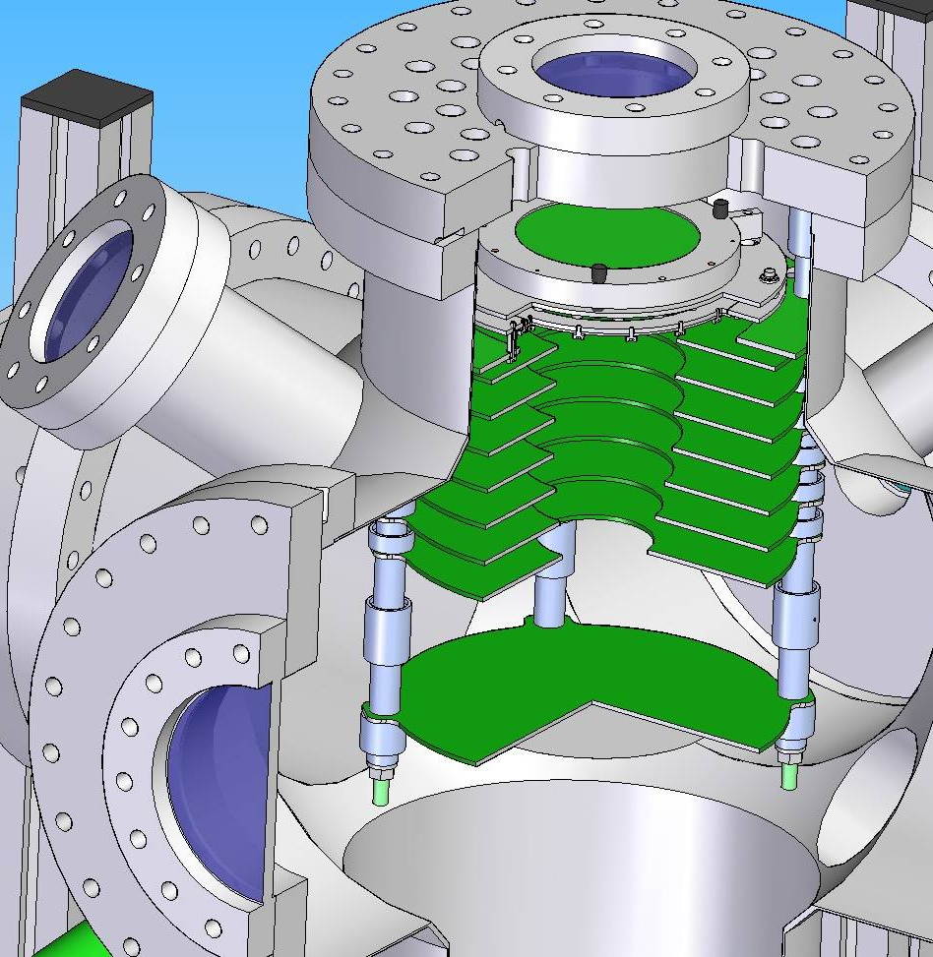
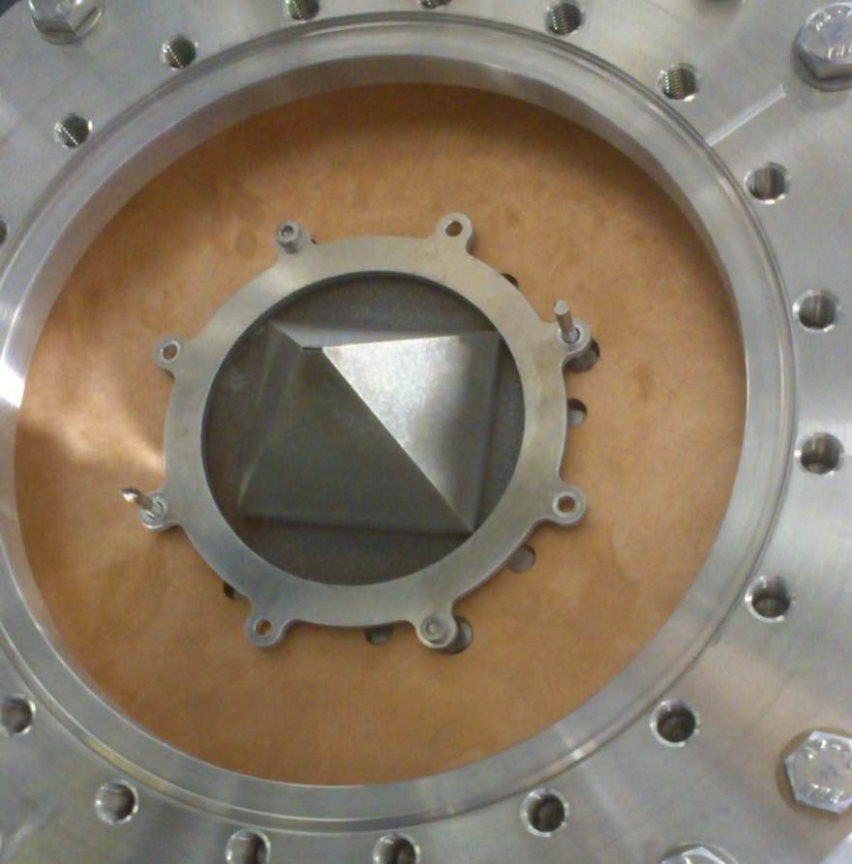
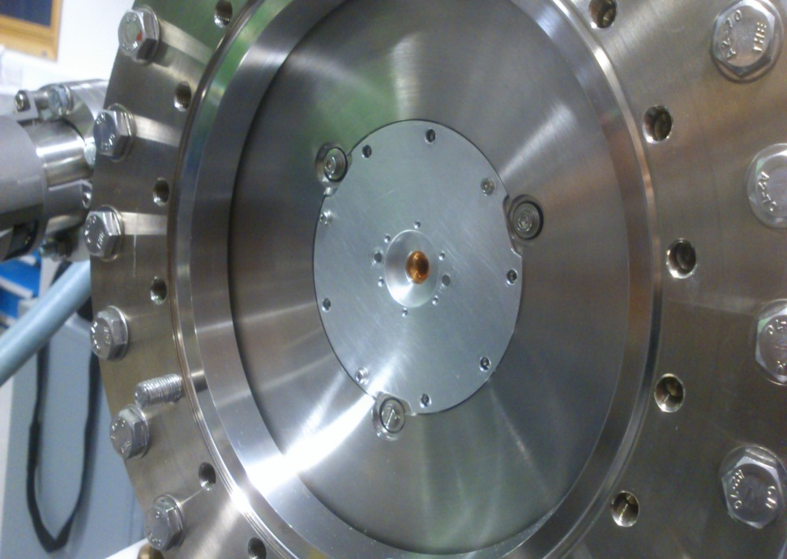
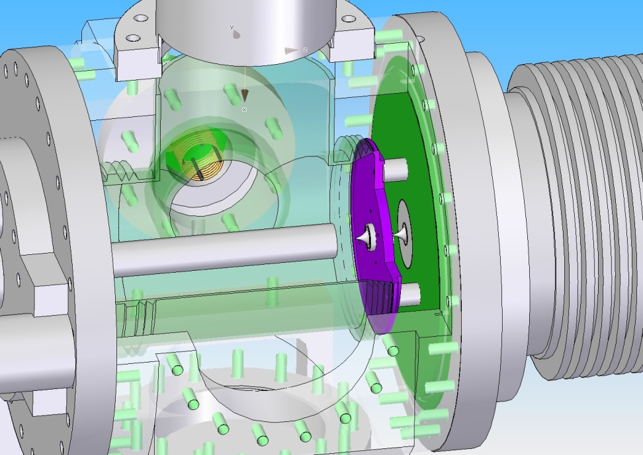
Gas jet formation
Reliable alignment and operation demonstrated
Pulsed jet mode
Gas jet characterisation
Skimmer tests for thinner jet ongoing
Jet dumping optimisation
adam.jeff@cern.ch Gas Jet Tests at Liverpool

Slide 31
Perpendicular optics
camera
+ Higher light intensity
+ Least space required
- Resolution depends on jet thickness
Particle beams
Gas Jet (into screen)
adam.jeff@cern.ch Gas Jet Geometry
Forward optics
camera
+ Best resolution (least dependent on jet thickness)
- Lower light intensity
- Specially made chamber
Particle beams
Gas Jet (into screen)

Slide 32
Monitor at end of solenoid:
+ Easier integration, access
+ More space for efficient pumping
- E-beam expands at edge of solenoid:
is measurement meaningful?
adam.jeff@cern.ch Monitor Integration
Monitor in middle of solenoid:
+ More direct measurement of e-beam shape
- Needs ~10cm separation of solenoid parts
- Needs 3 ‘tunnels’ in the cryostat
- Difficult access: shaping skimmer,
first lens inside cryostat

Slide 33
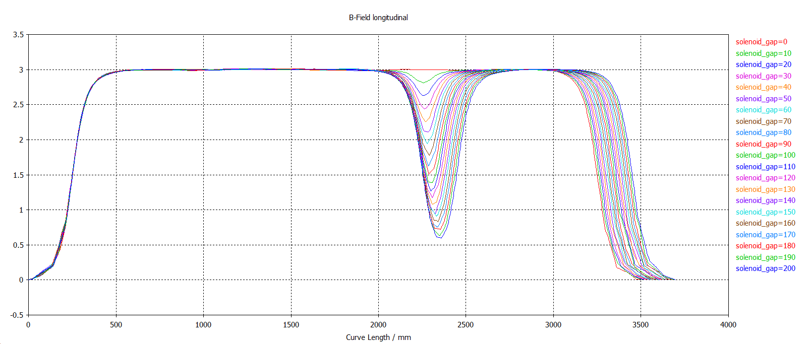
Gap in solenoid (Adam Jeff…confirmed by Giulio)
Field on axis with two solenoids of 2m and 1m
First solenoid starts at z=250mm
Gap in mm shown on right
Simulated for solenoid field=3T but should scale linearly
Very simplistic, ignores gun & collector solenoids, bends, beam pipe and other components.

Slide 34
Summary
E-lenses activity quickly rising at CERN. +International interest.
Halo collimation lenses (two) on their way to become part of HiLumi baseline.
Test-stand options at CERN will be agreed soon.
Most urgent: Get Halo-Monitoring projects set up to be ready end 2016 → TB autumn 2015
Support SPS wire measurements
Prepare LHC wire in jaw collimator installations
Overlap monitor: Start simple at the edge of SC magnet, more sophisticated arrangements if first prototype works.

