Slide 1
US CMS OT Meeting June 4, 2015
Received Bump bonded arrays from UCD/CVI at Fermilab
Measuring flatness as requested by CERN
Talking to RTI about making another set using Cornell wafers
  3 wafers will go to KIT for other studies
  We should begin fabrication of more wafers
June 18,19 meeting at Brown
Focus on details of fabrication, discussion of institutional responsibilities
Results in a proposal to US CMS with institutional intentions?
Fabrication R&D this summer – define areas at CERN and Brown
We need to have a critical mass at Brown – encourage engineers to attend.

Slide 2
Novati Wafers
Two wafers were diced
500 micron thick p-spray + p-stop
725 micron p-stop only
24 pieces/wafer
We can send these parts to testing sites. We should be able to connect these more easily to smaller probe stations and readout systems.
Fermilab now has the capability to laser dice these sections, so we can trim parts as needed.

Slide 3
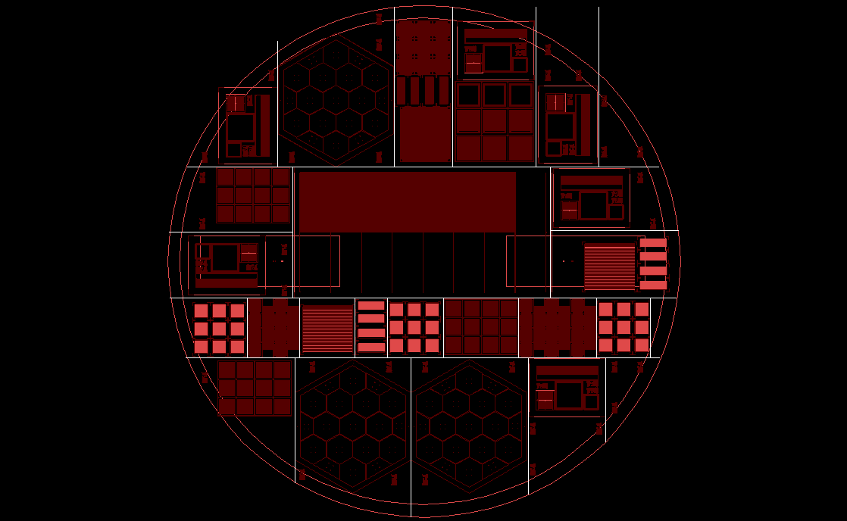

Slide 4
Dummy PS modules
We plan to produce ~10 dummy PS modules for thermal testing and distribution to
Collaborators
We should document the placement of heaters and construction techniques
Lead the RTDs and heaters to standard connectors.

