Slide 1
TDIS Glidcop Frame + CuNi Cooling Circuit
Thermo-Mechanical Studies
07.07.2015
I. Lamas Garcia (EN-STI-TCD)
Draft
EDMS xxxxxxx

Slide 2
introduction
Scope:
Thermo-mechanical study on TDIS low density jaws (frame + cooling circuit)
Simulation Parameters:
Beam: LIU-BCMS beam
Protons per pulse: 288 x 2.3x10¹¹
Pulse time = Simulation time = 8.175us
Impact: Accidental, miss-kicked beam impacts on TDI with central impact parameter. Secondary showers on frame.
Consideration:
Geometry from L. Gentini
1° and 2° segment analysed
Frame on Glidcop Al-15. Cooling circuit on CuNi.
Elements brazed as bonded contact. Rest are frictionless clamped.
Both fluka files incorporated at the same time in the APDL

Slide 3
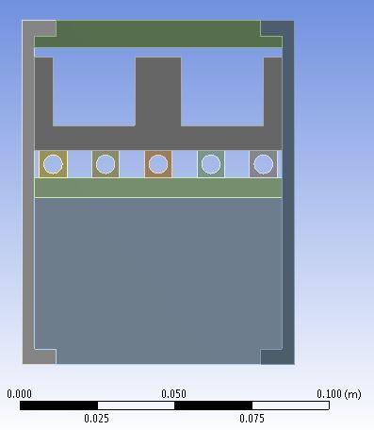
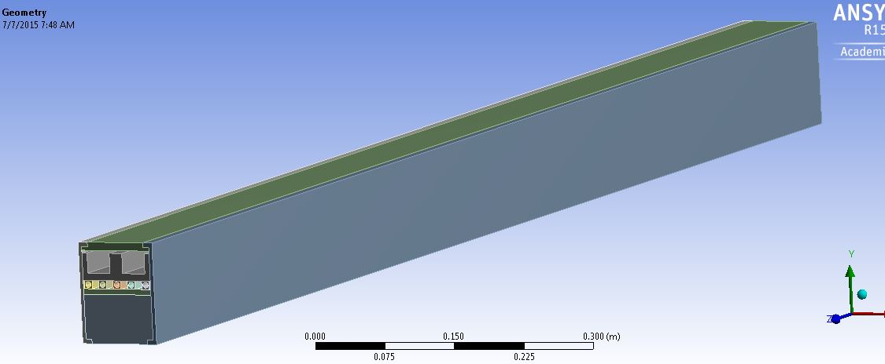
Jaw model

Slide 4
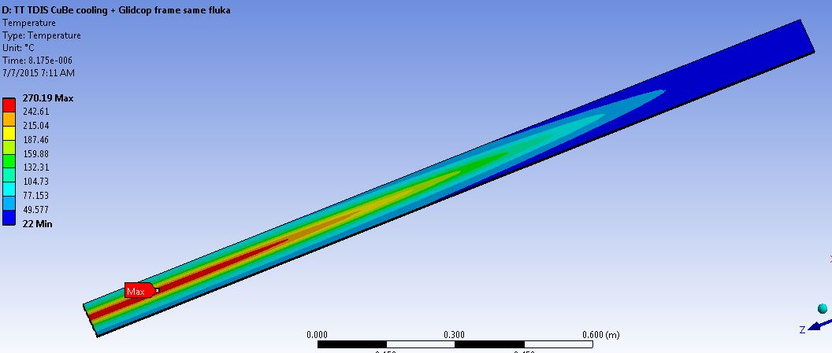
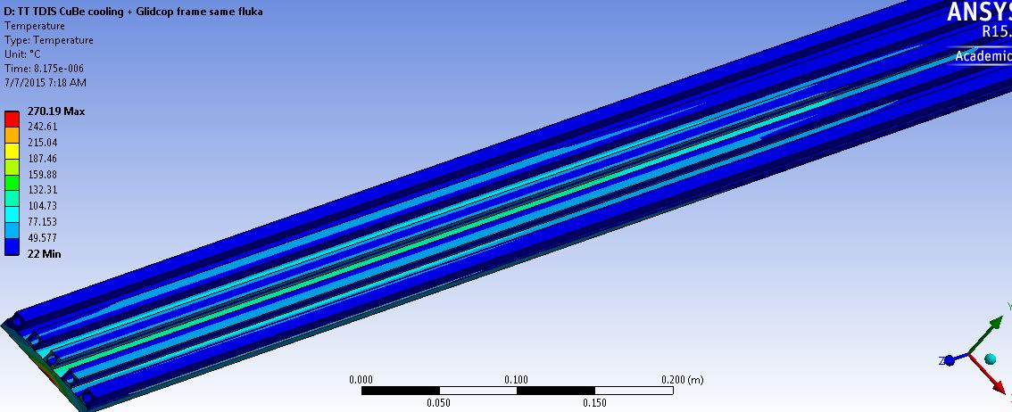
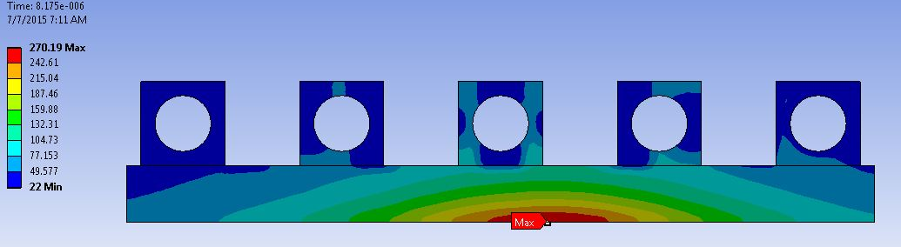
First Tdis segment
Temperature Max =
270C on Glidcop frame
At 1550mm from upstream

Slide 5
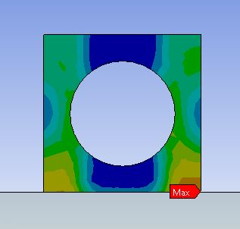
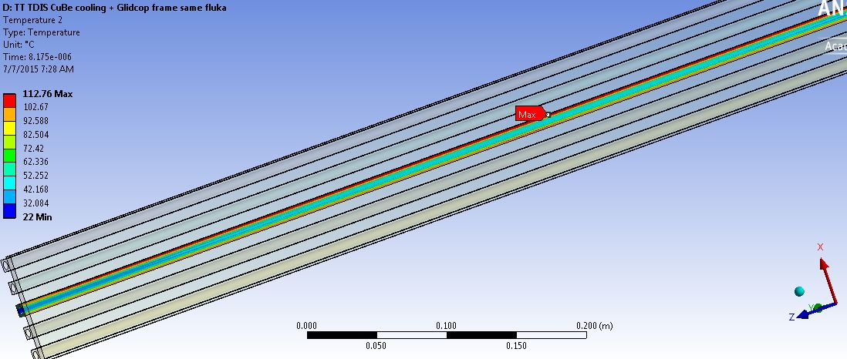
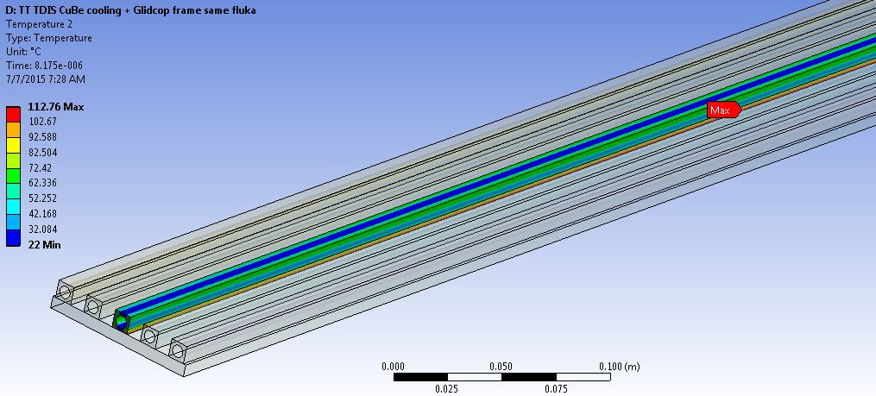
First Tdis segment
Temperature Max =
113C on hottest pipe of cooling circuit, on brazed surface with glidcop frame
At 1250mm from upstream

Slide 6
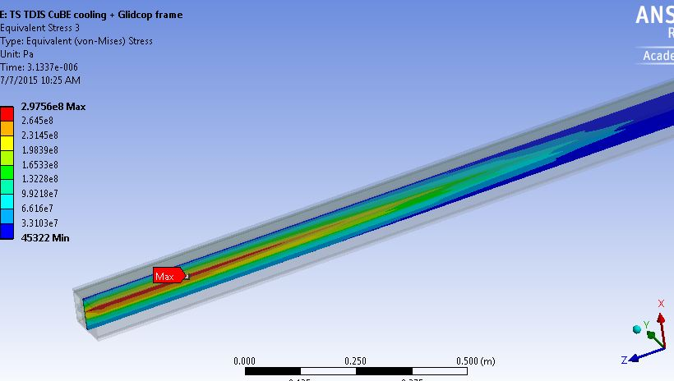
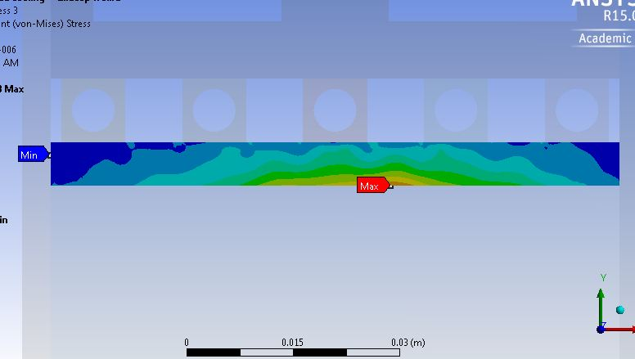
First Tdis segment
Max Eq Stress= 390MPa on glidcop plate

Slide 7
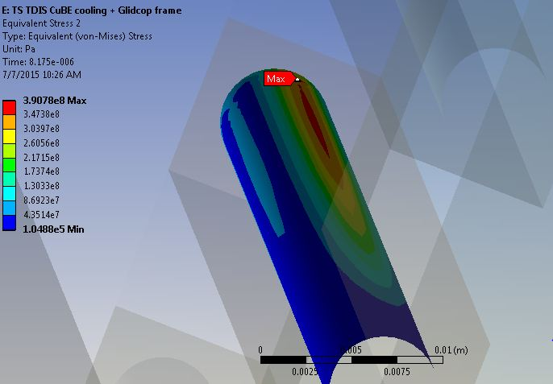
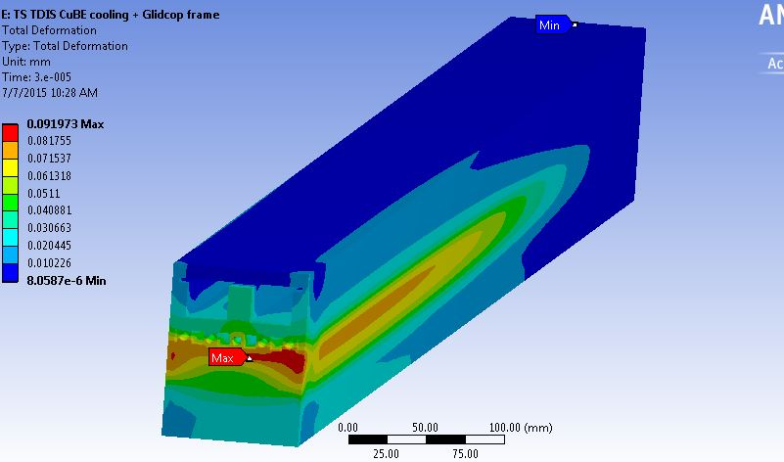
First Tdis segment
Max Eq Stress= 390MPa on pipe

Slide 8
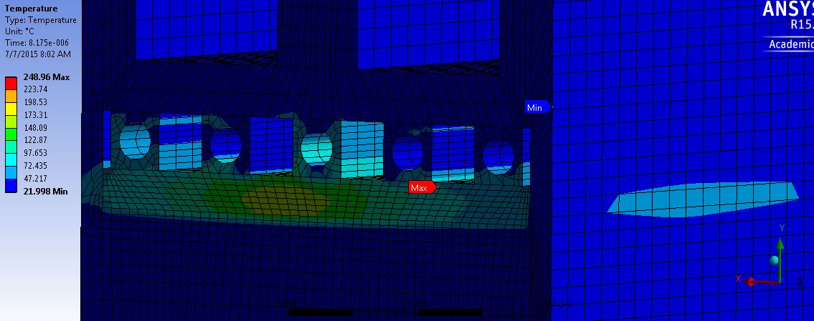
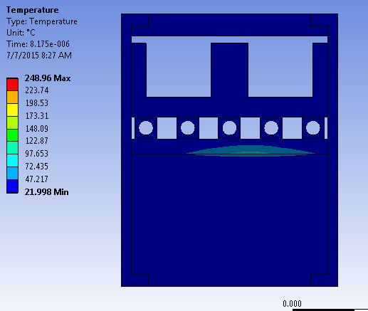
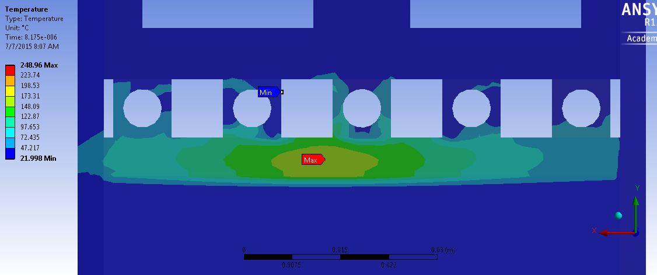
Second tdis segment
Temperature Max =
250C on Glidcop frame
At 320mm from upstream
Through downstream

Slide 9
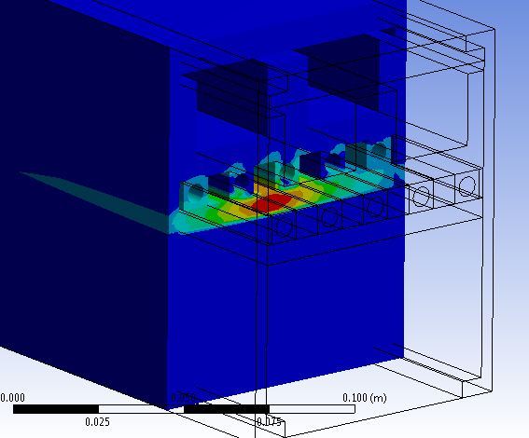
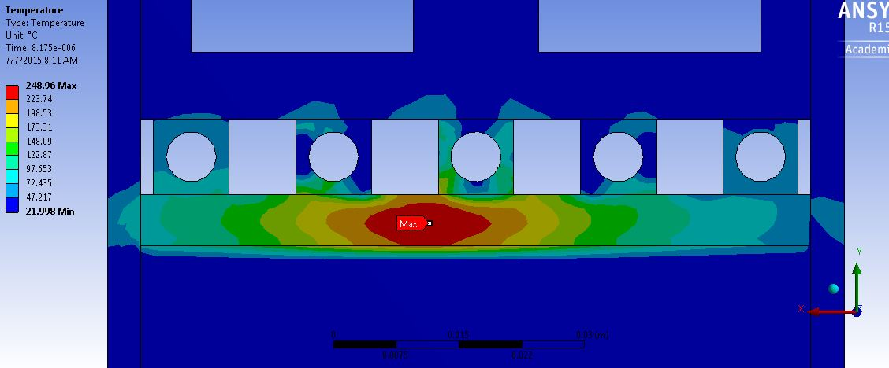
Second tdis segment
Temperature Max =
Section cut

Slide 10
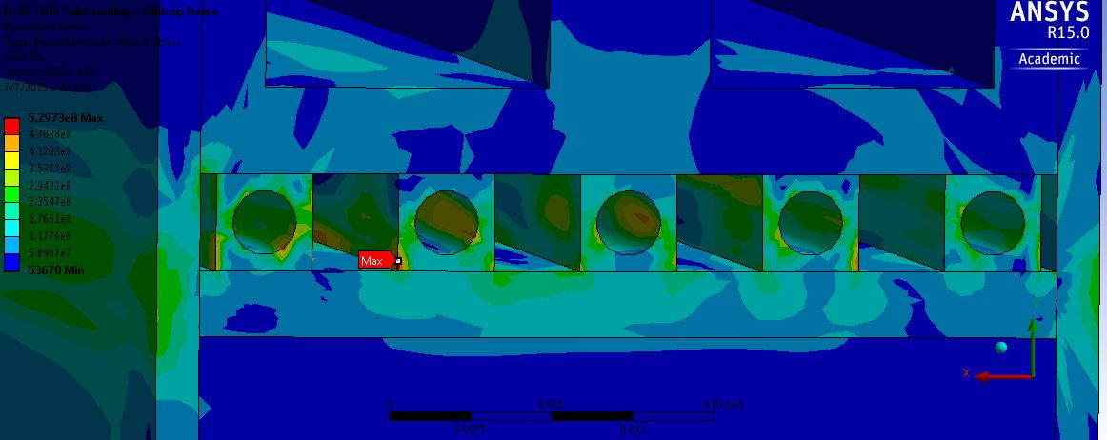
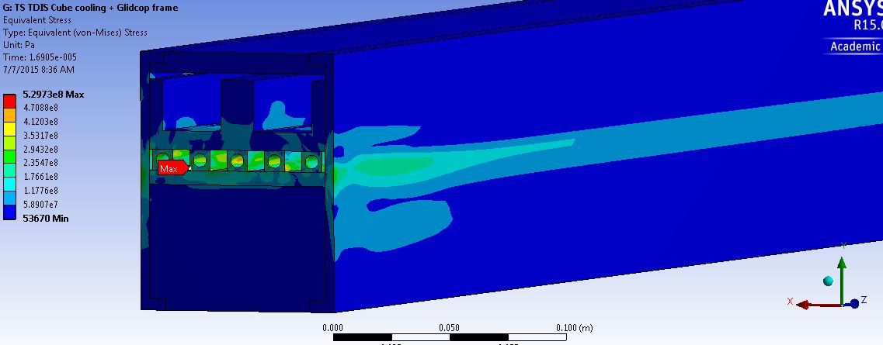
Second tdis segment
- Max Eq Stress= 530MPa on CuNi pipes. Different points depending on step/time. Discontinuities?
- Max Eq Stress= 320MPa on Glidcop plate & frame. Plastification?

Slide 11
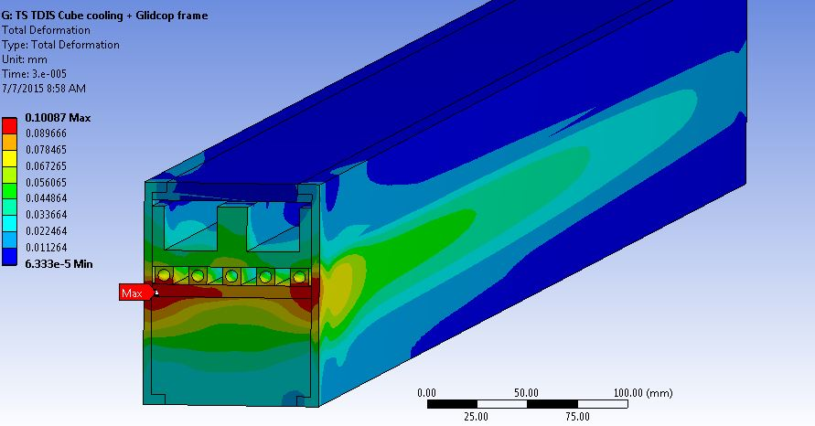
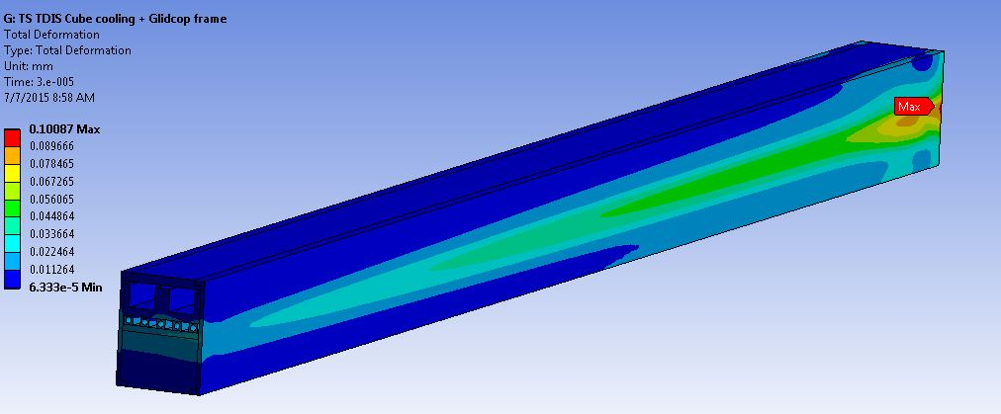
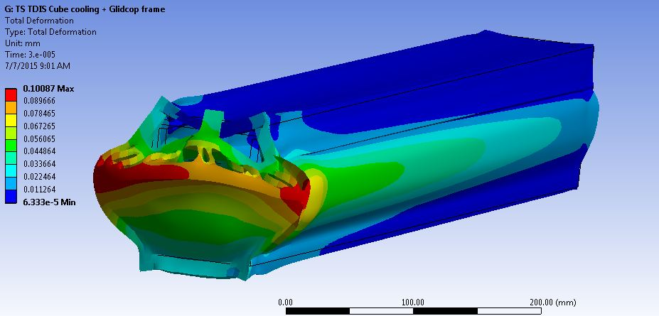
Second tdis segment
Deformation Max = 0.1mm on glidcop frame

Slide 12
Conclusions
Conclusions:
Need material review. Aluminium could be a better choice since:
  Glidcop would enter the plastic region, Ultimate Strenght 375 MPa
  Braze could be avoided
Increase glidcop plate & frame thickness?
Further simulations are needed
  Model for the CuNi pipes to be re-checked
  Need to take into consideration RF heating

