Slide 1
Rapidity window and centrality dependences of higher order cumulants
Masakiyo Kitazawa
(Osaka U.)
MK, Asakawa, Ono, Phys. Lett. B728, 386-392 (2014)
Sakaida, Asakawa, MK, PRC90, 064911 (2014)
MK, arXiv:1505.04349, Nucl. Phys. A, in press
HIC for FAIR workshop, Frankfurt, 30/Jul./2015

Slide 2
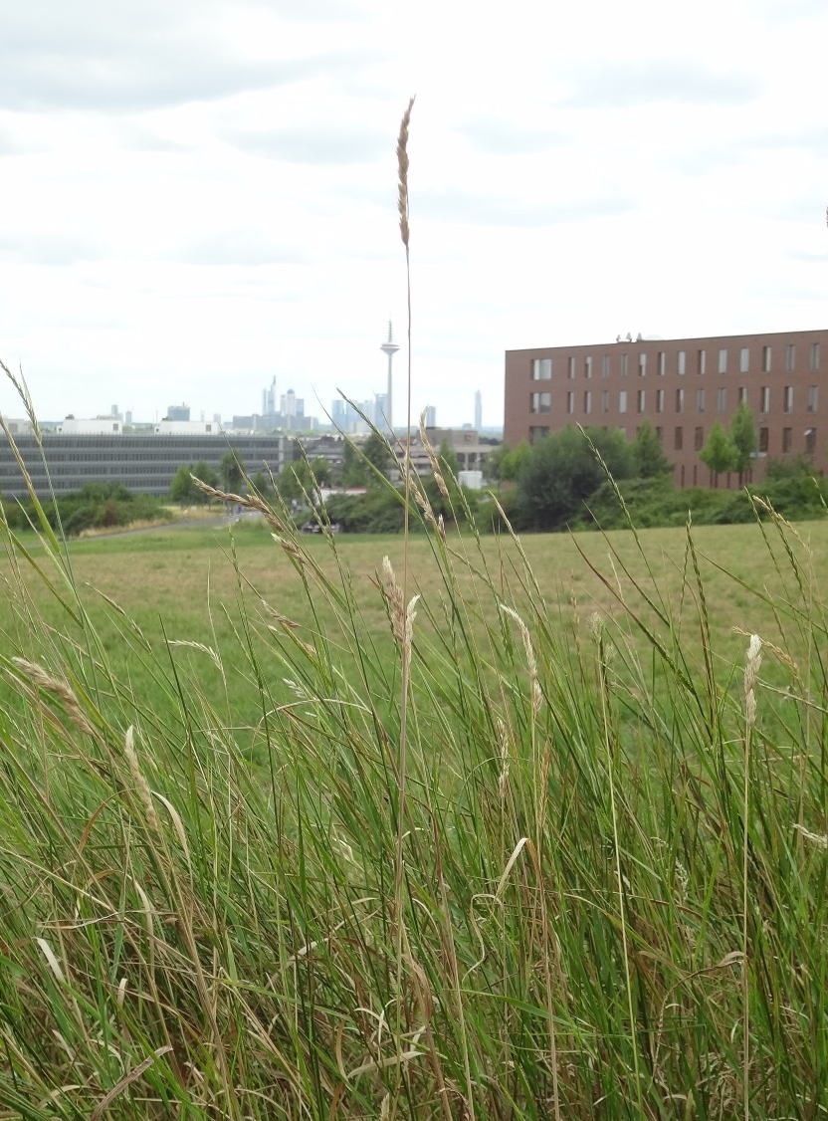
In “haiku”, a Japanese short style poem, a poet wrote…
Even on one blade of grass
the cool wind lives
Issa Kobayashi
1814
一本の草も涼風宿りけり
小林一茶

Slide 3
Physicists can feel hot early Universe
13 800 000 000 years ago
in tiny fluctuations of
cosmic microwave

Slide 4
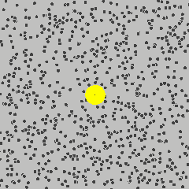
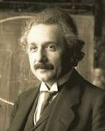
Physicists can feel the existence of microscopic
atoms behind random fluctuations
of Brownian pollens
A. Einstein
1905

Slide 5
Feel hot quark wind behind fluctuations
in relativistic heavy ion collisions
2010-

Slide 6
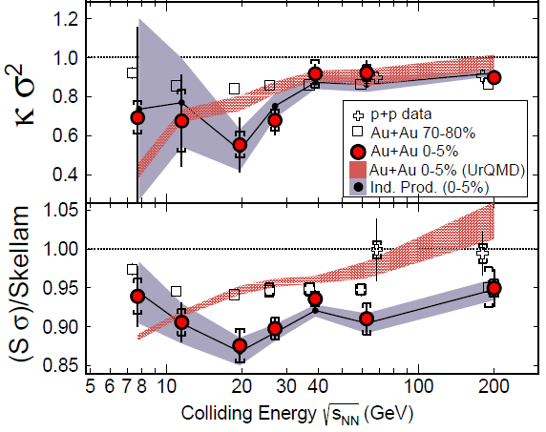
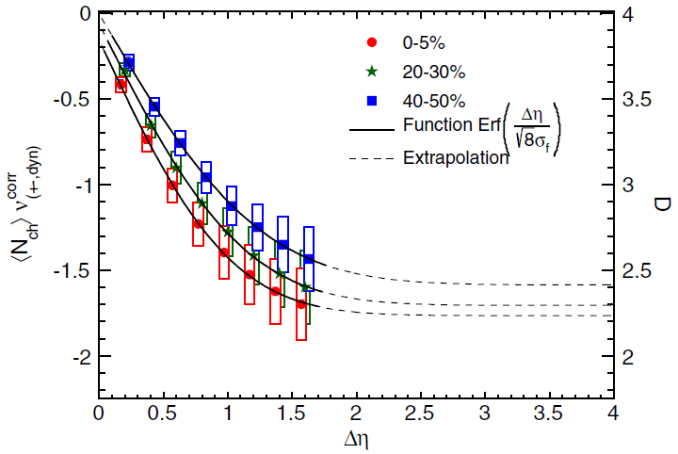
Feel hot quark wind behind fluctuations
in relativistic heavy ion collisions
2010-

Slide 7
Outline
A poem
Electric charge fluctuation @ ALICE
Thermal blurring in momentum-space rapidity
Δη dependences of higher order cumulants
Effect of global charge conservation
Ohnishi+, in preparation
MK, Asakawa, Ono, PLB(2014); MK, NPA(2015)
Sakaida, Asakawa, MK, PRC(2014)

Slide 8
Electric charge fluctuations @ ALICE

Slide 9
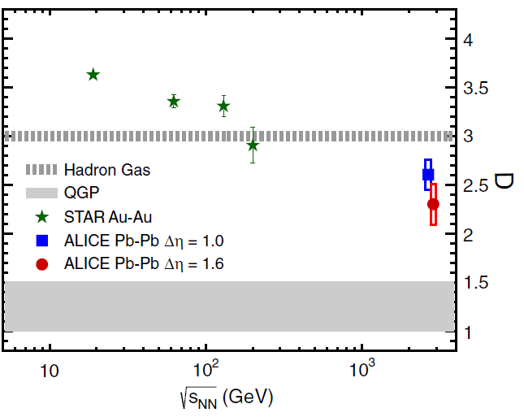
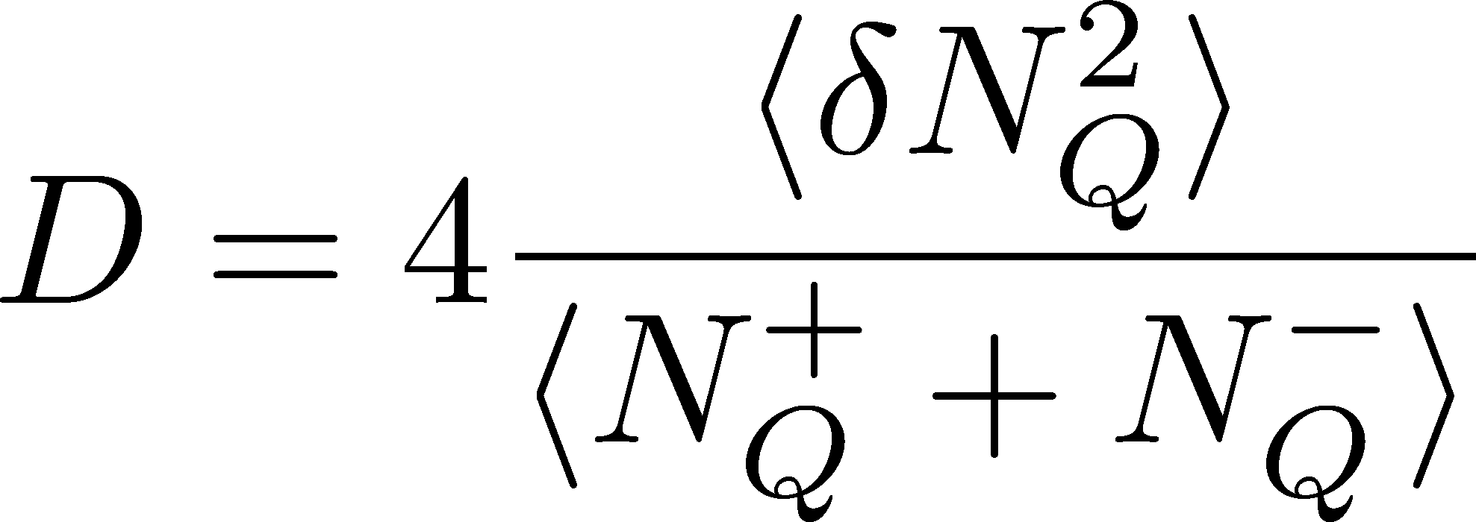
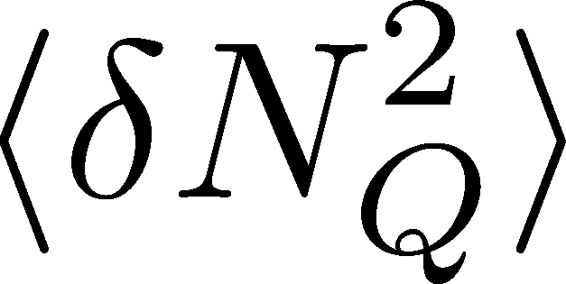
Charge Fluctuation @ LHC
ALICE, PRL110,152301(2013)
hadronic
D-measure
STAR
D ~ 3-4 Hadronic
D ~ 1-1.5 Quark
Suppression
from hadronic value
at LHC energy!
is not equilibrated at freeze-out at LHC energy!

Slide 10
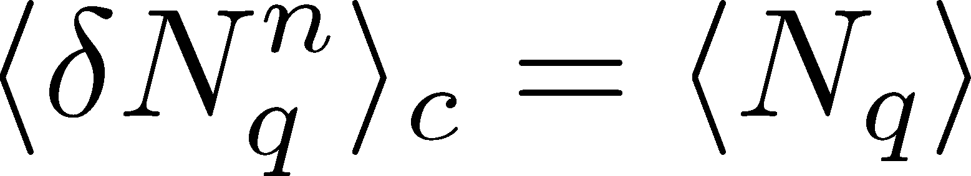
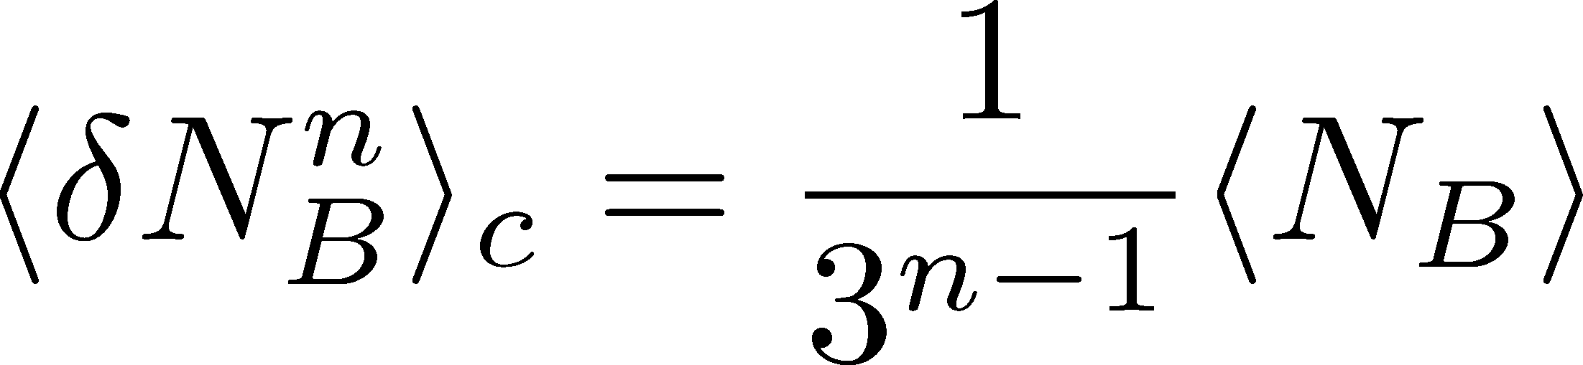
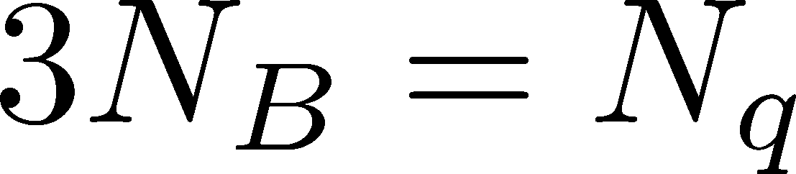
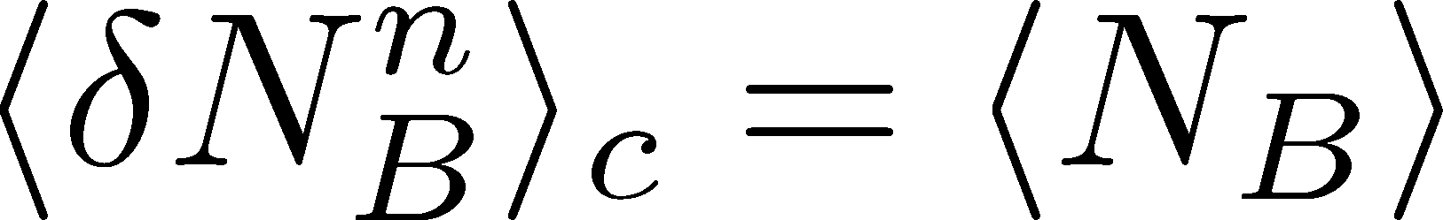
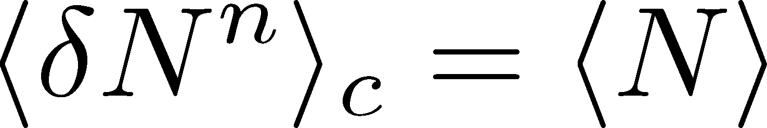
Fluctuations and Elemental Charge
Asakawa, Heinz, Muller, 2000
Jeon, Koch, 2000
Ejiri, Karsch, Redlich, 2005
Free Boltzmann → Poisson

Slide 11




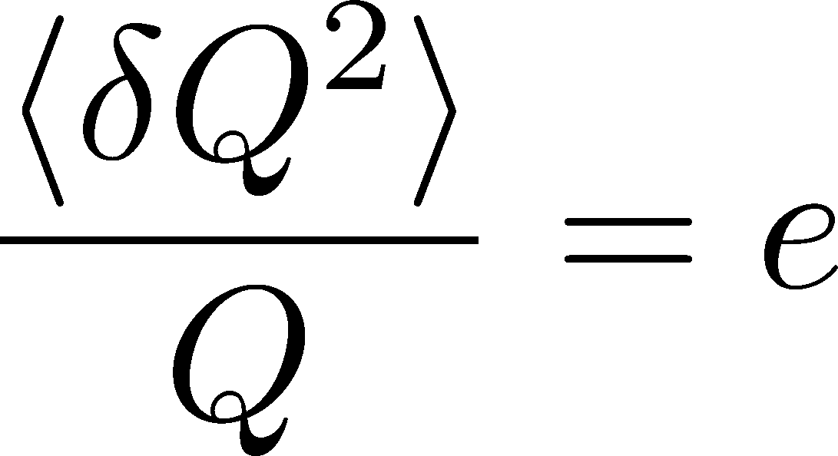
Shot Noise
e*
charge of quasi-particles
Total charge Q:

Slide 12
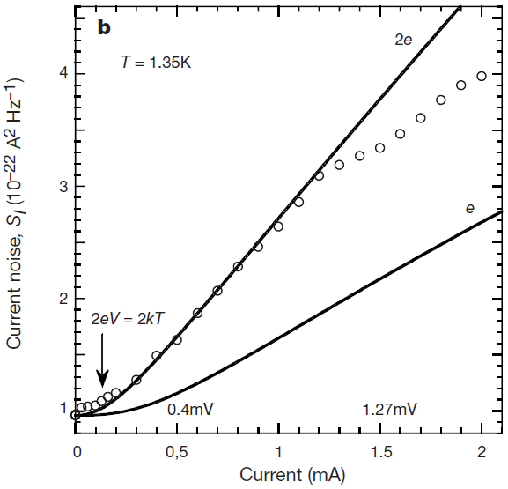


Shot Noise
e*
charge of quasi-particles
Superconductors
with Cooper Pairs
Fractional Quantum
Hall Systems
doubled!
Jehl+, Nature 405,50 (2000)
Saminadayar+, PRL79,2526 (1997)
Higher order cumulants:
3rd order: ex. Beenakker+, PRL90,176802(2003)
up to 5th order: Gustavsson+, Surf.Sci.Rep.64,191(2009)

Slide 13
Various Contributions to Fluctuations
Initial fluctuations
Effect of jets
Negative binomial (?)
Final state rescattering
Coordinate vs pseudo rapidities
Particle missID
Efficiency correction
Global charge conservation
Enhance
Enhance
Enhance
Enhance to Poisson
Enhance to Poisson
Enhance to Poisson
Ono, Asakawa, MK
PRC(2013)
Enhance to Poisson
Suppress
Sakaida, Asakawa,
MK, PRC(2014)
The suppression is most probably a consequence of the small fluctuation in deconfined medium.

Slide 14
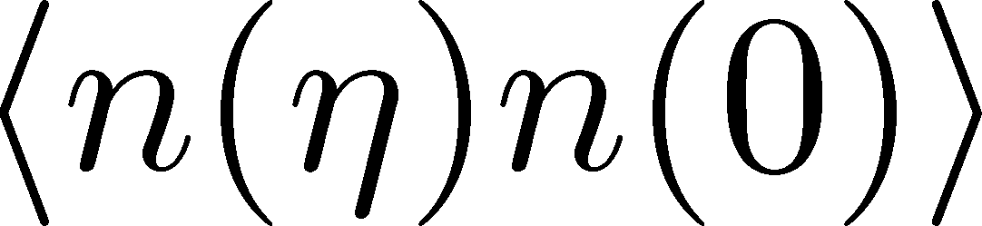
Δη Dependence @ ALICE
ALICE
PRL 2013
ALICE
PRL 2013
t
Δη
z
Same information as
rapidity window
2 particle corr.:
Balance function

Slide 15
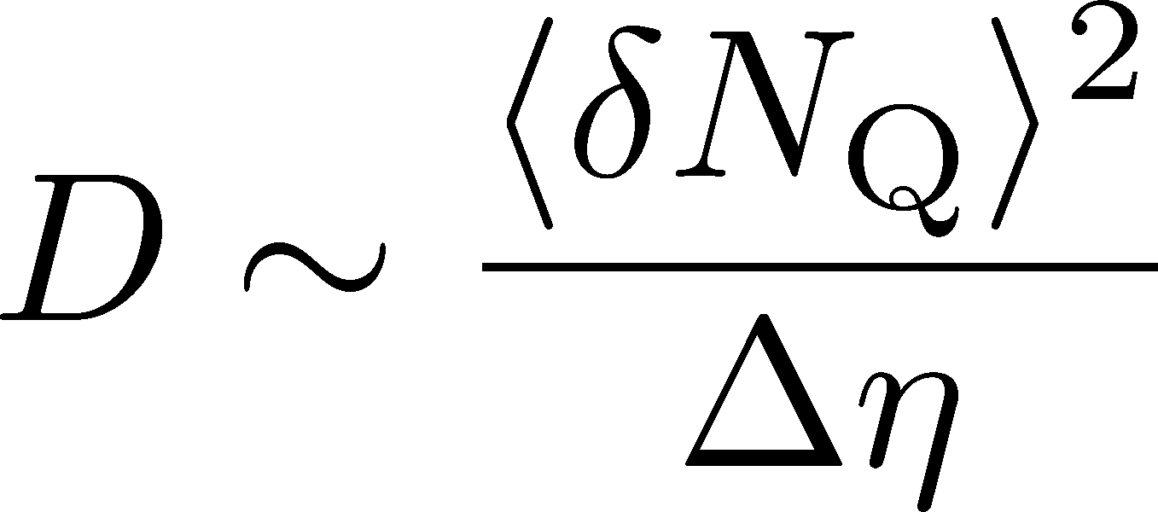
Δη Dependence @ ALICE
ALICE
PRL 2013
has to be a constant
in equil. medium
Fluctuation of N_{Q}
at ALICE is not the
equilibrated one.
rapidity window

Slide 16
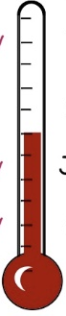

Δη Dependence @ ALICE
ALICE
PRL 2013
Δη dependent
thermometer?
large
small
rapidity window

Slide 17
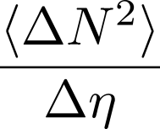



Time Evolution of Fluctuations
Quark-Gluon Plasma
Hadronization
Freezeout
Fluctuations continue to change until kinetic freezeout!!

Slide 18
Time Evolution of Fluctuations
Quark-Gluon Plasma
Hadronization
Freezeout
Variation of a conserved charge is achieved only through diffusion.
The larger Δη,
the slower diffusion

Slide 19
Conversion of Rapidities
Quark-Gluon Plasma
Hadronization
Freezeout
conversion
from coordinate-space
to momentum-space
rapidities
detector

Slide 20
Conversion of Rapidities
Quark-Gluon Plasma
Koch,
0810.2520
Hadronization
Freezeout
conversion
from coordinate-space
to momentum-space
rapidities
detector

Slide 21

Δη Dependence @ ALICE
Δη dependent
thermometer?
ALICE
PRL 2013
large
small
Δη dependences of fluctuation observables
encode history of the hot medium!
Higher-order cumulants as
thermometer?

Slide 22
Δη Dependence @ ALICE
Δη dependent
thermometer?
ALICE
PRL 2013
large
small
Even on one blade of grass
the cool wind lives
Δη dependences of fluctuation observables
encode history of the hot medium!
Higher-order cumulants as
thermometer?

Slide 23
Thermal blurring in momentum-space rapidity

Slide 24
Conversion of Rapidities
Quark-Gluon Plasma
Hadronization
Freezeout
conversion
from coordinate-space
to momentum-space
rapidities
detector
“Thermal blurring”

Slide 25
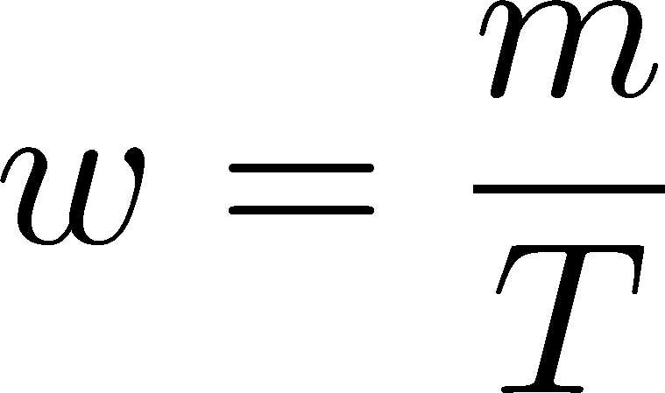


Thermal distribution in η space
Y. Ohnishi, MK,+
in preparation
nucleon
pions
nucleons
pion
Blast wave squeezes the
distribution in rapidity space
blast wave
flat freezeout surface

Slide 26
Thermal distribution in η space
Y. Ohnishi, MK,+
in preparation
nucleon
pions
nucleons
pion
width
blast wave
flat freezeout surface

Slide 27
Centrality Dependence
lower T
larger β
Smaller
blurring
More central
Is the centrality dependence understood solely by the thermal blurring at kinetic f.o.?

Slide 28
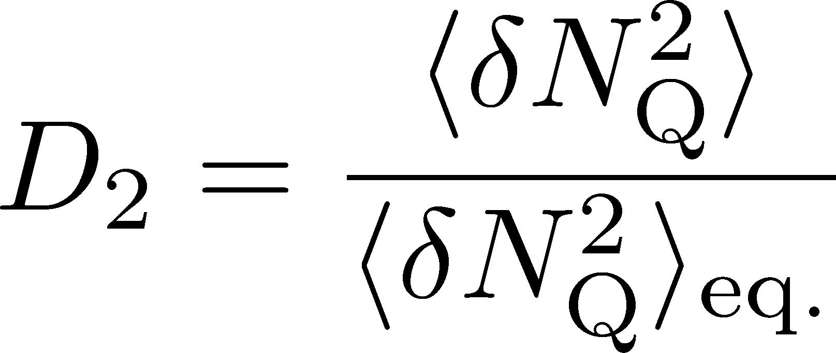
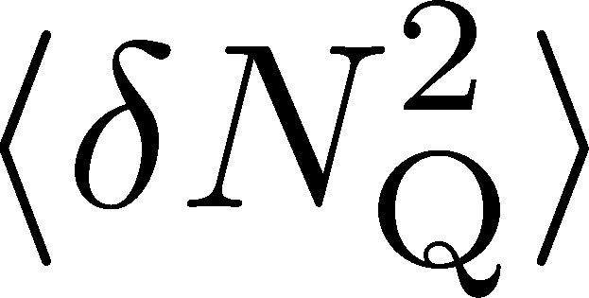
Centrality Dependence
Assumptions:
Centrality independent cumulant at kinetic f.o.
Thermal blurring at kinetic f.o.
Centrality dep. of blast wave parameters may not be large enough to describe the one of
Existence of another physics having centrality dep.
More accurate data is desirable!!

Slide 29
Rapidity Window Dependences of
Higher Order Cumulants

Slide 30


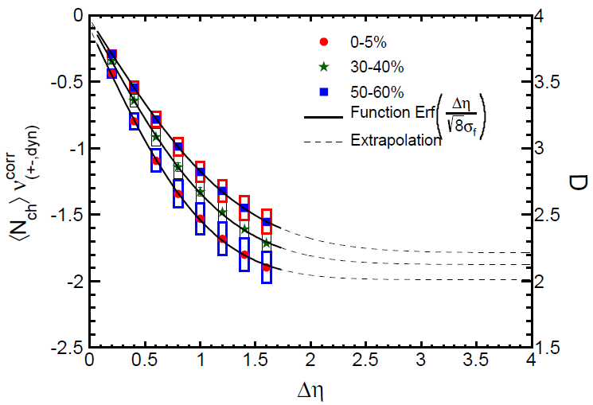
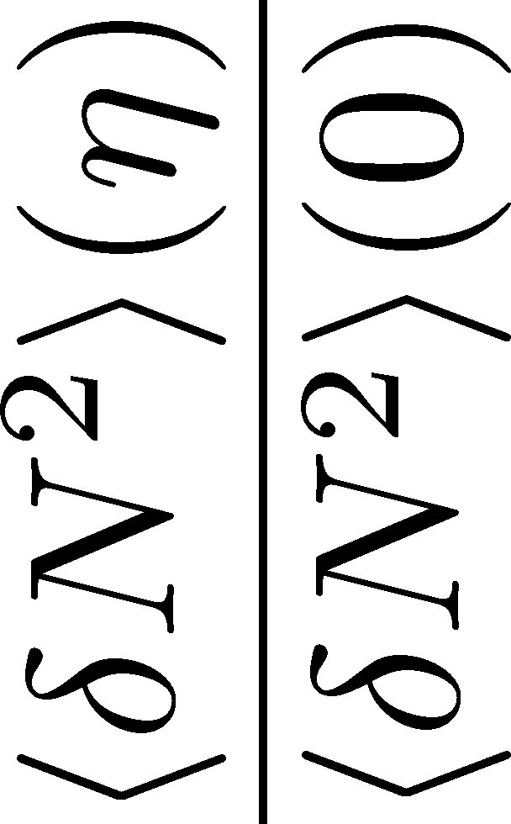

<δN_{B}²> and < δN_{p}² > @ LHC ?
should have different Δη dependence.
NEW
normalization!

Slide 31
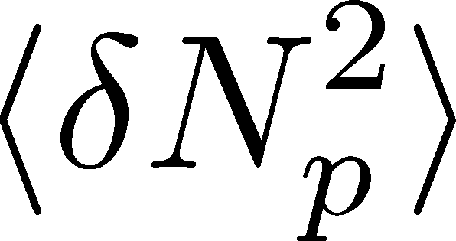
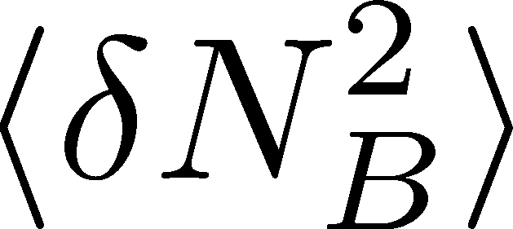

<δN_{B}²> and < δN_{p}² > @ LHC ?
should have different Δη dependence.
Baryon # cumulants are experimentally observable! MK, Asakawa, 2012

Slide 32
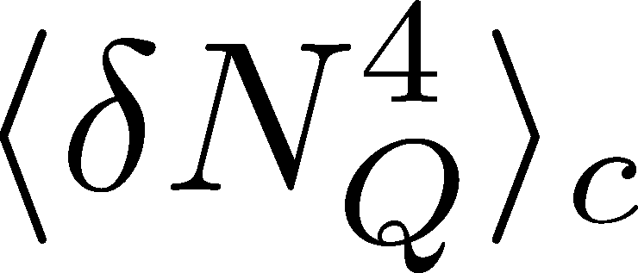
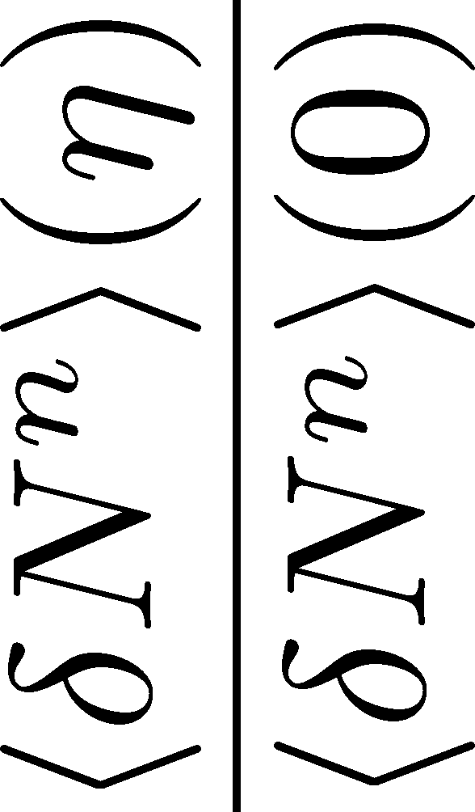
<δN_{Q}⁴> @ LHC ?
How does behave as a function of Δη?
suppression
or
enhancement

Slide 33
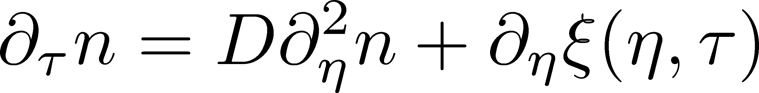
Hydrodynamic Fluctuations
Landau, Lifshitz, Statistical Mechaniqs II
Kapusta, Muller, Stephanov, 2012
Stochastic diffusion equation
Stephanov, Shuryak, 2001
Markov (white noise)
+
continuity
Fluctuation of n is
Gaussian in equilibrium
Gaussian noise
cf) Gardiner, “Stochastic Methods”

Slide 34
How to Introduce Non-Gaussianity?
Stochastic diffusion equation
Choices to introduce non-Gaussianity in equil.:
n dependence of diffusion constant D(n)
colored noise
discretization of n

Slide 35
How to Introduce Non-Gaussianity?
Stochastic diffusion equation
Choices to introduce non-Gaussianity in equil.:
n dependence of diffusion constant D(n)
colored noise
discretization of n
our choice
Fluctuations measured in
HIC are almost Poissonian.
REMARK:

Slide 36
A Brownian Particles’ Model
Hadronization (specific initial condition)
Time evolution
Freezeout
① Describe time evolution of Brownian particles exactly
② Obtain cumulants of particle # in Δη

Slide 37



Baryons in Hadronic Phase
time
chem. f.o.
hadronize
10~20fm
kinetic f.o.
Baryons behave like
Brownian pollens in water
mesons
baryons

Slide 38
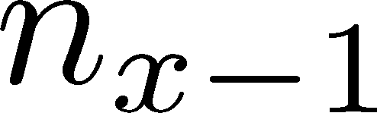

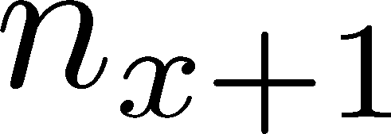
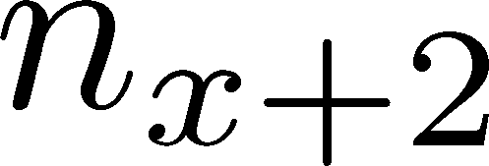



Diffusion Master Equation
MK, Asakawa, Ono, 2014
MK, 2015
Divide spatial coordinate into discrete cells
probability

Slide 39
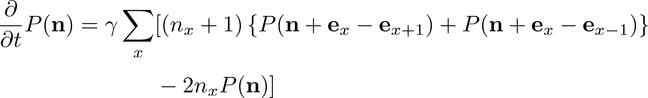
Diffusion Master Equation
MK, Asakawa, Ono, 2014
MK, 2015
Divide spatial coordinate into discrete cells
probability
Master Equation for P(n)
Solve the DME exactly, and take a→0 limit
No approx., ex. van Kampen’s system size expansion

Slide 40


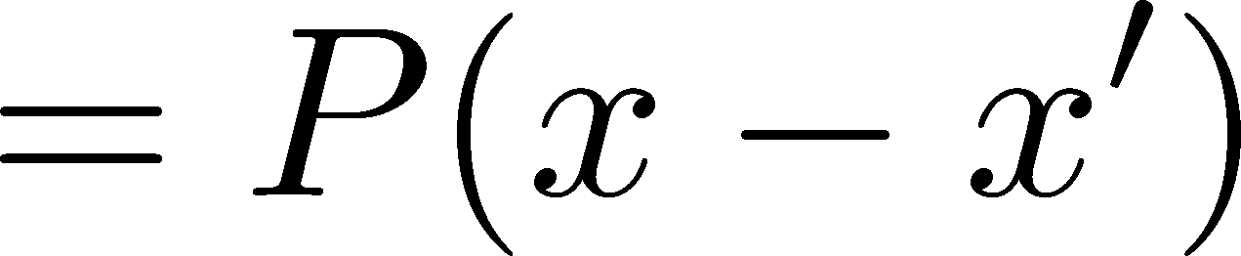
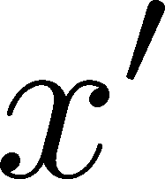
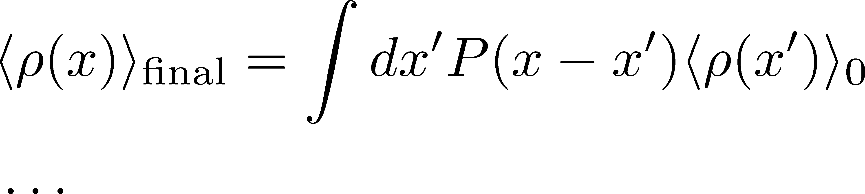
A Brownian Particles’ Model
Initial
Time evolution
Final
Each particle are uncorrelated
A particle moves x → x’ with probability P(x-x’)
Formula of cumulants

Slide 41

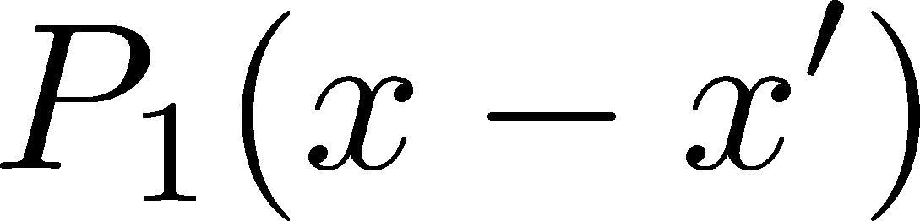
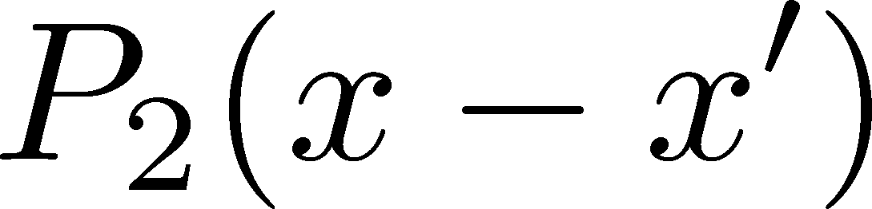
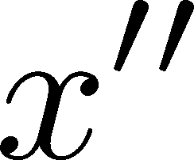
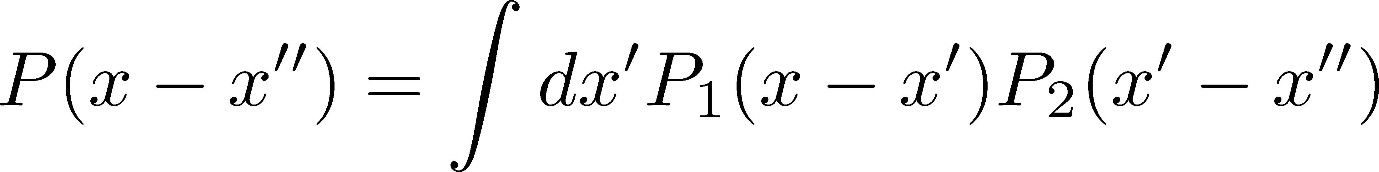
Diffusion + Thermal Blurring
Hadronization
Kinetic f.o. (coordinate space)
Kinetic f.o. (momentum space)
Diffusion and thermal blurring can be treated simultaneously

Slide 42

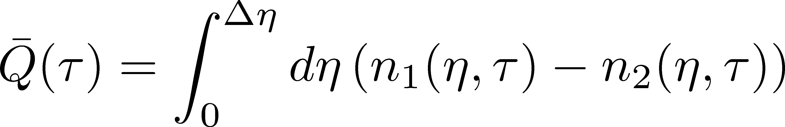
Net Charge Number
Prepare 2 species of (non-interacting) particles
Time evolution of Q up to Gauusianity is
consistent with the stochastic diffusion equation

Slide 43
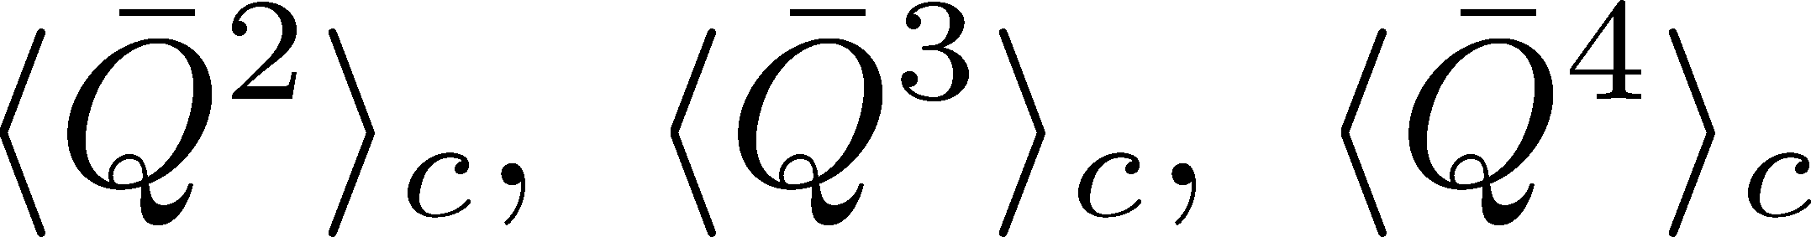
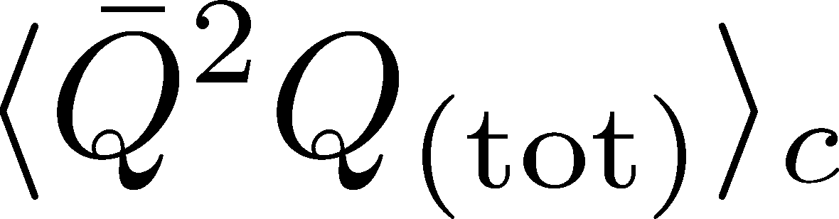
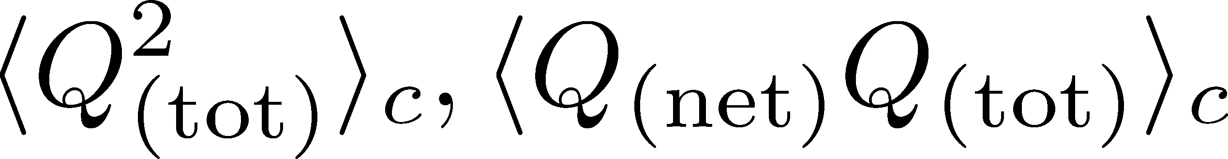
Time Evolution in Hadronic Phase
Hadronization (initial condition)
Boost invariance / infinitely long system
Local equilibration / local correlation
suppression owing to
local charge conservation
strongly dependent on
hadronization mechanism

Slide 44
Time Evolution in Hadronic Phase
Hadronization (initial condition)
Boost invariance / infinitely long system
Local equilibration / local correlation
Time evolution via DME
suppression owing to
local charge conservation
strongly dependent on
hadronization mechanism
Freezeout

Slide 45
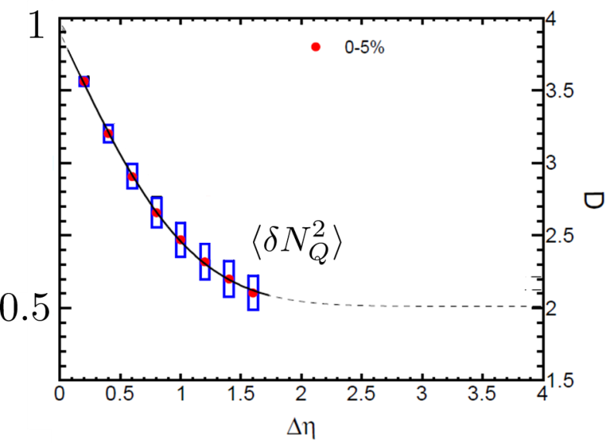
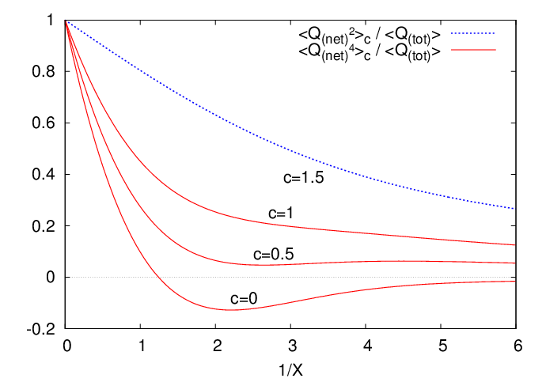
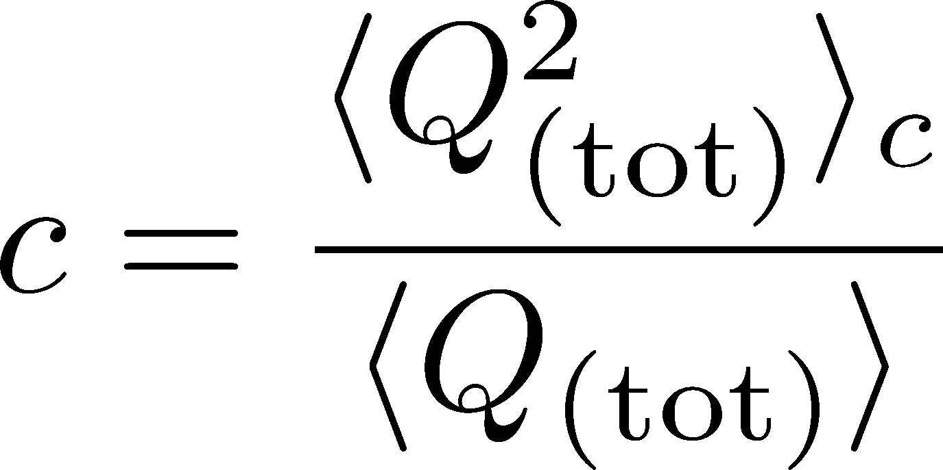
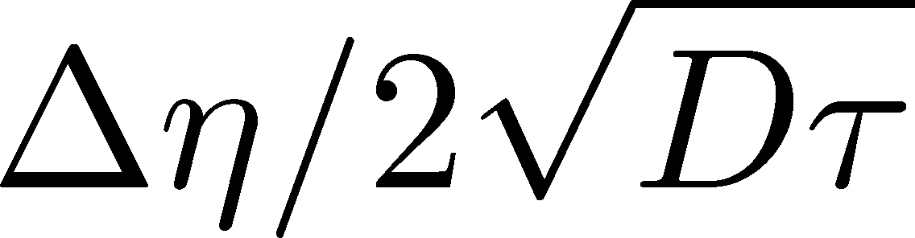
Δη Dependence at Freezeout
Initial fluctuations:
2nd
4th
parameter
sensitive to
hadronization

Slide 46
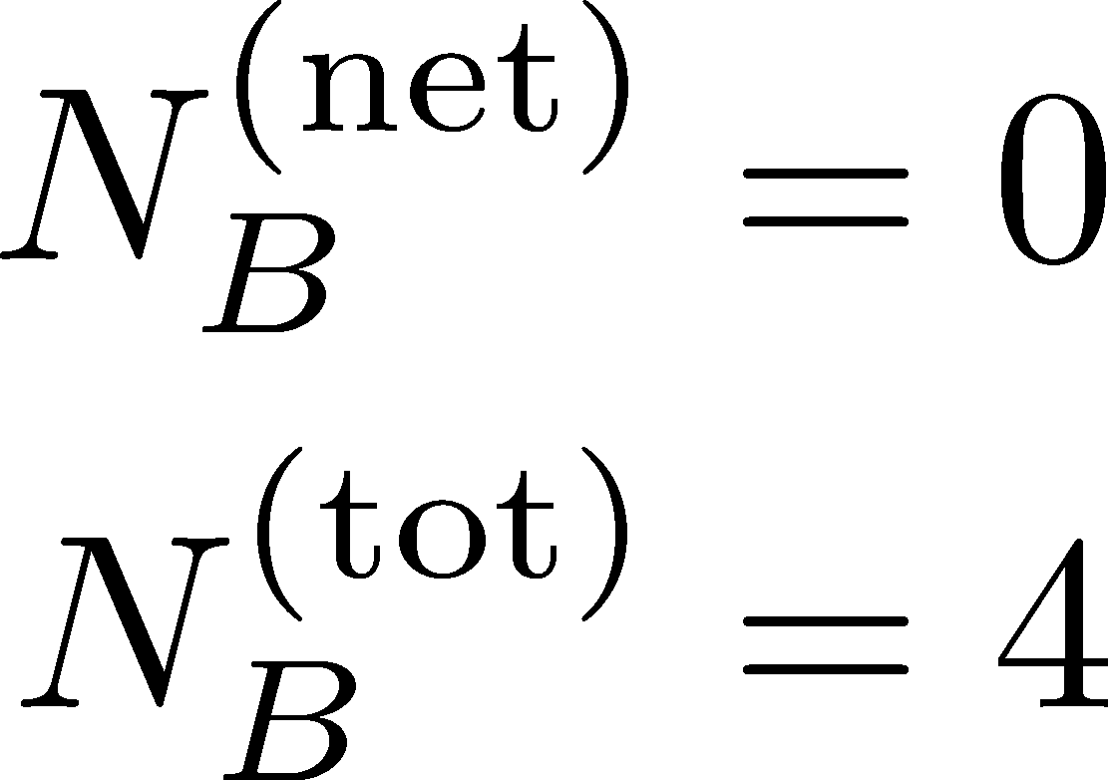
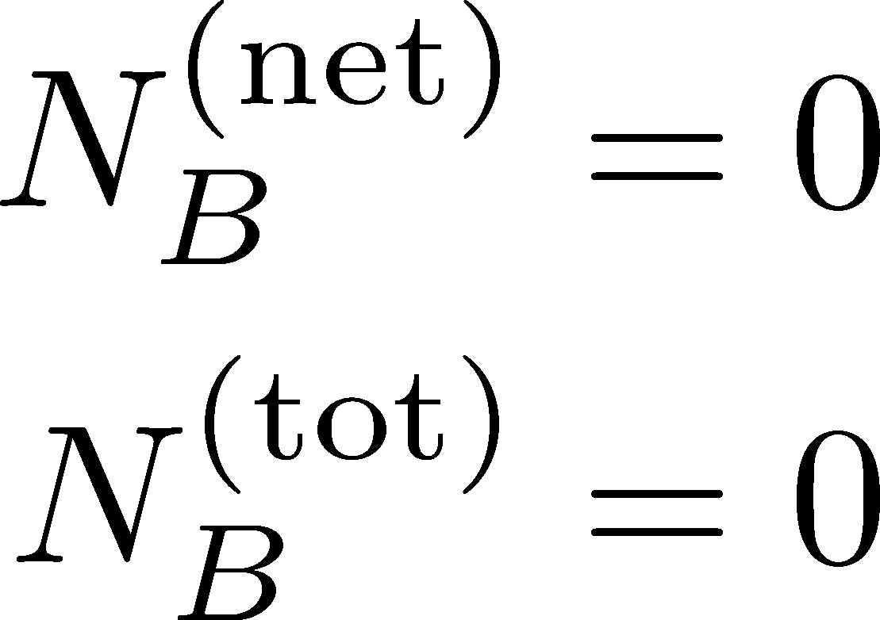


Total Charge Number
In recombination model,
6 quarks
6 antiquarks
can fluctuate, while does not.

Slide 47




Δη Dependence: 4th order
MK, arXiv:1505.04349
Initial Condition
Charcteristic Δη dependences!
Cumulants with a Δη is not the initial value.

Slide 48




Δη Dependence: 4th order
MK, arXiv:1505.04349
Initial Condition
baryon #
at ALICE
at ALICE

Slide 49



Δη Dependence: 3rd order
MK, arXiv:1505.04349
Initial Condition
baryon #
at ALICE
at ALICE

Slide 50



4th order : Large Initial Fluc.
MK, arXiv:1505.04349
Initial Condition
baryon #
at ALICE
at ALICE

Slide 51
Δη Dependence @ STAR
Figure from
Jochen Thäder, Yesterday
Non monotonic dependence on Δη ?

Slide 52
Effect of Global Charge Conservation
(Finite Volume Effect)
Sakaida, Asakawa, MK, PRC, 2014

Slide 53


Global Charge Conservation
Conserved charges in the total system do no fluctuate!
1
0

Slide 54

Global Charge Conservation
Conserved charges in the total system do no fluctuate!
1
0
An Estimate of GCC Effect
Jeon, Koch, PRL2000; Bleicher, Jeon, Koch (2000)

Slide 55





Diffusion in Finite Volume
Solve the diffusion master equation in finite volume
Infinite Sys.
(No GCC Effect)
: Average
Diffusion Length
: Diffusion
Coefficient

Slide 56

Diffusion in Finite Volume
Solve the diffusion master equation in finite volume
Infinite Sys.
(No GCC Effect)
: Average
Diffusion Length
effect of
GCC
: Diffusion
Coefficient
effect of
GCC
suppression only for

Slide 57










Physical Interpretation
slide by M. Sakaida
: Averaged Diffusion Distance
: Diffusion Coefficient
: Total Length of Matter
Time Passes…
Condition for effects of the GCC
Effects of the GCC appear
only near the boundaries.

Slide 58






Comparison with ALICE Result
without initial fluc.
with initial fluc.
time
No GCC effect in ALICE experiments!
Same conclusion for higher order cumulants

Slide 59
Very Low Energy Collisions
Large contribution of global charge conservation
Violation of Bjorken scaling
detector
Careful treatment is required to interpret fluctuations at low beam energies!
Many information should be encoded in Δη dep.

Slide 60
Summary
Plenty of information in Δη dependences
of various cumulants
and those of non-conserved charges, mixed cumulants…
With Δη dep. we can explore
primordial thermodynamics
non-thermal and transport property
effect of thermal blurring

Slide 61
Future Studies
Experimental side:
rapidity window dependences
baryon number cumulants
consistency between RHIC and LHC
Theoretical side:
rapidity window dependences in dynamical models
description of non-equilibrium non-Gaussianity
accurate measurements on the lattice
Both sides:
Compare theory and experiment carefully
Do not use a fixed Δη cumulant for comparison!!!

Slide 62
The noise is the signal.
R. Landauer
1998

