Slide 1

Overview of code status
D. Quartullo

Slide 2
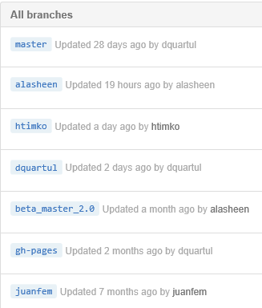
BRANCHES IN BLOND
Current BLonD version: 1.11.2 (13 May 2015) 2.0 (???) with complete cleaning up and optimization
Main branch, the one visible on the BLonD website (15th place out of 95700000 in the Google engine searching for ‘blond’!).
Developer
Developer
Developer
Beta branch.
Documentation branch.
Developer
teoarg
Developer (without branch but he helps a lot!)
All these branches are necessary and almost sufficient.
Why almost sufficient:
  Developers can create sub-branches to work on particular tasks
  The number of developers could increase in the future

Slide 3
SUGGESTED WORKFLOW
DEVELOPER 1
DEVELOPER 2
DEVELOPER 3
DEVELOPER N
…
BETA MASTER 2.0 = COPY OF CURRENT MASTER
NOT OK
AUTOMATING TESTING + CHECKS
OK
NEW MASTER
GH-PAGES

Slide 4
AUTOMATING TESTING ON LXPLUS: ACRONTAB
The script will launch the following operations automatically with a user-chosen frequency:
  Download the beta_master_2.0 from GitHub
  Save it to /afs/cern.ch/user/b/blond/public/BLonD
  Launch all the test cases
  Send the results (test case passed or not) via email to the developers
MULTIBUNCH DEVELOPMENT
Generation: the bunches are generated one by one taking into account the induced voltage deriving from previous bunches purely sequential
Track: the bunches are considered as if they were one single bunch with empty spaces inside not optimized but easy implementation working for all the cases

Slide 5
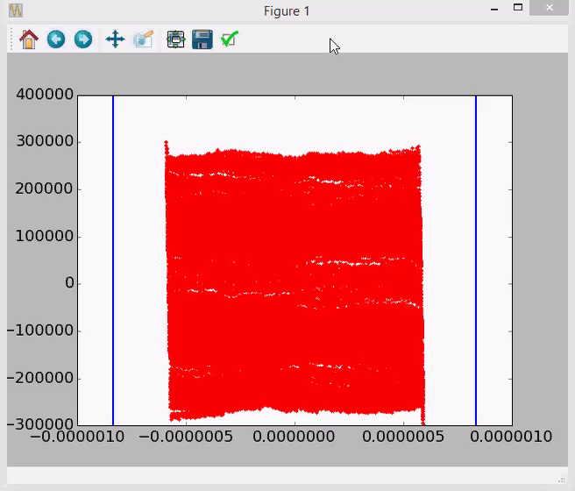
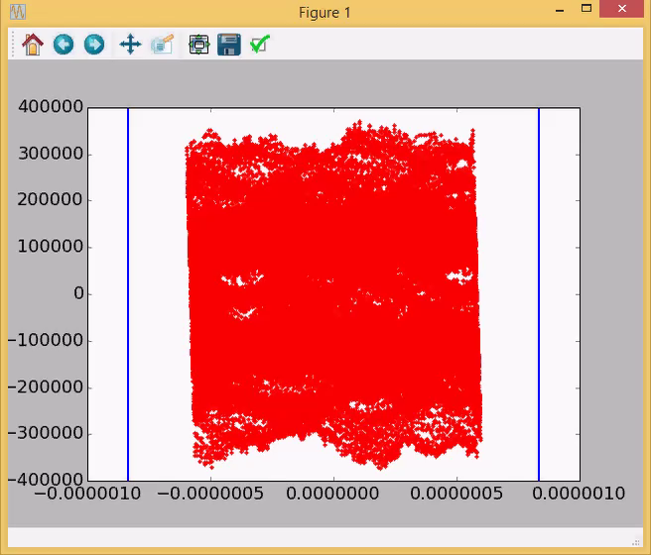
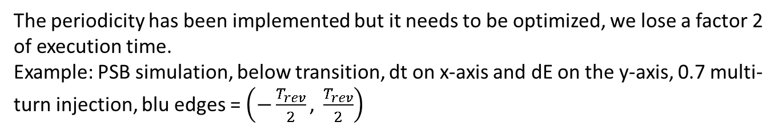
PERIODICITY
The periodicity has been implemented but it needs to be optimized, we lose a factor 2 of execution time.
Example: PSB simulation, below transition, dt on x-axis and dE on the y-axis, 0.7 multi-turn injection, blu edges = $\left(−\frac{T_{rev}}{2}\text{, }\frac{T_{rev}}{2}\right)$
NO PERIODICITY
PERIODICITY

Slide 6
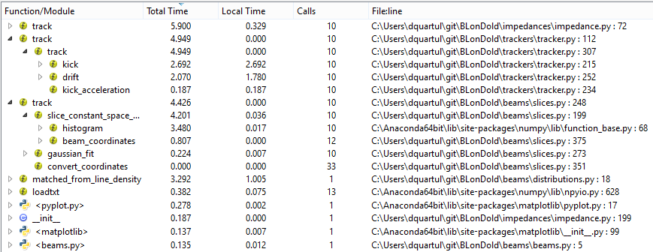
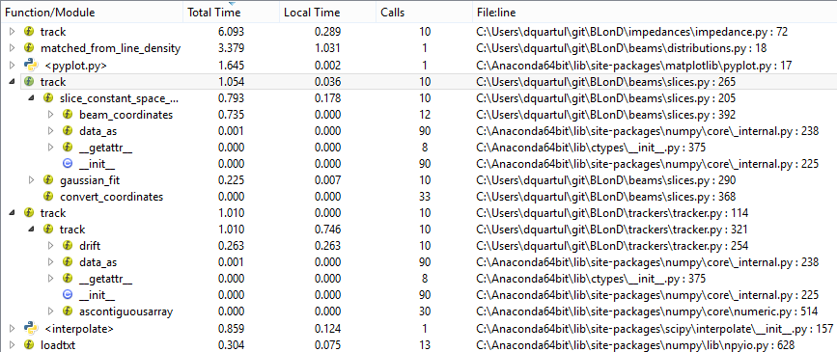
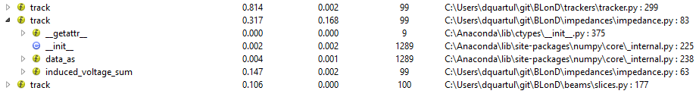
LAST BIG OPTIMIZATION
Some time ago we coded in C++:
    an optimized version of Python histogram for our constant width slice case
    the kick and drift equation of motions using the VDT library and vectorization
OPTIMIZATION
x 20 in histogram
X 5 in tracker
SPS with full impedance model at injection (n_macr = 5000000, n_slices = 500, n_turns = 10)
The impedance tracker became THE bottle neck.
In it there are basically interpolation and calculation of induced voltage through convolution or FFT.
The Python interpolation routine was coded in C++ using and extending the same idea behind the histogram C++ script small effort, very good improvement!
PYTHON INTERPOLATION
C++ INTERPOLATION
PSB with full impedance model at injection (n_macr = 513765, n_slices = 4000, n_turns = 100)

Slide 7
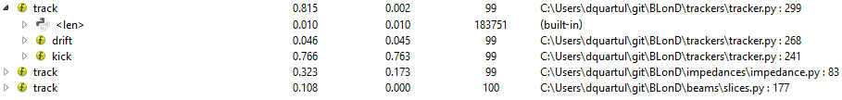
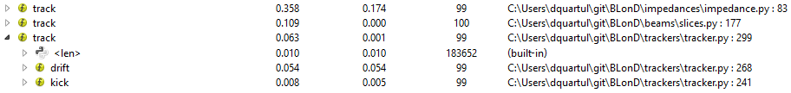
DISCRETIZATION OF THE KICK
Currently the execution time of the kick routine is the highest, even if the method is fully vectorised and a fast implementation of the sine function is used.
  an option to slice the sine function is introduced in the code
  big gain but discretization error
1000 slices
SUGGESTED IDE: LiClipse
LiClipse could (should!) be preferred to Eclipse since it has out of the box
  Git plugin
  PyDev plugin
  C/C++ editor
  No Java installation needed
  A lot of usability improvements for Eclipse
Thus the developers have what they need in one shot without possible conflicts with Java libraries!

Slide 8
NEXT STEPS
Physics features in BLonD:
    Implementation of multi-turn induced voltage
    Functionalities needed for PSB simulations (see S. Albright talk)
    Merging all the developers’ branches
BLonD cleaning up and restructuring (see A. Lasheen and H. Timko talks)
BLonD optimization (find new bottle necks and code them in C++ and parallelization)

