Slide 1
Kink effects on the FCC-ee beam polarization
I.Koop, BINP, Novosibirsk
CERN, Geneva, 11.06.2015

Slide 2
Different kink opportunities
Simple kink made by two vertical kicks of an orbit:
- Vertical emittance excitation by these kicks
- Spin precession stop bands near integer tunes
2. Series of twists between inclined arc-segments:
- No vertical emittance excitation!
- No additional dipoles
- Restore perpendicularity of the polarization vector
to the bend planes by solenoids
- No stop bands in the spin precession frequency
- No fast depolarization!

Slide 3
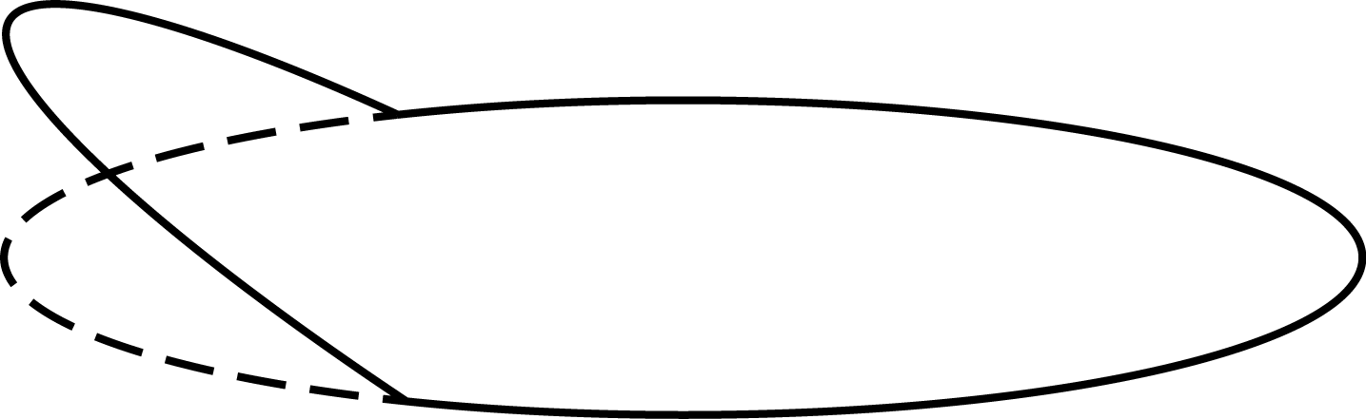
Simple kink made by vertical bends
Almost vertically directed kicks
Kicks must be made achromatic to prevent large influence on the vertical emittance.

Slide 4
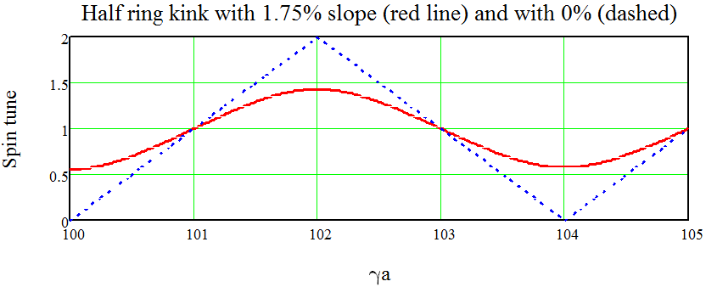
Spin tune energy dependence in a ring with vertical kicks of the orbit
Uncompensated distortion of spin motion, generated by the orbit kicks, made problematic energy determination near all even values of γa, where the derivative dν(E)/dE vanishes.
At odd tunes two kicks compensate each other due to π phase between them for the spin precession.

Slide 5
Orbit elevation created by twists of 3 arcs
Tree arc segments are rotated around the velocity directions at junction points by different angles, producing, thus, a smooth vertical deflection of an orbit. No additional synchrotron radiation compared to the flat ring option!

Slide 6
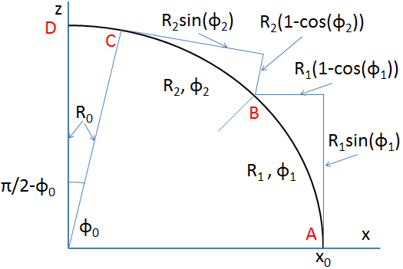
Projection of two inclined arcs on xz-plane
Point A is at maximal elevation, junction point B is at some intermediate level. Arc C-D is horizontal, be at zero level. To determine the needed twists one should solve a system of 6 equations, varying and 3 twist angles.

Slide 7
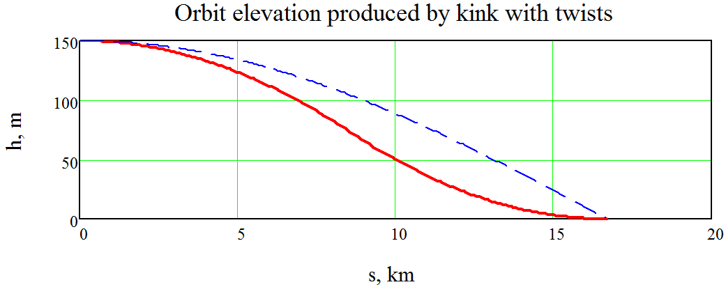
One half of a kink created by two twists
ϕ_{A}=-0.034076
Kink by vertical bend at point C
ϕ_{B}=0.060972
ϕ_{C}=0.03632
B
C
A
D
Left half of a kink is mirror symmetric, with points D’, C’, B’, A’.
Full kink is made of 3 arcs: the middle one: B’AB, inclined by ϕ_{A}, and two symmetrical C’B’ and BC. Arcs C’D’ and CD are horizontal.

Slide 8
Spin and orbit plane matching
To produce a twist ϕ of plane of oscillation one can rotate a unity/minus-unity insertion cell by the angle ϕ/2 around the longitudinal axis. This is simple, but such insertion do not rotate a spin!
To rotate spin around the longitudinal axis, so that it again becomes perpendicular to a new plane of bending, one shall use a solenoid with the field integral:
B·L= ϕ/(1+a)·BR (a≈0.0016 – electron moment anomaly)
But this solenoid rotates also the plane of oscillations by the angle ϕ/2(1+a). So, the rest of the total twist angle ϕ shall be provided by the mentioned above the quads insertion rotated by the angle: ϕ(1+2a)/4(1+a).
Then the grows of the vertical emittance will be suppressed!

Slide 9
Conclusion
If kinks are unavoidable, then I strongly recommend to use the proposed above orbit inclination technology with twists elements between the adjacent arc segments.
Spin matching is provided by relatively weak solenoids, which produce near a half of the full twist. Another half of the twist shall be provided by the rotated around the longitudinal axis the unity/minus-unity insertion cell.
As a result, the spin motion becomes not disturbed, same as in flat machine (linear dependence of the spin tune on energy).
Grows of the vertical emittance is also suppressed.

