Slide 1
Energy calibration in FCC-ee based on polarization
I. Koop, BINP, Novosibirsk
CERN, Geneva, 12.06.2015

Slide 2
Outline
Energy calibration concept
Longitudinal Compton Backscattering Polarimeter
Free precession frequency measurement approach
Spin precession de-phasing rates
Spin tracking results for various FCC-ee beam parameters
Discussion
Conclusion

Slide 3
Energy calibration concept
1. Production of polarized electrons from a laser photocathode.
2. Production of polarized positrons in a small energy damping ring
(1-2 GeV), with polarization time in the order of 10 min (wigglers).
3. Acceleration of polarized beams via linac, SPS (?) and finally in the
booster storage ring (100 km) using Siberian Snakes.
4. Injection of polarized bunches into the collider rings with the
horizontal spin orientation and measuring turn by turn free
precession frequency using the longitudinal Compton polarimeter.
5. Number of polarimeters should be large (4-12). Then one can
measure the spin precession phase advances per every arc. This
paves a way to validate the saw-tooth energy distribution model,
constructed on the full data set, such as RF-voltage/ RF-phases, plus
orbit data from BPMs, plus geodesy data, plus many other.

Slide 4
Energy calibration concept, cont.
Measuring the beam energy in several points (about 4-12), using
the magnetic spectrometer, based on Compton scattering of a
laser light on an electron beam (N. Muchnoi proposal).
Absolute calibration of such spectrometric system will be done by
measurement of the spin precession phases per arc segments.
Spin coherence time depends strongly on the value of
synchrotron modulation index: χ = σ_{δ}ν₀/ν_{s} (ν₀=γa). It should be
chosen not too large: acceptable is χ < 1.8 (ν_{s} ≈ 0.1-0.2 is
required). Examples will be shown at several slides.
9. Resonance depolarization is not excluded, but did not work near
integer resonances. In contrast, the free precession method works
everywhere!
10. Shall measure, suppress and account spin resonances in a broad
energy interval. Only after that can claim true energy value!

Slide 5
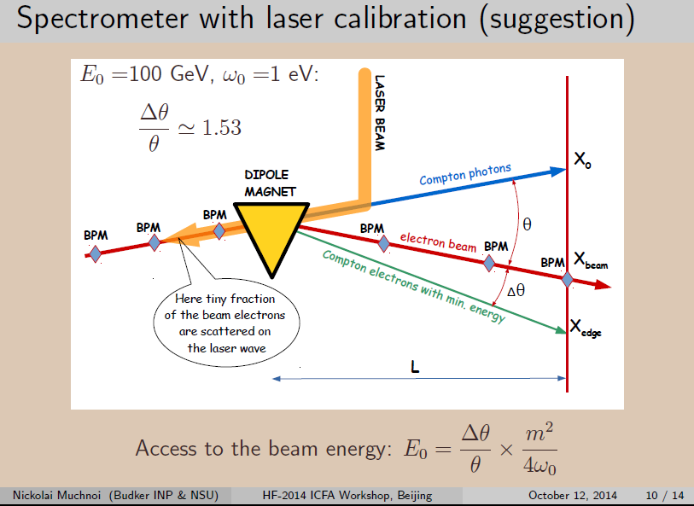

Slide 6
Compton scattering of a laser light
0.746
Detection of the
scattered electrons
instead of photons
provides selection of
events with maximal
momentum loss!
Let’s utilize the
highest value of the
analysing power!

Slide 7
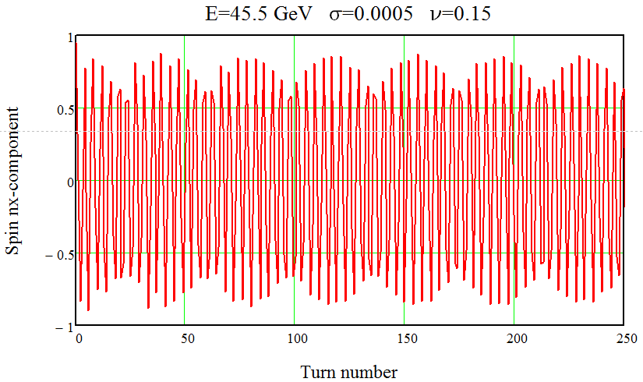
Spin tracking oscillogram. 125 test-particles.
E=45.5 GeV, σ_{δ}=0.0005, ν_{s} =0.15, τ_{s} =1320 turns
Loss of polarization degree due to de-phasing is small thanks to high enough ν_{s}.

Slide 8
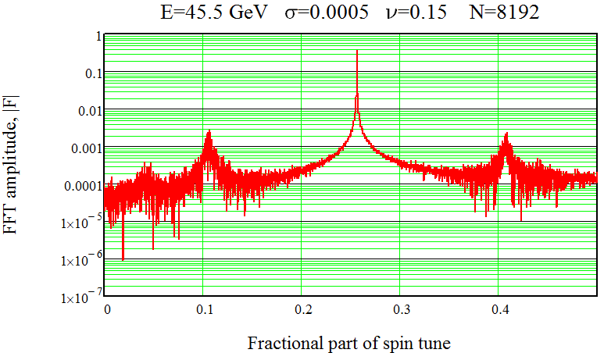
Spin precession spectrum. Number of turns 8192.
E=45.5 GeV, ν₀=103.25, σ_{δ}=0.0005, ν_{s} =0.15, χ=0.35
χ = σ_{δ}ν₀/ν_{s} = 0.35 – synchrotron modulation index.

Slide 9
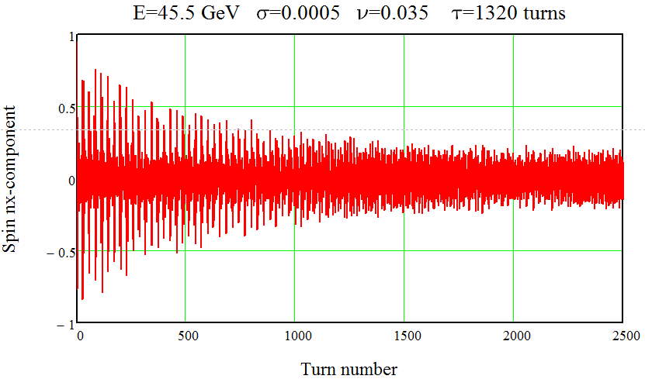
Spin tracking oscillogram. 125 test-particles.
E=45.5 GeV, σ_{δ}=0.0005, ν_{s} =0.035, τ_{s} =1320 turns

Slide 10
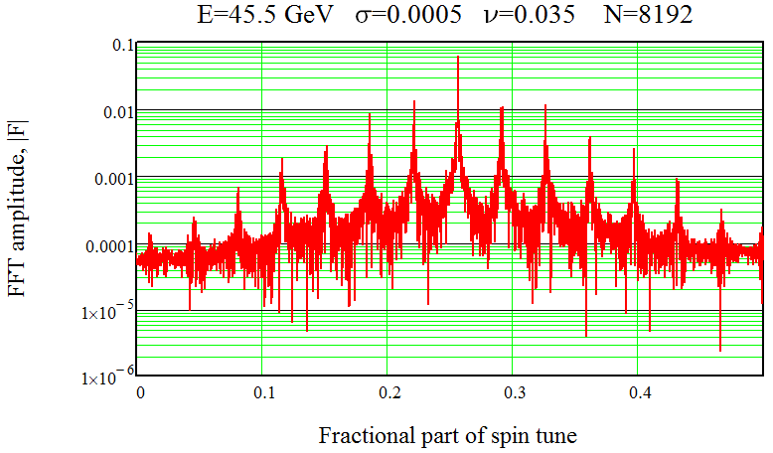
Spin precession spectrum. Number of turns 8192.
E=45.5 GeV, ν₀=103.25, σ_{δ}=0.0005, ν_{s} =0.035, χ=1.48
We want: χ < 1.7. With χ > 1.7 peaks will disappear!

Slide 11
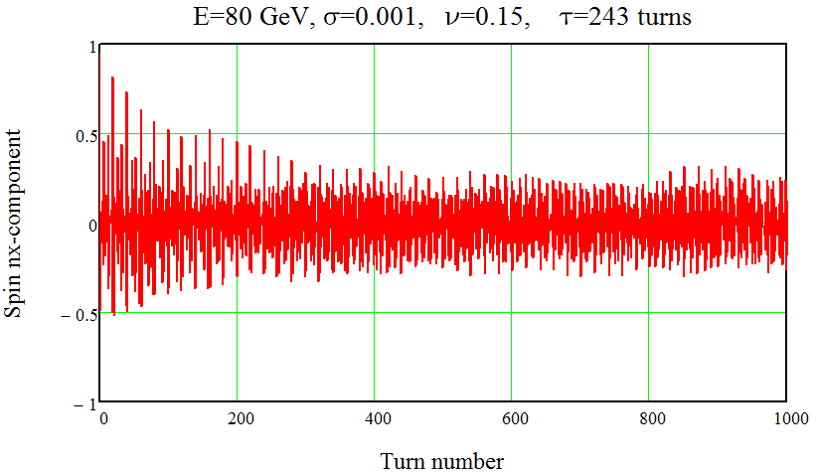
Spin tracking oscillogram. 125 test-particles.
E=80 GeV, σ_{δ}=0.001, ν_{s} =0.15, τ_{s} =243 turns

Slide 12
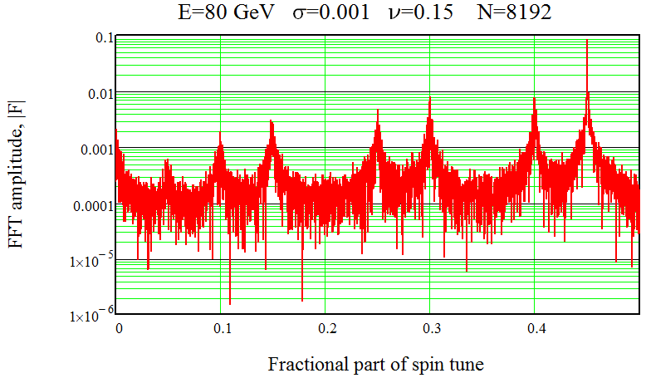
Spin precession spectrum. Number of turns 8192.
E=80 GeV, ν₀=181.55, σ_{δ}=0.001, ν_{s} =0.15, χ=1.21

Slide 13
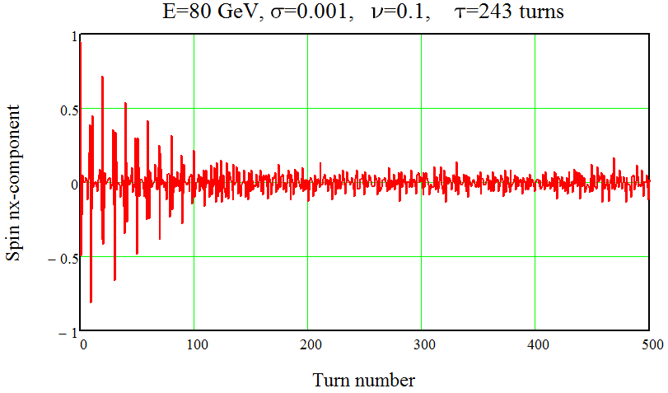
Spin tracking oscillogram. 125 test-particles.
E=80 GeV, σ_{δ}=0.001, ν_{s} =0.10, τ_{s} =243 turns
Fast de-phasing due to slow synchrotron motion!

Slide 14
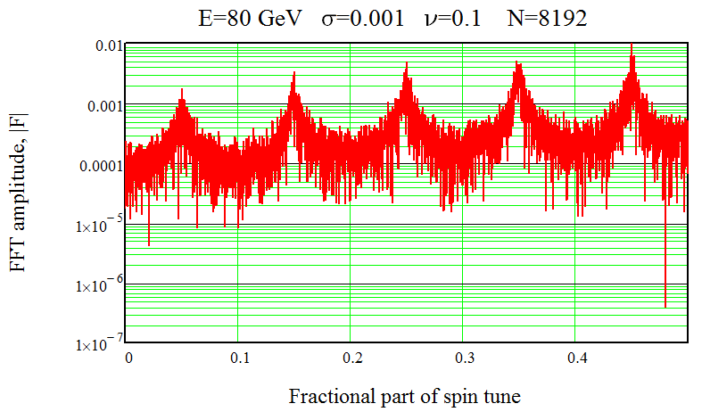
Spin precession spectrum. Number of turns 8192.
E=80 GeV, ν₀=181.55, σ_{δ}=0.001, ν_{s} =0.10, χ=1.82
Same results one gets with doubled both: energy spread and synchrotron tune.

Slide 15
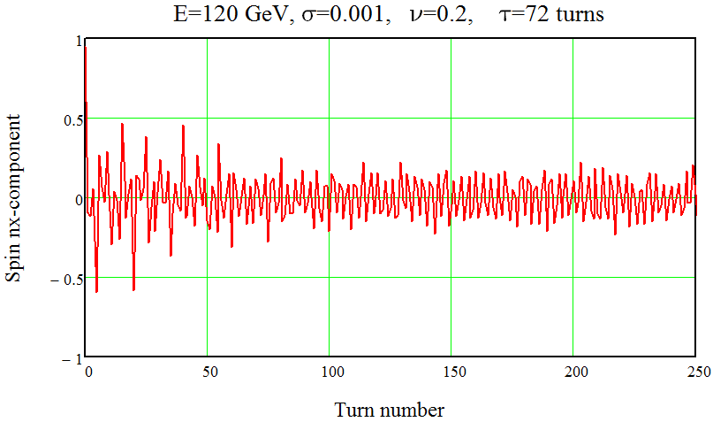
Spin tracking oscillogram. 125 test-particles.
E=120 GeV, σ_{δ}=0.001, ν_{s} =0.20, τ_{s} =72 turns
Fast de-phasing! Synchrotron modulation index is too high: χ=1.36.

Slide 16
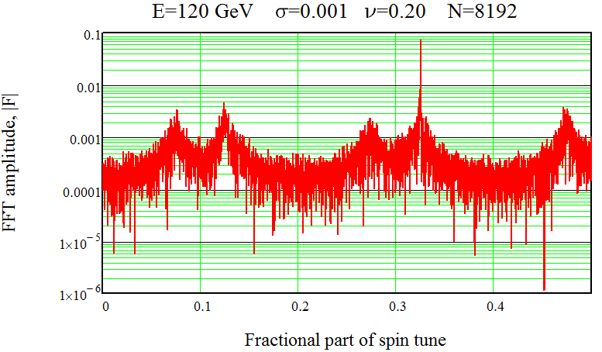
Spin precession spectrum. Number of turns 8192.
E=120 GeV, ν₀=272.325, σ_{δ}=0.001, ν_{s} =0.20, χ=1.36
Same results one gets with scaled both: energy spread and synchrotron tune.

Slide 17
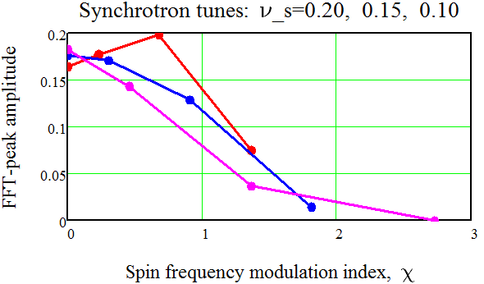
Discussion
Spin dephasing rate is governed by the synchrotron
frequency modulation index χ. It should be low enough:
χ < 1.7 at least. Collision with the half-intensity bunch will
reduce σ_{δ}, may help? Special polarization runs with high ν_{s},
to calibrate the Compton based spectrometers!?
VEPP-4 team performs just now the experiment “Pulsar” which, hope, will validate free spin precession technique.

Slide 18
Conclusion
Free precession approach provides extremely fast
method of spin frequency measurement.
It is limited only by the energy spread averaging rate, provided by the synchrotron oscillations. This is expressed via synchrotron modulation index. It should not exceed a factor x < 1.7 or lower. This, in general, leads to choice of high synchrotron tunes.
FCCee-CW parameters do not satisfy this requirement: ν_{s}≈ 0.015-0.05. So, special calibration runs with high ν_{s} are needed from time to time, then calibrated Compton magnetic spectrometers shall continuously monitor beam energy during normal runs.

Slide 19
Plans for future work
Incorporate into the ring the 90⁰ spin rotator insertions for experiments with longitudinally polarized beams at Z-peak. Required additional space could be shared with RF.
Make numerical simulations of the saw-tooth energy model reconstruction code.
Develop/understand the acceleration chain for polarized beams.
Simulate tools for suppression of spin resonances.
Consider technical aspects of Compton polarimeter and Compton magnetic spectrometer. Combine them in one?
Think on resonance depolarization technique, as an alternative to free spin precession method.
There are more experts at BINP for these tasks! Polarization is our specialty since 70-th!

