Slide 1
11T Dipole models instrumentation

Slide 2
Strategy for V_{taps} location in the original design
Mid-plane turn (high stress region) and pole turn (high field) “fully monitored” to have a good quench location.
Every block instrumented (redundant configuration) to study quench propagation within the coil.
Splice monitoring
31 V_{TAPS} per coil up to coil #113

Slide 3
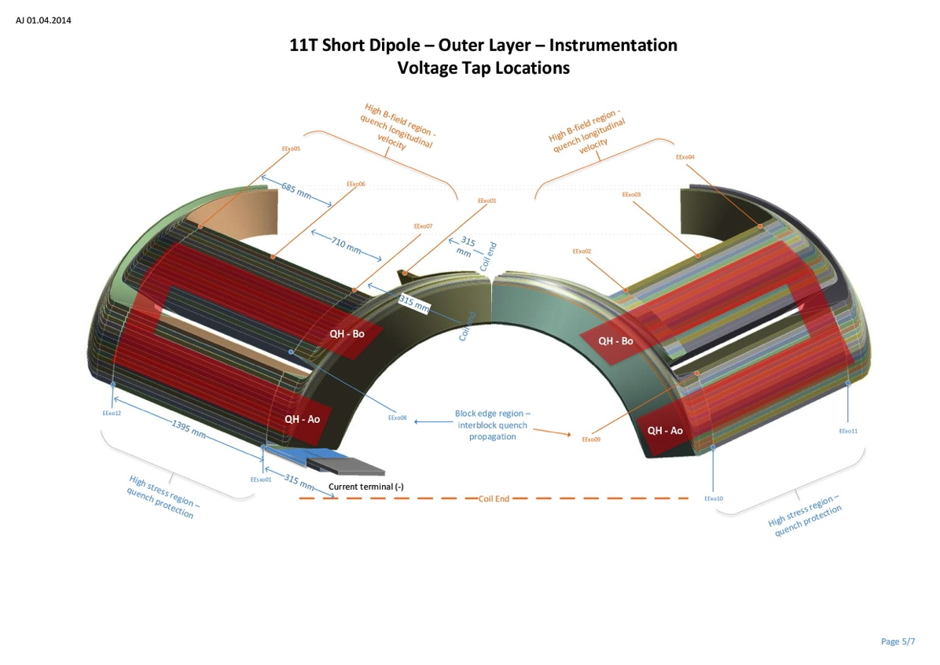
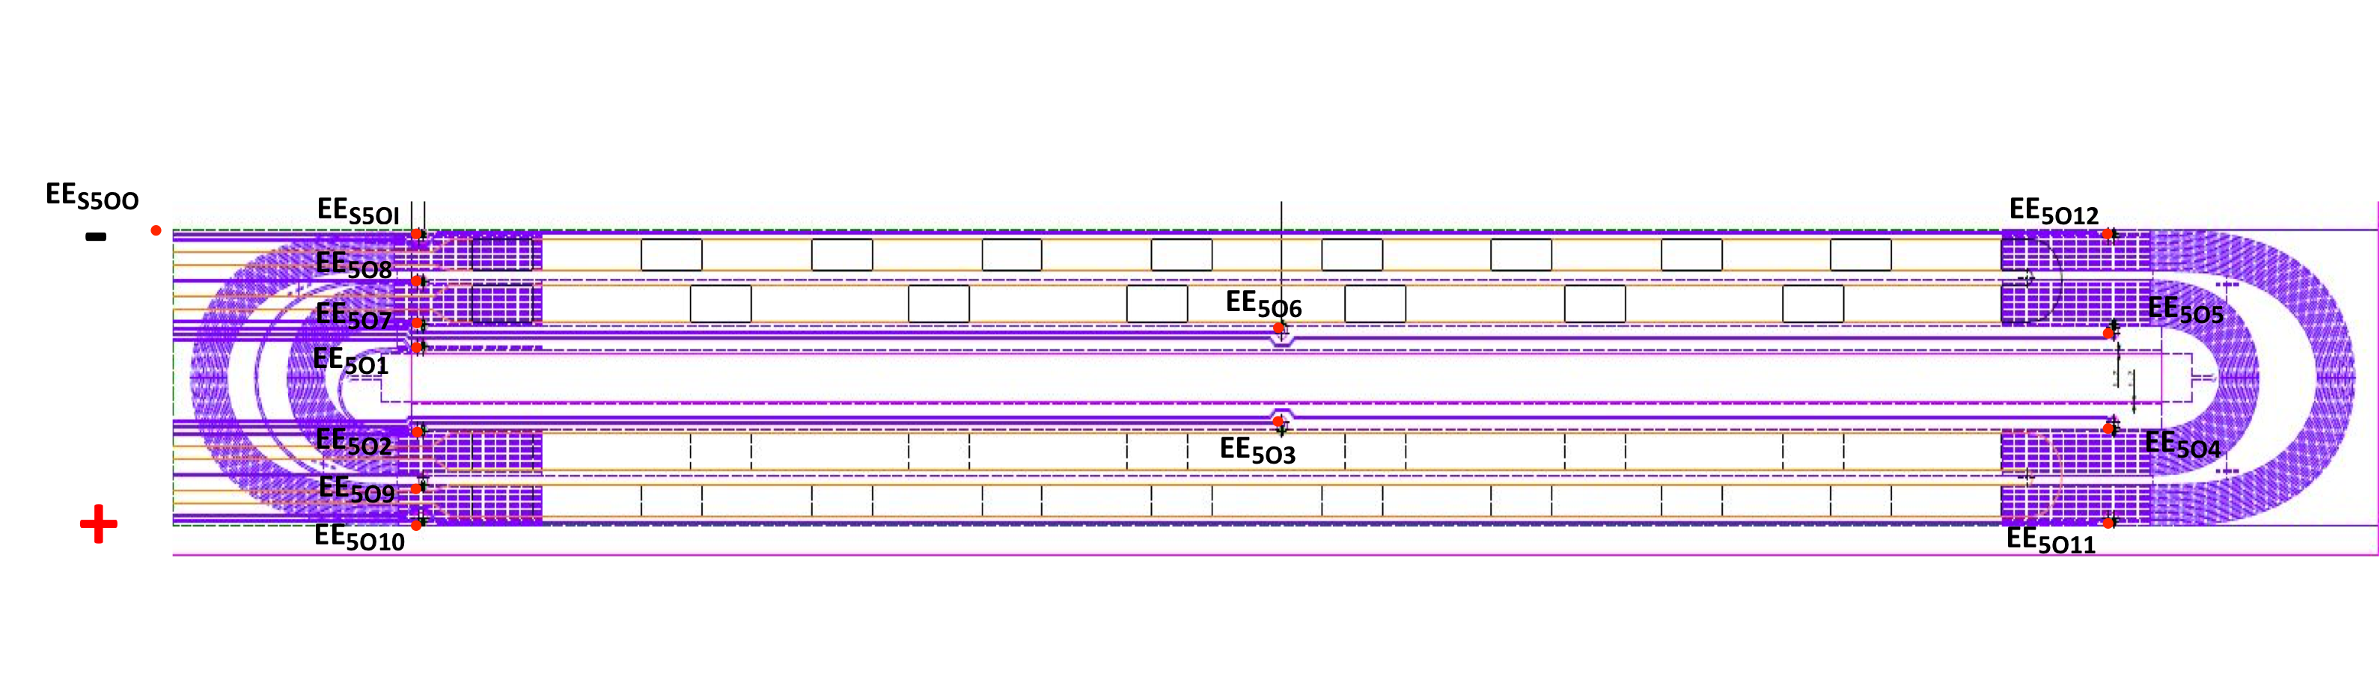
Present Coil instrumentation layout. Outer layer V_{TAPS} configuration up to coil #113
13 V_{TAPS} on the outer layer turns
1 V_{TAP} on the NbTi powering lead for splice resistance measurement

Slide 4
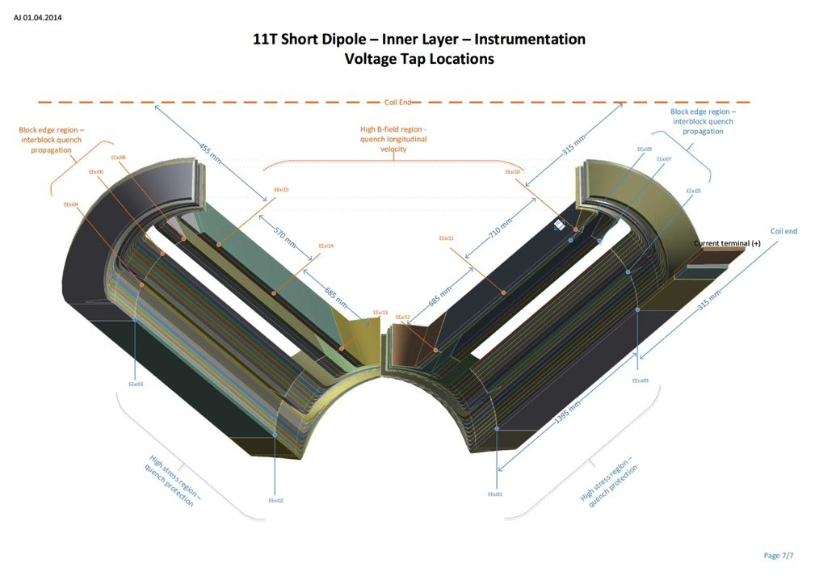
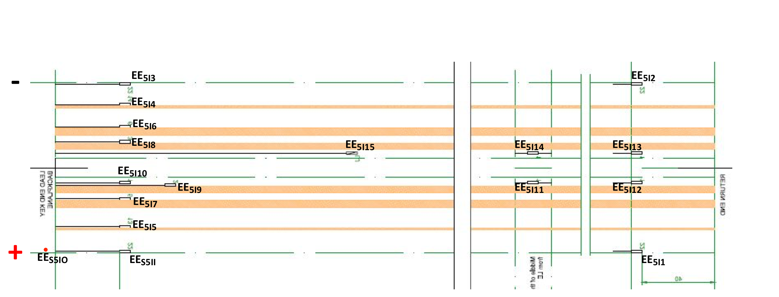
Present Coil instrumentation layout. Inner layer V_{TAPS} configuration up to coil #113
16 V_{TAPS} on the inner layer turns
1 V_{TAP} on the NbTi powering lead for splice resistance measurement

Slide 5
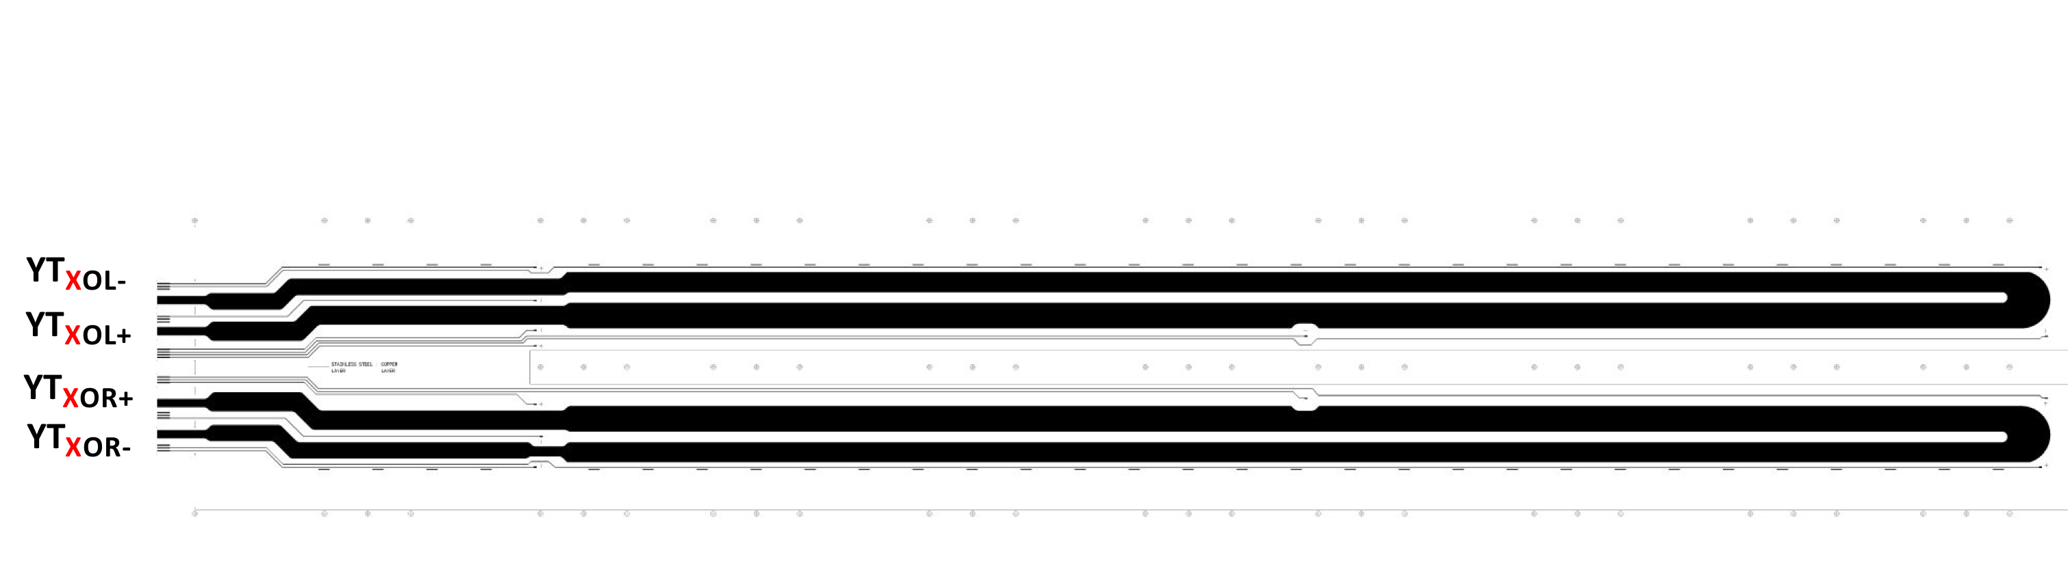
Quench Heaters
Quench heater only in the outer layer
2 independent heater circuit per coil
8 powering leads per aperture

Slide 6
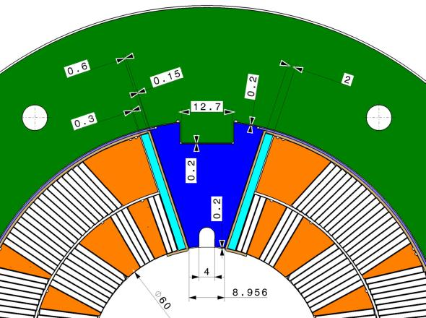

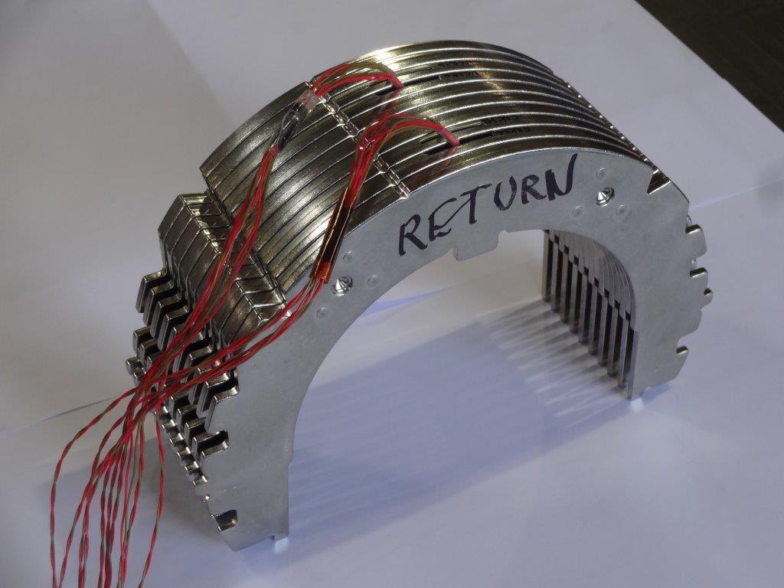
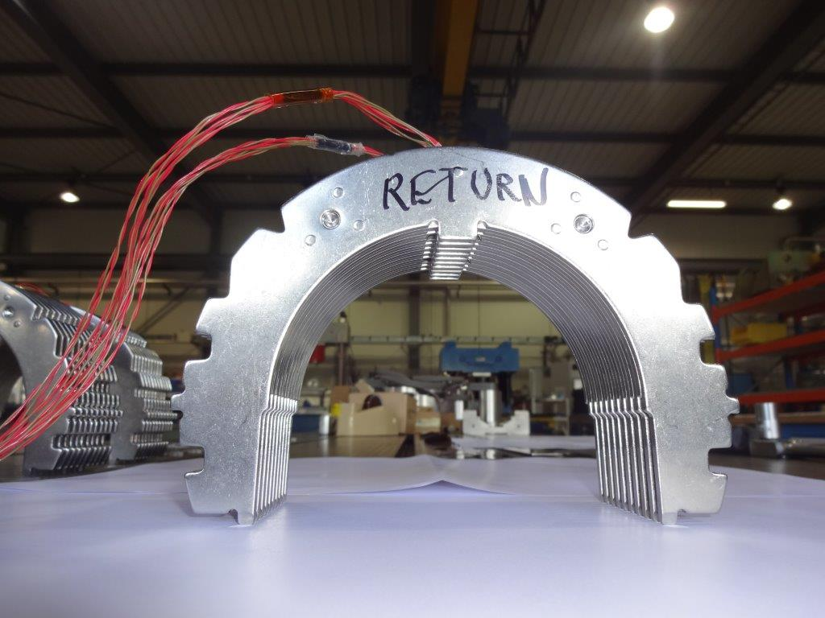
Instrumented collar packs configuration on MBHSP102 & MBHSP103
2 Strain gauges per collar in ½ bridge configuration (5 wires/gauge)
A collared coil is assembled using 3 instrumented collar-packs equipped with 8 strain gauges each

Slide 7
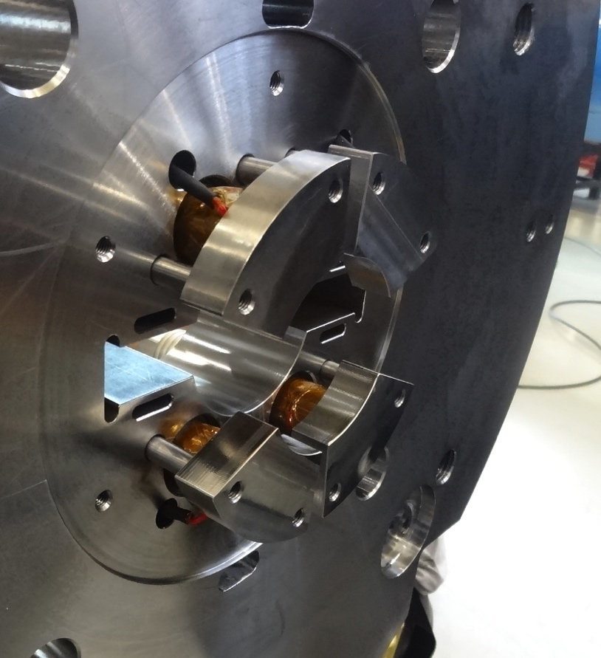
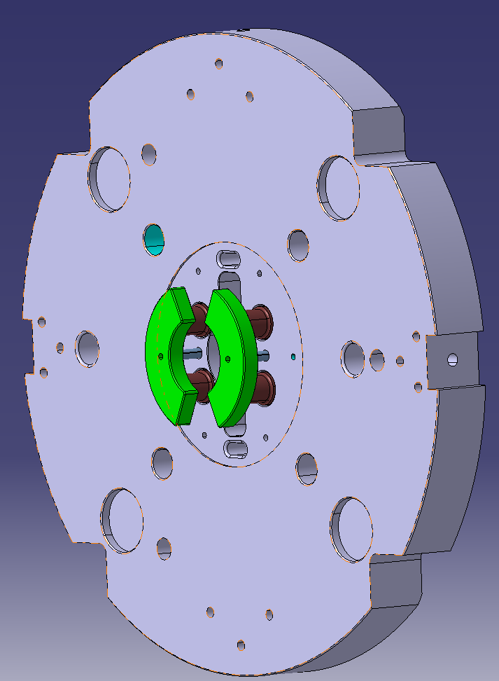
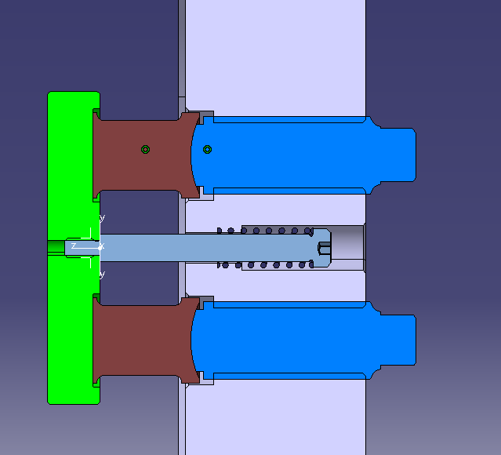
Bullet gauges
4 bullet per extremity equipped with 4 gauges in full bridge configuration
40 wires used for bullet gauges monitoring
New bullet gauges design from MBHSP103

Slide 8
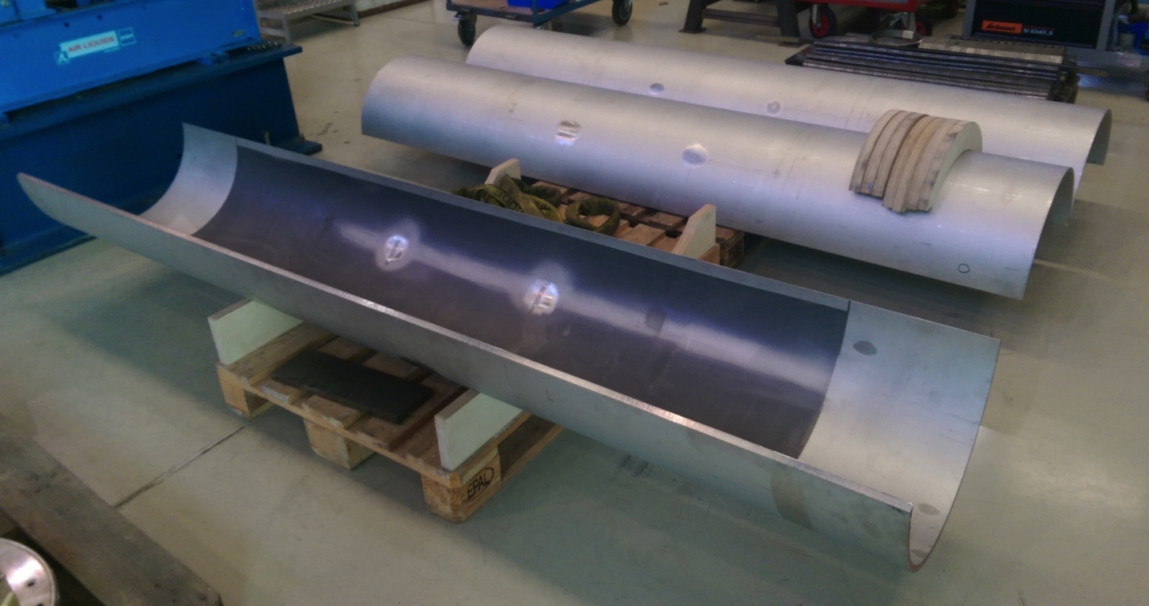
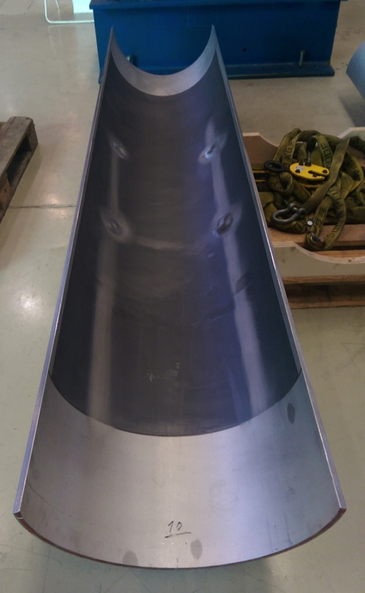
½ shells instrumentation
2 stainless steel ½ shells instrumented at 8 different locations (inner & outer radius: 16 strain gauges)
4 wires configuration (1/4 bridge)
4 temperature compensators requiring 4 wires each (1/4 bridge)
80 wires in total for shells instrumentation

Slide 9
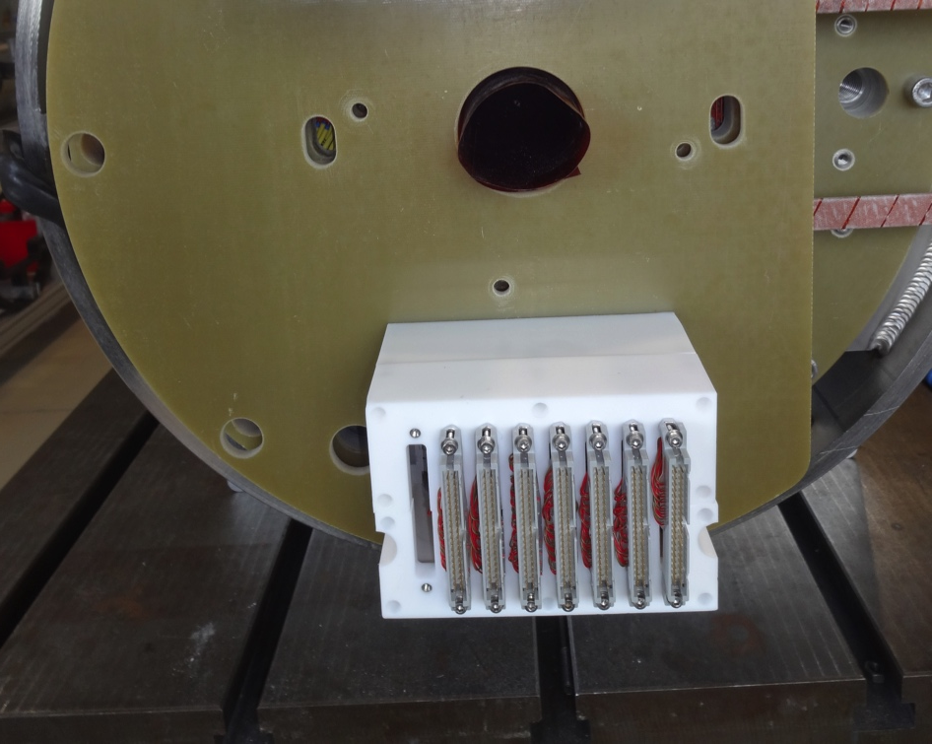
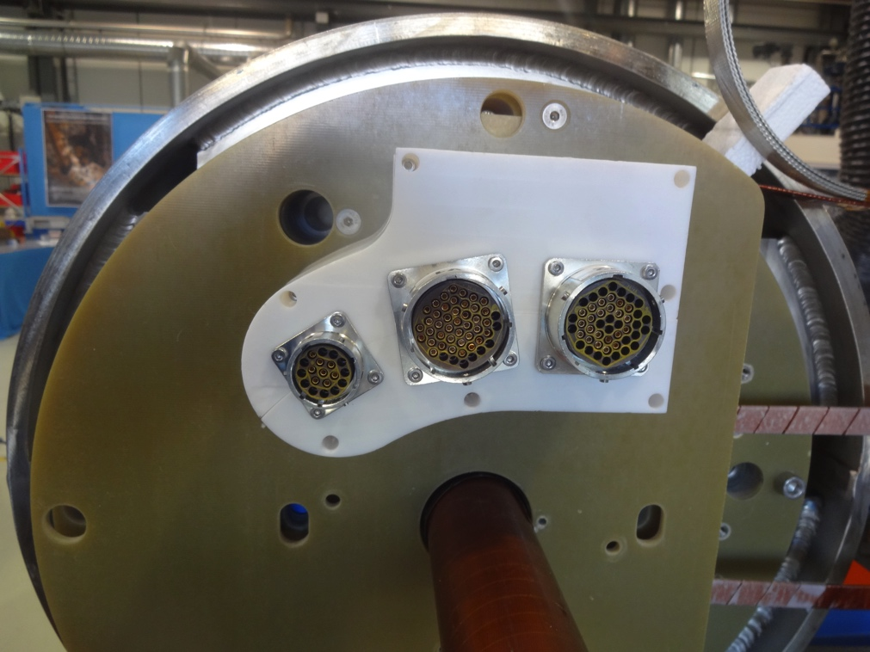
Instrumentation connectors on single aperture
1 Burndy 19 pins connector for Quench Heaters (8 contacts used)
2 Burndy 48 pins connector V_{taps} (2 * 31 contacts used)
6 “3M” 40 pins connectors for mechanical instrumentation (248 contacts)
2 “3M” 40 pins connectors for shell instrumentation (80 contacts)

Slide 10
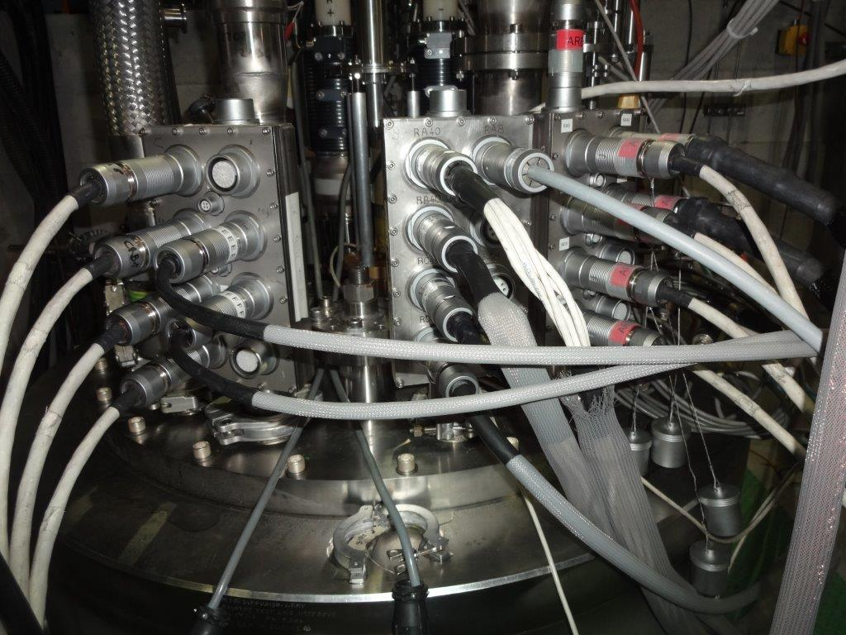
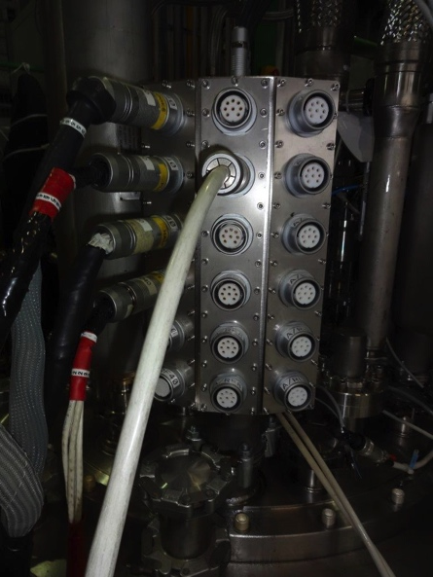
Wires & connectors
 | QH connectors | QH wires | Vtaps connectors | Vtaps wires | Instrum. connectors | Instrum. wires
Long insert 1 | 2 * 8 pins | 16 | (13 * 8 ) | 104 – 4=100 | 9 * 40 | 360
Long insert 2 | 4 * 8 pins | 32 | (10 * 8 *2) | 160 – 4=156 | 9 * 40 | 360
1 in 1 models | 1 * 19 | 8 | 2 * 48 | 62 | 7 * 40 | 248
2 in 1 models | 2 * 19 | 16 | 4 * 48 | 124 | 14 * 40 | 416

Slide 11
What can we remove?
Based on what we learnt, what can be removed without loosing much information about quench location and protection?

Slide 12
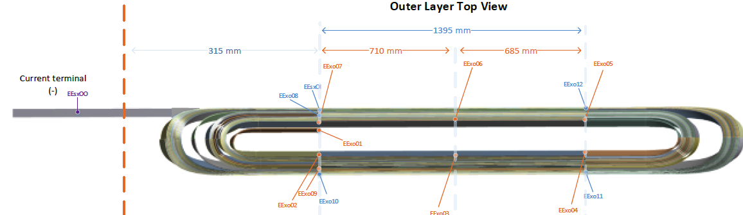
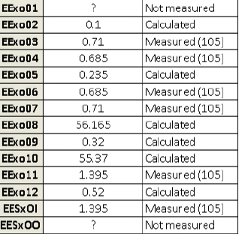
Outer layer V_{TAPS} configuration
Present outer layer
14 V_{TAPS}
8 V_{TAPS}
V_{TAPS} that can be removed
Without loosing significant information…
Redundant V_{TAPS} (xo09) (-1)
Mid V_{TAPS} on the pole turn (xo03 and xo06) (-2)
Loosing a bit of information…
If we are not worried about the mid-plane, we can also remove V_{TAPS}(xoO10, xoO11 and xoO12) (-3)
12

Slide 13
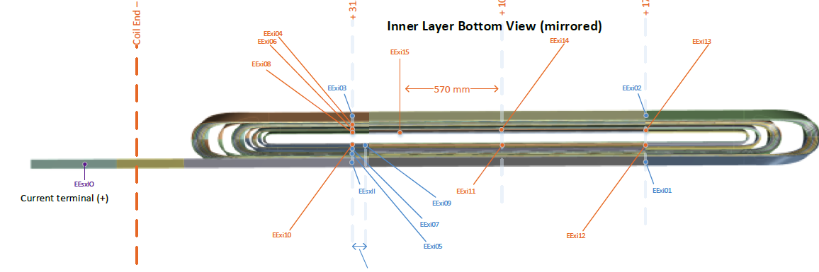
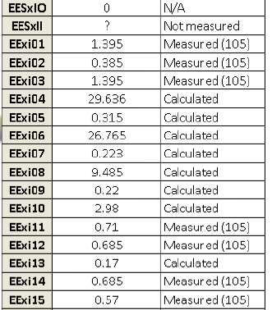
Inner layer V_{TAPS} configuration
Present inner layer
17 V_{TAPS}
9 V_{TAPS}
V_{TAPS} that can be removed
Without loosing significant information…
Redundant V_{TAPS} (xi04, xi06, xi08) (-3)
Mid V_{TAPS} on the pole turn (xi11 and xo14) (-2)
Loosing a bit of information…
If we are not worried about the mid-plane, we can also remove V_{TAPS} (xi01, xi02 and xi03) (-3)
13

