Slide 1
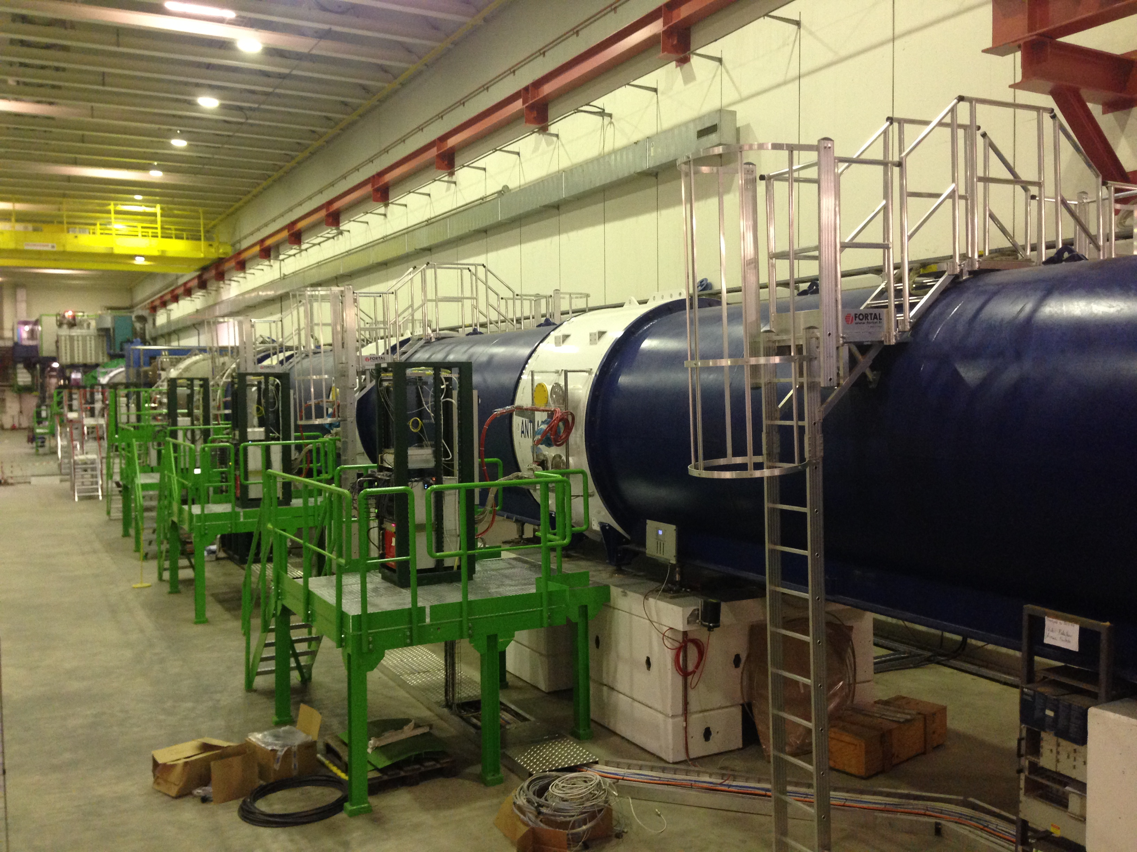
NA62
Vacuum control commissioning and alarms system
Jun 11, 2015

Slide 2
Overview
Corrective measures during TS
  Cabling & Esthetic
  Membrane gauges
New alarms and interlocks implemented
  General synoptic
  Alarms from clients
  Alarms to clients
  Interlocks
Commissioning
Jun 11, 2015
2

Slide 3
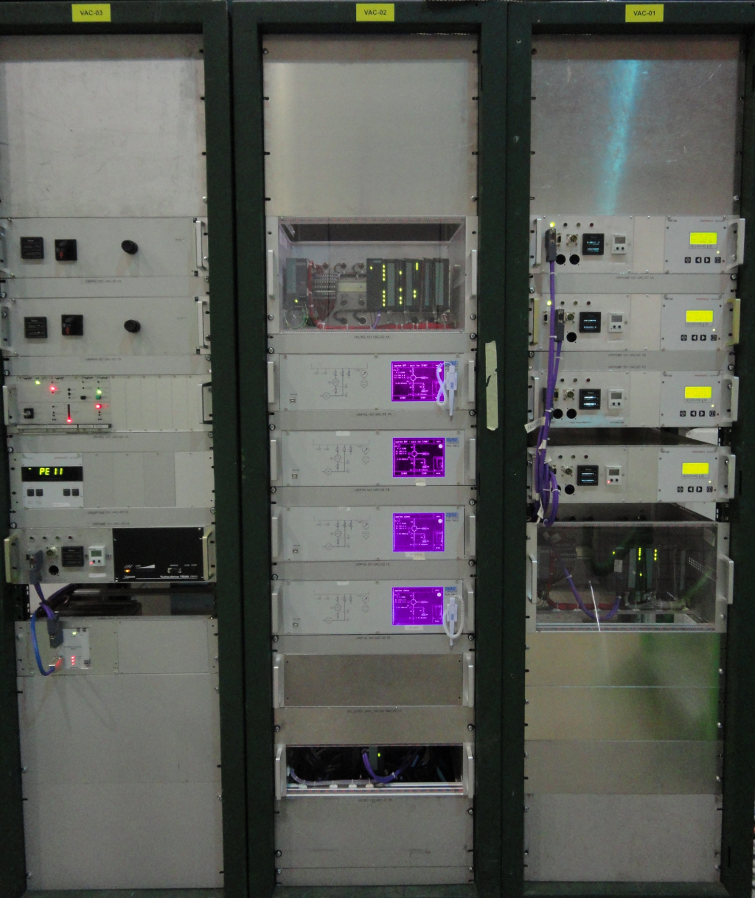
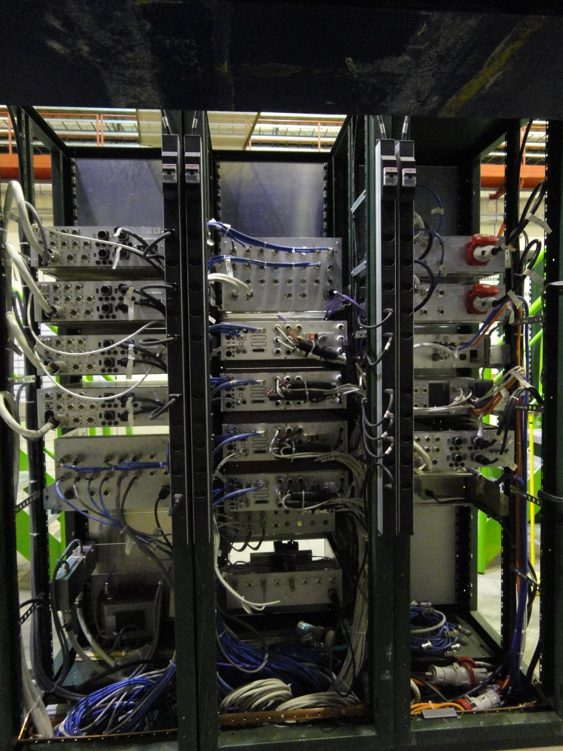
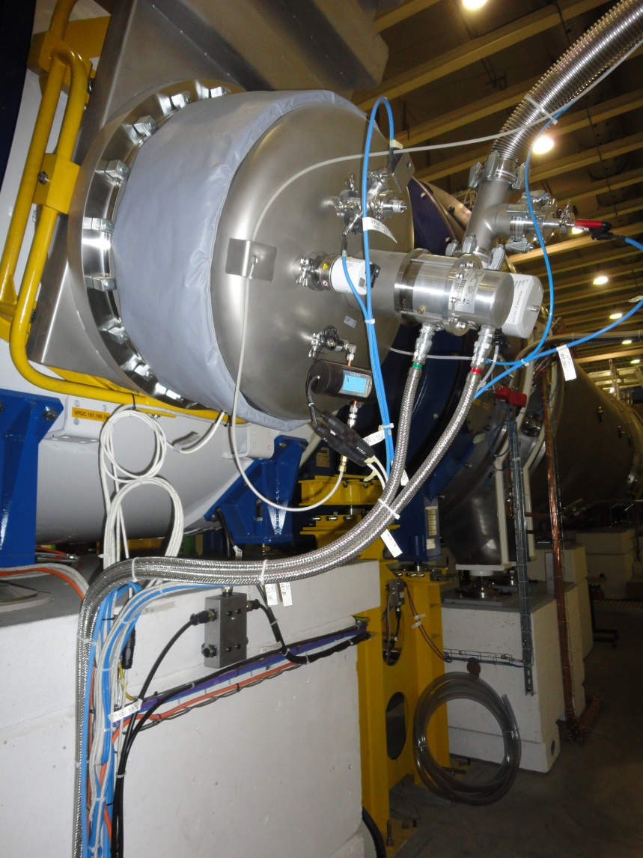
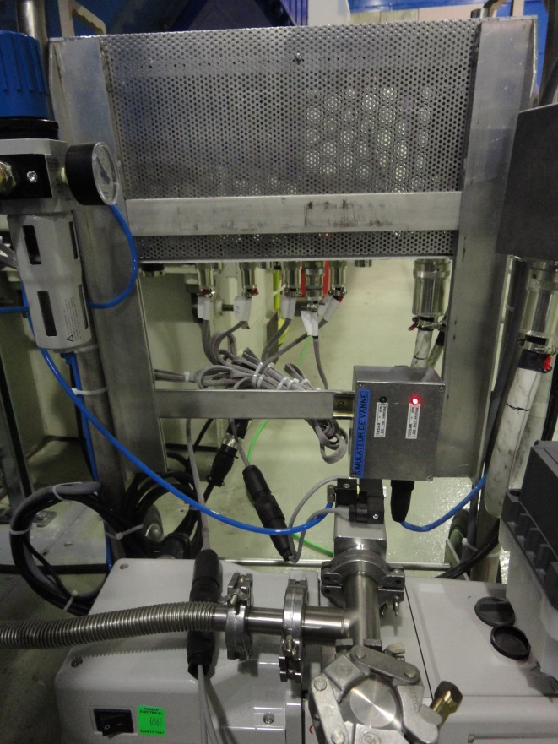
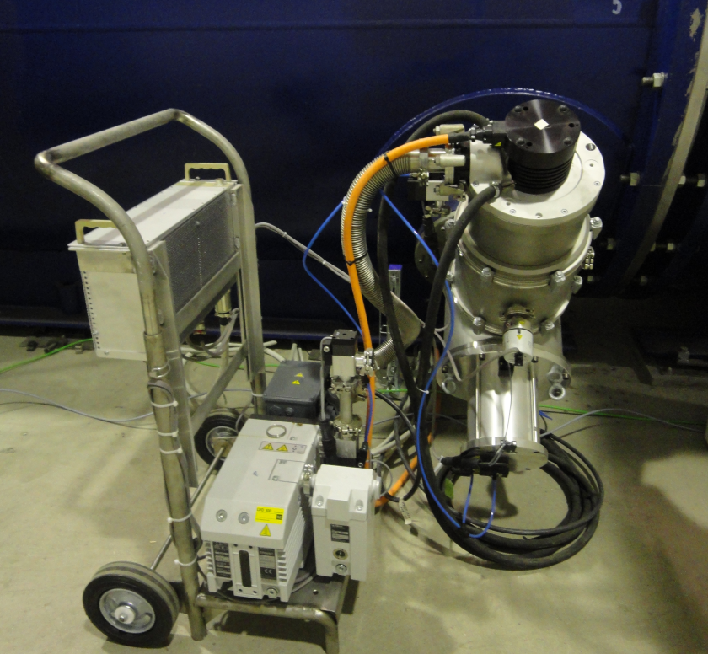
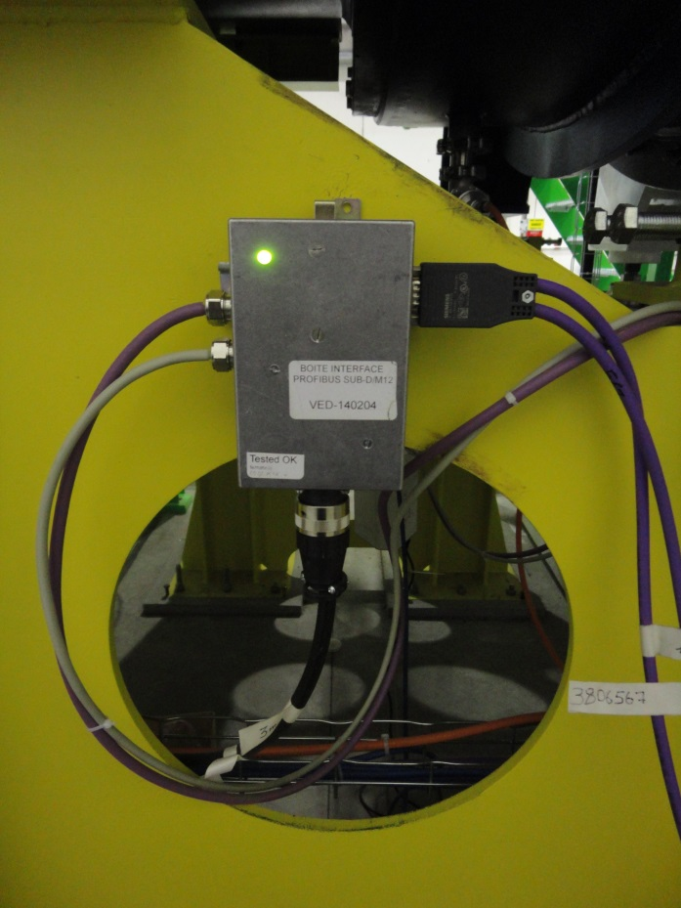
Corrective measures during TS: Cabling & Esthetic
Equipment:
8x Control racks
7x Cryo-pumps
6x VPGs
4x Profibus local boxes
2x Valve simulator boxes
Manpower
3 people (FSU)
~200h
2
3

Slide 4
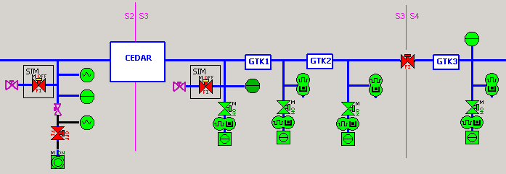
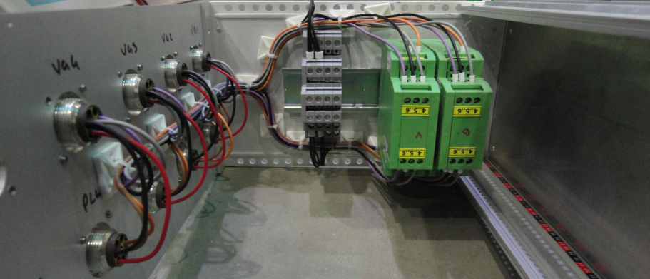
Corrective measures during TS: Membrane gauges
Membranes gauges with radiation tolerance were installed in sectors 2, 3 and 4 with the unusual voltage supply of ±13.5 VDC
The below electronic crate was designed in order to adapt the supply coming from the PLC crate: 24VDC / ±13.5 VDC
VED-141205(DC_DC_converter_chassis_for_gauges)
3
4
Jun 11, 2015

Slide 5
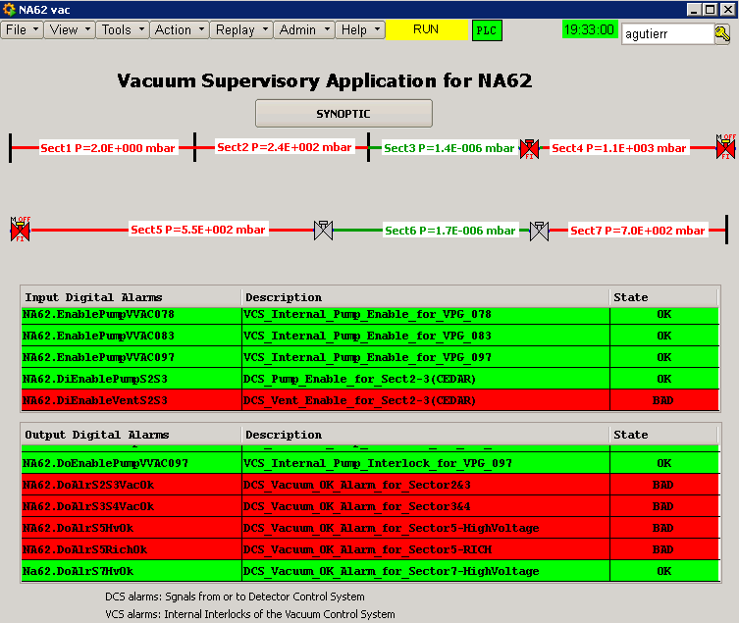
New alarms and Interlocks implemented: General synoptic
From clients
To clients
Jun 11, 2015
5

Slide 6
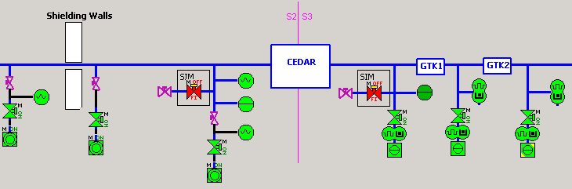
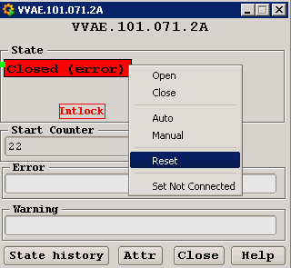
New alarms and Interlocks implemented: Alarms from clients
NA62.DiEnablePumpS2S3: OK
NA62.DiEnablePumpS2S3: BAD
If not rupture in CEDAR window VVRs = OK
If rupture in CEDAR window
VVRs = FULL INTERLOCK
CEDAR WINDOW: BAD
CEDAR WINDOW: OK
Jun 11, 2015
6

Slide 7
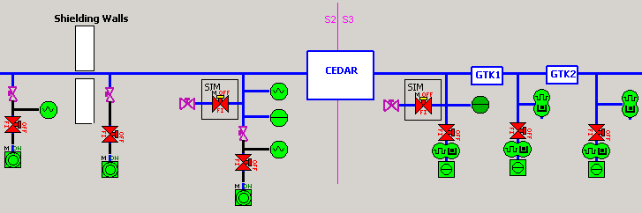

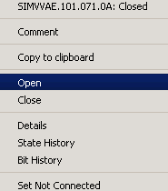
New alarms and Interlocks implemented: Alarms from clients
NA62.DiEnableVentS2S3: OK
NA62.DiEnableVentS2S3: BAD
If CEDAR not ATM
VV SIM = FULL INTERLOCK
If CEDAR at ATM
VV SIM = OK
CEDAR at ATM: OK
CEDAR at ATM: BAD
Jun 11, 2015
7

Slide 8
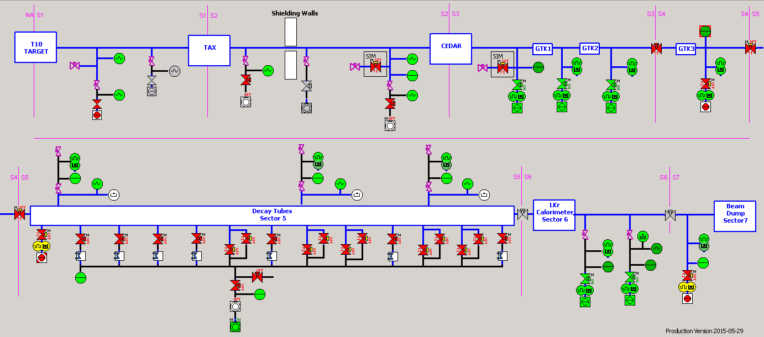
New alarms and Interlocks implemented: Alarms to clients
Output Digital Alarms | Description | Upper Threshold | Lower Threshold
NA62.DoAlrS2S3VacOk | Enable Inside CEDAR pumping (if S2 and S3 are under vacuum) | 1 mbar | 1 mbar
NA62.DoAlrS3S4VacOk | Enable GTK cooling (if S3 and S4 are under vacuum) | 1mbar | 1mbar
NA62.DoAlrS5HvOk | Enable High Voltage on LAV (if S5 atmosphere or under high vacuum) | 1099 / 8.5e-4 mbar | 900 / 8.1e-4 mbar
NA62.DoAlrS5RichOk | Enable Inside RICH pumping (if S5 is under vacuum) | 10 mbar | 10 mbar
Na62.DoAlrS7HvOk | Enable High Voltage on SAC (if S7 atmosphere or under high vacuum) | 1099 / 1e-4 mbar | 900 / 1e-4 mbar
[NA62]HW_Alarms(ProdVers)
Jun 11, 2015
8

Slide 9
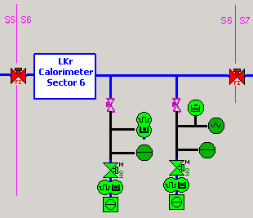
New alarms and Interlocks implemented: Interlocks
RACK: VAC-06
VVS ITL
1e-1.5mbar
To protect the LKr Calorimeter against over pressure:
2 new interlocks implemented (previous and before valves)
Designing of specific control crate to interlock VP3
VED-141114(Chassis VP-3 adapted for TPG_ITL)
Dedicated UPS crate supplying TPG 300 and VP3
Pumping groups connected to UPS strip socket
SMS and email notifications in case of VPG or VVR
error or switch off (e.g. Power cut)
VAT_VP3
VAT_VP3
Jun 11, 2015
9

Slide 10
Commissioning
In order to assure the correct functionality of the control system a careful commissioning is being carried out:
Checking the behavior of all the equipment after re-cabling
Testing alarms with the clients
Testing interlocks with vacuum operators
Following the pressure measure during the pump down
Special thanks to Jeremy, Philippe and Khalid for the great work done
Jun 11, 2015
10
Notes:
En effet, je connais les cartes de vannes, les chassis d’interlocks, experience en CPLD et FPGA/simulation
J’ai deja commence une collaboration avec un industriel pour trouver une alternative au TPG
J’ai deja etudie l’electronique de mesure des jauges dans les arcs
J’ai deja realiser des tests d’alimentation a decoupage industrielle pour le remplacement des anciennes
J’ai superviser les etudes pour les tests sous radiations
J’ai acquis une experience importante Durant le LS1 sur le HW primordial pour effectuer ces changements dans le future.

Slide 11
Thanks for your attention!!
Jun 11, 2015
11
Notes:
En effet, je connais les cartes de vannes, les chassis d’interlocks, experience en CPLD et FPGA/simulation
J’ai deja commence une collaboration avec un industriel pour trouver une alternative au TPG
J’ai deja etudie l’electronique de mesure des jauges dans les arcs
J’ai deja realiser des tests d’alimentation a decoupage industrielle pour le remplacement des anciennes
J’ai superviser les etudes pour les tests sous radiations
J’ai acquis une experience importante Durant le LS1 sur le HW primordial pour effectuer ces changements dans le future.

