Slide 1
Defining Separatrices of Penning Traps with Strong Magnetic Mirrors
Stephanie (Alex) Brown

Slide 2
AEgIS
(Antihydrogen Experiment: Gravity, Interferometry, Spectroscopy)
The main goal of AEgIS is to see how gravity interacts with antimatter
Antimatter does seem to have some differences from matter

Slide 3
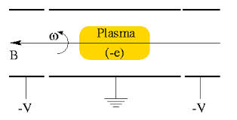
Holding Antihydrogen Plasma
Magnetic traps in a vacuum are used to hold Antimatter
We are using a Penning Trap with a magnetic mirror

Slide 4
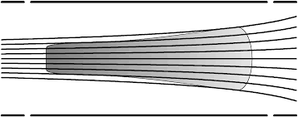
Problems?
Magnetic Mirrors
High mirror ratio

Slide 5
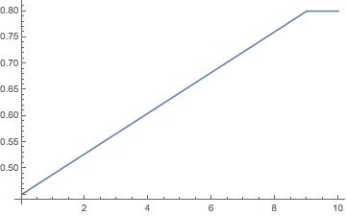
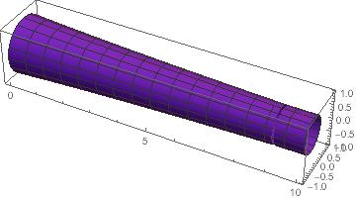
Enter: Summer Student

Slide 6
So the usual suspects are out…

Slide 7
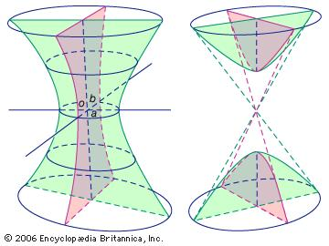
Next?
Separatrix!
These define the border of two regions:

Slide 8
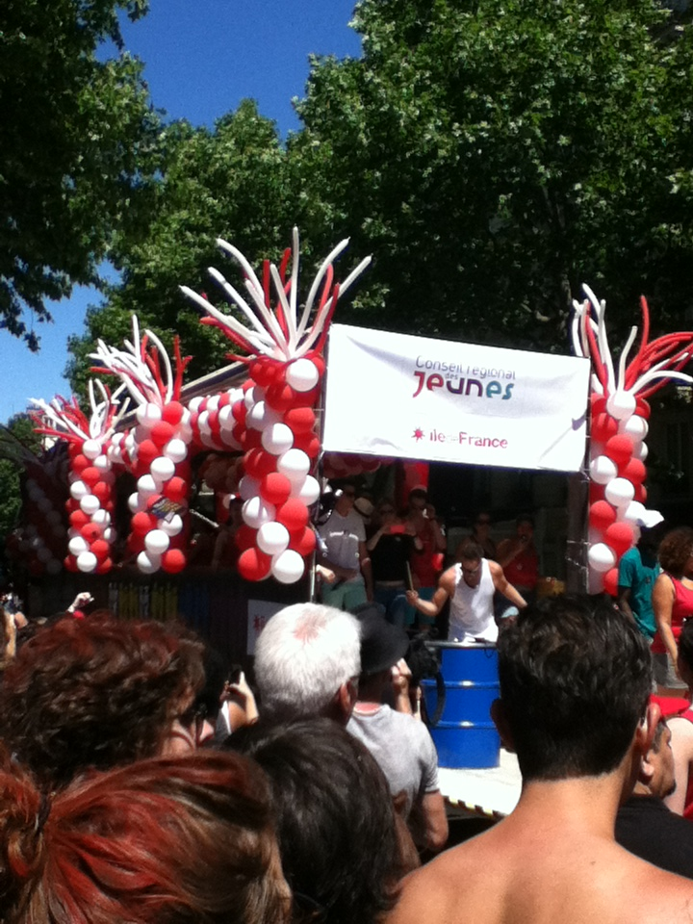
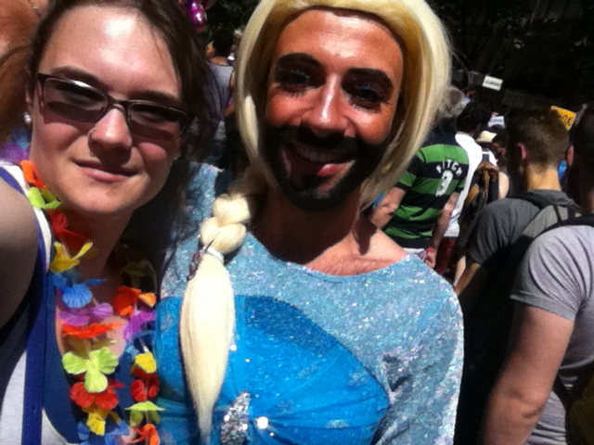
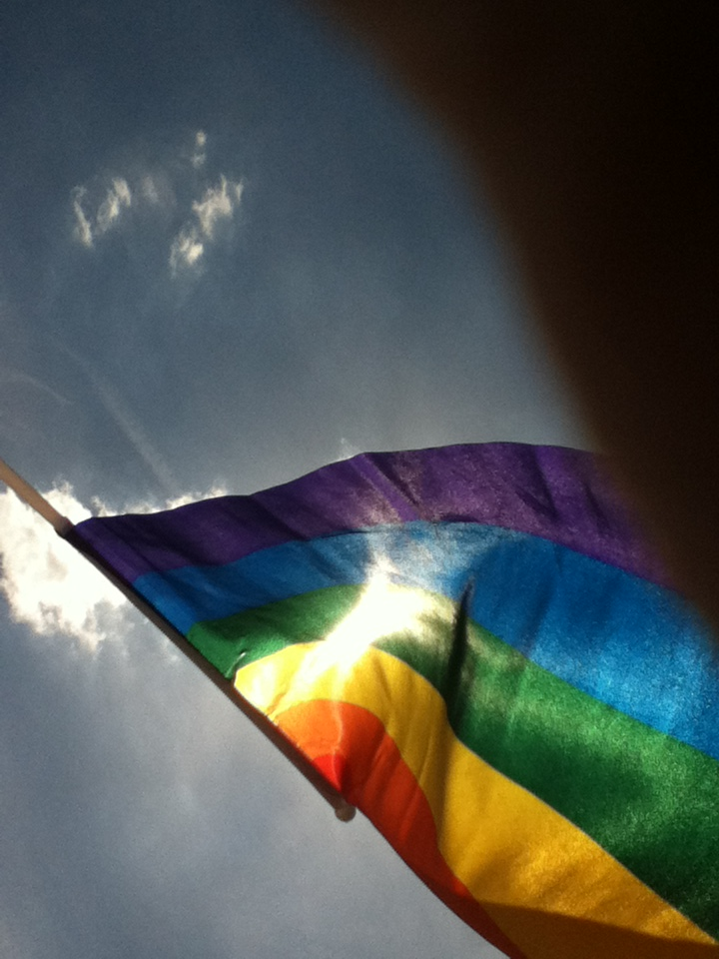
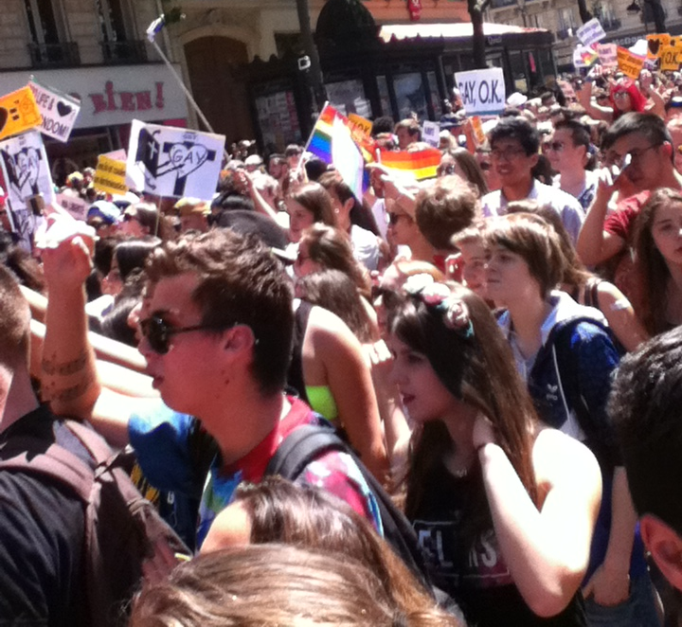
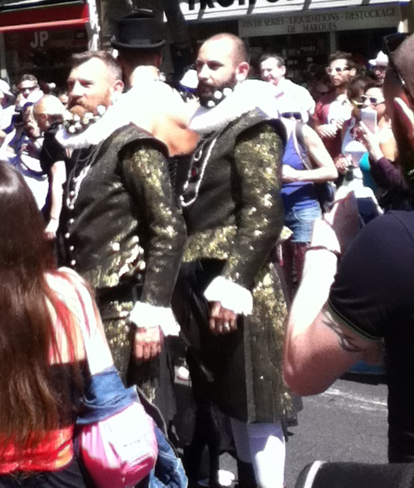
100,000

Slide 9
