Slide 1

Sarah Marie Bruno
Sarah.marie.bruno@cern.ch

Slide 2
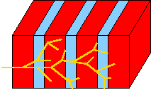
HGCAL OVerview
Endcap
      More sensitive to radiation
      Crystals degrade quickly and must be replaced – expensive!
      New design – replace with silicon sensors
Barrel
      Keep crystal (shashlik) design
      Crystal segments with scintillating fiber through the center

Slide 3
Gamma Gun Data Set
Simulation to test performance of HGCal (endcap calorimeter)
Pile-up-free sample (pile-up=noise in system, limitation of the detectors)
Not realistic – we know where the photons originate, because that is input in the simulation.

Slide 4
Tree organization
Data Set
Event
ROI
Cluster
Hit

Slide 5
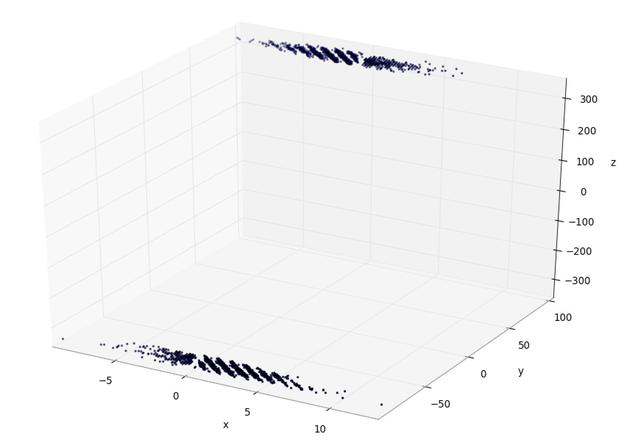
Scatter Plot - Reconstructed Collision (Event 1)
2 clusters in this ROI (C0 and C1)
ROI 1
2 Regions of interest correspond to the two photons.
3 clusters in this ROI (C2, C3,C4)
ROI 2

Slide 6
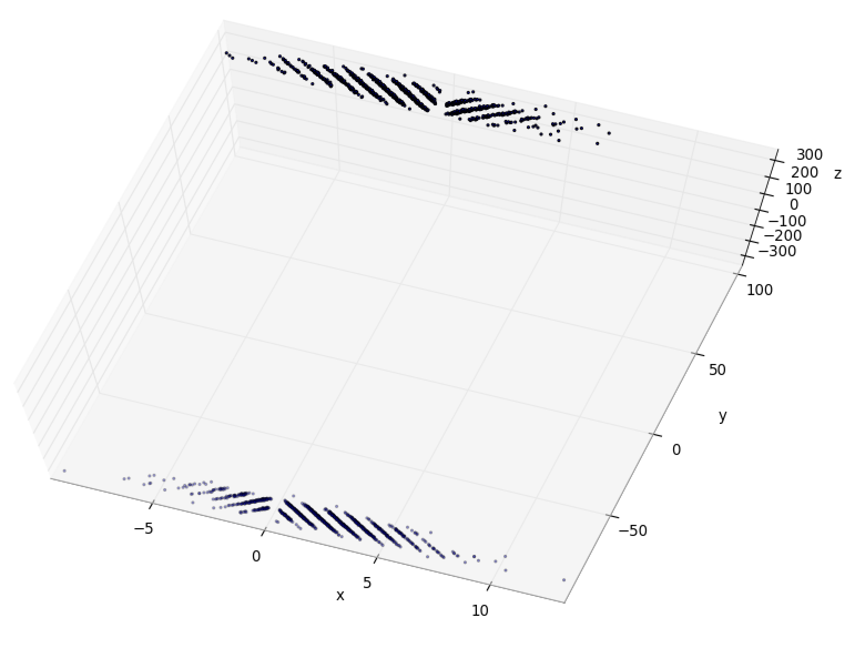
Scatter Plot - Reconstructed Collision
Diagonal lines of hits visible, showing location of sensor array.

Slide 7
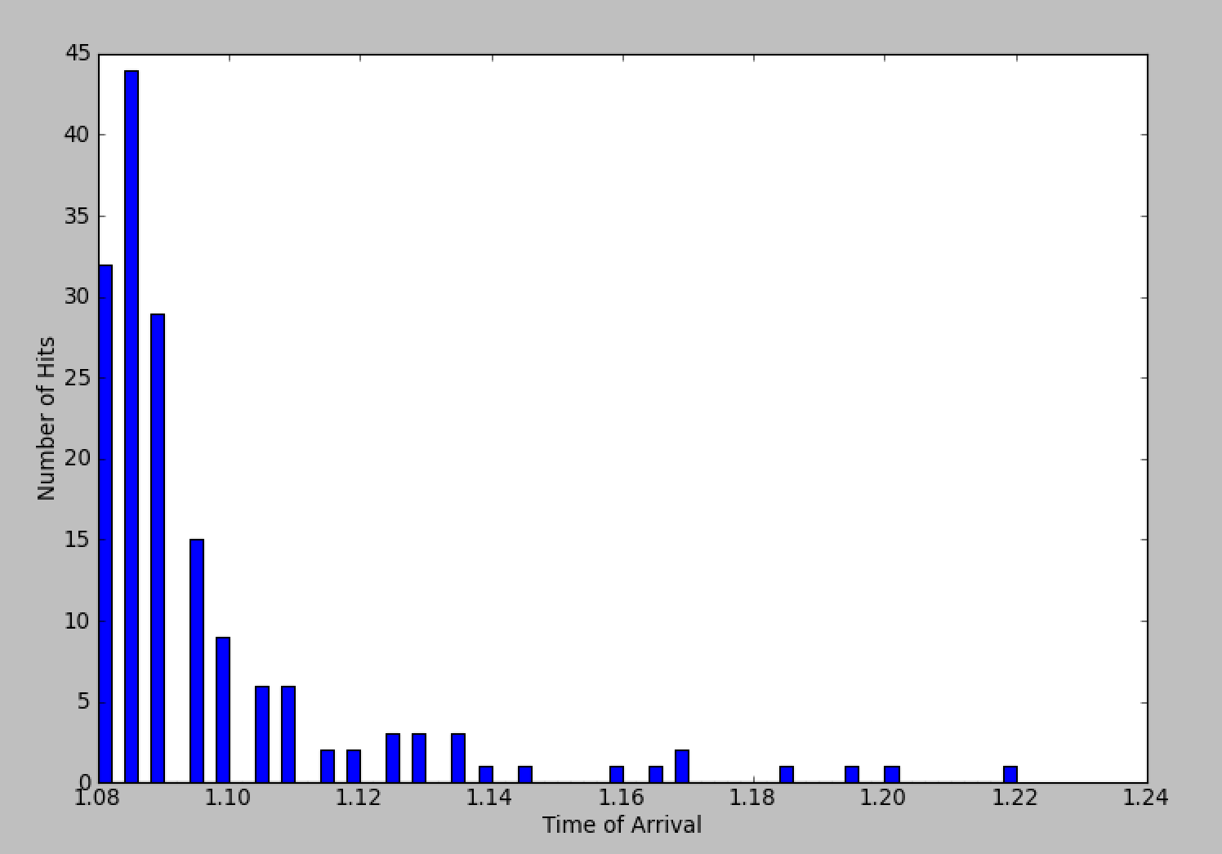
Number of Hits for a given time of Arrival (First Event, One cluster)
Can we improve the stability of the mean time of arrival?
First thought – either just take the mode or energy weight the hits recorded.
No – late hits are actual physics –photon propagating a long way in tracker.

Slide 8
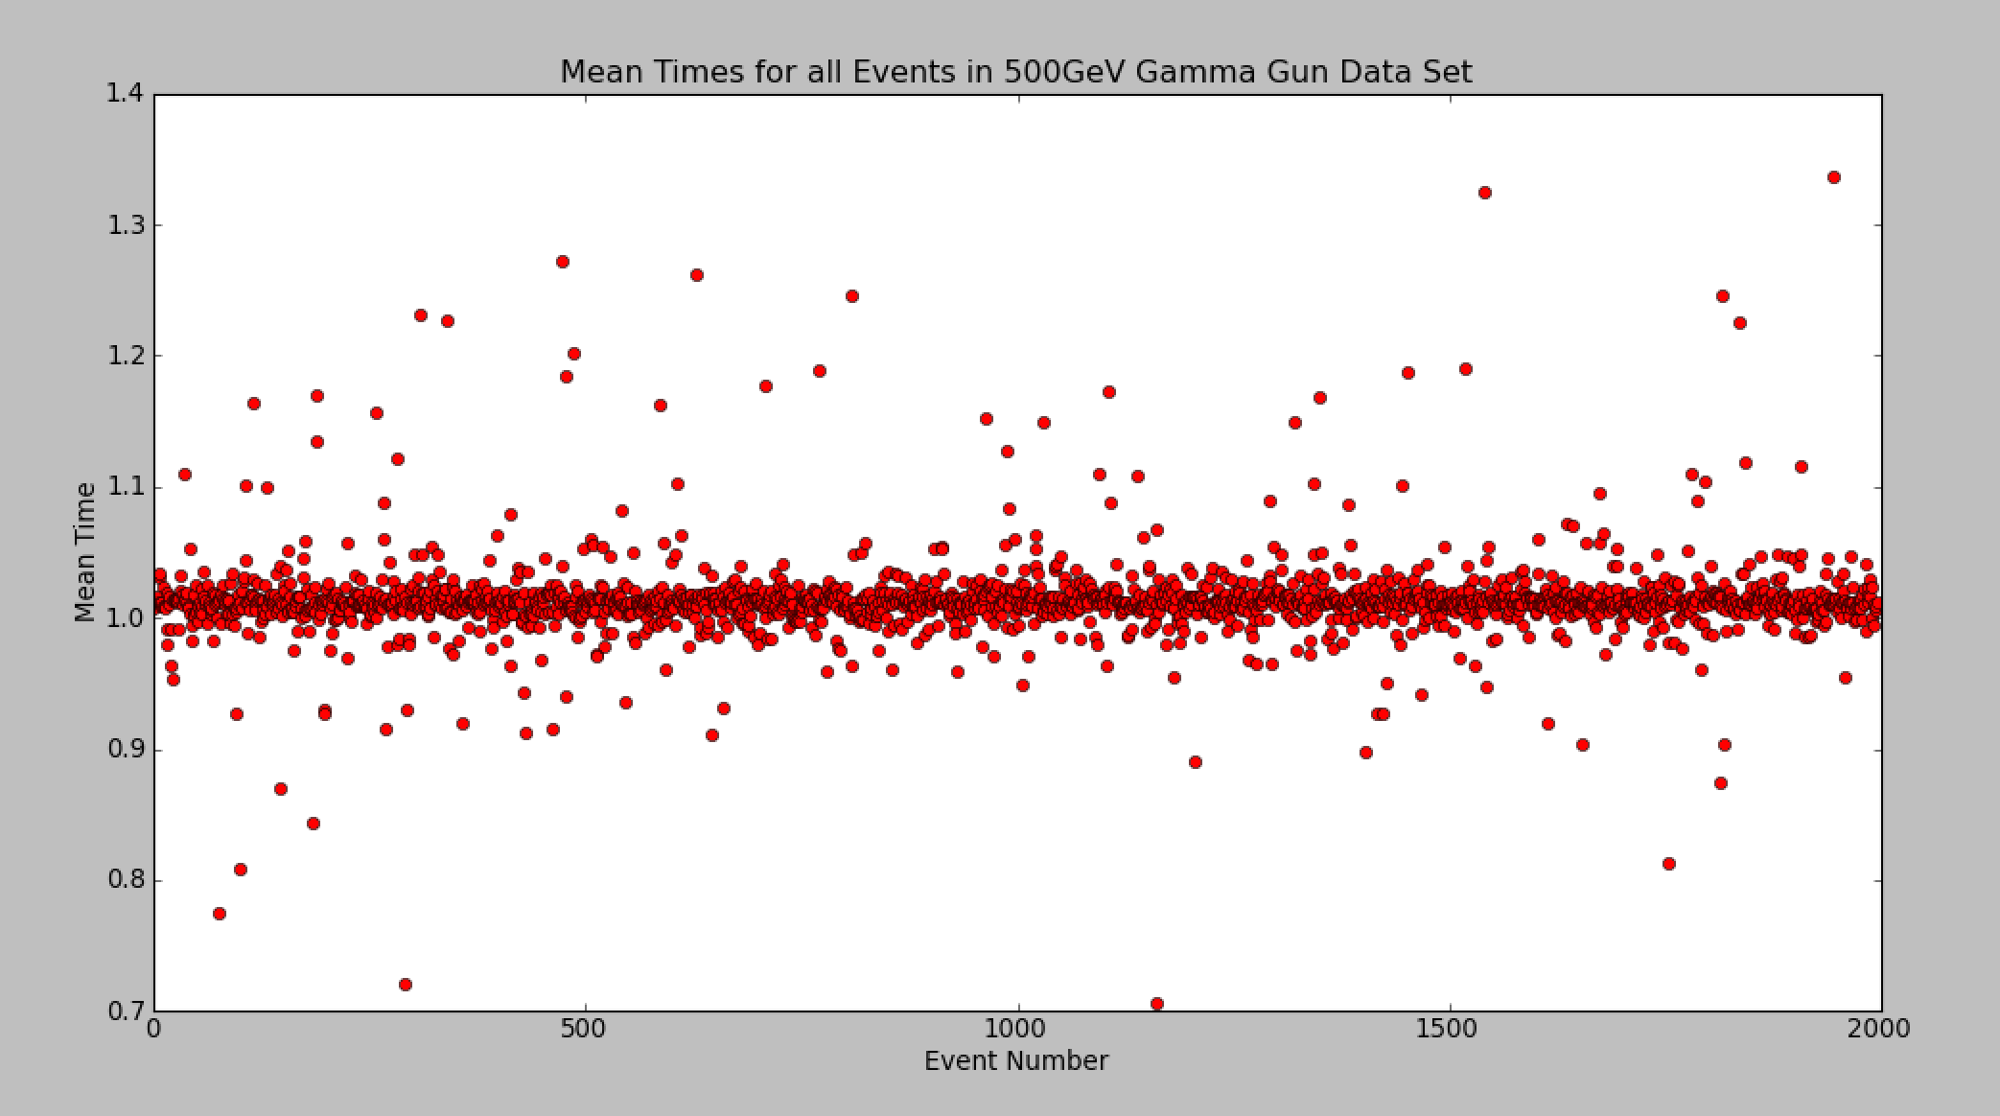
Timing information for all Events
More late hits than early hits.
Early hits are noise
Late hits noise, and effects of asymmetry in energy of the two electrons produced when a photon interacts with the tracker.
“Tail” of late hits
Average over all the mean times: 1.0135622966079492

Slide 9
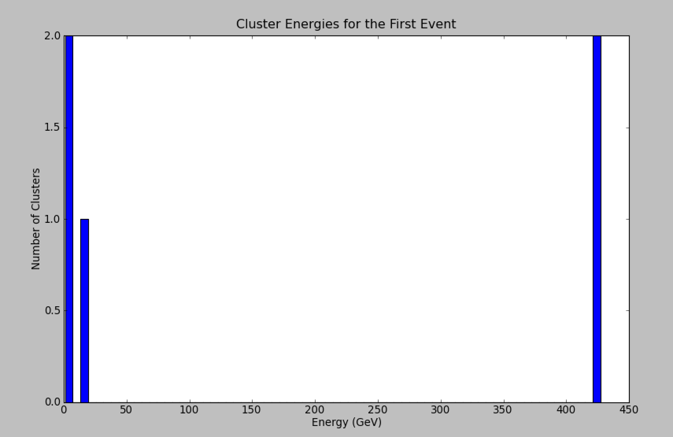
Energies of Clusters (First Event)
(5 Clusters total)
C0 and C2
C1 and C4
C1 and C4 have essentially no energy. This is an artifact of the clustering algorithm (not pile-up), and these two clusters can be discarded. We care about C0 and C2.
C3

Slide 10
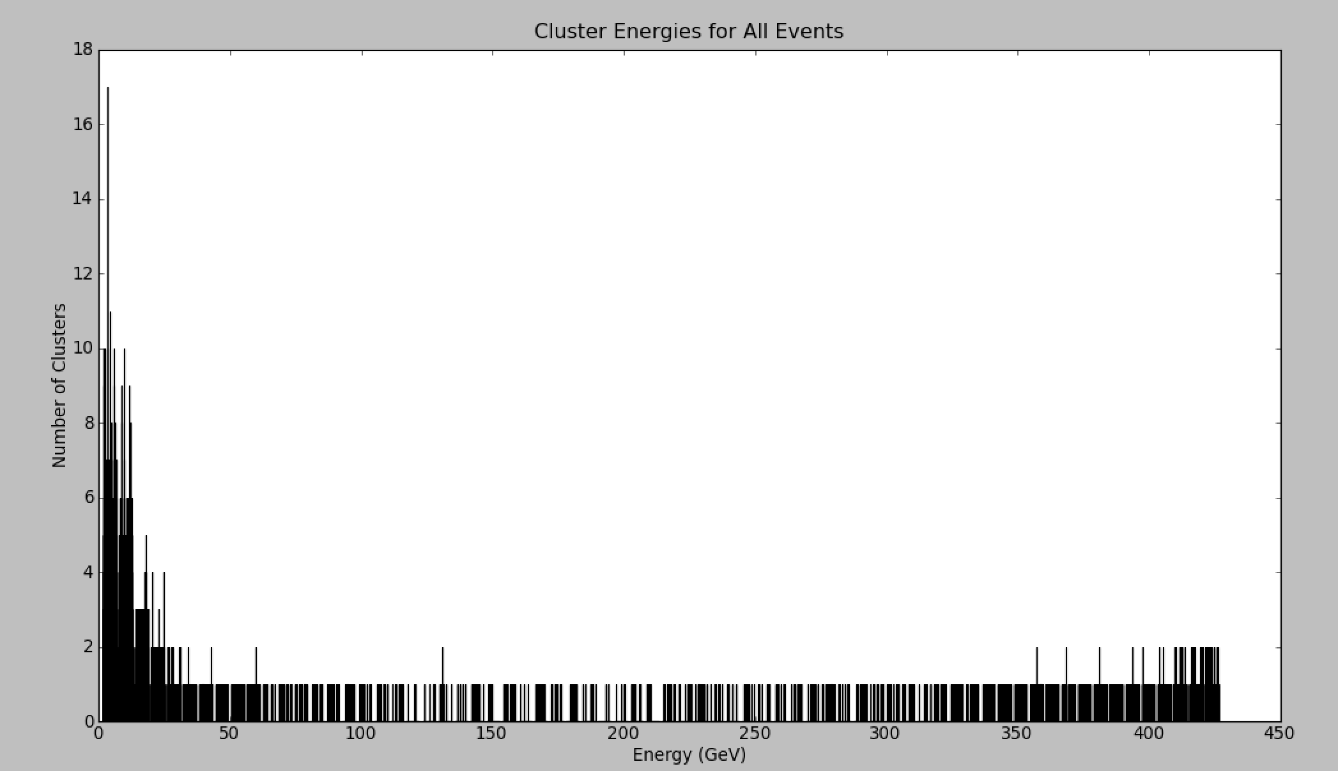
All Events

Slide 11
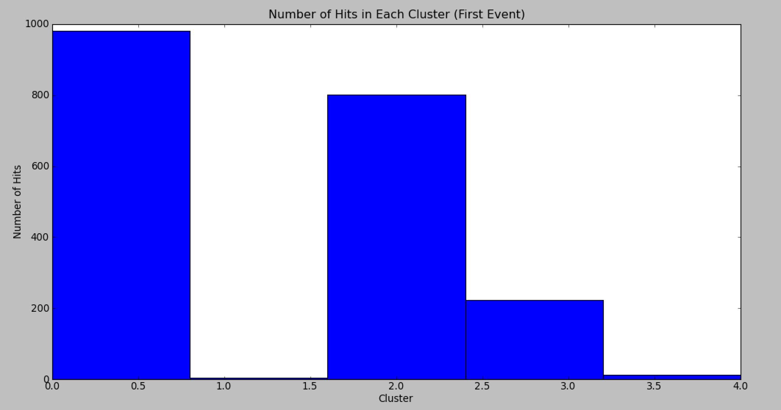
Hits by Cluster
Most hits are in C0 and C2. Again, we see that C1 and C4 have negligible contributions.
C2
C0
C1
C3
C4

Slide 12
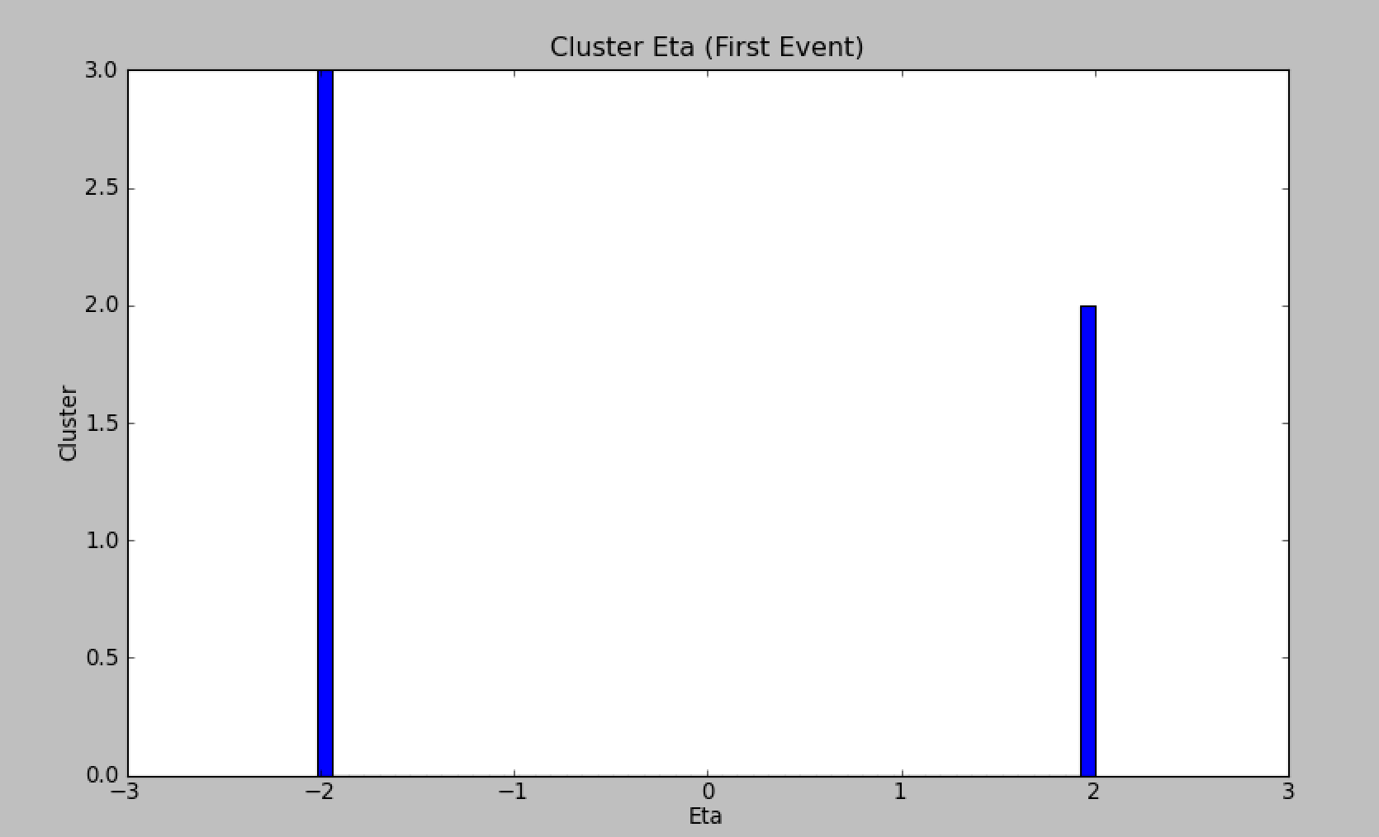
Eta of the Clusters

Slide 13
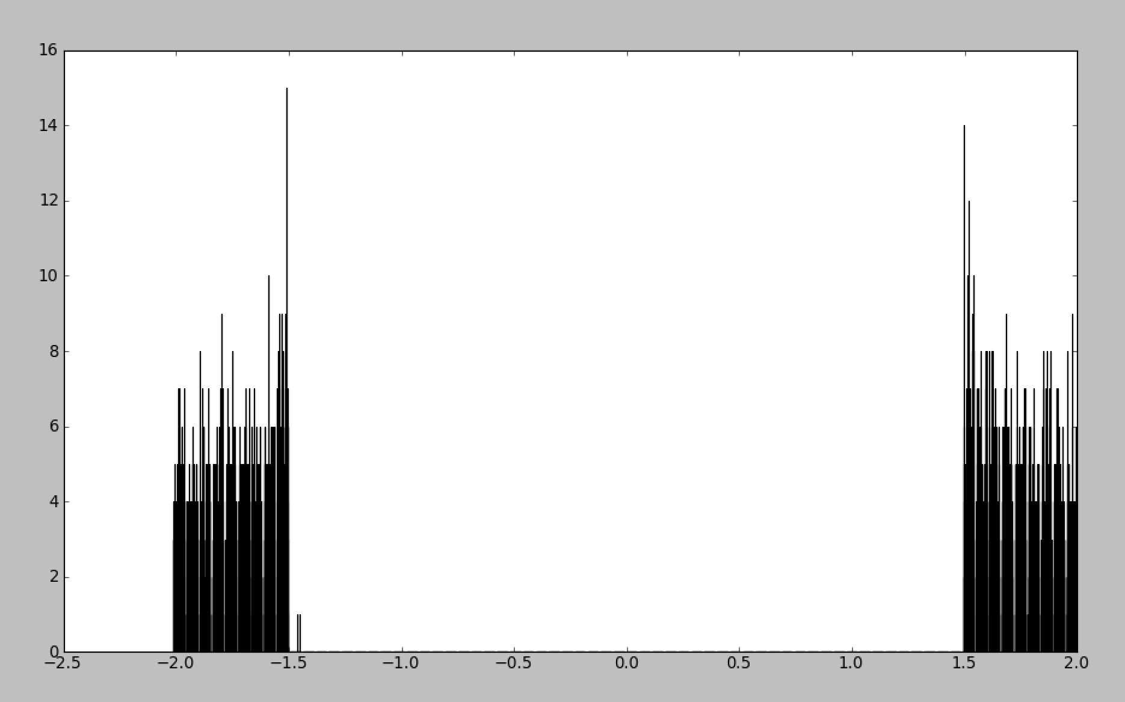
Cluster Eta for All events
Number of clusters
Eta

Slide 14
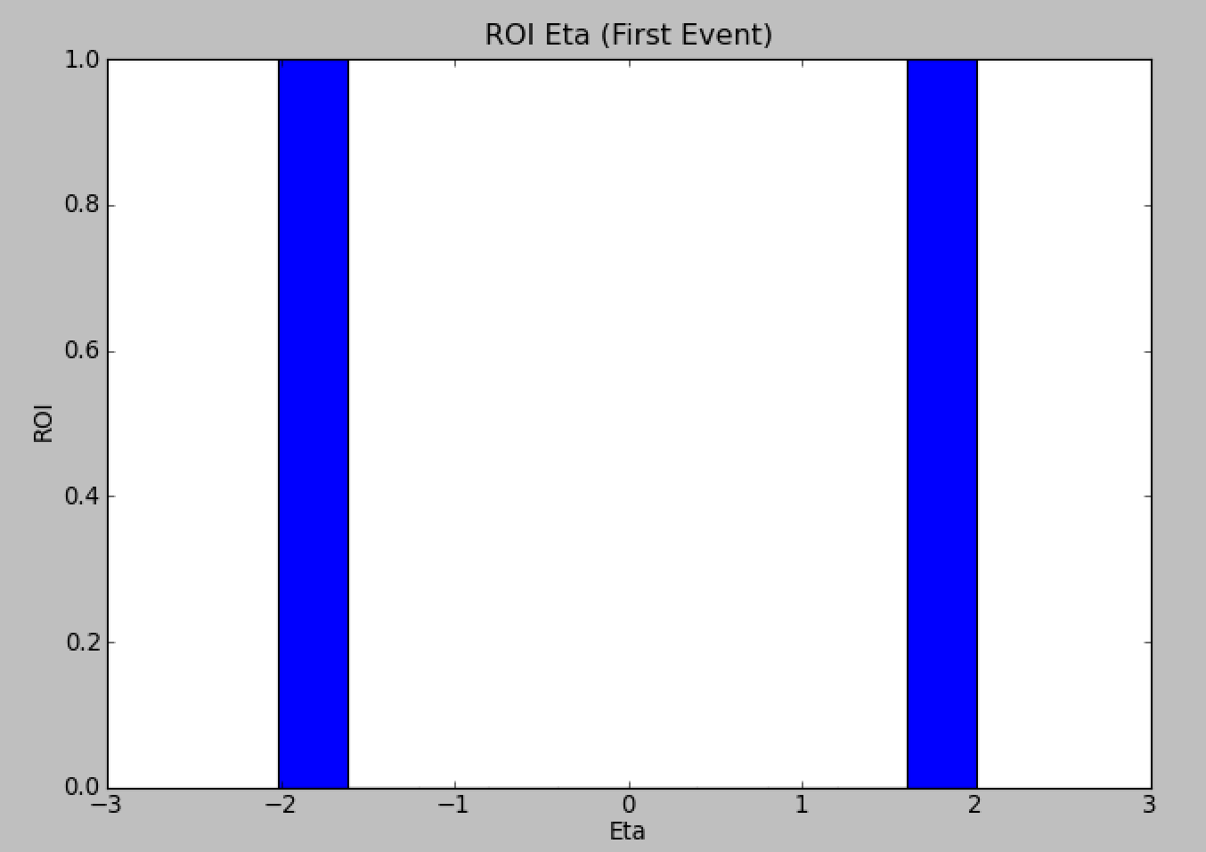
ROI Eta

Slide 15
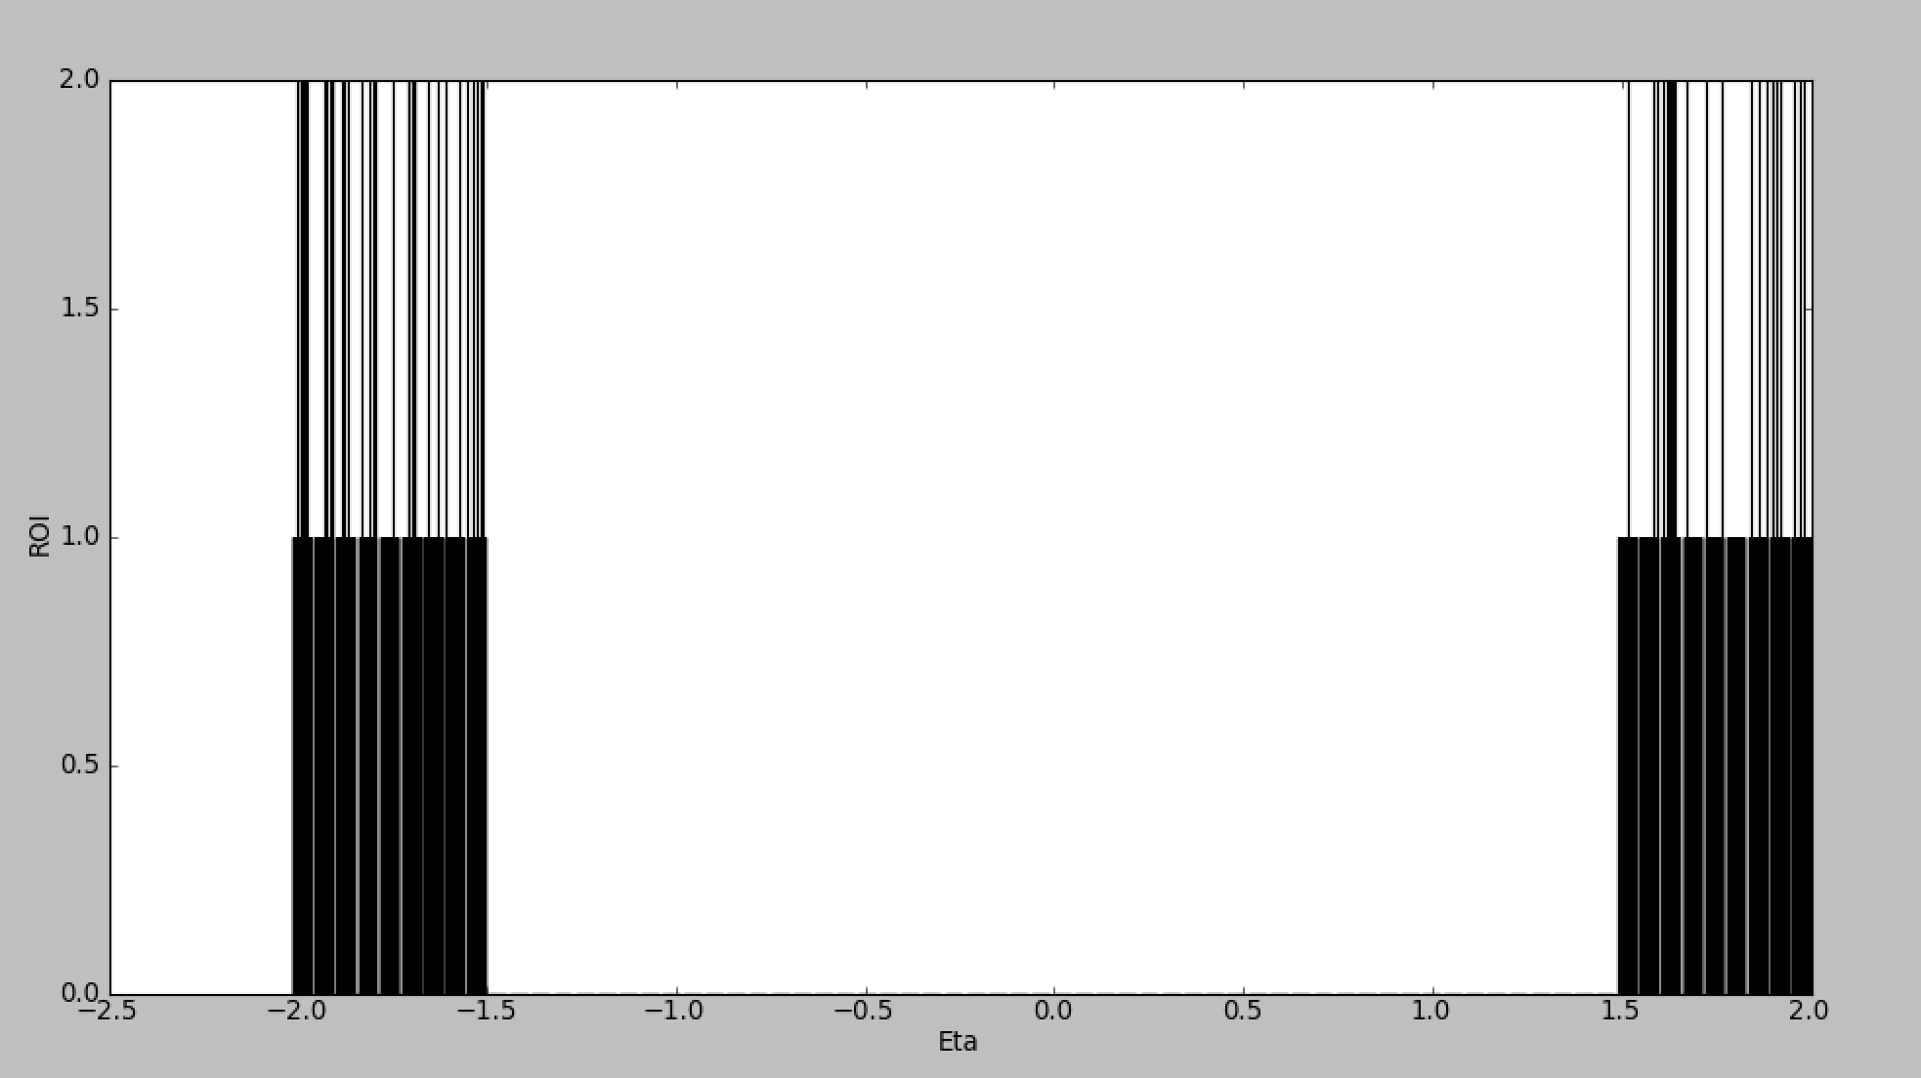
ROI Eta for all events

Slide 16
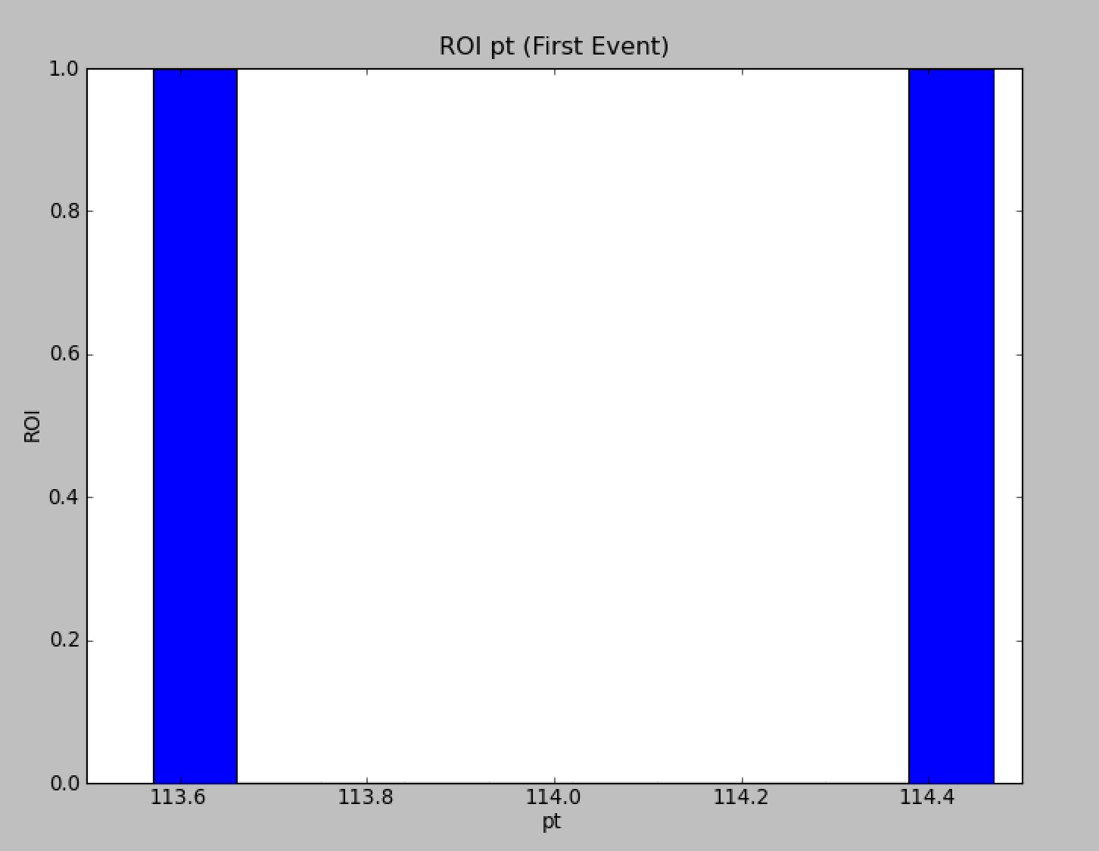
ROI p_{t}

Slide 17
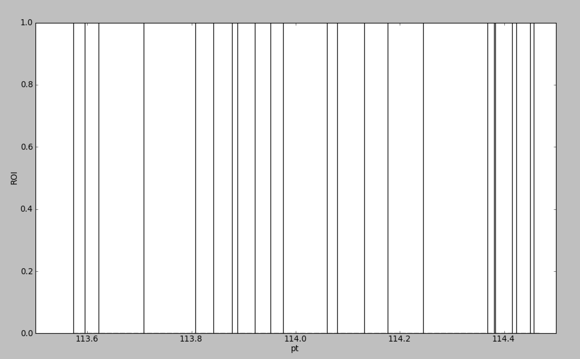
ROI p_{t} f0r all Samples
Samples constant in energy--need to look at energy rather than pt.
Energy = p_{t} * cosh(eta)

Slide 18
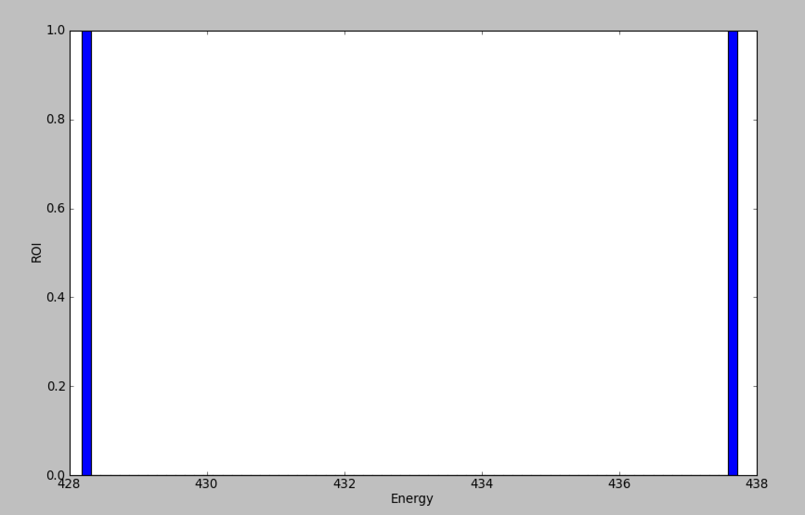
ROI Energy (Event 1)

Slide 19
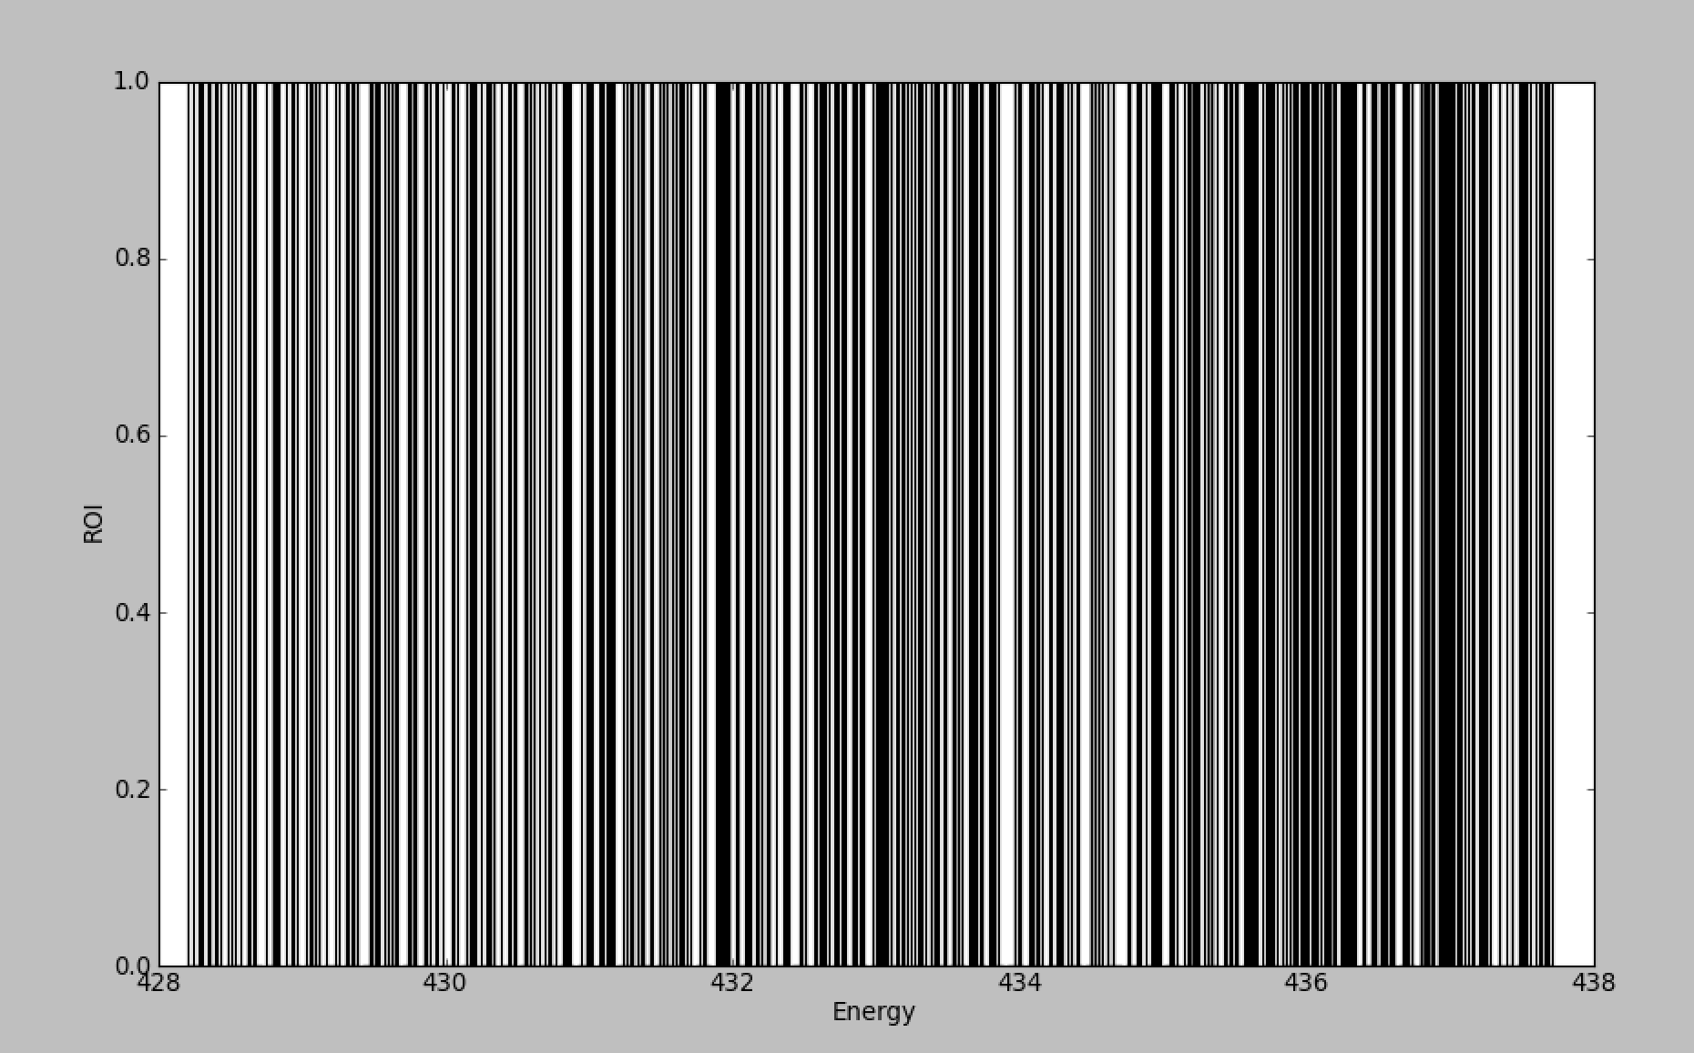
ROI Energy (All events)

Slide 20








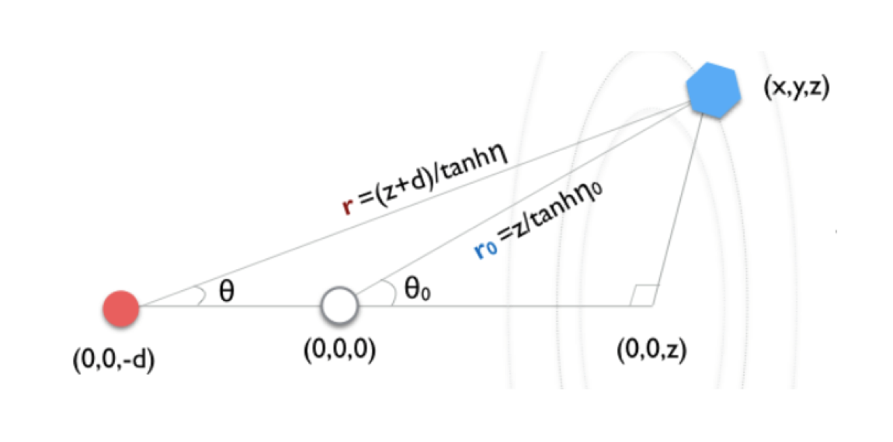
Finding the Collision time

Slide 21
Next Steps and questions to answer
Potential problem – Some photons have energies just below the threshold. For a slightly higher energy, their inclusion would create a larger spread in the hits. What is the probability of a particular hit being above threshold?
What fraction of Rechits are above threshold?
        How does this depend on eta?
        How does resolution vary with energy, eta and p_{t}?
Look at hits in the barrel as well (so far only endcap)
Higgs -> γγ sample

Slide 22
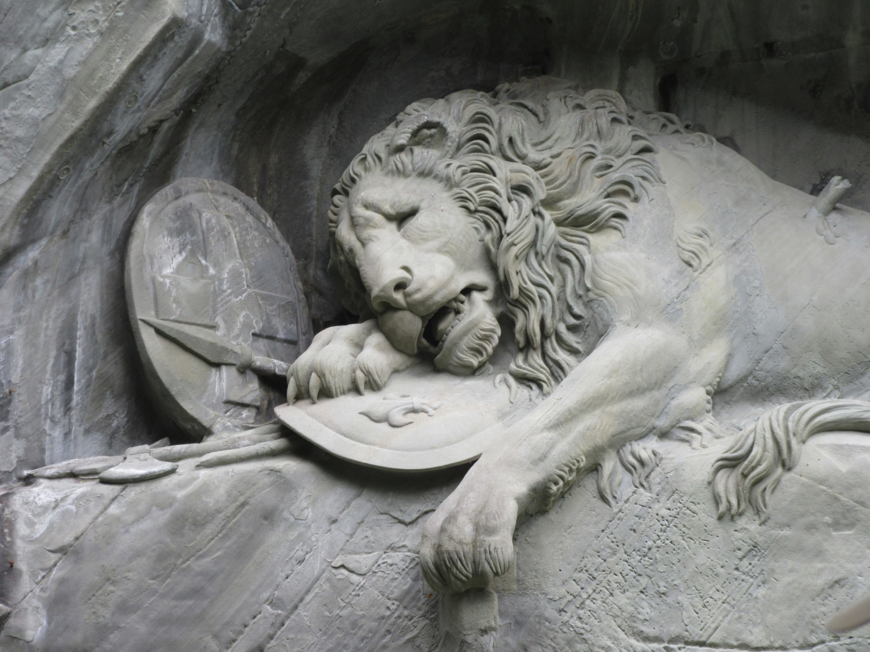
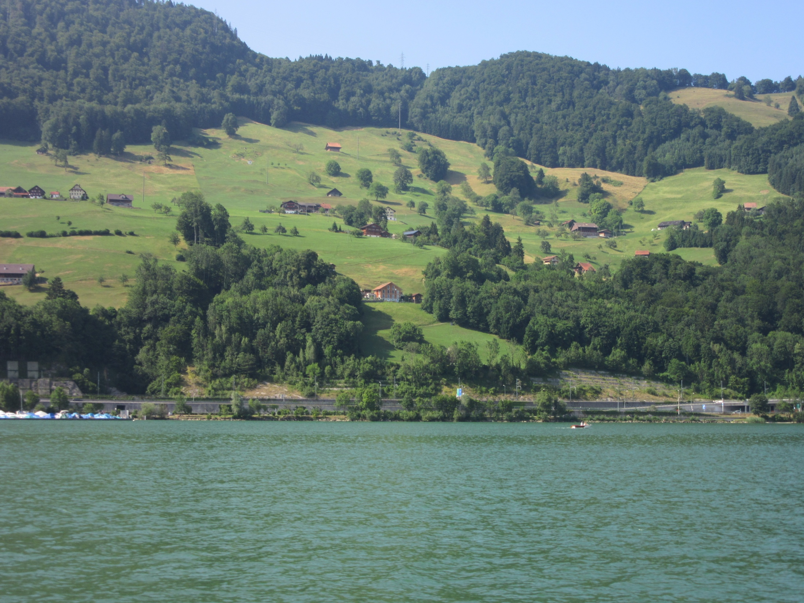

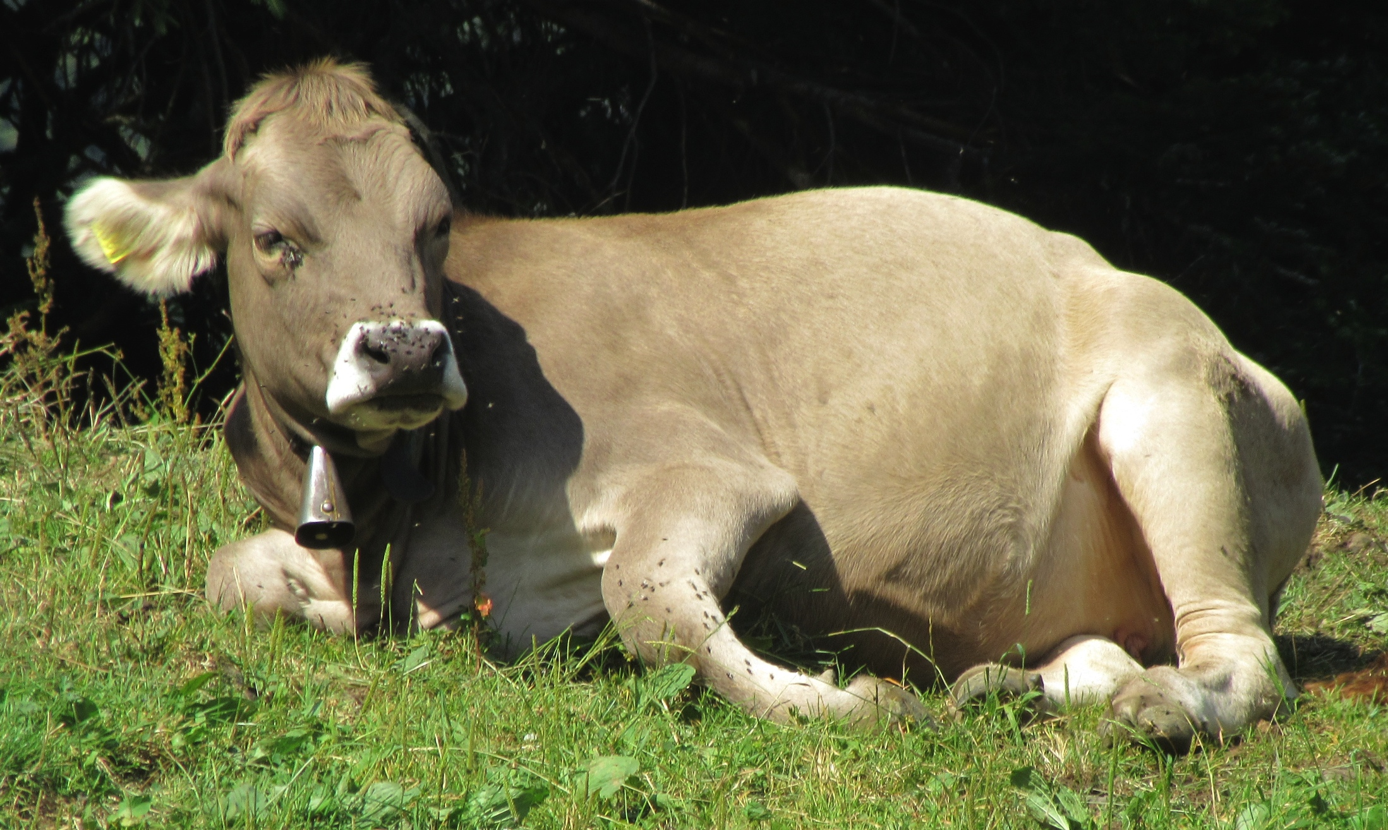
Outside of CERN

