Slide 1




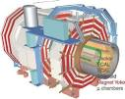

Excited Muon Analysis with final state 2mu+Gamma
Presented by:
Walaa Elmetenawee - Ahmed Abdelaliem

Slide 2
outlines
  Compositeness model
  μ*Production and decay modes
  MC Signal samples
  MC Background samples
  Selection Strategy
  Selection of muons
  Selection of photon
  Results

Slide 3
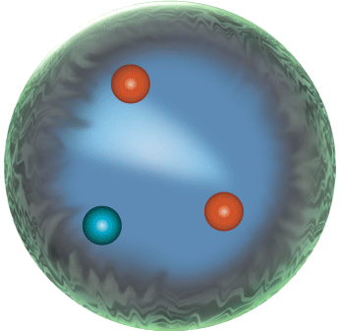
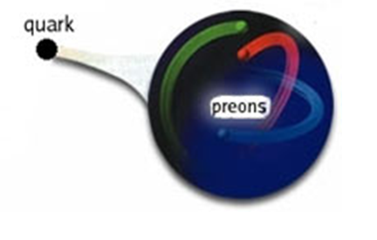
Compositeness model
above a characteristic energy scale Λ , leptons and quarks may not be fundamental particles but made of smaller constituents called preons . The constituents could be 3 fermions or a fermion and a boson.
Compositeness model can address some of the SM shortcomings like:
Fermion generations and their masses hierarchy
Free parameters: it may explain parameters such as particle mass, electric charge, and color charge
proton

Slide 4
Compositeness model
Below a certain characteristics energy scale Λ, the interaction become strong and binds the preons together to form quarks, and leptons.
At the scale of the constituent binding energies Λ, a new strong interaction among quarks and leptons constituents, preons, should appear.
Exact like the excited atom behaves, if quarks and leptons have substructure, it will exhibit excited states.
In this model, excited fermions are organized in weak isospin doublets and carry electromagnetic charges similar to those of ordinary fermions.
Assuming that the excited leptons have spin and isospin 1/2 to limit the number of parameters.
Only 2 free parameters Λ and m_{μ*.}

Slide 5
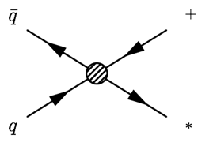
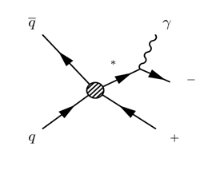
μ*Production and decay modes.
μ
The dominant production mechanism can be approximated by a four-fermion Contact Interaction (CI).
Three gauge-mediated decay modes for μ * :
  ν + W (2 j + E_{T} ^{miss} ) or (l + E_{T} ^{miss} )
  μ + Z (μ +2 j) or (μ + 2 l)
  μ + γ
So we use μ + γ channel so it has no jets in the final state clean channel
μ
μ
μ
μ

Slide 6
MC Signal samples
Monte Carlo signal samples for μ* are produced with PYTHIA 8 ranging from 0.5 to 3 TeV with 0.5 TeV steps with Λ = 10 TeV and ran through a GEANT4 detector simulation.
mμ*(in GeV) | Cross section [fb] | N Events | Status
500 | 0.0141791 | 10000 | Done
1000 | 0.00626384 | 10000 | Done
1500 | 0.0028749 | 10000 | Done
2000 | 0.0013137 | 10000 | Done
2500 | 0.000608637 | 10000 | Done
3000 | 0.000276288 | 10000 | Done

Slide 7
MC Background samples
Monte Carlo Background samples for μ* are produced with PYTHIA 8 & Madgraph 5
Process | N Events | Event Generator | Status
Zγ → 2μγ | 200000 | Madgraph 5 | In Progress
tt‾ | 200000 | Madgraph 5 | In Progress
ZZ | 200000 | Pythai 8 | In Progress
WZ | 200000 | Pythai 8 | In Progress
WW | 200000 | Pythai 8 | In Progress

Slide 8
Selection Strategy
  Selection-1:
  Select two highest PT muons and the highest PT photon within acceptance (pT & η )
  Selection-2:
  Applying Trigger: HLT_Mu17_Mu8_v
  Selection-3:
  select properly reconstructed muons, the ”High pT ID” of the muon POG

Slide 9
Selection Strategy
  Selection-4:
  select highest PT photon passing cut based tight version of photon ID
  dR > 0.7 is required between photon and the above selected muons.
  Selection-5:
  M(µµ) > 60 GeV
  Selection-6:
  ZVeto M(µµ) > (Mz + 25 GeV)

Slide 10
Selection of muons
  To select properly reconstructed muons, the ”High pT ID” of the muon POG is used:
  Acceptance: Each muon needs to have pT > 35 GeV and |η|< 2.1
  Muon is reconstructed as a global muon
  Number of muon hits in the global track > 0
  At least two muon stations with hit segments
  Transverse impact parameter dxy < 0.02 cm
  Longitudinal distance dz < 0.5 cm
  Number of hits in the pixel layers > 0
  Number of tracker layers with hits > 5
  ∆pT/pT < 0.3
  Particle Flow based relative isolation in a cone of size delta(R) = 0.4 < 0.12

Slide 11
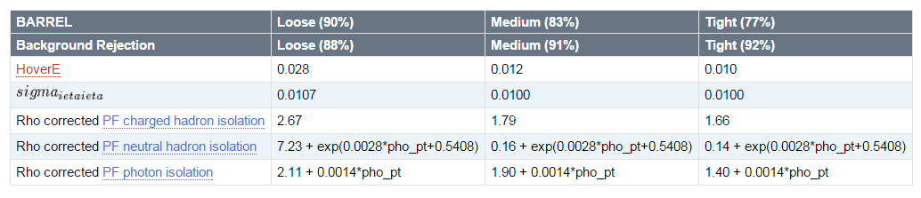
Selection of photon
  We select highest PT photon with
  PT > 35 GeV &|η| < 1.4442
  Then Cuts optimized for non-triggering photons (PHYS14 selection, conditions: PU20 bunch crossing 25ns)

Slide 12
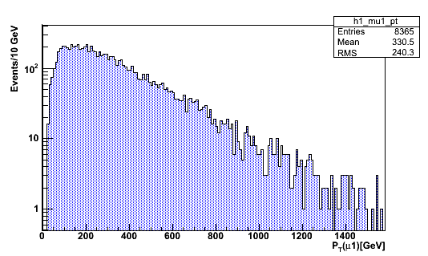
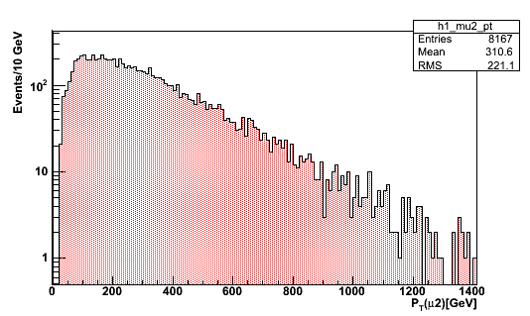
Results

Slide 13
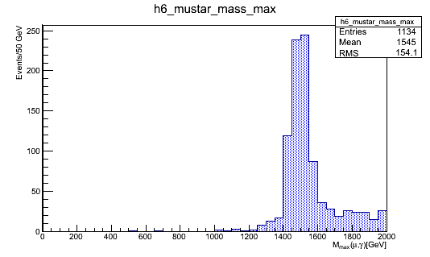
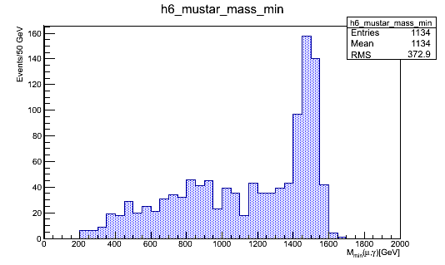
Results

Slide 14
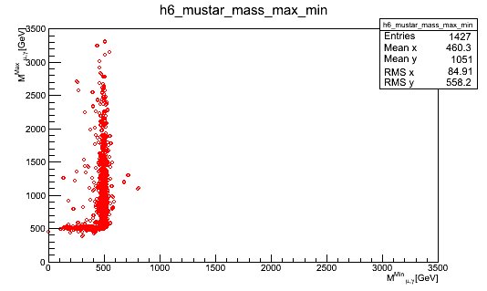
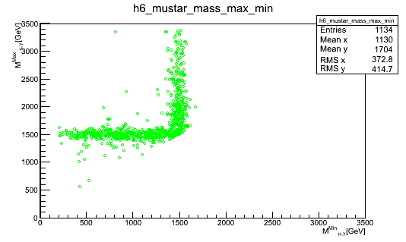
Results

Slide 15


