Slide 1
Roles
Committees Meetings
Eugenia Hatziangeli

Slide 2

Control systems upgrades aligned and thoroughly communicated to our users
Project leaders and the teams of developers
Tight collaboration with the shutdown sector coordinator, equipment groups - Shutdown Controls Coordinator
Communicate
Collaborate
Exploitation support Exploitation Manager
CO Systems Experts (HW,SW)
CO developers
Pushing for formal commitment of the eq. groups and hand over responsibility
MCCs
The Noble Eightfold
Path of Buddhism
The Noble Eightfold
Path of CO
Commit
Support
Take
Responsibility
Detailed planning of renovations/upgrades per machine by project team
Hardware and Installation teams & our FSUs
Plan
Operational Exploitation Responsibilities go to Exploitation Manager
Follow-up
Organise
Thorough CO Dry-Runs planning, organisation and execution
Shutdown Controls Coordinator
MCCs
MCC Leader
CO Experts-on-site
Thorough follow up of issues to resolution
MCCs
MCC Leader
CO Experts-on-site during Dry-runs

Slide 3
Technical Coordination
MCC Coordinator
CO PLs/Als
MCC LINAC3
MCC
LINAC 4
MCC
PSB
MCC
PS
MCC LHC
MCC
SPS
MCC LINAC2
MCC ISOLDE
MCC LEIR
MCC CTF
MCC ELENA
MCC AWAKE
MCC AD
CO Management
MCC
CO PLs/ALs
FE Responsible
CERN Project Leader
CO experts on site
Equipment groups
OP link people
CO Developers
CO Management
Shutdown
Controls Coordinator
Machine Supervisors
Sector Shutdown Coordinator
HW Technician
CO Installation Team
CO Management
Shutdowns – Extended TS
CO EXPL Manager
CO Experts
Machine Supervisors
CO PLs/ALs
CO Developers
CO Management
FOM
Operation teams
Machine
Supervisor
Machine Supervisors
CO PLs/ALs
CO Management
FOM
Operation teams
Operational Period

Slide 4
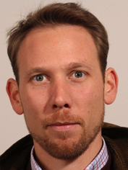
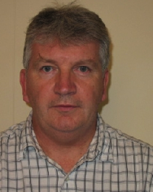
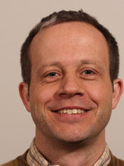
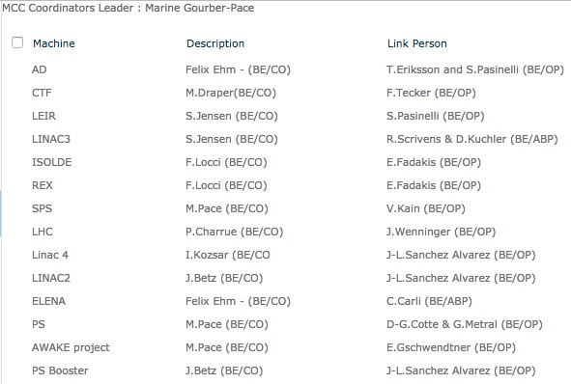
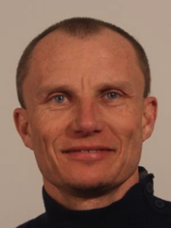
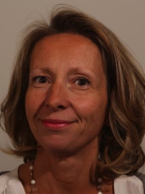
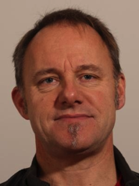
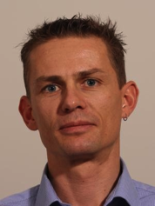
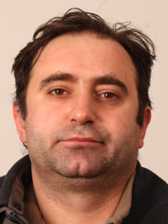
Machine Controls Coordinator
The Machine Coordinator is a CERN wide role.
In CO it has 3 key responsibilities
For New Accelerators or extensions of existing Accelerators,
  acts as representative of the CO group for the functional specification, design and budget estimation of the control system, as a whole. Typical example today is the LINAC4, AWAKE, ELENA,..
In the context of the specific renovation projects, e.g. ACCOR project (LS1),
  proposes a renovation plan taking into account the control system obsolescence problems and the operational constraints
  participates actively and follow the initial deployment and commissioning phase of the new technical solutions
During (re)-commissioning of any Accelerator after long shutdown periods (LS#), including YETS, EYETS,
  ensures that all parts of the control system are ready in accordance with the operational planning and that all modifications or extensions have been tested and validated
Meetings
  Project coordination meetings
Reporting
  SLM
  Section Meeting
Participation
  10% During Operations - 50% during shutdowns
The People
Added value to CO
One interface for one (or more machines) towards the upgrades/new projects. It takes active responsibility the moment we enter a long technical stop period but (s)he remains involved all through the operational year

Slide 5

MCC Leader
Gathers organizational requirements from all MCCs, ensure that an efficient framework is proposed and guarantee common practices over all MCCs (ex: procedure and tools to define the renovation workflow and supervise its progress)
Reports outstanding issues impacting the renovation process, discuss solutions with the group service providers, validate and promote the solution (ex: automation of device data propagation procedure)
Identifies common renovation needs, promote generic solutions and guarantee they are applied homogenously over all accelerators (B-trains, power converters control, etc.)
Works in close collaboration with the renovation project leader for all aspects related to Long Shutdowns (e.g.LS1 and following LS) activities (preparation meetings + help during commissioning meetings + co-management of activities workflow)
Meeting
  Projects coordination meetings
  SLM

Slide 6
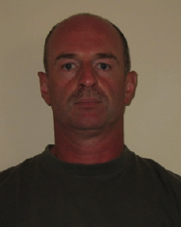
Shutdown Controls
Coordinator
Represents CO in the Shutdown, Extended TSs work planning sector meetings
Collect and plan CO installation work (IMPACT, PLAN)
Gathers requirements from all MCCs and MCC Leader
Gather from all MCCs their time requirements for commissioning and dry runs
Define and maintain a workflow which describes the work for the deployment/commissioning and dry runs for all machines
Meetings
  Shutdown, Extended TSs work planing sector meetings
  Project Meetings
  SLM

Slide 7

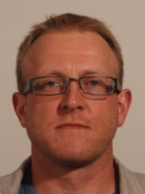
Machine Supervisor
The Machine Supervisors a CERN wide role
The activities of the machine supervisor are:
acts as machine Supervisor for 1 week out of 5 to 6 during the machine run:
  Expert service, meaning that the person should be reachable by phone 24‐7 during his/her supervision week.
  It is sometimes necessary to come in outside working hours to help the operations team on shift with a serious problem.
Participate in the weekly machine Supervisor meeting
At the end of the Supervision week and the Supervisor meeting write several summaries of the machine and beam status, including the problems that occurred and the solutions applied
Represent CO within the supervisor team and vice versa.
Particular responsibility for follow up of group issues
Propose improvements to machine operation and associated equipment and systems for better machine performance and exploitation
People
Reporting to
  SLM
  CO EXPL Manager
Meetings
  Machine Supervisor meeting
  Machine development sessions
Added value to CO
Strong links between CO group and the corresponding machine operation team.
Better mutual understanding of operations domains and CO issues, leading to a more efficient approach to problem resolution.
training and valuable experience in accelerator and beam physics operation.

Slide 8

Exploitation Manager
The controls exploitation manager organizes the BE-CO operational support (commonly known as “CO exploitation”) in order to ensure maximum operational availability.
Responsible for the exploitation of all machines concerning the controls infrastructure
Maintains an up-to-date list of controls experts per system
Follows outstanding issues impacting the operations, discuss solutions with the group service providers and controls experts
Reports in the FOM, (IEFC and LMC)
Identifies areas of general improvement in the controls infrastructure
Works in close collaboration with the operations crew, equipment experts and controls projects leaders to ameliorate the exploitation of the controls infrastructure and follows up the outstanding issues in MAM
Participate in the SUWG meetings aimed at planning and coordinating smooth BE-CO upgrades
During Technical Stop (TS), plan the start up in coordination with OP and EQP groups and define the time required for the setting up of the controls. Request dedicated controls test days prior to the TS; negotiate these days in the accelerator schedule and organize the planning of the tests with the BE- CO sections
Meetings
  FOM, 8h30 meeting, LBOC
  MAM
  SLM

Slide 9
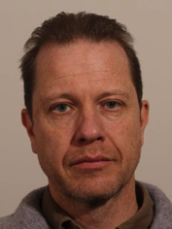
Smooth Upgrade WG
Launched in early 2012 in LMC to avoid/reduce downtime after TS caused by upgrades
  Make sure we can do necessary upgrades during TS
  In particular upgrades of core controls frameworks
  Improve collaboration and communication across AT sector
  Keep OP informed during all phases of the upgrade workflow
Members
  6 from equipment groups
  1 from EN/ICE, 1 from TE/MPE, 1 from GS/AIS
  6 from CO
  3-4 from OP
Meetings
  SUWG meetings
  LMC, IEFC
  SLM

Slide 10
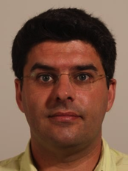
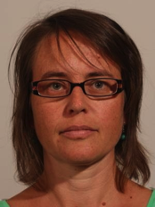
Controls Coordination
Technical Committee
Information sharing
Status/progress reports
Announcement of technical decisions
Not a decision making meeting
Chaired by the TEC and open to the whole group
TEX Task Force
Coordinated by the TEC
Reports to SLM and TC
Not a decision taking body
Resolve cross-section or cross-team issues with an impact on exploitation
Controls Coordination Committee CO3
Responsible for the coordination of controls strategy for the Accelerator Complex
Reports to Controls GLs, LMC, IEFC
Not a decision taking body
Fosters discussion and coordination of related controls issues
Ensures common strategy between OP, Eq. groups and controls groups in A&T sector and GS
Sector wide Committee
TC Unplugged
Not a decision making body
Attendees should be able to contribute to the discussion
Anybody can organise a meeting, however there is an overall coordinator
Regular meetings for brainstorming/constructive criticism, one topic per meeting
Process Coordinator
Not a decision making
Aim to arrive to a more coherent planning at the group-level (technology, projects, …)
In place to address specific areas of improvements in CO
Focuses on improving the communication between Product Owners and Section Leaders

Slide 11
Decision Making Meetings
LMC & IEFC
TEMB
SLM
SM APs
SM DS
BEMB
ENMB
SLM Retreats
SM IN
SM DO
SM HT
SM FE

