Slide 1
The CO-DO Atlassian Service
Vito Baggiolini with a lot of help from
Marian Zurek and Niall Stapley
With explicit input from:
K. Sigerud, C. Roderick, J. Wozniak, S. Deghaye, W. Sliwinski,
L. Burdzanowski, M. Pace, R. Gorbonosov, G. Kruk, M. Buttner
JC. Garnier (MPE), B. Todd, M. Dudek (EPC), P. Sollander (OP)

Slide 2
Outline
Overview of the Atlassian Service
Use cases
History and growth
Work done over the last 2 years
Satisfaction, dependency, shortcoming and requirements
Plans for the next 12 months (code name “PIA”)

Slide 3
Outline
Overview of the Atlassian Service
Use cases
History and growth
Work done over the last 2 years
Satisfaction, dependency, shortcoming and requirements
Plans for the next 12 months (code name “PIA”)

Slide 4
Atlassian components and relations to external services
(IT) SVN
(IT) MySQL
on demand
Confluence
Wikis
JIRA
Issues +
Agile
Fisheye
Code search
Crucible
Code reviews
Bamboo
Continuous
integration
Crowd
User+group
managemnt
CO testbed
(IT) E-mail
service
(IT)
LDAP
(GS)
E-groups
Atlassian Component
Other CO Component
External service
Notes:
Commercial product
Atlassian components: explain each.
Well integrated.
Connected to external services mainly from IT:

Slide 5
Outline
Overview of the Atlassian Service
Use cases
History and growth
Work done over the last 2 years
Satisfaction, dependency, shortcoming and requirements
Plans for the next 12 months (code name “PIA”)
Notes:
How some of the Atlassian Components are used.
Look at some more unexpected use cases.
First Wikis. We have all seen Wikis, and know how easy it is to share information.

Slide 6
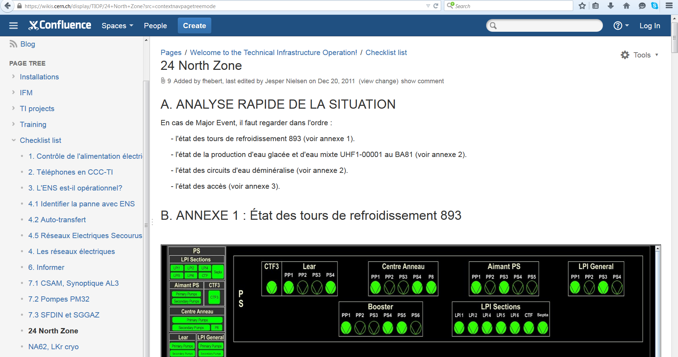
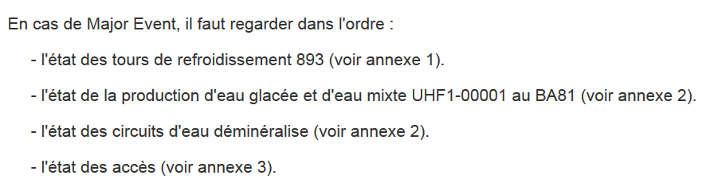
TI Operator’s checklist (Wiki)
Confluence
Wikis
Notes:
Let’s look at one of the prominent ones: Checklist for TI operators
Wiki has to be up so that they know what to do.

Slide 7
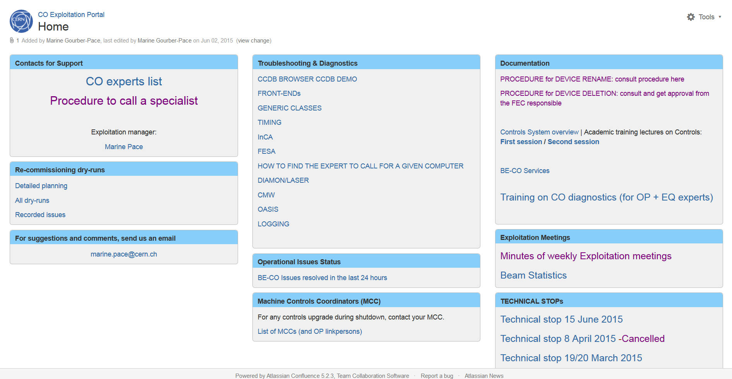
CO Exploitation Portal (by Marine)
Confluence
Wikis
Notes:
Similar example: CO exploitation Portal.

Slide 8
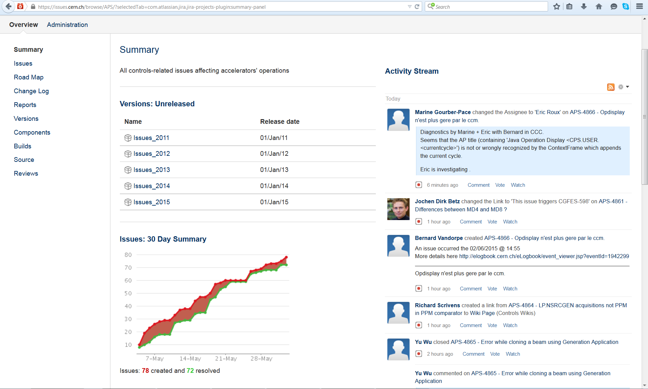
Controls operational issues (APS JIRA)
JIRA
Issues +
Agile
Notes:
Most of you should know this page
Activity stream
Issues follow up (if they are closed)

Slide 9
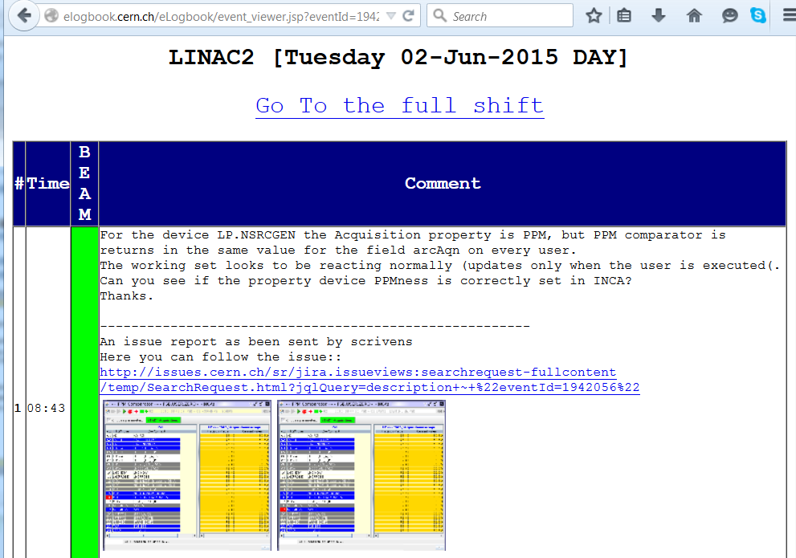
Issues send by e-mail from
E-logbook to JIRA
Notes:
Most issues come from OP e-logbook, their main tool.
Now they can even assign an issue.
Same text and images in JIRA.
Cross-linked, navigate back & forth

Slide 10
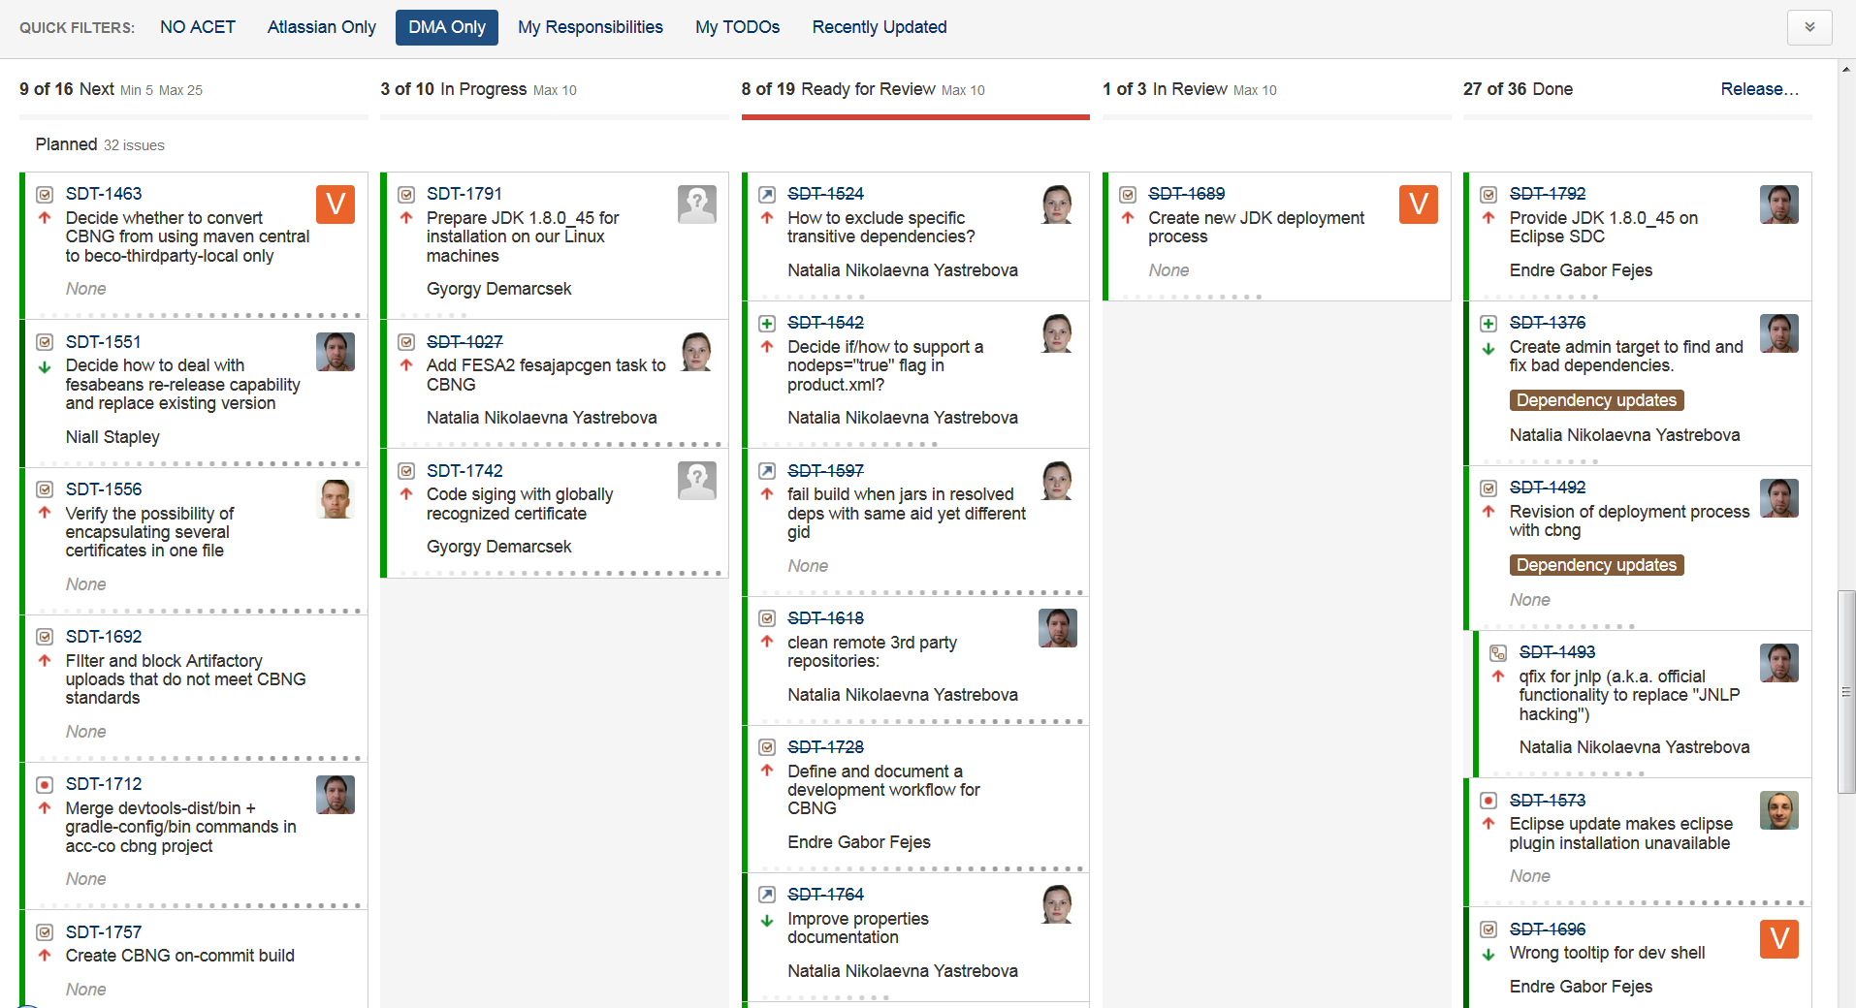
JIRA Kanban board example
JIRA
Issues +
Agile
Notes:
Extensively used in many CO software projects
Principles: follow a workflow [columns],
visualize the work, limit the work in progress

Slide 11
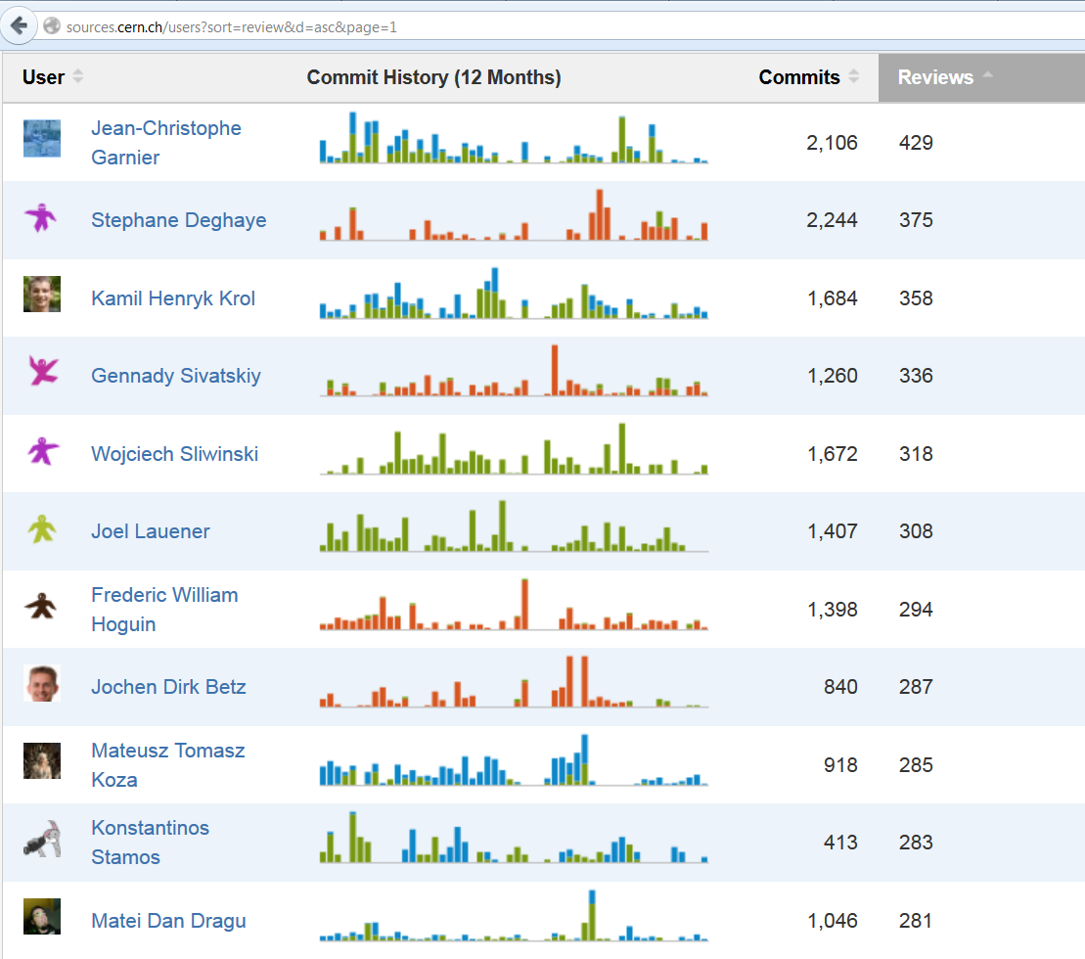
Fisheye/
Crucible
(code search + review)
Crucible
Code reviews
Notes:
Now quality assurance tool.
Look at users activity.
Sorted by code reviews.
Quiz?

Slide 12
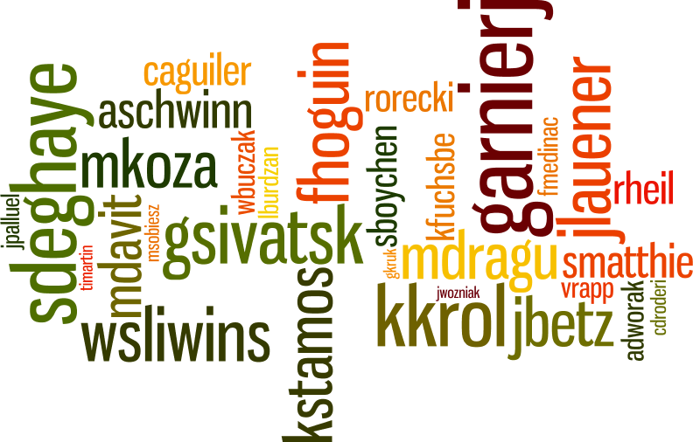
Crucible reviewers
.
Crucible
Code reviews
Notes:
Moskito

Slide 13
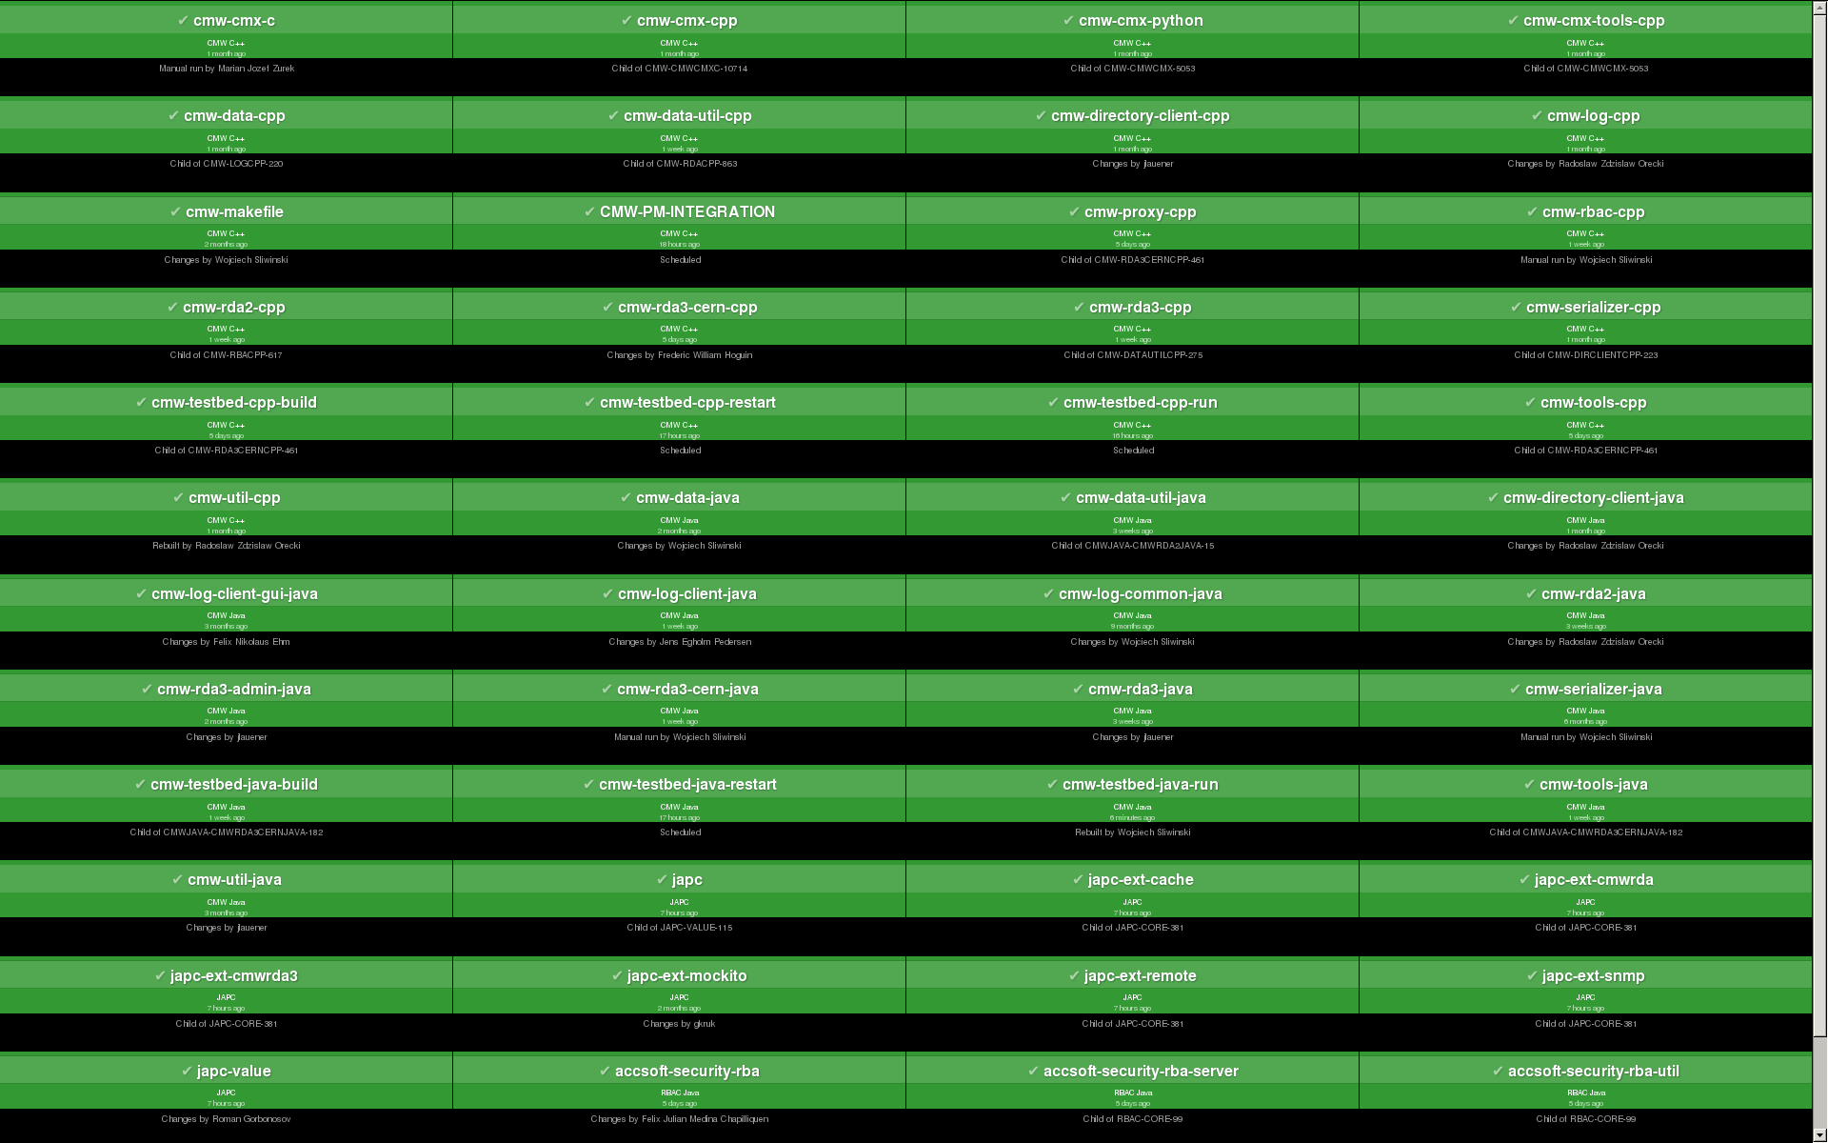
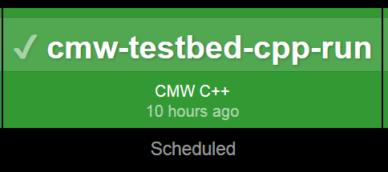
Bamboo
Continuous
integration
Notes:
Nighly build of CMW. Dashboard used by teams. If something goes wrong (red box) they react.
Many unit tests.
One special for testbed.

Slide 14
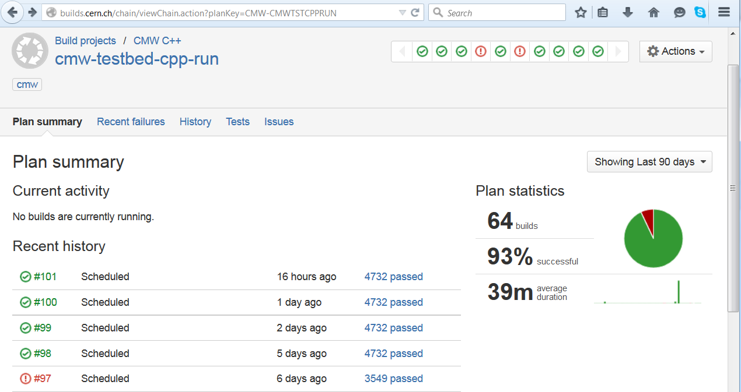
History of CMW testbed plan execution
Bamboo
Continuous
integration
Notes:
Run every night at 2 a.m.
4732 tests
Integration

Slide 15
Outline
Overview of the Atlassian Service
Use cases
History and growth
Work done over the last 2 years
Satisfaction, dependency, shortcoming and requirements
Plans for the next 12 months (code name “PIA”)

Slide 16
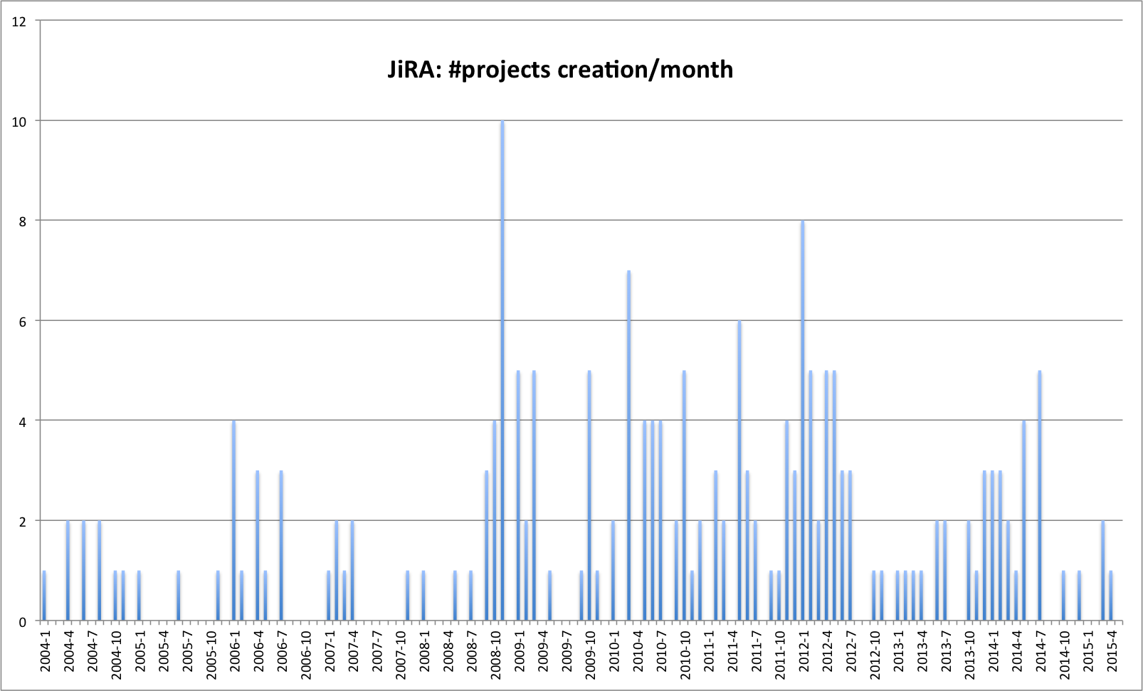
JIRA projects created/month 2004 - now
First external
projects
Thanks Marian!
“Controlled Growth”
“Enthusiastic Growth”
CO software only
TIM
RF
ABT
BI
EPC
774
TE-MPE
SIS
CCDB
Operational Issues
JAPC
FESA
CALS
OP-TI
CMW
ACCOR, MCCs, dry runs
LSA
OASIS
CESAR
LASER
InCA
2004-01
2008-10
2012-10
Notes:
Axes
JIRA project = long-term
Phases CO Software
First OP

Slide 17
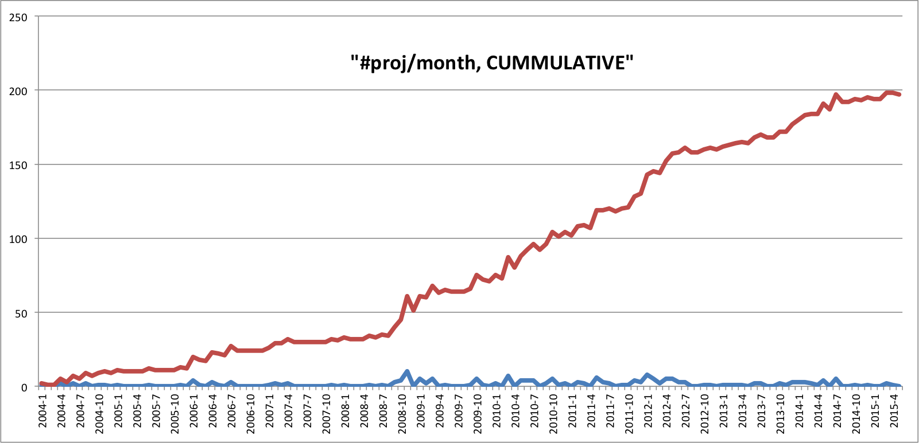
JIRA projects created 2004 – now (cumulative)
“Controlled Growth”
“Enthusiastic Growth”
CO software only
200
Notes:
200 projects total

Slide 18
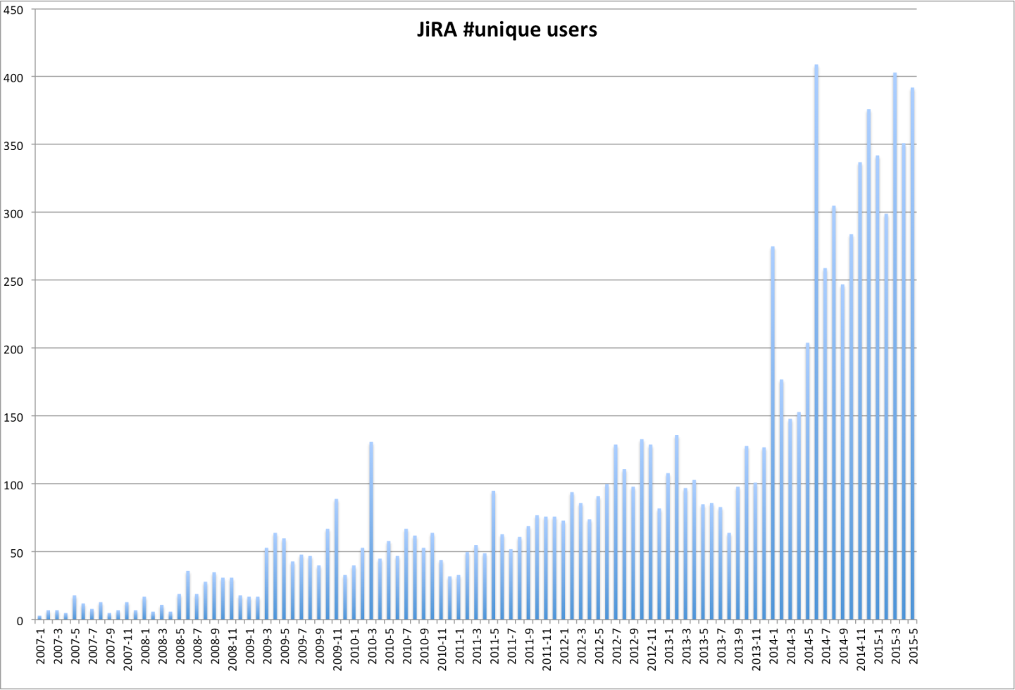
JIRA unique logged-in users
2007 - now
400
Aug-2013
Jan-2007
Notes:
Plus anonymous

Slide 19
JIRA Issues created and resolved (cumulative)

Slide 20
Not only growth in numbers just presented
Growth in other dimensions
  From CO to the full accelerator sector and beyond
  From SW development to HW and then to all kinds of activities
  From manual fault tracking to e-mail-based “help-desk” support
  From motivated, frequent Atlassian users to occasional, “forced” users
  From use of elementary features only to advanced use and configuration
Notes:
20’

Slide 21
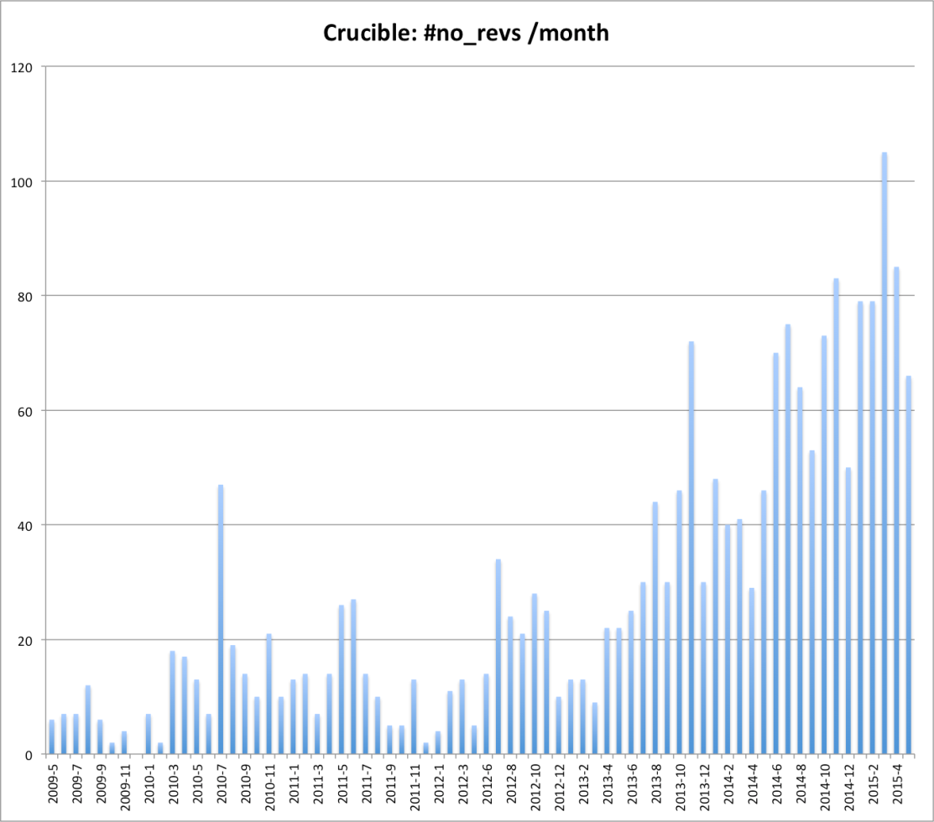
Crucible code reviews/month
2009 - now
~ 90
May 2009
Notes:
Quality Assurance

Slide 22
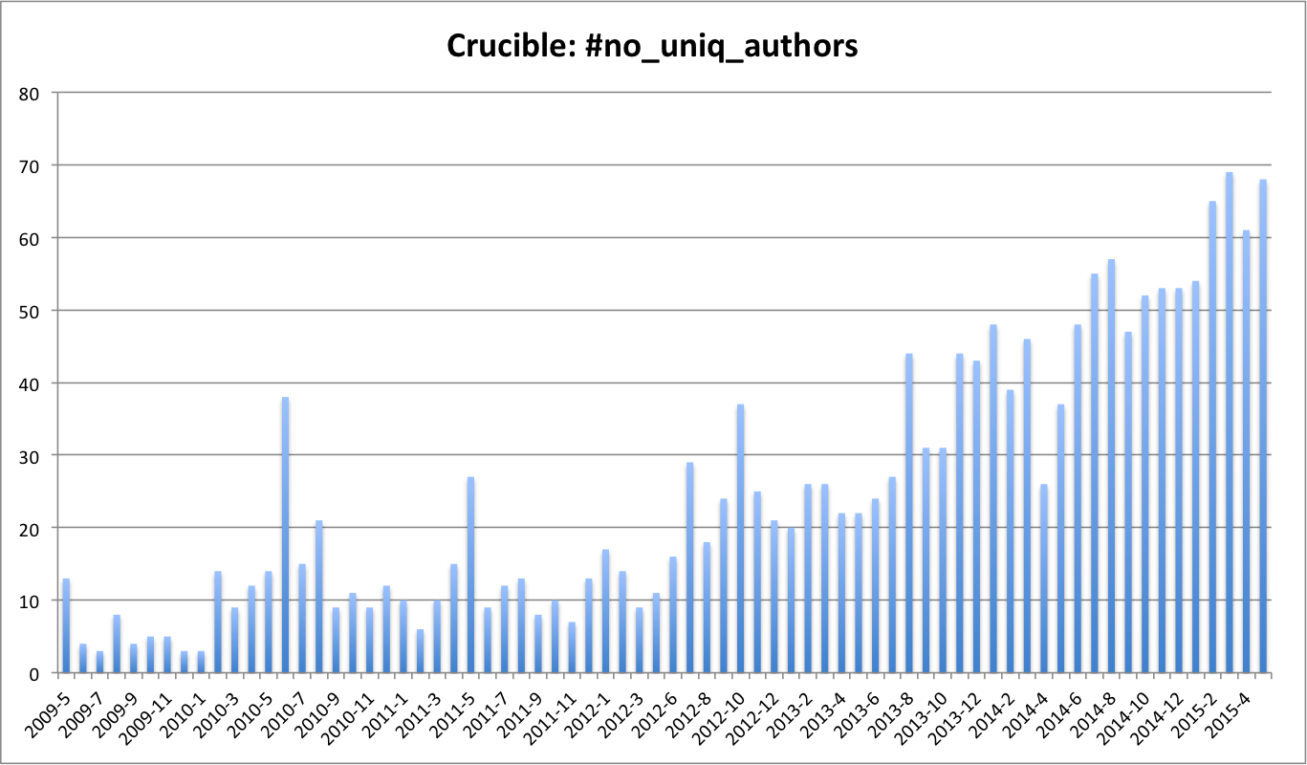
Developers participating in Code Reviews 2009 - now
60 -70
May 2009
Notes:
Code reviews are not automatic.
They take human time and effort.
We should be proud of this

Slide 23
Outline
Overview of the Atlassian Service
Use cases
History of growth
Work done over the last 2 years
Satisfaction, dependency, shortcoming and requirements
Plans for the next 12 months (code name “PIA”)

Slide 24
Maintenance Work: Periodic software upgrades
Upgrades of Atlassian application components
  Upgrade possible only from one minor to another,
  cannot skip over several versions (e.g. 5.1.0 to 6.2.3)
  Marian has introduced a thorough upgrade process with QA
  Upgrades take 1-2 weeks per system
Upgrades done (intermediate upgrades did not go into production):
  9 x Confluence (Wikis)
  11 x JIRA
  3 x FishEye/Crucible (code reviews)
  4 x Bamboo (continuous integration test execution)
  6 x Crowd (user management)
Notes:
e.g. from 5.1 to 6.1
Intermediate upgrades

Slide 25
Maintenance work: Technical Improvements
Security
  Moved from http to https (encrypted http) with IT Grid certificates
  Populated our Java JDK with relevant certificate information
  Collaborated with IT on setting up certification chain in our Firefox on Linux (so that there are no security warnings)
Moved Atlassian and Testbed from TN to GPN
  Reason: tests should not interfere with operational systems
  One bamboo build agent still TN trusted (needed for access to CCDB)
Hardware upgrades (with Enzo)
  2 powerful servers with a lot of memory
Service monitoring
  Check that our servers respond to https requests and give back meaningful contents
  Plus Hardware (disk space) and OS level monitoring
Notes:
https => No clear-text passwords

Slide 26
Maintenance: Following changes in IT
Database migrations
  Migrated JIRA from Oracle to MySQL
  Good decision, better support from Atlassian, good service by IT/DB
  Migrated all other Atlassian components from file-based databases to MySQL
Followed the move of IT services to OpenStack (SVN, MySQL, …)
  A lot of troubleshooting and testing
  Several problems intrinsic to cloud computing (machines disappearing aka rotation).
  Initial DB performance problems, solved after a while in collaboration with IT/DB.
Notes:
Useful performance feedback to IT/DB

Slide 27
Devtools support reorganization in 2012/13
From 2004 until early 2010 Niall could provided “passionate”, personalized, walk-in support. Not possible anymore.
We now have a similar support model as other CO teams:
  Team-based, rotational, first level support with escalation
  Niall does not participate in rotational support
  All support requests to accsoft-devtools-support@cern.ch. No walk-ins please!
We insist on support link persons in teams outside of CO and OP
  E.g. in BI, EPC, RF, MPE, GS/ASE
  They centralize all user requests and help newcomers.
  Only they are supposed to ask us for support (no direct users requests)
Our Support Service level agreement (SLA)
  Immediate reaction to service outages (service monitoring with notification)
  Response time according to emergency + severity; > ½ day for normal requests
  During working hours: support as described above
  Outside working hours only best effort.
  NB: We depend on IT (Official SLA: weekdays 8:00-18:00, 2-day for resolution).

Slide 28
Outline
Overview of the Atlassian Service
Typical use cases
History of growth
Work done over the last 2 years
Satisfaction, dependency, shortcomings and requirements
Plans for the next 12 months (code name “PIA”)

Slide 29
Assessment of Atlassian Tool and Atlassian Service
Asked a representative set of users (10 BE-CO, 4 others)
  How they use the Atlassian service
  How much they rely on the service
  Their satisfaction and needs
  K. Sigerud, C. Roderick, J. Wozniak, S. Deghaye, W. Sliwinski,
  L. Burdzanowski, M. Pace, R. Gorbonosov, G. Kruk, M. Buttner
  JC. Garnier (MPE), B. Todd, M. Dudek (EPC), P. Sollander (OP)
Notes:
Not Integrated: JIRA + Twiki

Slide 30

Reliance/Dependency of Users on Atlassian Tools
Very high dependency on Confluence (Wikis)
  Many teams have put all their intervention documentation on our Wiki:
  TI-OP, equipment groups, many CO teams
  Wiki downtime would delay interventions.
  Problem outside of working hours…
  Loss of data would be a major problem for most users
Very high dependency on JIRA
  Most CO teams organize and follow-up their daily work with JIRA
  Most operational issues are tracked in JIRA, very efficient workflow
  5’000 issue updated per week, 500/week for operational issues only
  Without JIRA a considerable loss of efficiency and activity tracking
High dependency on Bamboo especially for C++ projects
  Test execution is an essential part of the release for FESA, CMW (and MPE)
  Manual execution used to take 3 person-days each for CMW and for FESA
NB: The beam does not, and should not depend on Atlassian tools!
We can have ½ - 2 days of unexpected down time
Notes:
“We are not cowboys anymore”

Slide 31
User Satisfaction with CO-DO Atlassian service
The Atlassian Service is generally highly appreciated
Very important that the different Atlassian components are well integrated
Support is considered “priority-aware”, response time and competency is considered good
They like the possibility of having individual, direct face-to-face contact
Some people would like us to be more flexible in accepting individual configurations and adding new features (plugins)

Slide 32
User-perceived shortcomings and missing functionality
Unsatisfactory or missing functionality
  Confluence (Wikis) search does not yield relevant results
  Issue creation from e-mail does not work 100% reliably
  Need to login too frequently and to each individual service
  Clutter: Too many JIRA project, Wiki spaces, Bamboo build plans, etc.
  Bamboo not reliable enough
  Too many clicks (instead of automation), especially for Bamboo configuration
Conservative attitude of the team
  We moderate requests for new JIRA projects, Wiki Spaces, Bamboo plans etc.
  We restrict per-project JIRA workflows, notification schemes, custom fields
  We limit access to users in the Accelerator sector (with some justified exceptions)
We often say “no” to new requests
  no support for git repos, no special plugins, e-mail support only for e-logbook, no deployment from bamboo, …
Notes:
Kicked out projects from non-acc dep

Slide 33
Shortcomings + challenges perceived by the team
Lack of automation and insufficient delegation
  Too much repetitive, manual support.
  Two levels of configuration power: project admin or global admin. Difficult to delegate a part of the power => More requests to us.
A lot of technical debt
  Clean-up is not done systematically. Manually, and requires negotiations with users.
  Redundant user lists/e-groups, configurations, global fields, non-standard issue types…
  User management relies on old (Ivan Koblik's) connector
  Need to completely move bamboo out of the TN
  Many other minor complaints and failures reported but never fixed
Data safety and backup
  We have man-years of work from the whole accelerator sector in Atlassian!
  Reassuring information from IT/DB about their set-up and backups
  But (1) not fully redundant (need $$$), and (2) we never tested disaster recovery.
Manpower
  Currently one temporary resource (Marian) + backup by Niall (<20%)
  Hand-over with long initial learning period of several months

Slide 34
Assessment of Atlassian as a tool (our own opinion)
It was a good choice (even after 11 years)
It is the market leader so it will continue to exist
It has good features out of the box, can be automated and extended.
No intrinsic performance problems.
But: commercial, vendor lock-in.

Slide 35
Outline
Overview of the Atlassian Service and typical use cases
History of growth
Work done over the last 2 years
Satisfaction, dependency, shortcoming and requirements
Plans for the next 12 months (code name “PIA”)

Slide 36

Code name “PIA”
PIA = Project to Improve Atlassian
We propose to define a Project with concrete work items and deadlines and resources
  One-time, limited effort
We want to keep maintenance and support as low as possible
  Therefore we don’t need a perpetual increase of man-power but a project

Slide 37
Strategy for the function and service
Same strategy as other services provided by CO
We provide and support a “standard service” with features useful for a majority of users
  We collaborate with our users to define this “standard” service + features
  We delegate support by means of self-service tools
  We give full admin power only to some selected users
  Who does unapproved customizations and extensions against our recommendation does not get support.
Currently our system is not in this desired state (technical debt)
  Taken some shortcuts over the years
  Many uncontrolled extension/configs done in the past
  We need to negotiate, phase-out and correct these

Slide 38
Strategy for extending functionality (e.g. plugins)
We are careful when adding JIRA plugins, because of
  Additional maintenance and support, possibly also license cost
  Upgrade liability (discontinued plugins, changes in licensing/cost)
  Users who read the manual come with advanced support requests
  Removing a plugin requires difficult, sector-wide coordination
We would be ready to give a special treatment for CO (and maybe other SW teams we trust)
  Need to define criteria who gets “special treatment”
  Caveat: Limiting access to plugins is technically difficult to implement
We intend to move towards a collaborative approach for extensions
  Like other collaborations CO does (e.g. Sequencer, PMA, LSA, …)
  Collaborations for well-defined developments or extensions
  Based on trust, clear responsibilities, and agreement on maintenance.
Notes:
E-mail handler: Advanced users might set up wild schemes

Slide 39
Tasks to tackle most urgent user requirements
[1] Upgrade to latest version of the products.
  This will deliver some of the functionality users have been waiting for
[1] Improve Confluence (Wikis) search.
  More focused searches with CQL query language in new Confluence version
  Also requires some restructuring and use of labels
[1] Configure Crowd SSO → login once per week for all services.
[1] Full support for e-mail issue submission, beyond e-logbook.
  Evaluate commercial plugin.

Slide 40
Tasks to converge to a “standardized service”
[1] JIRA: Clean-up custom fields e.g. “600A EE” (which disturb with JQL) make them local to the JIRA projects that need them.
[1] All: Promote use of personal dashboards and favourite spaces/projects/ build plans to remove clutter
[2] JIRA: Streamline and standardize other global artifacts (workflows, notification schemes, issue types, …) remove redundant/overlapping ones. Collaborate, negotiate, automate.
[2] JIRA, Bamboo: Clean-up project categories, assign all projects to a meaningful category.
[2] Bamboo: Reduce number of build plans (850) by restructuring them, or adding bamboo instances if needed (additional license cost).

Slide 41
Tasks to tackle challenges/shortcomings seen by team
[1] Better clean-up scheme of old pages, issues, etc.
  Clear strategy based on usage statistics
  Automatic scheme where issues etc are slowly deprecated, then removed
[1] Define and enforce naming conventions for future projects
[1] Exercise backup recovery with IT-DB and CO-IN
[1] Better auditing of modifications done by users with overall admin power
[2] Automatic performance monitoring of service, with notifications
[2] Automatic production of administrative statistic reports and trends as presented in this TC

Slide 42
Summary
The CO Atlassian service has grown in several dimensions
  More Wiki spaces, Jira projects, Crucible projects, Build plans, etc.
  More active users
  More user diversity (with different use cases)
  Increased importance for operations and development
The CO Atlassian service provides a lot of value to our users
  Better and easier communication and knowledge sharing
  Higher software quality
  Better follow-up of problems
  Higher efficiency in general
We need t a Project to further Improve our Atlassian service

