Slide 1
Gamma-ray/Electron Separation and CALET One Year Exposure Map
Nicholas Cannady
LSU CALET Group
CALET TIM June 2015
Pisa, IT

Slide 2
γ/e separation
Goal: Develop algorithm for separation of gamma-rays from electron dataset
Method: Cut events based on ionization energy deposit thresholds in CHDx and CHDy
How: Generate and study gamma-ray and electrons events in the CAL using EPICS/Cosmos instrument Monte Carlo code

Slide 3
Event generation
Approximately 2,000,000 events generated for electrons and gamma-rays in three energy bins:
  10 – 100 GeV
  100 – 1000 GeV
  1 – 10 TeV
Events generated on the LSU-HPC SuperMike-II cluster using the CALET-LSU allocation
  EPICS 9.161, Cosmos 7.644, CAD Rev 15
  Important sphere configuration parameters to note are:
    sphere radius = 78cm, sphere midpoint = 24.53cm, sphere theta = 0-110°
  Important sepicsfile input parameters to note are:
    InputP = ‘usph’, Xinp = 180, Yinp = 0, Zinp = 110, InputA = ‘cos 1’, CosNormal = (0.0, 1.0)

Slide 4
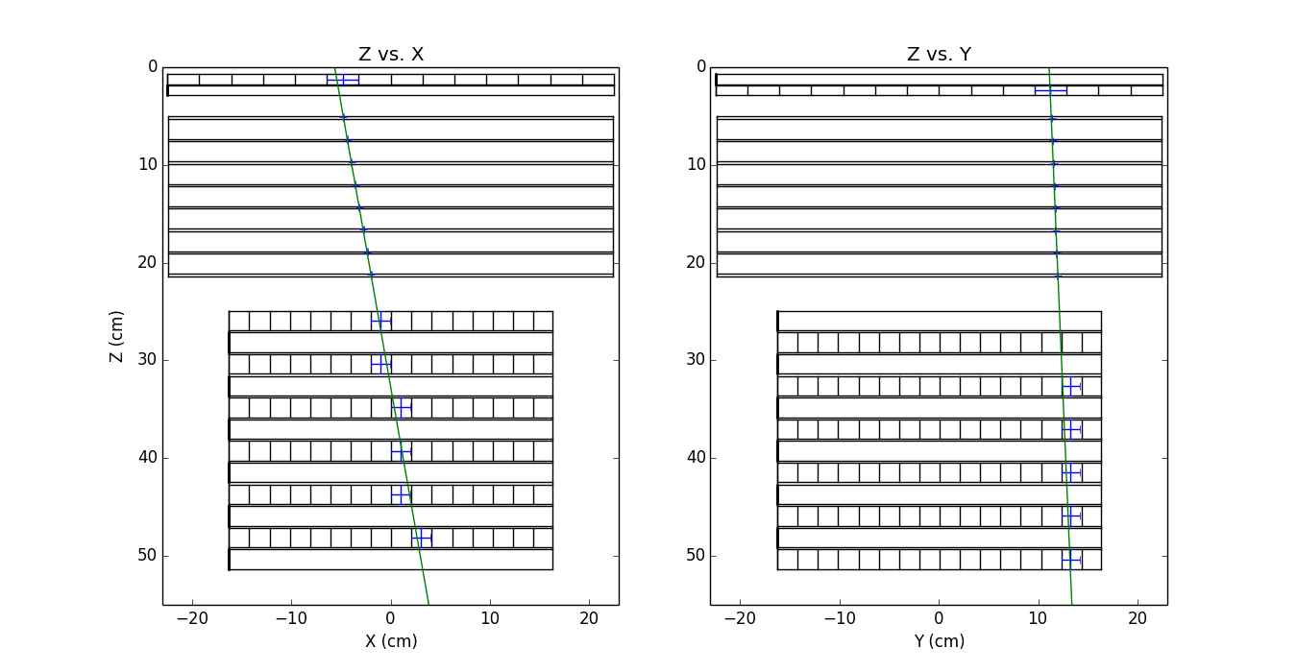
Mapping ‘hit’ components
‘Hit’ components are those passed through by the primary particle trajectory.
Event in image:
  Input: trajectory direction cosines
  Output: list of component numbers passed through (blue)

Slide 5
Event selection
Filtered events based on trajectory:
  Primary path must pass through the top of the CHD and the bottom of the TASC (type B geometry as defined in M. Mori 2013)
For events that have more than one strip per layer hit, the energy deposuts for those strips have been summed

Slide 6
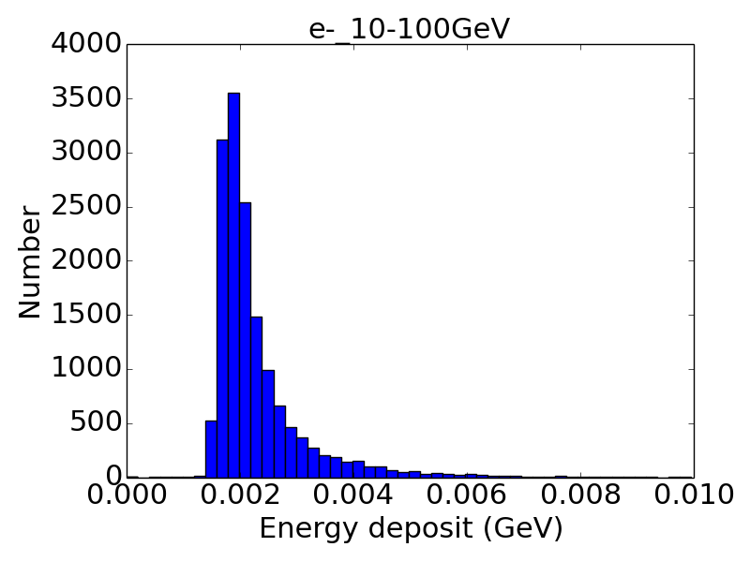
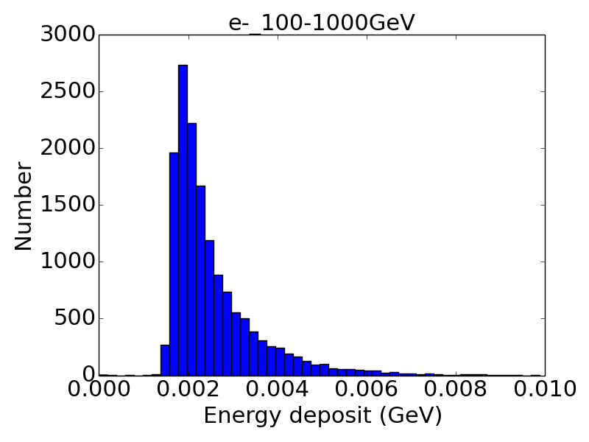
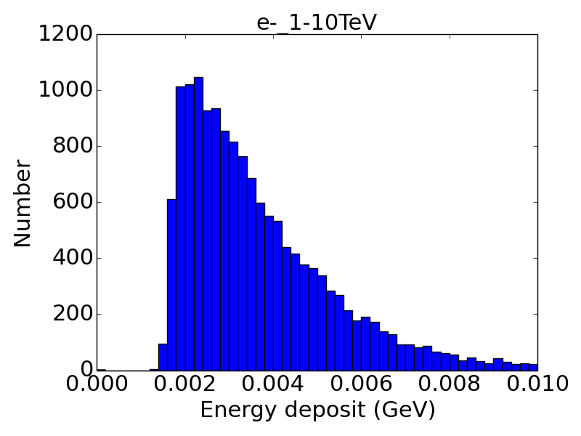
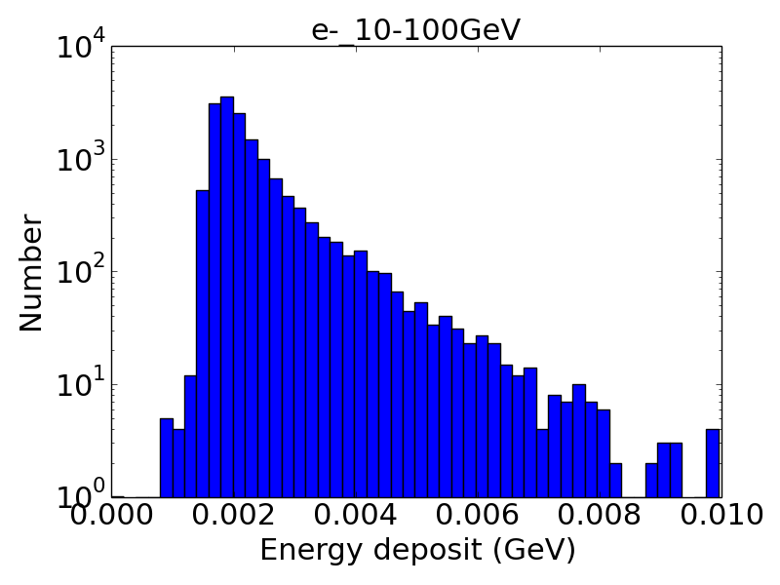
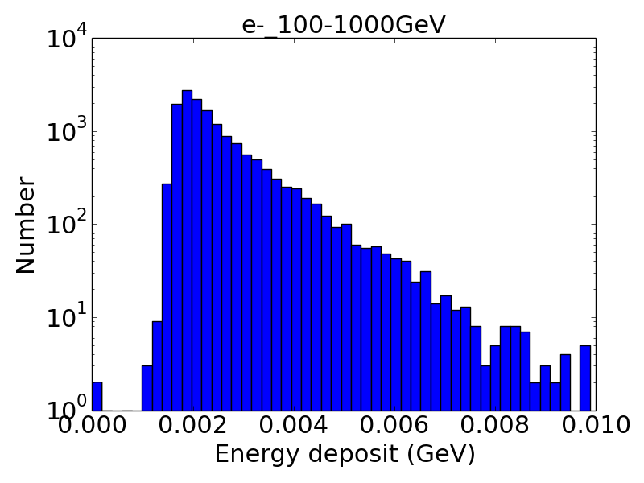
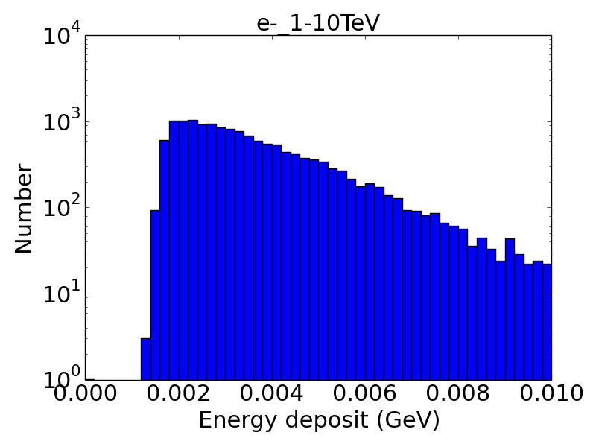
CHD histograms (e-)

Slide 7
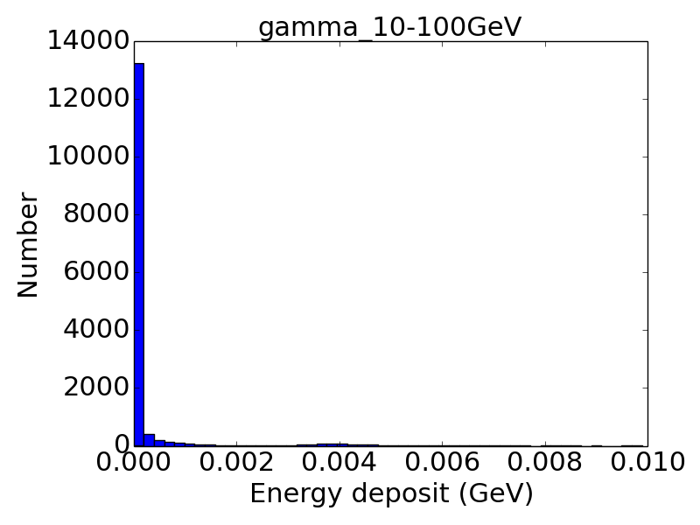
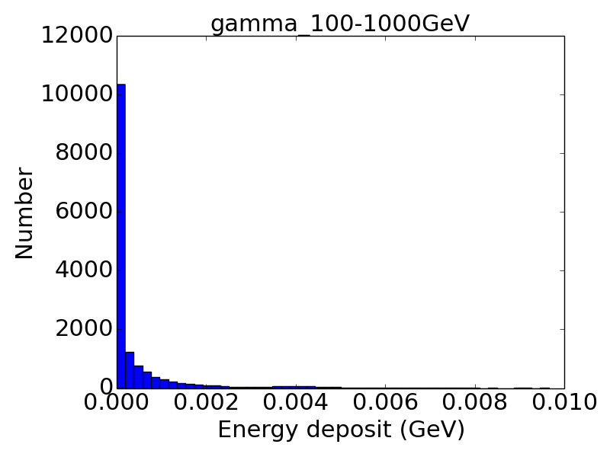
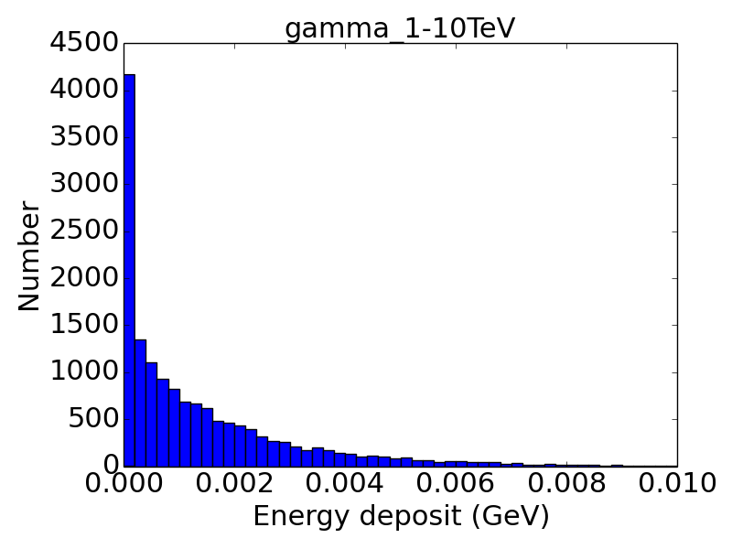
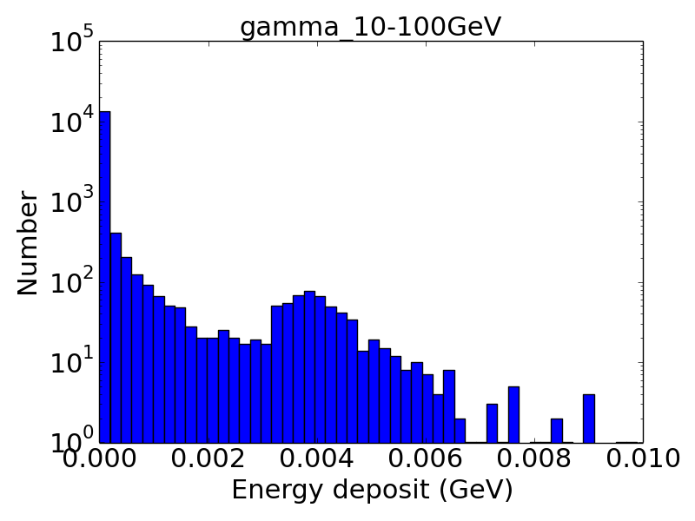
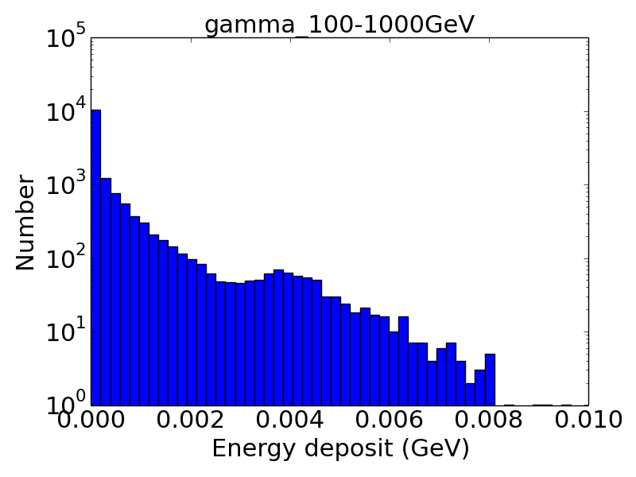
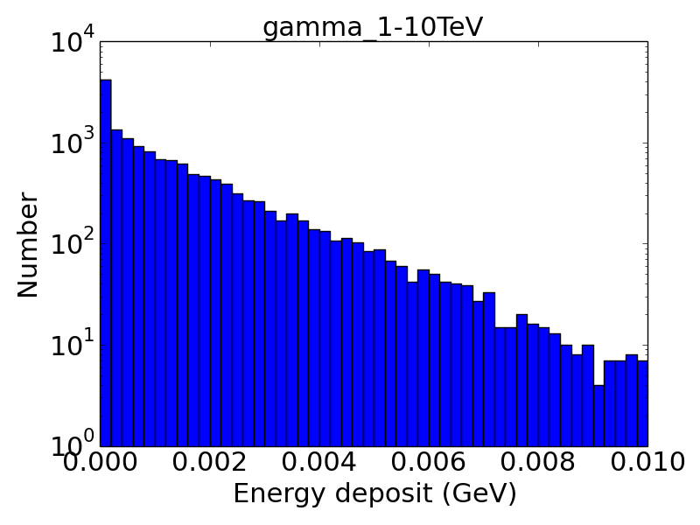
CHD histograms (γ)

Slide 8
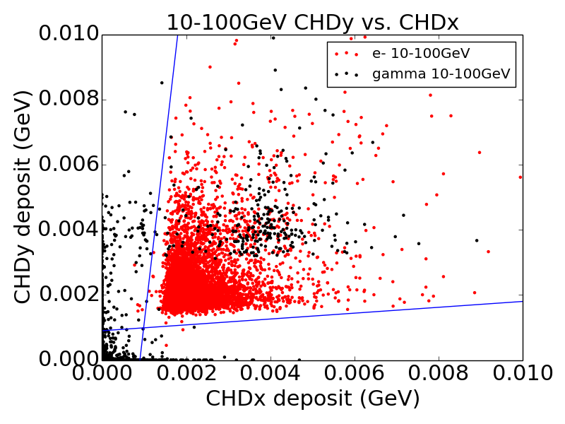
CHD coincidences

Slide 9
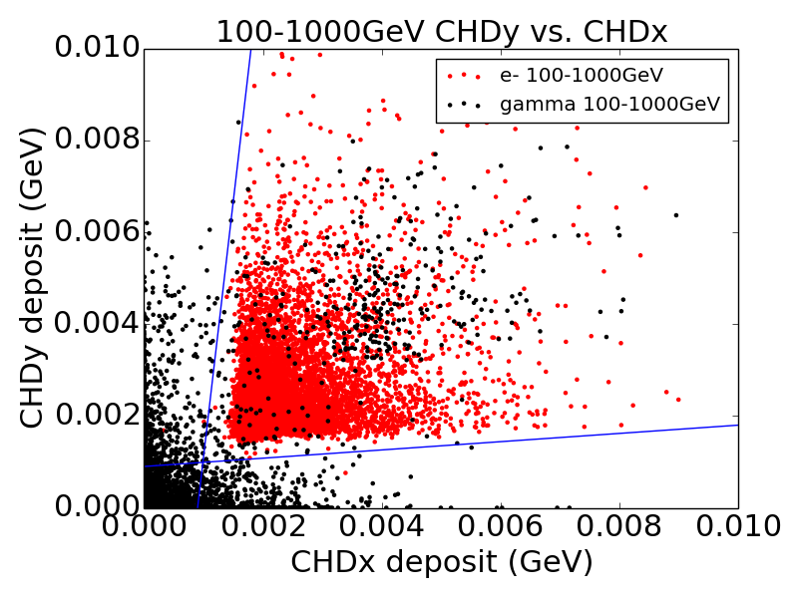
CHD coincidences

Slide 10
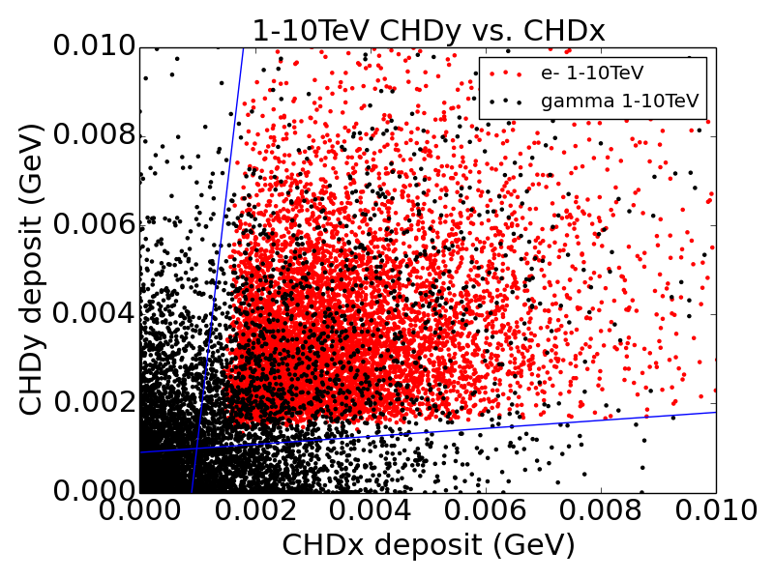
CHD coincidences

Slide 11
Separation statistics
Primary species | Energy range | # thrown | # in geometry | ID’d as γ (num) | ID’d as γ (%) | ID’d as e (num) | ID’d as e (%)
e | 10-100 GeV | 2,000,896 | 7675 | 8 | 0.104% | 7667 | 99.9%
 | 100 GeV – 1 TeV | 2,000,896 | 7554 | 5 | 0.0662% | 7549 | 99.9%
 | 1-10 TeV | 2,000,896 | 7485 | 5 | 0.0668% | 7480 | 99.9%
γ | 10-100 GeV | 2,000,896 | 7482 | 7217 | 96.5% | 265 | 3.54%
 | 100 GeV – 1 TeV | 2,000,896 | 7649 | 7275 | 95.1% | 374 | 4.89%
 | 1-10 TeV | 2,000,896 | 7573 | 5797 | 76.5% | 1776 | 23.5%

Slide 12
Exposure map
Goal: Estimate the number of photons detected by CALET in orbit and the significance of steady sources
Method: Generate a full-sky exposure map for one year of CALET orbit and use Fermi-LAT reported fluxes to calculate event rates
How: Calculate ISS zenith pointing as function of time and convolve with known fluxes and CALET geometrical factor and efficiency

Slide 13
Gamma-ray sources
Three broad classes of high-energy gammas:
  Steady point sources – systems such as AGN
  Transient point sources – systems exhibiting flares
  Diffuse flux – background radiation from cosmic-ray interactions and, possible, dark matter annihilation
Needed for calculation:
  Steady source flux – Fermi-LAT source catalog
  Diffuse flux – Fermi-LAT gamma-ray galactic background and isotropic models
  Exposure map – Generated using orbit parameters

Slide 14
Determining exposure
Fermi-LAT diffuse background model divided into 0.125° x 0.125° galactic latitude (b) and galactic longitude (l) bins
Angular separation between two bins with central coordinates (l, b) and (l’, b’) calculated using Haversine formula:

Slide 15
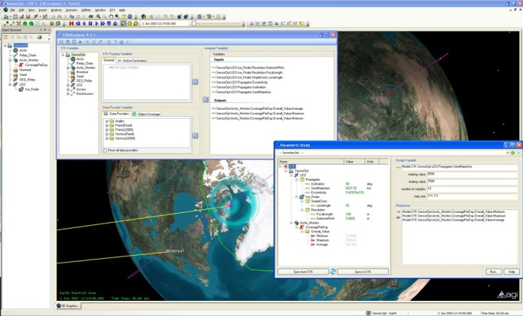
Calculating the orbit
Orbit calculated using AGI STK
ISS zenith RA and Dec (J2000) generated for 2015/11 – 2016/10 at 1s resolution
Translated to galactic coordinates using C WCS routines

Slide 16
Exposure algorithm
Given a pointing (l, b) and the knowledge that the pointing is approximately constant over a 1s window:
  Find bin that (l, b) lie within
  Find all bins with centers (l’, b’) within 45° of the pointing direction (l, b)
  Increment the exposure time for all of those bins by 1 second
  Repeat for all pointing directions

Slide 17

Bins in f.o.v.
Start with the pointing bin at (l0, b0)
Log bins with l = l0 and b between b0 - 45° and b0 + 45°
Start at top bin and step to the right until a bin is found that has Δs > 45°
Repeat until minimum b is reached
Reflect these across the central line
Increment exposure of all bins within these boundaries

Slide 18
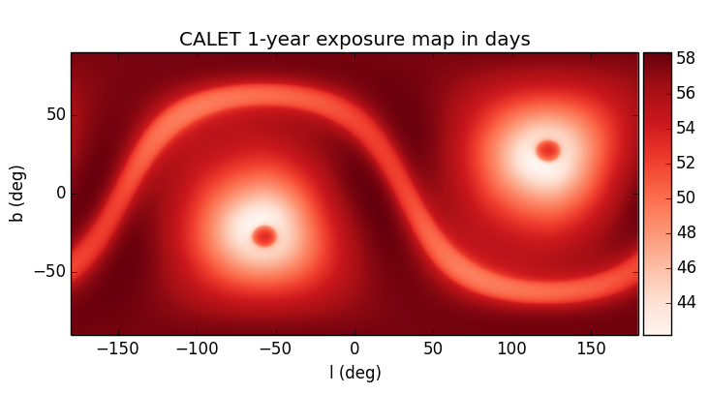
Exposure map

Slide 19
Photons incident
Using an effective area of 500cm², the number of type-B geometry photons incident is
  Approx. 3500 from combined galactic diffuse (10-500 GeV) and isotropic (10-600 GeV) sources
  Approx. 350 from persistent sources
    15 sources with ≥ 3 photons
    4 sources with ≥ 10 photons, including Crab, Vela, and Mkr 421

Slide 20
Photons incident
1FHL Designation | Common Name | Type | # of photons
J0835.3-4510 | Vela | PWN | 22
J0534.5+2201 | Crab | PWN | 19
J2028.6+4110e | MGRO J2031+41 | N/A | 12
J1104.4+3812 | Mkn 421 | HBL | 11
J0617.2+2234e | IC443 | Shell | 8
J0633.9+1746 | Geminga | PWN | 7
J2158.8-3013 | PKS 2155-304 | HBL | 7
J1709.7-4429 | HESS J1708-443 | PWN | 5
J1824.5-1351e | HESS J1825-137 | PWN | 5
J0222.6+4302 | 3C 66A | IBL | 4
J1923.2+1408e | W51C | Shell | 4
J2021.0+4031e | VER J2019+407 | N/A | 4
J0538.8-4405 | N/A | N/A | 4
J1801.3-2326e | W28 | SNR | 3
J2253.9+1608 | N/A | N/A | 3

Slide 21
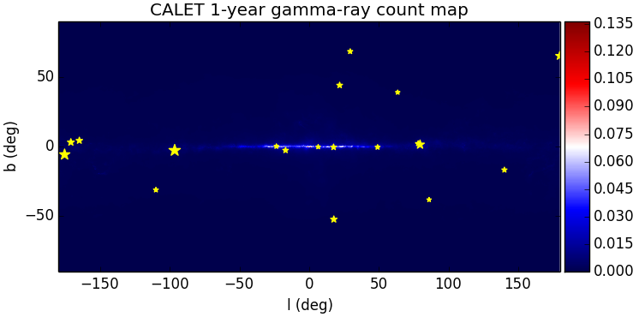
Photons incident

Slide 22
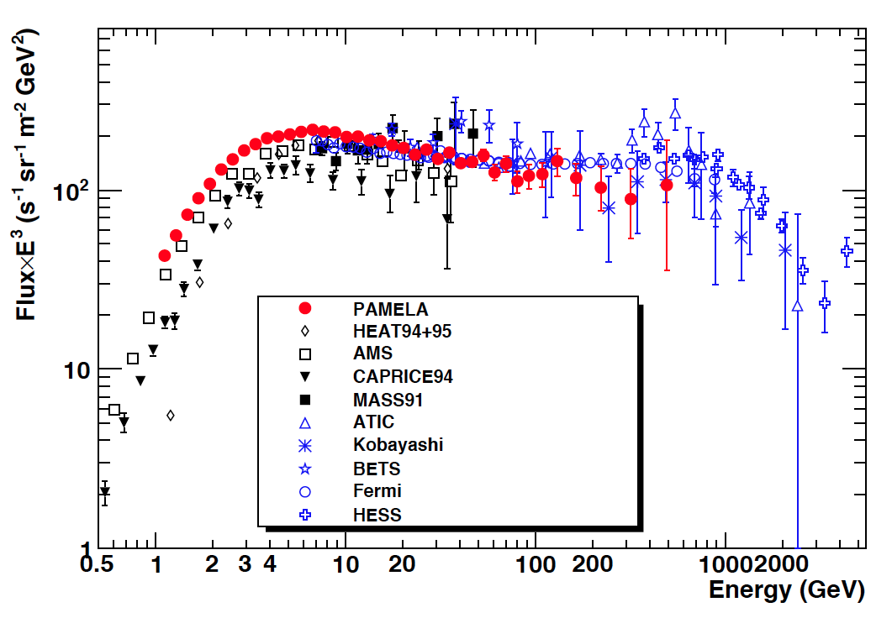
Electron contamination
The electron flux was obtained via PAMELA results
Integrating the spectrum from 10-600 GeV yields an expectation of:
5 x 10⁻³ sr⁻¹ s⁻¹, with an average of 0.07 per sky bin after 1 year.

Slide 23
Crab flares
Estimated number of
  Approximate exposure time for Crab on day when it is optimally in field of view is 21600s (25% of day)
  Denoting as α the flaring Crab flux in units of ambient Crab flux (α = Φ_{flare}/Φ₀), the number of photons expected for one ideal day of flare observation is
  For a 1-day flare, α = 25 gives an expectation of 2 photons

Slide 24
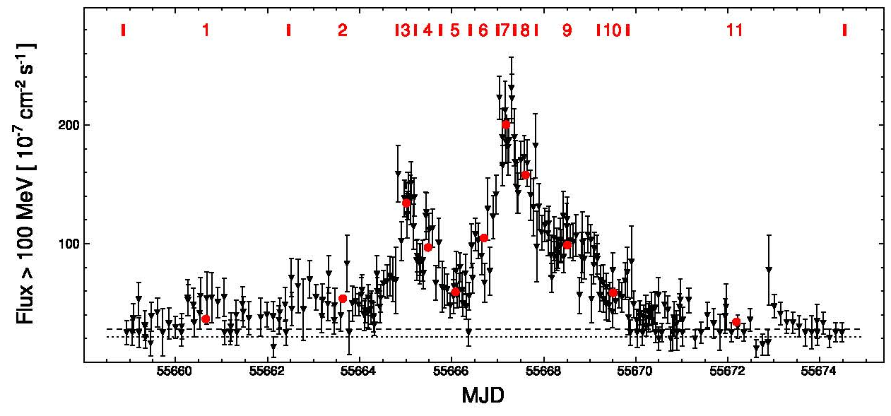
Historical flares:
  04/2011: α ≈ 30, t ≈ 10 d
  03/2013: α ≈ 20, t ≈ 14 d
Scale relation to 16% of day (average, rather than ideal)
Expected number of photons:
  15 from either of the noted flares (~3.8σ significance)
Detection at these energies would indicate inverse Compton source (only synchrotron observed to date)

Slide 25
Results
Gamma-rays can be separated from electrons up to 1 TeV with >95% efficiency and electron rejection of better than 1 in 10³
CALET will significantly detect some persistent sources, but will not be able to compete with Fermi-LAT on studying these
All-sky scanning will be possible with CALET, making it a valuable tool for detecting high-energy flares such as those from Crab

Slide 26
Extra slides

Slide 27
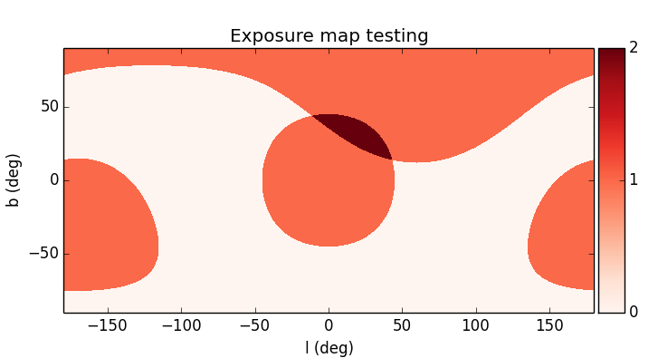
Example results
Sample exposure map generated using three pointing directions. In galactic coords.,
(l, b) = (0.0, 0.0), (190, -30), (60, 57).

Slide 28
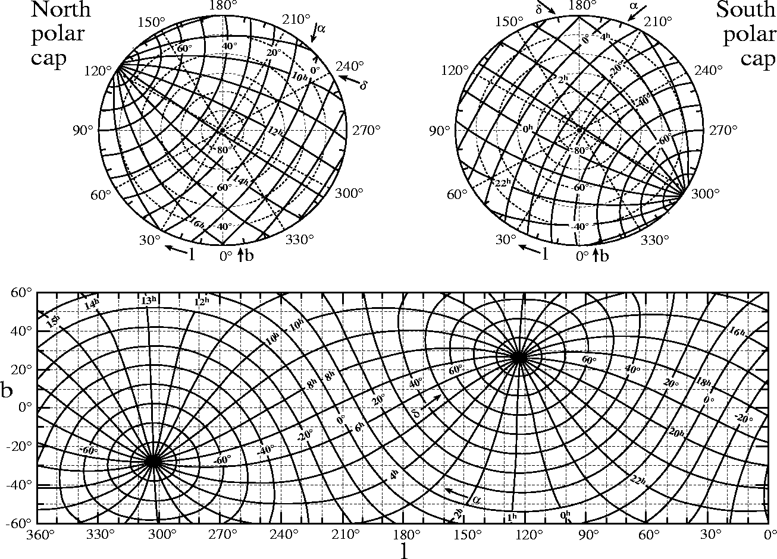
Coordinates

Slide 29
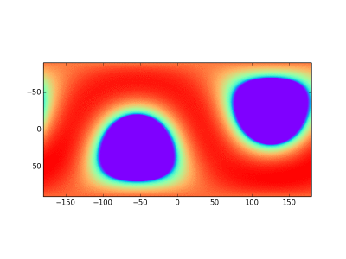

100ks frames

