Slide 1

Predicted CALET Measurements of Heavy and Ultra-Heavy Cosmic Ray Nuclei
Brian Flint Rauch
Washington University
CALET Technical Interchange Meeting
INFN sez. di Pisa
June 26, 2015

Slide 2

Introduction
UH GCR are interesting because they tell us about the GCR source and acceleration mechanism.
Update prediction of UH statistics that CALET will see in 5 years.
Predict heavy GCR statistics that CALET will see in 5 years.

Slide 3
Galactic Cosmic Rays Compared to Solar System
SS abundances from K. Lodders, ApJ 591, 1220 (2003)

Slide 4
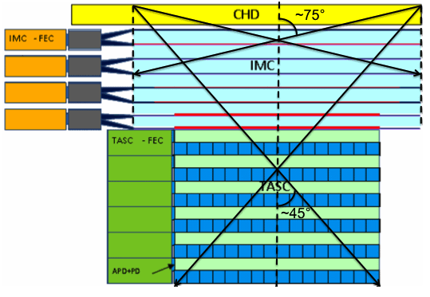
Improved Collecting Power for Higher Energy Events
TIGER data for scintillators similar to those used in CALET
Above a C1 threshold of ~5000 (~600 MeV/nucleon) Fe-peak resolution does not vary much with energy
Charge determinations of UH GCRs can be made with scintillator signals alone
Passage through the CHD and the top four fiber layers in the IMC gives a larger geometry factor, 0.40 m²-sr, than for the total instrument, 0.12 m²-sr

Slide 5
Measured Differential Spectra
Spectra 5 ≤ Z ≤ 32 from 2009ApJ...698.1666G

Slide 6
Integral Spectra

Slide 7
Fe Integral Spectra Scaled with Relative Abundances for UH
Spectra have not been measured for UH GCRs, so the Fe spectrum is scaled by relative abundances.
Modulation seen by CALET is likely to be between Solar Minimum and Maximum, so calculations use averages.

Slide 8
Nuclear Critical Momenta
Critical Momentum Dependence on East-West Angle and Geomagnetic Latitude from Störmer Theory
In GeV/c where λ is geomagnetic latitude and γ is the East-West angle

Slide 9
Vertical Cutoff Rigidities
Bilinear interpolation of 5° latitude × 15° longitude grid at 450 km altitude by Smart & Shea AdSpR, 44, 1107 to 1° pitch

Slide 10
Geomagnetic Latitudes
Converting vertical cutoff rigidities to geomagnetic latitude using Störmer theory:
In GV, where λ is geomagnetic latitude

Slide 11
Masked Out SAA Based on AMS-02
Contour plot of geomagnetic latitude derived from Smart and Shea (2009) and SAA Schael et al., 2013.

Slide 12
Determining Geomagnetic Latitude Exposure
ISS Orbit Fraction
Geomagnetic Orbit Fraction
Use ISS orbit fractional latitude residence time to derive fractional geomagnetic latitude residence time

Slide 13
Accounting for Detector Saturation and Interactions
Added saturation cut in addition to interaction cuts based on zenith angle (θ) used in ICRC analysis.
Use differential geometry factor of CALET for East-West angle (γ) and zenith angle (θ) to model exposure and nuclear interaction survival probabilities – reducing by 25% for θ > 45° for ISS obstructions

Slide 14
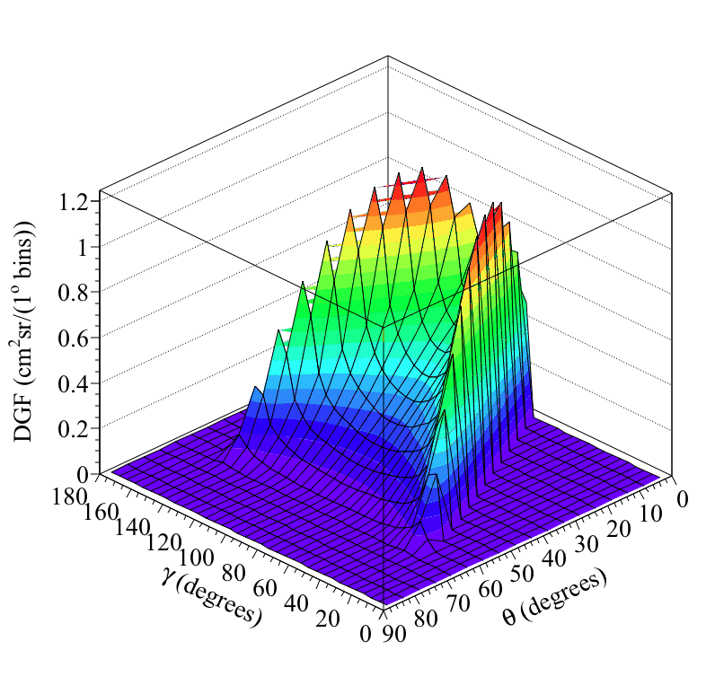
Consider Different Acceptances
UH Mode – UH Trigger
UH Mode – HE Trigger
Full Geometry
4400 cm²sr
1700 cm²sr
700 cm²sr

Slide 15
Predicted UH Results
double time_in_orbit=5*365*24*60*60; // 5 years times seconds per year
Previous Prediction
Current Analysis
CALET ≈ 2×TIGER: Neglected to multiply by 5!

Slide 16
Full CALET Acceptance Statistics
Used similar approach to UH analysis without rigidity threshold limit.

Slide 17
Summary
Expected CALET UH statists from Heavy Trigger 5 times greater than previously reported.
UH statistics within full geometry for 5 year exposure not much less than from first SuperTIGER flight.
More abundant nuclei 5 year statistics predicted accounting for geomagnetic shielding and interactions in CHD.

