Slide 1
Status update for US CALET Data Center (USCDC)
Doug Granger
LSU
CALET TIM June 2015

Slide 2
US-CDC Purpose
Designed to be the centralized CALET Data storage Center for the US group of CALET.
  Storage for Official CALET Data Products (Level1.X, Level2.x, etc)
  Storage for Process and Analysis Tools
  Capability to distribute data packages to all US Members
Interface with Foreign Collaborators for Data Handling and Analysis product sharing
  Retrieval of Flight Data from The WCOC
  Sharing of analysis tools
  Data sharing for Analysis
Provide a system for communication to all members
  Data Quality Checks Server
  Data Logging Server
  LSU Document Host Server
  LSU HPC Simulation Log Server

Slide 3
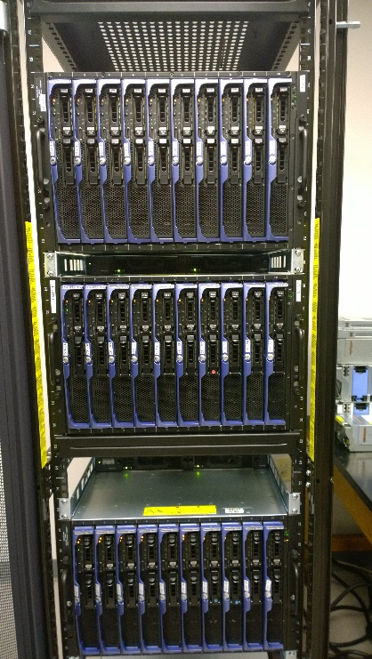
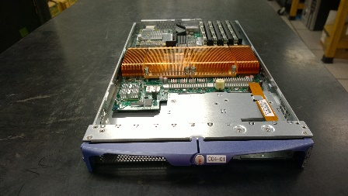
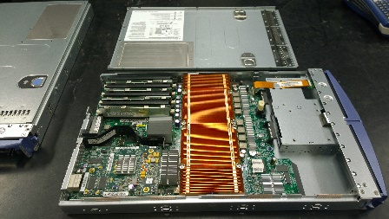
Description of US-CDC hardware
30 Blade Rack
  4 Processors per Blade
    2 dual Core CPUs per Blade (4 total Processors)
    2.66GHz Xeon 64-Bit
  16GB of Ram (currently) per blade
  32GB on host node
  110 Available Processors (currently)
  Gigabit networking capability
38 TB DS1815+ Synology NAS
  RAID5 (38TB usable)
  4 – Gigabit network pipes
  8 X 6TB drives
  Expandable to 96TB max
30 TB Direct Access Disk Array
  RAID6 build
  Gigabit networking capability
  15 X 2TB SAS Hard Drives
Additional 30TB NAS (Possible)
  16 X 2TB SATA Hard Drives

Slide 4
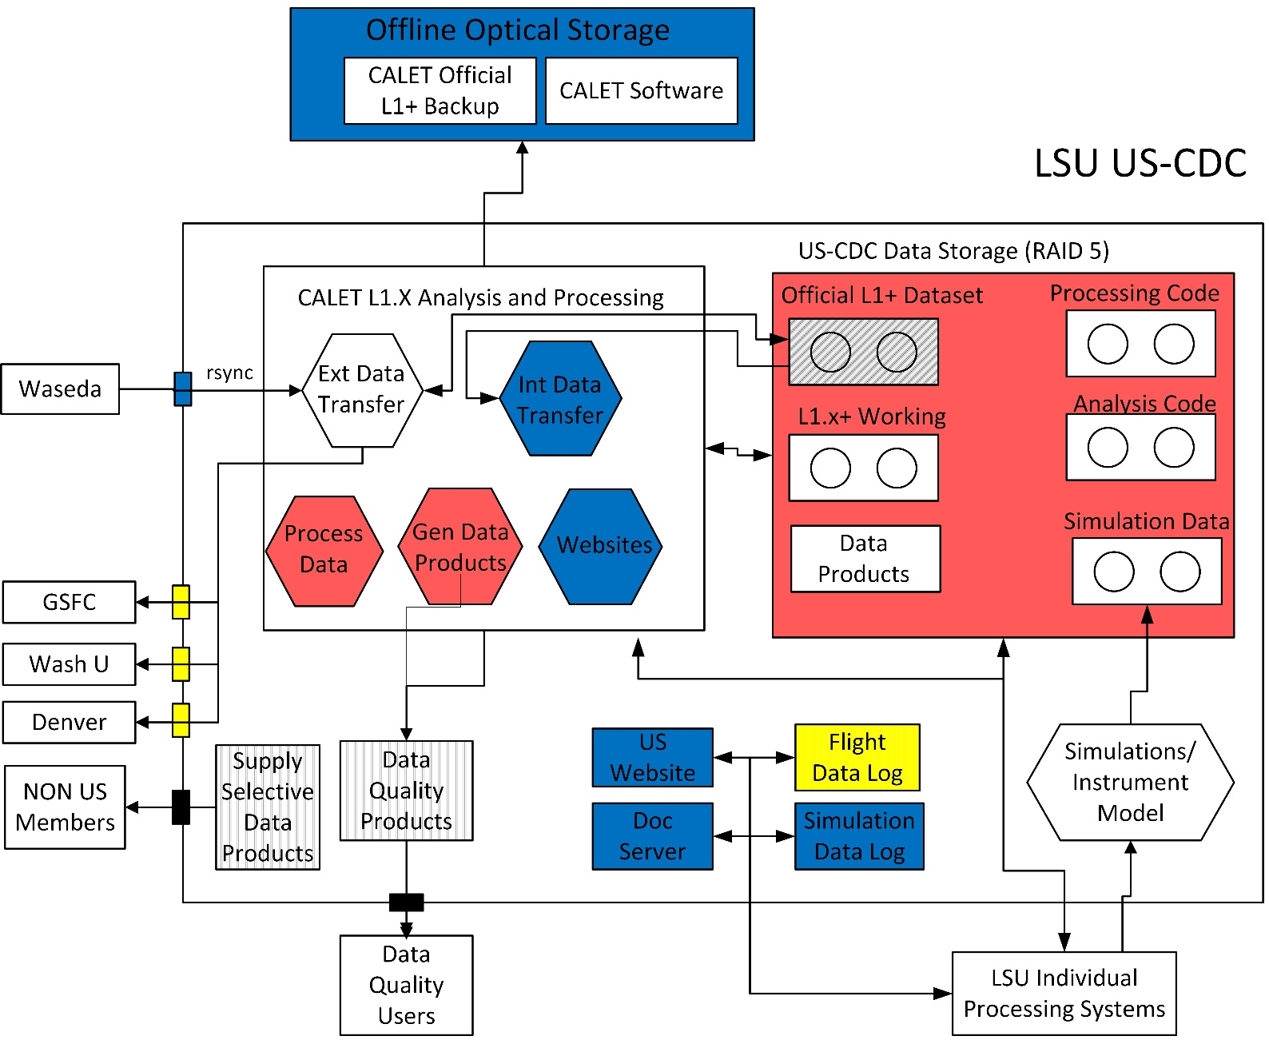
High Level System Design

Slide 5
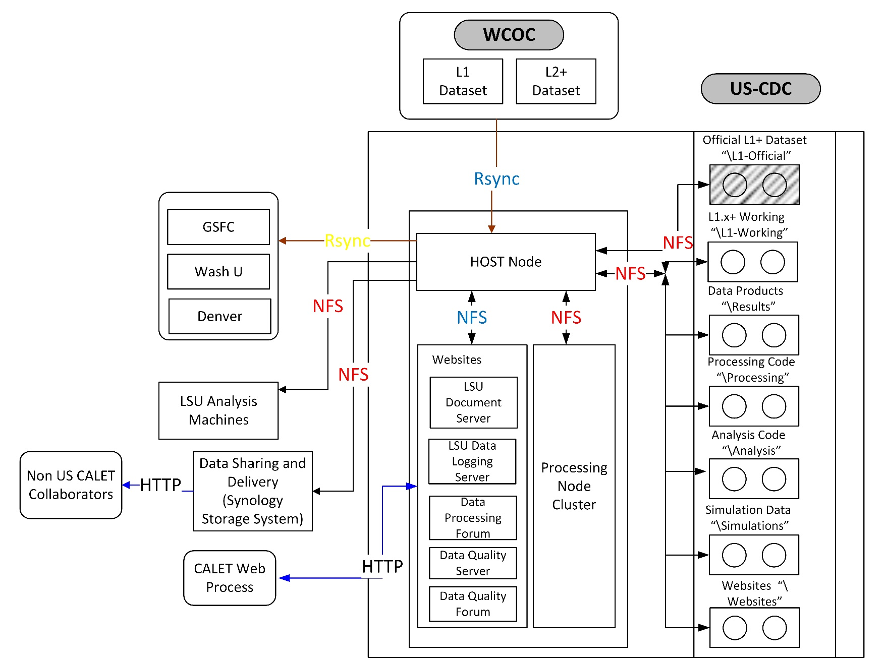
Software Data Flow

Slide 6
Main USCDC System Processes
CALET Level 1.X Data Transfer
  Transfer of CALET Data from Waseda and to US Collaborators
  rsync application
Internal Transfer System Process
  Transfer of raw data and data products to internal USCSC sub-systems
External data transfer process
  Data transfers in and out of the USCDC from remote locations
  Web server, LSU document server, HPC Simulation Log
Web Systems Process
  Main member of the external data transfer process
  Single location for distribution of data products
  Data Quality Check Server

Slide 7
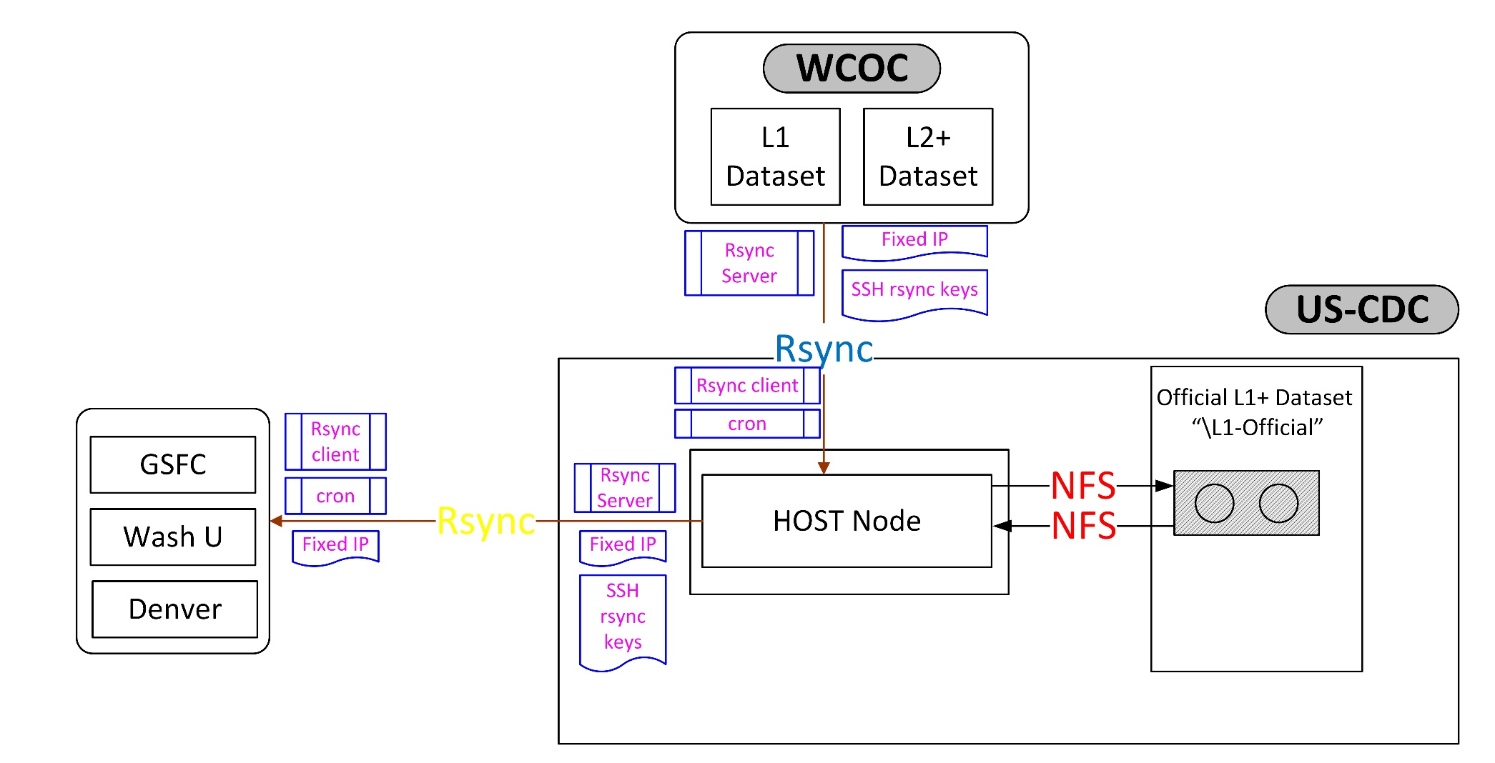
CALET Level 1.X Data
Transfer Process

Slide 8
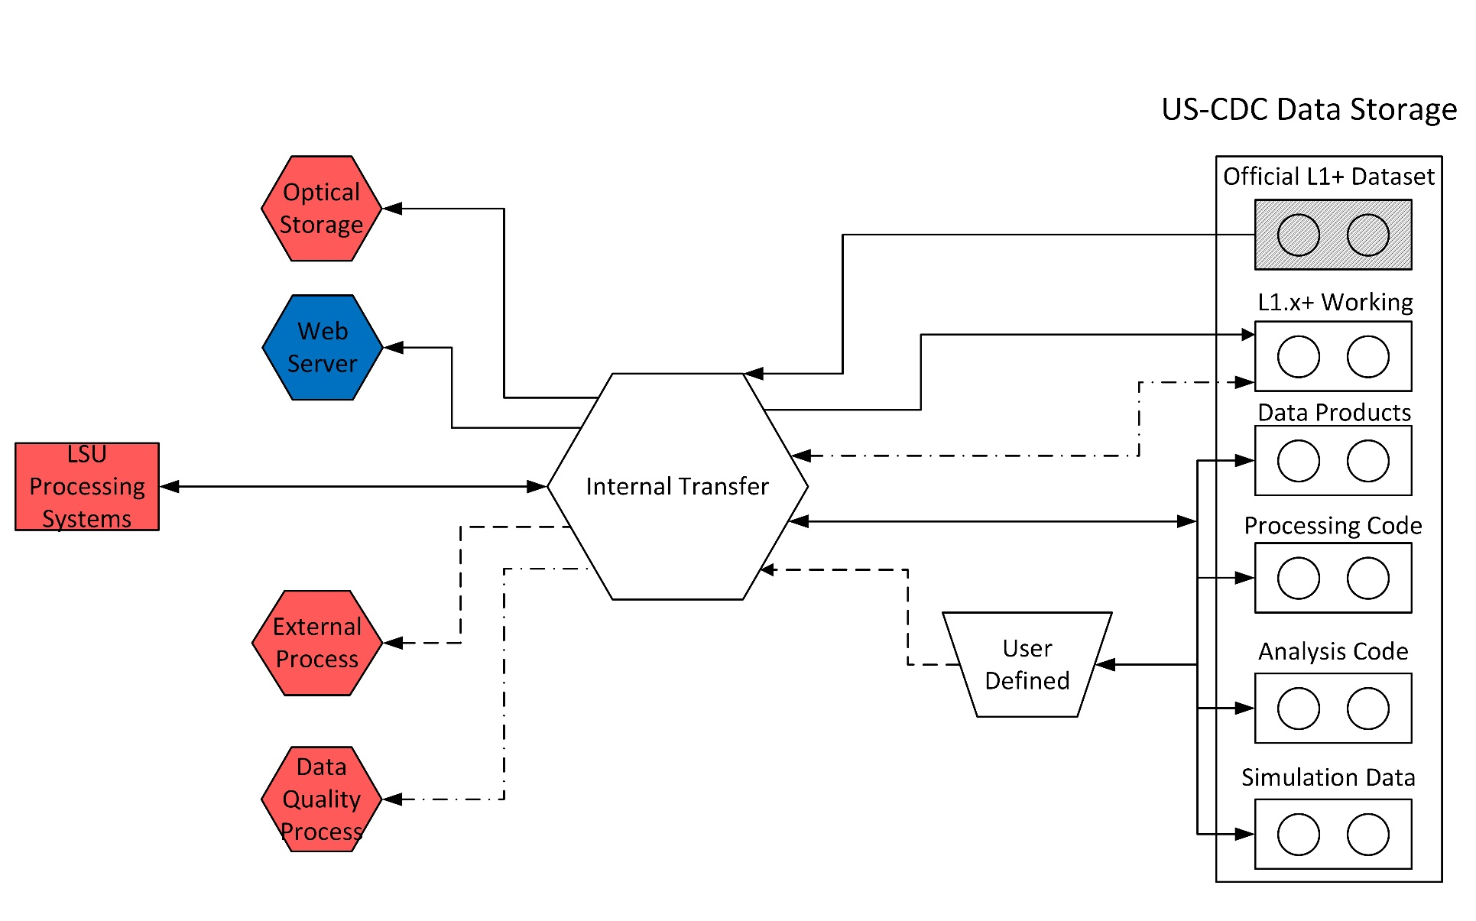
Internal Transfer System Process

Slide 9
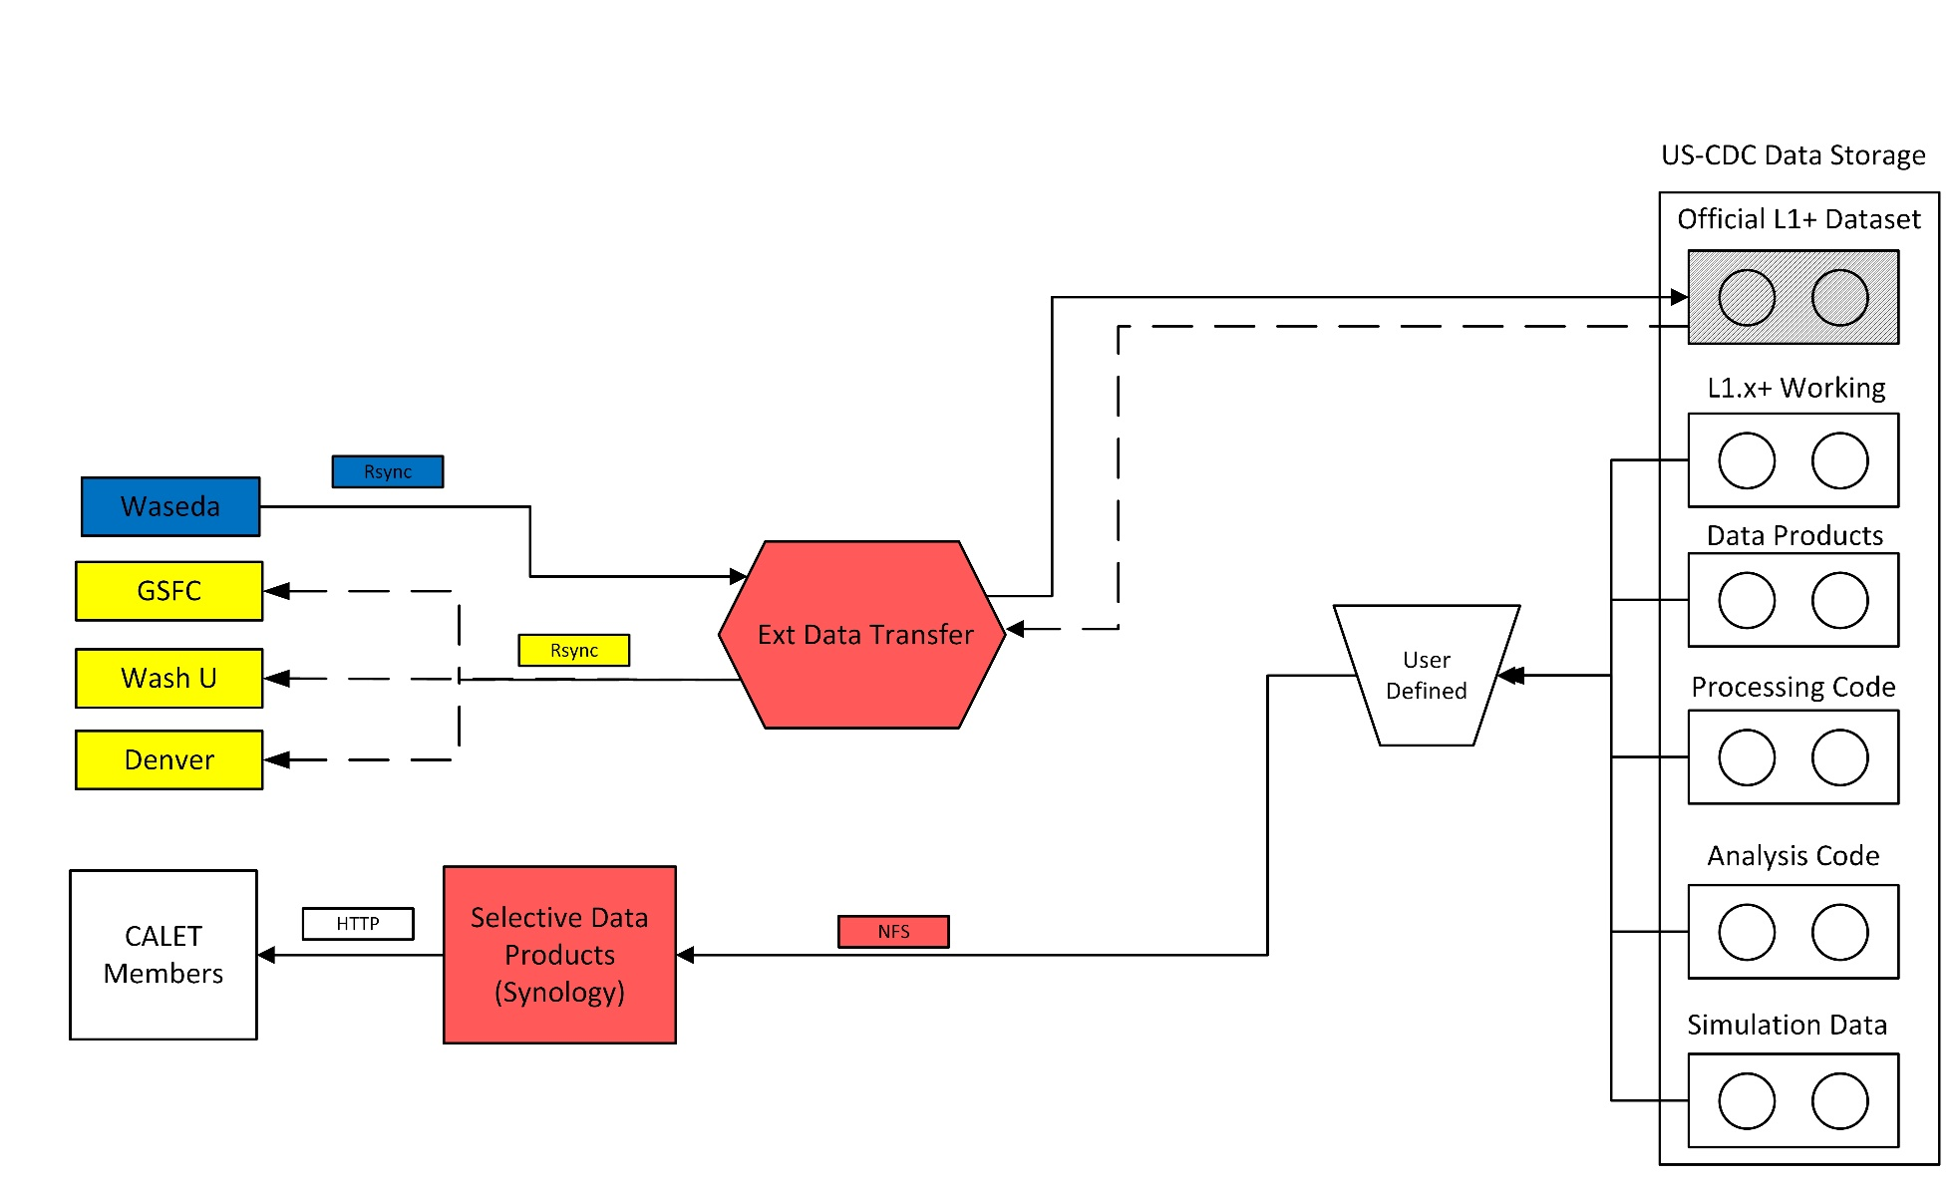
External Data Transfer Process

Slide 10
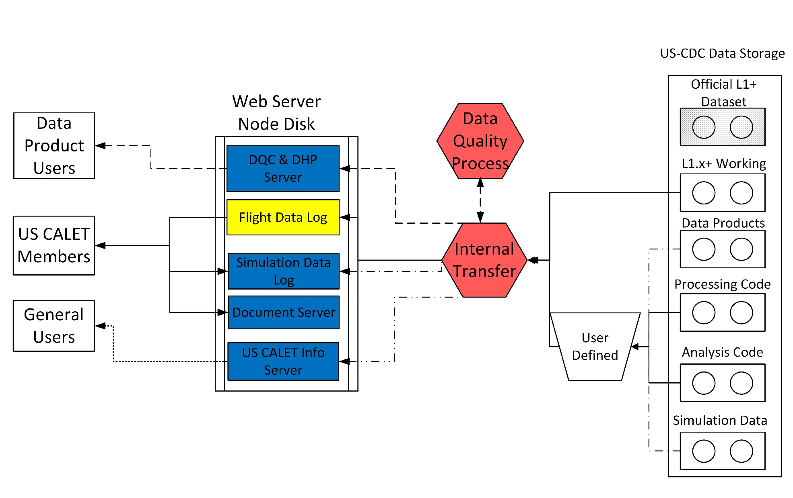
Web Systems Process

Slide 11
Main USCDC System Processes
Status Update
CALET Level 1.X Data Transfer
  Internal testing complete
  Waseda to LSU functions on test server, deployment to USCDC underway
  LSU to US Collaborators design underway
Internal Transfer System Process
  Completed and tested on the USCDC, except the web server process which is still on test servers
External data transfer process
  Data products delivery process is designed and deployed, awaiting final directory structure
Web Systems Process
  Most functions have been deployed on test server
  Deployment to main USCDC imminent
  Flight Data log web interface under development

Slide 12
Accessing the US-CDC
L1 Flight data
  US collaboration will access data via rsync connection to the USCDC
  Access to both L1 and HDF5 data
  Will be password-less ssh connection to allow for pull automation
  Awaiting final IP from LSU ITS before publishing
Data Products access
  Web interface using the synology file manager software.
    Similar to modern operating system file manager
  Single username and password for CALET Members for ease of access
  Current address HTTP://calet-sys.phys.lsu.edu
  Awaiting LSU ITS approval for external IP VLAN access.
Information Web servers
  Planned location: HTTP://calet-sys.phys.lsu.edu

Slide 13
Current Status
System is installed and operational
  Server room power is installed
  Network capability functional
  Need to have LSU ITS move the assigned IP into the External VLAN IP space.
  Need to finish populating the LDAP with users and groups
All installed blades are functional
  16GB of RAM
  RHEL6.5 server installed on all systems
  Backup blades needs to be tested
Disk Array systems
  Synology box fully populated and installed
  Poweredge is populated but there are a few issues with integration still exist

Slide 14
Current Status (continued)
Software Installed
  Exelis IDL
  Torque
  Intel Fortran
  EPICS (this week)
  COSMOS (this week)
  gcc
  c++
Future software packages?
  ROOT
  R statistical analysis package

Slide 15
Questions/Comments?

