Slide 1
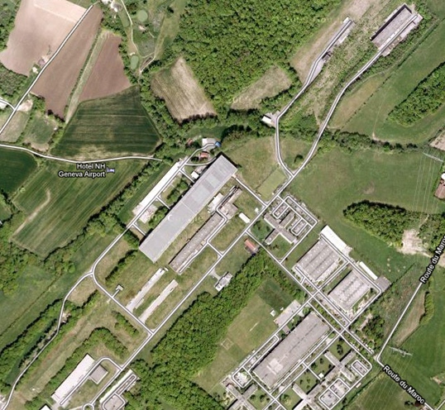
North Area Consolidation
What have been done ?
Meeting 18.06.2015
Mats Wilhelmsson

Slide 2
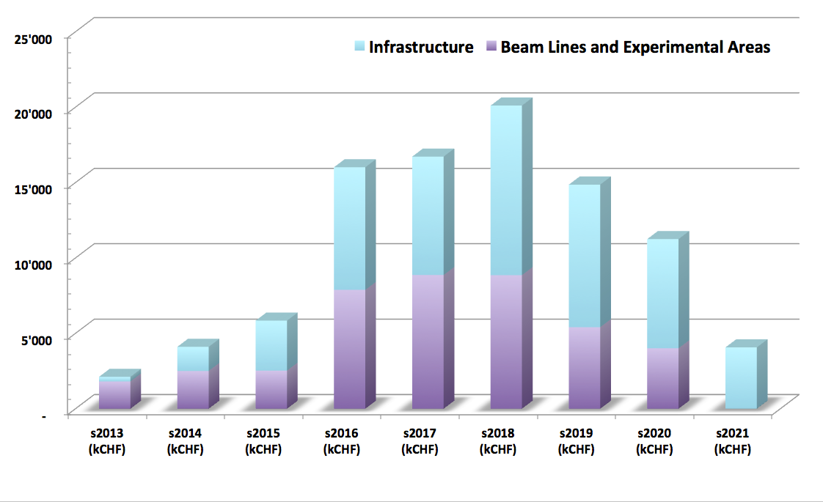
Some achievements done and some started

Slide 3
TCC2/TDC2 renovation
The renovation of the target area TCC2/TDC2 took priority due to severe needs and high impact in case of failure. The renovation includes :
Targets, collimators and TAX tables
Magnets and vacuum items
Cooling and Ventilation system
Cabling/electric system (halogen removal)
Some illustrations here thanks to Sebastien Evrard:

Slide 4
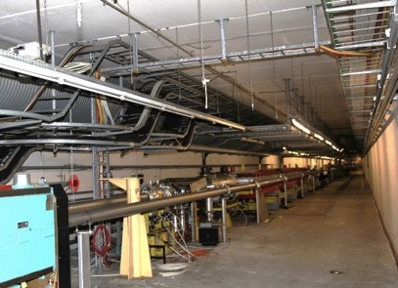
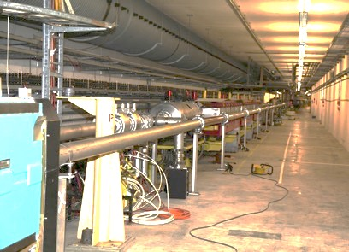
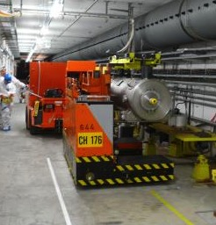
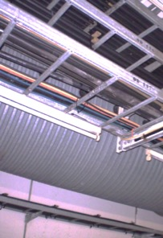
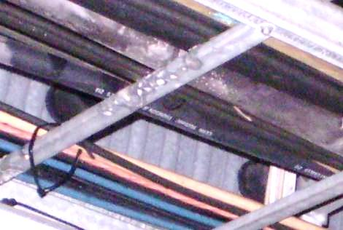
Consolidation of TCC2-TDC2
Corrosion issue
Reengineering of splitter magnet area
Infrastructure upgrade
Renewal of key beam line elements (collimator, targets, XTAX tables)
370 people involved, 10 months
before
after
Remotely controlled replacement of an unlucky collimator which had been sitting for years under degrading PVC cables

Slide 5
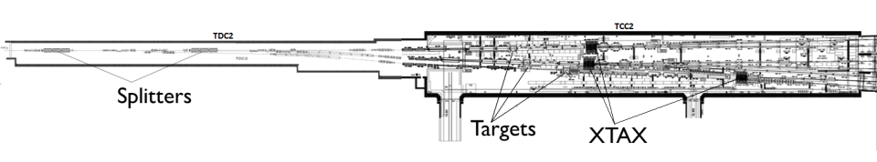
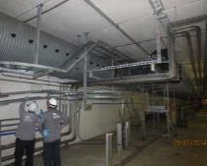
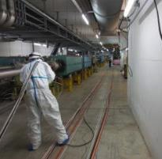
Consolidation of TCC2-TDC2
Cabling
> 2000uSv/h
< 50uSv/h
< 1000uSv/h
<50
< 100
< 500
< 100uSv/h
<500
<100
< 50uSv/h
< 1000uSv/h
< 500uSv/h
< 50uSv/h
> 2000uSv/h
> 2000uSv/h
< 10 uSv/h
< 10 uSv/h
< 5
< 15
< 15
< 10 uSv/h
< 10 uSv/h
High radiation temporary storage zone
< 5
< 5
< 5
< 5
RP Survey September 2013
EDMS: 1319247
Additional RP measurements April 2014
 | Number of cables to lay | Length of cables to lay [km] | Number of cables to remove | Length of cables to remove [km]
DC Cables | 70 | 4.2 | 70 | 4.9
Control Cables | 85 | 7.9 | 93 | 5.7
Cable Trays |  | 0.12

Slide 6
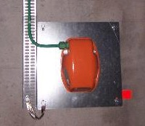
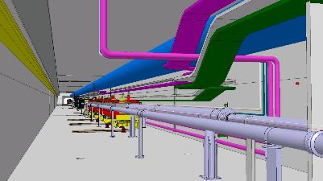
Consolidation of TCC2-TDC2
Low Voltage
Removal of obsolete lighting system and installation of radiation resistant emergency lighting system
Replacement of AUG and power distribution systems by new generation equipment
Renovation of the Low Voltage distribution
Installation of dedicated feeders for heated collar system to improve lifespan of vacuum pumps
Re-location of cable containment and extensive cabling campaign

Slide 7
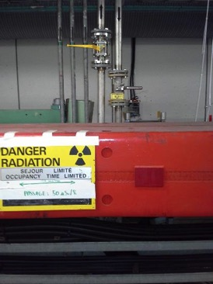
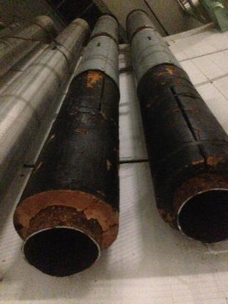
Consolidation of TCC2-TDC2
Cooling
Demineralised water circuit
Replacement of 18 leaking manual isolation valves
Chilled water circuit
Replacement of chilled water piping including asbestos removal
Replacement of chilled water coils
Ventilation
Replacement of the regulation of the ventilation units (temporary solution: permanent solution foreseen in 2016)
Replacement of condensation pipes of the ventilation units
Sumps
Modification of power supply for two sumps from BA2
Installation of a sump pump outside TCC2 structure
Installation of a pipe if evaporator needed

Slide 8
LS1 related issues in the halls
EHN1 underwent an enormous cleaning up project: hundreds of obsolete physics equipment, were dismanteled and skipped
Fill with volume etc..

Slide 9
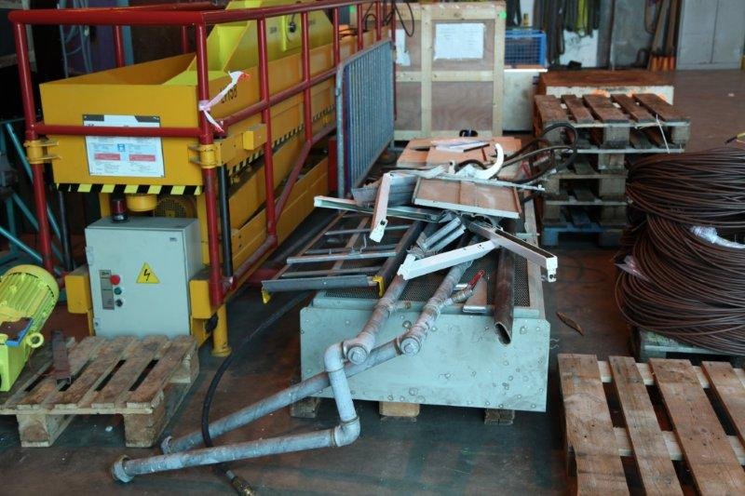
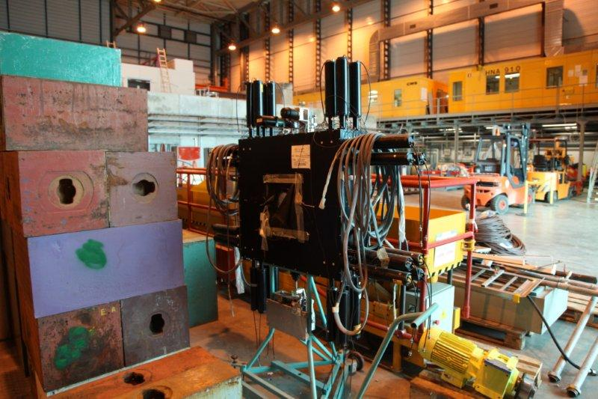
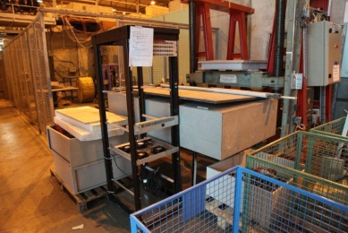
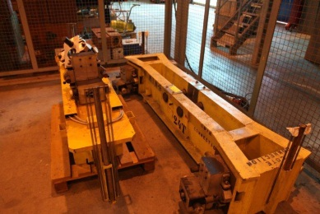
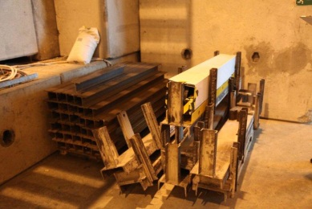
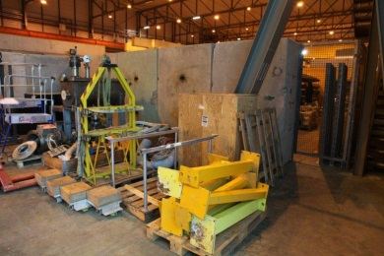
EHN1 before LS1

Slide 10
After moving, sorting, dismantling,
RP-checking and cleaning:
The hall is transformed
For operation in run2.

Slide 11
Other started high priority items
The roof of EHN1 had repair
One of the access rampes to EHN1 was re-surfaced
Chilled water network replacement
Ventilation renovation for the ECN3 hall
Spare collimator (TCSC)

Slide 12
Chilled water pipe replacements

Slide 13
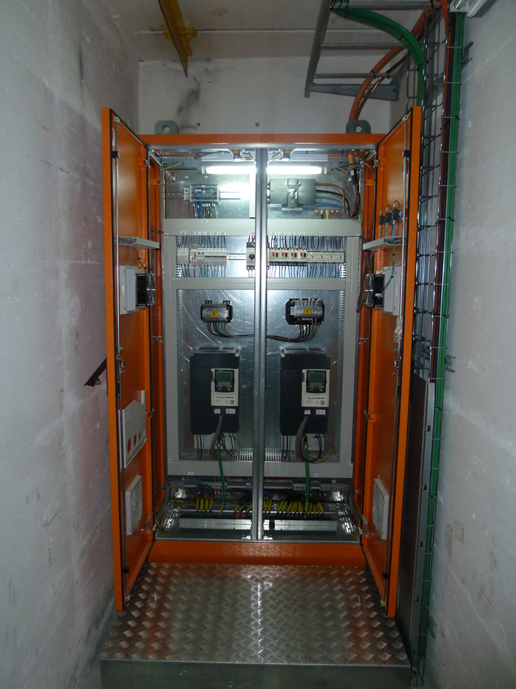
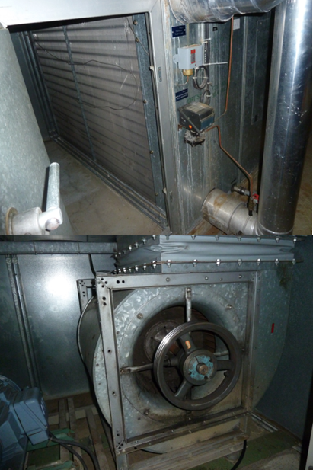
A 40 years old ventilation system for ECN3 was replaced by a
Completely new system adapted for the operation of NA62

Slide 14
Strong candidates for 2016:
And the gas safety of the gas buildings – inventory needed !

Slide 15

Items to be postponed (?):

