Slide 1
SPS NA Consolidation
  I. Efthymiopoulos
  A. Fabich

Slide 2
SBA Consolidation
Consolidation project for the PS East Area and SPS North Area is included in the general CERN Consolidation Project
Continuous effort from several groups, with important steps concluded during LS1
  PS East Area: new IRRAD facility, infrastructure renovation for the building, CESAR deployment, access system, radiation monitoring, cleanup
  SPS North Area: TCC2/TDC2 renovation, ECN3 infrastructure, infrastructure renovation for buildings and services
    Pre-LS1 consolidation: BI & STI electronics
Still lot to be done to assure the proper (and SAFE) operation of the facilities for the next 15 years!
  Both EA & NA are core facilities for CERN, highly popular for the experiments and with important NEW projects scheduled and proposed.

Slide 3
SBA Consolidation - Status
Beyond LS1 activities presented by the groups in a series of IEFC presentations this summer
Summary presented at the Chamonix’14 workshop
Proposed actions and budget profile summarised in the EDMS documents:
  EDMS 1456636, “SPS North Area Consolidation Program - Renovation and Consolidation Analysis Report”
  EDMS 1471844, “The East Area Upgrade - Specifications and Cost Estimates”
The documents include the collection of all identified activities including a ranking based on a risk analysis separated for three scenarios:
  Baseline (high - priority items) - Preservation - Value added

Slide 4
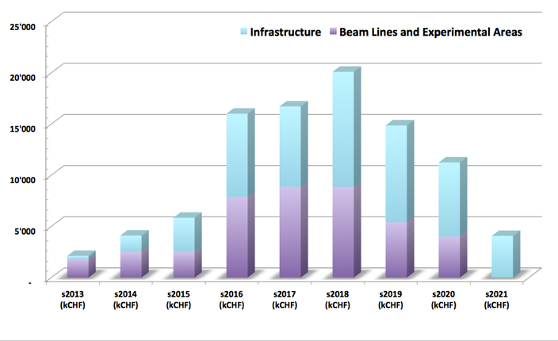
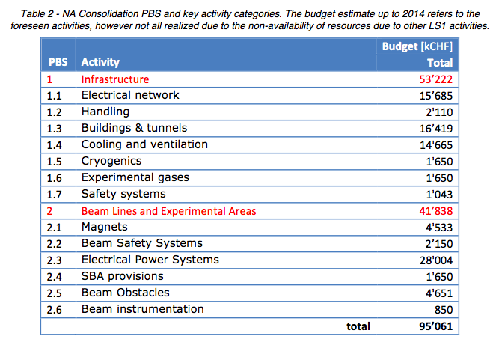
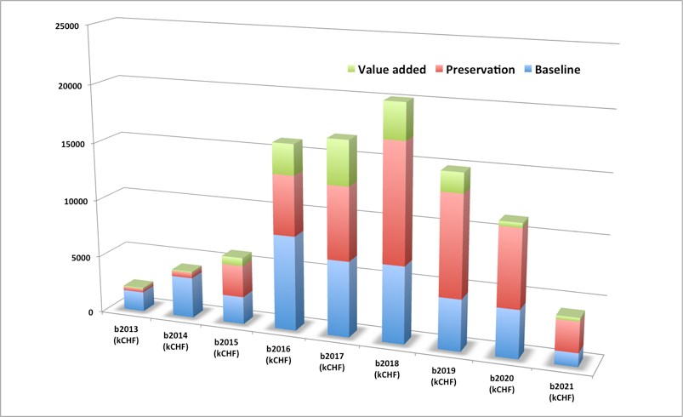
NA Consolidation
Clearly the requests exceed the allocated budget
Need to do a selection, based on the risk and scenario, but also including schedule, compatibility with operations, availability of resources and links between activities

Slide 5
SBA Consolidation Project Follow-up
Coordination Team (S. Evrard - M. Wilhelmsson) to follow the activities and budget.
  Define work-packages for each activity, collect all relevant information from the work package holders
  Check that all work activities are documented in detail following the quality assurance plan (Space reservation, Engineering Change Requests, Functional Specification, Engineering Specification, Installation Procedure, Tests Procedure etc…).
  Schedule and follow the activities, ensuring the compatibility of the beam operations and available manpower
  Work-package meetings along with YETS/EYETS planning meetings to discuss the details
  Regular report to EATM

