Slide 1
New global alignment framework
for Alice Barrel
(PWGPP-73)
R.Shahoyan, 02/07/2015

Slide 2
ALICE Barrel detectors alignment
Until now barrel detectors were aligned internally
(sometimes using some information from other detectors):
  ITS: internal alignment, constraining track curvature to TPC measurement.
  Based on Millipede implementation in aliroot and global fit track model with
  average MS accounting (no energy loss)
  TPC, TRD: internal alignment between chambers
Then detectors were aligned one wrt another with tracks linking them:
  TRD sectors globally aligned wrt TPC, ITS globally wrt TPC
  TOF sectors (no individual strips) aligned wrt extrapolation from TPC/TRD

Slide 3
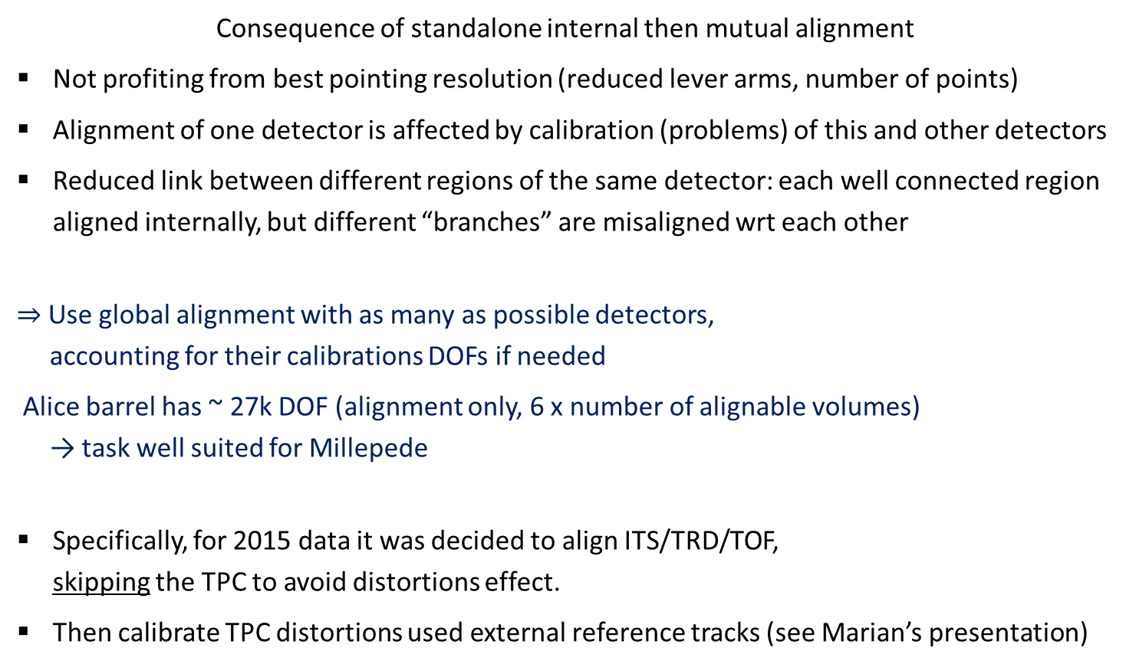
ALICE Barrel detectors alignment
Consequence of standalone internal then mutual alignment
Not profiting from best pointing resolution (reduced lever arms, number of points)
Alignment of one detector is affected by calibration (problems) of this and other detectors
Reduced link between different regions of the same detector: each well connected region aligned internally, but different “branches” are misaligned wrt each other
$⇒$Use global alignment with as many as possible detectors,
accounting for their calibrations DOFs if needed
Alice barrel has ~ 27k DOF (alignment only, 6 x number of alignable volumes)
→ task well suited for Millepede
Specifically, for 2015 data it was decided to align ITS/TRD/TOF,
skipping the TPC to avoid distortions effect.
Then calibrate TPC distortions used external reference tracks (see Marian’s presentation)

Slide 4
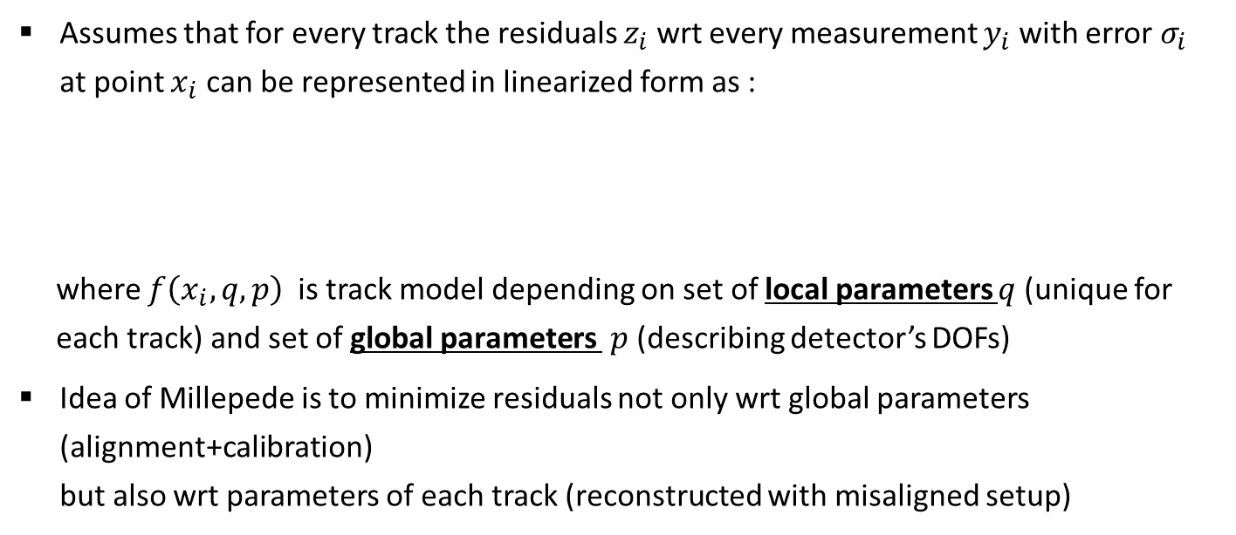
Millepede II (MP)
https://www.wiki.terascale.de/index.php/Millepede_II
Assumes that for every track the residuals $z_{i}$ wrt every measurement $y_{i}$ with error $σ_{i}$
at point $x_{i}$ can be represented in linearized form as :
where $f\left(x_{i},q,p\right)$ is track model depending on set of local parameters $q$ (unique for each track) and set of global parameters $p$ (describing detector’s DOFs)
Idea of Millepede is to minimize residuals not only wrt global parameters (alignment+calibration)
but also wrt parameters of each track (reconstructed with misaligned setup)

Slide 5
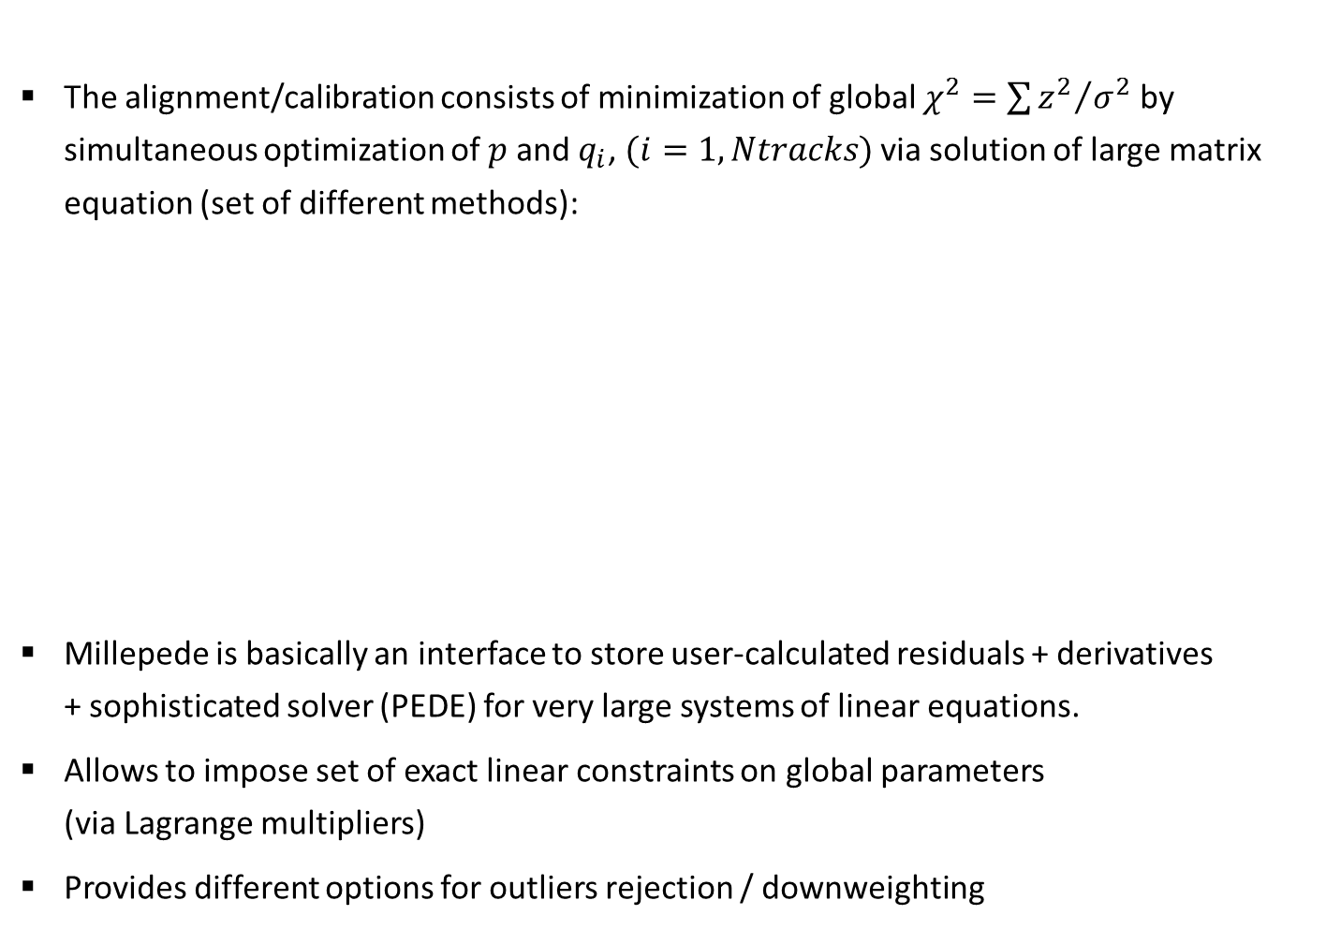
Millepede II (MP)
https://www.wiki.terascale.de/index.php/Millepede_II
The alignment/calibration consists of minimization of global $χ^{2}=\sum{{z^{2}}/{σ^{2}}}$ by simultaneous optimization of $p$ and $q_{i}$, $(i=1,Ntracks)$ via solution of large matrix equation (set of different methods):
Millepede is basically an interface to store user-calculated residuals + derivatives
+ sophisticated solver (PEDE) for very large systems of linear equations.
Allows to impose set of exact linear constraints on global parameters
(via Lagrange multipliers)
Provides different options for outliers rejection / downweighting
Global parameters block
Local parameters block
for each track
Correlation between global and local parameters

Slide 6
Track model for Alice Millepede
Millepede needs derivatives of track position wrt its parameters
(e.g. defined at some reference point).
Kalman track model used in ALICE is not directly applicable to MP since it has no “reference” track parameters and their global covariance matrix per se:
instead it provides set of best estimates for track state and its errors at each measured point, related via transport matrix.
LHCb managed to adopt Kalman tracks to MP via very convoluted math, based on analytical smoother, but it is also not appropriate for ALICE, since we use rotations when going from one sensor to another, which prevents from describing transport as really linear transformation
Preferable to use track model as much as possible close to what is used in reconstruction,
to minimize systematic effects of model approximations
→ Use synthetic track model consisting of usual AliExternalTrackParam defined in the
reference point + corrections (again AliExternalTrackParam) for kinks due to the mult.scattering between measurements separated by material

Slide 7
Track model for Alice Millepede
Creating alignment track: initial fit
Extract measurement for participating detectors from ESDfriends AliTrackPoints
(misaligned coordinates in global frame)
  Transform from global frame to volume ideal local frame using alignment matrices used at reconstruction time
  If needed, correct for known problems (e.g. TOF Z…)
  Transform to volume tracking frame using matrices of reference alignment (wrt which we define updated alignment)
If track has small DCA to vertex and vertex has enough number of tracks, add it as a measured point
Perform standard Kalman fit from outmost point towards reference point
(X=0 or Vertex if used as a constraint), accounting for materials
→ reference param. $P_{o}$: {$Y_{r},Z_{r},{\sin{φ}}_{r},\tan{λ},{qp}_{Tr}^{−1}$}

Slide 8
Track model for Alice Millepede
Creating alignment track: initial fit
Extract measurement for participating detectors from ESDfriends AliTrackPoints
(misaligned coordinates in global frame)
  Transform from global frame to volume ideal local frame using alignment matrices used at reconstruction time
  If needed, correct for known problems (e.g. TOF Z…)
  Transform to volume tracking frame using matrices of reference alignment (wrt which we define updated alignment)
If track has small DCA to vertex and vertex has enough number of tracks, add it as a measured point
Perform standard Kalman fit from outmost point towards reference point
(X=0 or Vertex if used as a constraint), accounting for materials
For cosmic track, do the same separately for upper, lower legs
(accounting for inverse track direction in material corrections of
upper leg and merge them at reference point
(Kalman update of lower leg by upper one)
→ reference param. $P_{o}$: {$Y_{r},Z_{r},{\sin{φ}}_{r},\tan{λ},{qp}_{Tr}^{−1}$}

Slide 9

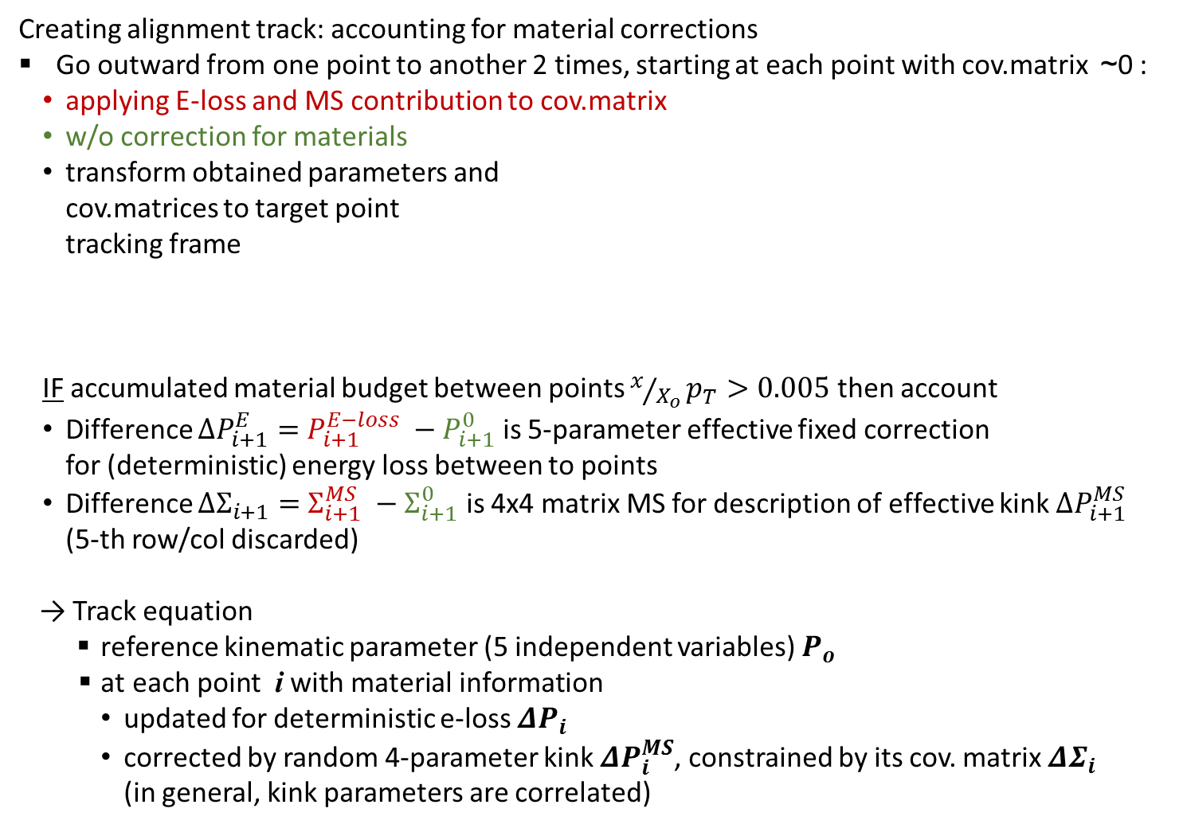


Track model for Alice Millepede
Creating alignment track: accounting for material corrections
Go outward from one point to another 2 times, starting at each point with cov.matrix ~0 :
  applying E-loss and MS contribution to cov.matrix
  w/o correction for materials
  transform obtained parameters and
  cov.matrices to target point
  tracking frame
  IF accumulated material budget between points $x/{X_{o}}p_{T}>0.005$ then account
  Difference $ΔP_{i+1}^{E}=$ $P_{i+1}^{E−loss} −P_{i+1}^{0}$ is 5-parameter effective fixed correction
  for (deterministic) energy loss between to points
  Difference $ΔΣ_{i+1}=$ $Σ_{i+1}^{MS} −Σ_{i+1}^{0}$ is 4x4 matrix MS for description of effective kink $ΔP_{i+1}^{MS}$
  (5-th row/col discarded)
→ Track equation
reference kinematic parameter (5 independent variables) $P_{o}$
  $\text{at} \text{each} \text{point} \text{i} \text{with} \text{material} \text{information}$
    updated for deterministic e-loss $ΔP_{i}$
    corrected by random 4-parameter kink $ΔP_{i}^{MS}$, constrained by its cov. matrix $ΔΣ_{i}$
    (in general, kink parameters are correlated)
Material
$$P_{i+1}^{0},Σ=0$$
$$P_{i}^{},Σ=0$$
$$P_{i+1}^{E−loss},Σ_{i+1}^{Eloss+MS}$$

Slide 10
Alice Millepede global alignment framework
Implemented:
ESD + ESDFriend
AliAlgSteer
Steering,
IO
geometry
OCDB
Steering class AliAlgSteer:
  General I/O, manipulations with different geometries
  Assignment of DOFs to detectors

Slide 11
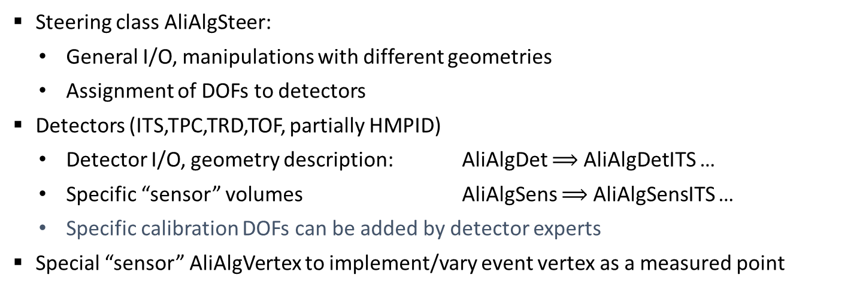
Alice Millepede global alignment framework
Implemented:
AliAlgDet
ESD + ESDFriend
AliAlgSteer
DOFs
ITS
Detector-specific operations
Declare DOFs and calculates track-cluster residuals wrt these DOFs
Steering,
IO
tracks, clusters
TPC
geometry
OCDB
residuals + their derivatives
TRD
TOF
…
Steering class AliAlgSteer:
  General I/O, manipulations with different geometries
  Assignment of DOFs to detectors
Detectors (ITS,TPC,TRD,TOF, partially HMPID)
  Detector I/O, geometry description: AliAlgDet $⟹$AliAlgDetITS …
  Specific “sensor” volumes AliAlgSens $⟹$ AliAlgSensITS …
  Specific calibration DOFs can be added by detector experts
Special “sensor” AliAlgVertex to implement/vary event vertex as a measured point

Slide 12
Alice Millepede global alignment framework
Implemented:
AliAlgDet
ESD + ESDFriend
AliAlgSteer
DOFs
ITS
Detector-specific operations
Declare DOFs and calculates track-cluster residuals wrt these DOFs
Steering,
IO,
Preparation of input for PEDE
tracks, clusters
TPC
geometry
OCDB
residuals + their derivatives
TRD
TOF
…
AliAlgTrack
AliAlgPoint
Fits, derivatives
Meausurement
Materials
Conversion of AliTrackPoints from ESDfriends to AliAlgPoint: measurement in the relevant tracking frame + material budget information
Automatics undoing of alignment/calibration used during reconstruction and application of reference alignment/calibration.
Alignment track (AliAlgTrack) fit + linearization of derivatives over track parameters (including MS). Two modes: (i)collision tracks, (ii) cosmic tracks made of 2 legs
Automatic/manual constraints according to detector hierarchy
(total movement of child nodes in the parent node frame = 0)

Slide 13
Alice Millepede global alignment framework
Implemented:
AliAlgDet
ESD + ESDFriend
AliAlgSteer
DOFs
ITS
Detector-specific operations
Declare DOFs and calculates track-cluster residuals wrt these DOFs
Steering,
IO,
Preparation of input for PEDE
tracks, clusters
TPC
geometry
OCDB
residuals + their derivatives
TRD
TOF
…
Output, QA
AliAlgTrack
AliAlgPoint
AliAlgControlRes
Lin.Sol. (biased)
Kalman (unbiased)
Fits, derivatives
Meausurement
Materials
AliAlgMPRecord
Automatic/manual constraints according to detector hierarchy
(total movement of child nodes in the parent node frame = 0)
Control residuals
  Biased (all points contributing, linear eq. solutions, like in PEDE)
  Unbiased (smoothed Kalman residuals, probed point does not contribute to track)

Slide 14
Alice Millepede global alignment framework
Implemented:
AliAlgDet
ESD + ESDFriend
AliAlgSteer
DOFs
ITS
Detector-specific operations
Declare DOFs and calculates track-cluster residuals wrt these DOFs
Steering,
IO,
Preparation of input for PEDE
tracks, clusters
TPC
geometry
OCDB
residuals + their derivatives
TRD
TOF
…
Updated geometry (calibration)
Output, QA
AliAlgTrack
AliAlgPoint
AliAlgControlRes
Lin.Sol. (biased)
Kalman (unbiased)
Fits, derivatives
Meausurement
Materials
PEDE
solver
AliAlgMPRecord
Blue: preparation of input data for PEDE II, processing of its output,
various utilities for OCDB manipulation
Green: external PEDE II solver (Fortran 90 + OpenMP) supported by DESY

Slide 15
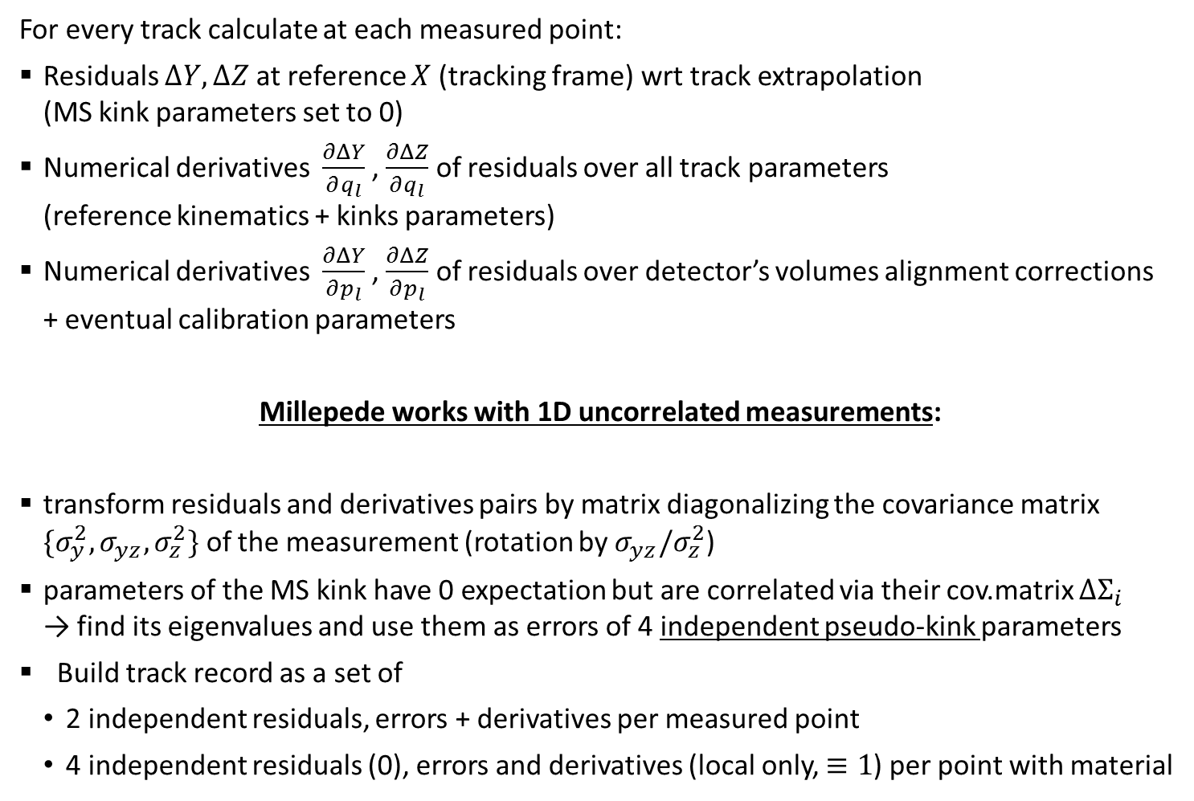
Input data for PEDE solver
For every track calculate at each measured point:
Residuals $ΔY, ΔZ$at reference $X$ (tracking frame) wrt track extrapolation
(MS kink parameters set to 0)
Numerical derivatives $\frac{∂ΔY}{∂q_{l}}$ , $\frac{∂ΔZ}{∂q_{l}}$ of residuals over all track parameters
(reference kinematics + kinks parameters)
Numerical derivatives $\frac{∂ΔY}{∂p_{l}}$ , $\frac{∂ΔZ}{∂p_{l}}$ of residuals over detector’s volumes alignment corrections
+ eventual calibration parameters
Millepede works with 1D uncorrelated measurements:
transform residuals and derivatives pairs by matrix diagonalizing the covariance matrix $\{σ_{y}^{2},σ_{yz},σ_{z}^{2}\}$ of the measurement (rotation by $σ_{yz}/σ_{z}^{2}$)
parameters of the MS kink have 0 expectation but are correlated via their cov.matrix $ΔΣ_{i}$
→ find its eigenvalues and use them as errors of 4 independent pseudo-kink parameters
Build track record as a set of
  2 independent residuals, errors + derivatives per measured point
  4 independent residuals (0), errors and derivatives (local only, $≡1$) per point with material

Slide 16
Problems affecting alignment

Slide 17







TGeometry precision
ROOT TGeometry volume positioning/alignment managed by TGeoHMatrix objects
  Each volume i has its Local-to-MARS transition ideal matrix which after alignment
  becomes aligned matrix where is alignment correction matrix for volume j in global representation, connected with local one as
  The hierarchy of volumes in geometry branch goes from j = 0 (top node in MARS)
  The alignment framework stores by convention these global correction matrices
Alignment procedure produces an incremental corrections for each volume, which must be convoluted with initial alignment as:
  Therefore, in case of 0 incremental correction:
$$G_{i}$$
${\overline{G}}_{i}=Δ_{0}{… Δ_{i}G}_{i}$
$$Δ_{j}$$
$δ_{j}$
$${Δ_{j}G}_{j}=G_{j}δ_{j}$$
$$Υ_{j}$$
${\tilde{Δ}}_{i}={[Δ}_{0}…Δ_{i−1}]^{−1}$ $Υ_{i}$ $Δ_{0}…Δ_{i}= G_{i−1}{\overline{G}}_{i−1}^{−1}Υ_{i} G_{i}^{−1} {\overline{G}}_{i}$
$${\tilde{Δ}}_{i}≡Δ_{i} ⟹ {\tilde{Δ}}_{i} Δ_{i}^{−1} −I=0$$

Slide 18
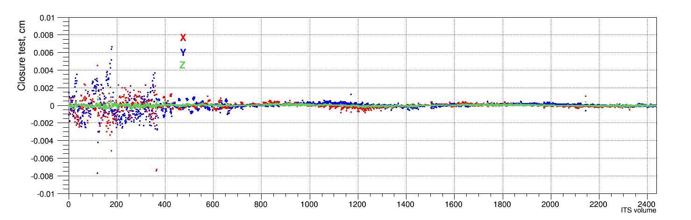
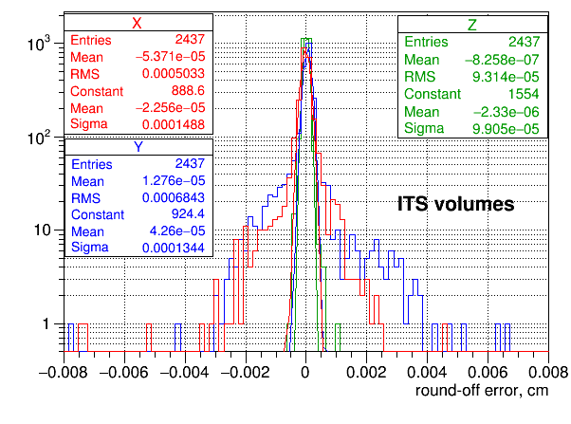

TGeometry precision
Instead, the closure test for $Σ= {\tilde{Δ}}_{i}Δ_{i}^{−1} −I={(G}_{i−1}{\overline{G}}_{i−1}^{−1} G_{i}^{−1} {\overline{G}}_{i}){ Δ}_{i}^{−1} −I$ shows
(case of ITS, particularly bad for SPD due to many rotations by angles far from k$π/2$):
Reported values X,Y, Z are shifts of
residual matrix $Σ$
$⟹$Matrix inversion/products introduces
significant round-off error which limits the
precision of TGeometry
Might be critical for ITS-upgrade if not corrected

Slide 19
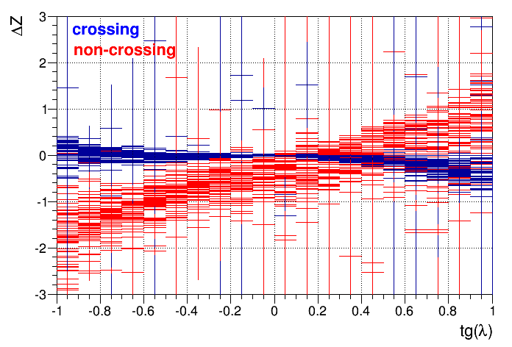
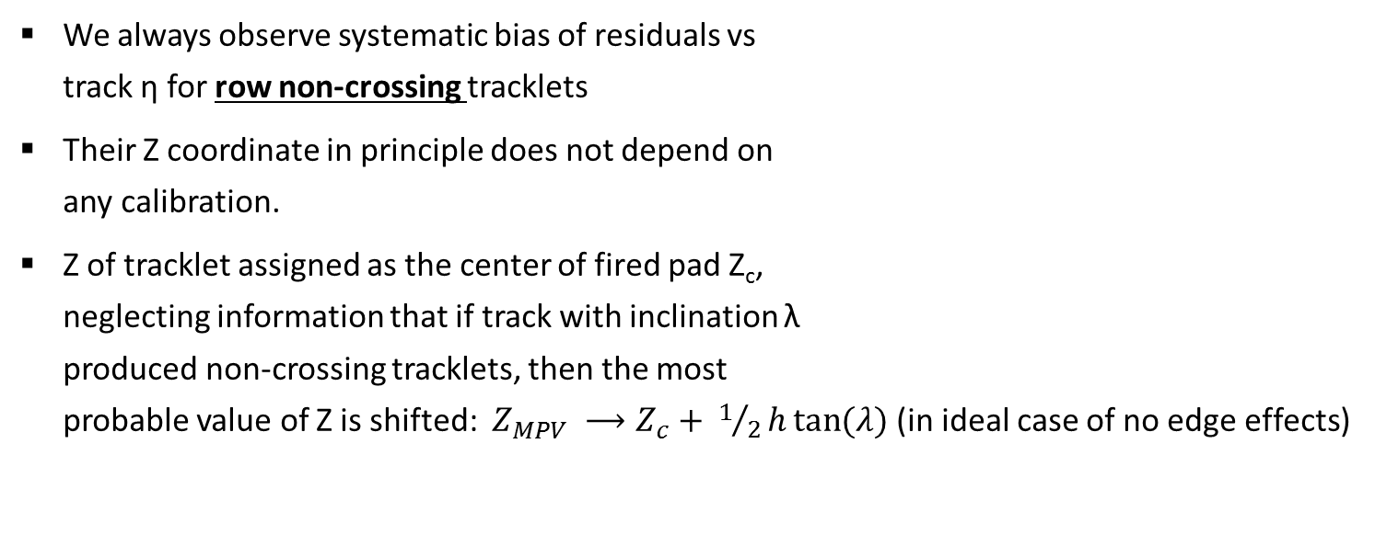
TRD measurement assignment
We always observe systematic bias of residuals vs
track η for row non-crossing tracklets
Their Z coordinate in principle does not depend on
any calibration.
Z of tracklet assigned as the center of fired pad Z_{c},
neglecting information that if track with inclination λ
produced non-crossing tracklets, then the most
probable value of Z is shifted: $Z_{MPV} ⟶Z_{c}+ 1/2h\tan{(λ)}$ (in ideal case of no edge effects)
z_{MPV(λ)}
h (30mm)
z_{c}
x
ΔZ
This bias is equivalent to (fake) shift
in X, which would introduce a bias for
row-crossing tracklets
(potentially more precise but depending on calibrations)
Due to the tilt of pads in by 2º YZ, the bias is translated also to Y assignment
Due to the attempts to align biased data, the chambers get fake shifts and rotations.
z
λ
λ

Slide 20
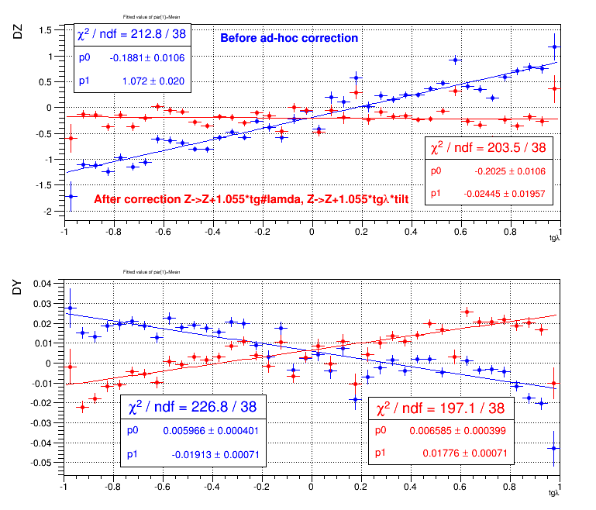
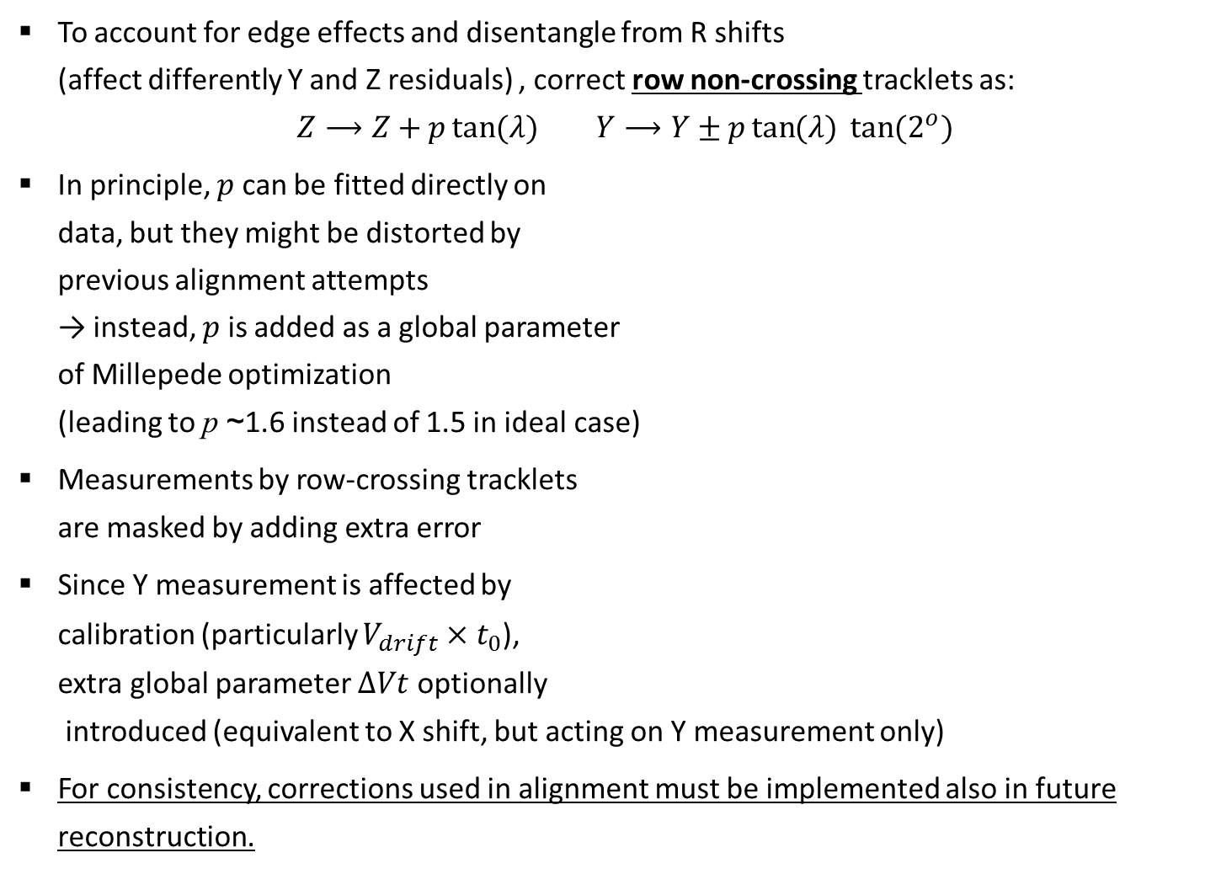

TRD measurement assignment
To account for edge effects and disentangle from R shifts
(affect differently Y and Z residuals) , correct row non-crossing tracklets as:
$Z⟶Z+p\tan{(λ)}$ $Y⟶Y±p\tan{(λ) }\tan{(2^{o}) }$
In principle, $p$can be fitted directly on
data, but they might be distorted by
previous alignment attempts
→ instead, $p$ is added as a global parameter
of Millepede optimization
(leading to p ~1.6 instead of 1.5 in ideal case)
Measurements by row-crossing tracklets
are masked by adding extra error
Since Y measurement is affected by
calibration (particularly $V_{drift}×t_{0}$),
extra global parameter $ΔVt$ optionally
introduced (equivalent to X shift, but acting on Y measurement only)
For consistency, corrections used in alignment must be implemented also in future reconstruction.
After correction $Z⟶Z+1.055\tan{λ}$,
$Y⟶Y±1.055\tan{λ }\tan{2^{o} }$

Slide 21
Bug in applying TOF alignment
TOF clusters use r, ϕ and Z in lab, frame
Because the alignment matrix is applied on-the-fly only in calculation of r and ϕ
the Z measurement is never corrected for the misalignment (~2 cm)
This should not be critical for TOF matching, since the clusters user only for matching candidate preselection, with large tolerances (to be verified)
→ TOF trackpoints stored in ESDfriends contain correctly misaligned lab. X, Y but ideal Z!
To account for this TrackPoints → AliAlgPoint converter in the AliAlgSensTOF
tries to recover ideal {X,Y,Z} in local frame by accounting for wrong transformations
→ Some distortions are inevitable due to the rotations in existing TOF alignment
(should be limited to ~100µm, will below TOF σ ~ 0.7 cm)
To be fixed in TOF code, with special bit flag set on TrackPoints in ESD friends to signal modified content

Slide 22
Results from LHC15a,c (cosmic) + LHC15f alignment
 | B | N .Ev, 10⁶ | N.Tracks Inp, 10⁶ | N.Tracks Acc., 10⁶
Cosmic | 0 | 126 | 33 | 4.1 ⁽¹⁾
Cosmic | + | 53 | 12 | 0.9 ⁽²⁾
Cosmic | - | 28 | 11 | 0.7 ⁽²⁾
Beam | 0 | 1.6 | 54 | 2.5 ⁽³⁾
Beam | + | 5.0 | 94 | 2.3 ⁽³⁾
Beam | - | 20. | 247 | 6.2 ⁽³⁾
No obligatory ITS hit requested, TOF and TRD must contribute to each cosmic leg
At least 2 ITS hits + either TRD or TOF must contribute to each cosmic leg
At least 3 ITS hits (min 1 SPD) + either TRD or TOF must contribute to a track
Detailed plots at https://alice.its.cern.ch/jira/browse/PWGPP-73

Slide 23
DCA-Y to Vertex
Vertex from reconstruction with old alignment!
Was used as fixed measured point for new alignment
(assuming that errors were cancelled out)
Attempt to “align” vertex by X,Y,Z shift (field independent) was not successful.
Systematic DCA dependence on ϕ, p_{T}
is not yet eliminated
Currently running test with vertex point downweighed by additional 50 µm error
Vertex bias also affects alignment at innermost ITS layer
B-
B-
B-
B+
B+
B+

Slide 24
DCA-Z to Vertex
Same observation as for Y, although larger gain in DCA uniformity and resolution
B-
B-
B-
Z in old alignment had larger residual misalignments
B+
B+
B+

Slide 25
SPD0
Effect of biased constraint by the vertex
B- field results only shown on following slides

Slide 26
SPD1
With all tracks (with and w/o vertex constraint)
With tracks w/o vertex constraint

Slide 27
SDD2
Y measurements is affected by non-calibrated SDD (masked in fits by additional 5 mm error)
SDD3

Slide 28
SSD4
SSD5

Slide 29
TRD Layer 0
TRD Layer 5

Slide 30
TOF sector Layer 1
TOF sector Layer 17

Slide 31
Bin-by-bin (sensor-by-sensor) residuals spread
B+
B-
B0

Slide 32
SPD0
SPD1
ΔY ΔZ
ΔY ΔZ
before
after
B+
B+
B-
B-
B0
B0

Slide 33
SDD2
SDD3
ΔY ΔZ
ΔY ΔZ
before
after
B+
B+
SDD Y is NOT calibrated and has large random error
→ Y measurement is masked by adding 5mm error
SDD Y is NOT calibrated and has large random error
→ Y measurement is masked by adding 5mm error
B-
B-
B0
B0

Slide 34
SSD4
SSD5
ΔY ΔZ
ΔY ΔZ
before
after
B+
B+
B-
B-
B0
B0

Slide 35
TRD
TOF
ΔY ΔZ
ΔY ΔZ
before
after
B+
B+
B-
B-
B0
B0

Slide 36
Outlook
Millepede alignment
  Try to improve vertex DCA (bias in ϕ, p_{T})
  Systematic difference between B+, B- and B0 is still observed:
    In the current ITS/TRD/TOF alignment schema only TRD may introduce such
    dependence via run/field dependent calibrations
    Introduce calibration DOF sets for field and run dependent calibration parameters to improve alignment quality (and TRD calibration also)
  Finalize HMPID module
  Many ITS sensors are not in the data (list in the backup)
  SPD0: 6/80, SPD1: 10/160,
  SDD2: 9/84, SDD3: 21/176,
  SSD4: 66/748 SSD5: 80/950
  Need additional alignment if reappear in the future data
For the Run3 upgrade: problems with ROOT TGeoHMatrix precision might be critical for ITS upgrade, fix is needed

Slide 37
Outlook
Aliroot reconstruction
  TRD Z assignment for pad-row non-crossing tracklets must be fixed
  Ion-tail cancelation in TRD: correction for B=0 is applied as for B<0 field → to be fixed
  The corrections themselves
  (up to ~200 and ~400 µm depending in B sign) to be checked
  TOF clusters should receive proper misalignment
  Once TPC distortion maps are ready, reconstruct high pT filtered data
  with TRD (TOF?) in the reconstruction, to check the effect on pT resolution, efficiency.

Slide 38
BACKUP

Slide 39
Missing ITS detectors
SPD0:
Sector1/Stave1/HalfStave0 Sector2/Stave0/HalfStave1 Sector2/Stave1/HalfStave1
SPD1:
Sector3/Stave1/HalfStave1 Sector4/Stave0/HalfStave0 Sector5/Stave1/HalfStave0
Sector6/Stave1/Halfstave1 Sector8/Stave1/Halfstave0
SDD2:
Ladder2/Sensor2 Ladder3/Sensor0 Ladder3/Sensor1 Ladder3/Sensor2 Ladder6/Sensor3
Ladder6/Sensor4 Ladder6/Sensor5 Ladder9/Sensor4 Ladder12/Sensor5
SDD3:
Ladder0/Sensor0 Ladder2/Sensor3 Ladder2/Sensor5 Ladder3/Sensor0 Ladder3/Sensor1
Ladder3/Sensor7 Ladder8/Sensor3 Ladder9/Sensor0 Ladder9/Sensor5 Ladder10/Sensor2 Ladder10/Sensor6 Ladder11/Sensor0 Ladder13/Sensor7 Ladder14/Sensor3 Ladder14/Sensor4 Ladder14/Sensor5 Ladder16/Sensor2 Ladder17/Sensor3 Ladder17/Sensor5 Ladder18/Sensor1 Ladder18/Sensor6 Ladder20/Sensor2 Ladder20/Sensor5 Ladder21/Sensor0
SDD4:
Ladder0/Sensor9 Ladder1/Sensor5 Ladder2/Sensor3 Ladder2/Sensor10 Ladder2/Sensor19 Ladder4/Sensor14 Ladder4/Sensor19 Ladder5/Sensor12 Ladder6/Sensor2 Ladder6/Sensor15 Ladder8/Sensor12 Ladder8/Sensor13 Ladder8/Sensor14 Ladder8/Sensor15 Ladder8/Sensor16 Ladder8/Sensor17 Ladder8/Sensor18 Ladder8/Sensor19 Ladder8/Sensor20 Ladder8/Sensor21
Ladder14/Sensor8 Ladder14/Sensor12 Ladder14/Sensor13 Ladder14/Sensor14 Ladder14/Sensor15 Ladder14/Sensor16 Ladder14/Sensor17 Ladder14/Sensor18 Ladder14/Sensor19 Ladder14/Sensor20 Ladder14/Sensor21 Ladder15/Sensor5 Ladder15/Sensor12 Ladder15/Sensor13 Ladder15/Sensor14 Ladder15/Sensor15 Ladder15/Sensor16 Ladder15/Sensor17 Ladder15/Sensor18 Ladder15/Sensor19
Ladder15/Sensor20 Ladder15/Sensor21 Ladder18/Sensor7 Ladder21/Sensor6 Ladder21/Sensor10 Ladder23/Sensor7 Ladder23/Sensor11 Ladder26/Sensor0 Ladder27/Sensor6 Ladder29/Sensor1 Ladder29/Sensor11 Ladder29/Sensor20 Ladder29/Sensor21 Ladder30/Sensor9 Ladder32/Sensor12 Ladder32/Sensor13 Ladder32/Sensor14 Ladder32/Sensor15 Ladder32/Sensor16 Ladder32/Sensor17
Ladder32/Sensor18 Ladder32/Sensor19 Ladder32/Sensor20 Ladder32/Sensor21 Ladder33/Sensor2 Ladder33/Sensor12

Slide 40
Missing ITS detectors
SSD5:
Ladder0/Sensor12 Ladder1/Sensor0 Ladder1/Sensor9 Ladder1/Sensor22 Ladder2/Sensor10 Ladder4/Sensor1 Ladder4/Sensor6 Ladder4/Sensor9 Ladder4/Sensor12 Ladder4/Sensor13 Ladder4/Sensor14 Ladder4/Sensor15 Ladder4/Sensor16 Ladder4/Sensor17 Ladder4/Sensor18 Ladder4/Sensor19 Ladder4/Sensor20 Ladder4/Sensor21 Ladder4/Sensor22 Ladder4/Sensor23
Ladder4/Sensor24 Ladder5/Sensor20 Ladder5/Sensor21 Ladder8/Sensor0 Ladder8/Sensor4 Ladder8/Sensor11 Ladder9/Sensor10 Ladder9/Sensor22 Ladder11/Sensor13 Ladder11/Sensor22 Ladder13/Sensor0 Ladder13/Sensor1 Ladder13/Sensor2 Ladder13/Sensor3 Ladder13/Sensor4 Ladder13/Sensor5 Ladder13/Sensor6 Ladder13/Sensor7 Ladder13/Sensor8 Ladder13/Sensor9
Ladder13/Sensor10 Ladder13/Sensor11 Ladder14/Sensor1 Ladder14/Sensor7 Ladder15/Sensor0 Ladder16/Sensor0 Ladder17/Sensor0 Ladder17/Sensor1 Ladder17/Sensor2 Ladder17/Sensor3 Ladder17/Sensor4 Ladder17/Sensor5 Ladder17/Sensor6 Ladder17/Sensor7 Ladder17/Sensor8 Ladder17/Sensor9 Ladder17/Sensor10 Ladder17/Sensor11 Ladder17/Sensor12 Ladder17/Sensor22
Ladder20/Sensor14 Ladder22/Sensor8 Ladder22/Sensor16 Ladder22/Sensor18 Ladder22/Sensor22 Ladder24/Sensor4 Ladder32/Sensor0 Ladder33/Sensor6 Ladder33/Sensor7 Ladder33/Sensor18 Ladder33/Sensor20 Ladder33/Sensor24 Ladder34/Sensor0 Ladder34/Sensor5 Ladder34/Sensor7 Ladder36/Sensor10 Ladder36/Sensor11 Ladder37/Sensor20 Ladder37/Sensor21 Ladder37/Sensor23

Slide 41
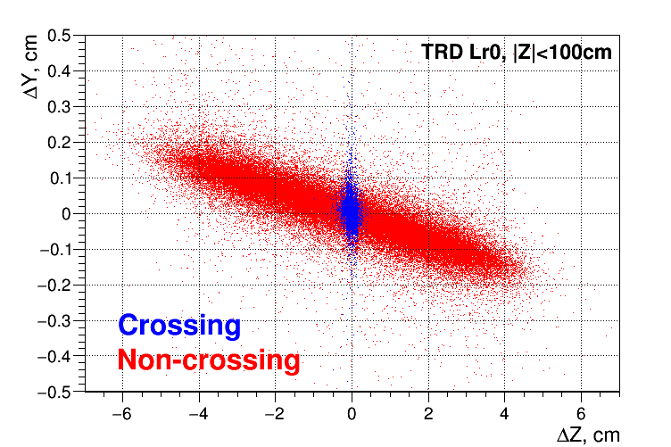
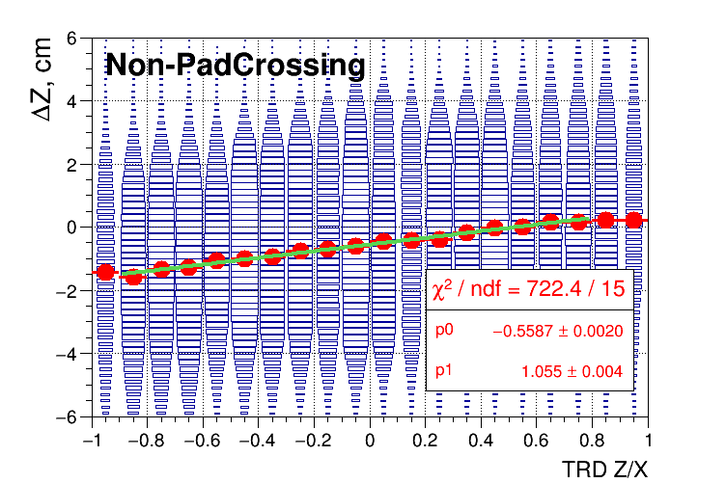
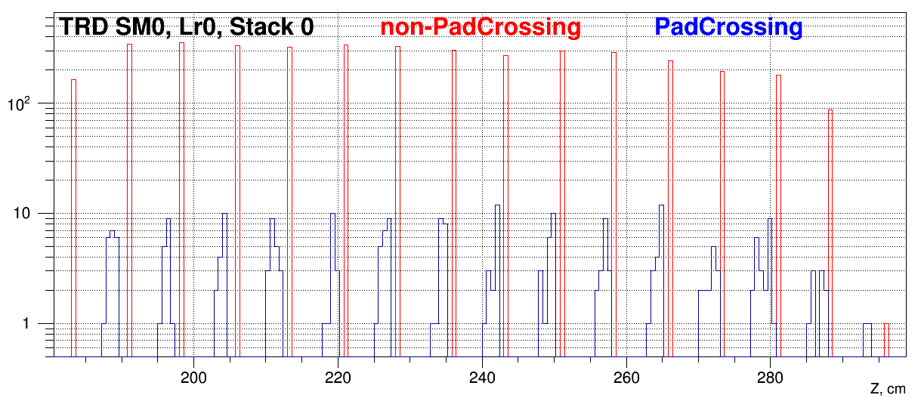
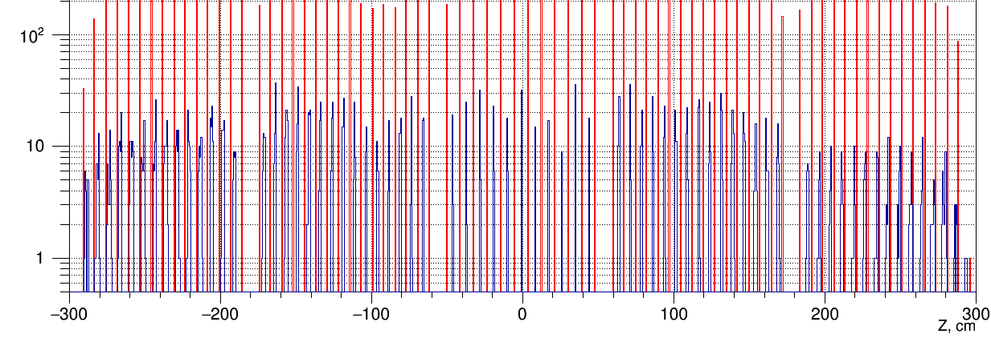

Slide 42
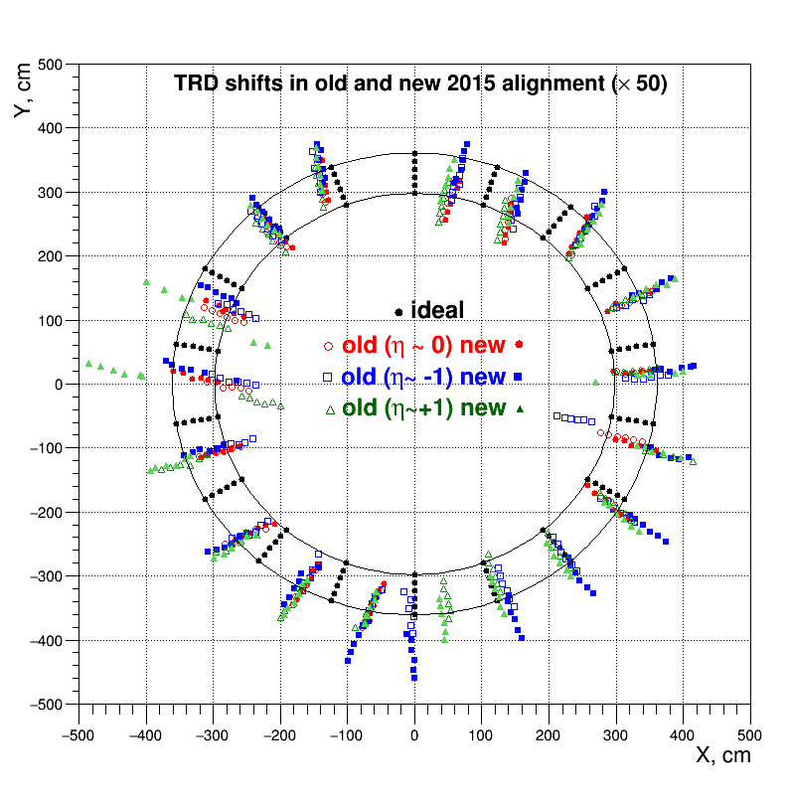

Slide 43
