Slide 1
Operations
Maarten Litmaath
CERN-IT-SDC
ALICE Offline week
July 3, 2015

Slide 2

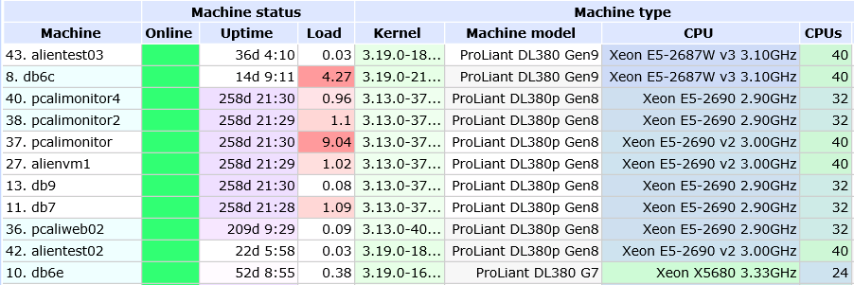
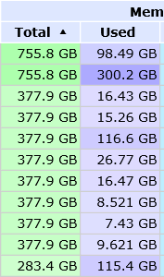
Central service support
For the record:
  Keep them running OK, improve the SW
    See talks by Miguel and Pavlo
  HW upgrades!
…
…
…
…
…

Slide 3
Site support
Alert and/or assist sites having issues with their VOBOX services, CE, WN, SE
  Noticed in MonALISA and/or reported by users/admins
Help new sites get started
  HPC → see Costin’s talk
  Clouds → several ongoing and planned activities
Assist sites with changes
  SE additions, upgrades, migrations, cleanups
    See talks of Miguel and Adrian
  Transition to ARC CE
    Thanks to Pavlo
Interface with WLCG
  SAM tests
  Reporting

Slide 4
User support
“Cannot get token!”
  Often due to issue with user machine or network
Mistakes in JDL
  Bad TTL, inconsistent SW versions, …
  AliEn now catches some of these → see Miguel’s talk
Segfaults / memory leaks not seen in a quick test
  Uninitialized variables, undeclared transients, double deletes, lacking cleanup, …
Problem with installing AliEn, AliRoot, …
  Dario’s exact recipes usually are the answer
CAF?
  Got a whole lot easier with the transition to the VCAF!
    See Dario’s talk
Many experts on the analysis task force and operations lists help other users → thanks!

Slide 5
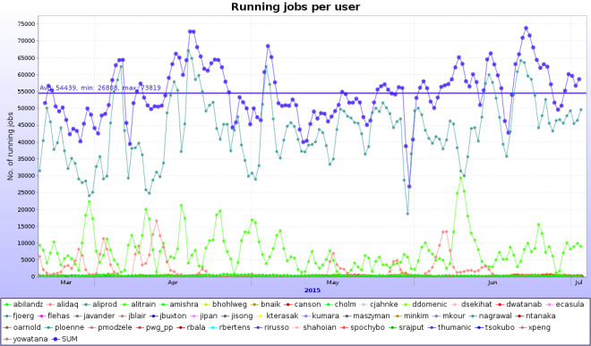

Busy times
82k concurrent jobs reached on April 19
80k for many hours on June 21-22
Taking advantage of increased + opportunistic resources

Slide 6
RFC proxies
All WLCG VOBOXes are running with RFC proxies since a few months
We then tried making the AliEn v2-19.276 the default for “alienv”
That caused simulation jobs everywhere to fail in libgfortran
We went back to v2-19.223 as default
  It has the same version of that library…
We discovered that the way we use 276 at the sites still has some “pollution” from the default version (now again 223)
→ to be fixed
The matter still needs to be debugged further

Slide 7
Middleware
SL5 will be deprecated for MW next spring
  Already there have been openssl compatibility issues
    Will only get worse
CentOS/EL7 will come this autumn
  Myproxy.cern.ch was upgraded already
ARC CE + HTCondor becoming more popular
  BITP and RAL in production since last autumn
  GRIF_IRFU, Oxford
  CERN prototype OK → HTCondor will replace LSF
  Some issues will be fixed in the AliEn ARC client

Slide 8
SAM
New Availability / Reliability profile based on selected MonALISA results not yet critical
Waiting for a few Dashboard GUI fixes to be released to production
The new profile should take over after the summer break
Sites will first be alerted to compare old and new profile results
  SE test failures will reduce the A / R!
Direct submission to ARC CE in production since a few months (also for LHCb)
  Thanks to Pavlo!

Slide 9
Xrootd
Sites need to start planning upgrades to Xrootd >= 4.1
  Stable and well supported
  Required for IPv6 support
    Steadily becoming more important
T1 sites are particularly concerned
  They receive raw data exported from T0
  Latest CASTOR incompatible with old xrd3cp
    Gateway hosts have been set up as a temporary workaround
Communication via LCG Task Force list as usual for expert advice
SL6 hosts now can have xrootd for ALICE installed through rpms!
  http://linuxsoft.cern.ch/wlcg/
  Thanks to Adrian Sevcenco!

Slide 10
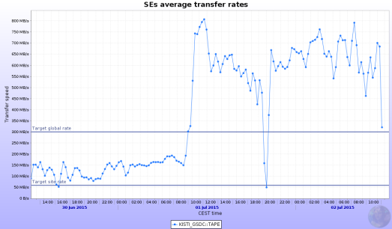
Networks
KISTI OPN link at 10 Gbps since Apr 24
KISTI leadership for network evolution in Asia
  Proposal to use OPN link also for LHCONE
  → improve connectivity of Asian T2 sites
  Conference on network evolution in Asia, Sep 22-24
    https://indico.cern.ch/event/395656/
Raw data export
to KISTI OK
  600+ MB/s
  Via CASTOR
  gateway hosts!

Slide 11
Sites mostly OK – thanks!
However…
VOBOX or WN issues
  CVMFS problem, CE not ready for jobs, myproxy running low, …
  Absence of “system” library
    HEP_OSlibs rpm helps avoid that
Files unavailable due to SE problem
Admins please check site issues page
  http://alimonitor.cern.ch/siteinfo/issues.jsp
Subscribe to relevant notifications
  http://alimonitor.cern.ch/xml.jsp

