Slide 1
BEAM DYNAMICS IN A HIGH FREQUENCY RFQ
S. Myers : head of office for medical applications at CERN
The “750MHz” team (layout and beam dynamics, radio-frequeuncy and mechanics) : A. Dallocchio, V. A. Dimov, M. Garlasché, A. Grudiev, A. M. Lombardi, S. Mathot, E. Montesinos, M. Timmins and M. Vretenar.
Alessandra M Lombardi

Slide 2
Office for CERN medical applications
Lead by Steve Myers with the aim for CERN to become established as an important facilitator of medical physics in Europe
It will work to develop
  a CERN biomedical facility using the LEIR storage ring, suitably adapted with external funding.
  It will increase the use of ISOLDE in developing isotopes for clinical trials, and
  work to develop on-going accelerator, detector and information technologies in ways that will benefit medicine.

Slide 3
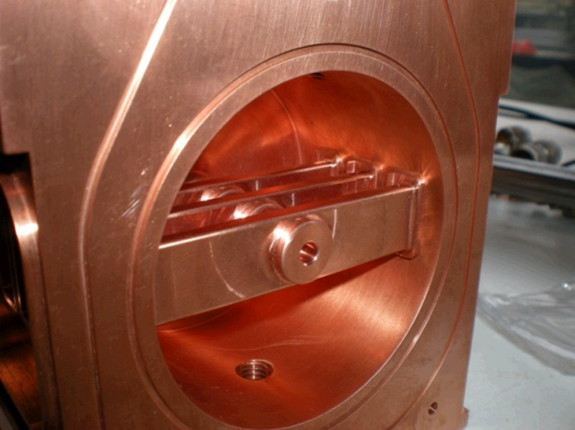
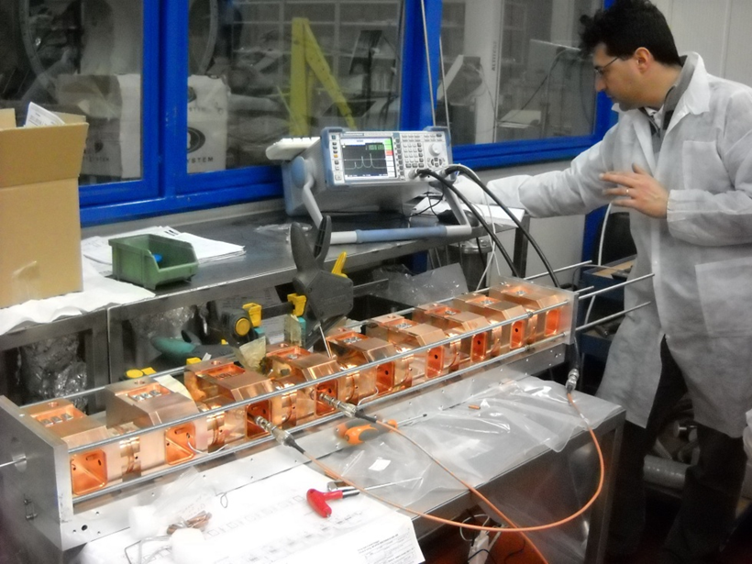
LINAC-based hadron-therapy facility
Around 20 m long system of accelerators to deliver protons around 250 MeV
Based on high frequency RF cavities adapted to non- relativistic beta (3 GHz)
Successful acceleration demonstrated from 10 MeV onwards, it is likely to work from 5 MeV
Issue is the energy range from tens of kev to 5 MeV, where the use of 3 GHz is excluded.
3GHz SDTL structure
Courtesy ENEA Frascati

Slide 4
50keV to 5 MeV : missing link
Recapture at 5 MeV
Bunch-to-bucket injection
Free choice of a off-the-shelf accelerator : Cyclotron or a linac
Free choice of frequency
Drawbacks :
  Extremely long or bulky system
  Losses at 5MeV
Frequency must be a sub-harmonic of 3GHz (600,750 or 1000Mhz)
Unexplored frequencies for a pre-injector :
  Short wave-lenght/rfq length and tunability can be an issue
  Small dimension and machining tolerances

Slide 5
An unconventional RF Quadrupole
Standard design are not applicable
Both the longitudinal and the transverse acceptance at 5 MeV are extremely tight
Need to balance the challenges between the source and the RFQ
Source and RFQ parameters
RF Frequency | Subhar of 3GHz
Input energy | >30keV
Output Energy | 5 MeV
Output Pulse Current | 30 µA
Repetition frequency | 200 Hz
Pulse duration | 20 µsec
Transverse Emittance (100%,normalized) | 0.4 (π mm-mrad)
Bunch length | ±20 deg at 3 GHz
Energy spread | ±35 keV
Length | Less than 2.5m
Notes:
The only easy part is the duty cycle!!!!

Slide 6

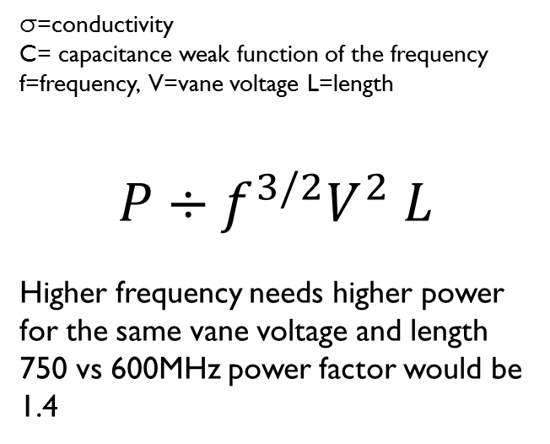
Choice of the frequency
fix voltage =80 kV
750 MHz , 170 cm (=4.25 lambda)
600 MHz , 260 cm (=5.2 lambda)
Length *f ^{3/2} is about constant, power is the same
fix the length = 5lambda
750 MHz , 200 cm (=5 lambda) V=65 kV
600 MHz , 260 cm (=5.2 lambda) V=80 kV
For the same length in units of lambda the 750 MHz version would require 70% of the power of the 600 MHz version
σ=conductivity
C= capacitance weak function of the frequency
f=frequency, V=vane voltage L=length
$$P÷f^{3/2}V^{2} L$$
Higher frequency needs higher power for the same vane voltage and length
750 vs 600MHz power factor would be 1.4

Slide 7
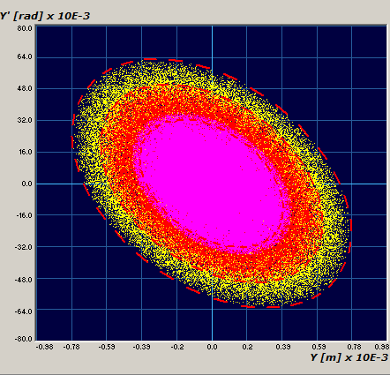
Initial choices - transverse
30µA in 0.4 pi mm mrad
Emittance budget (norm total mm mrad)
0.4 | acceptance at 5MeV 3GHz
0.3 | RFQ acceptance, allowing for 20% emittance increase
0.15 | Target source emittance
Intensity budget (µA)
30 | Into SDTL
40 | Out of RFQ
100-50 | Into the RFQ
Current in emittance for existing sources
600 | LINAC4 (60mA at 45keV in 1.5 mm mard)
4500 | LINAC2 (200mA at 90keV in 1 mm mrad)
Acceptance of 3GHz structure
RFQ Design acceptance
Target source emittance

Slide 8

Initial choices – longitudinal
Acceptance at 3GHz , 5MeV
Backwards Design philosophy
from “SPECIFICATIONS FOR A RFQ TO BE USED AS INJECTOR FOR LIGHT ACCELERATOR” by J. Nardulli, C. Ronsivalle
  Accelerate to 5 MeV only what can be captured.
  Special bunching system in the RFQ : size the stable bucket around the longitudinal acceptance at 3GHz and make sure that the particle outside the acceptance have energies below few hundreds keV

Slide 9
Acceptance = 0.3 pi mm mrad, V_source=40 kV, V_vane=80KV , 750 MHz
Short 180 cm 30% trans.
Medium 240 cm 40% trans. | 2 independent RF cavities (120cm/5cm/120cm)
Long 360 cm 90% trans. | 3 independent RF cavities (120cm/5cm/120cm/5cm/120cm)

Slide 10
Short it is ….
maximum RF peak power of 400kW;
maximum electric field on the vane tip of 50 MV/m corresponding to 2 Kilpatrik limit;
a two-term potential vane profile, a constant average aperture radius and a constant transverse radius of curvature for an easier tuning and the possibility of machining with a 2D cutter;
Cooling for a higher dc than needed
Source and RFQ parameters
RF Frequency | 750 MHz
Input/output Energy | 40 keV/5MeV
Length | 2m
Vane voltage | 65kV
Peak RF power | 400kW
Duty cycle / max | 0.4% /(5%max)
Input/Output Pulse Current in 3GHz acceptance | 100/30 µA
Transv. emittance 90% | 0.1 pi mm mrad
Average aperture (r0) | 2mm
Transverse radius (ρ) | 1.5 mm
Maximum modulation | 3

Slide 11
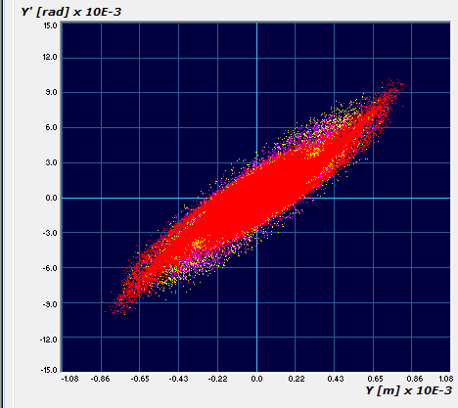
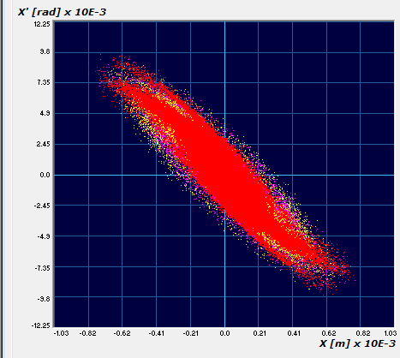
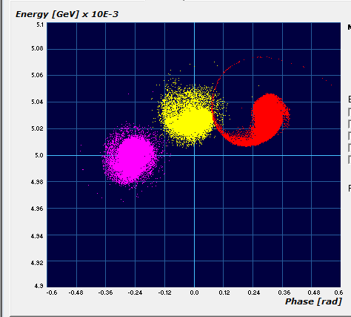
Beam dynamics
3 independent codes
PARMTEQ (LANL) : field from 3D static calculation, described with 8 m-pole components.
TOUTATIS (CEA-Saclay): 3d field solver.
PATH/TWin + HFSS : full 3d field map.

Slide 12
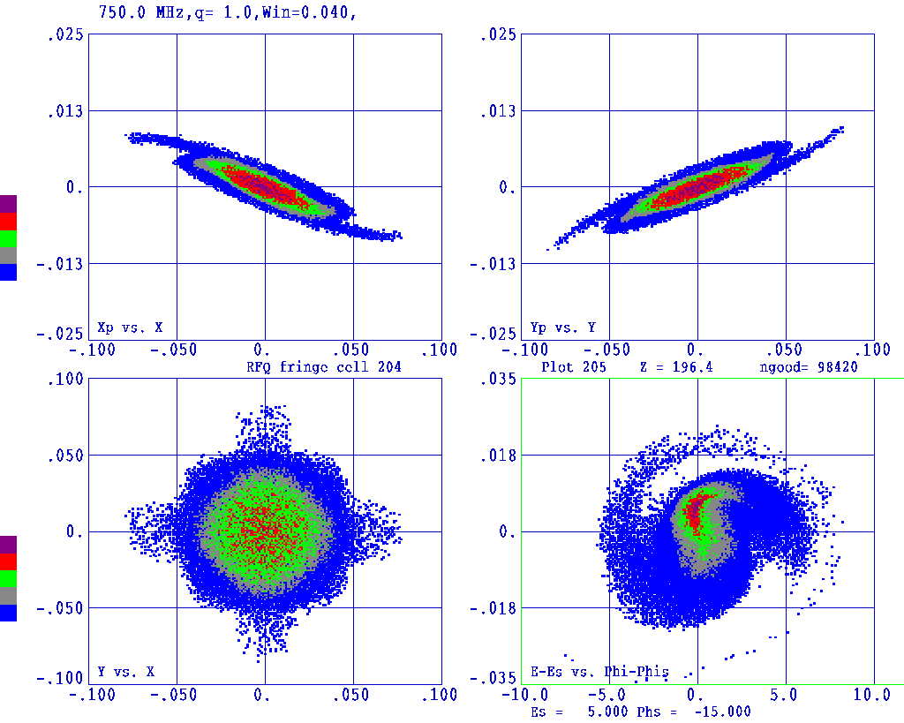
Beam at 5 MeV and losses
The highest energy particle lost carries 500 keV ; 99.5% of the lost particles have an energy below 100keV.
Transverse phase spaces (cm and rad) : top
Transverse profile (cm) : bottom left
Longitudinal phase space(deg and MeV) : bottom right

Slide 13
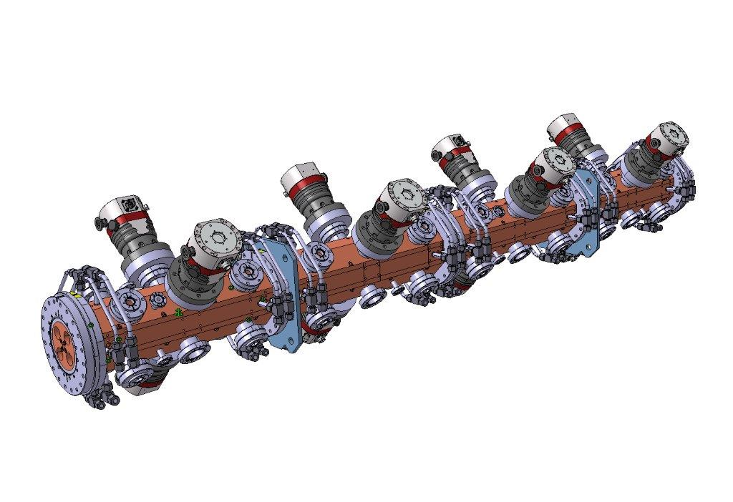
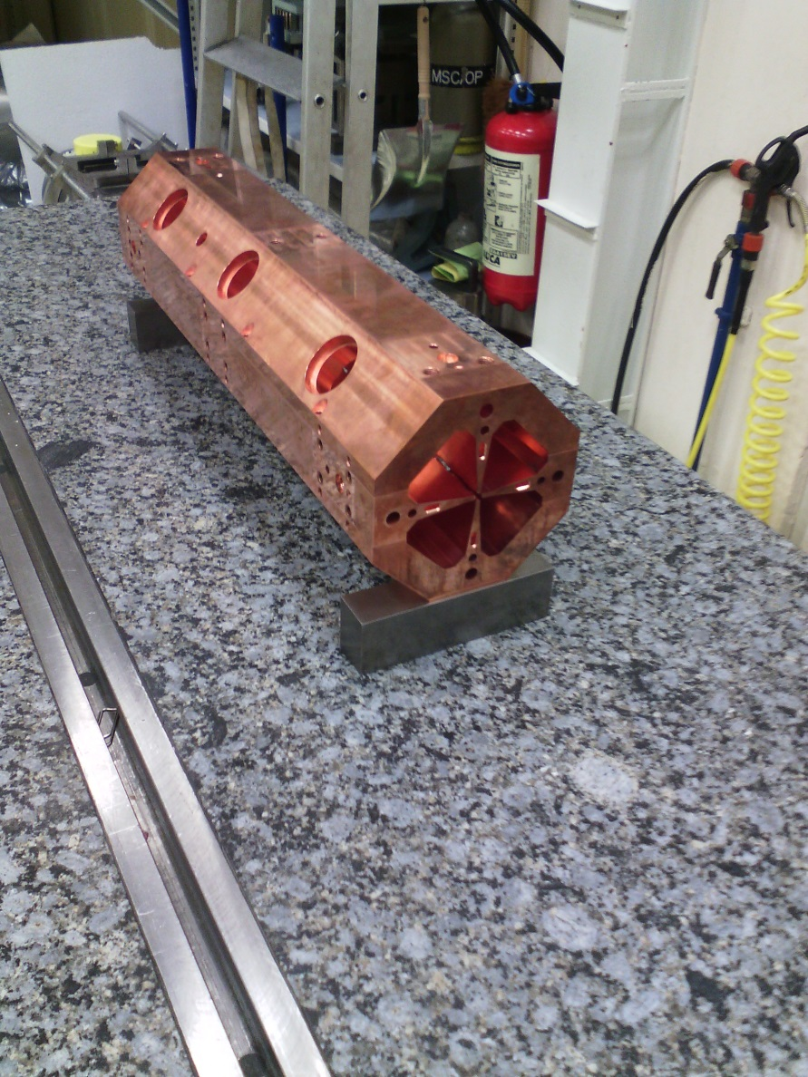
…..towards realising

Slide 14
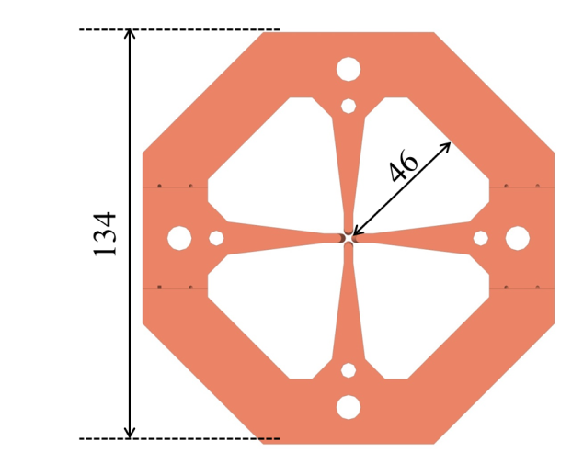
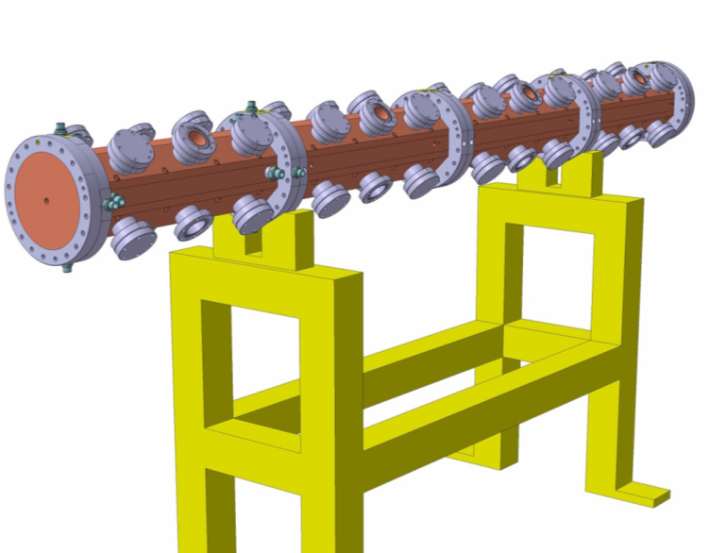
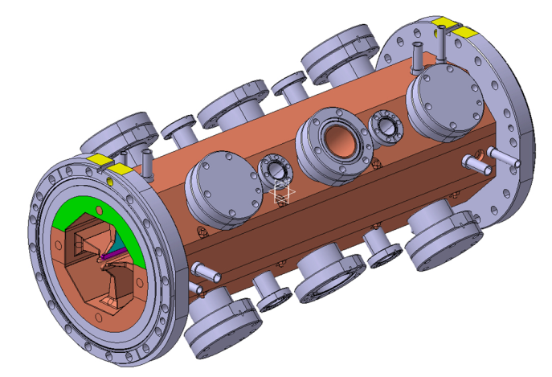
Mechanical design
Mechanical design and construction procedure based on the Linac4 RFQ:
4-vane structure with 2 brazing steps. Inner radius 46 mm; total weight 220 kg.
Modular design: assembly of 0.5 m long modules, each with 8 tuning ports and 4 combined tuner/power coupler ports. The modules differ only by the vane modulation (and for the end cells at both ends).

Slide 15
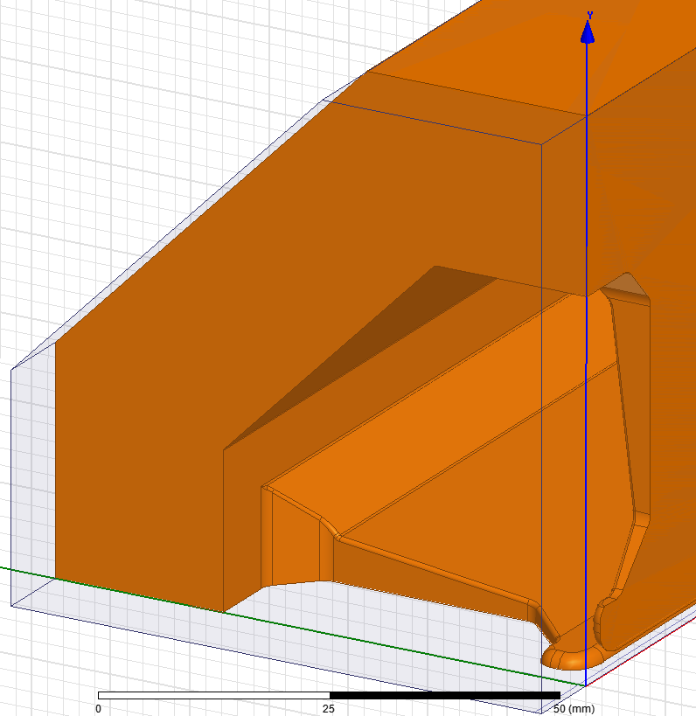
RF design
Challenge : length is 5 times the wave-length, limit for tuning the RFQ with simple tuners. 2 tuners/section with provision of a third one.
Minimisation of RF power losses
  Cavity geometry
  Number and shape of tuners
  3D simulations to keep into account all the effects
Input vane tip – 3d detail
Including all margins we need 0.043 kW/m (kV)2

Slide 16
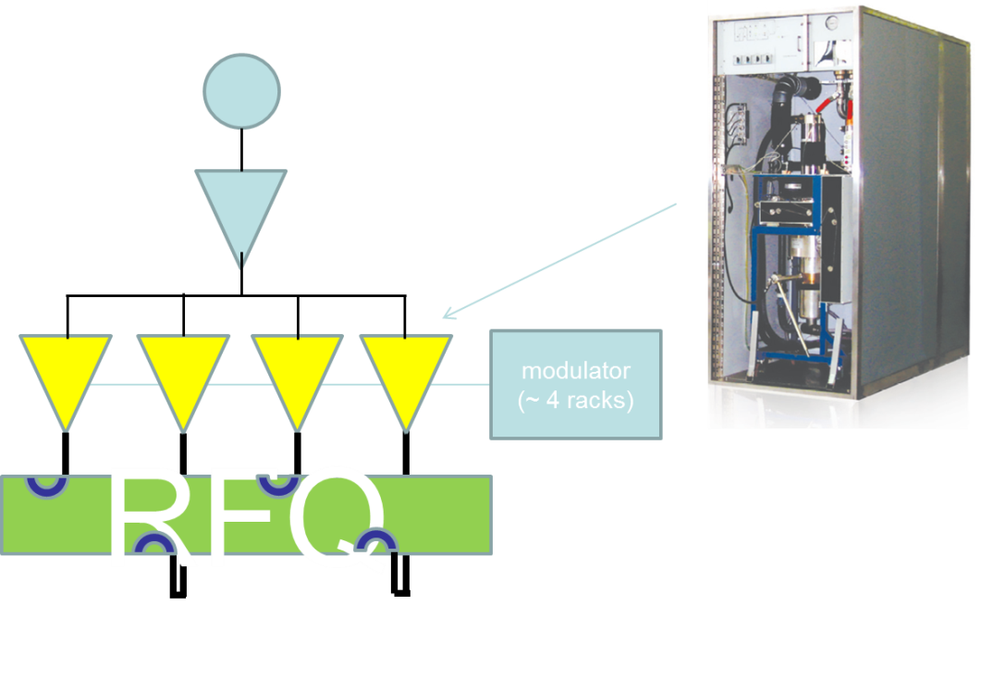
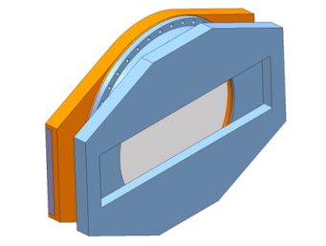
RF system
Basic concept:
Combine several small RF amplifiers into the RFQ (that acts like a combiner).
Testing of the prototype RFQ: arrangement of 4 IOT-based amplifiers on a common modulator, each connected to an RF coupler. Most economic and easier to procure option.
Work on reducing the cost of the RF system:
Use of solid-state amplifiers
«Stripped-down» units with minimum control and LLRF (RFQ does not need phase control and requires only a limited voltage control).

Slide 17
Error studies and alignment tolerances
Alignment errors :

Slide 18
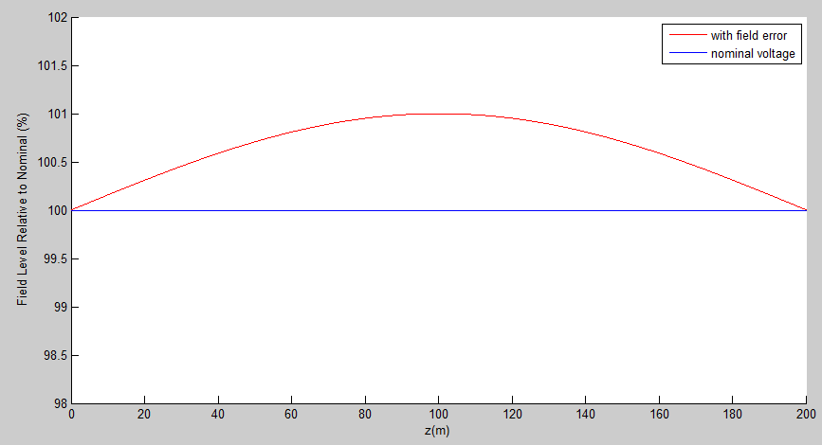
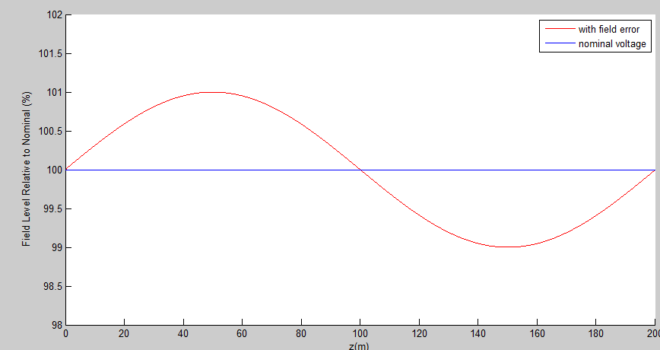
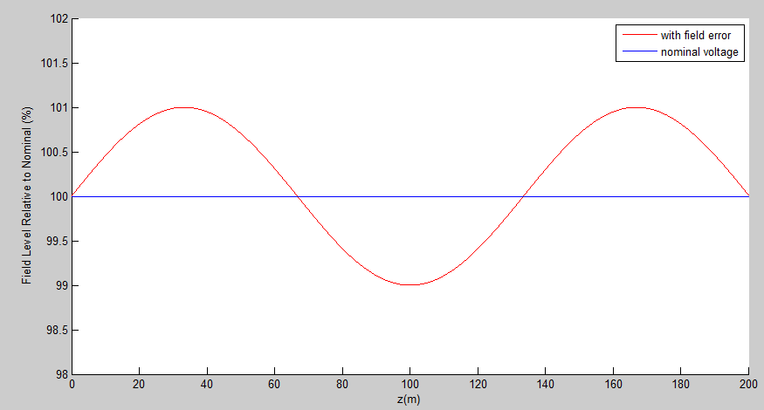

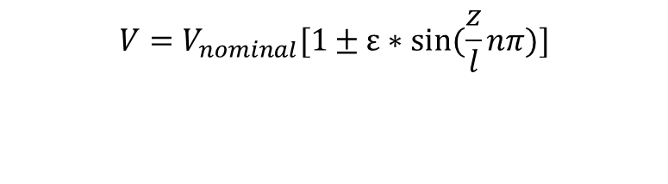

Error studies and tuning errors
Error distribution
$ε$ is the max error (in %) along the RFQ
± (multiplication factor) defines if the voltage is higher or lover at z→0+
Function (cos or sin) defines where the maximum error occurs along the RFQ
$n$ defines how many peaks we will see in the error profile.
$l$ is the length of the RFQ, $z$ is the distance from the beginning of the RFQ.
$${V=V}_{nominal}[1±ε∗cos⁡(\frac{z}{l}nπ)]$$
$${V=V}_{nominal}[1±ε∗sin⁡(\frac{z}{l}nπ)]$$

Slide 19
Tolerances
Error | Tolerance | Part concerned
Field error | ±1% to ±2 | Tuning
Transverse radius of curvature | ±10 µm | Cutting tool
longitudinal profile | ±10 µm | Machining
X and y pole displacement | ±30 µm | Assembly before brazing and brazing process
Longitudinal pole displacement | ±40 µm
X and y pole tilt | ±30 µm
X and y segment tilt | ±60 µm | Assembly of sections
X and y segment displacement | ±20 µm

Slide 20
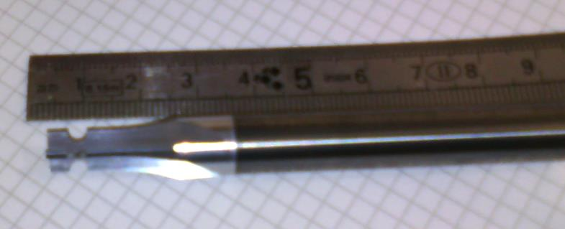
Cutting metal….
Choice of constant transverse radius of curvature allows for a 2d machining with a relatively cheap and simple tool
Shape tools made by the company BOUDON-FAVRE, Feillens (France).
Precision machining obtained with a CNC grinding machine ANCA type mx7 with camera control Iview

Slide 21
Well within the tolerances
Shape tool #9 – 150 mm Test piece #11 (13.3.2015)
Error on the modulation vs nominal value well within ± 5 µm.

Slide 22
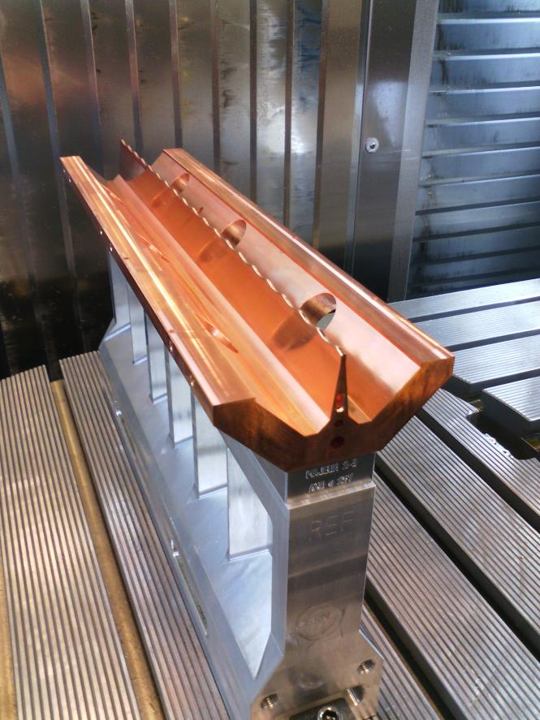
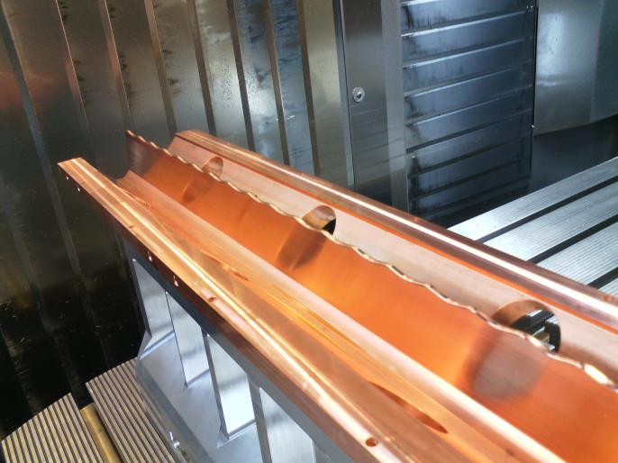
Module 2 – Major vane – Final machining (16.3.2015)

Slide 23
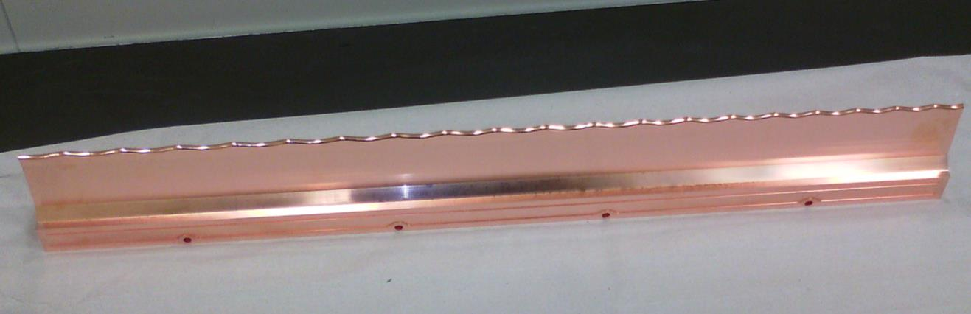
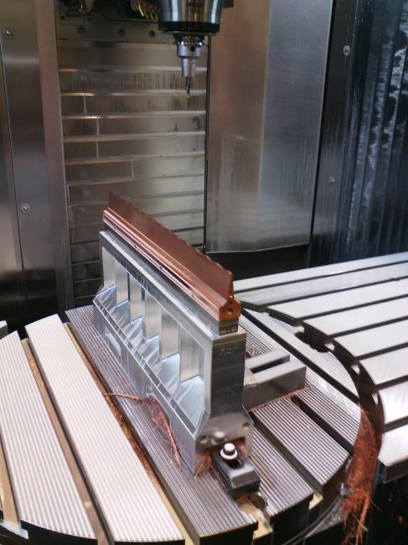
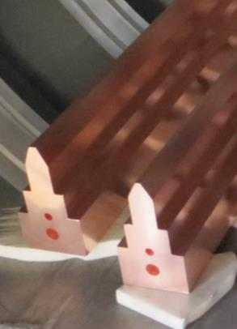
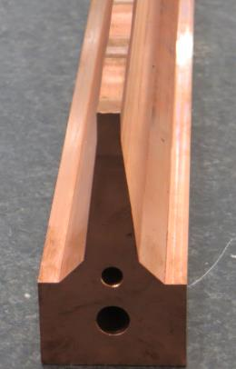
Module 2 – Minor vane
Rough to Final Machining

Slide 24
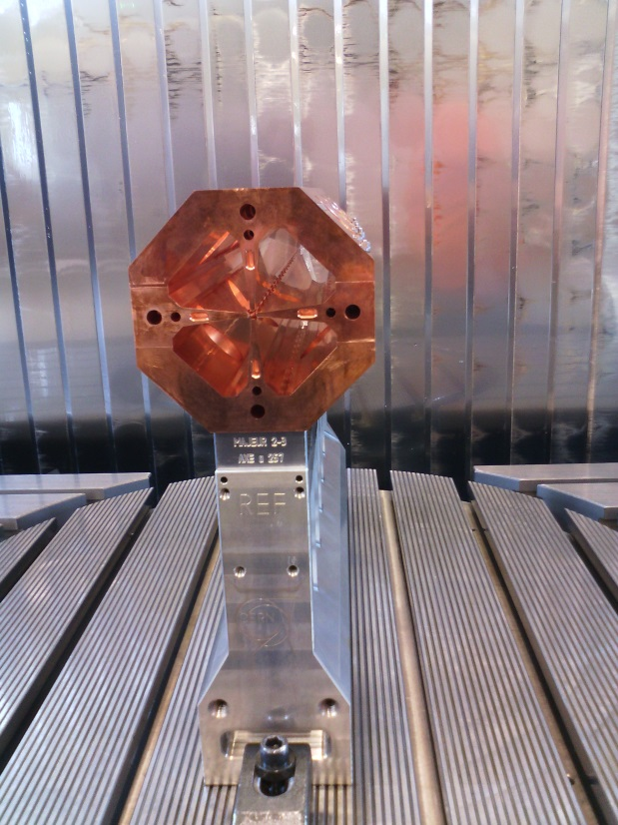
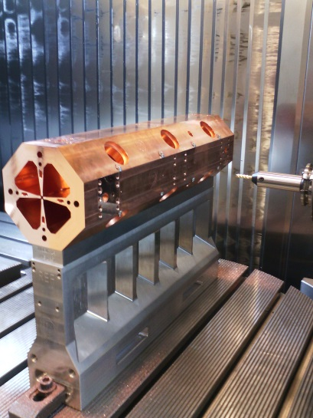
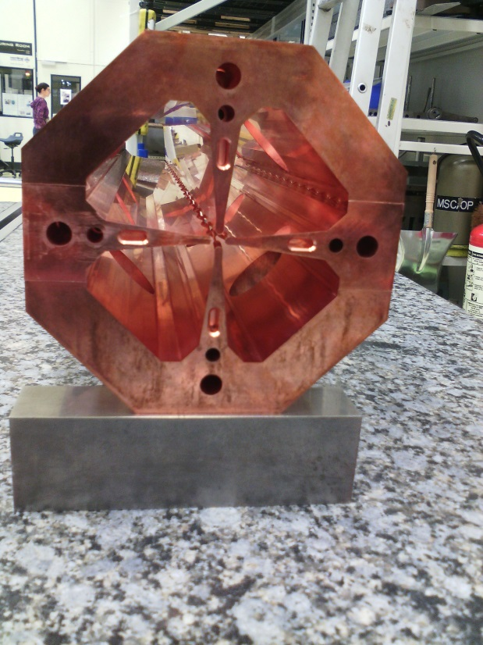
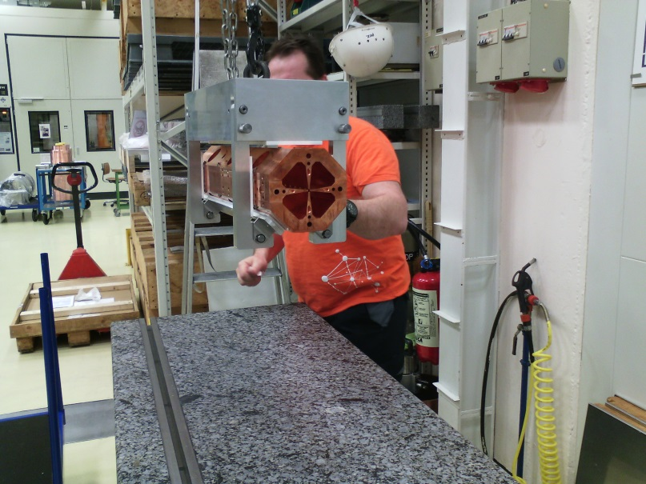
One/four section assembled, 50 cm long 13 cm across. Getting ready for brazing

Slide 25
May 2015 – first section assembled

Slide 26
What next?
Completing machining, brazing assembling
RF measurements and tuning
    Learn about scaling factor for power
    Learn about max electric field on vane-tip
Test with beam at the ADAM test facility at CERN during 2016
    Validate the layout approach
    Learn about beam quality and source optimisation
By 2016 we should have all the information necessary to further optimise the design of the next RFQ, with higher duty cycle, higher current or a combination of both!

Slide 27

Further developments , among others
Energy of 10MeV for isotope production in hospitals
2 RFQs
Source W = 40 KeV
L = 4 m
Output W = 8-10 MeV
Average current = 50 mA
Duty cycle = 5 % or 1%
Peak current = 1 mA or 5 mA

Slide 28
Conclusions and outlook
We have established a new beam dynamics design for RFQ which allows the use of higher frequencies
This opens up the road for compact RFQ for use in medical facilities
The results of the test in the ADAM test facility at CERN will (hopefully) confirm our design choices and enhance our knowledge of high frequency RFQ issues.
The next step is to attempt a design at 1Ghz and/or a design for q/m =1/2 able to accelerate C6+ (or Alpha particles)

Slide 29
Mario Weiss Ken Crandall
if I saw further
is by standing on their shoulders

Slide 30
Extra slides

Slide 31
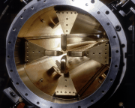
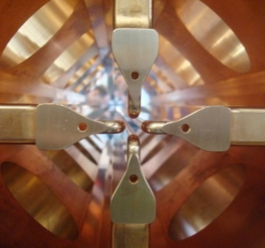
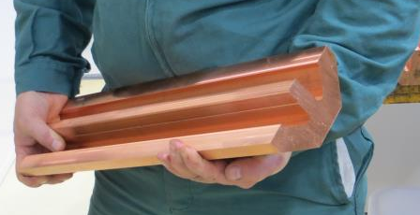
The higher the frequency..
1990 RFQ2 200 MHz 0.5 MeV /m Weight : Ext. diametre : ~45 cm | 2007 LINAC4 RFQ 352 MHz 1MeV/m Weight : 400kg/m Ext. diametre : 29 cm | 2014 HF RFQ 750MHz 2.5MeV/m Weight : 100 kg/m Ext. diametre : 13 cm

Slide 32
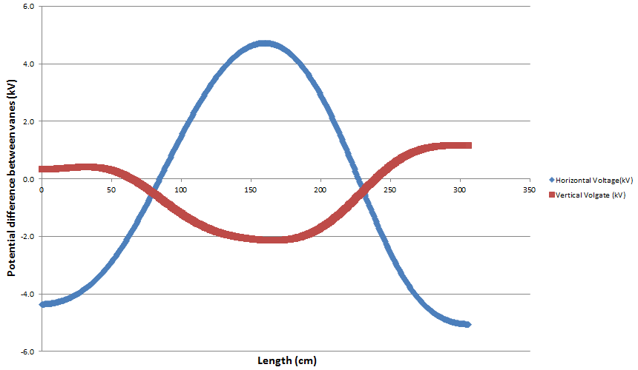
Example from Linac4
Dipole voltage error
Nominal vane voltage
78kV

