Slide 1
New Trigger Strategies
Discussion
Perimeter Institute HL-LHC Workshop
June 8, 2015
Eva Halkiadakis,
Matt Strassler,
Gordon Watts

Slide 2
Discussion of triggers in HL-LHC environment
What do we expect to face?
What are new capabilities?
What have we done in the past?
How do we prevent interesting new physics from slipping through the triggering cracks?
When do we panic?

Slide 3
LHC program
2010- 2012 | 2013- 2014 | 2015- 2018 | 2018- 2019 | 2019- 2022 | 2023- 2025 | 2025- 203X
Run1: 7-8TeV | LS1 | RunII: 13TeV | LS2 | Run3: 14TeV | LS3 | HL-LHC 14 TeV
25fb⁻¹ | Phase 0 upgrade | ~120fb⁻¹ | Phase 1 upgrade | ~300fb⁻¹ | Phase 2 upgrade | ~3000fb⁻¹
PU 20 (50ns) |  | PU 20-40 (50ns, 25ns) |  | PU 50-80 |  | PU 140-200
7x10³³ cm⁻² s⁻¹ |  | ~1x10³⁴ cm⁻² s⁻¹ |  | ~2x10³⁴ cm⁻² s⁻¹ |  | ~5x10³⁴ cm⁻² s⁻¹
You are here
You are heading here

Slide 4
HL-LHC
Trigger Upgrades
ATLAS TDR:
http://cds.cern.ch/search?ln=en&cc=LHCC+Public+Documents&sc=1&p=atlas&action_search=Search&op1=a&m1=a&p1=&f1=
CMS technical proposal:
https://cds.cern.ch/record/2020886
New Track Trigger at L1
Upgrades to the detector readout, L1 trigger and HLT systems
L1 read-out: up to 750kHz-1MHz -- Compared to current 100kHz
Up to 7.5 kHz permanent event storage rate -- Compared to the current 0.5 to 1 kHz
For 140 PU, at least 1500 kHz of L1 acceptance rate would be required to maintain the same physics acceptance as outlined for Phase-I.
For an environment of 200 PU the same L1 menu would require almost 4000 kHz.
    Beyond the technical feasibility of upgrades
Adding tracking information to L1 trigger objects substantially reduces these rates to about 260(500) kHz for the same beam conditions of 140(200) PU.

Slide 5
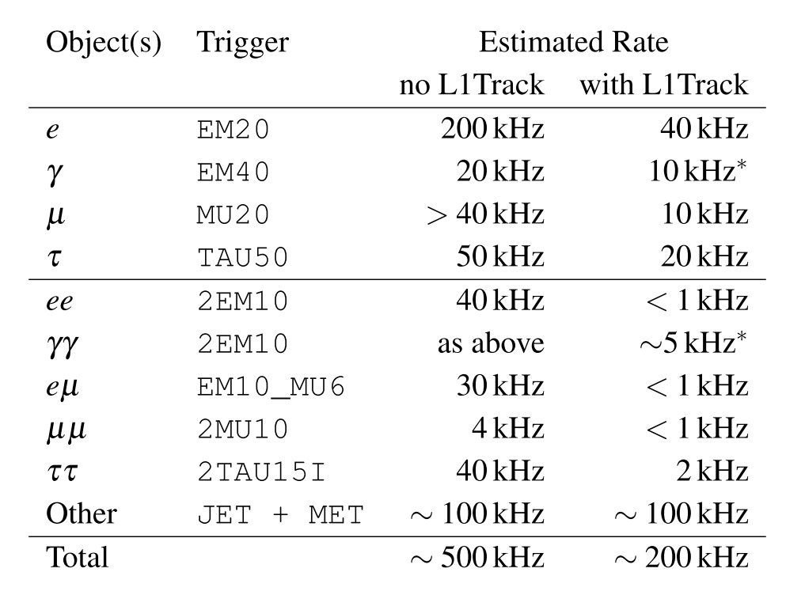
ATLAS – with and without a L1 Track Trigger
Factor of 4 to 5 reduction in rate

Slide 6
Overall Rates
ATLAS
 | Capabilities | Accept Rate
Level 0 | Calo/Muon | 1 MHz
Level 1 | Calo/Muon/Tracking (RoI) | 200 kHz
HLT | Software | 3kHz – 10 kHz
CMS
 | Capabilities | Accept Rate
Level 1 | Calo/Muon/Tracking | 1 MHz
HLT | Software | 3kHz – 10 kHz

Slide 7
ATLAS and CMS trigger upgrades

Slide 8
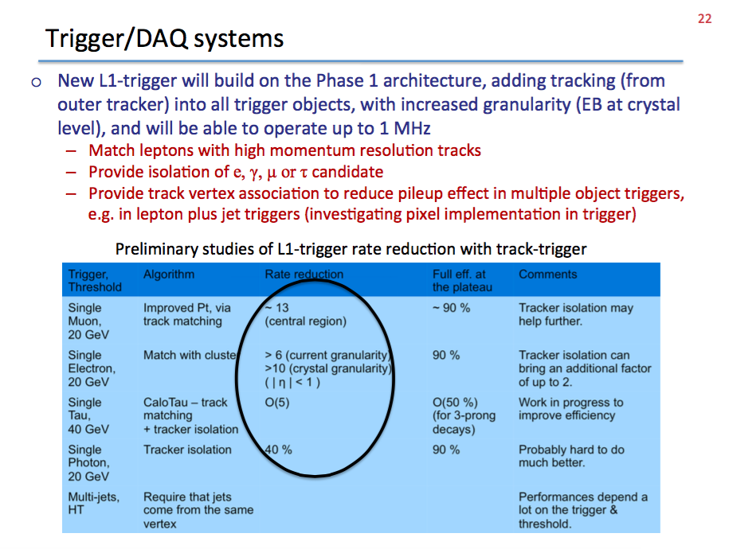
CMS Trigger Upgrade
Taken from:
https://indico.cern.ch/event/272893/contribution/6/material/slides/0.pdf

Slide 9
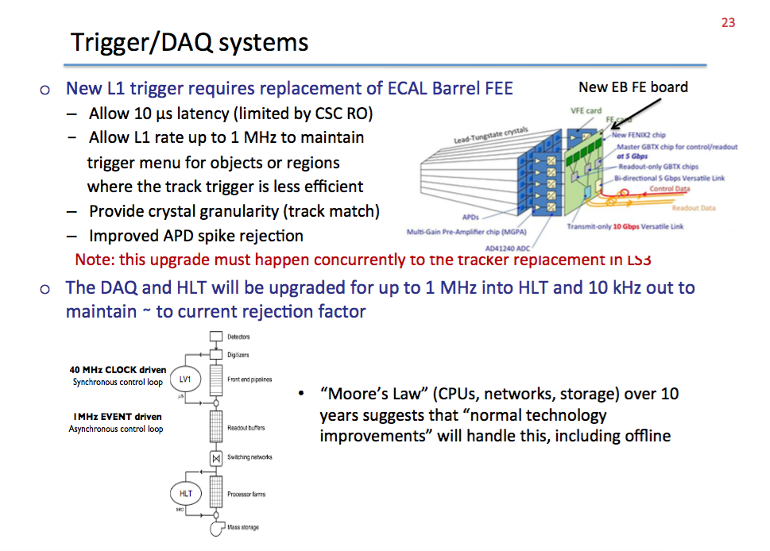
CMS Trigger upgrade
Taken from:
https://indico.cern.ch/event/272893/contribution/6/material/slides/0.pdf

Slide 10
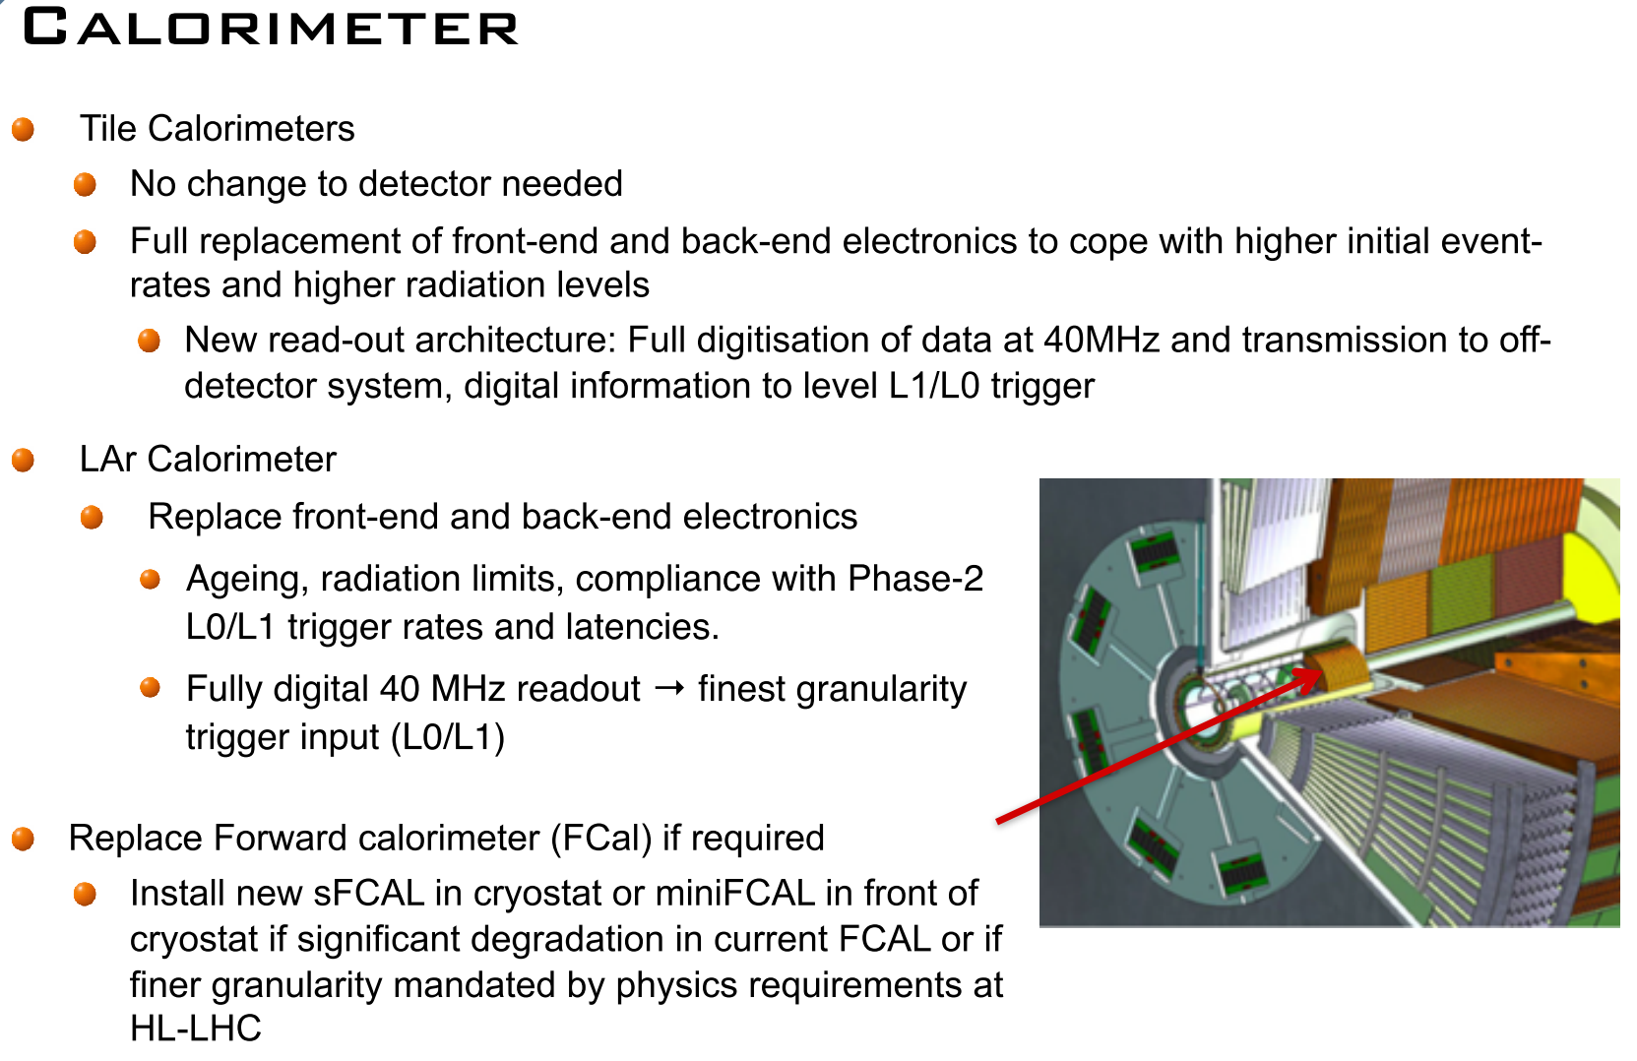
ATLAS Calorimeter Electronics Upgrade
Digitize full Cal on each crossing
Level 0 and Level 1 now have access to shower shape information
Upgrade occurs over both Phase I and Phase 2

Slide 11
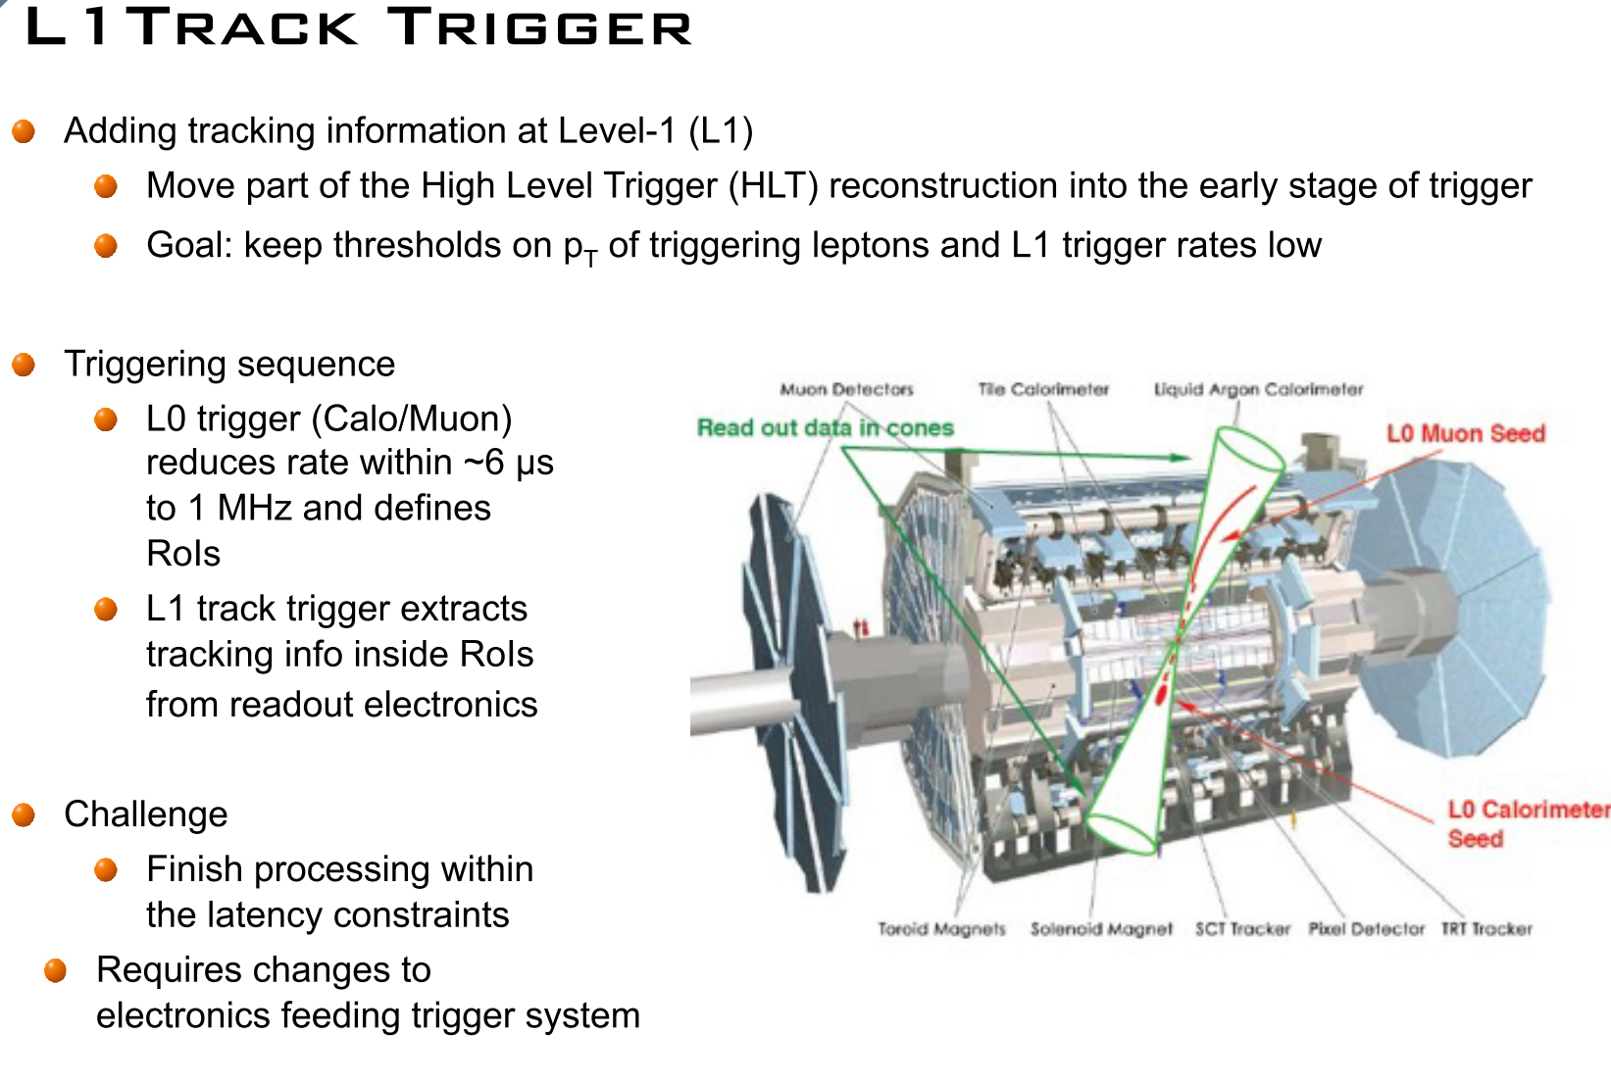
ATLAS Track Trigger @ HL-LHC
RoI based track reconstruction planned
Full detector possible; studies ongoing now.

Slide 12
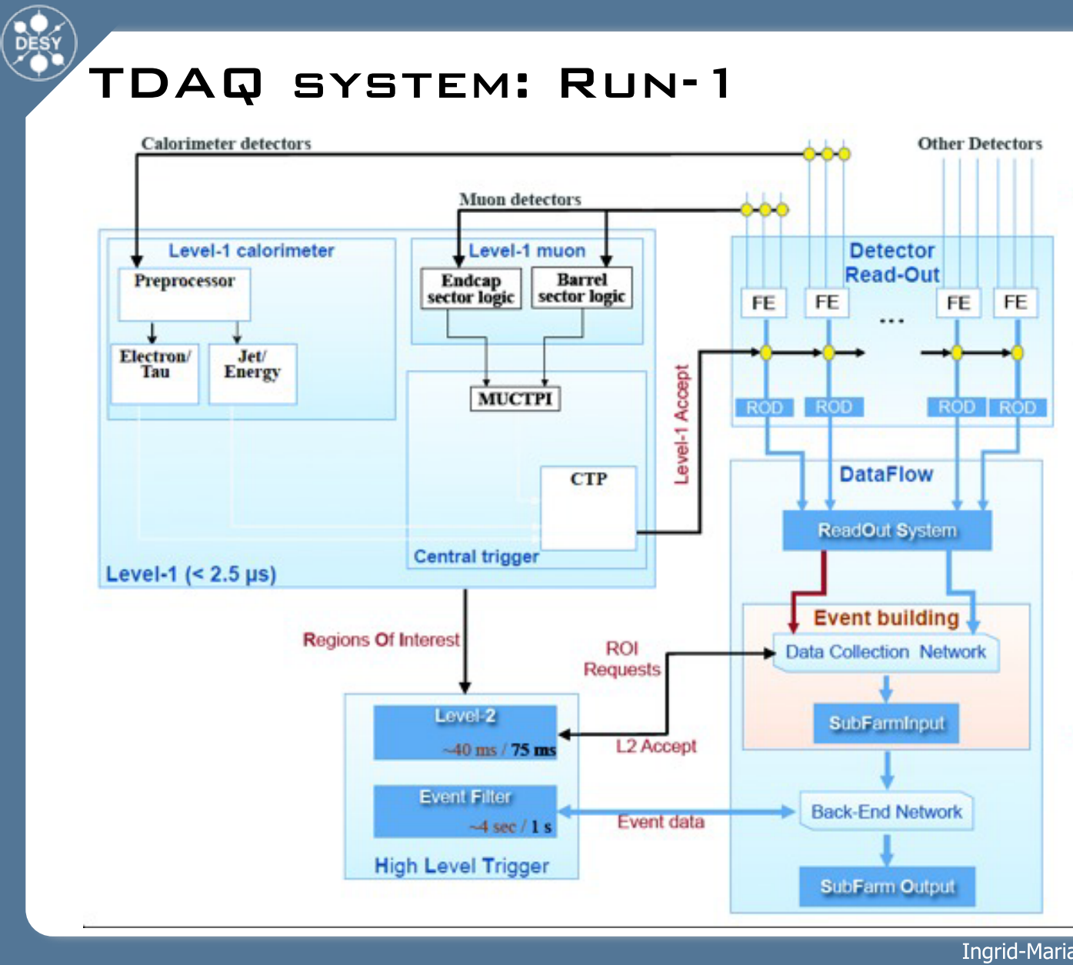
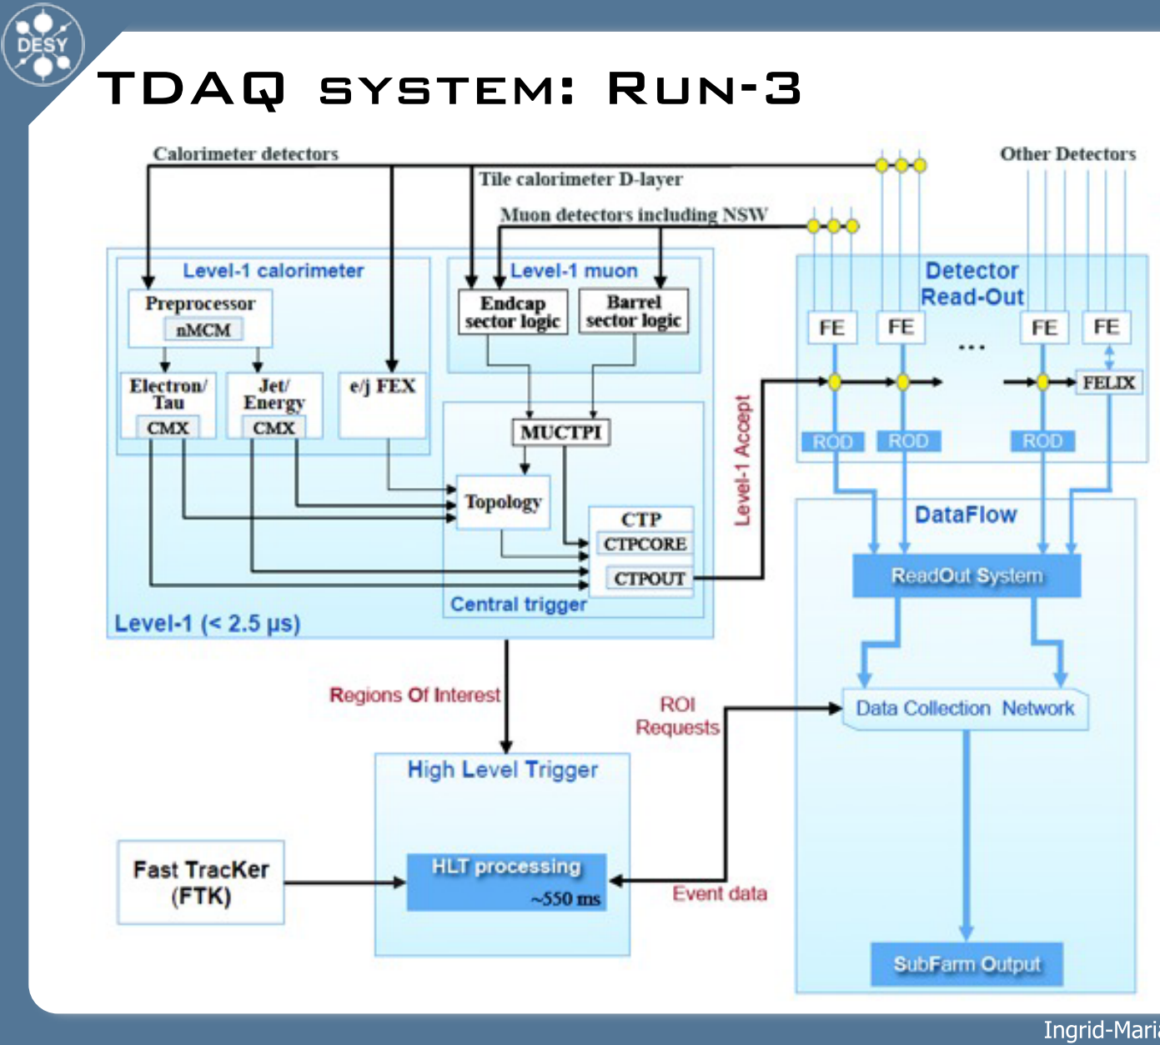
ATLAS: Trigger Evolution

Slide 13
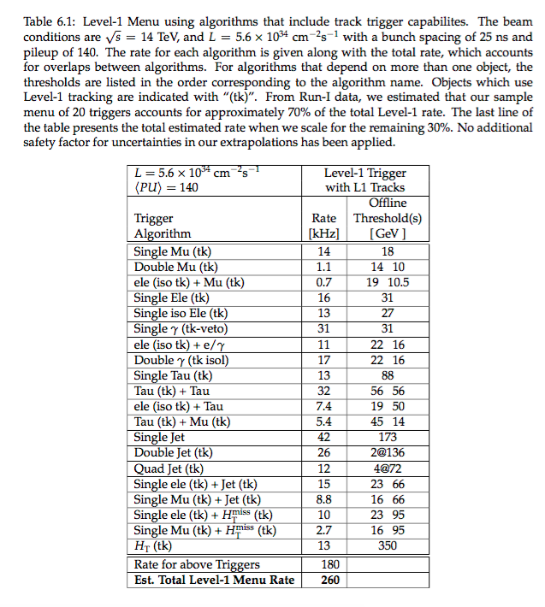
CMS: Estimated total L1 Menu Rate
ATLAS Goals are similar
CMS technical proposal: https://cds.cern.ch/record/2020886

Slide 14
What has worked in the past?
Beyond having standard single object triggers, CMS and ATLAS have implemented:
  Data scouting: save only a small subset of the event content (e.g., only the HLT-level jet objects)
  Data parking: send events from the HLT to tape without reconstructing them, analyze later.
  Multi-object triggers

Slide 15
To discuss …
Entirely different trigger concepts?
Are there holes in trigger strategy? Can we anticipate this before Run II conclusions?
Different trigger strategies:
  Assuming we find new physics in Run II
    Would trigger strategy change depending on flavor of new physics?
  Assuming we have yet to find new physics in Run II
Thoughts/comments?

