Slide 1
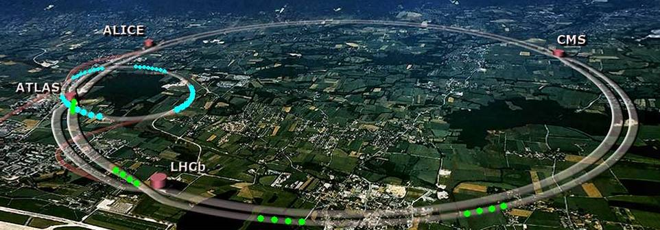
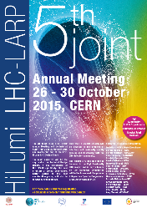
Introduction to the Collider-Experiment Interactions Day
29 October 2015
B. Di Girolamo

Slide 2
Collider-Experiments Interactions
There is a need for several interactions between HL-LHC and the experiments with different urgency and importance
  It is important to agree on:
    How to tackle them
    How to establish links between experts and a forum to discuss
    How to follow up on issues
    Collect ideas and a checklist of future studies

Slide 3
Structure of the day - morning
We made a selection of topics
  Understanding apertures and beam loss scenarios as we did for LHC
    High luminosity implies higher apertures in the Triplet magnets and smaller more intense beams
    A lot of work has been done to quantify effects
    Iterations will be important
    Aim is also to finalize the experimental beam pipe layout (not just the central section)

Slide 4
Structure of the day - morning
We made a selection of topics
  Understanding the impact of the vacuum equipment displacement
  Put again on the table the discussions about
    Pile-up maximum
    Pile-up density
    Bunch length
  Overview of Experiments upgrade plans

Slide 5
Goal of High Luminosity LHC (HL-LHC) as fixed in November 2010
From FP7 HiLumi LHC Design Study application
The main objective of HiLumi LHC Design Study is to determine a hardware configuration and a set of beam parameters that will allow the LHC to reach the following targets:
A peak luminosity of L_{peak} = 5×10³⁴ cm⁻²s⁻¹ with levelling, allowing:
An integrated luminosity of 250 fb⁻¹ per year, enabling the goal of L_{int} = 3000 fb⁻¹ twelve years after the upgrade.
This luminosity is more than ten times the luminosity reach of the first 10 years of the LHC lifetime.
Concept of ultimate performance (use of existing margin) defined:
L_{ult} ≅ 7.5 10³⁴ cm⁻²s⁻¹ and Ultimate Integrated L_{int ult} ∼ 4000 fb⁻¹
LHC should not be the limit, would Physics require more…

Slide 6
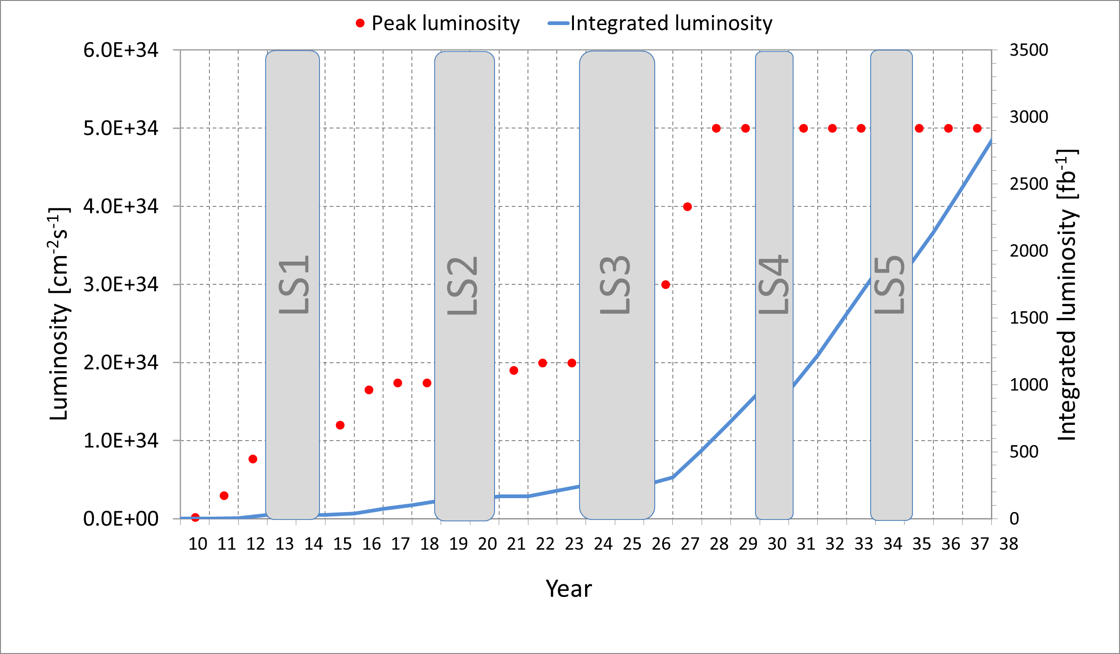
Nominal upgrade parameters
3000 fb⁻¹ would be reached in 2037
Issues of ions performance and plan being addressed (HL-LIU day, Thursday C.-Exp. Interface Day
M. Lamont (Lumi plots are maintained by the Head of LHC operation)
Time for proton physics till 2030 is standard; then it increases (no ions and MDs and less Tech Stops.)

Slide 7
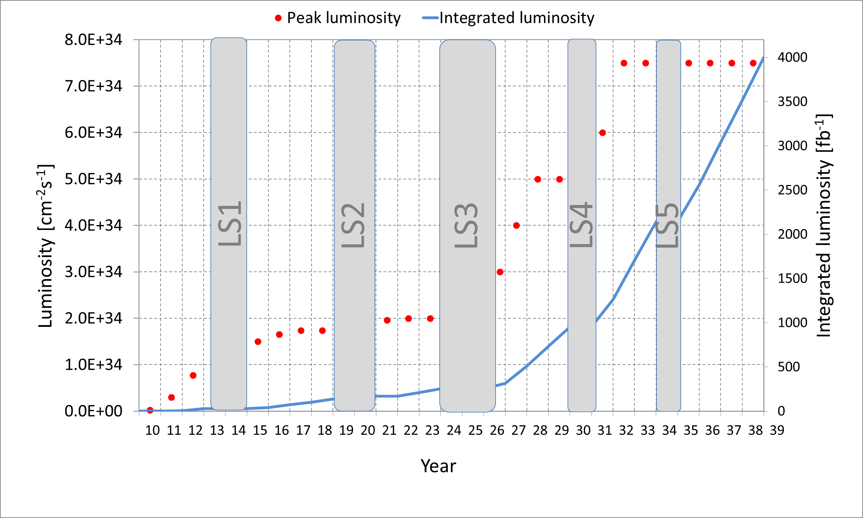
HL-LHC ultimate performance
Ultimate lumi (not yet studied in details)
L = 5 → 7.5 10³⁴ cm⁻²s⁻¹
Int. L = 3000 → 4000 fb⁻¹
Pile up μ ∼ 200

Slide 8


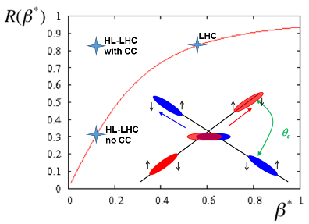
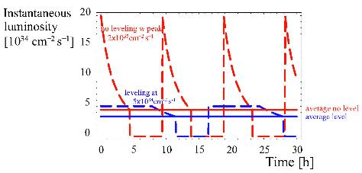
Luminosity the main ingredients
L_{int}
Beam current
energy
Beam size
Levelling!

Slide 9
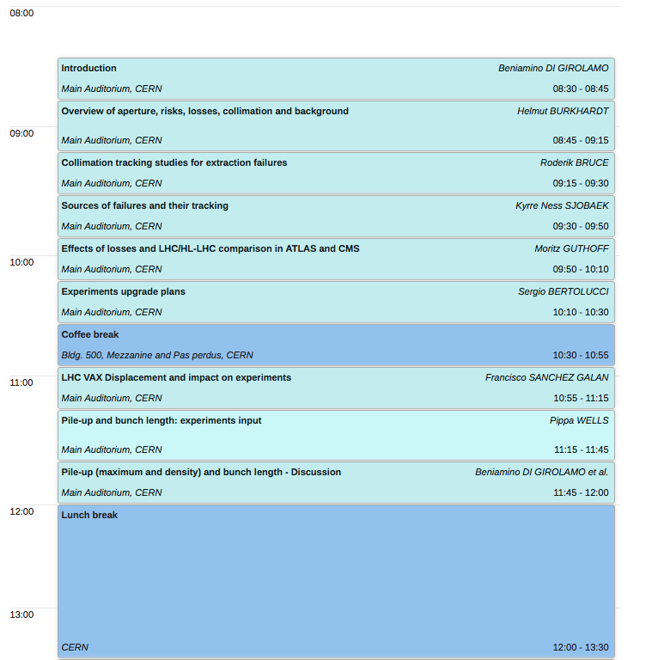

Slide 10
Structure of the day - afternoon
We made a selection of topics
  Response to the request to study the impact on the collider for supplying nominal LHC luminosity to LHCb
  Latest updates to Heavy Ions
    Requests
    Possibilities

Slide 11
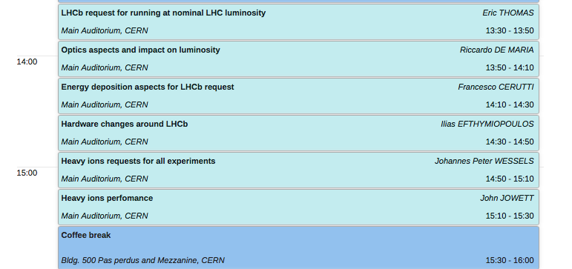

Slide 12
Spirit of this session
We had no way of being exhaustive
Many studies are far from being completed because of the hectic schedules and documents, activities, shutdowns, data taking
But we wanted to resume links and communication from both sides
By the end of the morning we will have a discussion session and proposals for further studies
I asked the speakers to respect the time to allow discussions

Slide 13
What we can’t cover
Although equally important
  Physics motivations
  Possible synergies around the R2E topics
  Deeper discussions on radiation levels and background
  Civil Engineering synergies
    I invite the experiments colleagues to review the presentations of the Tuesday plenary session https://indico.cern.ch/event/400665/timetable/#20151027.detailed
  The list can be long... It means it will deserve more interactions in the future

Slide 14
Concluding…
Please:
  Enjoy
  Discuss
  Don’t be shy
  We can still explore ideas, but please express them before too late
A BIG THANK YOU TO ALL PLAYERS
  Really a lot of effort has been done for this session

